Slide 1
Preliminary analysis of 2015 ion beams
H. Bartosik, A. Huschauer, G. Rumolo
LIU beam parameter meeting, 8th January 2016

Slide 2
Introduction – data analysis
Data from 2015 Pb-Pb run
  Only NOMINAL beam (no MDs)
  Reference period: December 8th (good performance level reached and maintained)
Intensity evolutions
  Linac3: FBCT (ITH line)
  LEIR: DC-BCT (Ring)
  PS: DC-BCT (Ring)
  SPS: DC-BCT (Ring)
  LHC: FBCT at injection (bunch-by-bunch)
Emittance measurements
  LEIR: IPM (data analysis to be done)
  PS: SEM grids in TT2
  SPS: Wire scanners (data analysis to be done)
  LHC: Wire scanners at injection

Slide 3
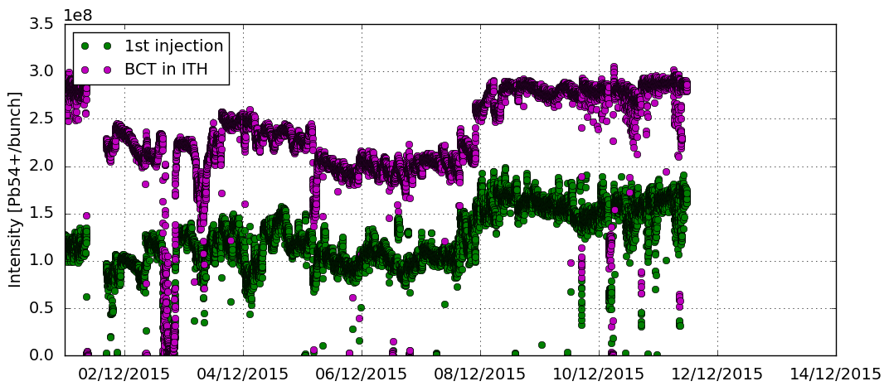
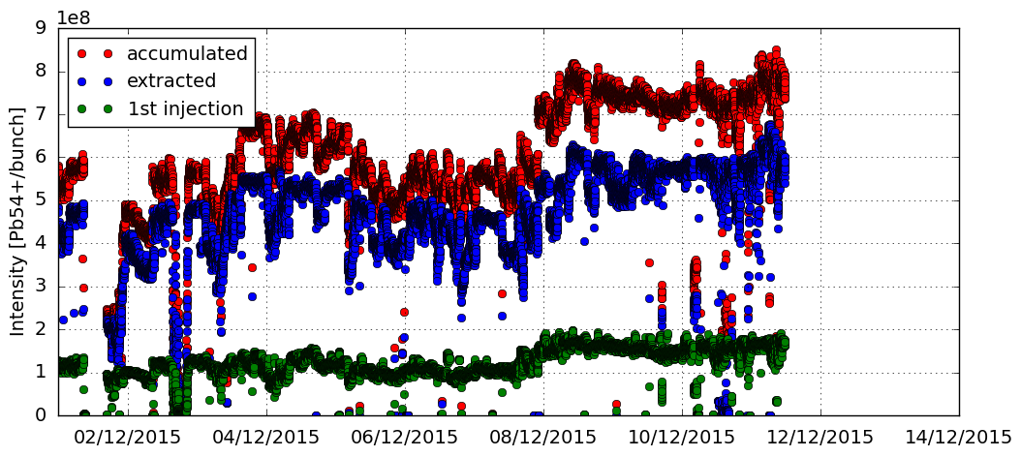
Linac3 & LEAR intensity evolution

Slide 4
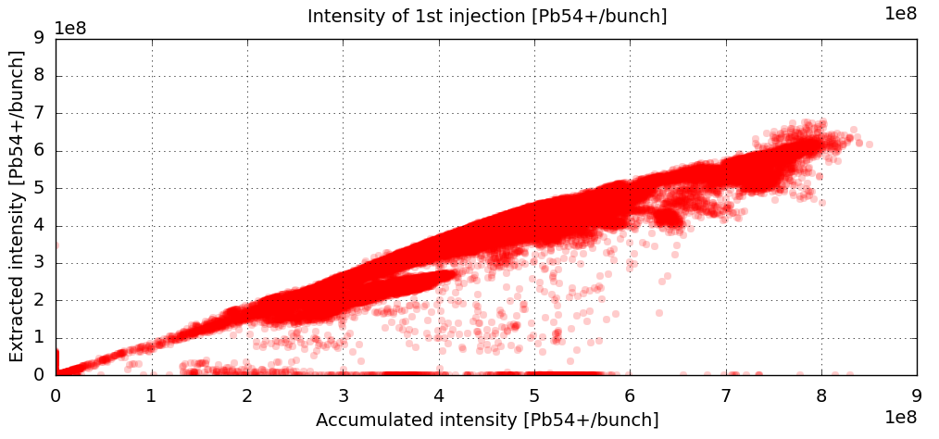
LEIR transmission

Slide 5
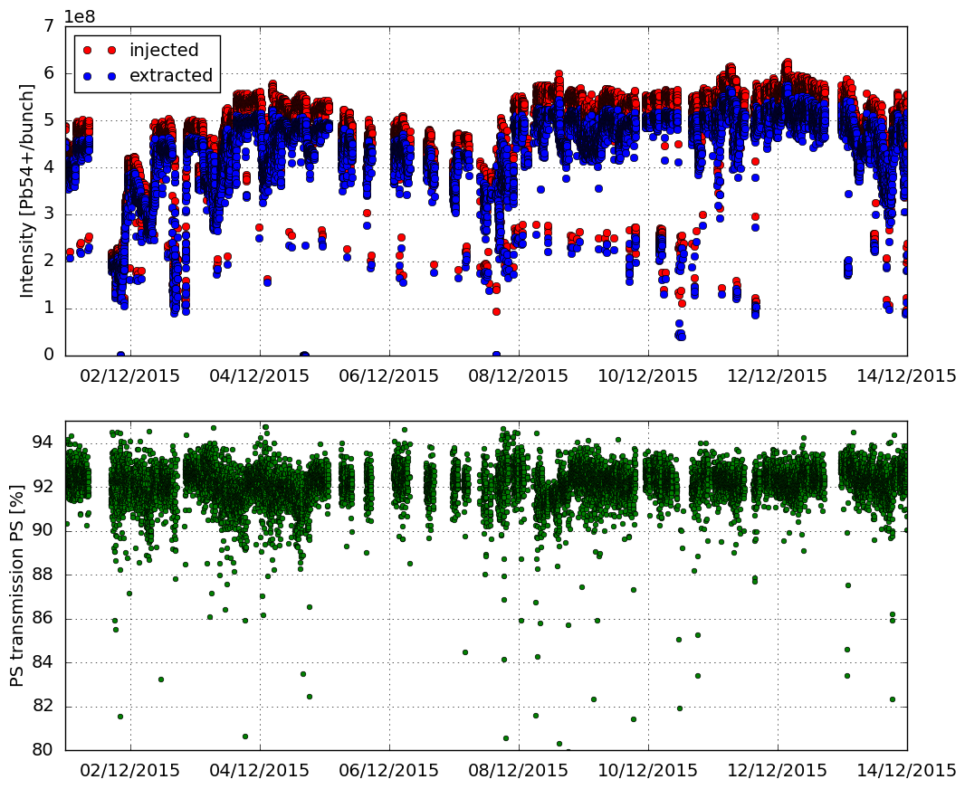
PS intensity evolution

Slide 6
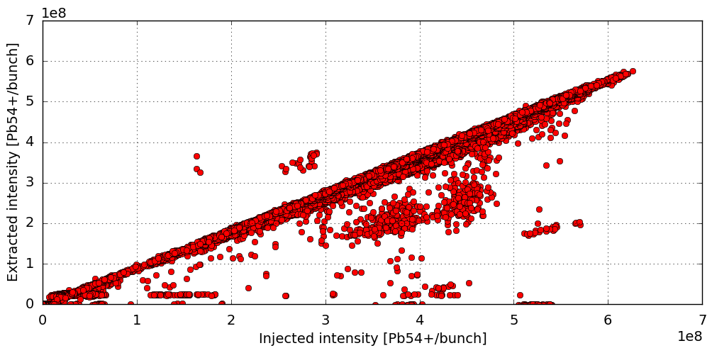
PS intensity evolution

Slide 7
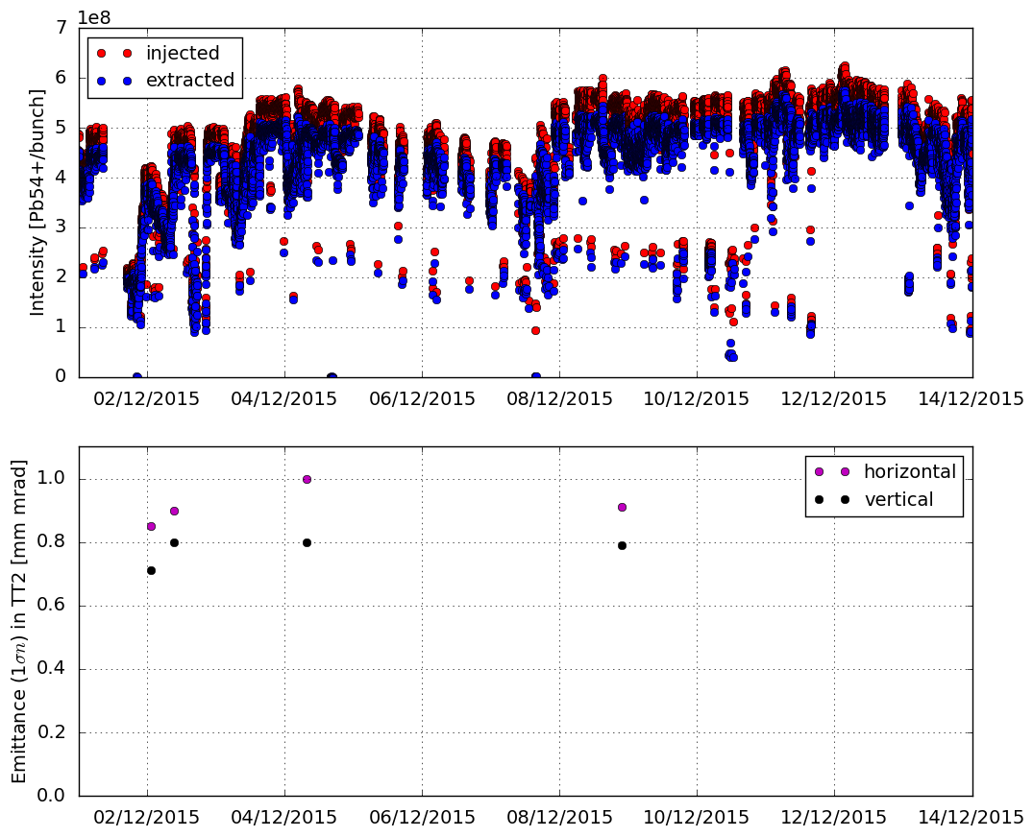
PS emittance in TT2

Slide 8
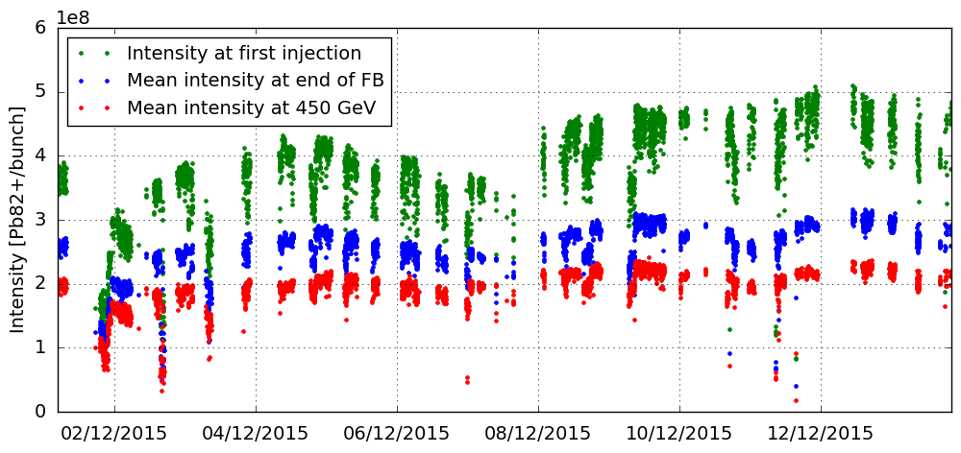
SPS intensity evolution

Slide 9
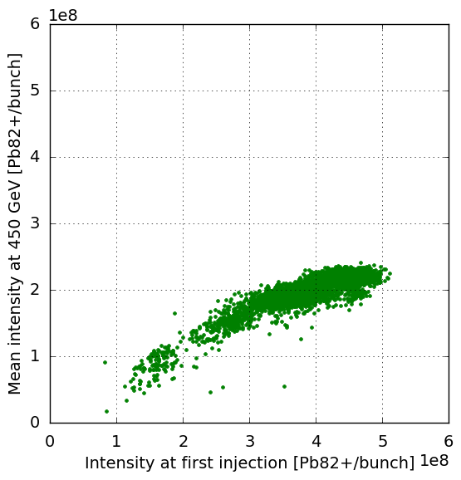
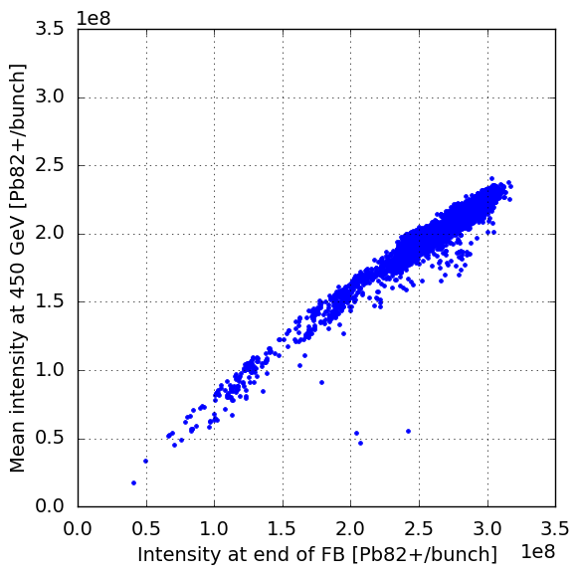
SPS transmission

Slide 10
SPS bunch length
T. Bohl

Slide 11
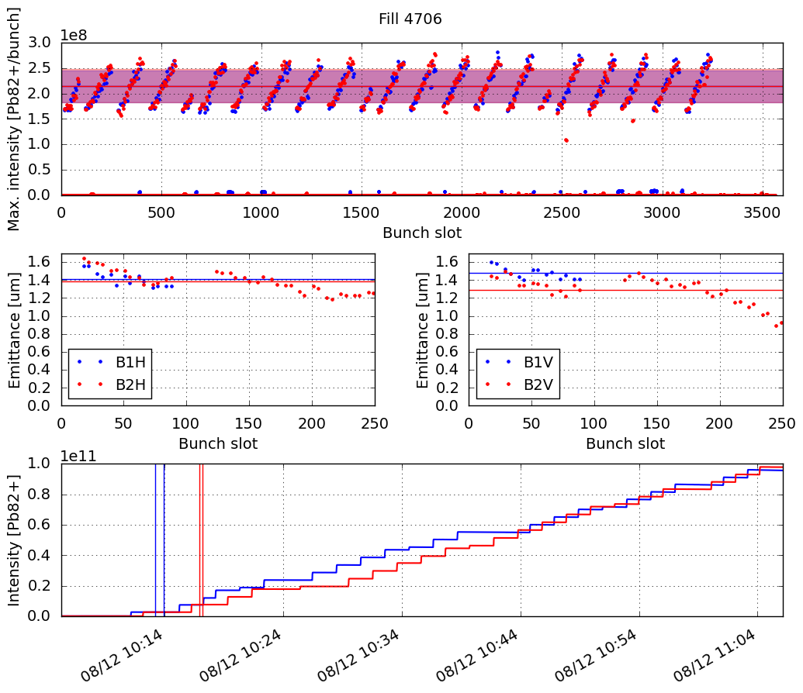
LHC fill 4706

Slide 12
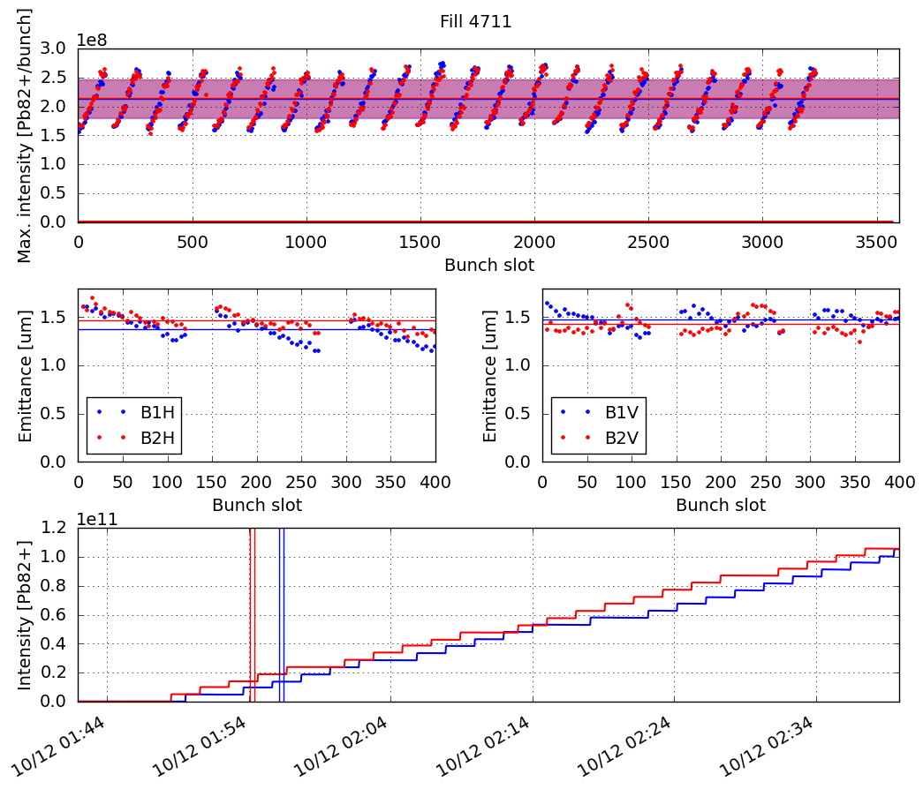
LHC fill 4711

Slide 13
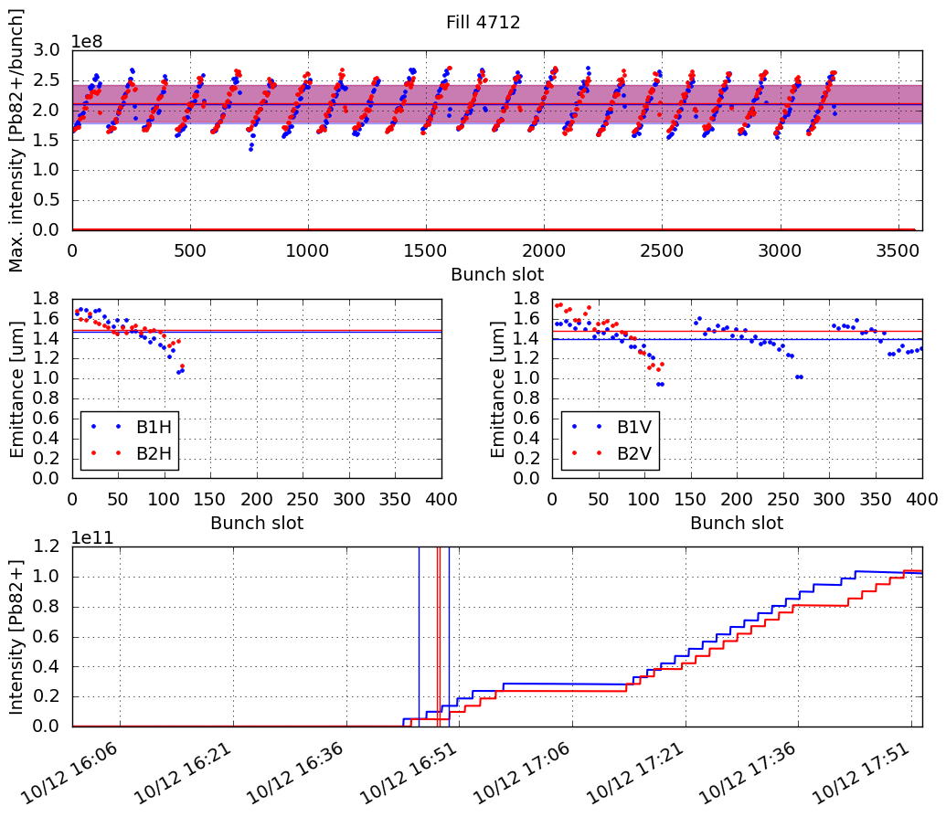
LHC fill 4712

Slide 14
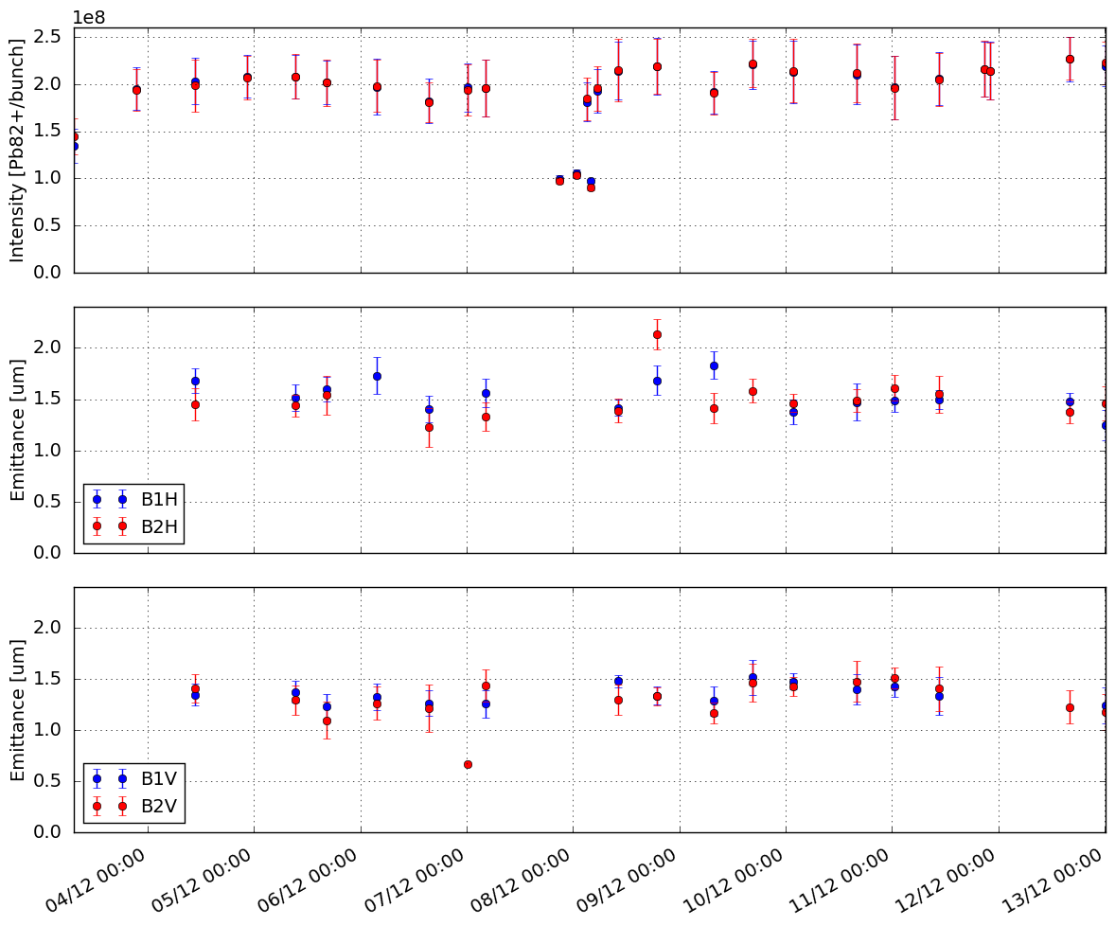
LHC overview

Slide 15
Summary

Slide 16
Summary

Slide 17
Thank you for your attention!

