Slide 1



E-JADE WP 5:
Training and Knowledge Transfer
Status
Thomas Schoerner-Sadenius
E-JADE Second General Meeting
CERN, 4 February 2016

Slide 2
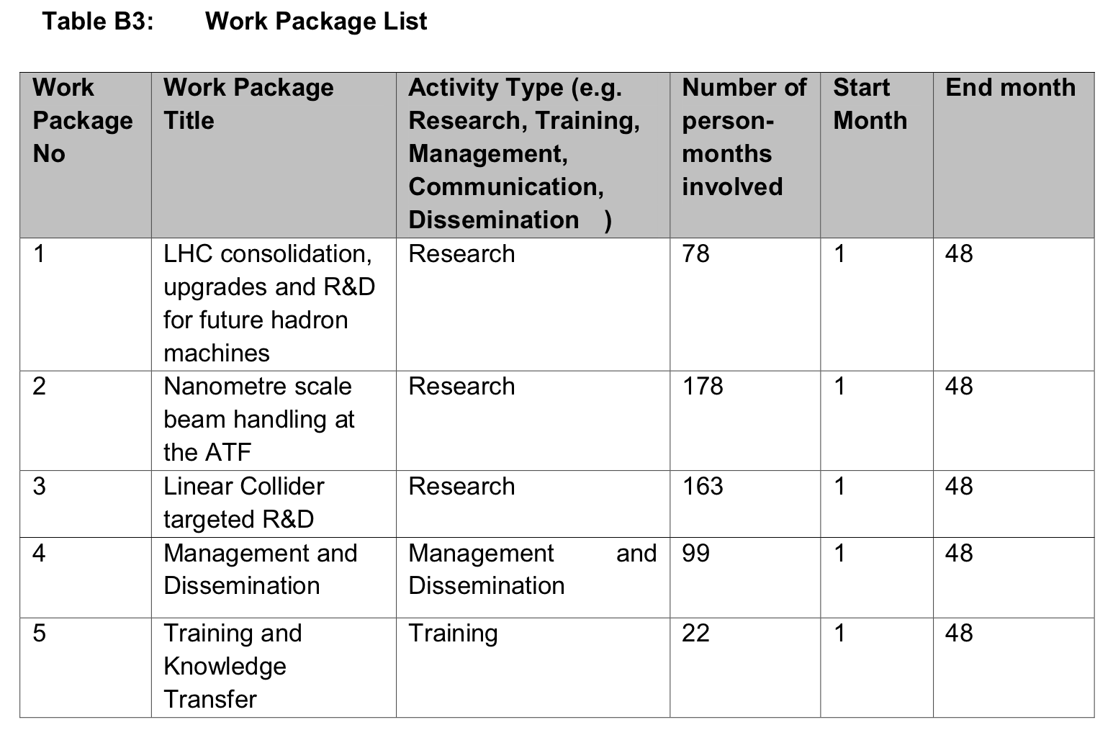
REMEMBER – E-JADE WORK PACKAGES

Slide 3
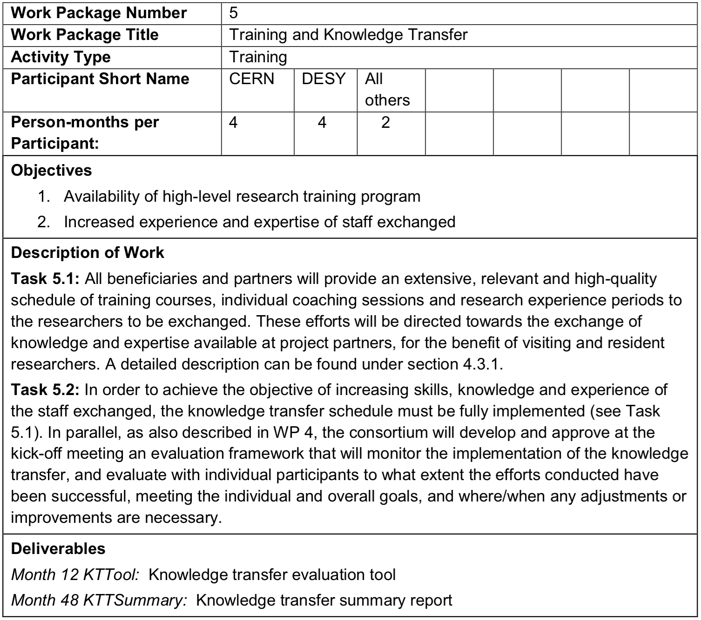
REMEMBER – WORK PACKAGE 5

Slide 4
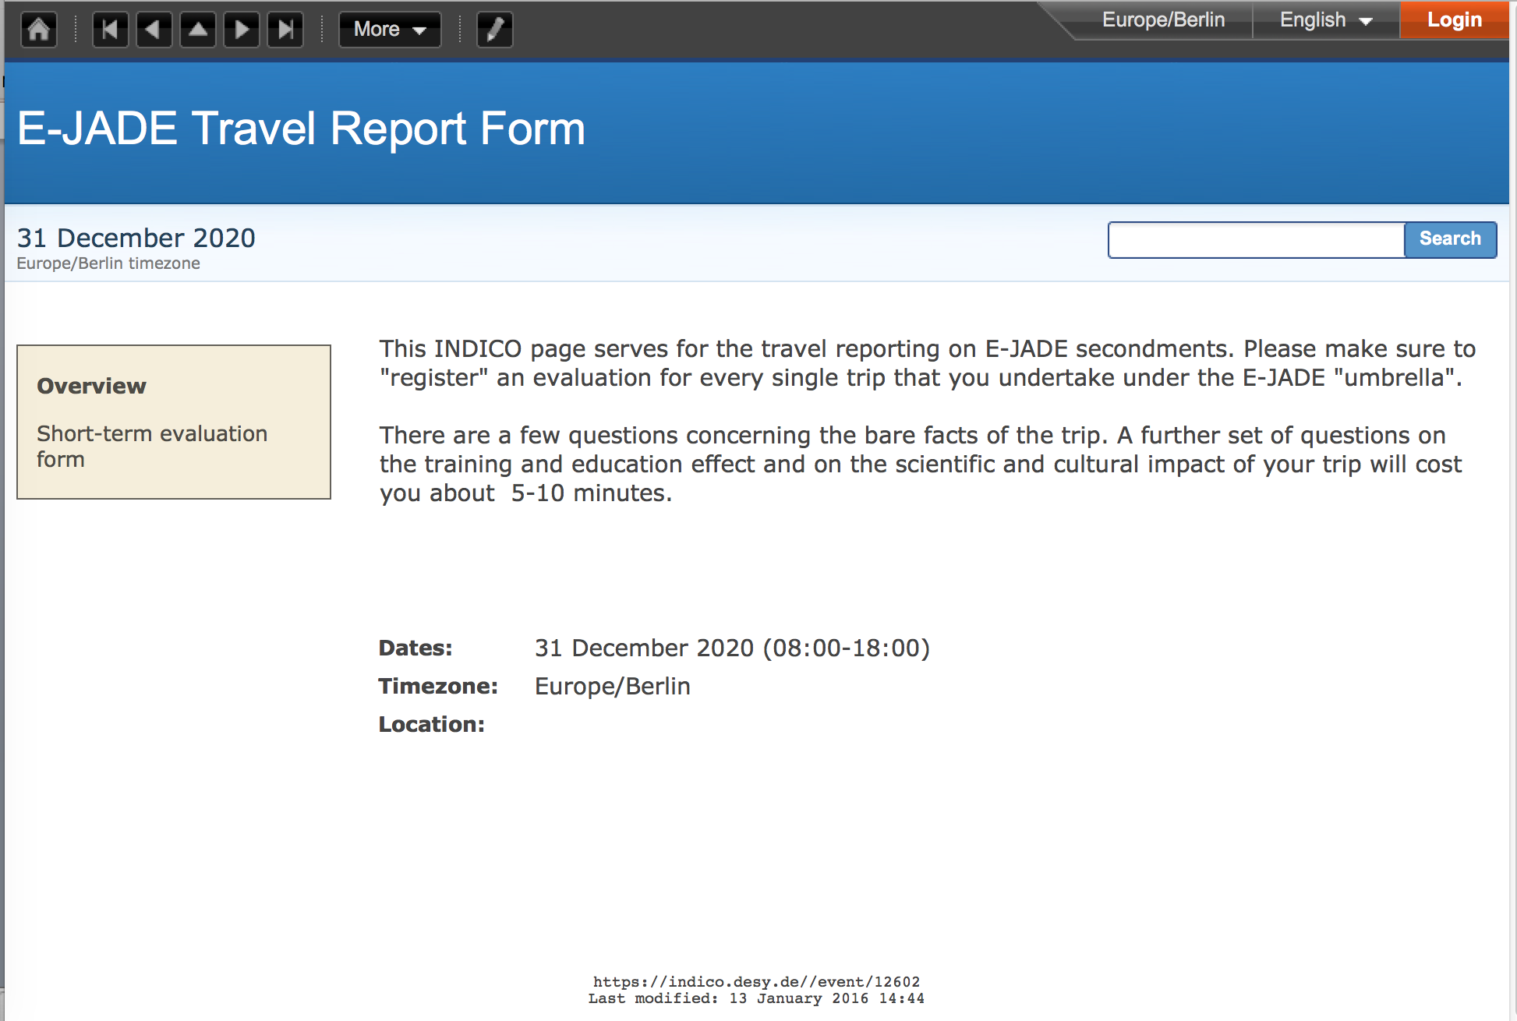
WORKP PACKAGE 5 DELIVERABLES
Month 12: KTTTool
Simplest possible form …
Comments from P. Bambade not yet implemented.
Please – everybody insert their travels!
Evaluation (how?) is deliverable at the end …

Slide 5
WORKP PACKAGE 5 TASK 5.1
Knowledge transfer schedule (?) to be implemented
Requires all partners to “provide an extensive, relevant and high-quality schedule of training courses … “
➔ nothing happened here; basically no input from partner institutions.
But: Where and how does this have to be documented anyhow?

