Slide 1



E-JADE WP 4:
Management and Dissemination
Status
Thomas Schoerner-Sadenius
E-JADE Second General Meeting
CERN, 4 February 2016

Slide 2
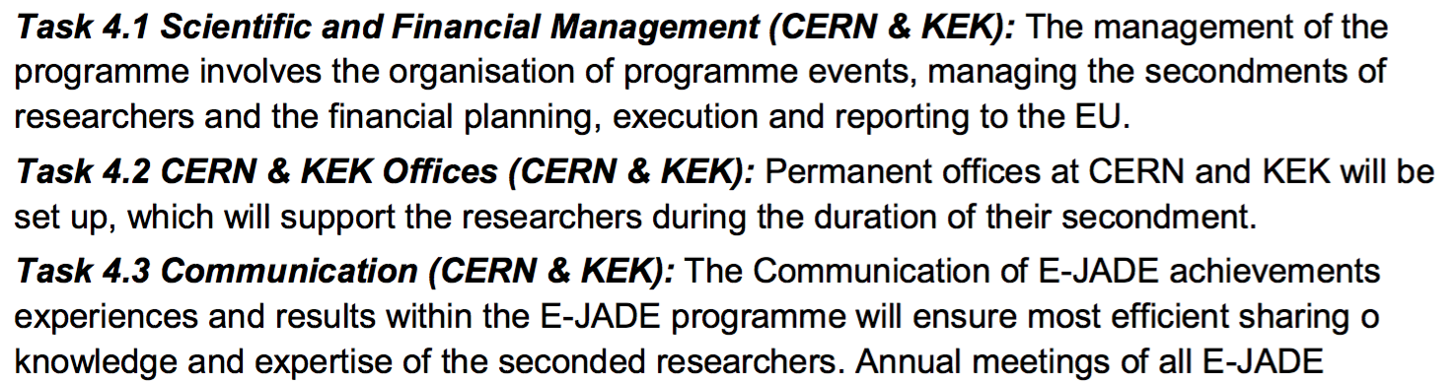
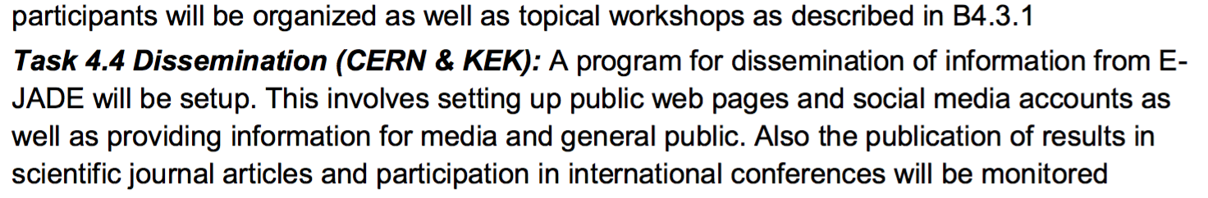
REMEMBER – WORK PACKAGE 4

Slide 3
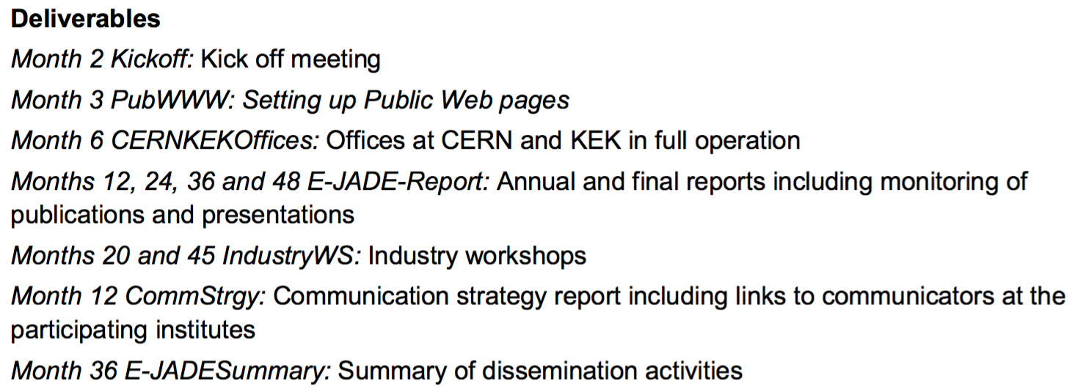
WORK PACKAGE 4 - DELIVERABLES
✔
✔
✔
In preparation, requires WP input!
??????
In preparation, requires institute input!

