Slide 1
Storage of Vacuum data
December 8th 2008

Slide 2
PVSS Archives with PVSS timestamp:
On changes for equipment state
Every 2 seconds for VGI & VGP on beam Vacuum
Every min for all other gauges or pumps measurement
Vacuum Control System
LHC Logging DB (Timber)
VAC PVSS Server
cernvaclhc03
PVSS Scripts
PVSS Archives
Every 2 seconds for VGI and VGP on beam vacuum if data changes
Every minute for the rest of equipment if data change
On changes for sector valves
Bat 513
Window Time Service
PVSS S7 Driver
PVSS Timing and PLC timing are different
Asking for new data in all PLCs every 1 s (polling rate) and transfer them to PVSS Server if it has changed.
! Timestamp is given to the value at this moment by PVSS !
DATA
VAC PLCs
(data sources)
NTP Timing
UNDERGROUND

Slide 3
PVSS Archive/LHC logging
State changes are stored on event for all devices (ON/OFF, underrange, overrange, OPEN/CLOSE, etc…) and send to LHC logging only for sector valves
Pressure measurement from VGP and VGI on beam vacuum are stored in PVSS ( and LHC logging) every 2 seconds if they have changed.
And pressure measurement for all others equipments are stored every minutes in PVSS (and LHC logging) if they have changed.

Slide 4
Logic to create Excel File
Data are taken from PVSS archive, so if data have changed, data have been stored every 2 seconds for VGP and VGI on beam vacuum and every minute for others gauges and pumps.
Theory
  VGP1 on QRL:
    1.E-9 @ 12:00:00
    2.E-9 @ 12:01:00
  VGP2 on cryo:
    8.E-10 @ 11:59:30
    1.5E-9 @ 12:00:30
  VGP1 VGP2
    12:00:00 1.E-9 8.E-10
    12:00:30 1.E-9 1.5E-9
    12:01:00 2.E-9 1.5E-9

Slide 5
Practical Data
Date/Time | VGR.503.20R3.Q | VGR.503.28R3.Q | VGR.501.34L4.Q
19.09.2008 11:14:54 | 1.81E-03 | 1.43E-03 | 4.95E-04
19.09.2008 11:15:56 | 1.84E-03 | 1.43E-03 | 4.95E-04
19.09.2008 11:16:06 | 1.84E-03 | 1.40E-03 | 4.95E-04
19.09.2008 11:17:00 | 1.81E-03 | 1.40E-03 | 4.95E-04
19.09.2008 11:17:21 | 1.81E-03 | 1.40E-03 | 4.95E-04
19.09.2008 11:18:05 | 1.84E-03 | 1.40E-03 | 4.95E-04
19.09.2008 11:18:37 | 1.84E-03 | 1.67E-03 | 4.95E-04
19.09.2008 11:18:58 | 1.84E-03 | 1.67E-03 | 2.07E-03
19.09.2008 11:19:05 | 1.38E-03 | 1.67E-03 | 2.07E-03
19.09.2008 11:20:06 | 8.71E-04 | 6.60E-04 | 2.07E-03
19.09.2008 11:20:20 | 8.71E-04 | 6.60E-04 | 4.95E-04
19.09.2008 11:21:07 | 8.35E-04 | 1.43E-02 | 4.95E-04
19.09.2008 11:21:24 | 8.35E-04 | 1.43E-02 | 2.95E-03
19.09.2008 11:22:08 | 8.35E-04 | 4.00E-02 | 2.95E-03
19.09.2008 11:22:11 | 6.26E-04 | 4.00E-02 | 2.95E-03
19.09.2008 11:22:36 | 6.26E-04 | 4.00E-02 | 2.02E-03
19.09.2008 11:23:09 | 6.26E-04 | 4.84E-02 | 2.02E-03
19.09.2008 11:23:12 | 5.75E-04 | 4.84E-02 | 2.02E-03
19.09.2008 11:23:41 | 5.75E-04 | 4.84E-02 | 2.02E-03
19.09.2008 11:24:12 | 5.75E-04 | 5.40E-02 | 2.02E-03
19.09.2008 11:24:17 | 5.10E-04 | 5.40E-02 | 2.02E-03
19.09.2008 11:24:43 | 5.10E-04 | 5.40E-02 | 2.05E-03
19.09.2008 11:25:13 | 5.10E-04 | 5.81E-02 | 2.05E-03
19.09.2008 11:25:18 | 5.58E-04 | 5.81E-02 | 2.05E-03
19.09.2008 11:25:53 | 5.58E-04 | 5.81E-02 | 2.02E-03
In red the value measured,
In black the value completed by the ‘export to Excel’ script with the last measured value.

Slide 6
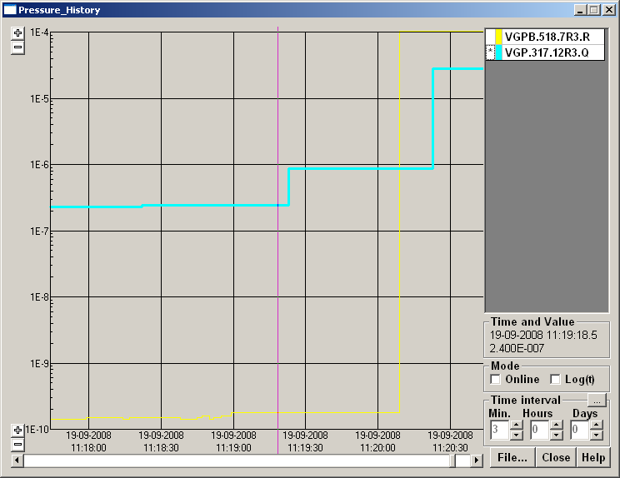
Example with two pennings from two different vacuum
Date/Time | VGPB.518.7R3.R | VGP.317.12R3.Q
19.09.2008 11:15:51 | 1.40E-10 | 2.20E-07
19.09.2008 11:16:01 | 1.40E-10 | 2.20E-07
19.09.2008 11:17:14 | 1.40E-10 | 2.30E-07
19.09.2008 11:17:59 | 1.50E-10 | 2.30E-07
19.09.2008 11:18:05 | 1.50E-10 | 2.30E-07
19.09.2008 11:18:11 | 1.50E-10 | 2.30E-07
19.09.2008 11:18:14 | 1.40E-10 | 2.30E-07
19.09.2008 11:18:17 | 1.50E-10 | 2.30E-07
19.09.2008 11:18:22 | 1.50E-10 | 2.40E-07
19.09.2008 11:18:38 | 1.40E-10 | 2.40E-07
19.09.2008 11:18:41 | 1.40E-10 | 2.40E-07
19.09.2008 11:18:45 | 1.50E-10 | 2.40E-07
19.09.2008 11:18:47 | 1.60E-10 | 2.40E-07
19.09.2008 11:18:50 | 1.40E-10 | 2.40E-07
19.09.2008 11:18:52 | 1.50E-10 | 2.40E-07
19.09.2008 11:18:55 | 1.60E-10 | 2.40E-07
19.09.2008 11:18:59 | 1.80E-10 | 2.40E-07
19.09.2008 11:19:23 | 1.80E-10 | 8.70E-07
19.09.2008 11:20:09 | 1.00E+04 | 8.70E-07
19.09.2008 11:20:23 | 1.00E+04 | 2.80E-05
19.09.2008 11:21:41 | 1.00E+04 | 3.70E-05
19.09.2008 12:14:41 | 1.00E+04 | 3.70E-05

Slide 7
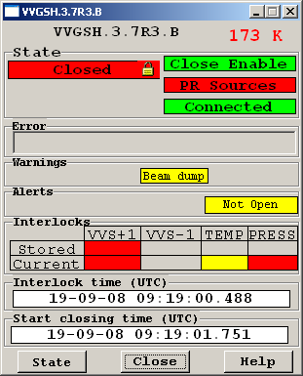
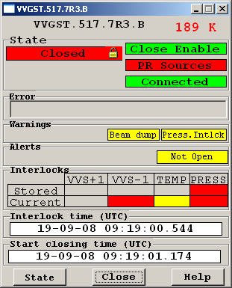
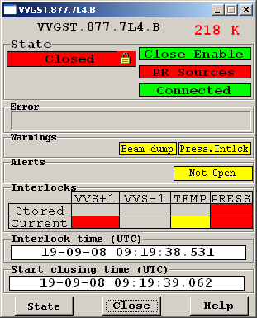
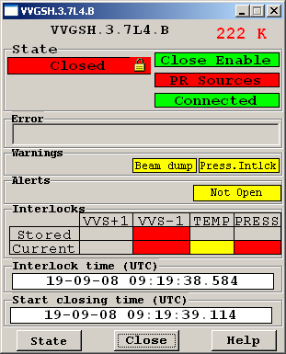
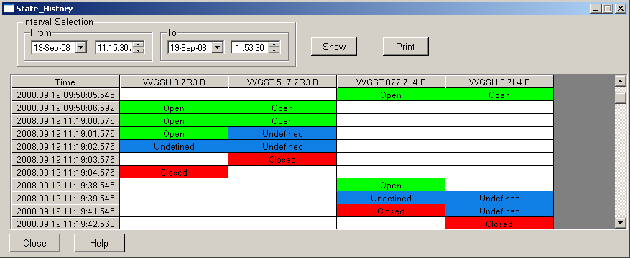
Difference of timing between PLC and PVSS (beam Blue)
NTP Timing, the same for all the machine
PLC_UJ33 Bic_33_B
PLC_UA43 Bic_43_B
Difference between PLC timing and PVSS timing can change at each moment
PVSS Server Timing, the same for all the machine

Slide 8


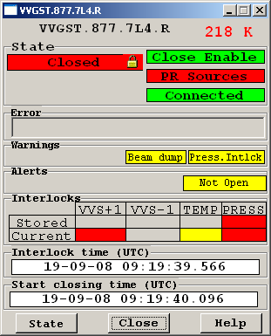

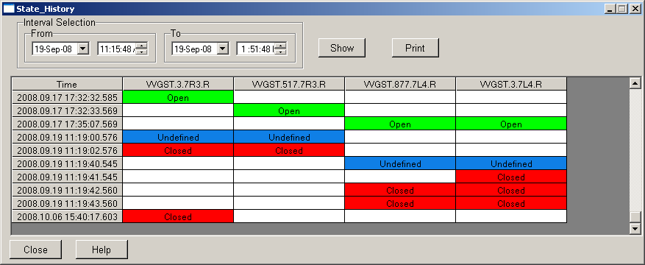
Difference of timing between PLC and PVSS (beam Red)
PLC_UJ33 Bic_33_R
PLC_UA43 Bic_43_R
Difference between Interlock time et Start closing Time is the response time of BIC system in case of beam and the movement of the valve itself, lost of opened state.

Slide 9
Improvements
Synchronize our PVSS server to NTP Timing (accelerators).
For post-mortem analysis, adding the storage of Interlock time and Start closing time (means PLC times) in PVSS archive to be able to retrieve the history in case of problem (on going).
Remove ms in PVSS, not significant (on going).

