Slide 1
FP420 Vacuum
Ray Veness

Slide 2
Contents
What is FP420?
How would it be installed in the LHC?
What would it look like?
What are the issues/interest for our group?

Slide 3
What is FP420?
What does it stand for?
  FP420 = Forward Physics at 420 m (in the LHC)
What is it?
  Currently an international R&D Project
  Plan to add new detectors at 220 m and 420 m either side of IP 1 and/or 5
  Technical proposals being prepared in ATLAS and CMS experiments
    Would become part of one or both of these experiments if approved
How does it work?
  Higgs discovery mechanism using the LHC dipole magnets as a spectrometer
    Higgs produced at the IP from two colliding protons
    These protons remain intact and continue along the beam axis having lost a fraction of their energy
    When these protons go through the machine dipoles (separation and dispersion suppressor) they are separated from the circulating beam by the magnetic field
  Insert (silicon) detectors very close to beam ~5 mm (20σ)
    Detect these particles and precisely measure their arrival time
    Use this data, along with detectors in the central detector to re-construct the event

Slide 4
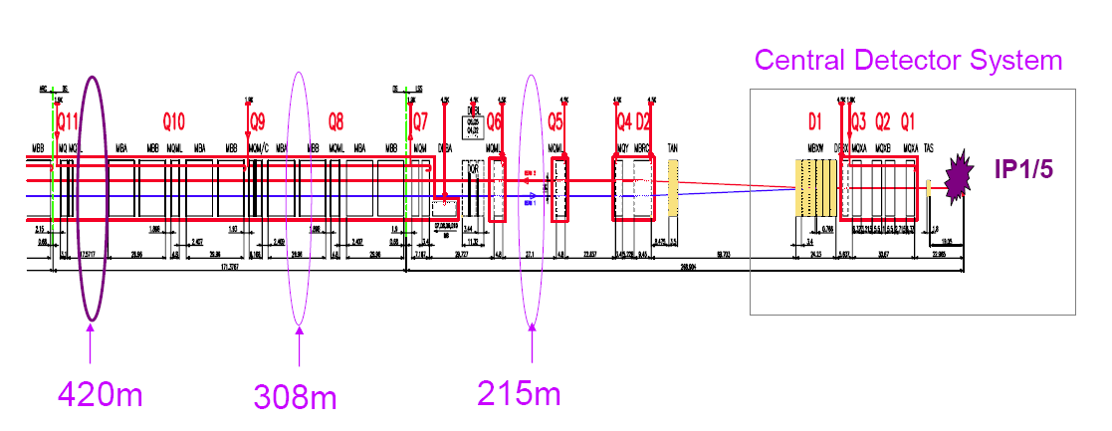
Layout
Main issues
  420 m from the IP is inside the continuous cryostat between Q10 and Q11
  220 m is occupied by TOTEM roman pots in IR5

Slide 5
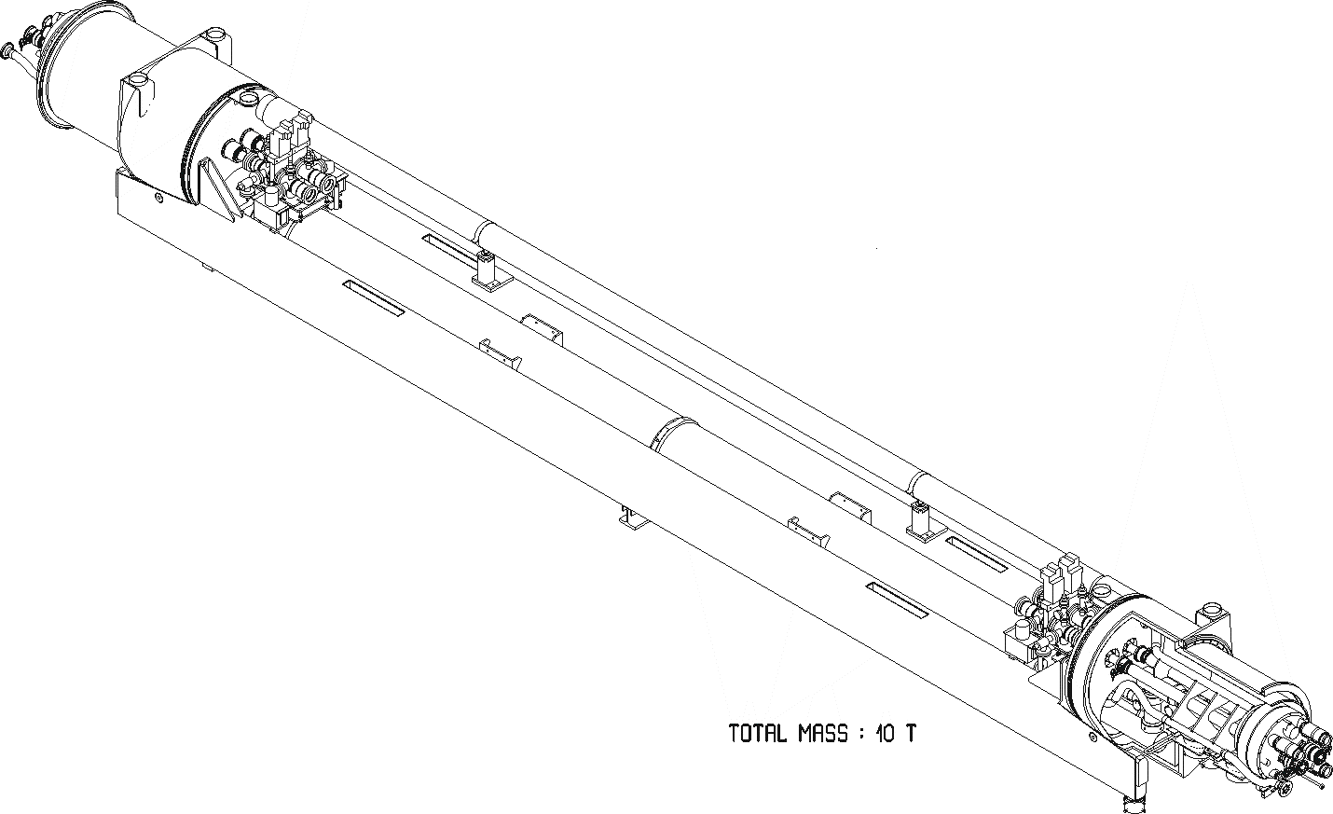
Add a New Warm Sector
Design
  Use modified Arc Termination Modules (ATM)
  Standard VAB-type vacuum instrumentation assemblies
  Leaves ~7.6 m warm space for detectors
3D view of proposed new warm sector, replacing connecting cryostat

Slide 6
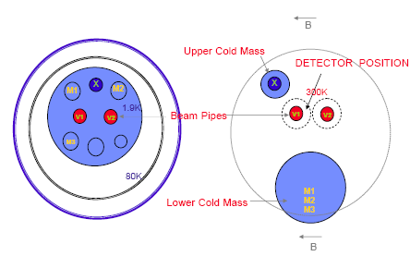
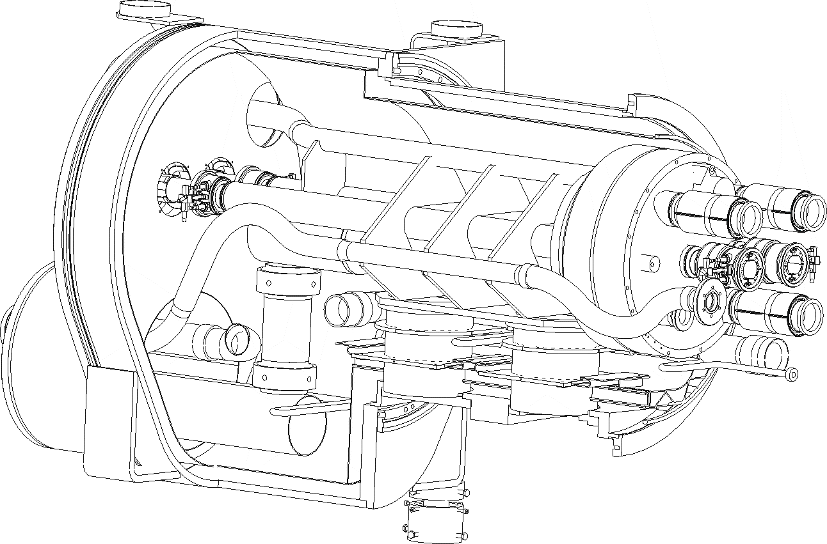
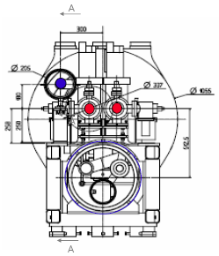
ATM details
Schematic positions of magnet lines
3D part-section of modified ATM (T.Renaglia)
ATM and VAB from warm sector

Slide 7
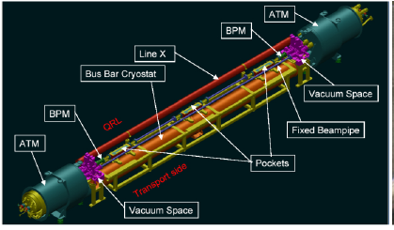
Layout in the Warm Sector
Main issues
  Detectors need to move in and out of the beam
  Detector geometry not compatible with ‘standard’ roman pots
  2 detector stations need to be as far as possible from each other

Slide 8
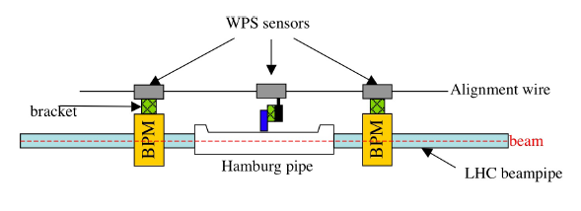
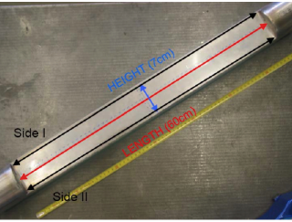
‘Hamburg Beampipe’ Proposal
Concept
  Move the entire vacuum chamber, complete with detectors and BPMs in and out of the beam
  A long, thin-walled ‘pocket’ contains the detectors
  Detectors remain in air
  System can be baked-out before detector insertion (as with LHC roman pots)
Design
  Ongoing, by FP420, ATLAS and CMS, but…
  I am pushing them to use standard LSS components wherever possible
    Bellows modules for lateral movements
    LSS-type BPMs
‘Hamburg Beampipe’ Schematic
Thin-walled ‘pocket’ for silicon detectors
Figures courtesy of: J.Pater JoP 110 (2008) 092022

Slide 9
Summary
Current status
  CERN have produced a mechanical design for the new ATM
  Technical Proposals are being prepared with a view to an installation in 2010/11 shutdown at the earliest
Next steps
  FP420 would like to discuss with VSM early next year with a view to a collaboration, with possible subjects including:
    Design and test of (near) standard LSS components for the moving beampipe
    Impact on the LHC beam vacuum of this additional warm sector
    Consultancy (or more) on the thin window for the detector pocket
Are there any ‘show-stoppers’ for the vacuum system?
  Dynamic vacuum issues related to a warm sector in the dispersion suppressor?
    Synchrotron radiation?
  Mechanical risks?
    Additional risk of venting the continuous cryostat?
    Detector will not retract from beam (risk also for roman pots)

Slide 10
Additional Material

Slide 11
Bellows unit: Standard Options
L_{total}
LSS warm module
LSS drift vacuum chamber
LSS warm module
Standard LHC LSS: L_{total} = 1215 mm
  Existing standard LSS component designs, used with offsets as specified for the LSS
‘Optimised LSS’: L_{total} ~500 mm
  Existing standard LSScomponent designs, using offsets considered acceptable for 500 cycles by the bellows manufacturer
  Additional testing would be required to verify acceptability for 4000 cycle (FP420?) lifetime.

