Slide 1
Dark Matter Searches with the Fermi Large Area Telescope
Eric Charles
on Behalf of the Fermi-LAT Collaboration
CERN Seminar
April 5, 2016

Slide 2
Outline
Dark matter and dark matter particle candidates
Gamma-ray astronomy and the Fermi-LAT
Astrophysical backgrounds for dark matter searches
Dark matter searches with the Fermi-LAT
  Search strategies and current results
  Projections for additional data-taking
  Comparison with other efforts
Summary
Lots of extra slides on related topics:
Other Fermi-LAT science – Projections for other LAT DM searches – WIMP Limits from cosmic-ray data – Modeling Galactic diffuse emission – Pulsars – Dwarf galaxy kinematics

Slide 3
I. Dark Matter and Dark Matter Particle Candidates

Slide 4
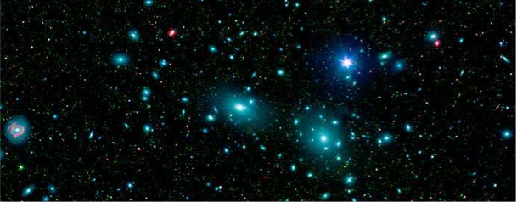
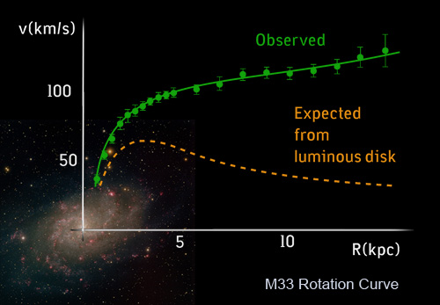
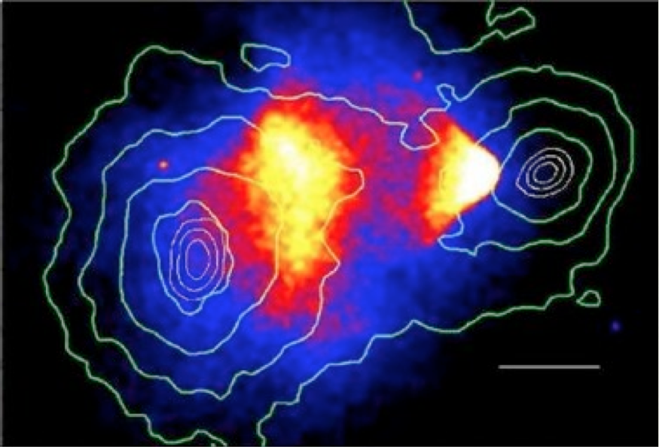
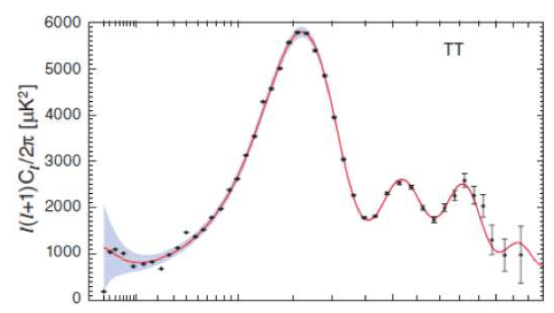
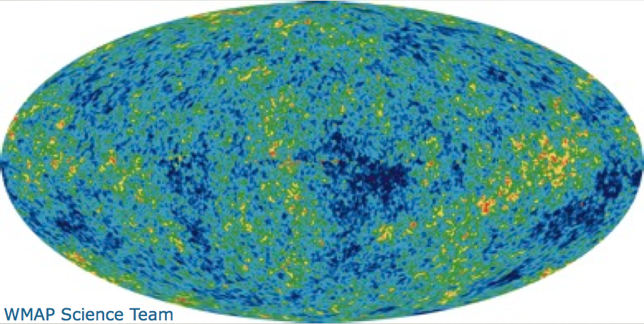
Evidence for / Salient Features of Dark Matter
Comprises majority of mass in Galaxies
Missing mass on Galaxy Cluster scale
Zwicky (1937)
Large halos around Galaxies
Rotation Curves
Rubin+(1980)
Non-Baryonic
Big-Bang Nucleosynthesis,
CMB Acoustic Oscillations
WMAP(2010), Planck(2015)
Almost collisionless
Bullet Cluster
Clowe+(2006)

Slide 5
Evidence for / Salient Features of Dark Matter
All of the evidence for dark
matter is astrophysical!
Comprises majority of mass in Galaxies
Missing mass on Galaxy Cluster scale
Zwicky (1937)
Large halos around Galaxies
Rotation Curves
Rubin+(1980)
Non-Baryonic
Big-Bang Nucleosynthesis,
CMB Acoustic Oscillations
WMAP(2010), Planck(2015)
Almost collisionless
Bullet Cluster
Clowe+(2006)

Slide 6
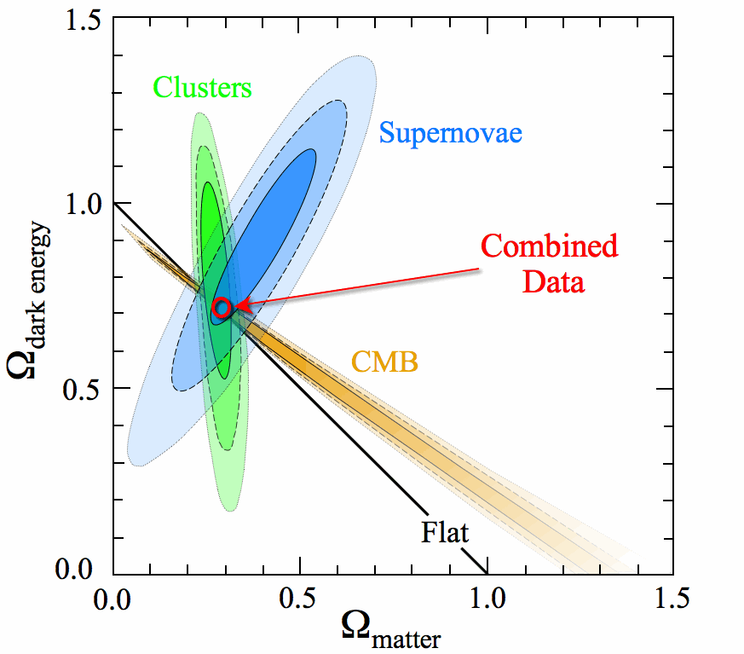
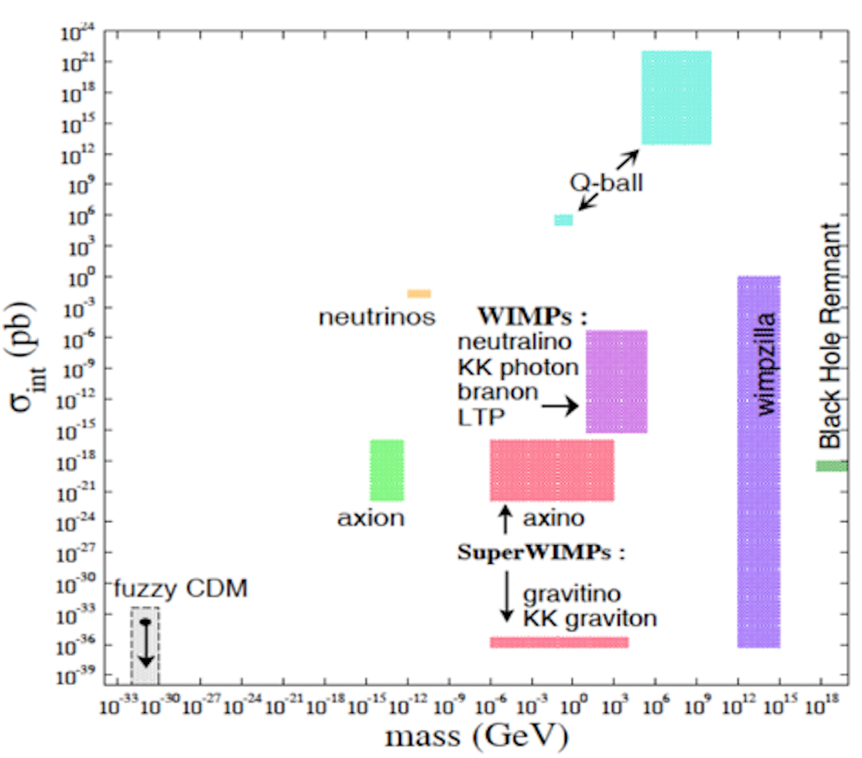
Cosmological Constraints on Dark Matter
Λ−CDM Concordance Fits
DM Candidates by Mass & Cross Section
Adapted from
Kowalski+ (2008)
Park+ (2007)
No Standard Model particle matches the known properties of dark matter
Many candidate particles have been proposed:
  In this talk I will focus on WIMPs
  LAT is also sensitive to signals from axion-like particles (covered in the white paper), primordial black holes and gravitinos

Slide 7
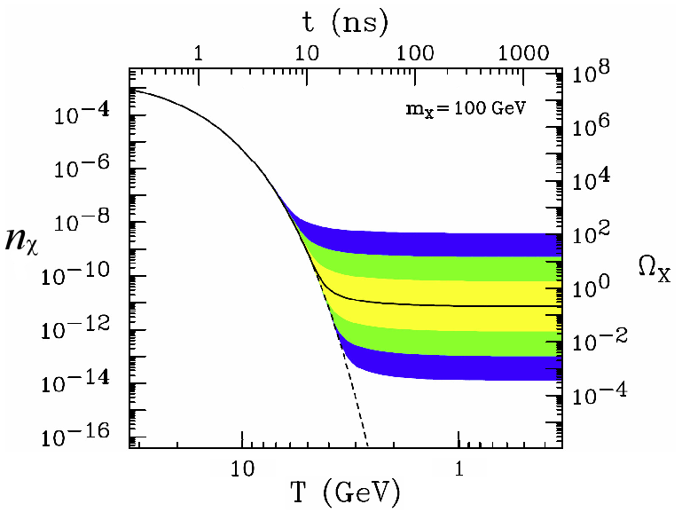
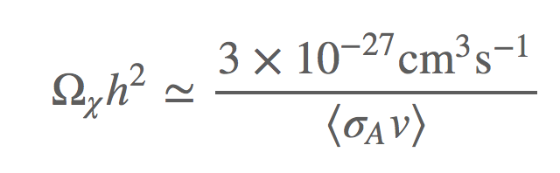
WIMP Dark Matter as a Thermal Relic
DM Density v. Temperature
Small cross-section:
freeze out too early,
too many WIMPs
Freeze out
Large cross-section:
freeze out too late,
too few WIMPs
Feng (2010)
The calculation of the thermal-averaged cross-section <σv> needed to obtain the relic density is robust and gives <σv> ~ 3 10⁻²⁶ cm³s⁻¹
At that cross-section we are probing the entire class of particle models that would generate GeV-to-TeV dark matter

Slide 8
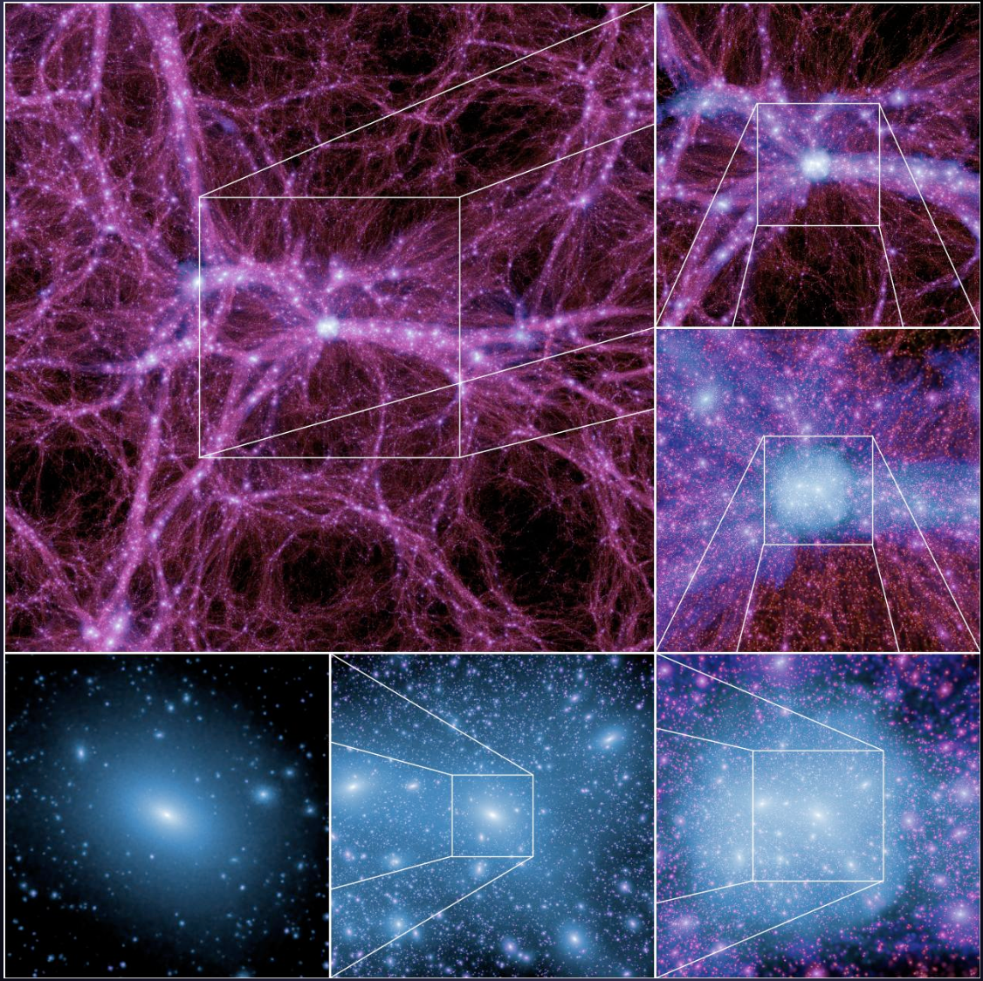
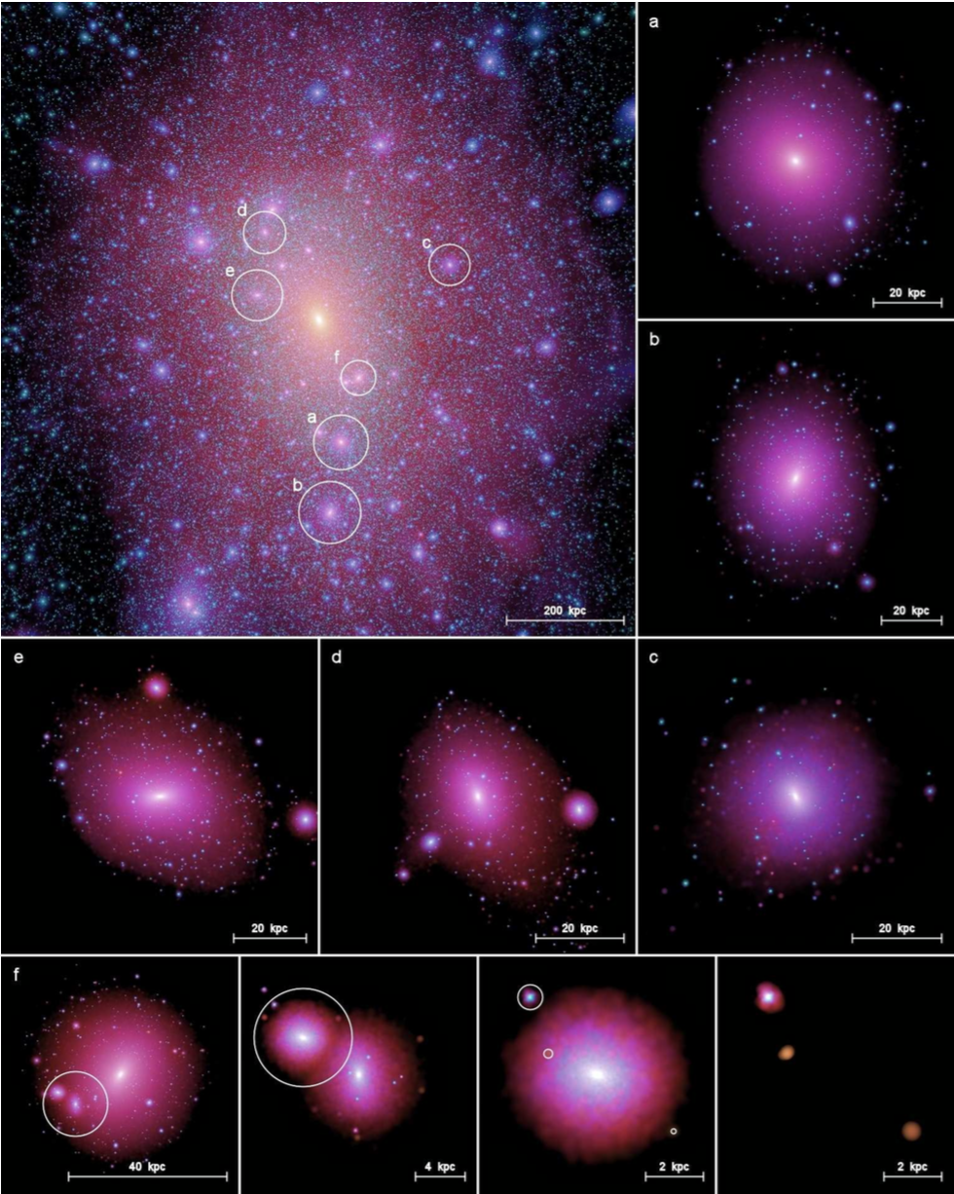
DM Structures are Present on Many Scales
Zoom Sequence of DM Structure on 100 Mpc Scales
Milky Way-like Halo and Several Sub-Halos
We can probe DM by looking for signal contributions from halos:
  On cosmological scales (left)
  In the Milky Way virial radius (~300 kpc = ~1 MLY, right) (Visible size of MW = ~ 20 kpc)
Left: Boylan-Kolchin+ 2009MNRAS.398.1150B
Right: Springel+ 2008MNRAS.391.1685S

Slide 9



The Key Formula for WIMP Searches
Particle Physics
Astrophysics (J-Factor)
dN/dE for 200 GeV DM
J-factor for the Galactic Center
Note: J-factor includes distance, i.e., J-factor would decrease by four if a point-like source were twice as far away
Note: the key factor of 1/m_{χ}² is b/c we express the J-factor as a function of mass density (which we can measure), not number density
Notes:
Make sure to note that the photons start to pile up a factor of 10-100 down from m_chi

Slide 10
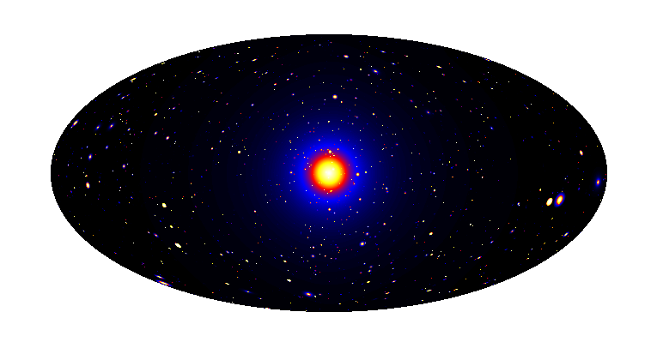
Dark Matter as Seen From Earth
Galactic Center
Satellites
Milky Way Halo
Isotropic contributions
Galaxy Clusters
Dark Matter simulation: Pieri+ 2011PhRvD..83b3518P

Slide 11
II. Gamma-ray Astronomy and the Fermi-LAT

Slide 12
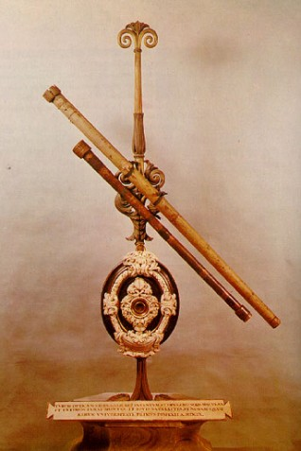
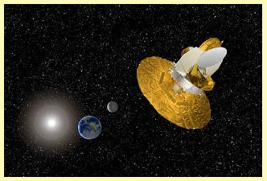
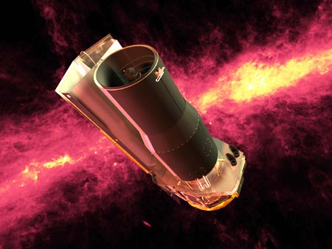
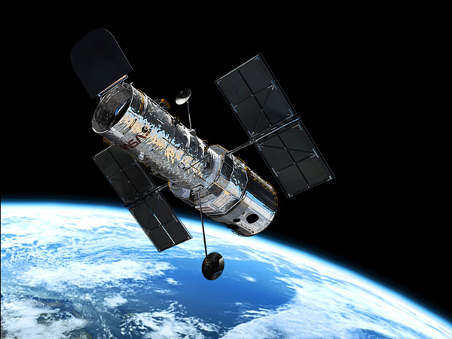
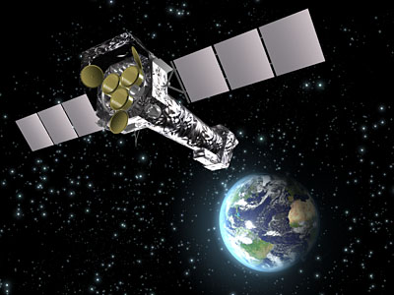
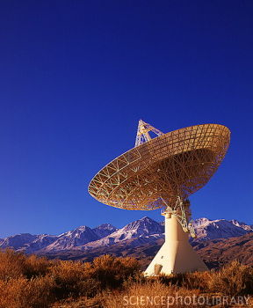
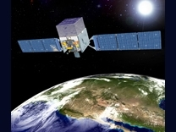
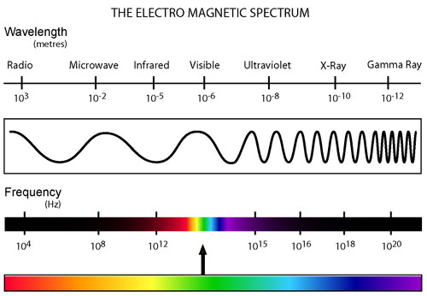
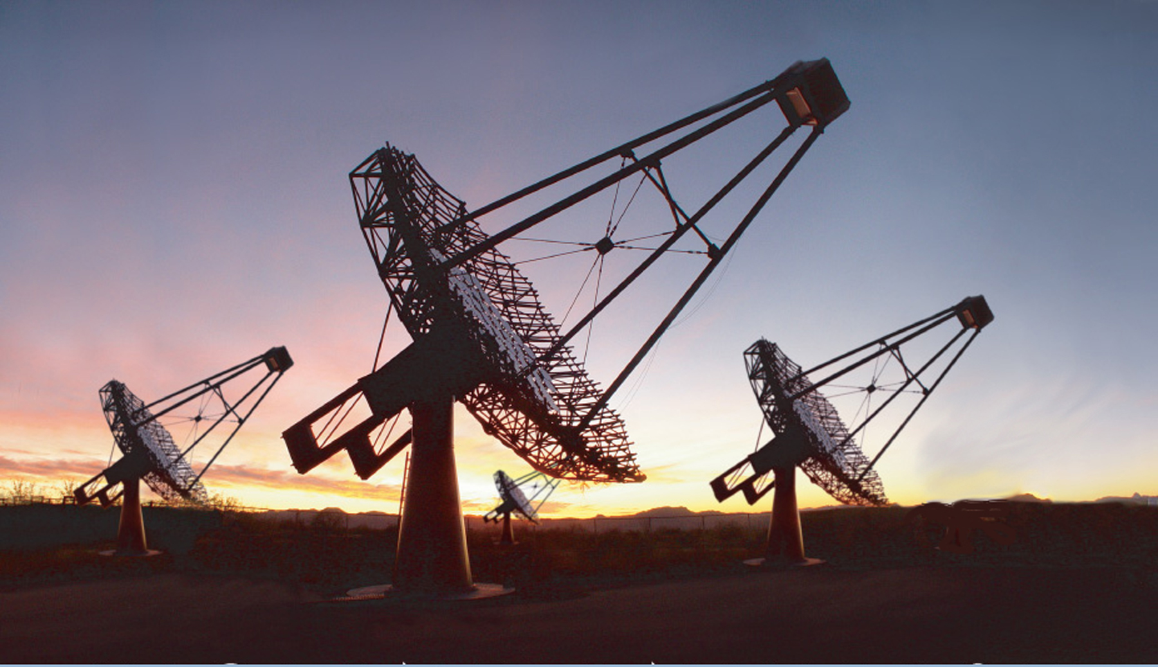
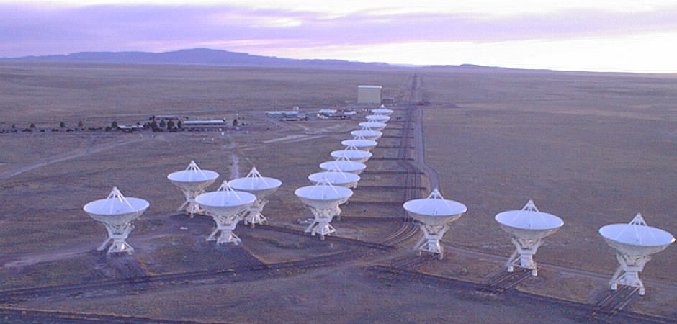
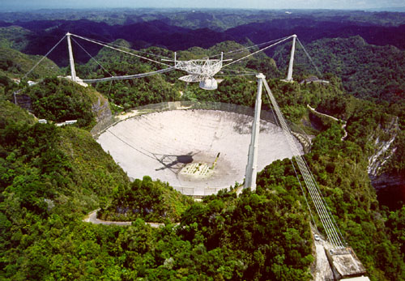
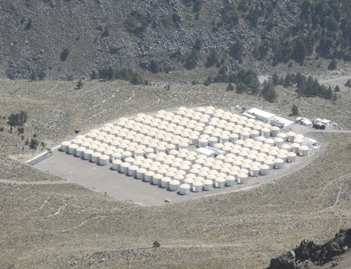
Astronomy across the electromagnetic spectrum

Slide 13
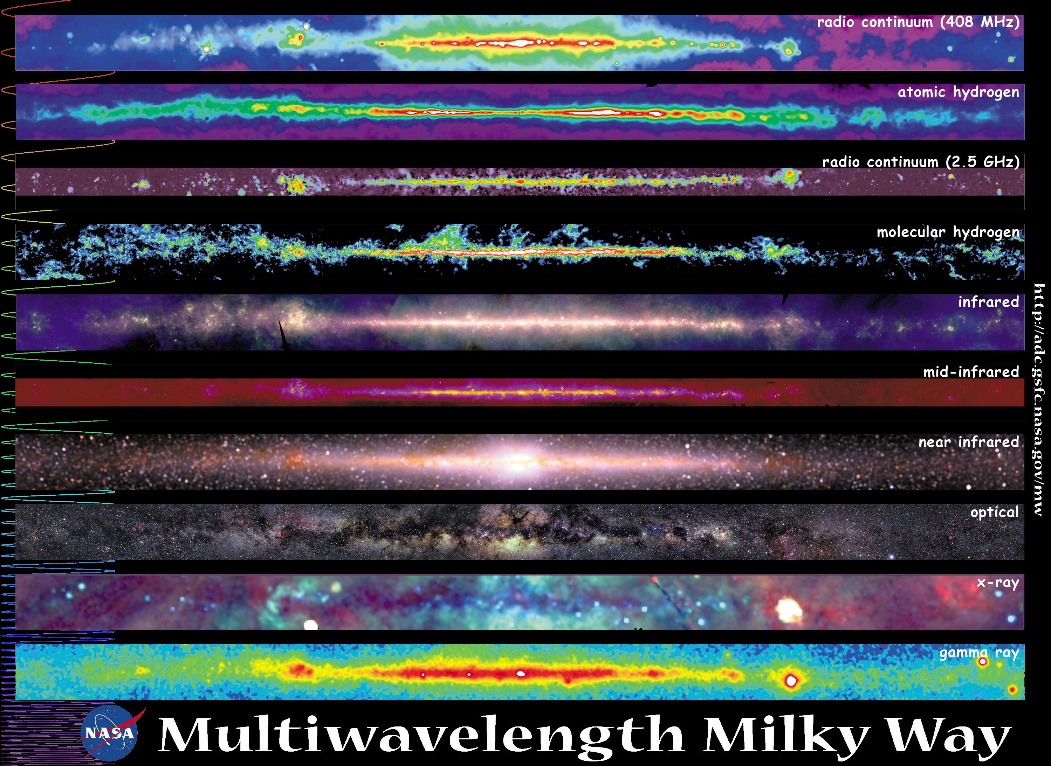
Put another way
Higher Energy

Slide 14


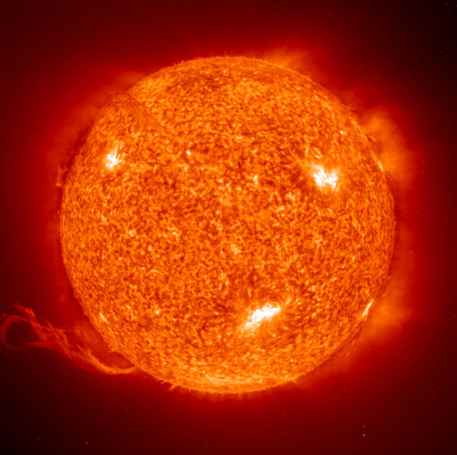


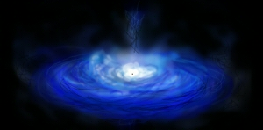
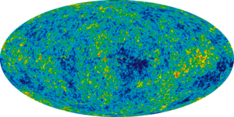
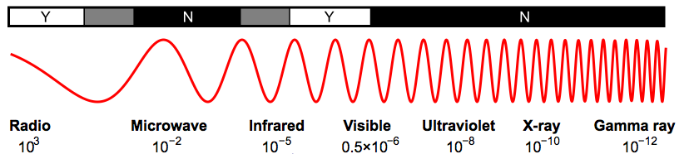
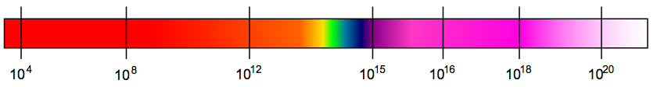
γ-rays Probe the Extreme, Non-Thermal, Universe
Dark Nebula
Dim, young star
Our Sun
Globular Cluster
Thermal Processes
CMB
Accretion Disk
λ (m)
ν (Hz)
Extreme Universe
Notes:
g-ray astronomy probes most violent and energetic phenomena in the sky
g-ray and CRs detected up to and beyond highest collider energies
Aside: in radio observations non-thermal processes also represent significant contribution.

Slide 15
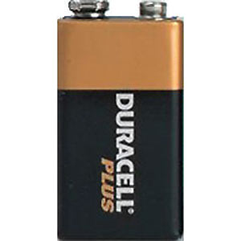
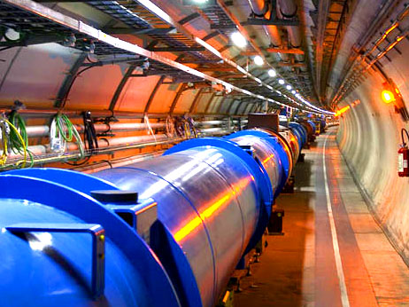
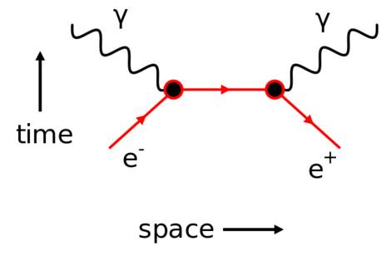
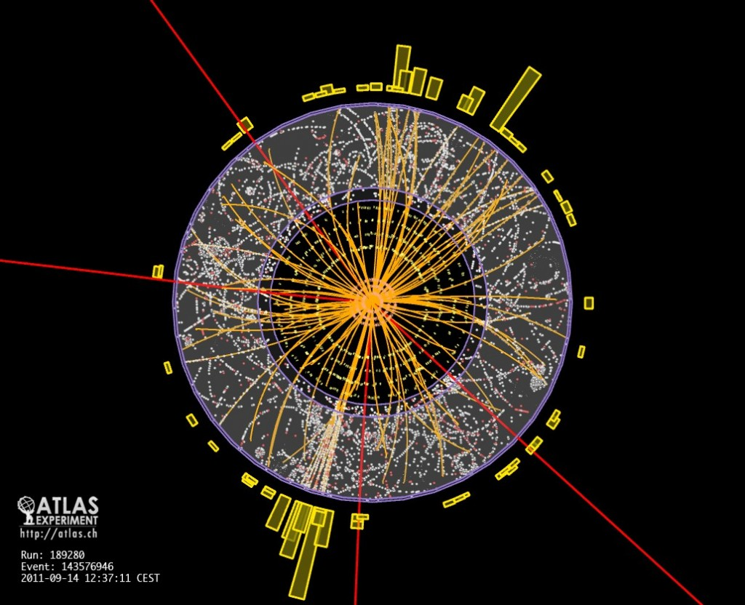
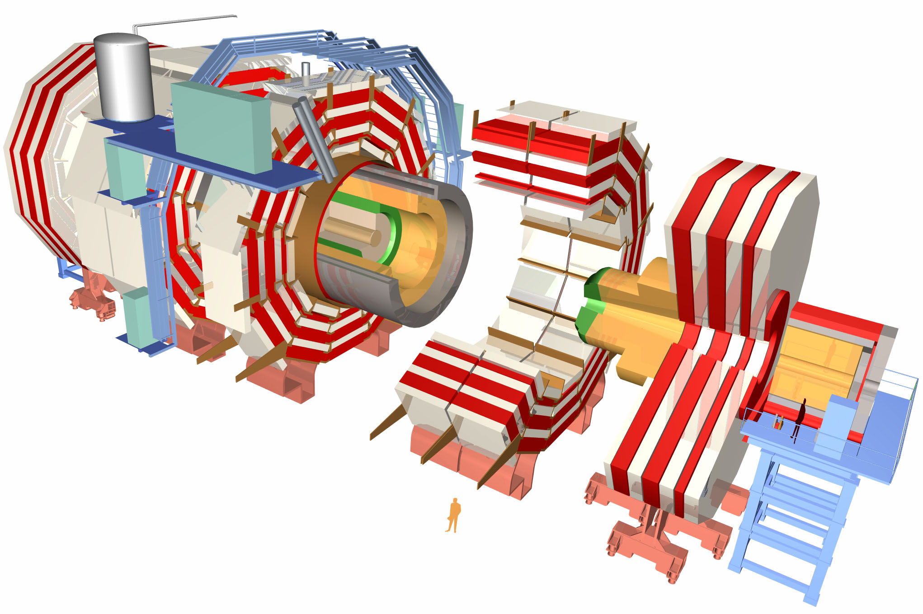
Non-Thermal γ-ray Emission
Acceleration
mechanisms:
γ-ray production
mechanism:
Energy source:
Absorption/
Propagation:
Particles
Notes:
The point of this slide is to give the flow of the talk in terms of the elements needed to produce non-thermal emission.

Slide 16
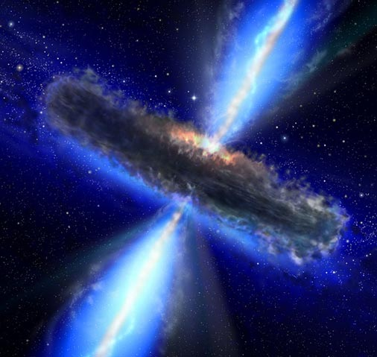
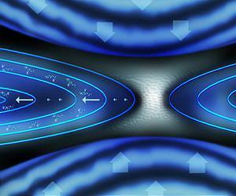
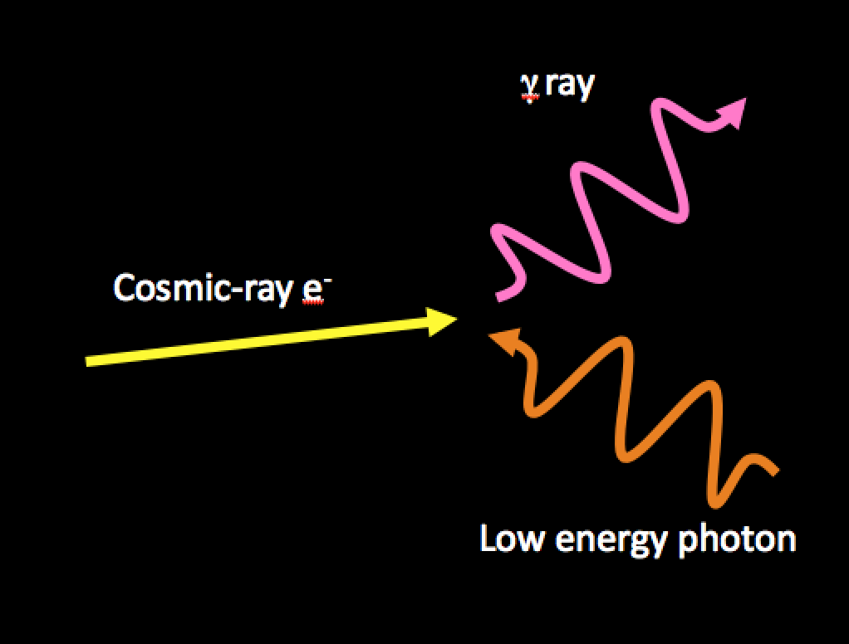
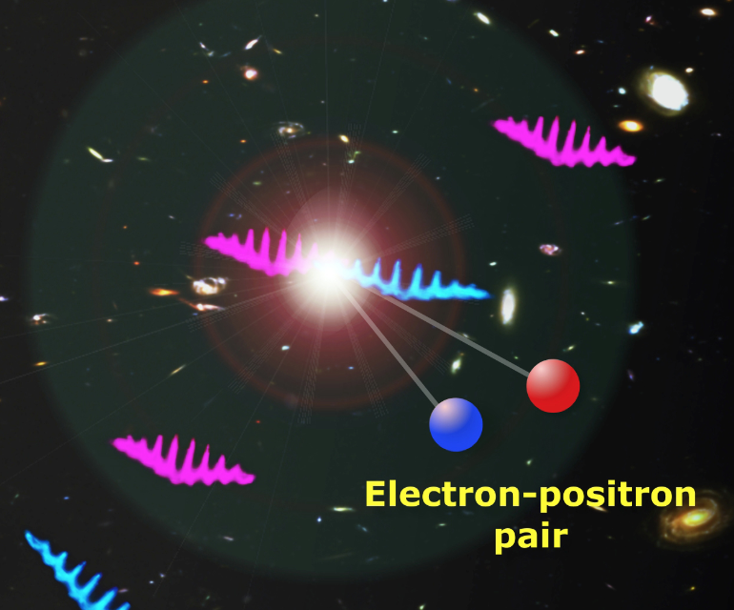
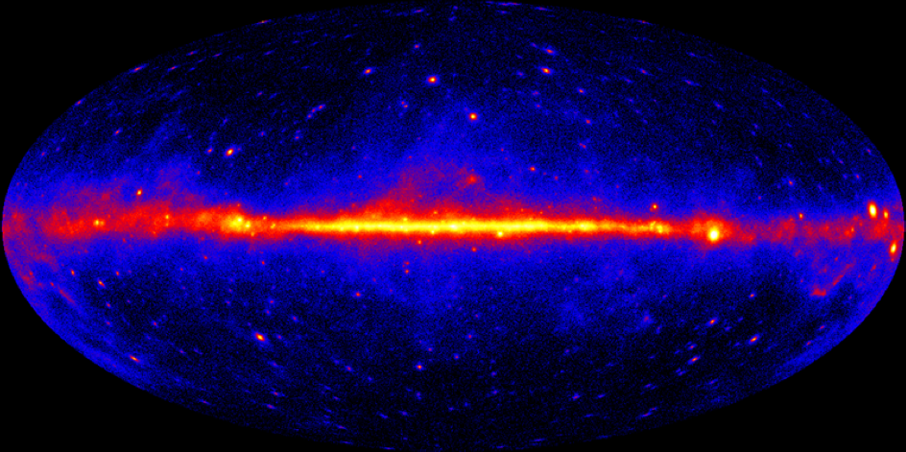
Non-Thermal γ-ray Emission
Acceleration
mechanisms:
extreme fields
γ-ray production
mechanism:
cosmic rays
and targets
Energy source:
extreme events & systems
Absorption/
propagation:
foregrounds
-ray sky
Notes:
The point of this slide is to give the flow of the talk in terms of the elements needed to produce non-thermal emission.

Slide 17
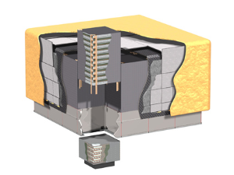
The Fermi Large Area Telescope
Sky Survey:
With 2.4 sr field-of-view LAT sees whole sky every 3 hours
from 20 MeV to over 300 GeV
Fermi-LAT Collaboration:
~400 Scientific Members,
NASA / DOE & International
Contributions
Large Area:
A_{eff} > 0.9 m² on-axis,
~ 0.4 m² 60° off-axis,
over almost 3 decades
(1 GeV – 1 TeV)
Atwood et al. [LAT Clb] 2009ApJ...697.1071A
Ackermann et al. [LAT Clb] 2012ApJS..203....4A
http://www-glast.stanford.edu/
Energy-Dependent PSF:
Point-spread function improves with energy,
R_{68%} (100 MeV) ~ 5°
R_{68%} (10 GeV) ~ 0.2°
Good energy resolution:
Well-matched to A_{eff},
ΔE/E_{68%} < 10% over 3 decades
(1 GeV – 1 TeV)
Public data:
All photon data released to public within hours
Notes:
Fermi-LAT is a g-ray pair conversion telescope
Also sensitive to CRs
Fermi-LAT subsystems are “standard” particle physics detectors adapted for use in space
Fermi-LAT collaboration is a large, multi-national collaboration
Include both particle physicists and astronomers/ astrophysics
Public data release: not all results presented here are LAT work
Sky survey mode permits time-domain astronomy.

Slide 18
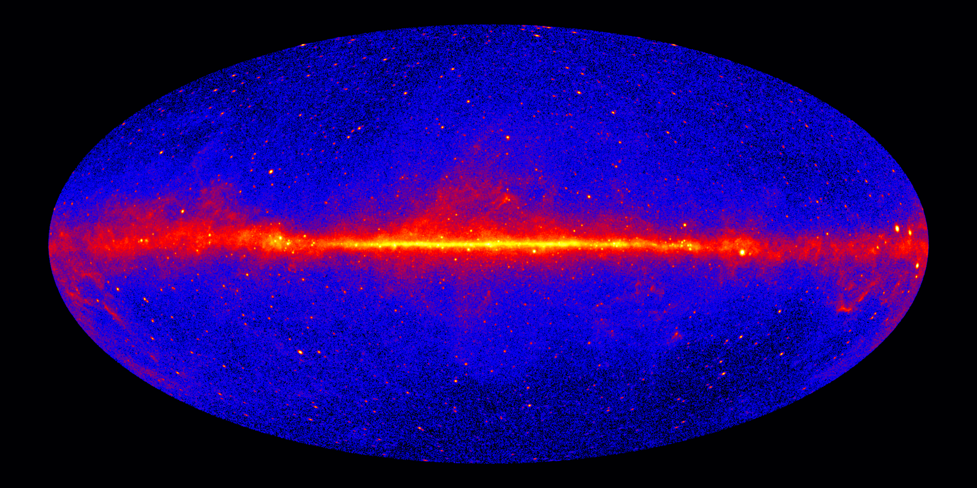
Gamma-ray Sky
Fermi-LAT: 7 Year Sky,
Front-converting events > 1 GeV
Notes:
The things to emphasize here is that Fermi covers the whole sky. The map is in a Hammer-Aitoff projection, and is _not_ exposure corrected, but the exposure is relatively uniform (within a factor of 2) across the whole sky.

Slide 19
III. Astrophysical Backgrounds for Dark Matter Searches

Slide 20
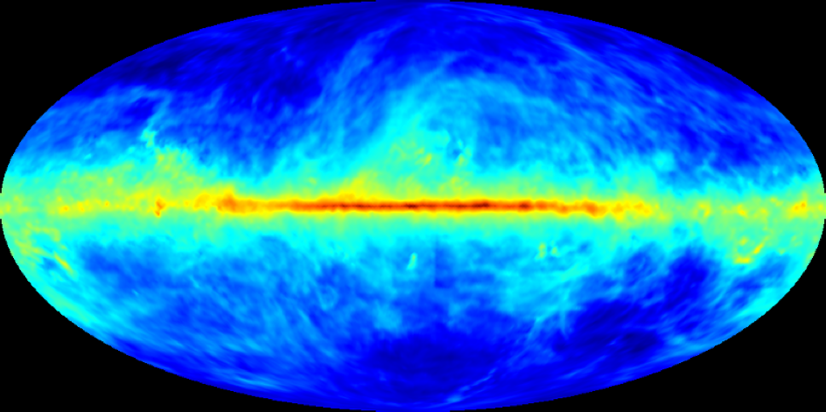
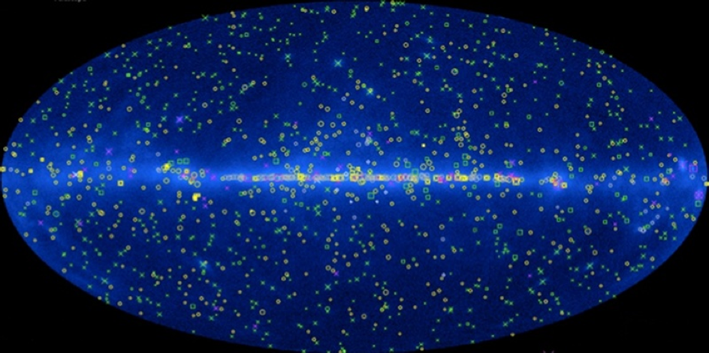

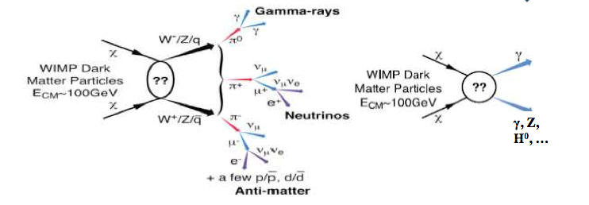
Indirect Searches for DM in the Fermi Sky
???
Fermi Sky
Galactic
Point Sources
Isotropic

Slide 21
Astrophysical Backgrounds (GeV)
Diffuse Backgrounds:
  Cosmic-ray interactions with interstellar matter and radiation fields
Source Backgrounds:
  Pulsars
  Blazars and Active Galactic Nuclei
  Supernova Remnants
  Galaxies (starburst galaxies)
Unresolved Sources

Slide 22
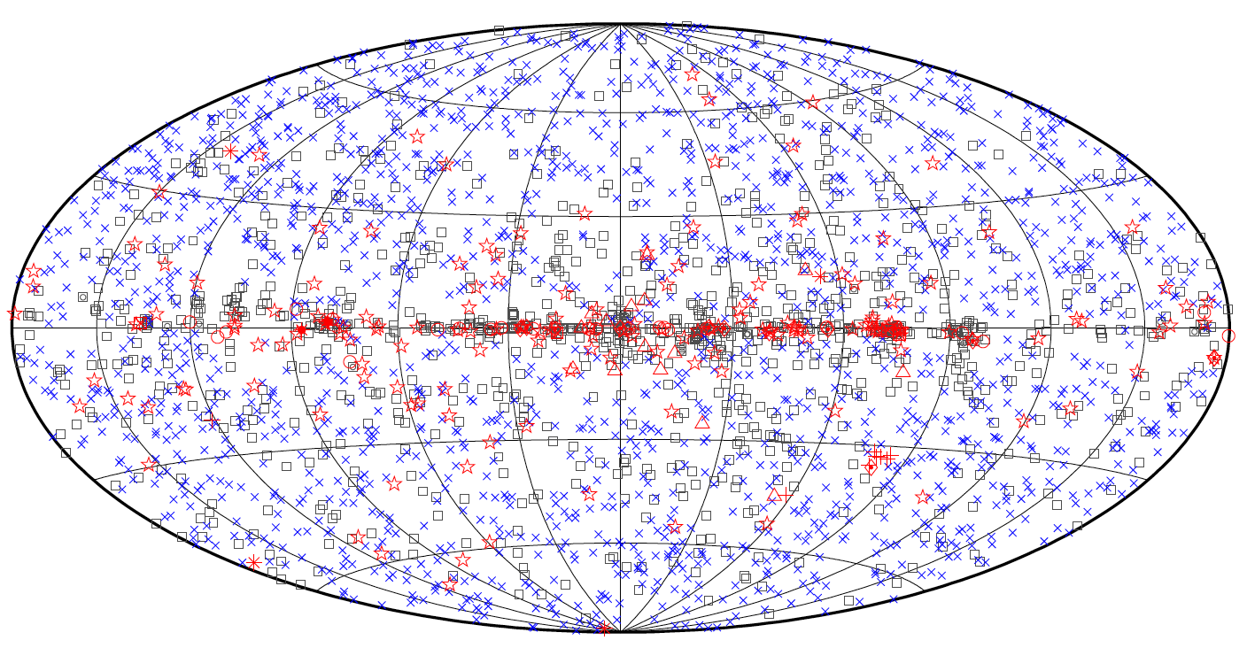
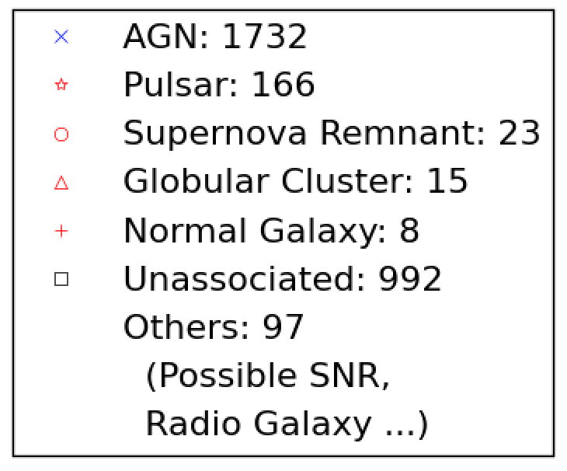
Census of γ-ray Sources
Third Fermi-LAT Source Catalog (3FGL)^{[1]}
[1] Acero et al. , 2015ApJS..218...23A [2-4,7-9] Abdo et al. 2009ApJ...707L.142A,2010Sci...328..725A, 2010ApJ...709L.152A, 2009Sci...325..845A, 2010Sci...329..817A, 2009Sci...325..848A, 2009Sci...325..840A [6,10,14] Ackermann et al. 2012Sci...335..189F, 2012ApJ...753...83A, 2012ApJ...747..121A [11-13] D’Absruco et al. 2013ApJS..206...12D Massaro et al. 2013ApJS..206...13M, Maselli et al. 2013ApJS..206...17M & related works
Fermi-LAT catalog include source classes not seen pre-Fermi:
  non-AGN galaxies^{[2,3,4]}, globular clusters^{[5]}, high-mass binaries^{[6]}, novae^{[7]}.
Some source classes are more populated than expected:
  millisecond pulsars^{[8]}, radio-quiet pulsars^{[9]}, high-redshift AGN.
30% of sources and still unassociated/ unidentified:
  many pulsars & AGN^{[10-13]}, new source types, dark matter^{[14]}?
Notes:
The point of this slide is to focus on the diversity of γ-ray sources. It is probably worth calling out blazars & pulsars as the main contributors.

Slide 23
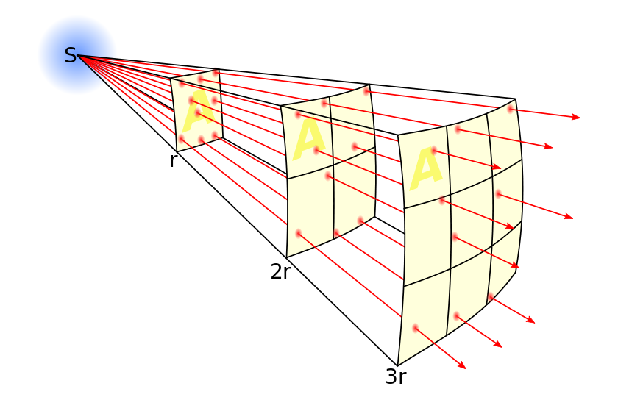
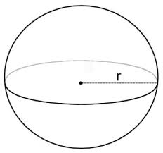
Improvement of Source Catalogs as a Function of Instrument Sensitivity (S)
Flux falls as 1 / d²
Volume grows as r³
The LAT Collaboration regularly constructs catalogs of known γ-ray sources: 1FGL (11 months), 2FGL (2 years), 3FGL (4 years) …
The number of cataloged sources increases faster than sqrt(t)
  For a population of objects with the same intrinsic brightness uniformly distributed in space:
    N ( Flux > S ) scales as S^{-1.5}
    The total unresolved flux decreases linearly with S

Slide 24
IV. Dark matter searches with the Fermi-LAT

Slide 25
Dark Matter Search Strategies
Satellites
Low background and good
source id, but low statistics
Galactic Center
Good statistics, but source
confusion/diffuse background
Milky Way Halo
Large statistics, but diffuse
background
Spectral Lines
Little or no astrophysical uncertainties, good
source id, but low sensitivity because of
expected small branching ratio
Isotropic contributions
Large statistics, but astrophysics, Galactic diffuse background
Galaxy Clusters
Low background, but low statistics
Dark Matter simulation: Pieri+ 2011PhRvD..83b3518P

Slide 26
Search Strategies (against the γ-ray Sky)
Satellites
Low background and good
source id, but low statistics
Galactic Center
Good statistics, but source
confusion/diffuse background
Milky Way Halo
Large statistics, but diffuse
background
Spectral Lines
Little or no astrophysical uncertainties, good
source id, but low sensitivity because of
expected small branching ratio
Isotropic contributions
Large statistics, but astrophysics, Galactic diffuse background
Galaxy Clusters
Low background, but low statistics
LAT 7 Year Sky > 1 GeV

Slide 27
The Milky Way Galactic Halo
Recent papers: Gordon & Macias 2013PhRvD..88h3521G, Abazajian+ 2014PhRvD..90b3526A
Calore+ 2015PhRvD..91f3003C , Daylan+ 2016PDU....12....1D ,
Ajello+ [LAT Clb] 2016ApJ...819...44A
The goal is to look for DM in the inner Galaxy
Because of the large astrophysical foregrounds, we must first understand the γ-ray emission from the Galaxy and from known source classes

Slide 28
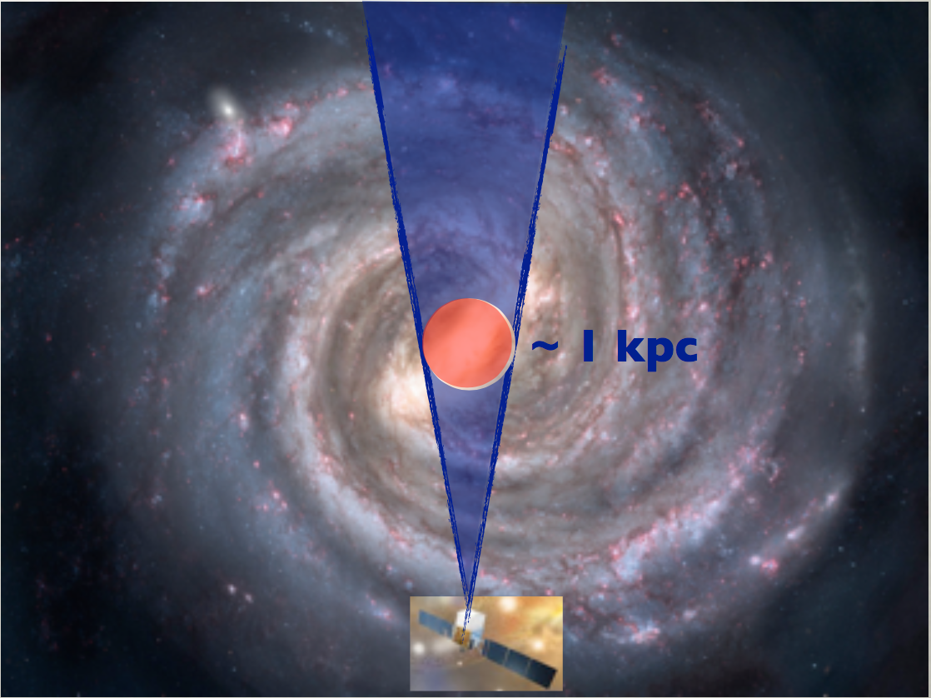

Observing the Inner Galaxy
LAT Intensity: 7 years, > 1 GeV, 15°x15°
Observations of the inner Galaxy include strong astrophysical foreground and backgrounds along the line of sight
  In the 1-100 GeV energy band these account for ~85% of the γ-rays in a 15°x15° box around the Galactic center

Slide 29

Galactic Center GeV Excess
Modeling the diffuse γ-ray emission from cosmic ray interactions with matter and radiation fields in the galaxy is challenging (see extra slides)
Spatially extended excess around the Galactic center at a few GeV has been report in several papers
LAT Residuals (counts): 5 years, > 1.6-10 GeV, 15°x15°
Ajello+ [LAT Clb] 2016ApJ...819...44A

Slide 30

Spectrum of the Galactic Center Excess
Spectral Energy Density for Galactic Center Excess Compared to Several Models
Emission above 50 GeV not from
50 GeV dark matter
Ajello+ [LAT Clb] 2016ApJ...819...44A
The presence for an γ-ray excess with respect to the modeled diffuse emission at the Galactic center at a few GeV is well established
However, the characteristics (and the interpretation) of the excess depend on the modeling of the astrophysical fore/background

Slide 31
Radial Profile of Galactic Center Excess
Radial profile of GC Excess (at 2 GeV) Compared to Predictions From N-Body Simulations
Schaller+
2016MNRAS.455.4442S
The radial profile of the GC excess is broadly consistent with dark matter expectations for N-body (red lines above)
  N-body simulations of Milky-Way like galaxies tend to show less DM signal in the inner few degrees than observations of the Galactic center (grey shaded region)

Slide 32

Estimating the Astrophysical Modeling Uncertainties
Spectral Excesses w.r.t. Diffuse Emission Model in as a Function of Galactic Longitude
Calore+ 2015JCAP...03..038C
2015PhRvD..91f3003C
Excess emission w.r.t. standard diffuse emission models peaking around a few GeV near the Galactic center is well-established
The interpretation of the excess is unclear (similar size excesses attributed to local sources of cosmic rays are present elsewhere)

Slide 33
Dark Matter Interpretations of GC Excess
Projected Upper Limits from a 15-year GC Analysis for Different Levels of Modeling Uncertainty
Studies of control regions along Galactic plane suggest
f_{syst} ~ 1% to 5% (depending on energy)
Notes:
The extrema of the bands correspond to the NFW (top) and gNFW with gamma = 1.2 (bottom) DM profiles.

Slide 34

Signal Degeneracy with Pulsars
Spectral Energy Density for 35 GeV WIMP Annihilation in the b-quark Channel
Note: the normalization
of these curves is arbitrary. The difference between the Geminga pulsar and the Inner galaxy pulsars is attributable to the different ages of the pulsars.
O'Leary+ (2015)
arXiv:1504.02477
Aliu+ (2015)
2015ApJ...800...61A
The γ-ray spectra for pulsars are similar to the spectra for low-mass DM
GC excess may be attributable to population of unresolved pulsars, as many have noted

Slide 35




Resolving the Pulsar / Dark Matter Degeneracy
Excess
Smooth Component
Unresolved Sources
f_{DM}
f_{PS}
Lee+ 2015JCAP...05..056L
See also:
Lee+ 2016PhRvL.116e1103L
Cholis+ 2015JCAP...06..043C
Bartels+ 2016PhRvL.116e1102B
Several authors have performed statistical analyses of pixel-by-pixel fluctuations γ-ray counts near the Galactic center to disentangle the pulsar / DM degeneracy
Data appear to favor population of unresolved point sources

Slide 36

Known Satellites of the Milky Way
Segue 1
Keck Observatory
Recent papers:
LAT: Ackermann+ [LAT Clb] 2015PhRvL.115w1301A
Drlica-Wagner+ [LAT + DES Clbs] 2015ApJ...809L...4D
Geringer-Sameth+: 2015PhRvL.115h1101G
Look for γ-ray emission from Dwarf spheroidal galaxies (dSphs), which are the most dark matter dominated objects known
This is a moderate-signal, low-background search strategy

Slide 37



Dwarf Spheroidal Satellites of the Milky Way
The Milky Way is surrounded by small satellite galaxies
Close to Earth
(25 kpc to 250 kpc)
Optical Luminosities range from 10³ to 10⁷ L
Astrophysically inactive
Most dark matter dominated objects known
30 kpc

Slide 38

Searches for DM in MW Satellites
Roughly two dozen Dwarf spheroidal (dSph) satellite galaxies of the Milky Way known up to the DES era
Negligible astrophysical γ-ray production expected

Slide 39

Example Count Maps for a dSph Galaxy
NFW scale radius
PSF containment (68%,98%)

Slide 40

Published Upper Limits from Dwarf Galaxies
χχ -> bb channel
Update to Current version

Slide 41

Undiscovered Satellites of the Milky Way
Simulated DM Satellite Diemand+ 2007ApJ...657..262D
Recent Papers:
Berlin& Hooper 2014PhRvD..89a6014B
Bertoni+ 2015JCAP...12..035B
(See also arXiv:1602.07303)
Look for population of LAT catalog sources that are consistent with DM signatures and inconsistent with known astrophysical source classes

Slide 42

Searches for DM Satellites in Unid. LAT Sources
Distance v. Mass for Via Lactea-II subhalos
low-mass subhalos
(extrapolated)
Larger DM Flux
than Draco
Search criteria:
  catalog sources, off-plane: |b| > 10°
  not associated with counterparts at other wavelengths
  steady emission, spectrum consistent with DM spectra
  spatially extended ( >~ 0.25° )
Results:
  Few sources pass criteria
  From N-body simulations we infer a constraints on annihilation cross-section
Ackermann+ [LAT Clb]:
2012ApJ...747..121A

Slide 43
Published Limits from Dark Satellite Searches
χχ -> bb channel
Note, Bertoni+ (2015) results
are a re-analysis of Berlin+ (2013)
LAT search requiring
source extension: (LAT: 2012)

Slide 44

DM Contributions to the “Isotropic” Background
Recent Papers:
Ackermann+ 2015JCAP...09..008T
Ajello+ arXiv:1501.05301
diMauro+ arXiv:1501.05316
Look for signatures of dark matter in the Isotropic background
This requires good knowledge of all the astrophysical foregrounds

Slide 45
Dark Matter Contributions to the Extragalactic Background
Comparison of Extragalactic Gamma-ray Background to Contributions from Sources
Ajello+
2015ApJ...800L..27A
Di Mauro & Donato
2015PhRvD..91l3001D
Estimating the contribution from unresolved sources requires deriving the cumulative luminosity function N(Flux > Threshold) as a function of the threshold (log N – log S in astronomy parlance)
Knowledge of the log N – log S can also constrain the DM emission from local DM halos

Slide 46
A Sample of Published Results from Indirect DM Searches with LAT Data
Representative Results for Different Search Targets for the b-quark Channel
Notes:
Mention the GeV excess here!! Also, note that Abazajian and Keeley (2015) studied effects of the DM profile uncertainties on the normalization of the GC center excess.

Slide 47





Projections for Additional Data Taking
Simulated background counts > 1 GeV for 15 years of data
Galactic diffuse
Catalog Sources
Unresolved Galactic Sources
Unresolved Extra-Galactic Sources
Isotropic Background

Slide 48
Making Projections that Account for Systematic Uncertainties
Effective Background (b_{eff}) v. m_{χ} for b-quark Channel for Different Search Targets
Systematically limited by
background modeling
Background noise limited
Signal limited
To estimate uncertainties we derive the “effective background” (b_{eff}), i.e., the background weighted by how much it overlaps with the signal.
From studies of control regions we estimate that the systematic uncertainty on the signal counts is a few percent of b_{eff} (Depends on the target).
The contribution from background noise to the statistical uncertainty on the number of signal counts is b_{eff}^{0.5}.

Slide 49

Growing Number of Known Dwarf Galaxies
DES Year 2 Data:
Drlica-Wagner+,
2015ApJ...813..109D
DES Year 1 Data:
Bechtol+:
2015ApJ...807...50B
Koposov+:
2015ApJ...805..130K
DECam
SDSS
Advent of deep, digital survey era in optical astronomy has led to the discovery of numerous new Milky Way-satellite dwarf galaxies
LSST & other surveys will continue to find new dwarf galaxies after the Fermi mission

Slide 50

Discovery Volume for DM Signals from Dwarf Galaxies
Optical surveys are quickly improving in both sky-coverage and depth, potentially giving us even better dSph targets
Assuming dSph J-factor scaling with distance we could currently expect a 5σ signal for 100 GeV DM at the thermal relic cross section in the b-quark channel for any new dSph within 8 kpc (a volume of 2100 kpc³)
With 15 years of data that increases to V > 4200 kpc³; i.e., doubles the discovery volume.
At higher masses, where the sensitivity is signal limited, doubling the data increases the discovery volume by (15/6)^{1.5} ~ 4.0

Slide 51
Scaling Behavior of dSph Sensitivity
Ratio of limits for 6 and 10 years v. m_{χ}
Ratio of limits for 6 and 15 years v. m_{χ}
We have performed extensive studies with the dSph analysis, using up to 15 years of simulated data
  These curves were made assuming 60 known dSphs, but the scaling behavior does not depend strongly on that number
As expected based on the estimated b_{eff}, we find that the scaling behavior moves from background-limited at low masses to signal-limited at high masses

Slide 52
Summary of Projected Sensitivity (10 Years)
Summary of Projected Limits for b-quark Channel, for 10 Years of Data

Slide 53
Summary of Projected Sensitivity (15 Years)
Summary of Projected Limits for b-quark Channel, for 15 Years of Data

Slide 54

Comparison with Other Indirect-Detection Methods
Comparison of LAT Projected Limits with Other Indirect-detection Limits for b-quark Channel
With 15 years of data the LAT would:
  Have the best sensitivity for indirect detection up to 800 GeV (b-quark channel)
  Probe the thermal relic cross section up to > 400 GeV (b-quark channel)
  Confirm or rule out a DM-interpretation of the GeV excess

Slide 55

Role of Indirect Detection Dark Matter Searches
Compared to collider searches: indirect detection is sensitive to high mass scales (particles already exist, stable final state particle spectrum peaks at ~10% of m_{χ})
Compared to direct detection: indirect detection is sensitive to annihilation rather than scattering off of nuclei (i.e., more sensitive when χ couples more to heavy quarks and vector bosons than to light quarks and gluons)

Slide 56
Importance of Indirect-Detection Searches
Comparison of LAT Current Limits with Direct-Detection and Collider Limits for b-quark Channel
Conversion of direct detection and collider
limits following EFT methodology of Bauer+ 2015PDU.....7...16B

Slide 57
Dark Matter Sensitivity, circa 2025
Comparison of LAT Projected Limits with Direct-Detection and Collider Limits for b-quark Channel
Conversion of direct detection and collider
limits following EFT methodology of Bauer+ 2015PDU.....7...16B

Slide 58
Summary
Indirect-detection dark matter searches look for dark matter signals associated with specific astrophysical targets with large known dark matter content, such as dwarf galaxies
Cosmology provides a robust prediction of the thermally averaged cross section for a thermal relic DM particle: <σv> ~ 3 x 10⁻²⁶ cm³ s⁻¹
The LAT sensitivity has reached the thermal relic level and thus is informing us about the DM production mechanism in the early Universe: LAT data have been used to rule out WIMPs at the thermal relic cross-section up to ~150 GeV (for annihilation to b-quarks)
For the most promising targets (the dSphs) the LAT sensitivity scales as better than sqrt(t) with more data. With 15 years of data:
  The dSphs would allow us to exclude the thermal relic cross section for masses up to > 400GeV for the b-quark channel,
  The dSphs would reach below 2 × 10⁻²⁷ cm³ s⁻¹ for masses of ∼ 50 GeV in the b-quark channel allowing us to confirm or rule out the DM interpretation of the Galactic center excess,
  the 5 σ “discovery volume” for a typical dSph would double

Slide 59
Extra Slides

Slide 60
A. Other Fermi-LAT Science

Slide 61


















Fermi Gamma-ray Space Telescope Science
One person’s background is another person’s source!
S147
Katsuta et al. (2012) ApJ 752.135
Supernova Remnants
25 published SNR + 30 cands in 2FGL
Multiwavelength objects
Require good diffuse emission modeling
Nolan et al. (2012)
Lunar Gamma rays
CR hitting surface
Correlated w/ solar activity
ApJ, 763, 71 (2013)
2FGL Catalog
1873 sources
437 unassociated sources
ApJ, 758, 140 (2012)
Gamma-ray Bursts
35 LAT, 1000+ GBM
GBM + LAT spectra
ApJ, 755, 164 (2012)
ApJ, 199, 31 (2012)
M. Ackermann 4th Fermi Symposium
(2012)
PRD 82, 092004 (2010)
NASA
Pulsars (e.g. Vela)
117 Fermi-LAT det. pulsars
Multiwavelength objects
PSR J2021+4026 shows variablilty
e⁻e⁺ Energy Spectrum
LAT can measure e’s too
board high-energy excess
Star-Forming Galaxies
LAT has seen 7
Potential LAT-CTA synergy
Terrestrial Gamma-ray Flashes
Associated w/ thunderstorms
Observed by GBM & LAT
Extragalactic bkg
Spectrum from 0.2-410 GeV
Ainsotropy →population info
NASA APOD
Blazars
Largest population of LAT known sources
PKS 1424+240 is harder than expected
Multiwavelength objects
NASA
NASA
Solar Flares
Observed by GBM & LAT
X-class Flare on March 7th, 2012
Fermi Bubbles
Unexpected high-energy excess lobes
Pulsar Wind Nebula (e.g. Crab)
15 candidates found by LAT
Multiwavelength objects
ApJ, 751, 159 (2012)
Solar System
Galactic
Extragalactic

Slide 62






Particle Acceleration
Fermi data have forced fundamental changes in our understanding of almost every source of high energy γ rays, and of particle acceleration processes that drive them
Pulsar γ-ray emission
does not come from polar caps
Cosmic rays are
trapped in cocoons and bubbles
AGN γ-ray emission
is not confined to region
near the central black hole
Solar Flares
high-energy γ rays are
associated with
mass ejections
GRBs are not
adequately described
by “Band” model
Supernova remnants
are sites of hadronic
acceleration

Slide 63
B. Projections from Other Dark Matter Search Techniques

Slide 64
Searching for Dark Satellites among Catalog Sources
N_{cand} v. Flux > 1 GeV for LAT catalogs, |b| > 10
Exclusion Threshold v. Time and N_{cand}
For each catalog we look for “dark satellite” candidates:
  Unassociated, not variable, spectrally consistent with DM
For each catalog we can estimate the “exclusion threshold”, S, above which we will find N_{cand} < N viable dark satellite candidate sources
  The exclusion threshold scales roughly as t^{-0.5}
  For a given catalog N_{cand} will decrease as multi-wavelength follow-up efforts find associations (in particular radio discoveries of pulsations)
From N-body simulations we can predict N_{cand}(S) for a given <σv>
  N_{cand} scales roughly as S^{-1.5} (we are probing larger volumes of space)

Slide 65
Projected Sensitivity from Dark Satellites in Unassociated Sources
Projected Upper Limits from Searches for Dark Satellites among LAT Catalog Sources

Slide 66
Projected Sensitivity from Studies of the EGB & IGRB
Projected Upper Limits for 15 Years of data, from Studies of the EGB
These limits are calculated by comparing the sum of contributions form the known γ-ray emitting source classes to the measured IRGB
To make projections we must estimate how the IGRB measurement will improve with additional data (including Planck microwave data)

Slide 67
Projected Sensitivity from Studies of the Anisotropy of the EGB & IGRB
Current and 15-year Projected Limits from the Analysis of the APS
We can also look for a signal from unresolved source populations in the IGRB, using statistical techniques such as analysis of the angular power spectrum (APS) or cross-correlation with catalogs from other wavelengths.

Slide 68
C. WIMP Limits from Cosmic-Ray Data

Slide 69


Indirect Detection of WIMPs
Fermi-LAT
AMS-02
What we observe are stable final-state annihilation products
  Neutral particles (γ; ν, observed by IceCube) travel directly to us
  Charged particles (e⁺,e⁻,p,anti-p) diffuse in Galactic magnetic fields

Slide 70

DM Limits from Cosmic-Ray Spectra
AMS-02 electron and positron fluxes
AMS-02 and PAMELA anti-proton fraction
Giesen+
2015JCAP...09..023G
Extracting constraints on DM cross section from anti-particle fluxes requires detailed modeling of source populations, cosmic-ray propagation and other astrophysical effects (see sources of uncertainty on right figure).

Slide 71
Published Limits from Anti-Proton Spectra
Summary of Current Limits for b-quark Channel from anti-Proton to Proton Ratio
These limits were derived from the same anti-proton spectrum (and similar cosmic-ray propagation models)

Slide 72
D. Modeling Galactic Diffuse Emission
Thanks to Seth Digel for the next slides. With
apologies to Seth, I’m using these slides to impress
the complexities on you, rather than to convey much
information.

Slide 73






Fitting the Astrophysical Diffuse Emission
???
Galactic
Point Sources
Isotropic
Inverse Compton
Bremsstrahlung
π⁰ decay

Slide 74

Interstellar gas as dark clouds
Interstellar clouds are not literally clouds but appear as dark nebulae or ‘clouds’ against the Milky Way
A. Mellinger

Slide 75

Why are the clouds dark?
What we see (in absorption) is the interstellar dust
IPAC
25-60-100 μm

Slide 76
Neutral interstellar medium
The neutral interstellar medium is gas mixed with dust; associations of gas, especially dense ones, are referred to as clouds – which doesn’t meaningfully help for understanding them
The gas very, very cold (few K to 10s of Kelvin) and very, very tenuous (10³ cm⁻³ is a high density)
  10³ H₂ molecules cm⁻³ at 5 K corresponds to a pressure of 10⁻¹³ torr, much lower than can be achieved in the laboratory
They are quite unlike atmospheric clouds in other ways
  To the extent that they are stable, they are (sort of) self gravitating, with important magnetic support
  They are huge and massive – largest ~100 pc and ~10⁶ Msun.
Overall, most of the mass of the interstellar medium is atomic hydrogen*
  The densest component of the neutral medium is primarily H₂
  This is where stars (OB assoc., SNR, pulsars, XRB, …) form
* He makes up 21% by mass of the ISM and is assumed to be in proportion to the H

Slide 77
Studying the neutral ISM
H (or H I) is abundant, has 21-cm hyperfine transition
  Detected in 1951 (Ewen & Purcell)
H₂ has no dipole moment, and so no rotational spectrum. The lowest vibrational bands are a few 1000 K above ground. It can be detected directly when shock heated or in absorption in the UV, but is not directly detectable under ordinary interstellar conditions
  CO is the 2nd most abundant molecule, down by a factor of ~10⁵ from H₂
  CO has a permanent dipole moment (0.1 Debye or so) and the lowest excited rotational level (J = 1) is only a ~5 K (115.271 GHz) above ground
  Detected in 1970 (Wilson, Penzias & Jefferts)

Slide 78

CO as a tracer of molecular clouds
For various reasons, CO ought to be at least an ok tracer of molecular hydrogen
  Conditions for their formation and destruction are similar, and as mentioned collisional excitation is well matched to conditions of molecular clouds
However, CO is abundant enough that it is certainly optically thick ( =bad news for a mass tracer; in principle you measure its temperature rather than its column density)
Dame/Mellinger

Slide 79
Distribution of CO in velocity
Dame, Hartmann, & Thaddeus (2001) composite survey
Notice that you can inferr the sense of Galactic rotation, you can see (some spiral arms), as well as the molecular ring (and the molecular hole), and clear evidence of non-circular motions

Slide 80
Putting together the pieces
A velocity-to-distance algorithm together with a large-area H I or CO survey leads to an almost-irresistible urge to derive the distribution of gas across the Milky Way
Automatic procedures don’t work very well
For example, systematic noncircular motions, especially in regions with poor kinematic distance resolution were early (late 1950s) recognized to produce ‘fingers of God’ pointing at us (Bok)
  They still do
Levine, Blitz, & Heiles (2006)

Slide 81

For gamma-ray astronomy
Since the COS-B era, ‘rings’ of H I and CO gas (column density) have been used to study and model the Galactic diffuse emission. This eliminates the kinematic distance ambiguity in the inner Galaxy
The down sides:
  It builds in axisymmetry to underlying models for distributions of cosmic rays
  And does not map directly to the 3-dimensional distribution of gas density.
  And the Galactic center and anticenter longitude ranges need to be filled in
[1] Ackermann et al. 2012ApJ...750....3A. [2] Ackermann et al. 2011ApJ...726...81A. [3] Abdo et al. 2010PhRvL.104j1101A [5] Casandjian 2012AIPC.1505...37C. [6-8] Ackermann et al. 2011Sci...334.1103A, 2012A&A...538A..71A, 2012ApJ...756....4A
https://confluence.slac.stanford.edu/display/SCIGRPS/Interstellar+Medium+Rings+for+GALPROP

Slide 82
E. Pulsars

Slide 83

Gamma-ray Pulsars
Animation of polar cap pulsar emission
Rotating neutron stars
Rotation periods range from ms to seconds
Emit strongly in radio and γ-ray bands

Slide 84

Gamma-ray Pulsars
Animation of polar cap pulsar emission
Animation of outer gap pulsar emission
Rotating neutron stars
Rotation periods range from ms to seconds
Emit strongly in radio and γ-ray bands
  LAT data show that radio and γ-ray emission coming from different regions of magnetosphere (i.e., depending on viewing angle radio & γ-ray pulse may or may not overlap)

Slide 85

Two Pulsar populations
Rotation Period v. Rate of Change of Period for All Known Pulsars (LAT-detected pulsars highlighted)
Young Pulsars
Abdo+ [LAT Clb]
2013ApJS..208...17A
Pulsars in Binary
Systems

Slide 86

Two Pulsar populations
Position in Galactic Coordinates of All Known Pulsars (LAT-detected pulsars highlighted)
Abdo+ [LAT Clb]
2013ApJS..208...17A
Young pulsars are found closer to Galactic plane
Millisecond pulsar are more isotropically distributed

Slide 87

Observational Horizon for Pulsars
Abdo+ [LAT Clb]
2013ApJS..208...17A
Most γ-ray detected pulsars are within 2 kpc
  Even less for ms pulsars
  GC at 8.5 kpc

Slide 88


Detecting Pulsars
Radio Detection in Intensity Time Series
γ-ray Detection: 1000 days of weighted photons phase-folded against timing solution
Pulsars are detected primarily in radio and γ-ray searches
Radio searches: point radio array at pulsar, look for pulses
  Weak towards galactic center where free electrons disperse pulse profile
γ-ray searches:
  Weak for binary searches where orbital motion modulates timing solultion
1000 days

Slide 89
F. Dwarf Galaxy Kinematics

Slide 90

Dwarf Galaxy Central Density
Dwarf Galaxies seem to have comparable central densities over a broad range of luminosity

Slide 91

Current Published Limits from Dwarf Galaxies
If most Milky Way dSphs are hosted by DM halos with similar central densities, predicted DM annihilation flux is mainly determined by heliocentric distance

