Slide 2
Proposal 1602 – Cable Stack
HiRadMat Technical board
V. Raginel, D. Kleiven, D. Wollmann
CERN TE-MPE

Slide 3
Outline
Scientific motivation
Goals of the “Cable Stack” experiment in HiRadMat
Overview of the experimental layout
Operational aspects- Beam Pulse list
Radiological risk
Removal and Post mortem analysis
Risk Assessment

Slide 4
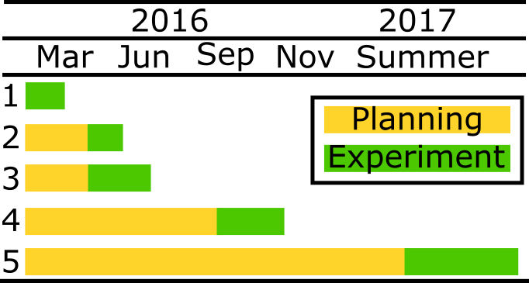
Determination of damage limit of sc. magnets for instantaneous beam impact
Original motivations coming from HL-LHC failure cases (injection, extraction)
Several experiments planned without beam and with beam:
  Heat stacks of cables in an oven to different peak temperatures and measure dielectric strength of the insulation
  Heat insulation by a short current pulse and measure dielectric strength
  Heat a single strand by a current pulse and measure critical current
  Expose stacks of cables to radiation in HiRadMat at RT and measure dielectric strength and critical current
  Expose stacks of cables to radiation in HiRadMat at cryogenic temperatures and measure dielectric strength and critical current

Slide 5
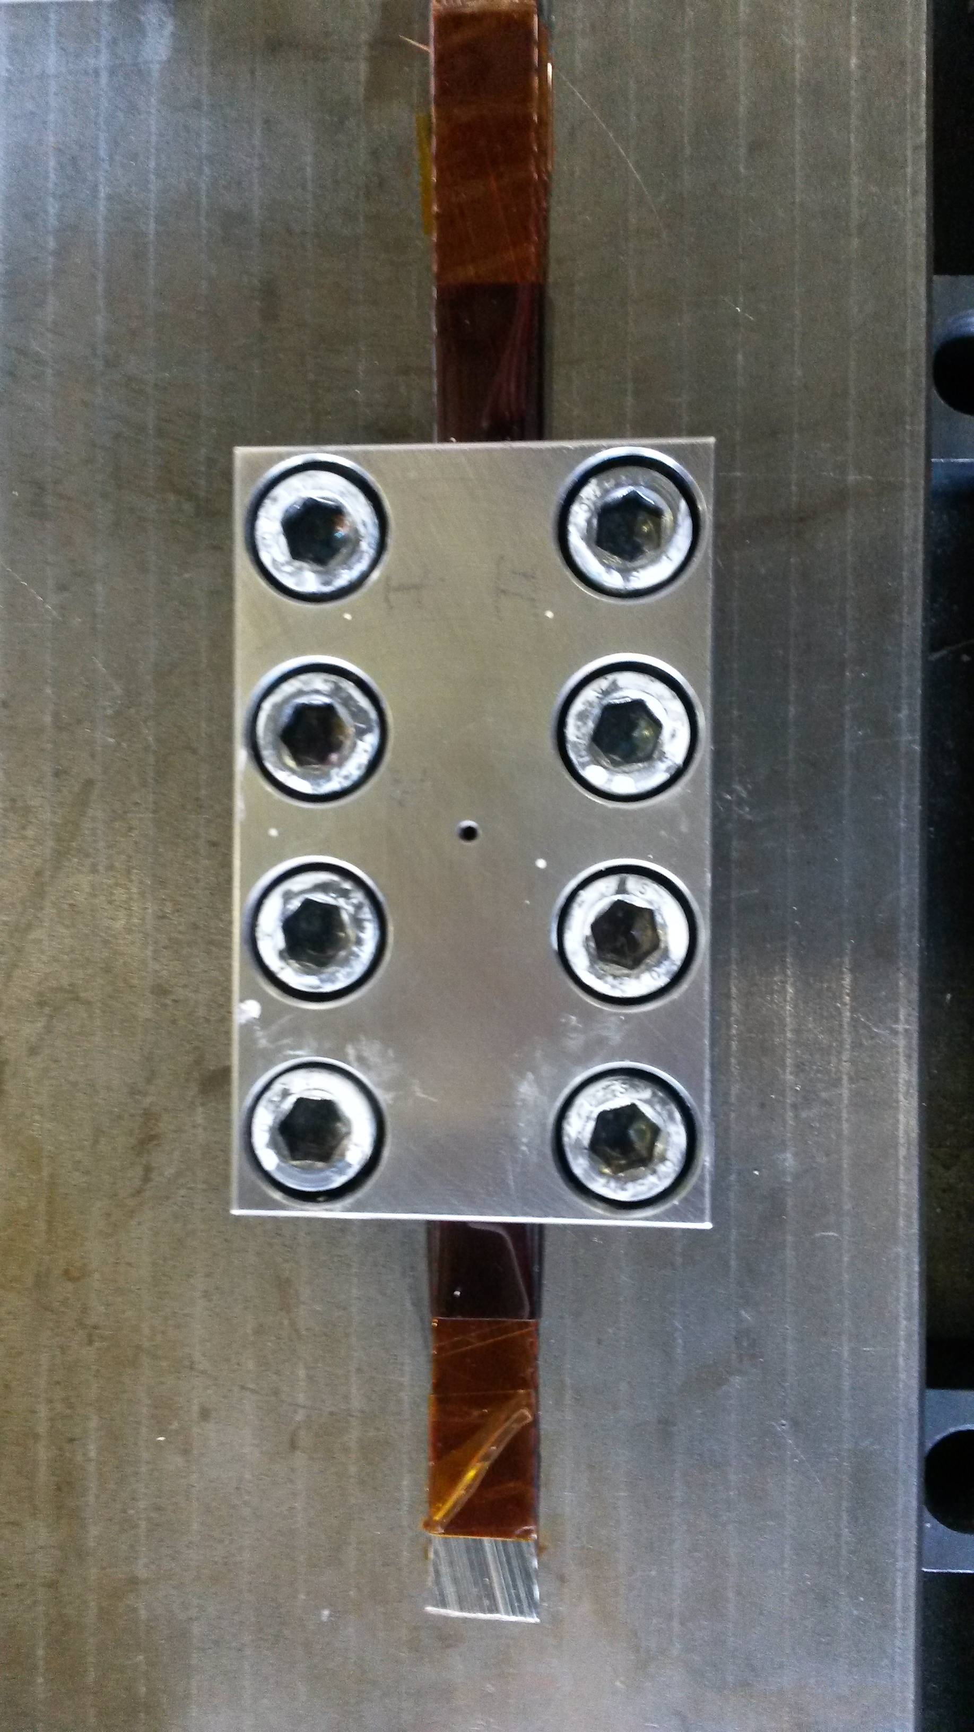
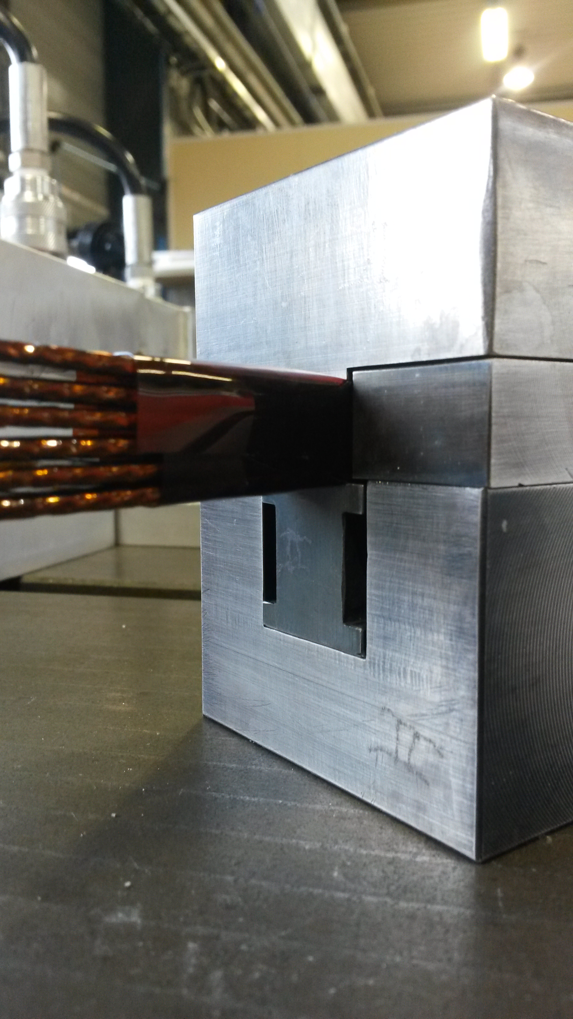
Objectives
Measure the degradation of the insulation
Measure the degradation of critical current of Nb-Ti
Check structural integrity of stainless steel plate to validate design of future HiRadMat experiment (cryostat)

Slide 6
Experimental Design Concept
Sc. cable stacks
600 mm
Six Cu/Nb-Ti cable stacks under compression in stainless steel moulds
  200 mm long cables
  Mould: 60 x 85 x 120 mm³
  (~ 4kg)
Aluminium container
  Air tight (to be tested up to 2 atm)
  Filed with Argon (1.1 atm)
  250 x 300 x 600 mm³
Stainless steel plate (thickness = 5 mm)
Vertically movable table (reusing from HRMT24) stroke of 500 mm
Diamond detector to be fixed on the container
Beam
300 mm
500 mm
Stainless steel plate

Slide 7
Peak Temperature – Design choice
Peak temperatures to be reach in sample based on results of experiments without beam
Peak Temperature (C) | Energy Density in Cu/Nb-Ti (kJ/cm³)
950 | 3.2
800 | 2.8
650 | 2.4
500 | 1.6
400 | 1.2
300 | 0.6

Slide 8
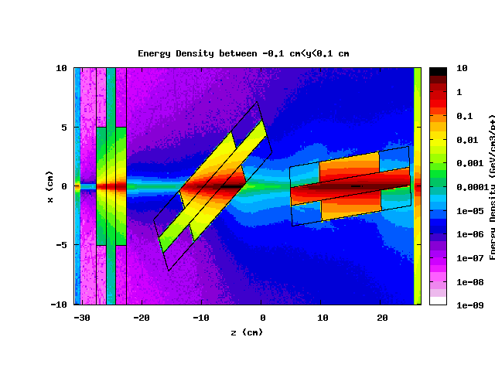
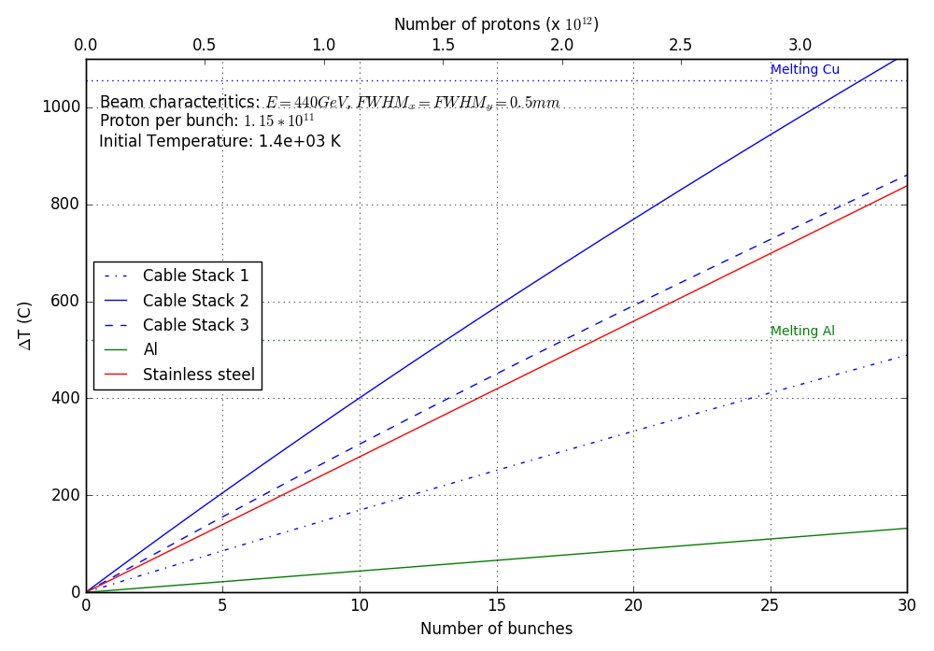
Energy Deposition and Temperature rise
Beam characteristics FWHM x = y = 0.5 mm, E = 440 GeV
Max. Temp in 3rd cable stack, stainless steel plate and container

Slide 9
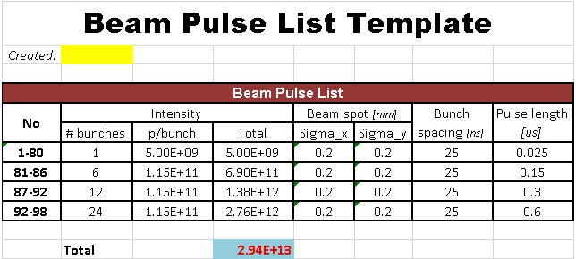
Operational process - Beam Pulse list
Single bunches for alignment (diamond detector)
After each “high” intensity pulse, the target is moved vertically (moving the target ~1 to 2 minutes
Estimated beam time: 1 shift

Slide 10
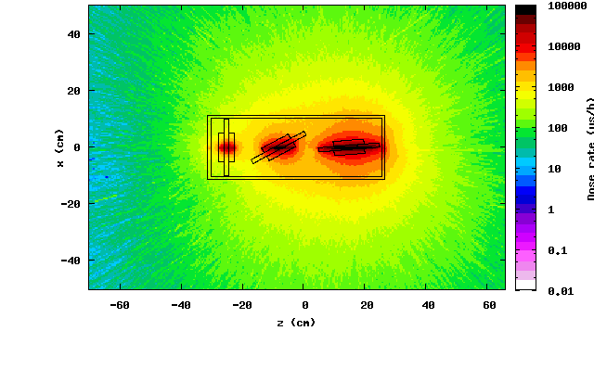
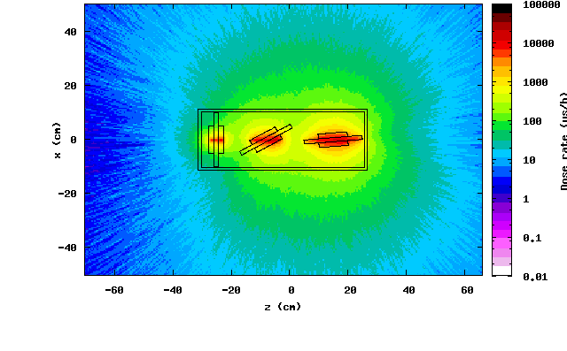
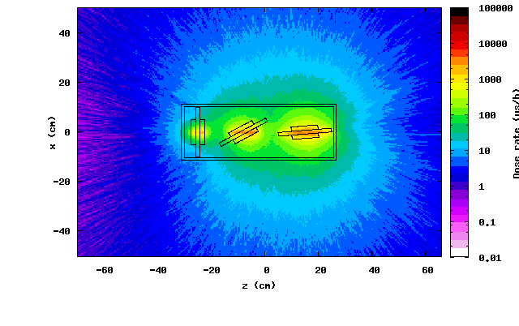
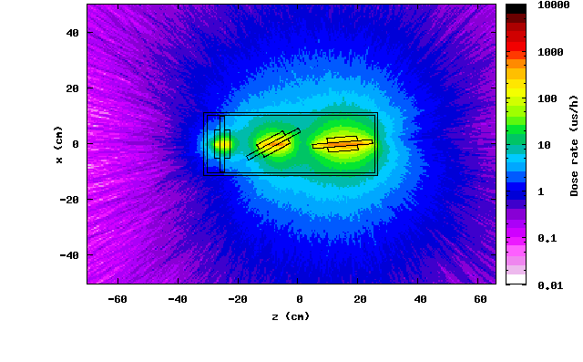
Radiological risks – residual dose in proximity of the container
Figures show spatial distribution of the residual dose rates in the horizontal plane
Total intensity ~ 240 bunches, 1.15E11 p/b
After 1 day
After 1 week
Cooling Period | Maximum residual dose rate at 40 cm (µSv/h) | Maximum residual dose rate at contact (µSv/h)
1 day | < 200 | 1.4 x 10⁴
1 week | < 30 | 4.5 x 10²
1 month | < 10 | 1.3 x 10²
6 months | < 1 | 3.5 x 10¹
After 1 month
After 6 months

Slide 11
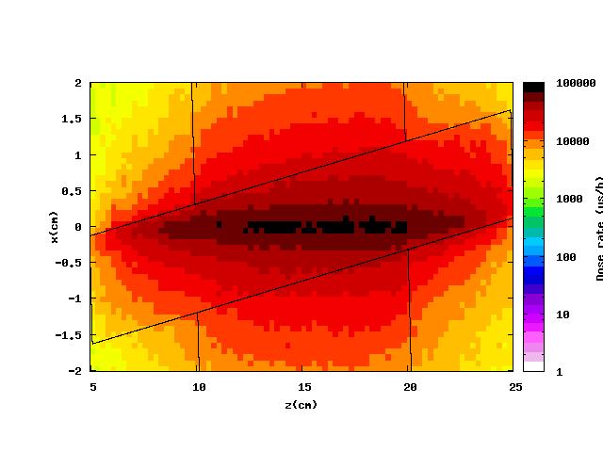
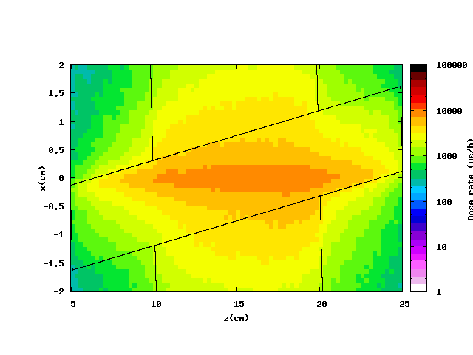
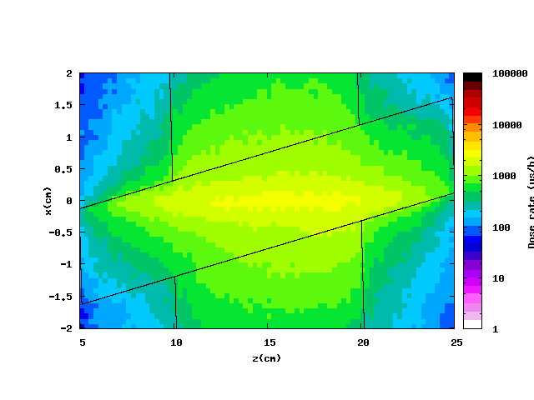
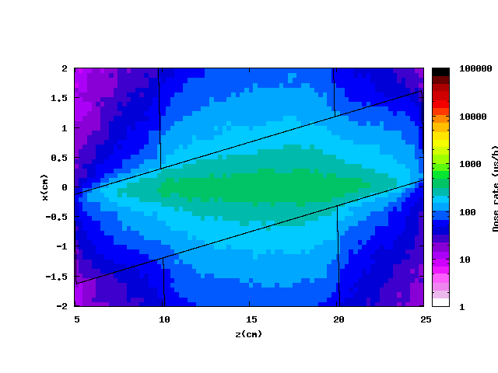
Radiological risks – residual dose rate within/at contact with the cable stack
After 1 day
After 1 week
Figures show spatial distribution of the residual dose rates in the horizontal plane
½ of the total intensity (120 bunches, 1.15E11 p/b)
Cooling Period | Maximum residual dose rate within cable stack (µSv/h)
1 day | 8.1 x 10⁴
1 week | 9.4 x 10³
1 month | 2.6 x 10³
6 months | 4.8 x 10²
After 1 month
After 6 months

Slide 12
Removal and disposal
After an appropriate cool down time to be defined in accordance with RP:
In BA7
Removal of the container from the table
Table will be left on the HiRadMat experimental table (to be used in future experiments)
  Transport container to an appropriate controlled area in B867 or in Radioactive WS (B109)
  In Building 867/ Radioactive WS
  Opening of the container and removal of the cable stacks (procedure to be define with RP experts)
  Container to be stored as a single object in an appropriate controlled area – can be reused for future experiment. Request to be performed
  Cable stacks and stainless steel plate package in boxes for further analysis.

Slide 13
Post mortem analysis
Procedure for post mortem analysis will be defined with RP
Cable stacks:
High Voltage test to be conduct either in building 867 or in the high voltage lab building 112
Critical current measurement to be perform in external lab (to be perform)
Stainless steel plate:
Structural analysis to be done in Microscopic Lab (B599) –(similar procedure as for the LPROT post mortem analysis)
After analysis the cable stacks, mould and the stainless steel plate become RP waste – request to be perform

Slide 14
Risk Assessment
Melting of the samples
  No contamination risk in HiRadMat
Melting of the container due to too many bunches send on the target
  Contamination risk
  Low probality due to pre pulsing in the SPS
Polyimide Film burning due to air contamination
  Air tight test of the container at 2 atm.
High Voltage for the Diamond detectors (100V DC)
  The handling of high voltage equipment will be performed by trained CERN personnel.
Radiological Risk
  The experiment has been designed to include as little material as possible.

Slide 15
Thanks you for your attention!

Slide 16
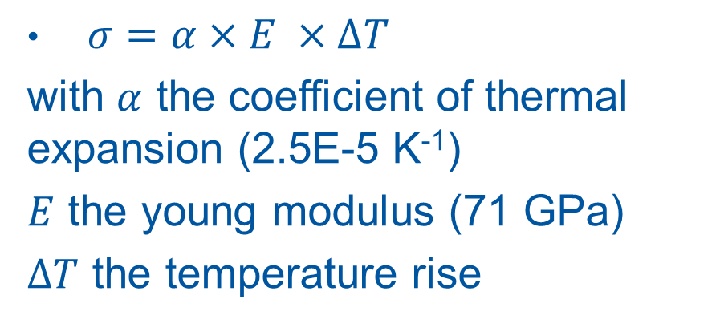
Stress in Aluminium
$σ=α×E ×∆T$
with $α$ the coefficient of thermal expansion (2.5E-5 K⁻¹)
$E$ the young modulus (71 GPa)
$∆T$ the temperature rise
# of bunches | ΔT (K) | σ (MPa)
6 | 26.5 | 43.2
12 | 53 | 86.4
24 | 106 | 172.8
Yield stress of aluminium 90 to 280 MPa

Slide 17
Pressure in container due to beam pulse
Energy stored in 24 bunches @ 440 GeV = 200 kJ
Temperature rise in all volume less than 3 K
Pressure rise < 0.1 mbar

