Slide 1
Concepts for magnet circuit powering and protection
M. Prioli with many inputs from A. Verweij, R. Schmidt and A. Siemko

Slide 2
Outline
Subject
  Circuit layout of the FCC main bending magnets
Goal
  To outline possible directions
Motivation
  To understand if powering is feasible
  To discuss new ideas for powering
  To identify the necessary R&D
Method
  Protection point of view (fast power abort), limiting factor: voltage to ground
  Powering point of view (ramp-up), limiting factors: voltage (maximum di/dt) and peak power

Slide 3

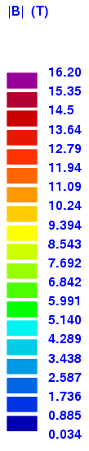
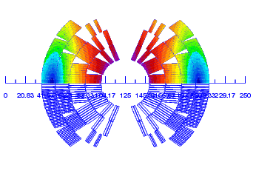
FCC magnet designs
Description | LHC MB | Cos-theta | Block Coil | Common Coil | Units
Number of turns per aperture | 80 | 230 | 306 | 394 | -
Nominal field | 8.33 | 16 | 16 | 16 | [T]
Current @ nominal field | 11.85 | 10.275 | 8.47 | 9.03 | [kA]
Inductance per aperture | 49 | 367 | 632 | 912 | [mH]
Stored energy per aperture | 3.5 | 19.4 | 22.7 | 37.1 | [MJ]
Description | LHC MB | Cos-theta | Block Coil | Common Coil | Units
Number of turns per aperture | 80 | 230 | 306 | 394 | -
Nominal field | 8.33 | 16 | 16 | 16 | [T]
Current @ nominal field | 11.85 | 10.275 | 8.47 | 9.03 | [kA]
Inductance per aperture | 49 | 367 | 632 | 912 | [mH]
Stored energy per aperture | 3.5 | 19.4 | 22.7 | 37.1 | [MJ]
A comparison among the designs is presented in (refer to Arjan presentation)
cos-theta 28b38
Block coil v26cmag
Common coil v1h intgrad

Slide 4
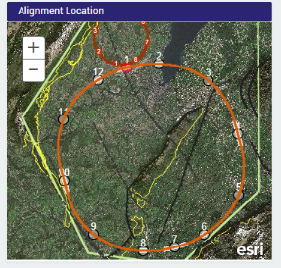
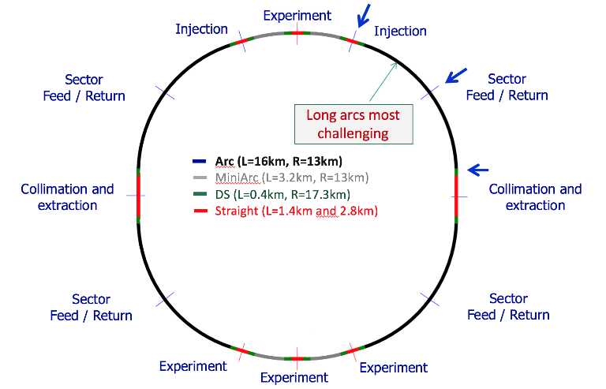
The FCC layout
Half arc (L=8km)
From R. Schmidt, FCC week Washington, March 2015

Slide 5
FCC vs LHC powering layout
In order to reduce the circuit inductance, the half arc of the FCC is subdivided in two powering sectors (PS)
The total number of power converters (PC) is doubled
LHC
PS 1
FCC
PS 1
PC 1
PC 1
PS 2
Sector 1
3km
HalfArc 1
8km
Description | LHC PS | FCC PS | FCC MiniArc | Units
Powering sector (PS) length | 3000 | 4000 | 3200 | [m]
Number of PS in the accelerator | 8 | 16 | 4 | -
Filling factor | 74% | 77% | 77% | -
Number of dipole magnets per PS | 154 | 215 | 172 | -
Inductance per PS | 15 | 272 | 218 | [H]
Stored energy per PS | 1 | 10 | 8 | [GJ]
PC 2

Slide 6
Powering layout options
EEa
EE1
EE2
PC 1a
A
B
PC 1
PC 1b
PS 1
EEb
PS 1
EE1
EE2
EE3
EE1a
EE2a
C
PC 1
PC 1a
D
EE4
PC 1b
PS 1
EE1b
PS 1
EE2b
EE1a
EE1b
PC 1a
EE1c
PC 1b
EE1d
SC link
E
PC 1c
EE1e
PC 1d
PC 1e
PS 1

Slide 7
Option A: 1 circuit with 2 EE
FCC
LHC
EE1
EE2
EE1
EE2
PC 1
PC 1
PS 1
PS 1
 | Description | LHC MB | FCC Block |  | Units
Energy and inductance | Diff. inductance per circuit | 15.2 | 272 |  | [H]
 | Stored energy per circuit | 1.1 | 9.8 |  | [GJ]
FPA | Maximum voltage to ground | 450 | 1000 | 2000 | [V]
 | Discharge time constant (τ_{disc}) | 100 | 576 | 288 | [s]
 | Resistance per energy extractor | 76 | 236 | 472 | [mΩ]
 | Integral of I^2(t)*dt (MIITs) | 7e3 | 21e3 | 10e3 | [MA^2 s]
 | Busbar size (adiabatic, ΔT=300K) | 220 | 370 | 260 | [mm^2]
Pros
Direct extrapolation of LHC layout
Cons
High stored energy per circuit
EE2 position
High voltage to ground for a lower discharge time constant (τ_{disc})

Slide 8
Option B: 2 circuits with 1 EE
EEa
PC 1a
PC 1b
EEb
PS 1
 | Description | LHC MB | FCC Block |  | Units
Energy and inductance | Diff. inductance per circuit | 15.2 | 136 |  | [H]
 | Stored energy per circuit | 1.1 | 4.9 |  | [GJ]
FPA | Maximum voltage to ground | 450 | 1000 | 2000 | [V]
 | Discharge time constant (τ_{disc}) | 100 | 576 | 288 | [s]
 | Resistance per energy extractor | 76 | 236 | 472 | [mΩ]
 | Integral of I^2(t)*dt (MIITs) | 7e3 | 21e3 | 10e3 | [MA^2 s]
 | Busbar size (adiabatic, ΔT=300K) | 220 | 370 | 260 | [mm^2]
Pros
The stored energy per circuit is halved (cf.A)
All EE are close to an access point
Cons
The number of circuits is doubled (cf. A), unless quadrupoles are powered in series
High voltage to ground for a lower τ_{disc}

Slide 9
Option C: 1 circuit with multiple EE
EE1
EE2
EE3
PC 1
EE4
PS 1
 | Description | LHC MB | FCC Block |  | Units
Energy and inductance | Diff. inductance per circuit | 15.2 | 272 |  | [H]
 | Stored energy per circuit | 1.1 | 9.8 |  | [GJ]
FPA | Maximum voltage to ground | 450 | 1000 | 2000 | [V]
 | Discharge time constant (τ_{disc}) | 100 | 288 | 144 | [s]
 | Resistance per energy extractor | 76 | 236 | 472 | [mΩ]
 | Integral of I^2(t)*dt (MIITs) | 7e3 | 10e3 | 5e3 | [MA^2 s]
 | Busbar size (adiabatic, ΔT=300K) | 220 | 260 | 180 | [mm^2]
Pros
A lower τ_{disc} is obtained for 1kV (cf.A)
Cons
High stored energy per circuit
Position of EE2, EE3 and EE4

Slide 10
Option D: 2 circuits with 2 EE
EE1a
EE2a
PC 1a
PC 1b
EE1b
PS 1
EE2b
 | Description | LHC MB | FCC Block |  | Units
Energy and inductance | Diff. inductance per circuit | 15.2 | 136 |  | [H]
 | Stored energy per circuit | 1.1 | 4.9 |  | [GJ]
FPA | Maximum voltage to ground | 450 | 1000 | 2000 | [V]
 | Discharge time constant (τ_{disc}) | 100 | 288 | 144 | [s]
 | Resistance per energy extractor | 76 | 236 | 472 | [mΩ]
 | Integral of I^2(t)*dt (MIITs) | 7e3 | 10e3 | 5e3 | [MA^2 s]
 | Busbar size (adiabatic, ΔT=300K) | 220 | 260 | 180 | [mm^2]
Pros
The stored energy per circuit is halved (cf.A)
A lower τ_{disc} is obtained for 1kV (cf.A)
Cons
The number of circuits is doubled (cf. A), unless quadrupoles are powered in series
Position of EE2a and EE2b

Slide 11
Option E: multiple circuits with 1 EE
EE1a
EE1b
PC 1a
EE1c
PC 1b
EE1d
SC link
PC 1c
EE1e
PC 1d
PC 1e
PS 1
 | Description | LHC MB | FCC Block |  | Units
Energy and inductance | Diff. inductance per circuit | 15.2 | 54 |  | [H]
 | Stored energy per circuit | 1.1 | 2 |  | [GJ]
FPA | Maximum voltage to ground | 450 | 1000 | 2000 | [V]
 | Discharge time constant (τ_{disc}) | 100 | 230 | 115 | [s]
 | Resistance per energy extractor | 76 | 236 | 472 | [mΩ]
 | Integral of I^2(t)*dt (MIITs) | 7e3 | 8e3 | 4e3 | [MA^2 s]
 | Busbar size (adiabatic, ΔT=300K) | 220 | 230 | 160 | [mm^2]
Pros
Relatively small energy per circuit (cf.A)
All EE are close to an access point
A lower τ_{disc} is obtained for 1kV (cf.A)
Cons
Higher number of circuits (cf.A)
SC link

Slide 12



Overview
Option | # Circuits | E [GJ] | # EE per circuit | V_{gnd} [V] | τ_{disc} [s] | MIITs [MA² s] | Energy | EE position | Circuit complexity
LHC | 1 | 1.1 | 2 | 450 | 100 | 7e3
A | 1 | 9.8 | 2 | 1000 | 576 | 21e3
 |  |  |  | 2000 | 288 | 10e3
B | 2 | 4.9 | 1 | 1000 | 576 | 21e3
 |  |  |  | 2000 | 288 | 10e3
C | 1 | 9.8 | Mult. (4) | 1000 | 288 | 10e3
 |  |  |  | 2000 | 144 | 5e3
D | 2 | 4.9 | 2 | 1000 | 288 | 10e3
 |  |  |  | 2000 | 144 | 5e3
E | Mult. (5) | 2 | 1 | 1000 | 230 | 8e3
 |  |  |  | 2000 | 115 | 4e3
Comparison between options A and B, and options C and D
  Same V_{gnd}, τ_{disc} , MIITs
  But B and D lead to the half stored energy and to a simpler positioning of the EE systems at the price of a more complex circuit
Option E seems promising if the SC link technology will be developed

Slide 13
Comments
Directions for traditional layouts:
  1 circuit per PS (Options A and C), R&D on safe operation at high energies
  OR
  2 circuits per PS (Options B and D), R&D on series powering of quadrupoles
  Long time constant (Option A and B with 1kV to ground), R&D on feasibility
  OR
  High voltage to ground (Option A and B with 2kV to ground), R&D on feasibility
  OR
  Multiple (4) EE per PS (Option C and D with 1kV to ground), R&D on feasibility
Direction for a new layout
  SC link (Option E with 1kV to ground), R&D on the SC link technology

Slide 14
FCC vs LHC ramp-up
Maximum power to ramp-up dipole magnets in the whole accelerator
  Independent of the circuit layout
  MiniArcs included
  Losses and inefficiency non included
For t_{ramp}=20 min, a factor 22 is obtained with respect to the LHC
310 MW
14 MW

Slide 15
FCC vs LHC ramp-up
P_{max}
P_{max}=310MW
Constant voltage
Constant voltage
P_{max}=160 MW
Constant power
P_{max}
For a single circuit (L=54 H)
For the whole accelerator

Slide 16
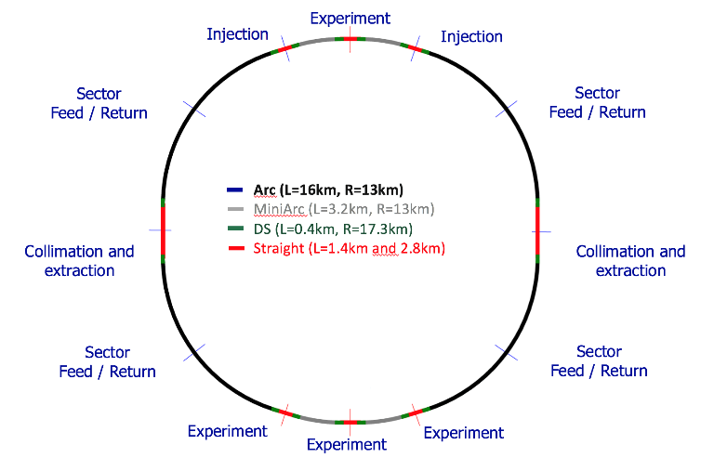
Distribution of power flows
15 MW
15 MW
17 MW
17 MW
17 MW
17 MW
17 MW
17 MW
15 MW
15 MW
Ramp-up of dipole magnets only, MiniArcs included, net power (no losses and inefficiency)

Slide 17
Conclusions
Possible directions for the layout of dipole circuits have been identified for the FCC
  Powering is feasible but R&D is necessary to identify the best option
For the ramp-up, the choice of the ramp time is a trade off between
  Peak power
  Machine availability
  Decrease the power peak while preserving the same ramp-up time is possible

Slide 18
Thank you for your attention
Questions, comments ?

