Slide 2
FCC Availability Studies
Andrea Apollonio, CERN – Technology Department
FCC Week 2016, 14/04/2016
Acknowledgements: R. Alemany Fernandez, M. Benedikt, V. Begy, J. Gutleber, A. Niemi, E. Rogova, A. Romero Marin, J.-P. Penttinen, R. Schmidt, P. Sollander

Slide 3
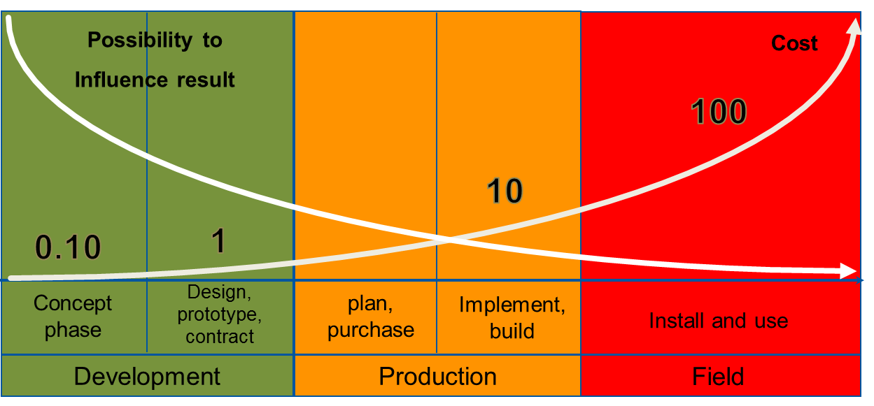
Motivation
Technological and financial boundary conditions set a limit for the peak beam performance for accelerators at the forefront of science
Important to address availability requirements from conceptual design and across the entire accelerator lifecycle

Slide 4
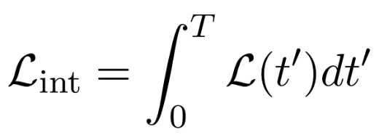
Qualitative Definitions
Availability is a measure of the useful time of beam delivered to physics experiments
Integrated luminosity [fb⁻¹] is the key performance indicator for particle colliders
Beam Performance
Availability!

Slide 5
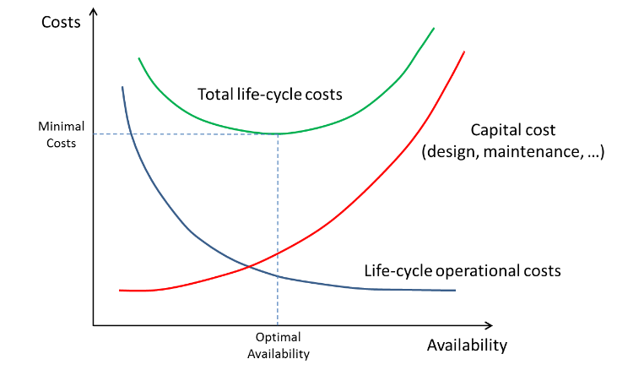
Availability and Costs
For a set target integrated luminosity, operation costs decrease with increasing availability
The cost to achieve higher availability requires higher capital expenses

Slide 6
Scope of the Study
Evaluate the suitability of industrial reliability methods for the domain of particle accelerators…
…taking the LHC as a case study
Identify and analyse possible design and operational scenarios for a h-h Future Circular Collider
Assess potential of methods for HL-LHC
Identify key impact factors on availability and luminosity production
This reliability & availability study DOES NOT intend to give specific guidelines for individual system design and optimization

Slide 7
Collaboration Contributions
CERN
Coordination, modelling
simulation, analytics,
data management,
use-case definition,
technical infrastructure
Ramentor Oy
Modelling and simulation
Software, training
Tech. Uni. Delft
Analytics, cryogenics system modelling
Tampere U. of Tech.
Method and tool consultancy
Uni. Stuttgart:
Method and tool consultancy, training
Uni. Wien
Data analytics platform development

Slide 8
FCC-hh – A New Machine
How should it be operated?
  What would the FCC-hh cycle look like?
  What are the impacts of different injector designs/options?
How should it be maintained?
  What is the ideal number of scheduled shutdowns?
  How can planned/condition-based/corrective maintenance contribute to availability improvements?

Slide 9


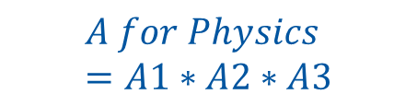

Accelerator Schedule
$A1=\frac{Operation}{Acc. Lifetime}$
Shutdown
Operation
Shutdown
Operation
Years
$A2=\frac{Lumi. Production}{Operation}$
HW Commissioning
Beam Commissioning
Luminosity Production
Technical Stop
Machine Studies
Weeks
$A3=\frac{Stable Beams}{Lumi. Production}$
$$A for Physics=A1∗A2∗A3$$
Machine Cycle
Stable Beams
Failure
Precycle
Hours

Slide 10
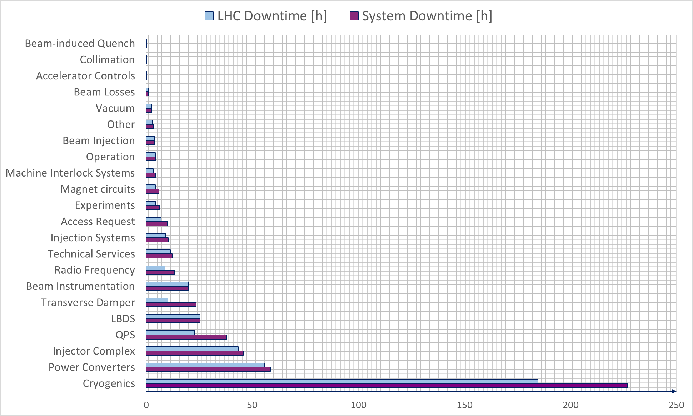
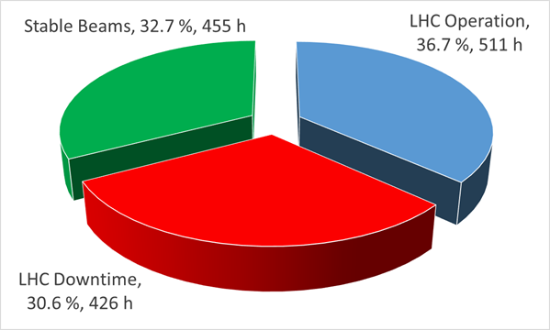
LHC – Our Reference
What do we know from the LHC? (25 ns Run in 2015)

Slide 11
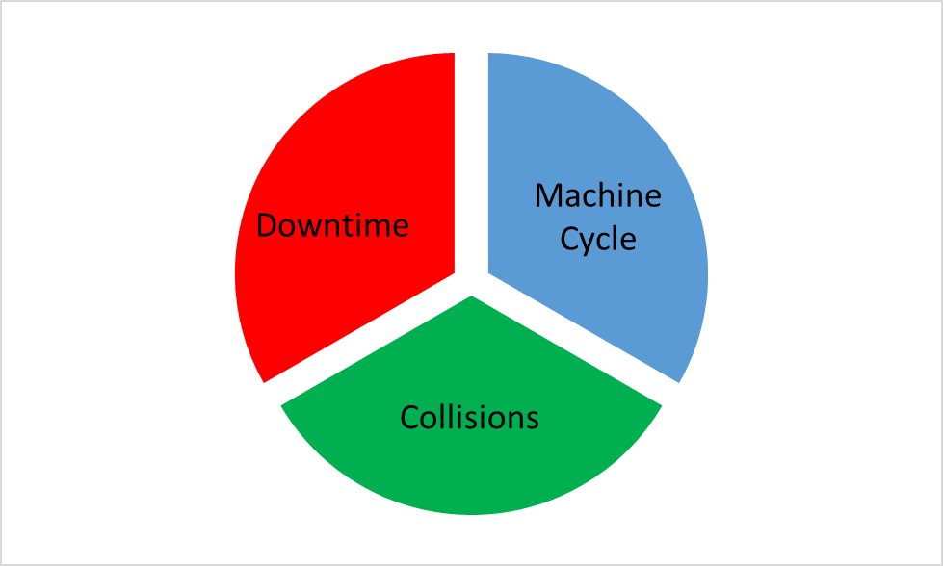
FCC-hh – A Complex Machine
4 times bigger machine = 4 times less availability?
Improve reliability for high-impact systems (redundancy)
Explore the potential of condition-based maintenance
High availability of the injector chain
Extremely efficient cycling
Sensitivity analyses of key contributors for luminosity production
Optimization of machine protection settings
Beam stability

Slide 12
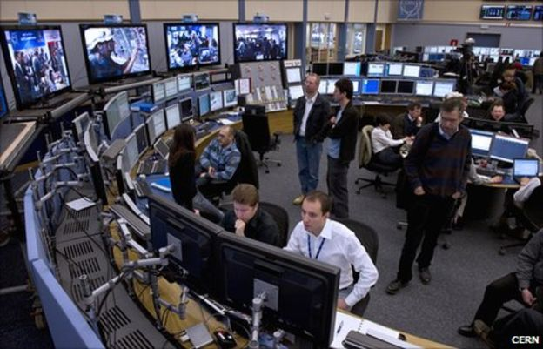
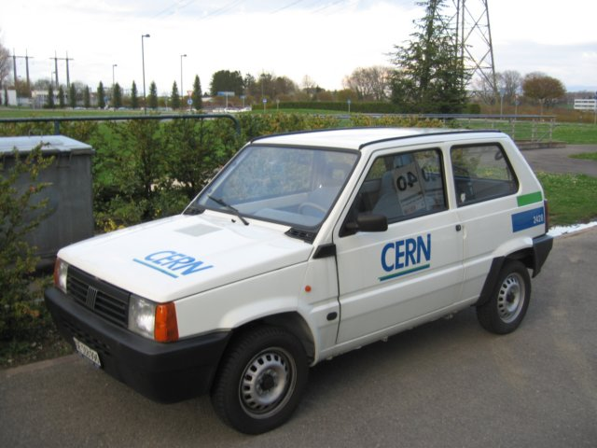

Breakdown of Failure Duration
Failure Duration
Identification
Diagnostics
Logistics
Restore
New strategies required!

Slide 13
Potential of Condition-Based Maintenance
Start of Beam Operation
Faulty slide valve (hydraulic)
Degradation and failure observed during 3 months (9 Mar-17 Jun)
22 Apr – failure recorded in the cryogenics logbook
5 Apr – Start of Beam operation
Online processing of data can predict failures!
Degradation
Failure
Repair during technical stop
E. Rogova, TU Delft

Slide 14
LHC Availability Model Elements
Failures and consequences
  Failure probability (distributions)
  Downtime (identification, diagnostics, logistics, repair/recovery)
System/accelerator dependencies
  Infrastructure supplies
  Injector complex
Failure dependencies
  Operational modes (beam commissioning, user operation,…)
  Beam parameters (intensity, energy)
  Environmental effects
Long term effects
  Experience
  Conditioning/deconditioning
  Ageing/maintenance effects

Slide 15
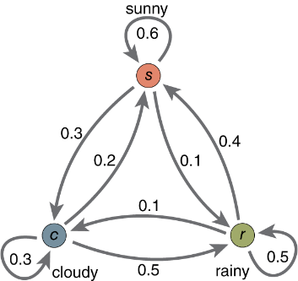
Model Implementation
Monte Carlo based reliability software tool used as a platform for modelling
Markov-chain models for state transitions
Probabilistic phase transitions (Markov chain)

Slide 16
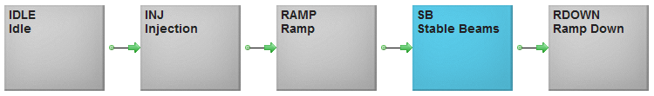
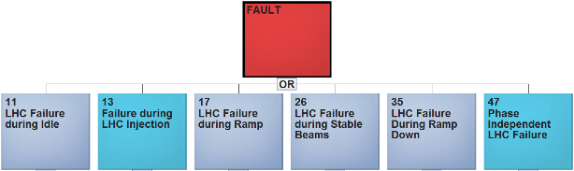
Model Implementation
Machine Cycle
Stable Beams
Failure
Precycle
Probabilistic phase transitions (Markov chain)
Hours
Randomly generated failures (base on calculated probability distributions)
Example: Failures in Injectors only relevant at Injection from the LHC perspective

Slide 17
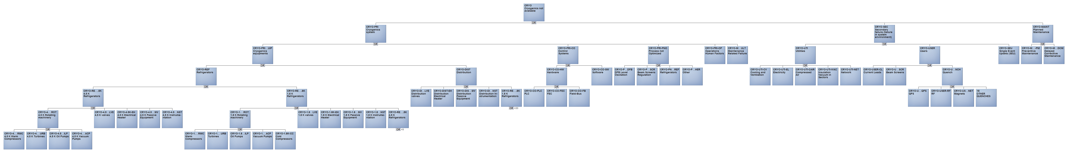
Example: Cryogenics Fault Tree
Model complexity – impractical to model the entire accelerator to a sufficient level of detail within the FCC study
Start from top contributors to downtime
LHC Cryogenics fault tree
BONUS: the developed cryogenic fault tree will be used in 2016 for fault data capture by the cryo-operations team

Slide 18
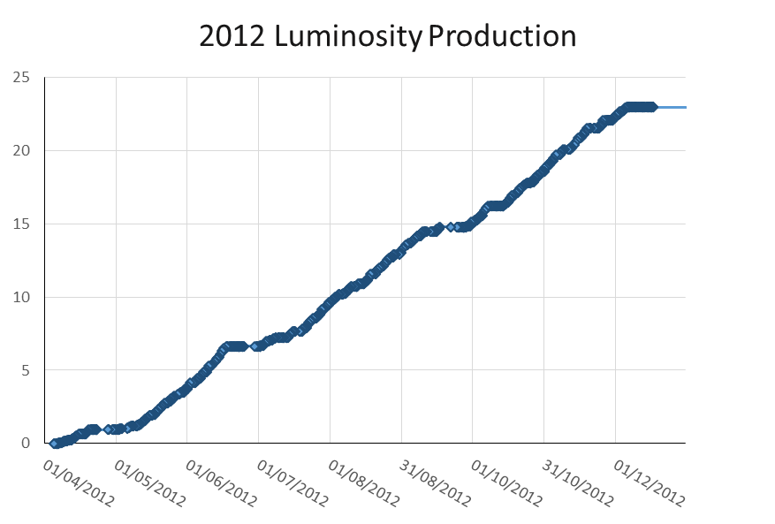
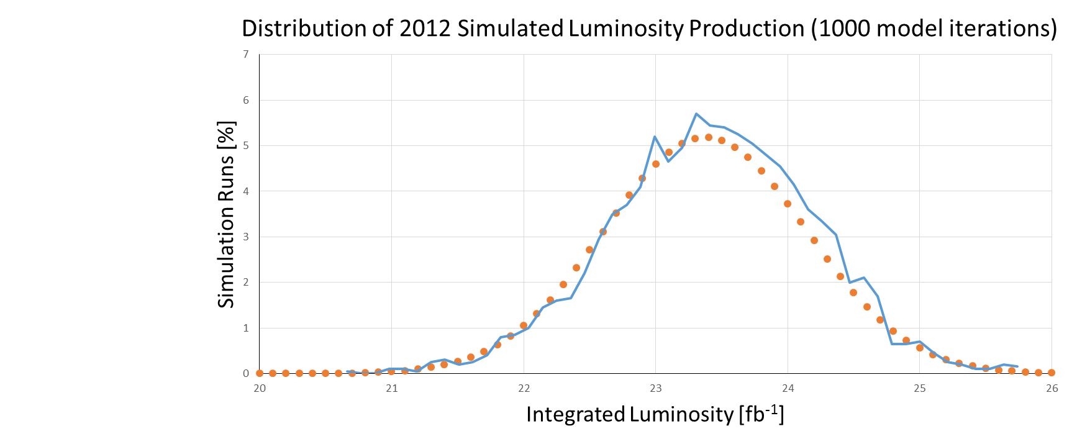
Model Validation: 2012 Luminosity Production
fb⁻¹
2012 LHC Luminosity production 23.27 fb⁻¹
Developed model allows predicting 2012 LHC luminosity production with > 1 % accuracy
Results from 1000 model iterations (~10 min)

Slide 19
Enabling Technologies for Modelling
Data availability and data quality – difficult to derive useful reliability figures without a dedicated effort
  Consistent monitoring of signal trends necessary for condition-based maintenance
FCC RAMS database (collaboration started with IT Department @CERN)
Equipment Control Systems
OP e-Logbook
Accelerator Fault Tracker
FCC RAMS DB
Logging DB
Post-Mortem

Slide 20
Conclusions & Outlook
Availability is one of the key performance indicators for the integrated luminosity production of a collider
Estimates of the achievable availability of the FCC-hh will be one of the main factors for the assessment of its feasibility
Future studies should focus on:
  Definition of a FCC cycle duration (also influencing system design)
  Analysis of different injector options (also influencing cycle duration)
  Identify strategy for scaling number of components (e.g. number of power converters, redundancy in cryogenic system,…)
  Data quality management (RAMS Database)
Possibility: extend the study to the FCC-ee?
  Requires expertise (and data) on lepton machines

Slide 21
Thanks a lot for your attention!
Join us in the FCC RAMS study!
Andrea.Apollonio@cern.ch

