Slide 2
2015 Evian Workshop Summary: Sessions 1 and 2 – Availability & Operations
Andrea Apollonio, TE-MPE-PE
Collection of slides from different speakers
07/01/2016

Slide 3
Availability:
Availability Summary (A. Apollonio)
QPS – operational aspects (M. Pojer)
Cryogenics (K. Brodzinski)
R2E – is it still an issue? (S. Danzeca)
RF hardware (O. Brunner)

Slide 4
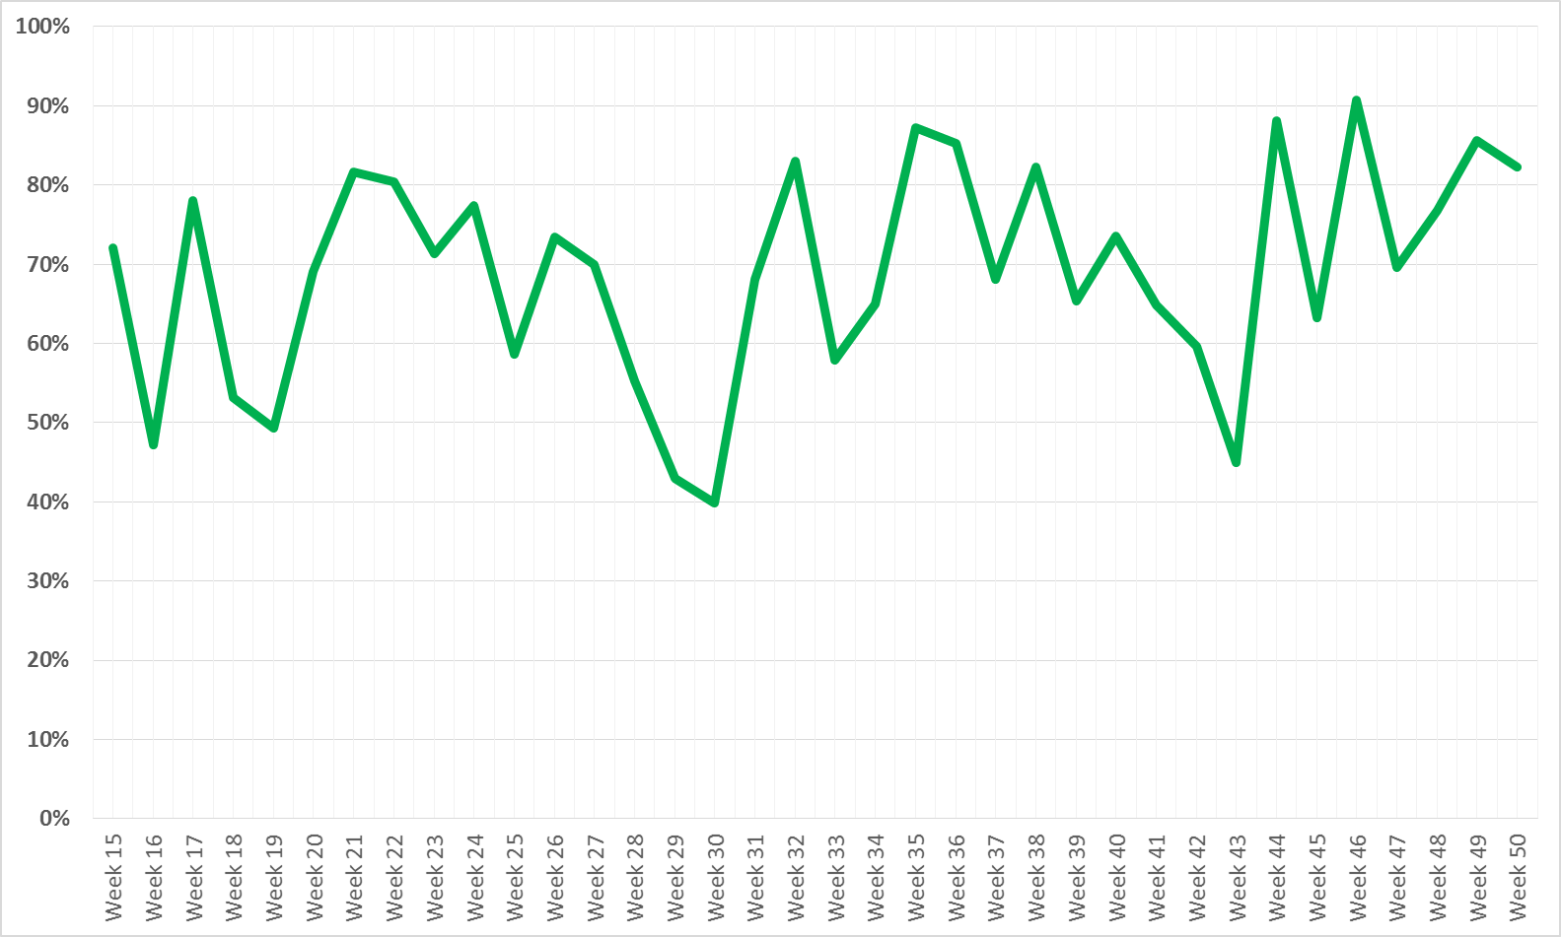
2015 Availability
69 %
Cryo CV + SPS magnet replacement
Linac2 HV Cable
Earth fault + cryo valve replacement + LBDS self trigger + ADT
Earth fault RCS.A78B2 + QPS mBS SEUs
Availability = (Total Time – Downtime*) / Total Time
Beam Commissioning
Sp. Ph.
TS
Scrub.
RU
50
MD
Scrub.
RU
25
MD
TS
25 ns Run
MD
TS
IS
Ion Run
* Downtime does not include precycles due to faults

Slide 5
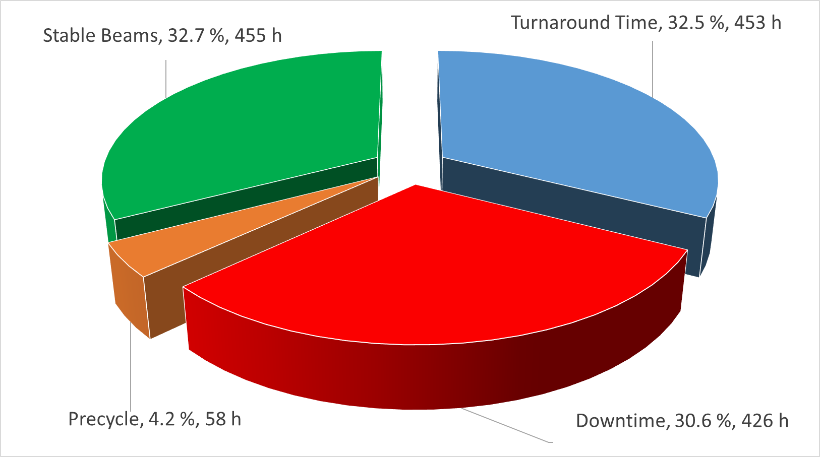
Availability for Physics – 25 ns Run
70 fills
22 End Of Fill, 48 dumped due to faults
Fraction of premature dumps: 48/70 = 68.6 %
Average turnaround (per SB) = 453/70 = 6.5 h
Average Fault time (per SB) = 426/70 = 6 h

Slide 6
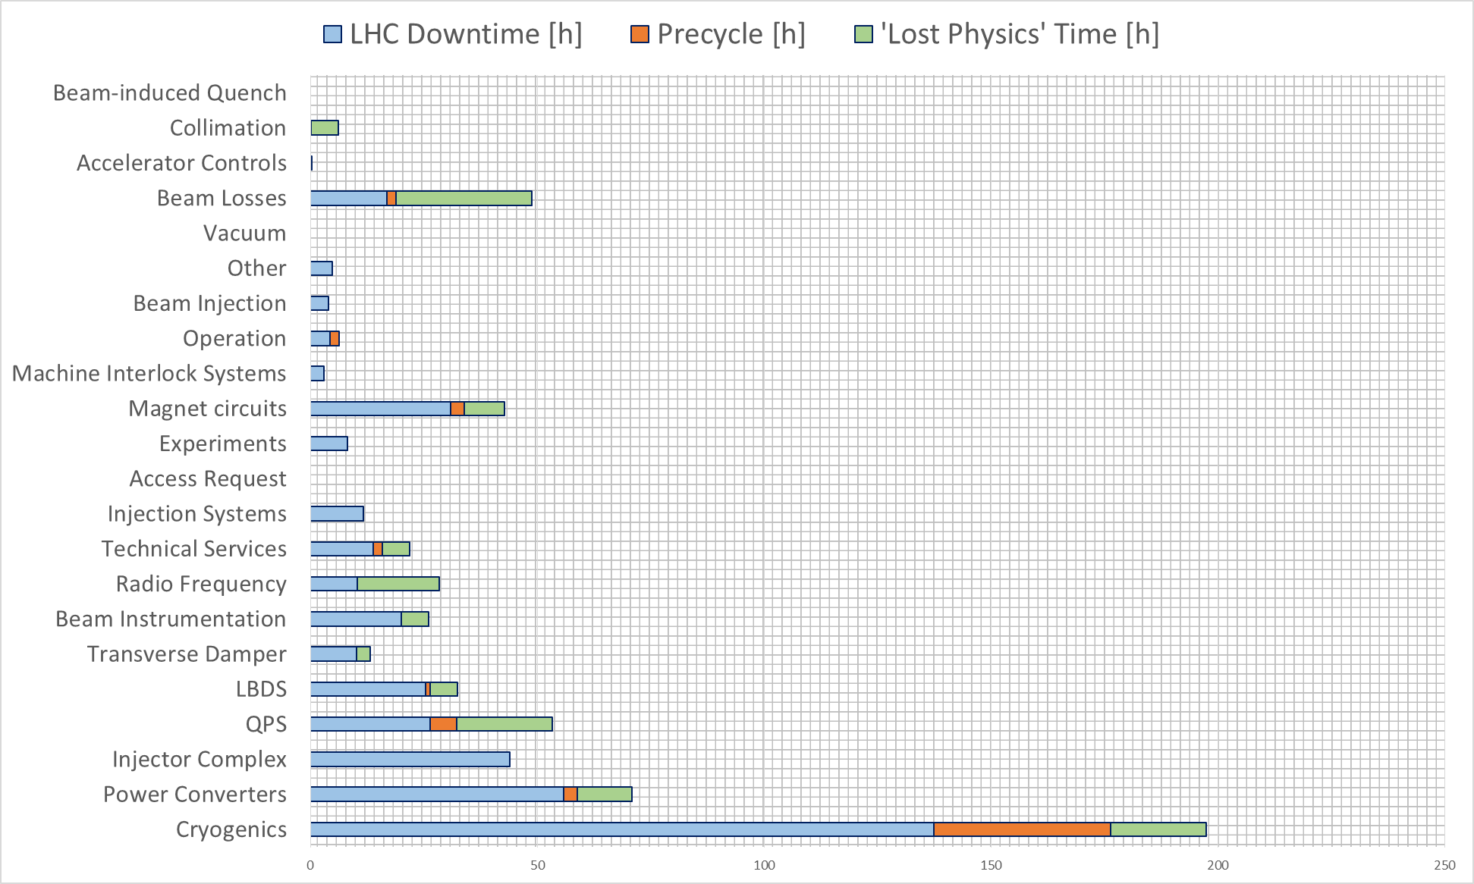
…Impact on LHC Operation (25 ns Run)
Lost Physics Time: 3 h additional time assigned to each fault dumping while in stable beams (i.e. optimistic turnaround)

Slide 7
Follow-up in view of the Chamonix WS
Compare pre-cycles in 2012 with those performed in 2015
Accurate breakdown of turnaround time
Enforce the use of availability matrices
Find common areas for improvement across different systems
Identify failure dependencies on energy/intensity/particle type

Slide 8
Quench Protection System (25 ns Run)
Total system downtime: 38 h
Total LHC downtime: 23 h
Total time as ‘child’: 5.5 h
Total time as ‘parent’: 9 h
Number of dumps in stable beams: 7
Number of precycles required: 6
Downtime [h]
 | < 1h | 1-4 | 4-8 | 8-12 | > 12
1/week
1/month
1/year
< 1/year
nQPS DAQ + COM (after TS2)
QPS DAQ + COM (after TS2)
Frequency
EE 600 A
QH PS
QPS HW
nQPS HW
CL HS
EE 600 A
DFB cabling
Talk by M. Pojer

Slide 9
The QPS in numbers
Circuit type | #
Main bends and quads | 24
Inner triplets | 8
Insertion region magnets | 94
Corrector circuits 600 A | 418
Total | 544
The Quench Protection System is ‘one’ of the most complex and extended systems in the LHC
Reliability, availability and maintainability are a major challenge and concern
Protection system type | Quantity
Quench detection systems | 7568
Quench heater discharge power supplies | 6076
Energy extraction systems 13 kA | 32
Energy extraction systems 600 A | 202
Data acquisition systems | 2516 (~71 TB/year)
System interlocks (hardwired) | 13722
Signals (analog) | 31924
Signals (flags, status) | 77792
90 standard racks in the LHC underground areas and alcoves
1670 special protection racks in the LHC tunnel
2298 protection crates
Thousands of control cables & connectors
88 fieldbus segments (44 gateways)
Courtesy of R. Denz

Slide 10
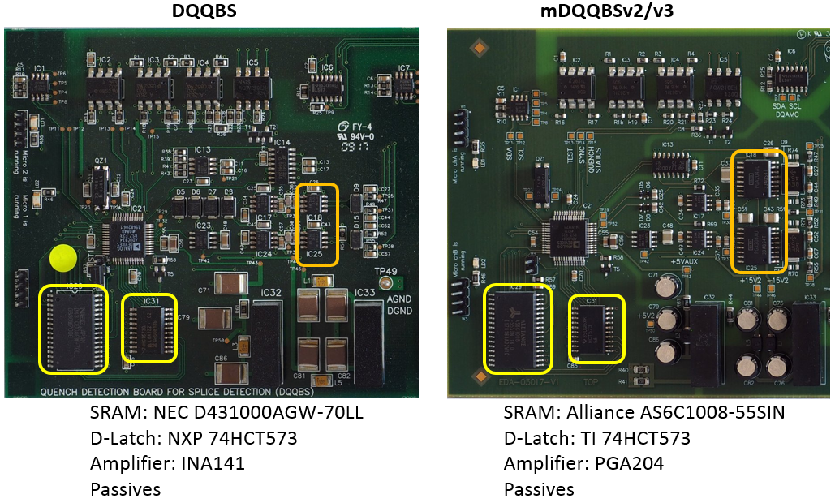
SEU on mDQQBS
A. Siemko at LMC#226
Changed input stage to a PGA to be able to perform CSCM
Polyvalent Firmware (CSCM and normal mode)
Some components had been changed to functionally equivalent replacement due to availability
57 SEU in mDQQBS boards detected
11 Triggers of mDQQBS (opening of interlock loop)
Firmware update was first tried
Complete replacement of all boards was necessary in TS#2
Statistics at 14.07.15
Net improvement in availability!

Slide 11
Concluding remarks
More than 200 primary quenches were detected and actively protected by QPS in 2015
  The QPS remains a fundamental system for the LHC
The reliability has grown during the year, above all after the mQPS boards replacement
  After initial problems, the performance has drastically improved
On the software side, many things could be automatized
  Working in that direction
  Very few manual actions will be left to the operators

Slide 12
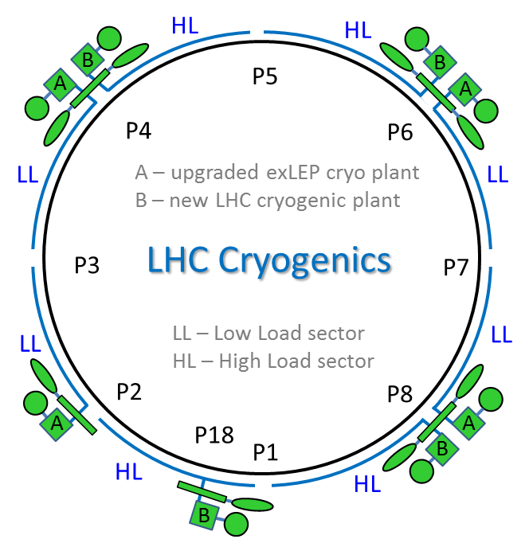
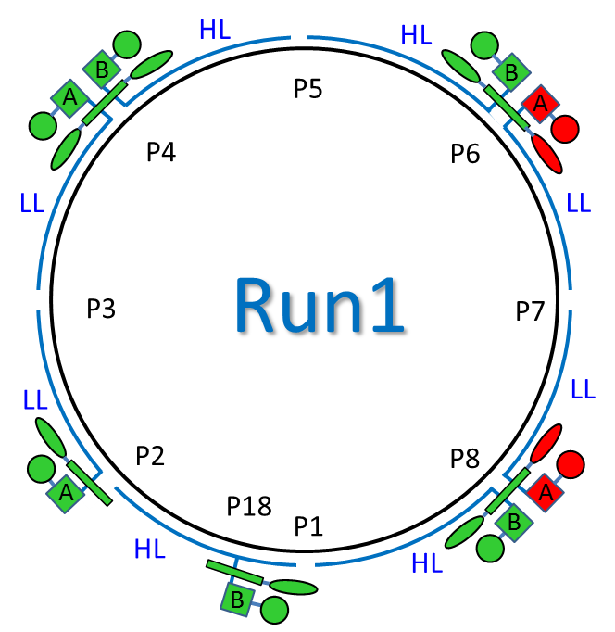
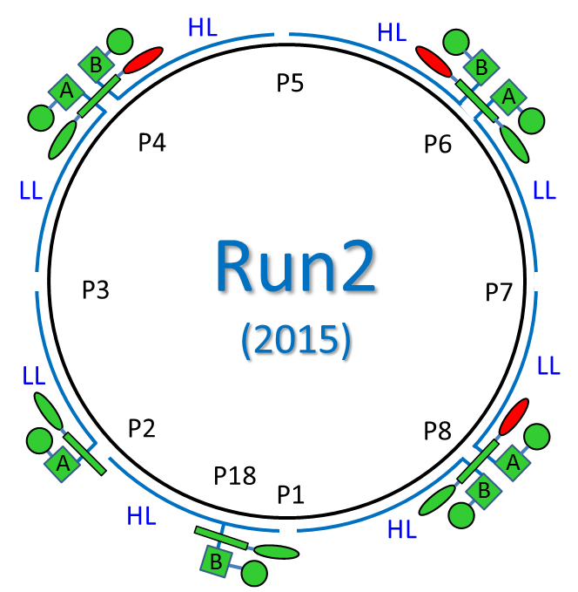
Introduction
Cooling capacity of A and B are designed to cover nominal LHC operation with equal margins on LL and HL sectors.
BUT:
w/o dynamic load B has more capacity margin than A -> easier recoveries,
B is more reliable for operation because of its design.
Thanks to build-in interplant connections some special configurations were possible during Run1 and Run2 (2015) for problems mitigation, lower power consumption or optimize for availability and helium losses.
Compressor station
4.5 K refrigerator
Interconnection box
1.8 K pumping unit (cold compressor)
Lowest capacity margin

Slide 13
BS cooling and high thermal load
The e-cloud thermal effect requires from cryogenics:
Fast dynamic increase of cooling capacity during injection and rump or fast dynamic decrease of the capacity during the dump
Large continue demand for cooling capacity during related fill
How to deal with “1”
Fast dynamic control logic applied on local BS cooling loops (acting by anticipation to thermal load, triggered with information about number of injected bunches)
Thermal capacity buffer of ~1.5 kW @ 4.5 K prepared before each beam injection
Modification of Cryo Maintain interlock (before T=30 K during 30 s, now T=40 K, 30 min)
How to deal with “2”
Process optimization – already well done, not a lot of margin left (limitations on main refrigerators – see slide 16)
Apply solution of equal split of return flow (3 valves to be changed – see slide 5)

Slide 14

Conclusions
Cryogenic Run2 (2015) was a success with CM availability at 92.1 %
New configuration was applied and validated – room for modifications exists
Main failure – 4.5 K refrigerator – to be repaired in January 2016
LS1 consolidations visibly helped (bravo all and R2E!, 0 SEU cases declared in 2015)
e-cloud thermal effect pushed the LHC cryo to the limits of capacity (over originally installed capacity foreseen for 4.5 -20 K)
Run2 (2016): referring to lesson learned in 2015, cryogenics guaranties at least the same level of capacity as done during run in 2015. Correct dealing with any higher heat load is not guaranteed and must be analyzed and tested.

Slide 15
Radiation Levels – Critical Areas
Critical Areas | 2012 HEH Measurements | 2015 HEH Predictions
UJ14/16 | 1.10E+08 | 5.04E+07
RR13/17 | 1.80E+07 | 1.68E+07
UJ56 | 1.20E+08 | 4.24E+07
RR53/57 | 1.80E+07 | 2.64E+07
UJ76 | 5.50E+07 | 6.48E+06
RR73/77 | 3.00E+07 | 1.92E+07
2015 Measurements (4fb-1)
6.82E+07
1.44E+07
9.77E+07
9.17E+06
9.75E+06
1.57E+07
2016 Predictions 35fb-1 | 2017 Predictions 45fb-1
5.7E+08 | 7.3E+08
1.2E+08 | 1.5E+08
8.1E+08 | 1.0E+09
7.6E+07 | 9.8E+07
8.1E+07 | 1.0E+08
1.3E+08 | 1.6E+08
UJ14/16 shielded 2011/2012
Sensitive equipment relocated from the UJs during the LS1
RR13/17/53/56 shielded improvement during the LS1
HEH fluence in the critical areas scale with the expected luminosity (apart from the UJ76 and RR73/77)
Operational parameters can have important impact (see UJ76)
Some failures can appear in the RR during the next years

Slide 16
Failures Overview
Equipment | Dump 2012 | Dump 2015
QPS | 32 | 2
Power Converter | 15 | 5
Cryo | 4 | 0
EN/EL | 1 | 0
Vacuum | 4 | 0
Collimation | 1 | 0
RF | 1 | 4
Others (hidden) | - | -
Total | 3 /fb⁻¹ | 3 /fb⁻¹ 1.2 /fb⁻¹
Dump 2016 35fb⁻¹
1-5
24
0
0
0
0
4
1-10
~1-1.5 /fb⁻¹
2015 going in the right directions approaching ~1 dump/fb⁻¹
2016 limited by the EPC equipment solved partially during the EYETS
2016 run will highlight if the RF failures are due to the radiation
2016 other new failures can appear due to increase of the radiation levels

Slide 17
Critical interlocks
RF load
Klystron Vacuum
ceramic window
MC Vacuum
ceramic window
HOM Power
WG
WG
HOM Temp
RF switch
klystron
circulator
k1 k2
k4
Arc
detectors
high voltage system
cavity
Helium level & pressure
crowbar
power converter
100kV 40A
O. Brunner

Slide 18
LHC run 2: all RF trips
25 ns proton & ions run
57 trips recorded
13 beam dumps (higher bars) – 7 during 25 ns run
15 categories
O. Brunner

Slide 19
Conclusions
Work done during LS1 and along run 2 proved to be effective -> No spurious trips since TS2
More frequent (minor) hardware failures!
  Only very few LLRF spares!
  Replacement campaign during YETS (e.g. 5V P.S.)
With increasing beam intensity the system is more sensitive:
  The RF system is approaching its limits - > time needed for RF conditioning & LLRF setup
  Arc detectors trips do not seem –all- real! -> new configuration and new diagnostic system installed during YETS
O. Brunner

Slide 20
Operations:
Cycle (M. Solfaroli)
Injection (D. Jacquet)
Feedbacks (L. Ponce)
Q and Q’ snapback, decay (M. Schaumann)
Optics model (A. Langner)

Slide 21
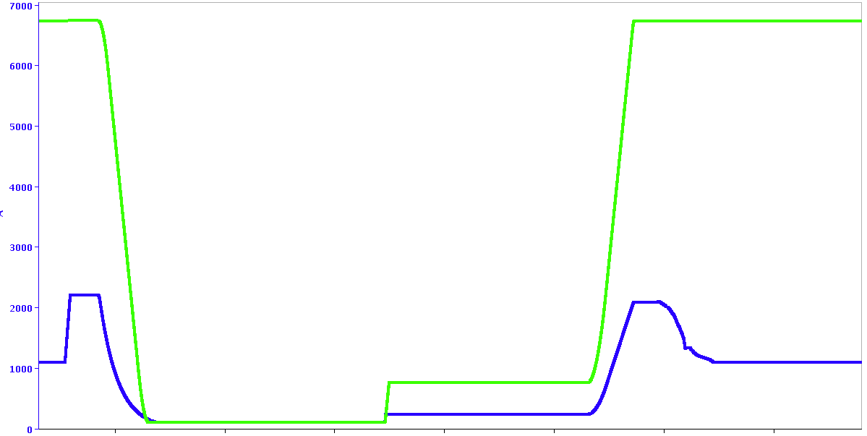
LHC operational beam modes
RB.A12
RQ5.L1
PRECYCLE/
RAMPDOWN
+
SETUP
RAMP
ADJUST
SQUEEZE
STABLE BEAMS
FLATTOP
PREPARE RAMP
BEAM DUMP
INJECTION
(PROBE then PHYSICS)
6th LHC operational workshop Evian 2015 – M.Solfaroli

Slide 22
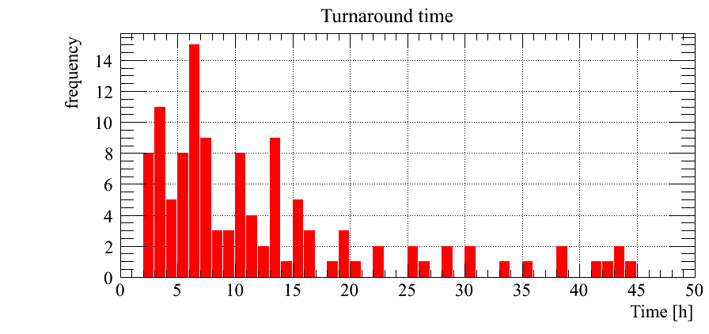
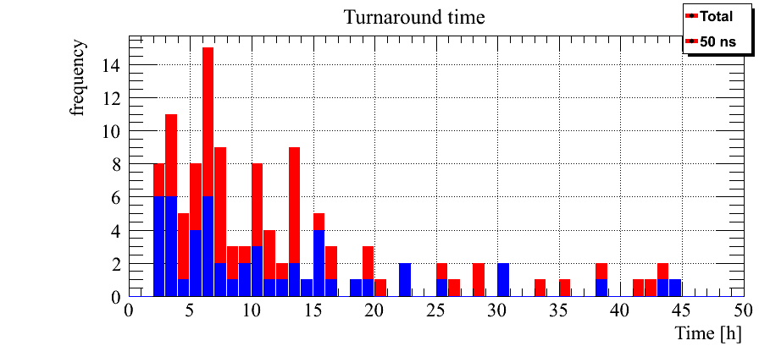
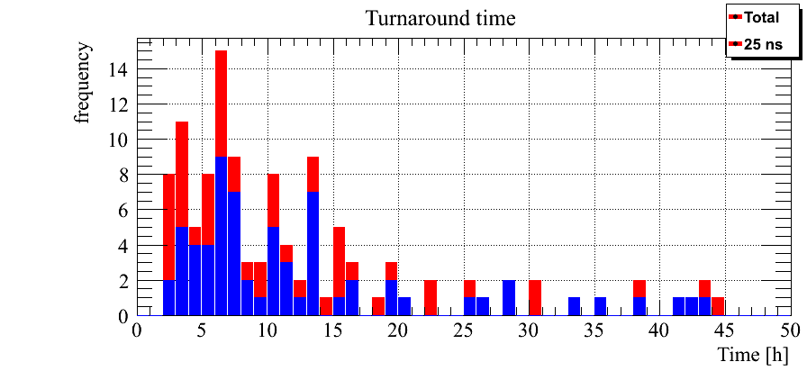
The LHC TURNAROUND
END of SB
time
START of SB
Turnaround = time from SB to SB
No correlation between the fills:
Aug-Sept-Oct
LM, Access, Precycle, TL steering,…
…
Short time mainly present for 50 ns. Independent on injection time and on chronological distribution
Turnaround 2015 6/7 hours
Turnaround (50 ns)
2/4 hours
+
6/7 hours
Turnaround (25 ns) 6/7 hours
6th LHC operational workshop Evian 2015 – M.Solfaroli

Slide 23
2012 vs 2015
 | AVG 2012 | AVG 2015 | Diff | Comment
INJECTION | 67 min | 72 min | +5 min | 25 ns (TDI, vac), often TL steering during filling
 | AVG 2012 | AVG 2015 | Diff | Comment
INJECTION | 67 min | 72 min | +5 min | 25 ns (TDI, vac), often TL steering during filling
PREPARE RAMP | 4.8 min | 10 min | +5.2 min | Heat load (cryo stabilization)
 | AVG 2012 | AVG 2015 | Diff | Comment
INJECTION | 67 min | 72 min | +5 min | 25 ns (TDI, vac), often TL steering during filling
PREPARE RAMP | 4.8 min | 10 min | +5.2 min | Heat load (cryo stabilization)
RAMP | 13.5 min | 20 min | +6.5 min | Higher E = longer ramp (7.4 min)
FLATTOP | 6.8 min | 5.9 min | -0.9 min | Tune change in 2012 was included in the squeeze, but we did a systematic check of Q with current of correctors
SQUEEZE | 17 min | 15.7 (14.1) min | -1.3 (2.9) min | Higher E (+ no Q change) = shorter squeeze (2.9 min)
 | AVG 2012 | AVG 2015 | Diff | Comment
INJECTION | 67 min | 72 min | +5 min | 25 ns (TDI, vac), often TL steering during filling
PREPARE RAMP | 4.8 min | 10 min | +5.2 min | Heat load (cryo stabilization)
RAMP | 13.5 min | 20 min | +6.5 min | Higher E = longer ramp (7.4 min)
 | AVG 2012 | AVG 2015 | Diff | Comment
INJECTION | 67 min | 72 min | +5 min | 25 ns (TDI, vac), often TL steering during filling
PREPARE RAMP | 4.8 min | 10 min | +5.2 min | Heat load (cryo stabilization)
RAMP | 13.5 min | 20 min | +6.5 min | Higher E = longer ramp (7.4 min)
FLATTOP | 6.8 min | 5.9 min | -0.9 min | Tune change in 2012 was included in the squeeze, but we did a systematic check of Q with current of correctors
 | AVG 2012 | AVG 2015 | Diff | Comment
INJECTION | 67 min | 72 min | +5 min | 25 ns (TDI, vac), often TL steering during filling
PREPARE RAMP | 4.8 min | 10 min | +5.2 min | Heat load (cryo stabilization)
RAMP | 13.5 min | 20 min | +6.5 min | Higher E = longer ramp (7.4 min)
FLATTOP | 6.8 min | 5.9 min | -0.9 min | Tune change in 2012 was included in the squeeze, but we did a systematic check of Q with current of correctors
SQUEEZE | 17 min | 15.7 (14.1) min | -1.3 (2.9) min | Higher E (+ no Q change) = shorter squeeze (2.9 min)
ADJUST | 9 min | 13.7 min | +4.7 min | Settings slightly shorter (70 sec)
 | AVG 2012 | AVG 2015 | Diff | Comment
INJECTION | 67 min | 72 min | +5 min | 25 ns (TDI, vac), often TL steering during filling
PREPARE RAMP | 4.8 min | 10 min | +5.2 min | Heat load (cryo stabilization)
RAMP | 13.5 min | 20 min | +6.5 min | Higher E = longer ramp (7.4 min)
FLATTOP | 6.8 min | 5.9 min | -0.9 min | Tune change in 2012 was included in the squeeze, but we did a systematic check of Q with current of correctors
SQUEEZE | 17 min | 15.7 (14.1) min | -1.3 (2.9) min | Higher E (+ no Q change) = shorter squeeze (2.9 min)
ADJUST | 9 min | 13.7 min | +4.7 min | Settings slightly shorter (70 sec)
STABLE | 6.5 hours | 5.7 hours | -0.8 hours | ;-((
6th LHC operational workshop Evian 2015 – M.Solfaroli

Slide 24
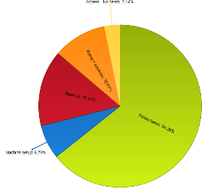
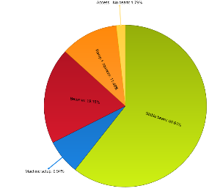
How long do we stay at injection?
Time at injection for PROTONS PHYSIC stable beam fills
Average nb of inj/fill: 22
SPS supercycle length: 59s
Time at injection in a perfect world: 22 +15 = 37mins
Average time really spent at injection
~1h30
% of time spent for each
phase for stable beam fills
Time at injection for IONS PHYSIC stable beam fills
Average nb of inj/fill: 36
SPS supercycle length: 65 s
Time at injection in a perfect world: 39+15 = 54mins
Average time really spent at injection ~1h50
Time spent at injection = beam mode INJECTION PROBE BEAM+ INJECTION PHYSICS BEAM +PREPARE RAMP
We consider only fills that have reached stable beam (discard all the special run and MDs)
Source is Timber and the accelerator performance and statistic page https://acc-stats.web.cern.ch/
D. Jacquet

Slide 25
Where is the time lost,
Can it be improved?
Injectors and beam set-up time
Filling schemes
Transfer line steering
Injection quality check
Measurements at injection
Limitations
D. Jacquet

Slide 26
L. Ponce

Slide 27
L. Ponce

Slide 28
Q and Q’ Decay - Origin of the Effect
During injection the superconducting magnets are at constant current.
The magnetic field multipoles drift when the magnets are on a constant current plateau, due to current redistribution on superconducting cables.
Decay of tune and chromaticity.
In the first few seconds of the ramp, when the magnetic field is increased, the original hysteresis state is restored:
snap-back
This dynamic behavior of the magnetic fields has been studied and model with the Field Description of the LHC (FiDeL) model.

Slide 29
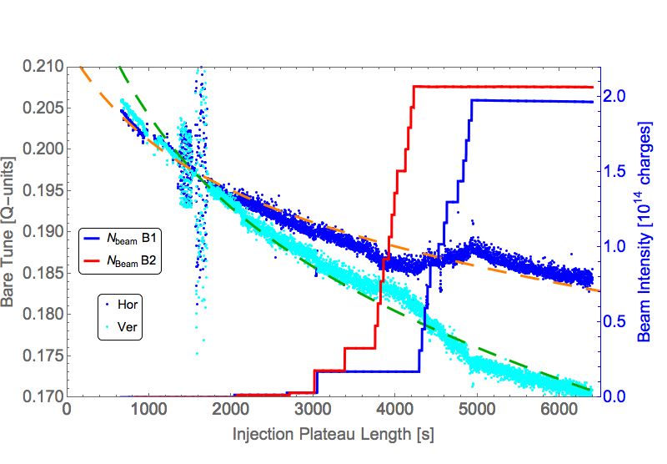
Tune Decay at Injection
Example of bare tune decay at injection with corresponding exponential fits.
Kink related to intensity increase
Beam 1
Fill 4526

Slide 30
Summary of Tune Analysis
Decay at Injection:
  Tunes at injection are under control, although the decay is not fully reproducible and influenced by beam intensity.
Snap-back:
  FiDeL trims are incorporated into the ramp according to the expected shape of the snap-back.
    Manual trims are still linearly incorporated, but contain leakage of the FiDeL model.
  Increasing beam intensity degrades snap-back correction.
  Unexplained drift of time constant (with beam intensity).
  With the help of the QFB, the snap-back is well controlled, but it can not do the job alone.
  With a better incorporation of the manual trims and feed-forward of the Laslett tune shift, the feed-forward corrections could be improved further.

Slide 31
A. Langner

Slide 32
A. Langner

Slide 33
Thanks a lot for your attention!

Slide 34
A. Langner

Slide 35
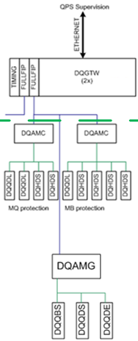
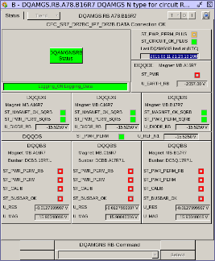

Post TS#2 QPS behaviour
SEU almost absent; over the whole year (mQPS faults not counted)
  DAQ systems: 139 transparent -mitigated- errors recorded (about 30 with ions), no fault, no downtime, no dump, no blocked uFIP (automatic recovery is active for 1232 devices so far)
  600 A detection systems: 2 cases causing beam dumps recorded (RR13 17/10/2015, RR57 31/10/2015). This is less than expected, as the devices have not been updated yet to a radiation tolerant version. The update for RR13, 17, 53, 57, 73 and 77 will take place during the YETS.
  Any other detection system including standard DQQBS boards re-installed during TS#2: once during ion run, at hot spot
  No R2E problems for any re-located equipment in (UL14, 16, 557)
  No R2E problems for upgraded detection systems type nDQQDI (ProASIC3E)
After installation of the old nQPS boards, an already known communication problem appeared
  Affecting the DQLPU type S (sitting below the B dipole)
  Has the consequence of losing comm with the various detectors
  Appeared in the initial commissioning, then disappeared
  Not reproducible in the lab
  The protection functionalities are not compromised
DQLPU-S

