Slide 1
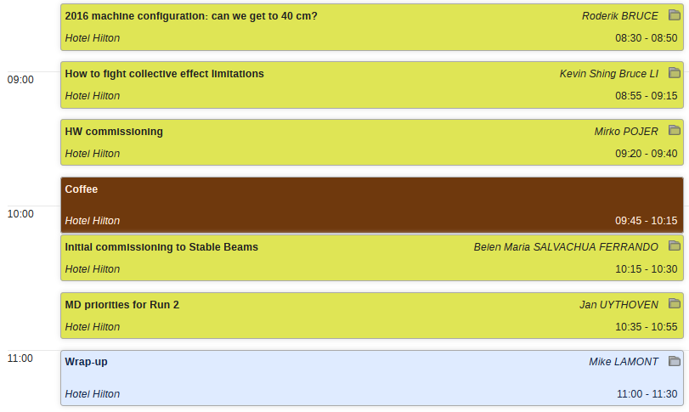

Knud: warm busbar measurements

Slide 2
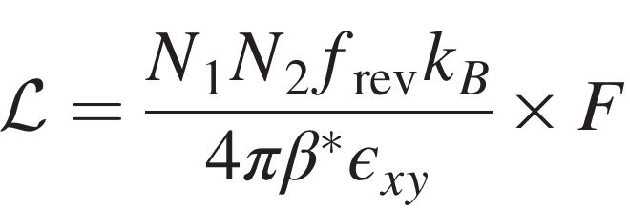
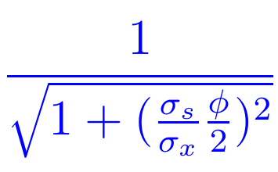
Pushing luminosity
Roderik Bruce
Increase number of bunches
Increase bunch intensity
Increase F: shorter bunches, smaller crossing angle
Smaller emittance
Smaller β*

Slide 3
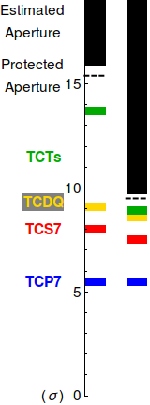
Collimation hierarchy and aperture
2015,
80cm
40cm
Collimators ordered in hierarchy, must protect aperture
Normalized aperture becomes smaller when β* is decreased
Need to significantly reduce collimation margins to accommodate small β*
Series of MDs carried out:
  MD 307: 40 cm aperture measured in excellent agreement with predictions.
    But aperture measurements with ions worse!
  MD 310: Are tighter collimator settings possible without jeopardizing cleaning and protection?

Slide 4
Summary
2015 : commissioning year, 2016: production year
2016 goal: increase performance as much as possible within limits of machine safety
  Try to maximize number of bunches and bunch intensity. Reduce emittance, bunch length, crossing angle, β*
Several MDs carried out to study ways to increase performance
Based on MDs and OP experience, presented scenarios for
65 cm, 50 cm and 40 cm.
We could reach β*=40 cm
  Use tighter collimation hierarchy, optics with re-matched phase advance dump kicker-TCT, 10 σ beam-beam separation
  Assuming proton aperture is reproducible. If aperture is worse as in ion run, be prepared to step back to β*=50 cm

Slide 5

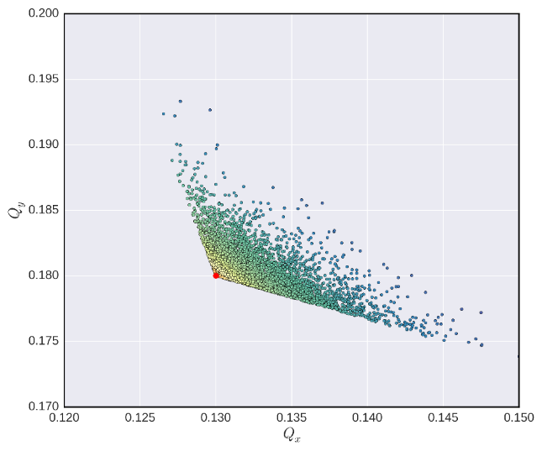
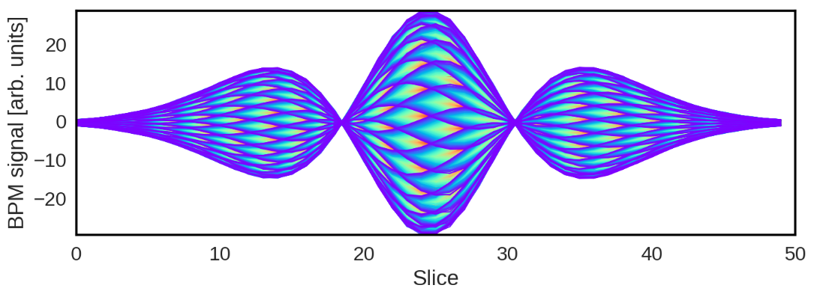
Instabilities & mitigation measures
Kevin Li
Instabilities are self-amplified excitations of particle motion by electromagnetic interaction of the beam with its environment
Instabilities can lead to beam quality degradation or beam loss
We tend to describe instabilities as distinct eigenmodes of the coupled accelerator-beam system characterized by the complex tune shift
→ mode numbers (radial and azimuthal) with rise times and real tune shift
Mitigation measures for instabilities include
  Active mitigation → Feedback systems
  Passive mitigation → Chromaticity & Landau damping
  Source suppression → Impedance reduction and scrubbing/coating etc.

Slide 6
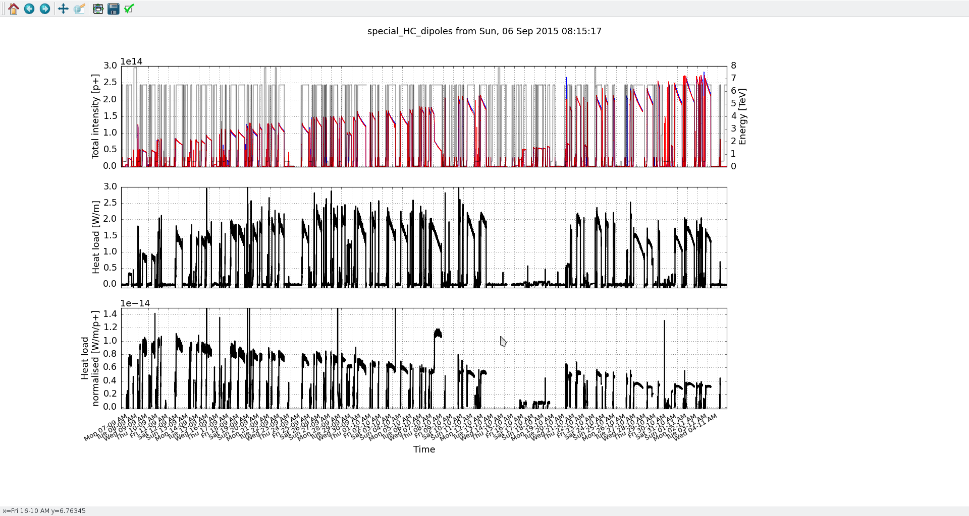
Main observations for instabilities in 2015
Flat-top:
  MD block before and after physics run (s. talk by L. Carver):
  A fair amount of conditioning takes place parasitically at flat-top during physics
Notes:
MDs, scrbbing and heat load

Slide 7
Some key ingredients for operation
General strategies:
Good control of machine is the basis upon which we can hope to maintain control over beam stability
In particular, it would be very useful to have good monitoring and control of:
Damper kick strength
Chromaticity
Coupling
Tunes
Important diagnostics that can help in a better understanding of instabilities:
Headtail Monitor
ADT ObsBox
See M. Solfaroli, LBOC No 45 e.g. for improved chromaticity measurement in 2015

Slide 8
Some key ingredients for operation
General strategies:
Good control of machine is the basis upon which we can hope to maintain control over beam stability
In particular, it would be very useful to have good monitoring and control of:
Damper kick strength
Chromaticity
Coupling
Tunes
Important diagnostics that can help in a better understanding of instabilities:
Headtail Monitor
ADT ObsBox
Procedure:
Complete intensity ramp-up with 25 ns standard beam – then start injecting BCMS beams
Inject with established machine settings:
Chromaticity
Octupoles
Damper gain
Working point (try lowering horizontal tune)
Reduce non-linearities (chromaticity and octupoles) when in collision to relax DA
See M. Solfaroli, LBOC No 45 e.g. for improved chromaticity measurement in 2015

Slide 9
Some key ingredients for operation
General strategies:
Good control of machine is the basis upon which we can hope to maintain control over beam stability
In particular, it would be very useful to have good monitoring and control of:
Damper kick strength
Chromaticity
Coupling
Tunes
Important diagnostics that can help in a better understanding of instabilities:
Headtail Monitor
ADT ObsBox
Procedure:
Complete intensity ramp-up with 25 ns standard beam – then start injecting BCMS beams
Inject with established machine settings:
Chromaticity
Octupoles
Damper gain
Working point (try lowering horizontal tune)
Reduce non-linearities (chromaticity and octupoles) when in collision to relax DA
Measures and fall-back solutions:
Raise chromaticity (beyond 15 and only during the squeeze)
Controlled emittance blow-up (BCMS beam)
Longer bunches (via controlled emittance blow-up)
Collide and squeeze
Wideband settings (test at beginning of the run)
Study Q’’ as new potential knob for additional Landau damping
See M. Solfaroli, LBOC No 45 e.g. for improved chromaticity measurement in 2015

Slide 10
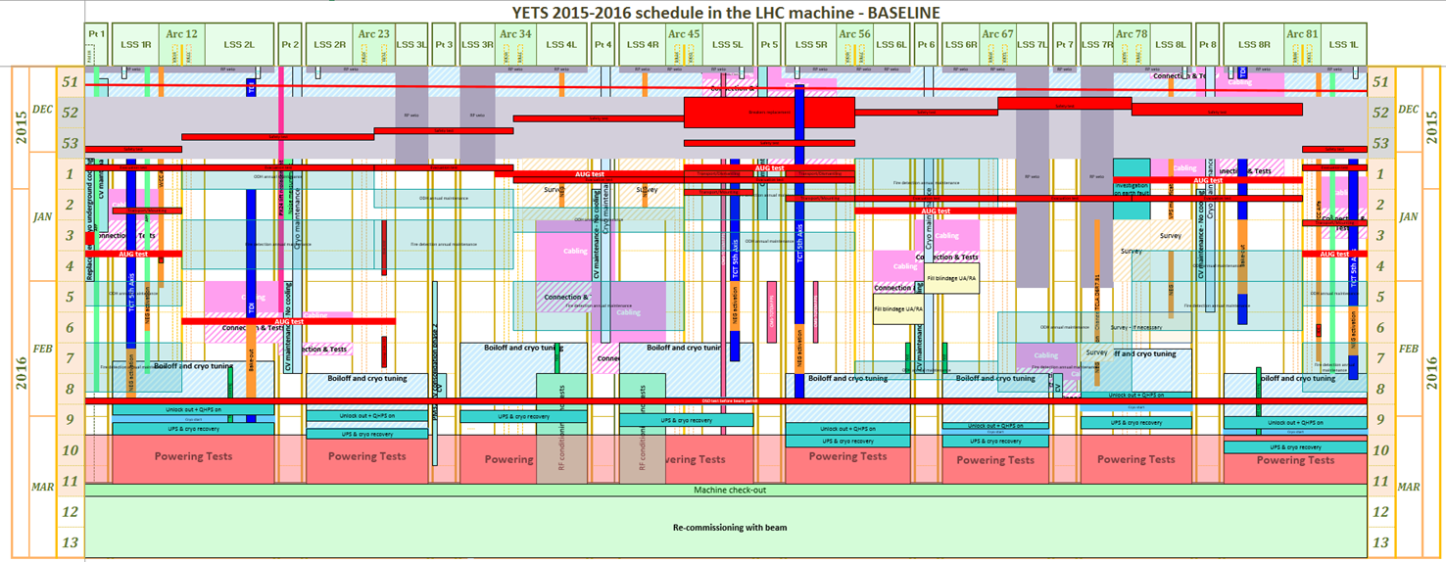
The present schedule
Mirko Pojer
https://espace.cern.ch/en-dep-mef-lpc/YETS2015-2016/Global%20Schedules/LHC_YETS2015_16_LinearSchedule_20151130.pdf
Key dates:
  DSO tests (machine in general mode before)
    Patrol scheduled on W8 for the DSO tests
    DSO tests on February 26 (and 27)
  March, 1 – beginning of UPS tests (could be integrated in the general AUG tests?)
  March, 4 – LHC tunnel closed and beginning of powering tests
  March, 16 – end of powering tests, experiments closed and (official) beginning of machine check-out
  March, 21 – beginning of beam commissioning
It would be important to close the experiments already from Mon.14 during night time

Slide 11
MPE - QPS
Could strongly impact the commissioning time!!
Installation & commissioning of radiation tolerant detection systems for 600 A circuits
  RR13, 17, 53, 57, 73 and 77
Installation & commissioning of new detection systems for circuits RU.L4 and RU.R4 (‘undulator’). Activity in conjunction with the upgrade of the corresponding current sensors performed by EE team
Upgrade of the firmware for the nQPS DAQ systems allowing easier recovery from local bus errors (436 units concerned).
  Locations: 8 sectors
Installation of a test system for the measurement of conical joints in the warm 13 kA circuits.
  Location: UA23 (t.b.c.)
  Requires lock-out and grounding of the associated power converter.
All DQHDS will be switched off during the YETS. Locations: 8 sectors
  The QPS team foresees as well a test of the QPS interlocks
Important to get a sector ASAP!
Test bench for HW and SW is needed!
Impact to be assessed
All must be up and running for the UPS tests!

Slide 12
MPE - EE
General and specific overhaul of the 32 installations of energy extraction in the LHC main dipole and quadrupole circuits.
  Locations: UAs (even points), RRs (13,17,53,57,73,7) & R34, R37
  Requires lock-out and grounding of the associated power converters
Supervision of a general overhaul of the energy extraction breakers of the ‘Atlas’ powering circuits for the superconducting Solenoid and Toroid.
  This task will be performed by an IHEP team of specialists.
  Location: Atlas (“power cavern”)
All must be up and running for the UPS tests!

Slide 13
MPE - ElQA
Check is part of the cryo tuning
Study of a possible relocation in point 6 of the CL heater sources and the Proximity Equipment related to a possible displacement of the RQ5.L6 quad
Checking and re-making, if required, the signal transmission line from the DQLCT of B23.L7, heater #1
ELQA investigations of the earth fault on the circuit RCS.A78B2 (near DFB)
  Decision taken by LMC to do the type test
  Final test to be discussed later
ELQA integrity verifications at the end of YETS
  Depending on the temperature variations and the interventions on the circuits.
To be verified before powering (IST)
Additional verification to be done
Would require more extensive test!
Impact on re-commissioning depends on the list of ElQA tests

Slide 14
Concluding remarks
The boundary conditions for the YETS are well defined; however
  Few critical activities could have an impact
  7000 tests have to be done in 12 days
As usual good coordination between PT and machine check-out will be fundamental for a smooth transition to the operational mode
  A lot of tests and verifications to be done
  All the systems finally connected together
We’ll have to work hard to prepare the machine in a coordinated and efficient way…also improving the communication in the LHC island…

Slide 15
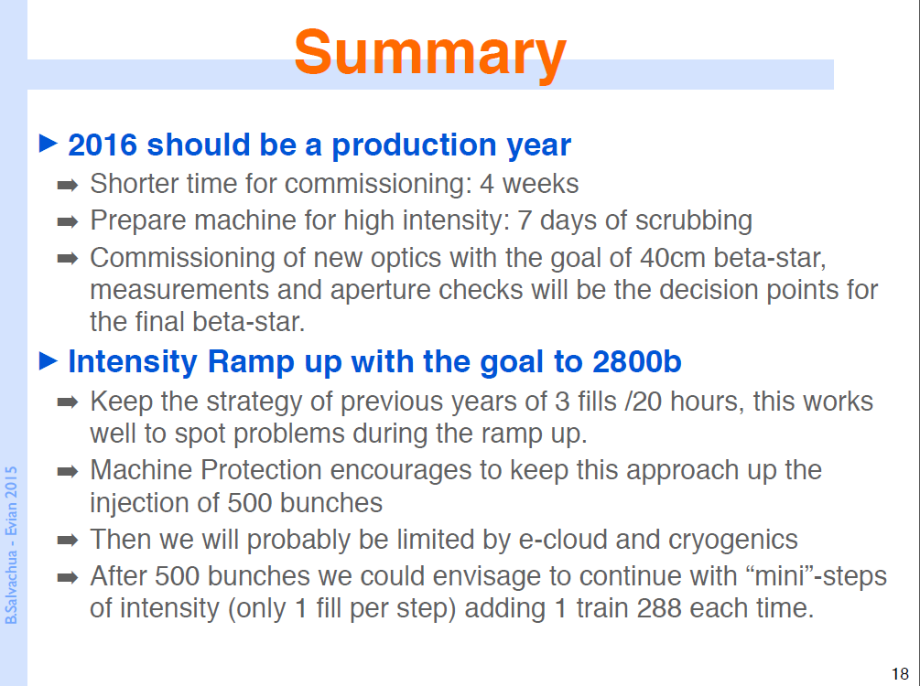
Belen Salvachua

Slide 16
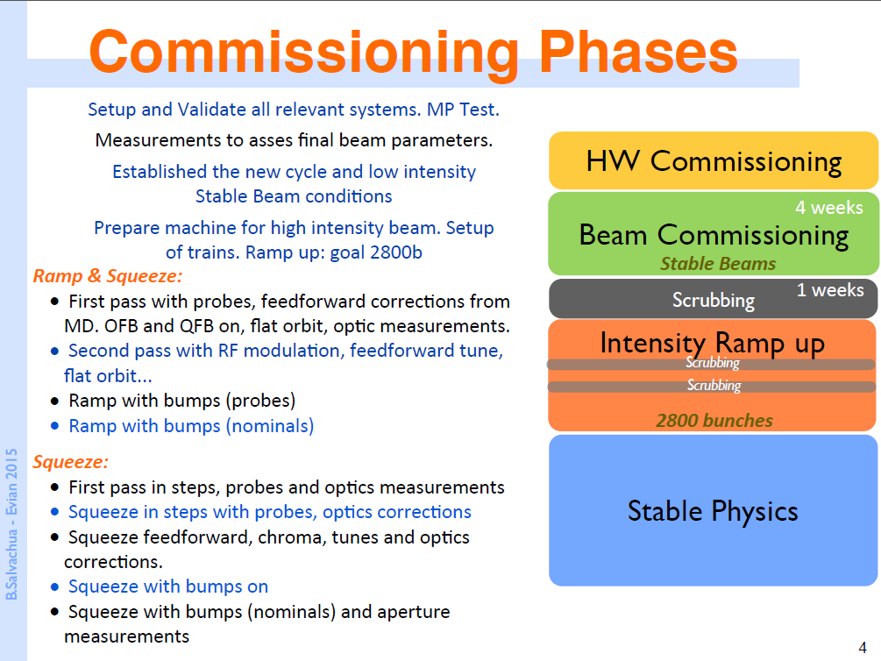

Slide 17
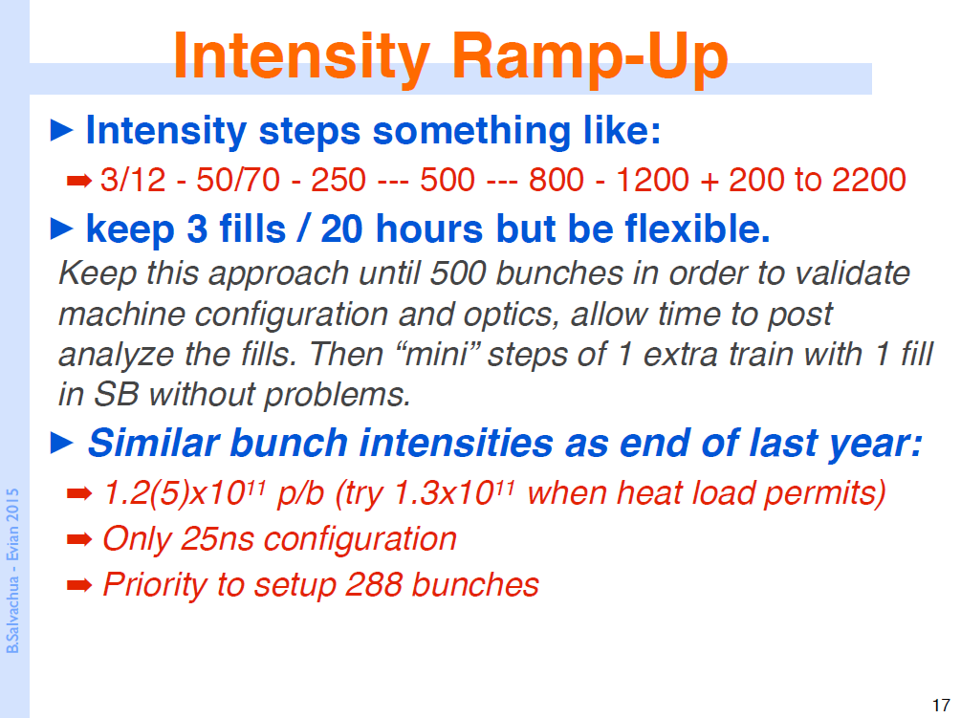

Slide 18
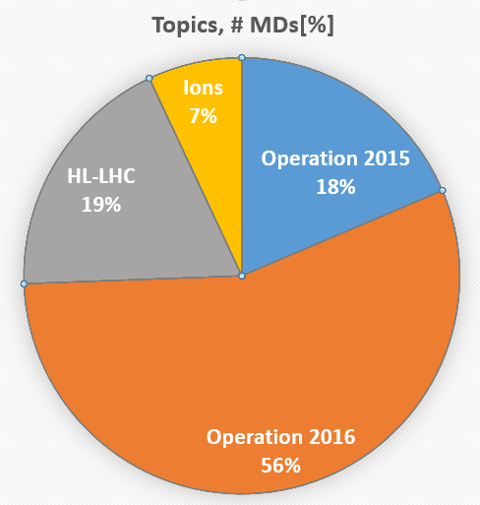
Distribution concerning Focus of MD
Jan Uythoven
18 % related to direct operation 2015. Ideally should be less
  Beam Instrumentation
  Collimation
Most of it concerning operation 2016 and beyond
  β* = 40 cm related
  Instabilities, impedance
  Beam Instrumentation
Some longer time line, HL-LHC
  Many related to collimation
  Quenches
  Vibrations
Ions are put separately
Classification can be a bit arbitrary …

Slide 19
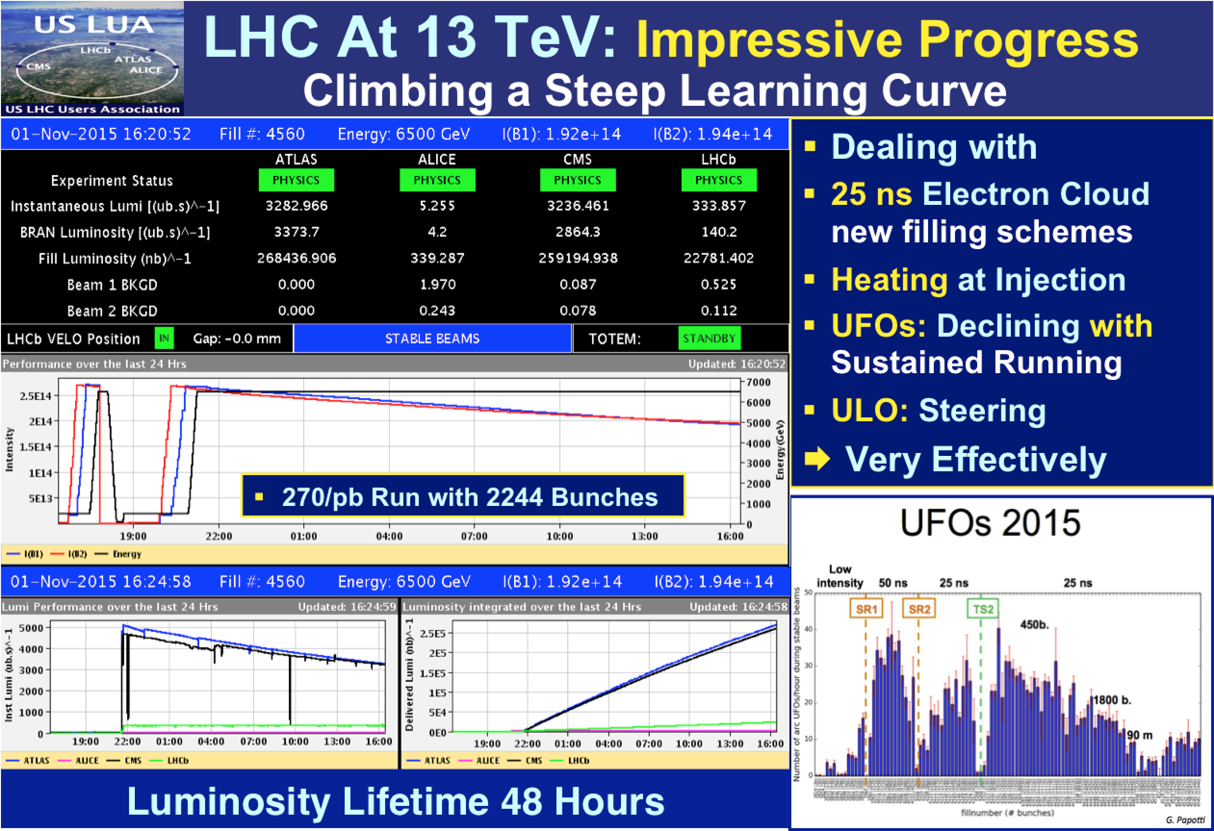
Mike Lamont

Slide 20
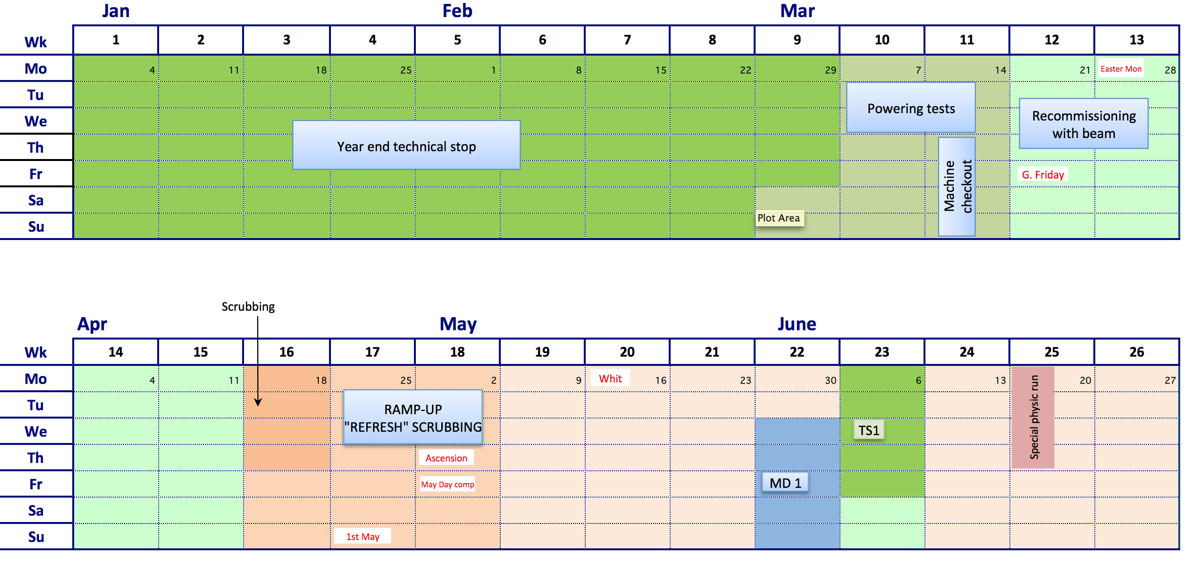
2016

Slide 21
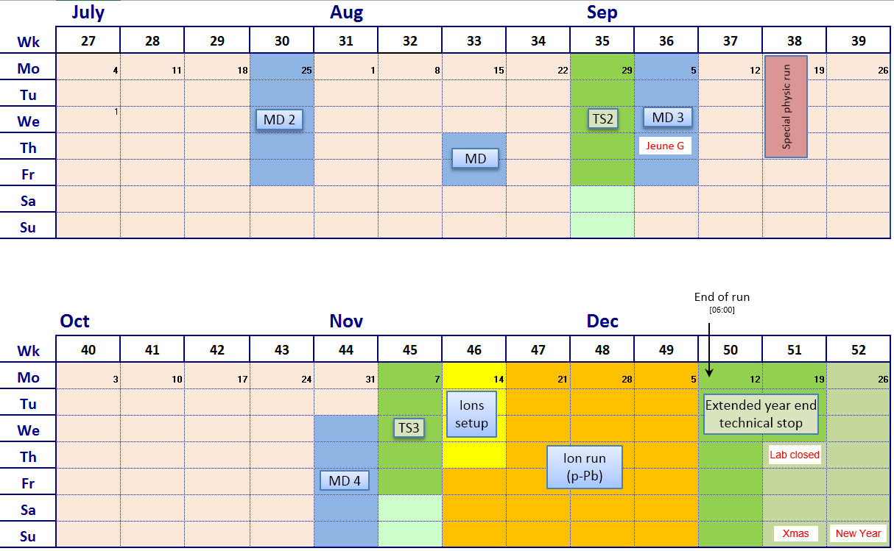
2016 Q3/Q4 (v1.0)

Slide 22
2016 version 1.0
Phase | Days
Initial Commissioning | 28
Scrubbing: 4 days initially and then as required during ramp-up | 7
Proton physics 25 ns | 152
Special physics runs (high beta*; 90 m; VdM (19 m) | 8
Machine development | 22
Technical stops | 15
Technical stop recovery | 6
Ion setup/proton-lead run | 4 + 24
Total | 266 days (38 weeks)

