Slide 2
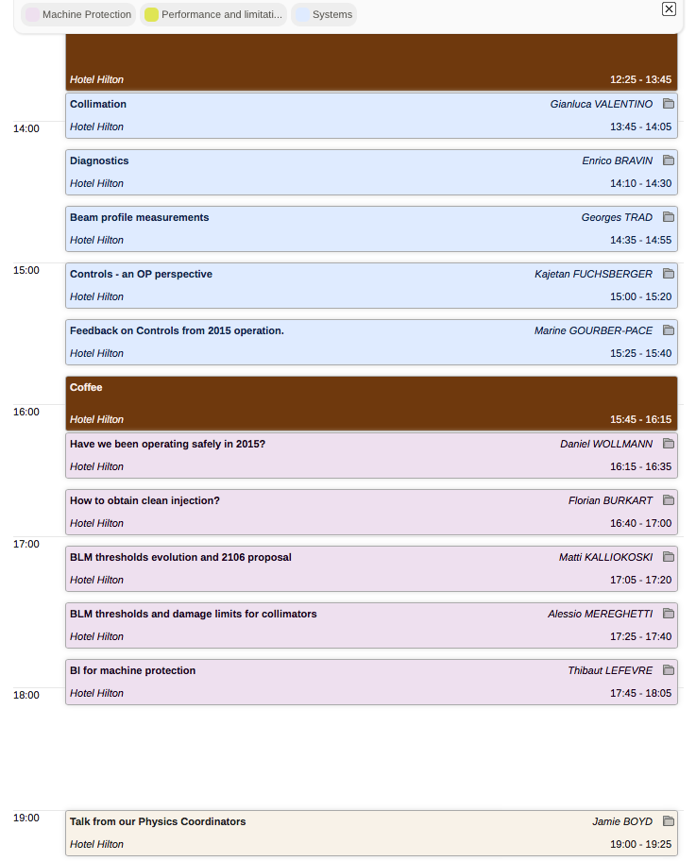
Evian Summary III (16.12. 14:00-20:00)
Systems part 2
Machine Protection
Some Physics results from the run 2015.

Slide 3
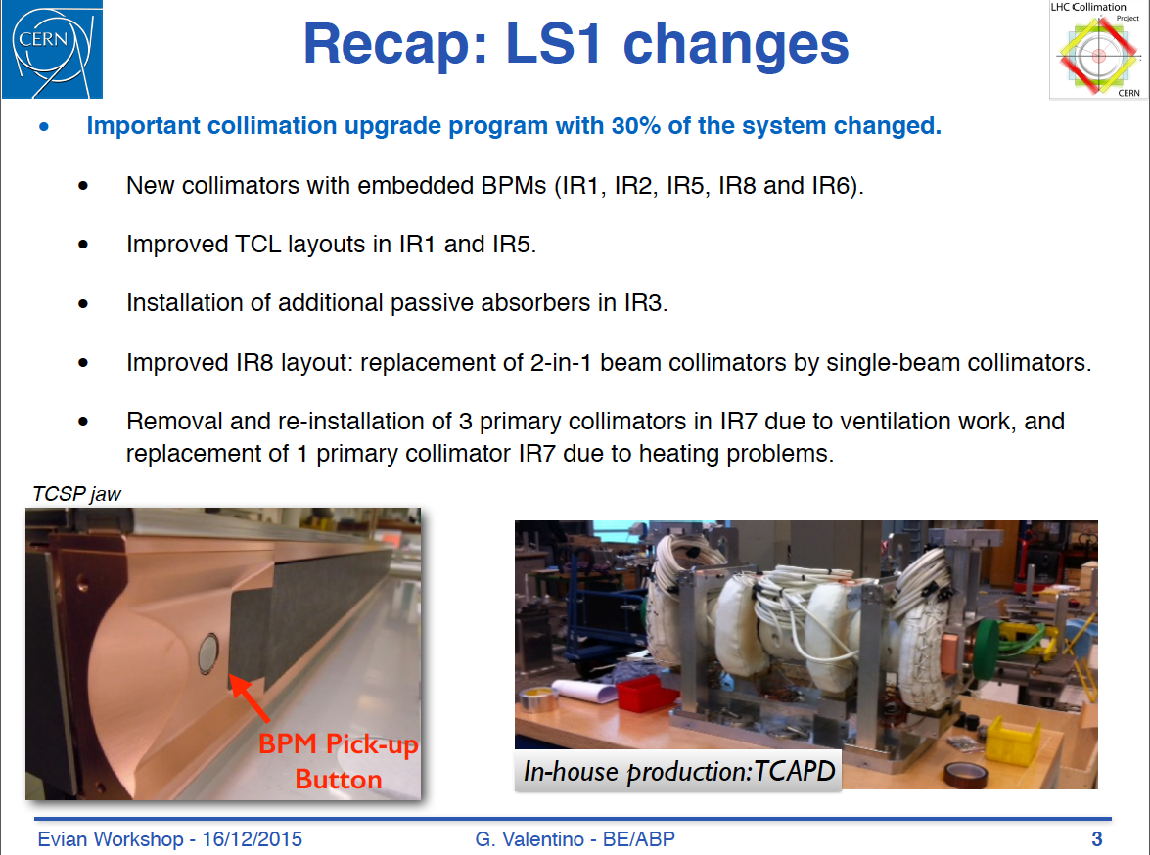
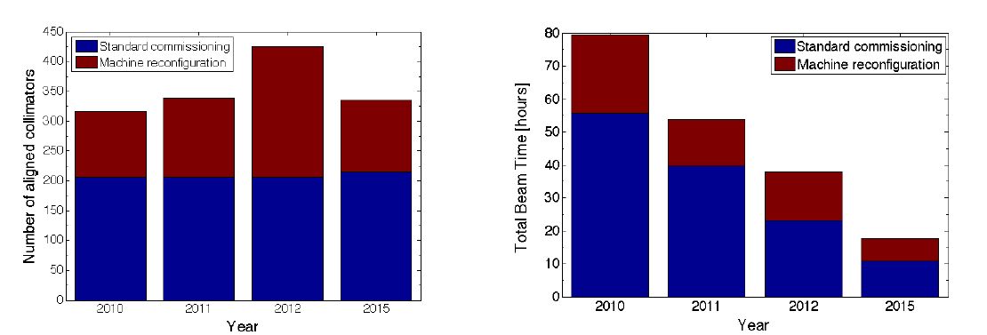
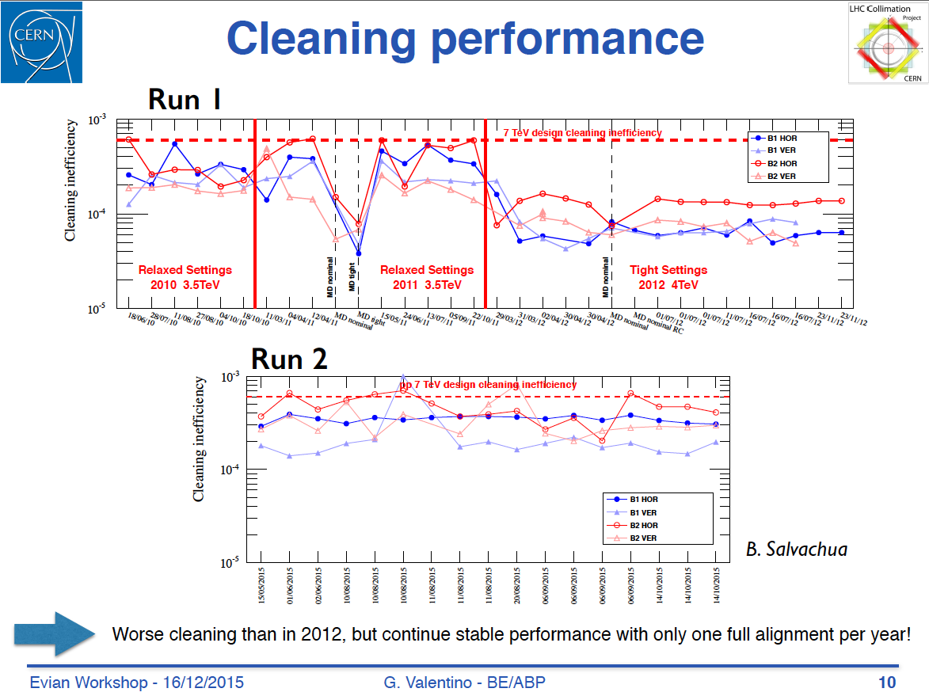
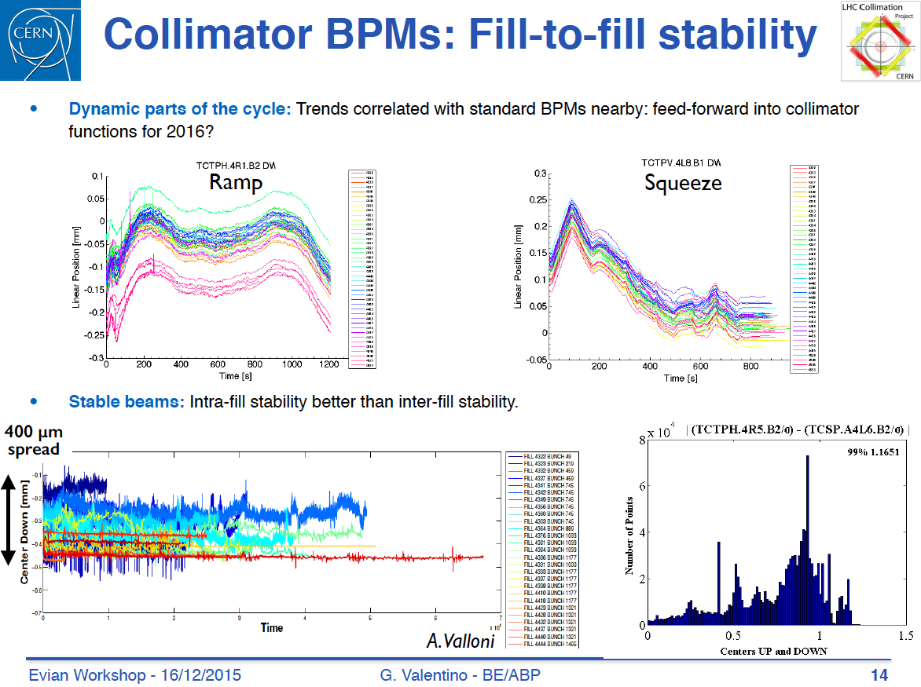
Collimation Performance 2015 – G. Valentino
MP tests: 1548 tests executed within 2 days
Alignment time for all 86 collimators now down to 4 hours from ~20 hours in 2010.

Slide 4
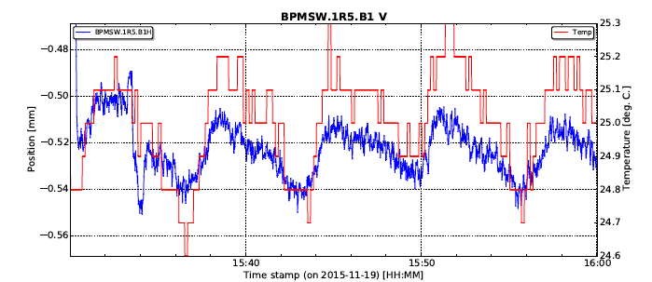
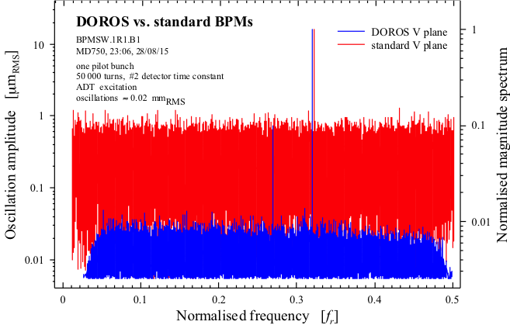
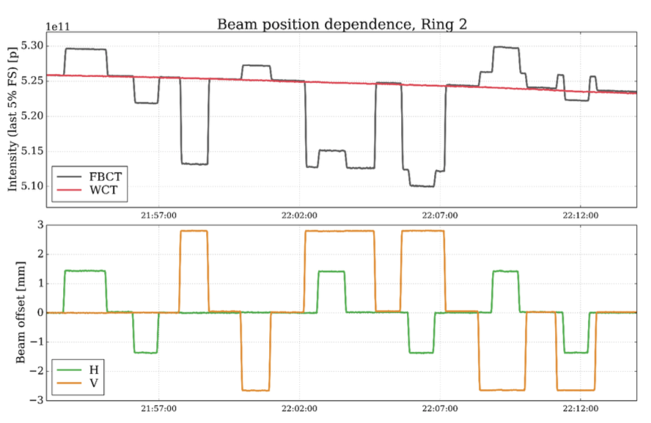
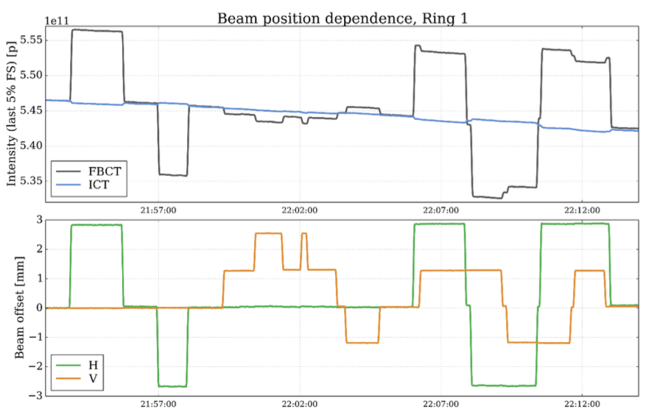
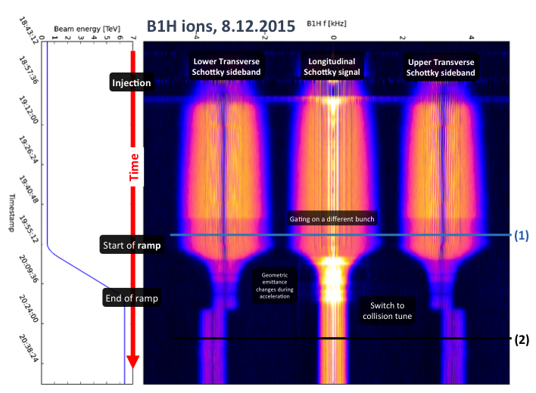
Beam instrumentation after LS1 – E. Bravin
BPMs
Transformers
BBQ
BTV
BRAN
Schottky
BSRL
BPM temperature stabilized racks installed during LS1 → temperature stability during fill ~0.5K
BCTs work well with some hick ups (SBF flickering, … ); new HW under test
BBQ operating stably
BRAN: New Cherenkov detectors developed and installed in IP2 and IP8 (replace CdTe), regularly used for measurement of overlap when putting beams in collision.
Schottky worked well with ions
BI can now focus toward HL-LHC

Slide 5
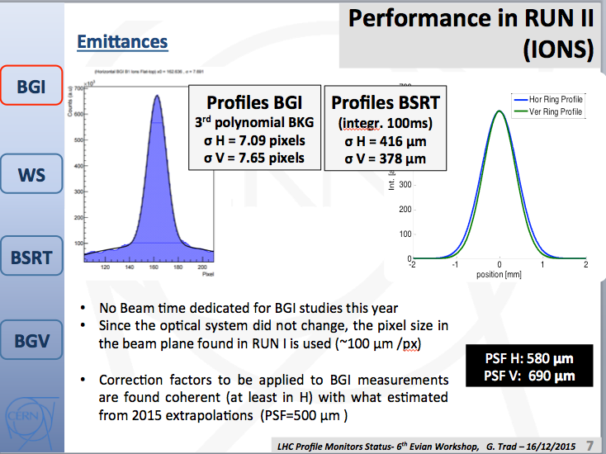
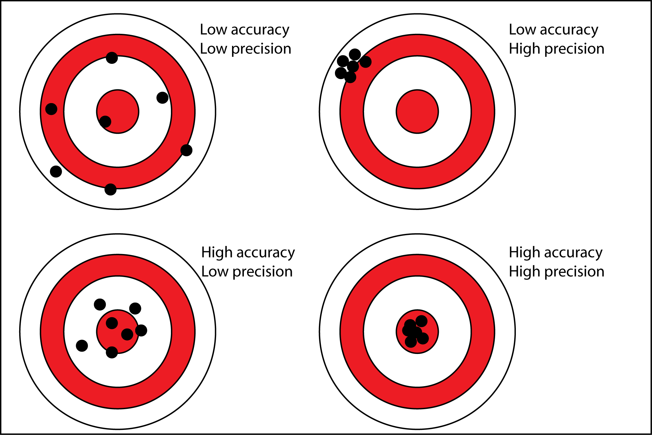
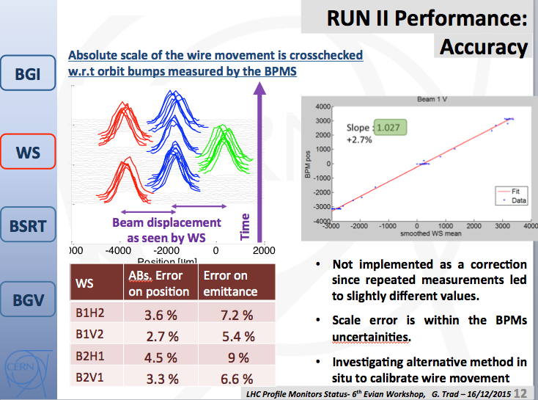
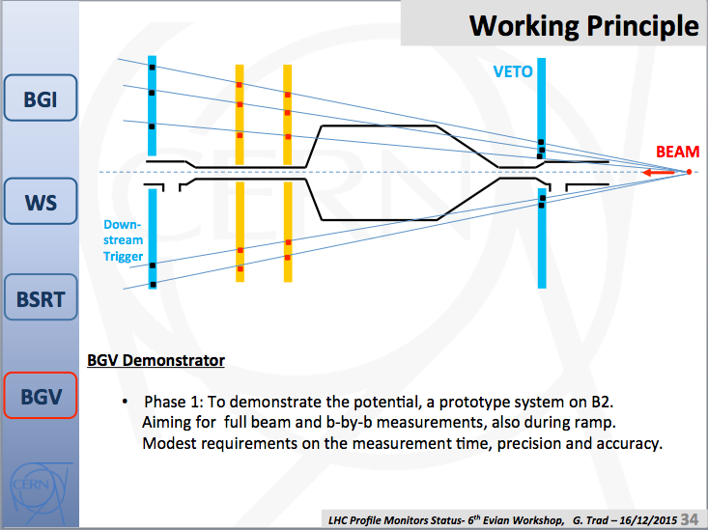
Status of the Beam Profile Measurements - G. Trad
BGI (Beam Gas Ionization)
WS (wire scanners)
BSRT (Beam Synchrotron Radiation Telescope)
BGV (Beam Gas Vertex)
BSRT is reliably operational for bunch-by-bunch measurements in 2015. Has been crucial for several studies (beam-beam, instabilities and EC studies) Crosschecked with independent measurement (op scans). Accuracy on beam size at the level of 5%

Slide 6
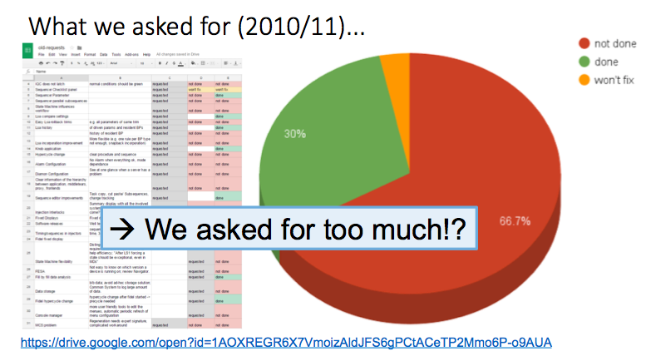
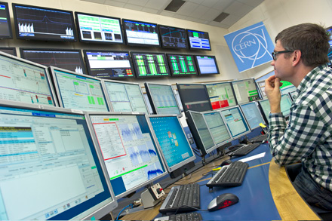
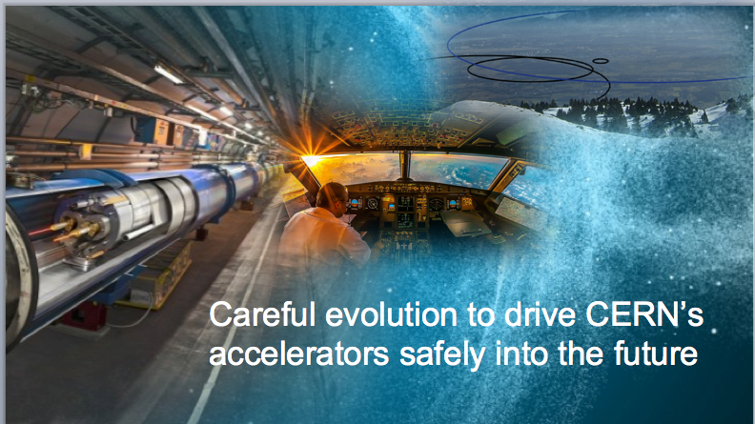
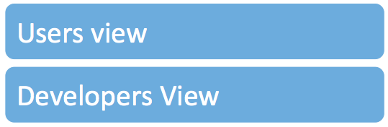
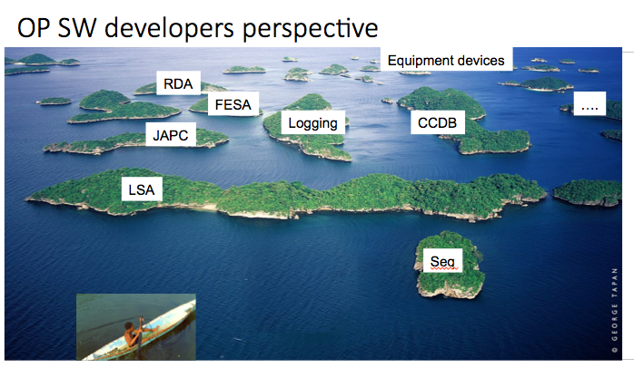
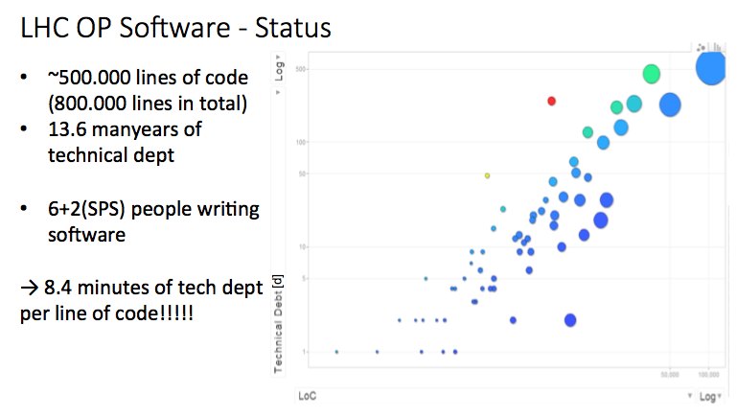
Controls – OP perspective – K. Fuchsberger
Good control system, but many wishes to improve
Maintainability of code is an issue.

Slide 7
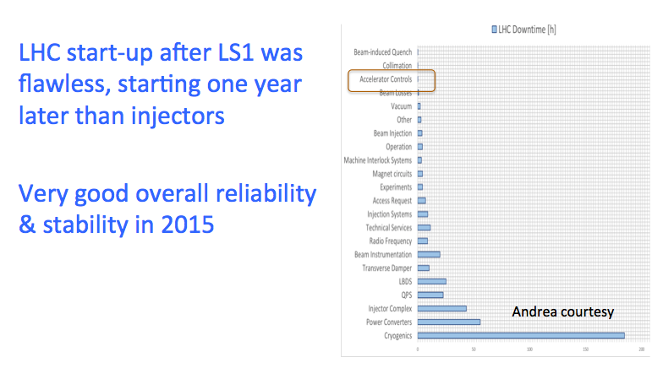
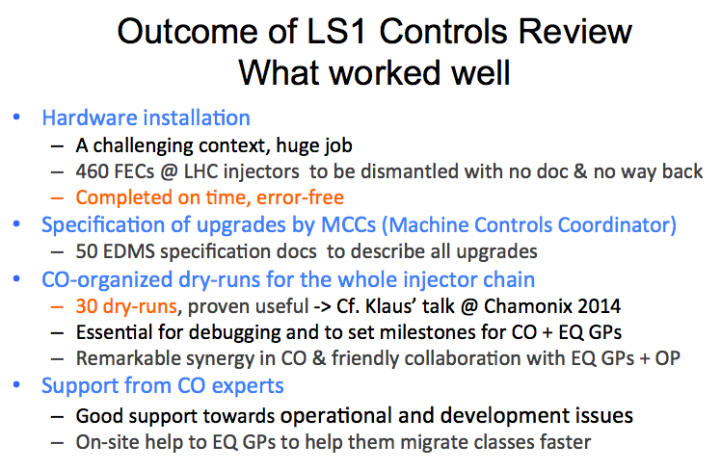
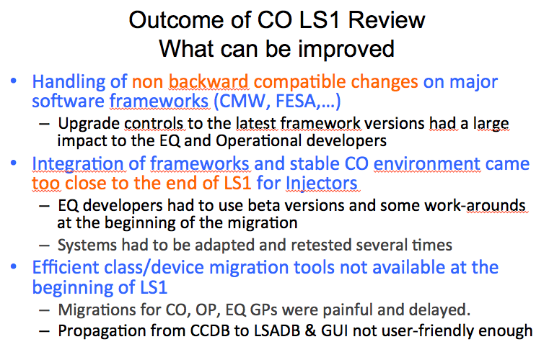
Feedback on Controls from 2015 Operation – M. Pace
From lessons learnt during LS1 and outcome of the LS1 CO review, CO will take actions to put in place a more efficient coordination with our users.

Slide 8
Evian Summary III (16.12. 14:00-20:00)
Systems part 2
Machine Protection
Some Physics results from the run 2015.

Slide 9
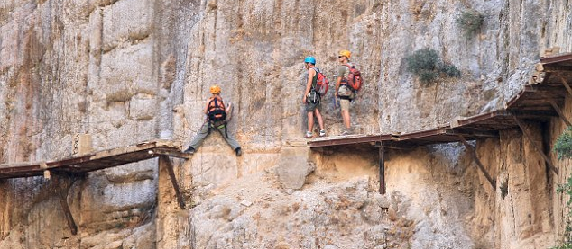
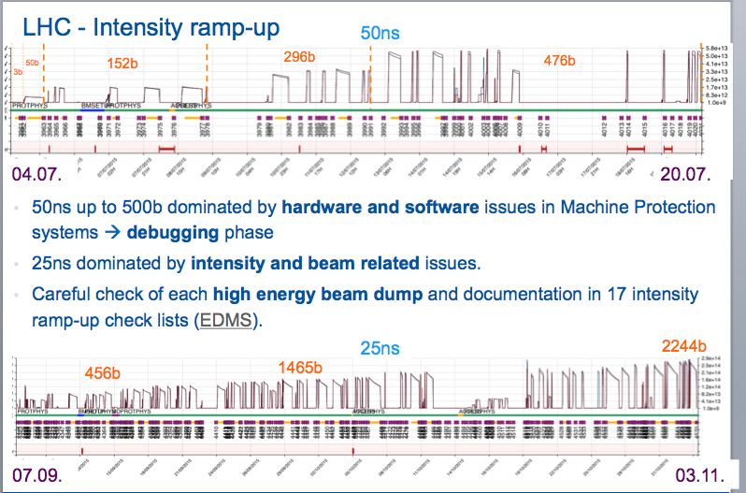
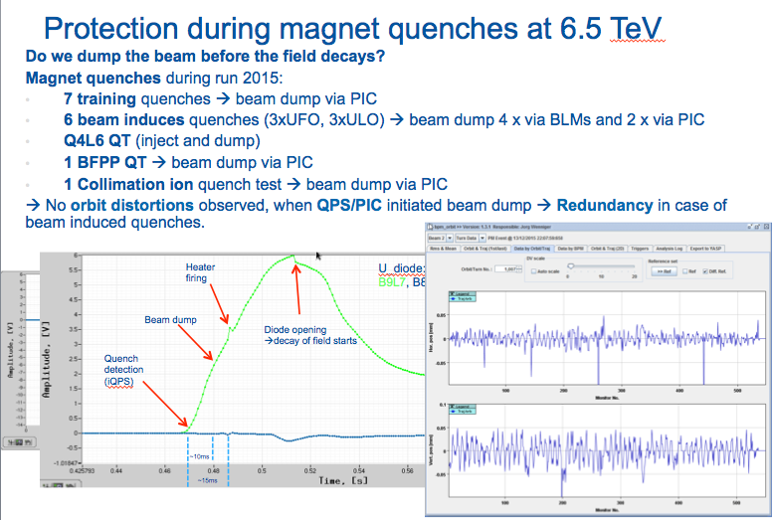
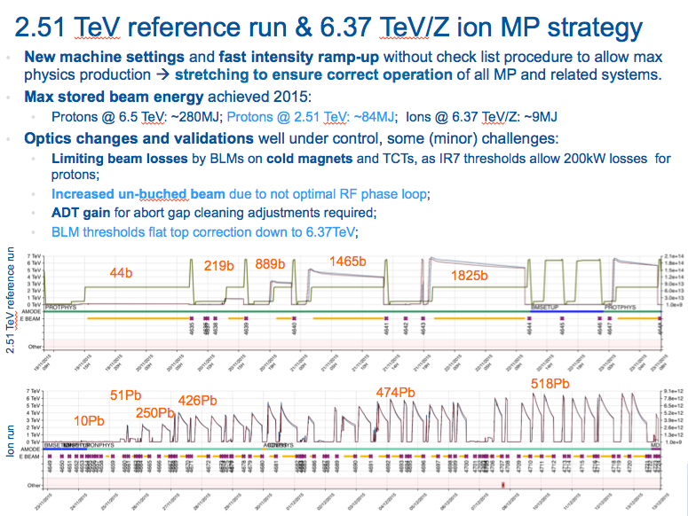
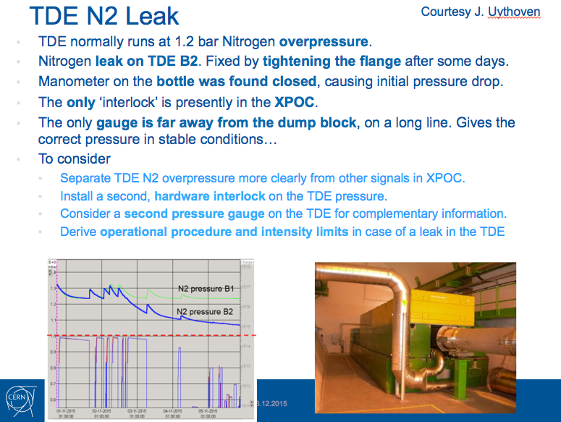
Have we been operating safely in 2015? - D. Wollmann

Slide 10
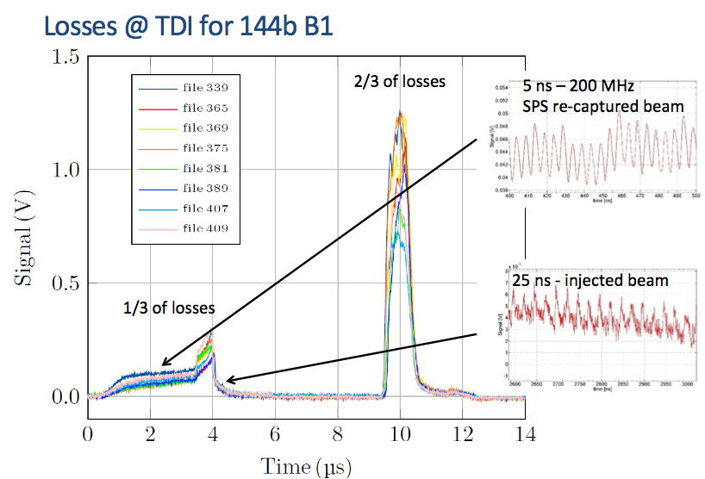
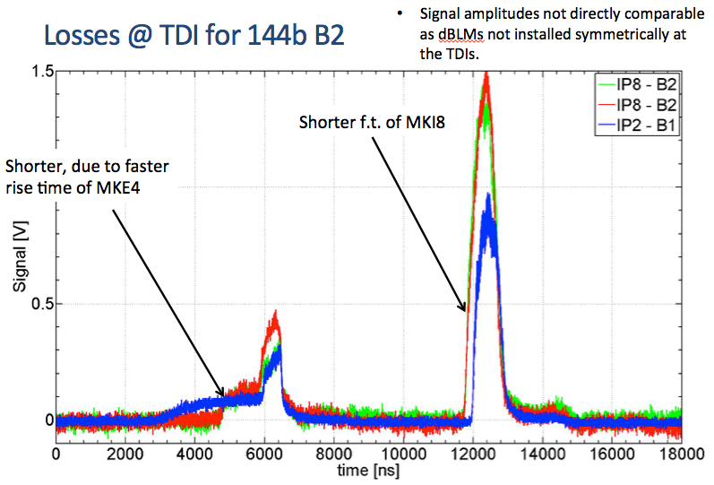
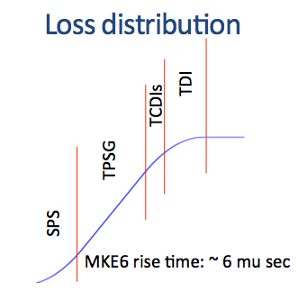
How to obtain clean injections? – F Burkart
Losses during injection dominated in 2015 by re-captured beam in SPS
Diamond detectors are key instrument for detection.

Slide 11
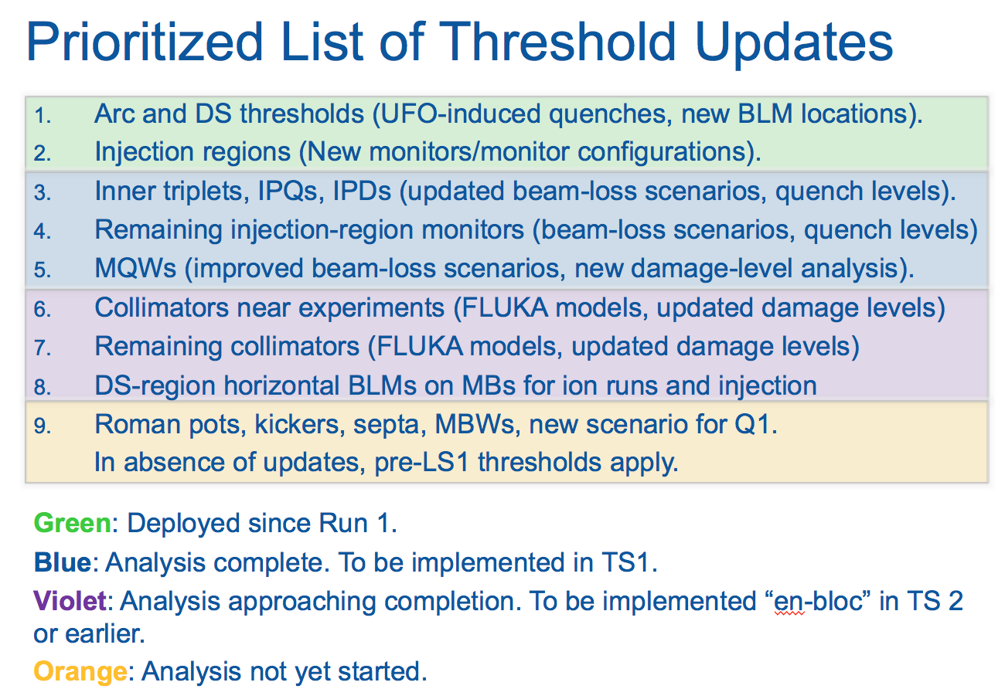
BLM thresholds evolution and 2106 proposal – M. Kalliokoski
Over 5700 modifications to the thresholds were made during 2015
New tools allow faster changes to threshold values with improved safety
Main changes in 2016 will be made to collimators (A. Mereghetti’s talk)
For other families, mainly ad-hoc adjustments to current values are foreseen
New thresholds for monitors at experiments (ALICE, AFP etc.)
xxx

Slide 12
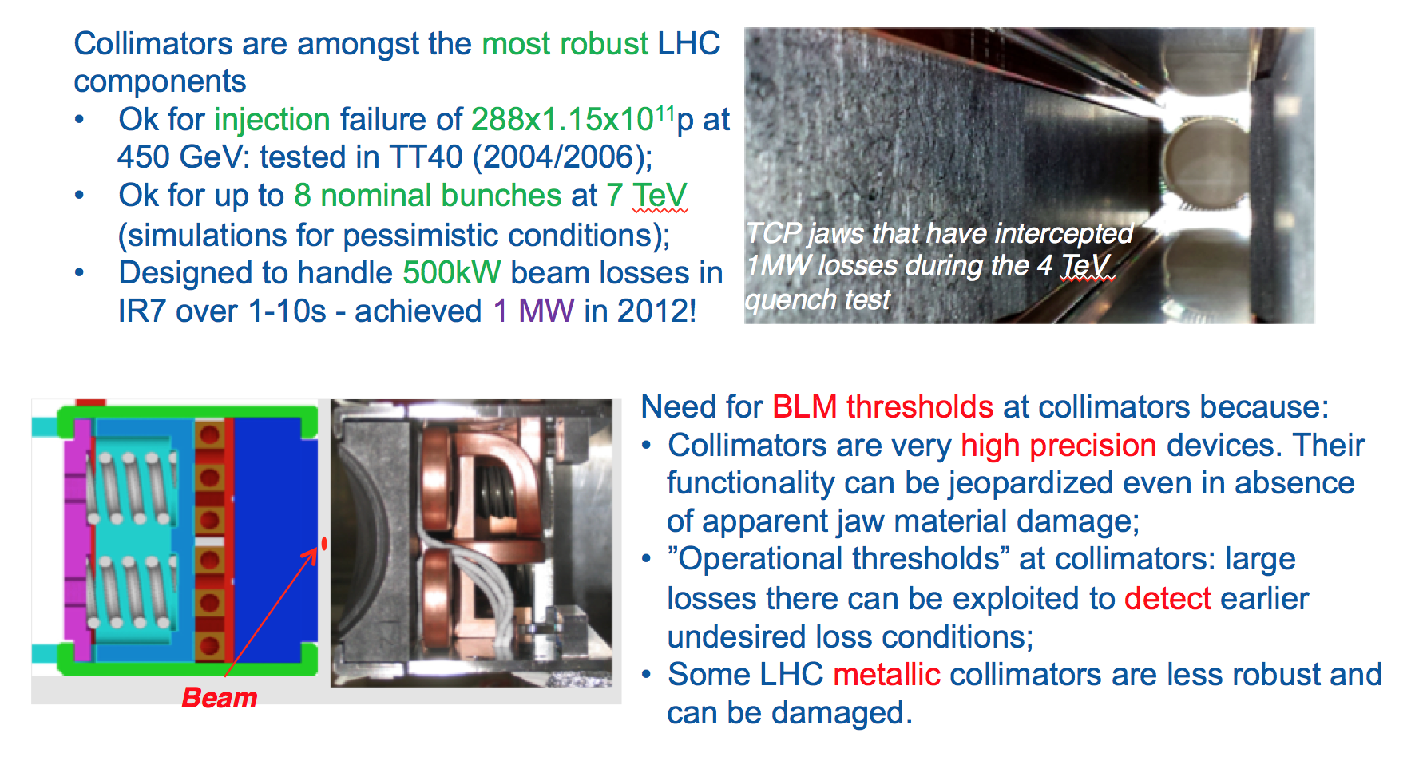
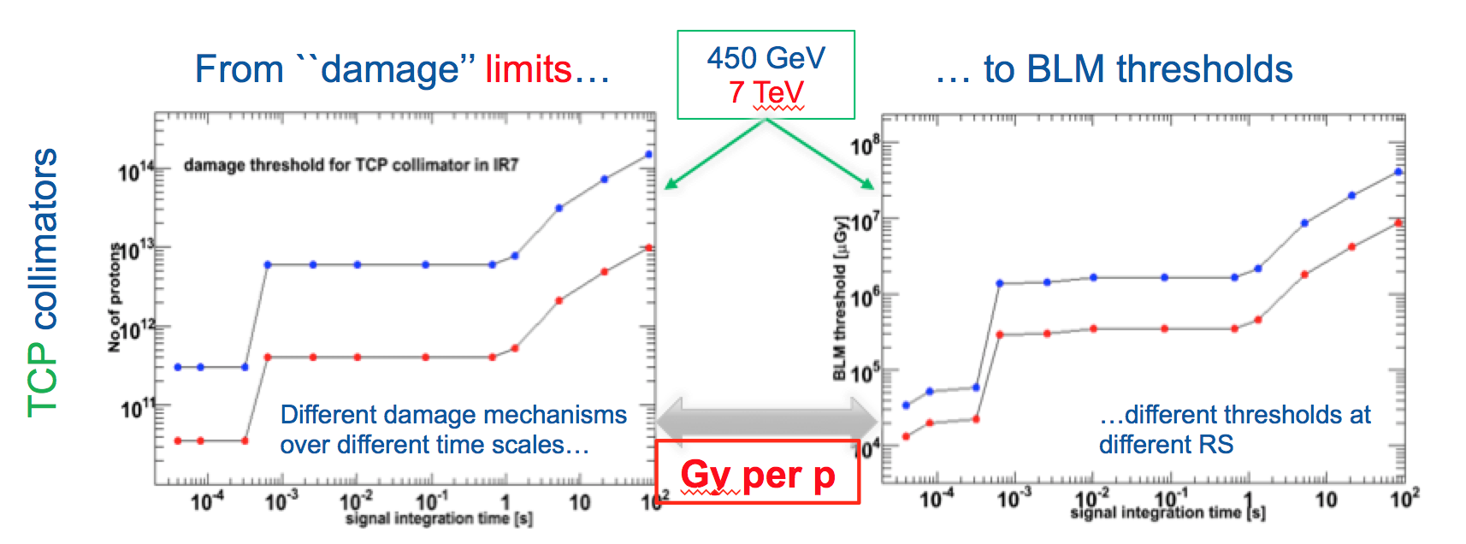
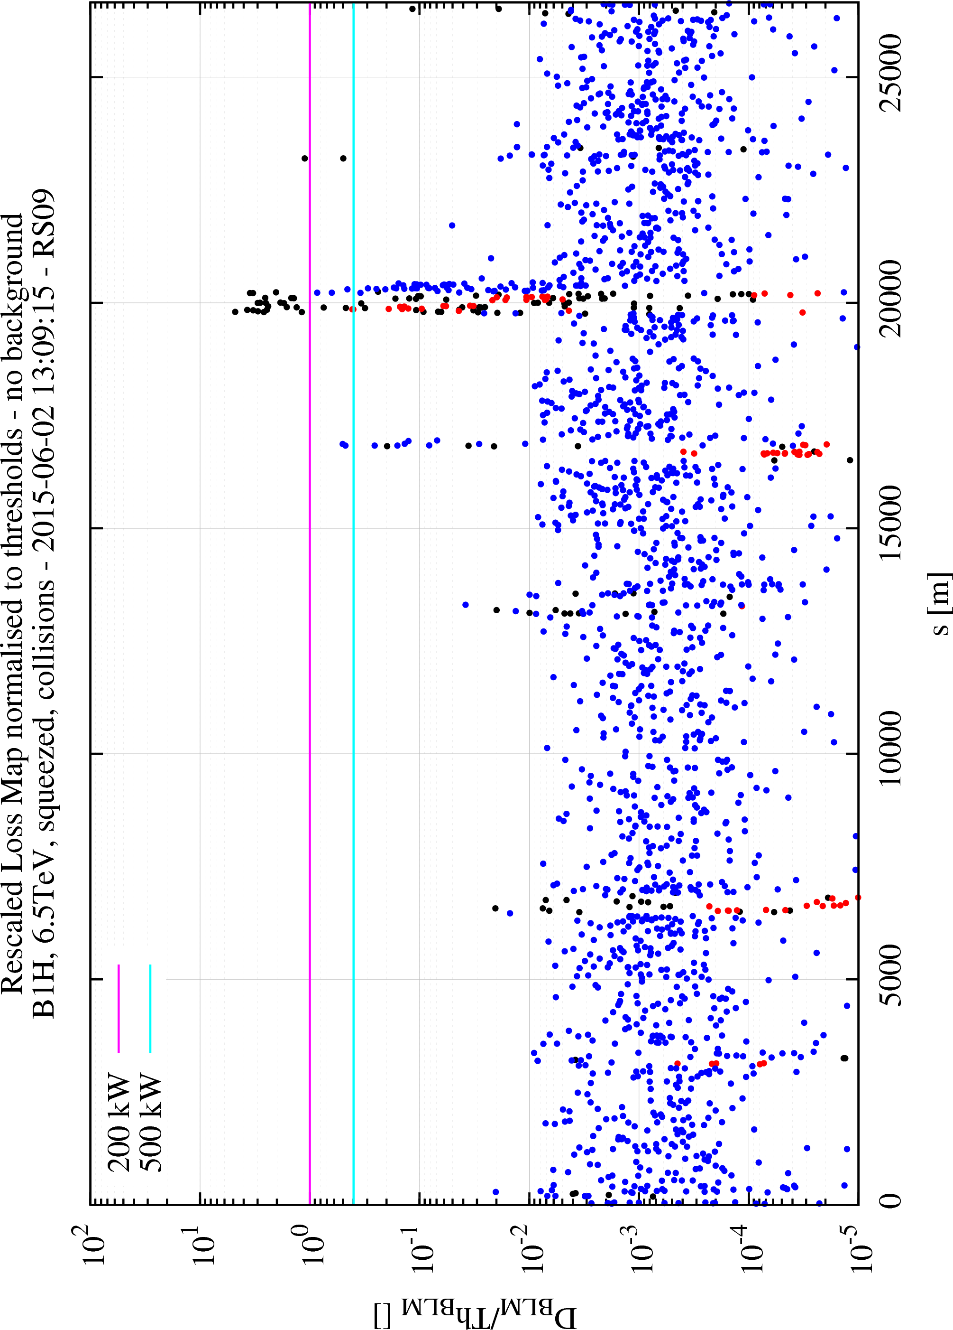
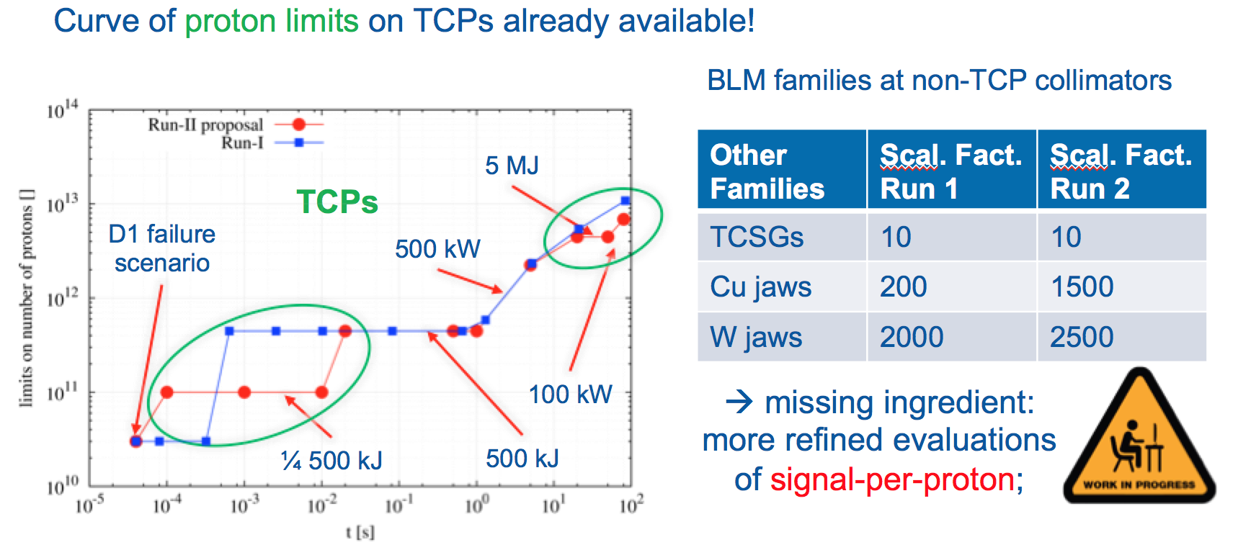
BLM thresholds and damage limits for collimators – A. Mereghetti
2015 scaling thresholds from loss maps to 200kW, respectively 500kW losses.
2016 plans

Slide 13
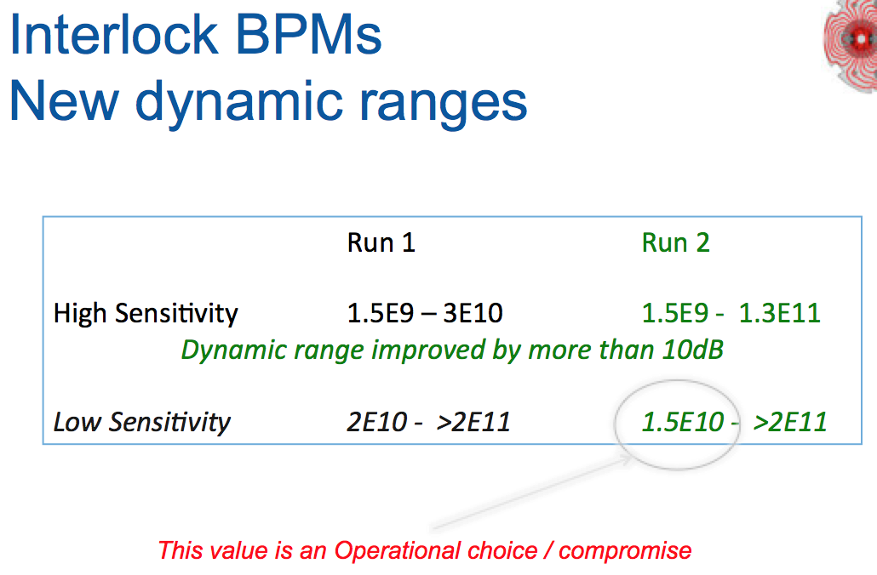
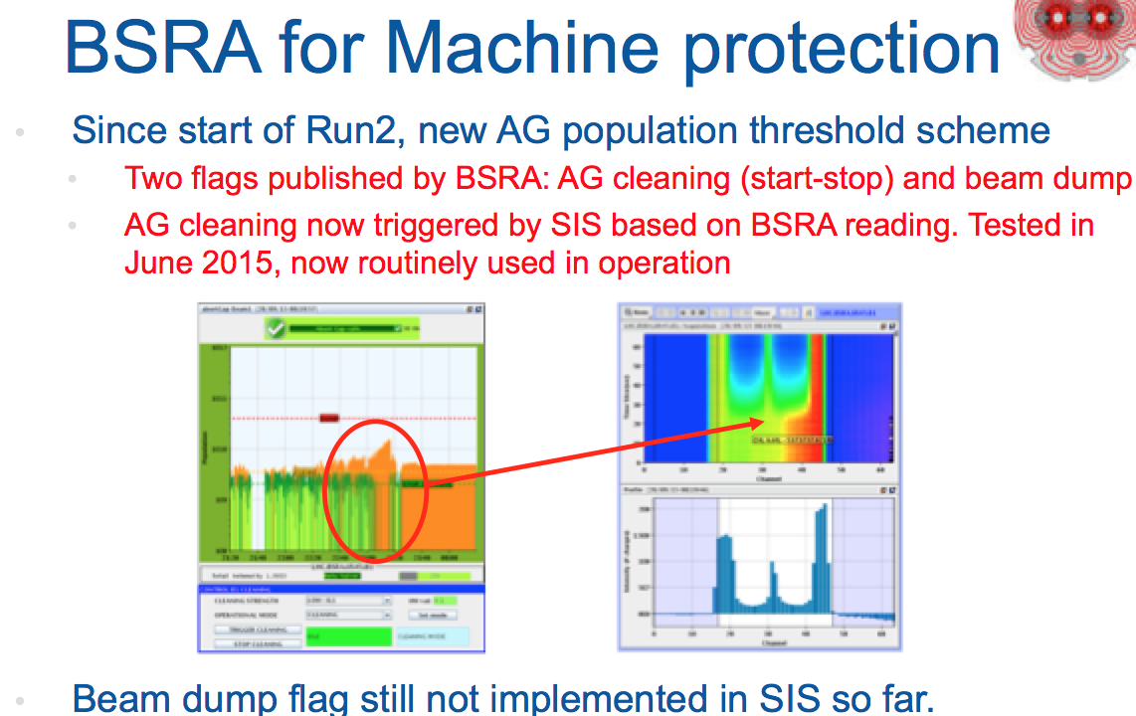
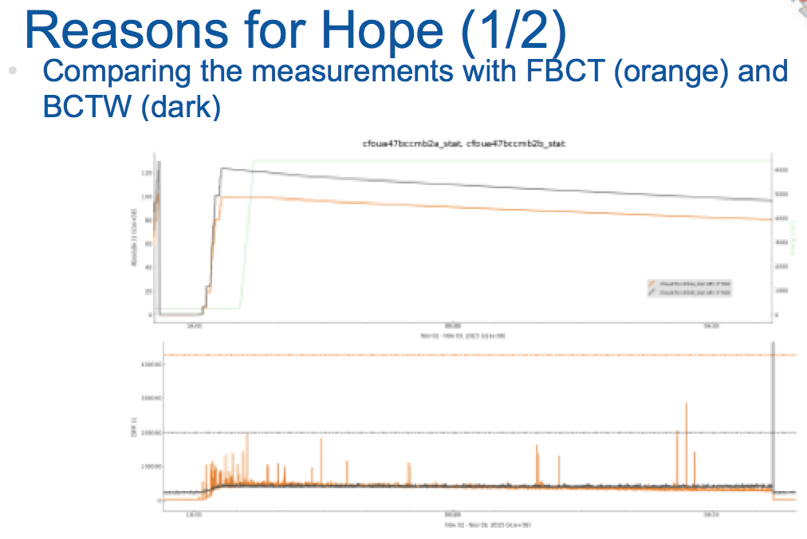
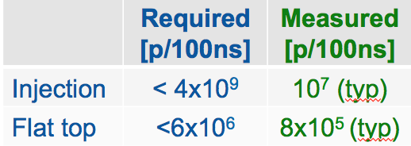
BI for machine protection – T. Lefrevre
Interlock BPMs (IP6): doublet were main challenge
Abort Gap Monitoring
Beam Current Change Monitor : dI/dt
BCCM 2015
9th of October – False dump
  Operational BCCMs disabled
  Understood later as a timing issue in the FPGA
New firmware uploaded into operational systems on 30th October
Investigations still on-going on the impact of a phase dependency in I/Q demodulation

Slide 14
Evian Summary III (16.12. 14:00-20:00)
Systems part 2
Machine Protection
Some Physics results from the run 2015.

Slide 15
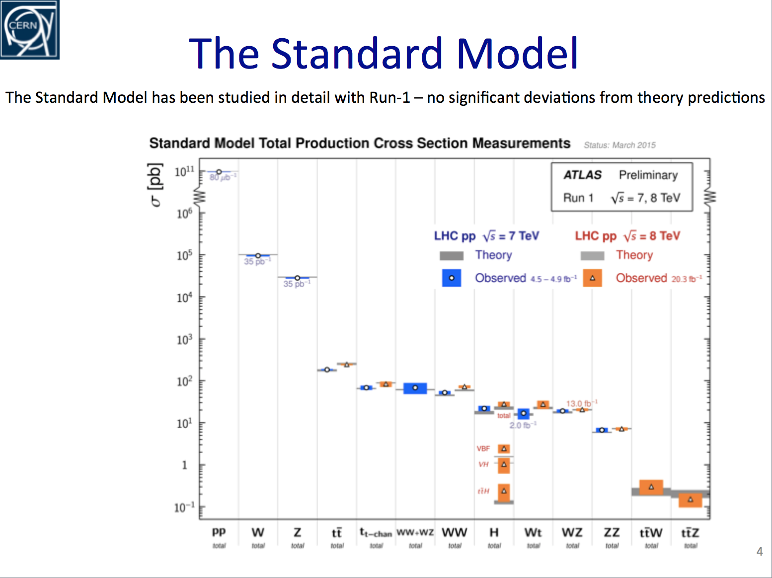
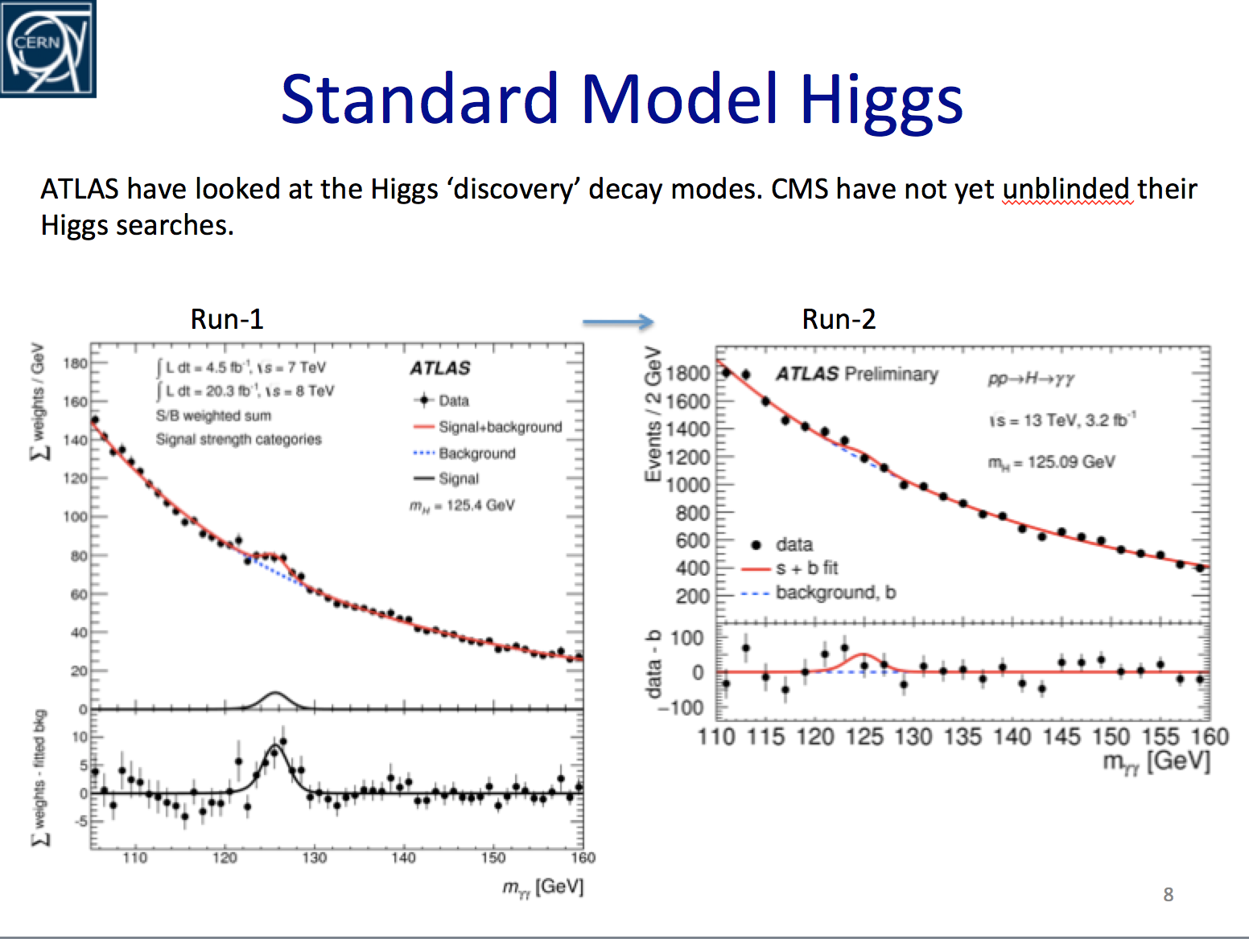
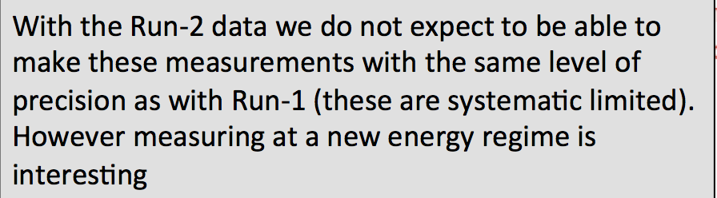
ATLAS / CMS First Run-2 Results – J. Boyd

Slide 16
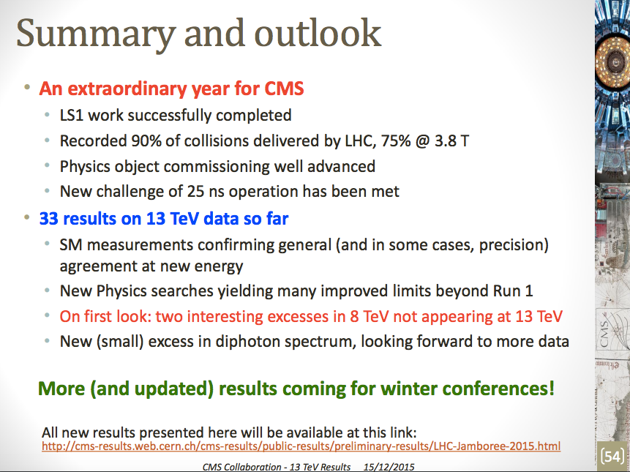
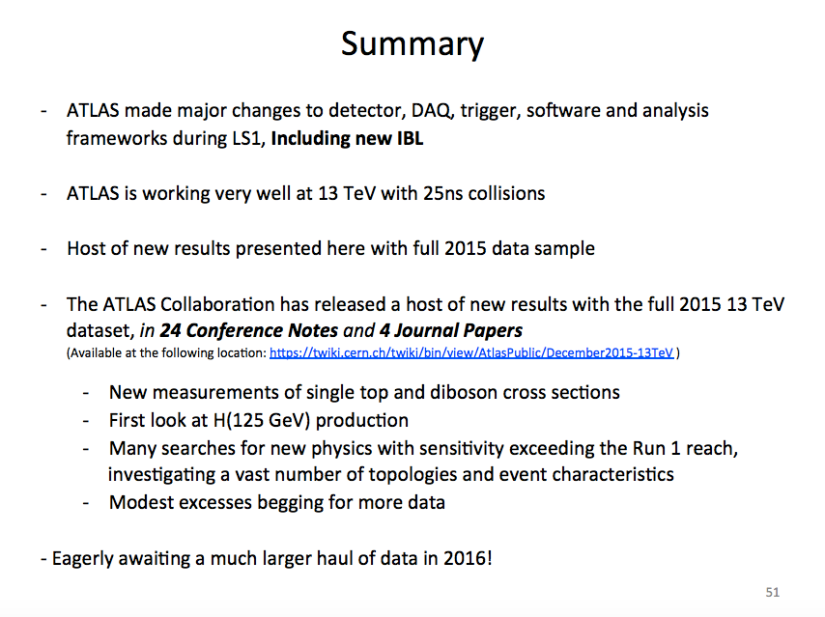
“New (small) excess in diphoton spectrum, looking forward to more data”
“Modest excess begging for more data”

