Slide 2

CLIQ-based protection of the D1-D2 chain
Alejandro Fernandez, Emmanuele Ravaioli (LBNL), Bernhard Auchmann
TE-MPE-PE
14.01.2016
CLIQ-based protection of the D1-D2 chain
A. Fernandez

Slide 3
Outline
HL-LHC insertion region and D1/D2 characteristics
CLIQ-based protection system design criteria
CLIQ description and operating principle
Simulation results for the independent magnet circuits
Failure scenarios and results for the D1-D2 chain
Results for the CLIQ system: 2 CLIQ units at 750 V / 60 mF
Study of the impact of CLIQ oscillations on a magnet chain
Comparison of the QH protection to CLIQ for the 2 m long D1 model
Ongoing studies
Conclusions
Annex
CLIQ-based protection of the D1-D2 chain
A. Fernandez

Slide 4
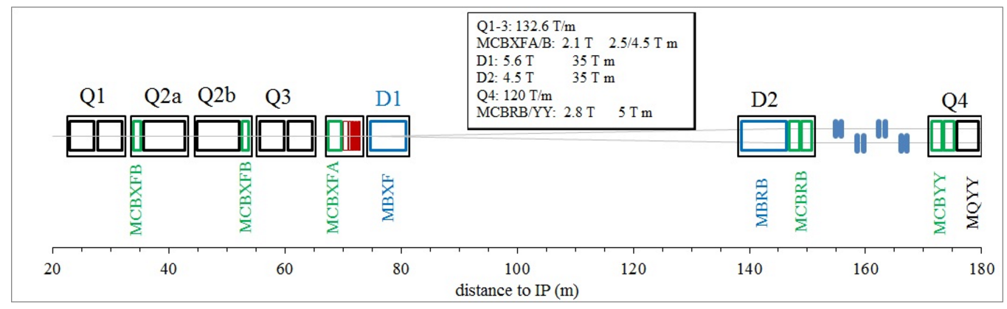
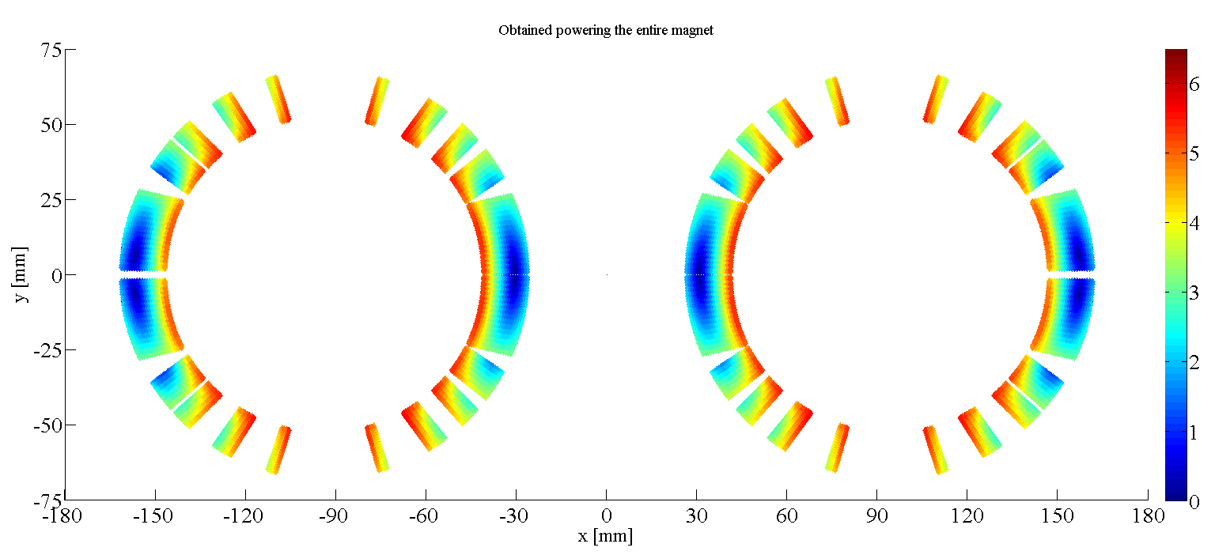
Layout of the Insertion Region of
HL-LHC
Separation Dipole
Recombination Dipole
CLIQ-based protection of the D1-D2 chain
A. Fernandez

Slide 5
D1 and D2 characteristics
CLIQ-based protection of the D1-D2 chain
A. Fernandez

Slide 6
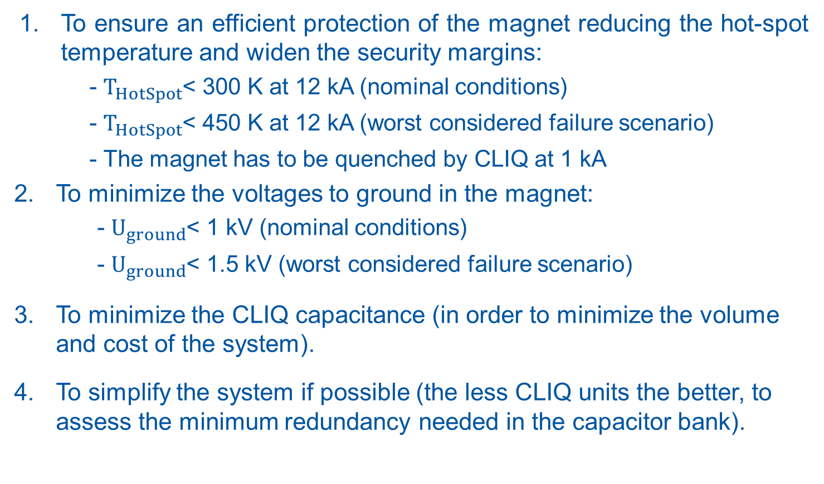
CLIQ-based protection system design criteria
To ensure an efficient protection of the magnet reducing the hot-spot temperature and widen the security margins:
- $T_{HotSpot}$< 300 K at 12 kA (nominal conditions)
- $T_{HotSpot}$< 450 K at 12 kA (worst considered failure scenario)
- The magnet has to be quenched by CLIQ at 1 kA
To minimize the voltages to ground in the magnet:
- $U_{ground}$< 1 kV (nominal conditions)
- $U_{ground}$< 1.5 kV (worst considered failure scenario)
To minimize the CLIQ capacitance (in order to minimize the volume and cost of the system).
To simplify the system if possible (the less CLIQ units the better, to assess the minimum redundancy needed in the capacitor bank).
CLIQ-based protection of the D1-D2 chain
A. Fernandez

Slide 7

CLIQ (Coupling-Loss Induced Quench)
Current change
Magnetic field change
Coupling losses (Heat)
Temperature rise
QUENCH
CLIQ-based protection of the D1-D2 chain
A. Fernandez

Slide 8
Typical magnet discharge induced by CLIQ
CLIQ-based protection of the D1-D2 chain
A. Fernandez

Slide 9
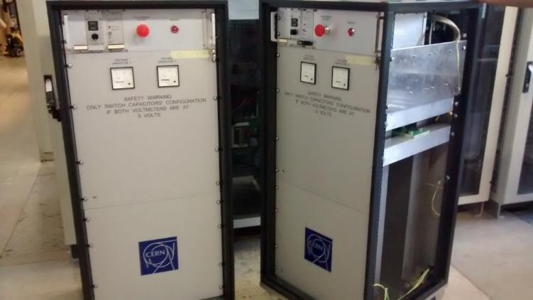
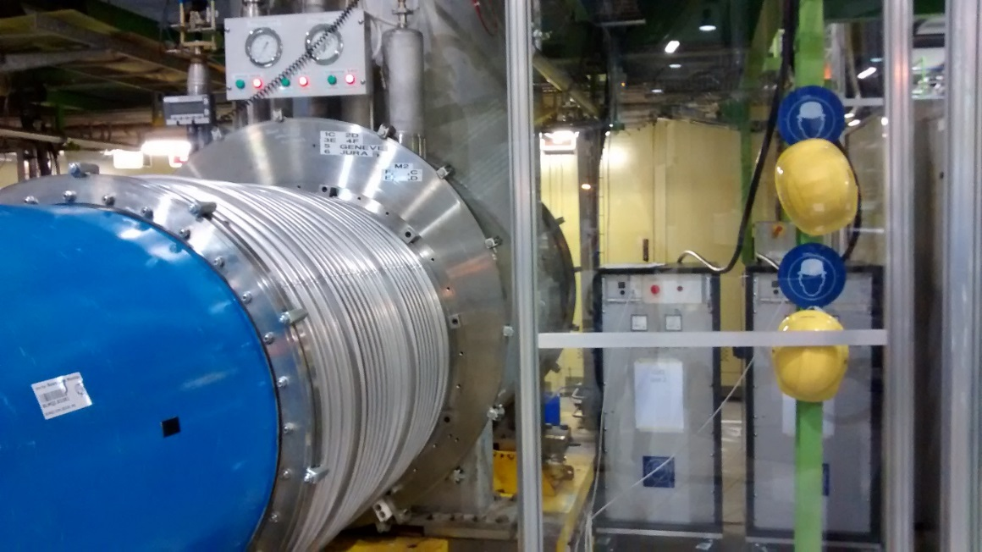
CLIQ units manufactured at CERN in 2015
CLIQ-based protection of the D1-D2 chain
A. Fernandez

Slide 10
CLIQ connection schemes: D1, D2 in independent electrical circuits
D2
1 CLIQ unit
D1
1 CLIQ unit
2 CLIQ units
CLIQ-based protection of the D1-D2 chain
A. Fernandez

Slide 11
D1 independent circuit
Simulations at 12 kA
CLIQ-based protection of the D1-D2 chain
A. Fernandez

Slide 12
D2 independent circuit
Simulations at 12 kA
At 2 kA the magnet quenches for every CLIQ configuration except in the cases 500 V, 20 mF and 600 V, 20 mF
CLIQ-based protection of the D1-D2 chain
A. Fernandez

Slide 13
CLIQ connection schemes:
D1-D2 chain circuit
2 CLIQ units
3 CLIQ units
CLIQ-based protection of the D1-D2 chain
A. Fernandez

Slide 14
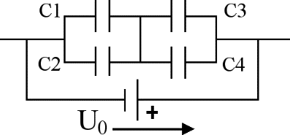
D1-D2 chain
Failure scenarios
One CLIQ unit not firing
One capacitor in a CLIQ unit in open-circuit
One capacitor in a CLIQ unit in short-circuit
One CLIQ unit triggered with a 1 ms delay
Spurious triggering of a CLIQ unit
Considered full redundancy in the capacitor bank of CLIQ
(Risk analysis in progress to assess the optimal redundancy level)
CLIQ-based protection of the D1-D2 chain
A. Fernandez

Slide 15
D1-D2 chain
Summary of the failure scenarios for several CLIQ systems
*All the hot spot temperatures are reached in D1 at maximum current, 12 kA
** The voltage to ground peaks are the same for low and high currents in most of the cases
CLIQ-based protection of the D1-D2 chain
A. Fernandez

Slide 16


D1-D2 chain. Current and coil resistance
2 CLIQ units at 750 V / 60 mF. Nominal conditions
D1
D2
$$t_{q}=9 ms$$
$$t_{q}=8 ms$$
CLIQ-based protection of the D1-D2 chain
A. Fernandez

Slide 17
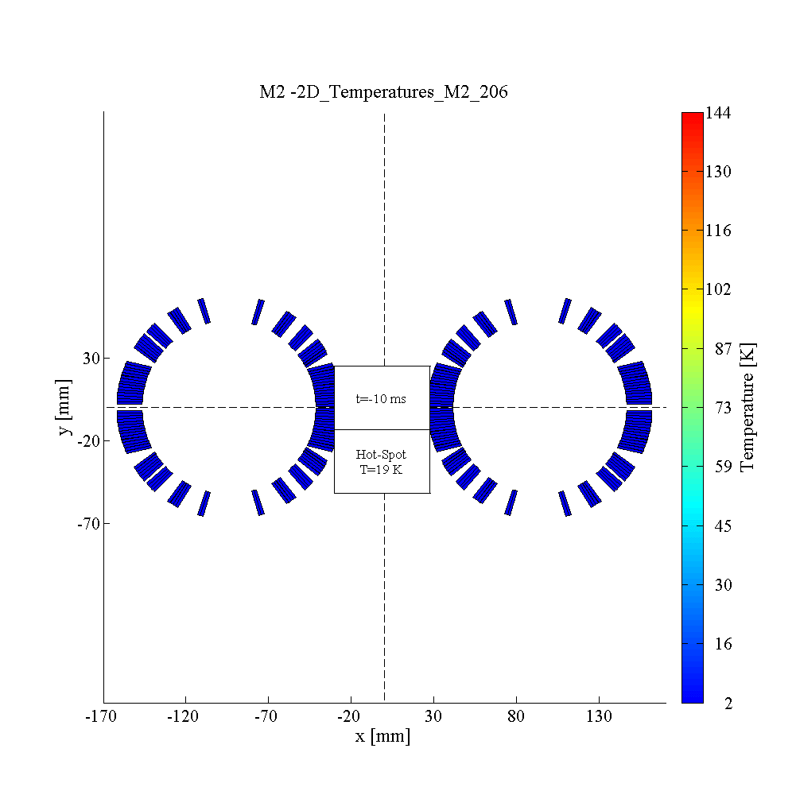
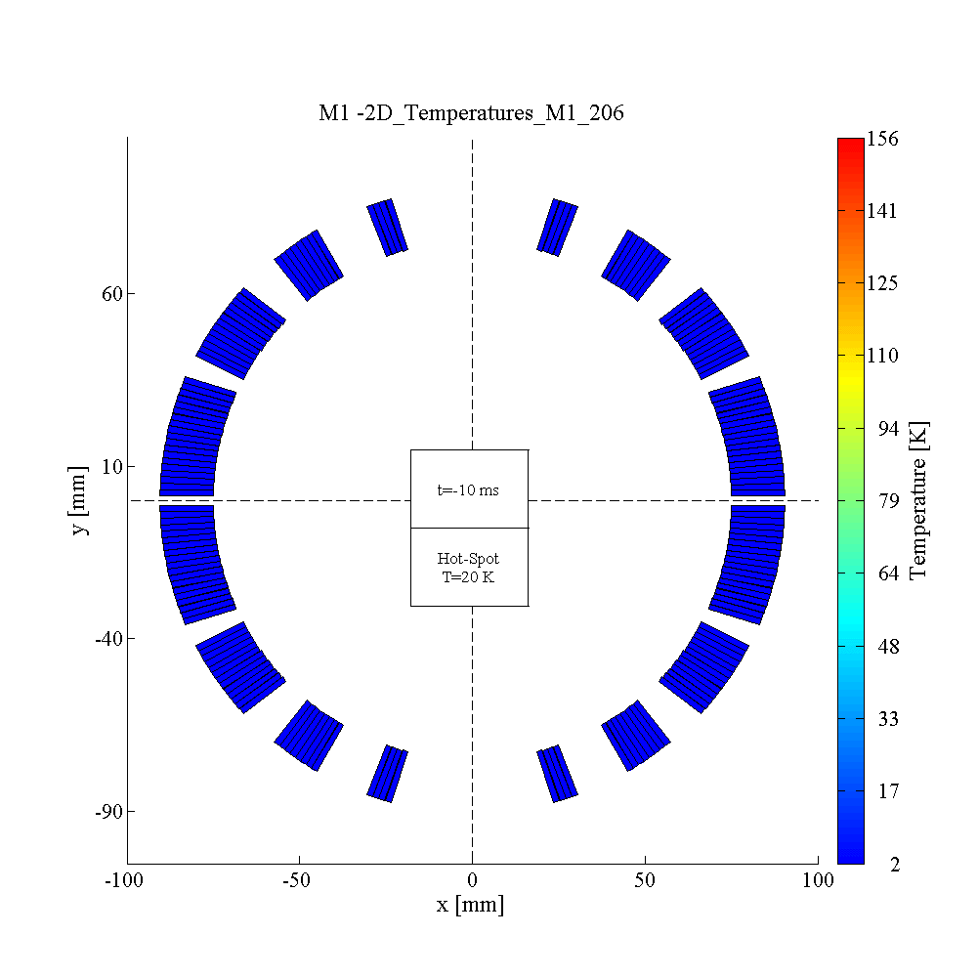
D1-D2 chain. Temperature profile (GIF)
2 CLIQ units at 750 V / 60 mF. Nominal conditions
D1
D2
CLIQ-based protection of the D1-D2 chain
A. Fernandez

Slide 18
D1-D2 chain. Voltages to ground
2 CLIQ units at 750 V / 60 mF. Nominal conditions
D1
D2
CLIQ-based protection of the D1-D2 chain
A. Fernandez

Slide 19
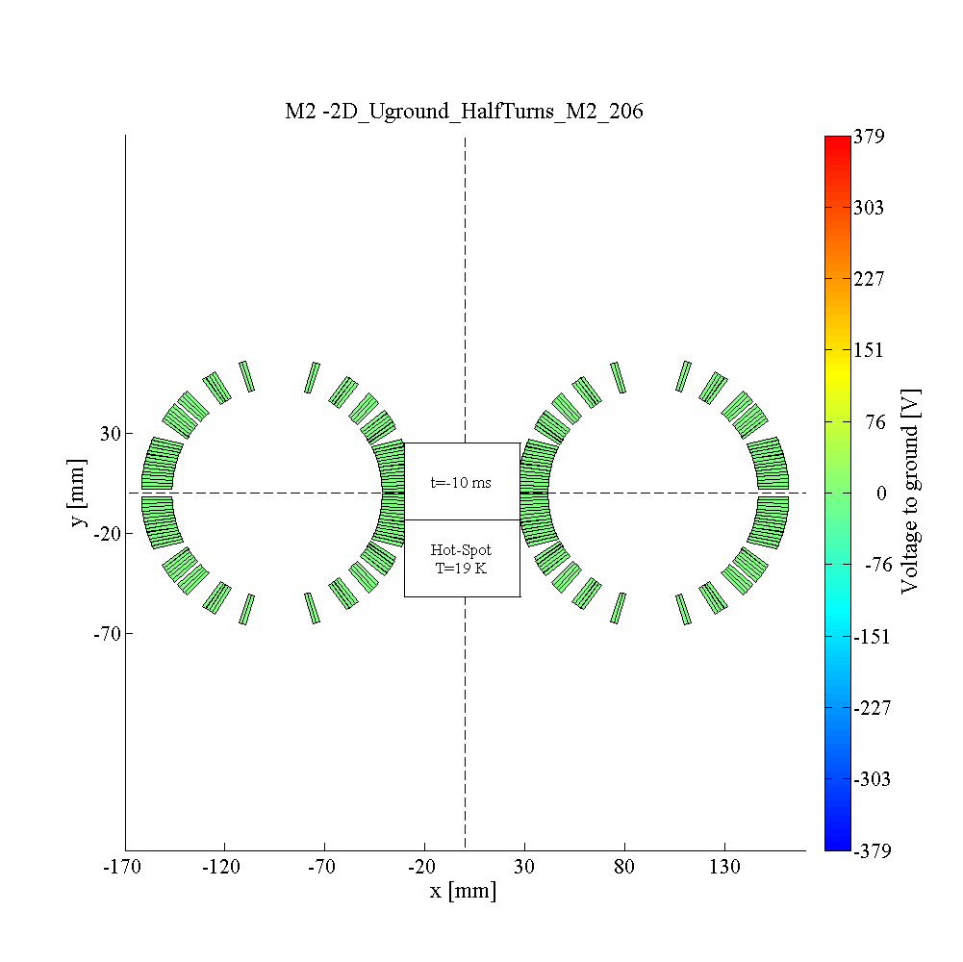
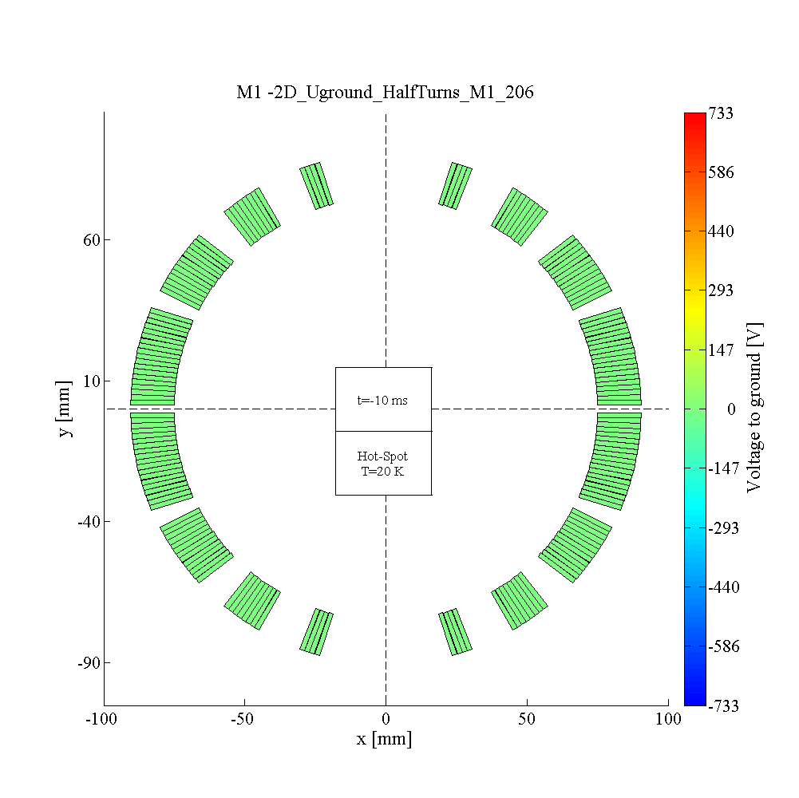
D1-D2 chain
Voltage to ground distribution (GIF)
2 CLIQ units at 750 V / 60 mF. Nominal conditions
D1
D2
CLIQ-based protection of the D1-D2 chain
A. Fernandez

Slide 20
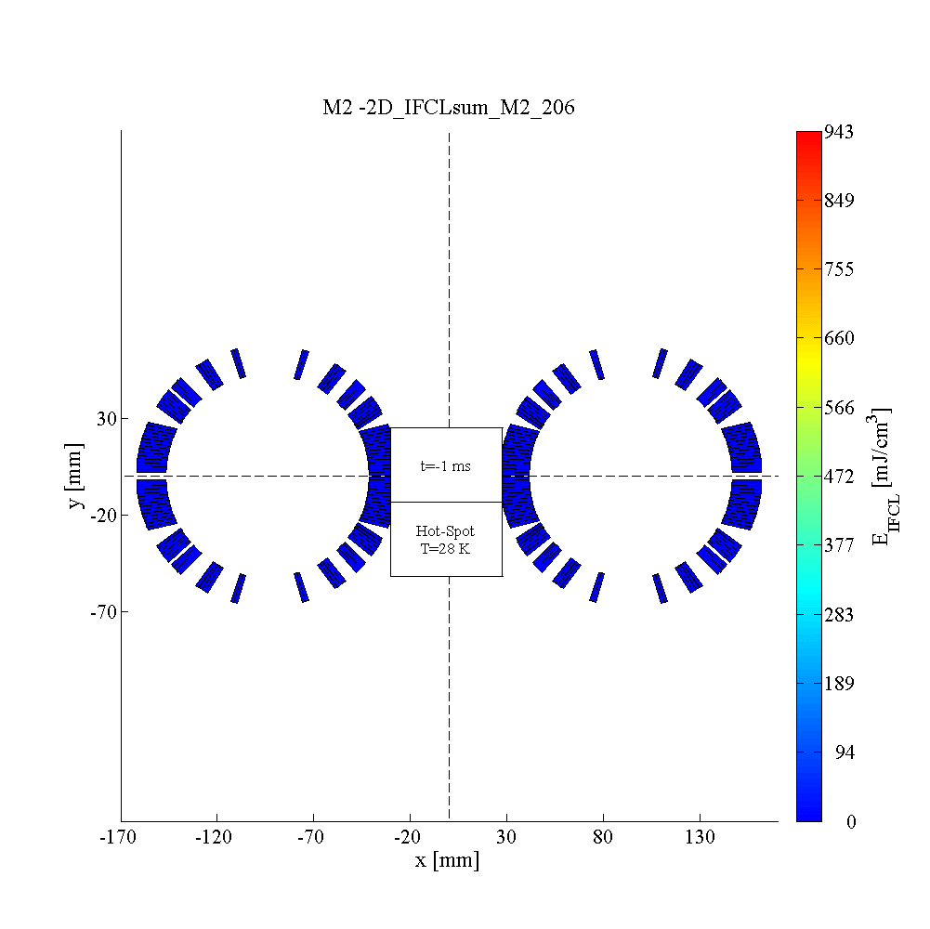

D1-D2 chain
Inter-Filament Coupling Loss distribution (GIF)
2 CLIQ units at 750 V / 60 mF. Nominal conditions
D1
D2
CLIQ-based protection of the D1-D2 chain
A. Fernandez

Slide 21

D1-D2 chain. Temperature profile (GIF)
2 CLIQ units at 750 V / 60 mF.
Worst considered failure scenario: CLIQ(D2) not triggered
D1
D2
Nominal conditions
CLIQ-based protection of the D1-D2 chain
A. Fernandez

Slide 22
D1-D2 chain. Voltages to ground
2 CLIQ units at 750 V / 60 mF. Worst considered failure scenario: CLIQ(D2) not triggered
D1
D2
CLIQ-based protection of the D1-D2 chain
A. Fernandez

Slide 23

D1-D2 chain
Study of the impact of CLIQ(D2) oscillations on D1
2 CLIQ units at 750 V / 60 mF. Failure case: CLIQ(D1) not fired
Modelled the same current discharge (but without CLIQ oscillations) by quenching every turn in D2 as if CLIQ(D2) were triggered.
$t_{q}$(oscill)= 30 ms $≪$ 160 ms=$t_{q}$(No oscill)
CLIQ-based protection of the D1-D2 chain
A. Fernandez

Slide 24


D1-D2 chain
Study of the impact of CLIQ(D2) oscillations on D1
2 CLIQ units at 750 V / 60 mF. Failure case: CLIQ(D1) not fired
With CLIQ oscillations
Without CLIQ oscillations
CLIQ-based protection of the D1-D2 chain
A. Fernandez

Slide 25

D1-D2 chain
Study of the impact of CLIQ(D1) oscillations on D2
2 CLIQ units at 750 V / 60 mF. Failure case: CLIQ(D2) not fired
Modelled the same current discharge (but without CLIQ oscillations) by quenching every turn in D1 as if CLIQ(D1) were triggered.
$t_{q}$(oscill)= 155 ms $≪$ 196 ms=$t_{q}$(No oscill)
CLIQ-based protection of the D1-D2 chain
A. Fernandez

Slide 26

D1-D2 chain
Study of the impact of CLIQ(D1) oscillations on D2
2 CLIQ units at 750 V / 60 mF. Failure case: CLIQ(D2) not fired
With CLIQ oscillations
Without CLIQ oscillations
CLIQ-based protection of the D1-D2 chain
A. Fernandez

Slide 27
QH-based protection system for the 2 m long model of D1
(QH configuration designed by Tatsushi Nakamoto)
QH Characteristics
4 heater strips in the low-field region
15 mm wide, 0.025 mm thick, 2000 mm long
Without copper plating (just at the ends for the solder joint)
Connected to 2 LHC heater power supplies of 900 V, 7.05 mF
CLIQ-based protection of the D1-D2 chain
A. Fernandez

Slide 28
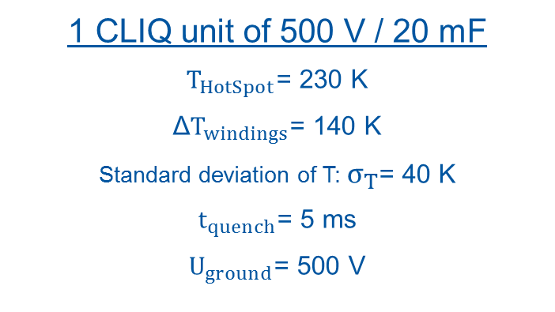
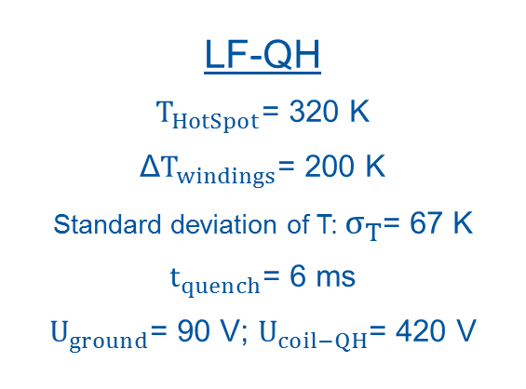
Protection of the 2 m long model of D1
QH compared to CLIQ
LF-QH
$T_{HotSpot}$= 320 K
Δ$T_{windings}$= 200 K
Standard deviation of T: $σ_{T}$= 67 K
$t_{quench}$= 6 ms
$U_{ground}$= 90 V; $U_{coil−QH}$= 420 V
1 CLIQ unit of 500 V / 20 mF
$T_{HotSpot}$= 230 K
Δ$T_{windings}$= 140 K
Standard deviation of T: $σ_{T}$= 40 K
$t_{quench}$= 5 ms
$U_{ground}$= 500 V
CLIQ-based protection of the D1-D2 chain
A. Fernandez

Slide 29


Protection of the 2 m long model of D1
Temperature profile (GIF)
QH
1 CLIQ unit of 500 V / 80 mF
CLIQ-based protection of the D1-D2 chain
A. Fernandez

Slide 30
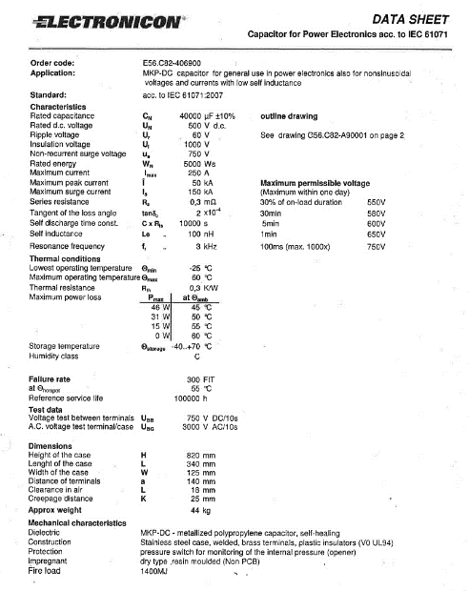
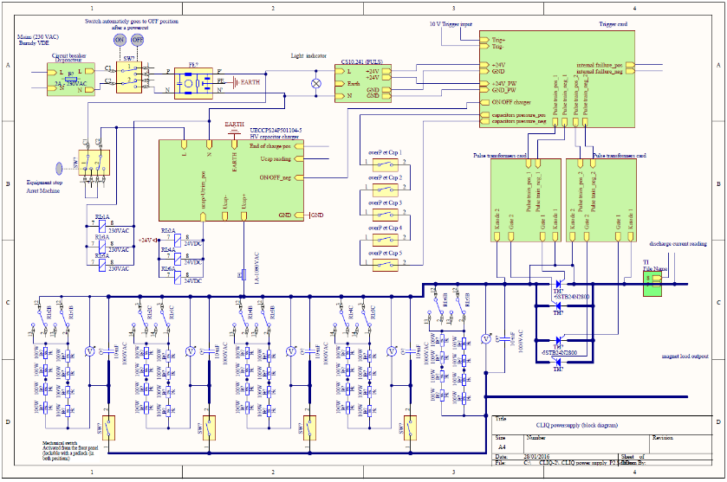
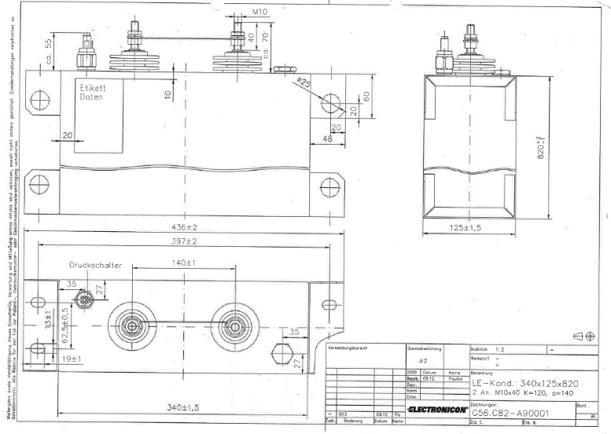
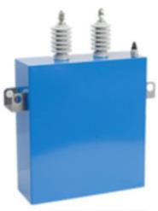
Ongoing studies
Looking for a failure-proof CLIQ system for D1-D2 by simulating nested CLIQ configurations. Studying the design of universal CLIQ units of 40 mF valid also for the 11T and MQXF magnets.
Failure Modes and Effects Analysis in progress, in order to calculate failure probabilities and to assess the optimal level of redundancy in the capacitor bank of CLIQ.
CLIQ-based protection of the D1-D2 chain
A. Fernandez

Slide 31
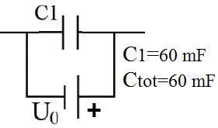
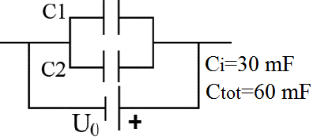
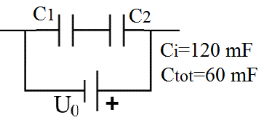
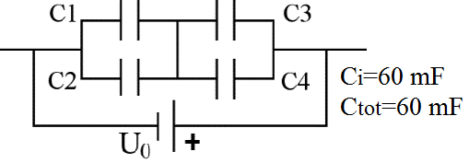
D1-D2 chain. Two CLIQ units at 750 V / 60 mF
Failure scenarios for different redundancy levels in the capacitor bank
CLIQ-based protection of the D1-D2 chain
A. Fernandez

Slide 32
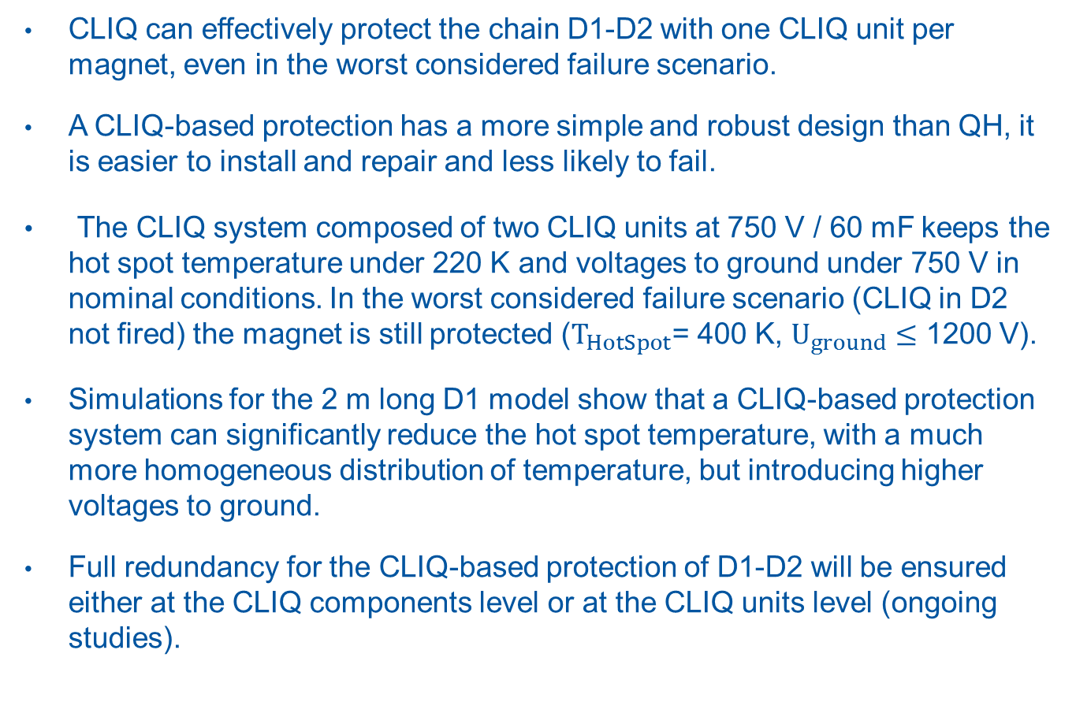
Conclusions
CLIQ can effectively protect the chain D1-D2 with one CLIQ unit per magnet, even in the worst considered failure scenario.
A CLIQ-based protection has a more simple and robust design than QH, it is easier to install and repair and less likely to fail.
The CLIQ system composed of two CLIQ units at 750 V / 60 mF keeps the hot spot temperature under 220 K and voltages to ground under 750 V in nominal conditions. In the worst considered failure scenario (CLIQ in D2 not fired) the magnet is still protected ($T_{HotSpot}$= 400 K, $U_{ground}≤$ 1200 V).
Simulations for the 2 m long D1 model show that a CLIQ-based protection system can significantly reduce the hot spot temperature, with a much more homogeneous distribution of temperature, but introducing higher voltages to ground.
Full redundancy for the CLIQ-based protection of D1-D2 will be ensured either at the CLIQ components level or at the CLIQ units level (ongoing studies).
CLIQ-based protection of the D1-D2 chain
A. Fernandez

Slide 33
Annex
CLIQ-based protection of the D1-D2 chain
A. Fernandez

Slide 34
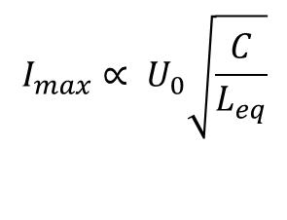

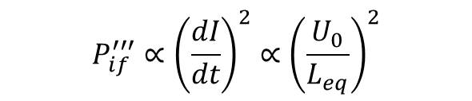
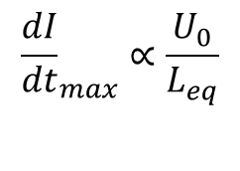
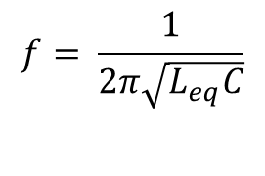
CLIQ behaviour
$$P_{if}^{′′′}∝{\left(\frac{dI}{dt}\right)}^{2}∝{\left(\frac{U_{0}}{L_{eq}}\right)}^{2}$$
$$E_{CLIQ}=N_{C} \frac{1}{2}CU_{0}^{2}$$
$$I_{max}∝ U_{0}\sqrt{\frac{C}{L_{eq}}}$$
$$f= \frac{1}{2π\sqrt{L_{eq}C}}$$
$${\frac{dI}{dt}}_{max}∝\frac{U_{0}}{L_{eq}}$$
CLIQ-based protection of the D1-D2 chain
A. Fernandez

Slide 35
D1-D2 chain
Single capacitor case. Short-circuit in CLIQ(D1)
2 CLIQ units at 750 V / 60 mF
CLIQ-based protection of the D1-D2 chain
A. Fernandez

