Slide 2
First results & Projects
M. Valette

Slide 3
Three main projects
HL LHC Machine Protection
  Crab Cavities Failure
  Other Magnets Failure (D1, D2, Triplet)
  Setup for detection of ultrafast losses in IP7
LHC Machine protection
  Follow up on high energy dumps and MP systems functionnement
  Study losses during dump (patterns, abort gap population dyanmics, …)
Implementation of Diamond Detectors in IP 6 & 7 into CCC automated applictions

Slide 4
Hi Lumi LHC Machine Protection
Study the effect of Crab Cavities Failure
  CCFM meetings every other week

Slide 5
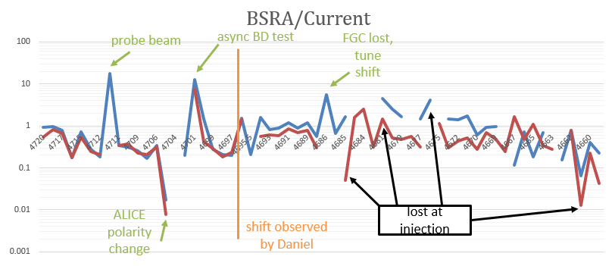
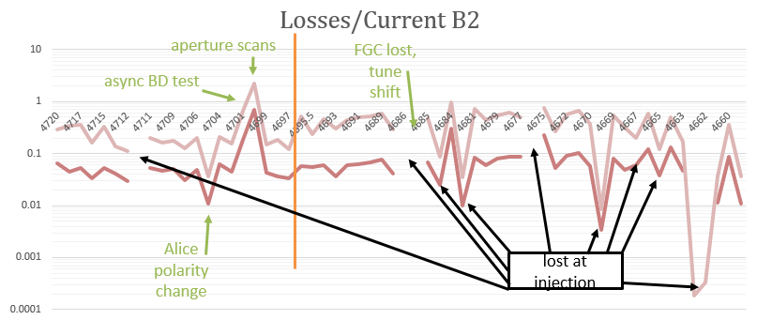
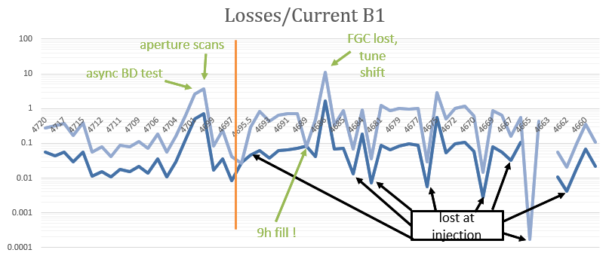
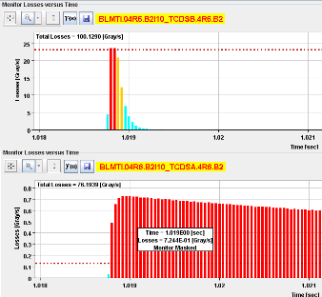
LHC operation
Follow up on high energy dump using PostMortem
  As a training analysis of the 2015 Pb run
Soon:
  B channel BLM data
  Automatic PostMortem Data retrieval

Slide 6
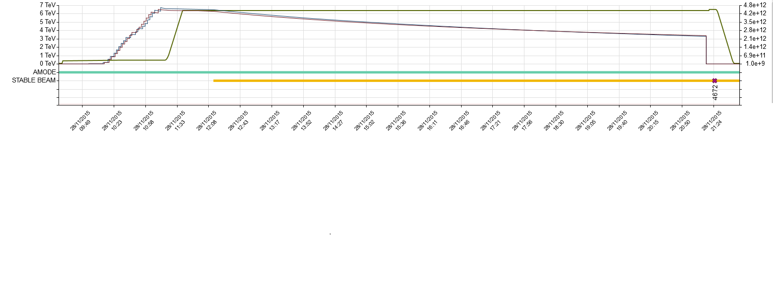
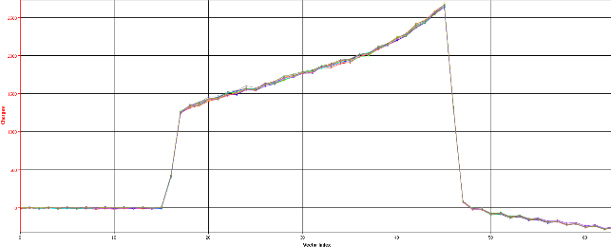
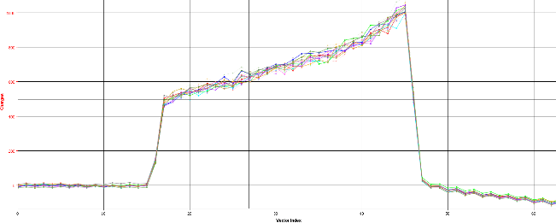
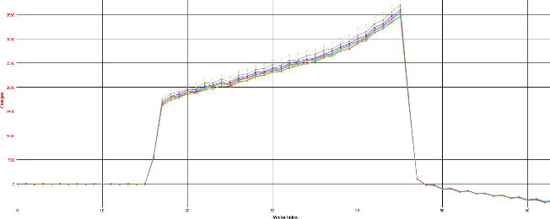
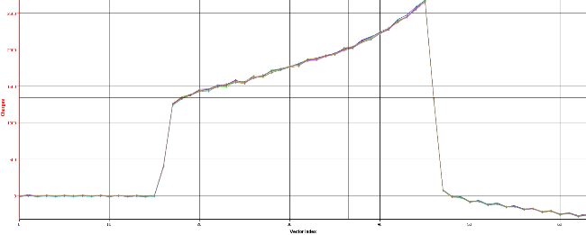
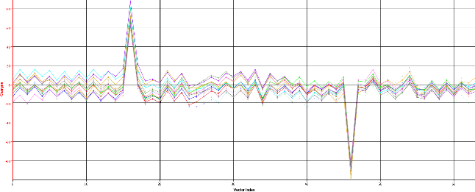
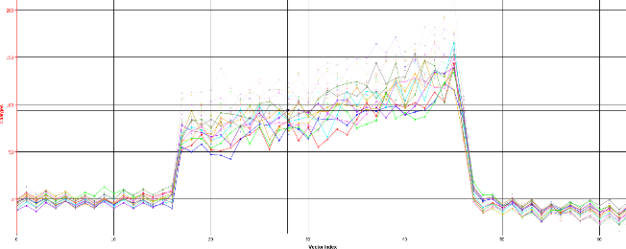
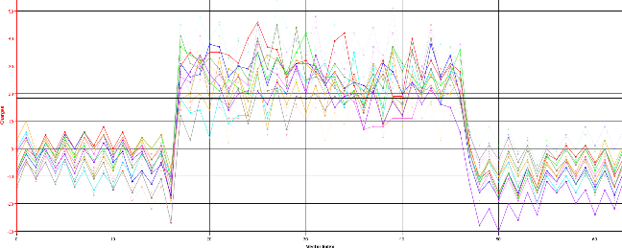
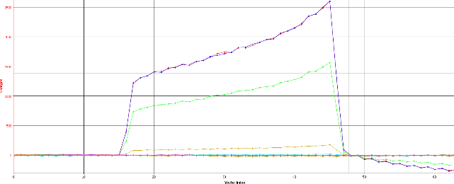
LHC operation
Abort gap population dynamics
  Using Timber Data from Fill 4671

Slide 7
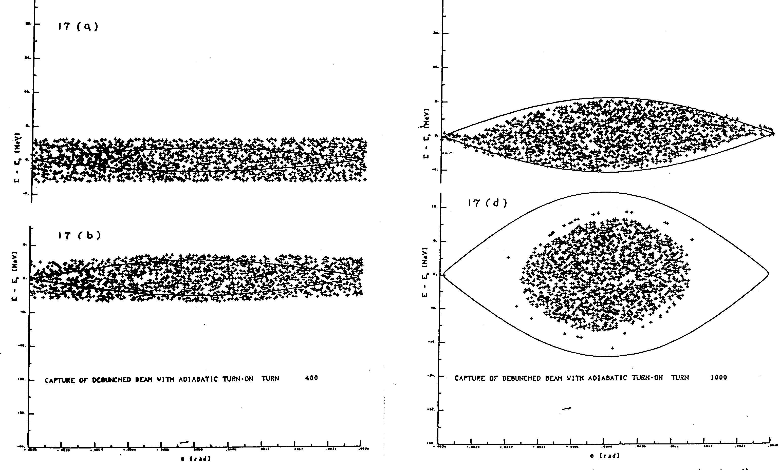
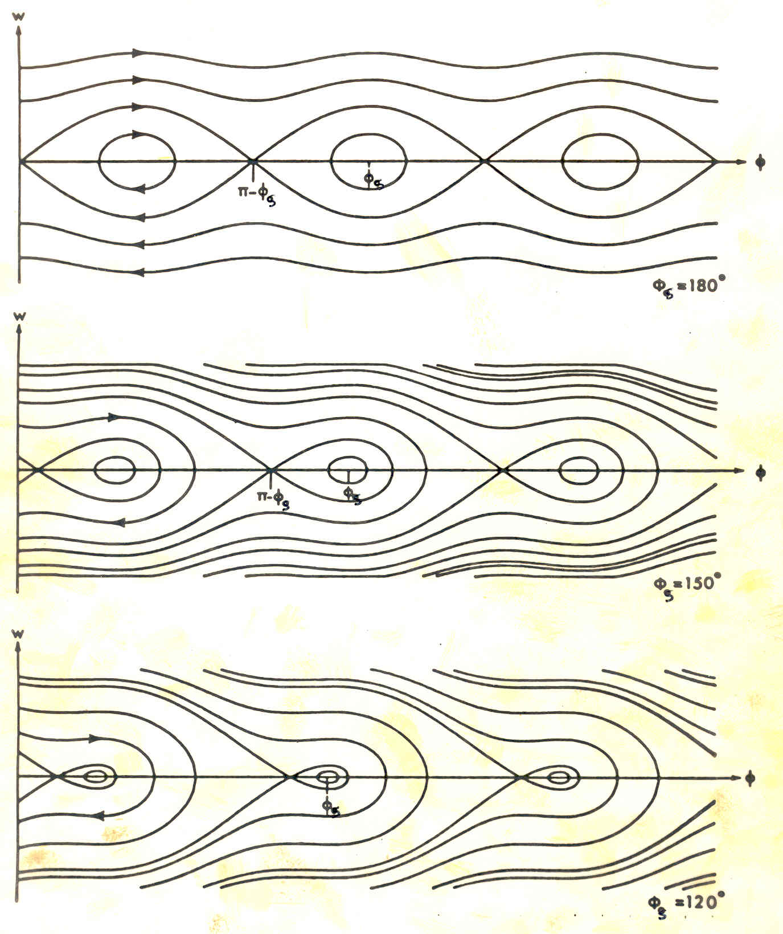
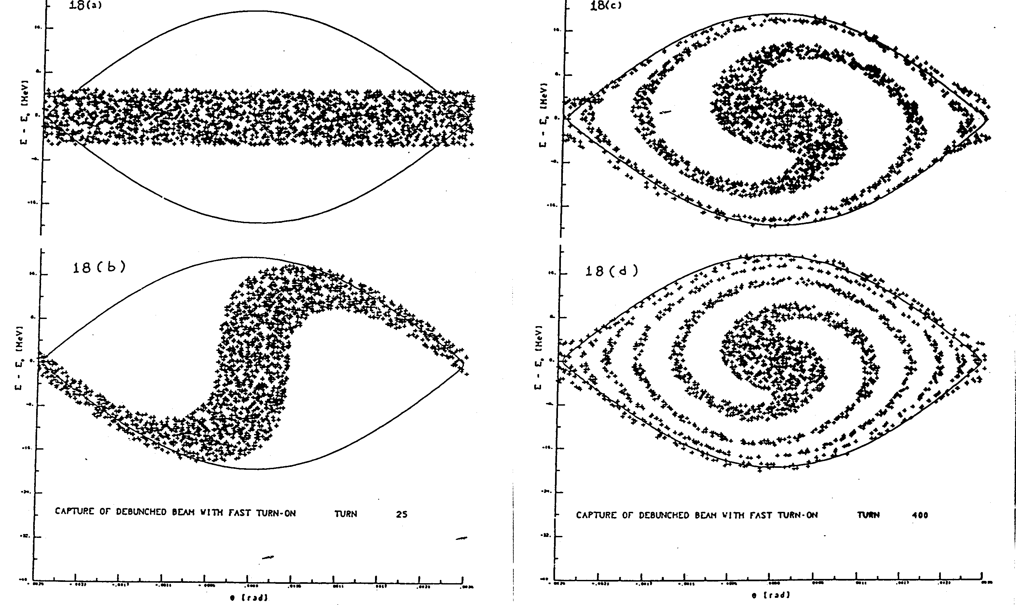
Longitudinal Dynamics

Slide 8
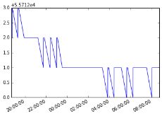
Diamond detectors
Implementation in Control Room Application
Diamonds in IP4 (RF)
  2 per beam around beam-gas interaction chamber
  Abort gap population measurement
  Investigation of low count rate and time spread with Oliver
Diamonds in IP7 (Halo Collimation)
  Next to the primary collimators
  Fast UFO buster ?
Diamonds in IP6 (Dump)
  Next to the TCDQ
  IC BLM supposedly saturated during an asynchronous beam dump
  Precise measurements of particles and energy deposition with diamond detectors to assess damage

Slide 9
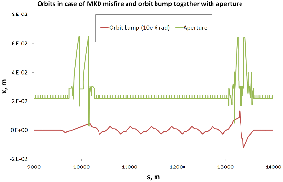
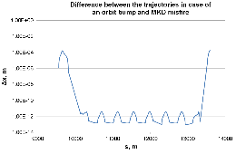
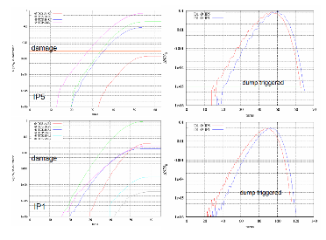
Experiments & MDs
Calibration of diamond particle detectors in IP6 (MD1182)
  Asynchronous beam dump test with controlled abort gap population
  Study Abort Gap population dynamics
New method for validation of aperture margins in the LHC triplet (MD1179)
  ~90 deg phase advance between IP6->1 and IP6->8
  Simulate a MKD misfire with closed orbit bump with increasing amplitude (follow up on Vera’s studies)
  Open collimation system
  Move in the collimators to
  verify aperture margins
Measure effect of D1 powering failure on the beam
(MD1184)
  Move in the collimators to verify aperture margins

Slide 10
Others
Machine Protection Pannel secretary
  Taking the Minutes and broadcast them
  Updatinging the MPP website
Supervise a Technical student supporting one of the topics => PhD student ?

