Slide 1
Brief summary of the 2016 LHC performance workshop
(aka Chamonix)
Andrea, Arjan, Bernhard, Daniel
Indico 448109 for all presentations
Summing up session on 3/3/2016 PM in Main Auditorium

Slide 2
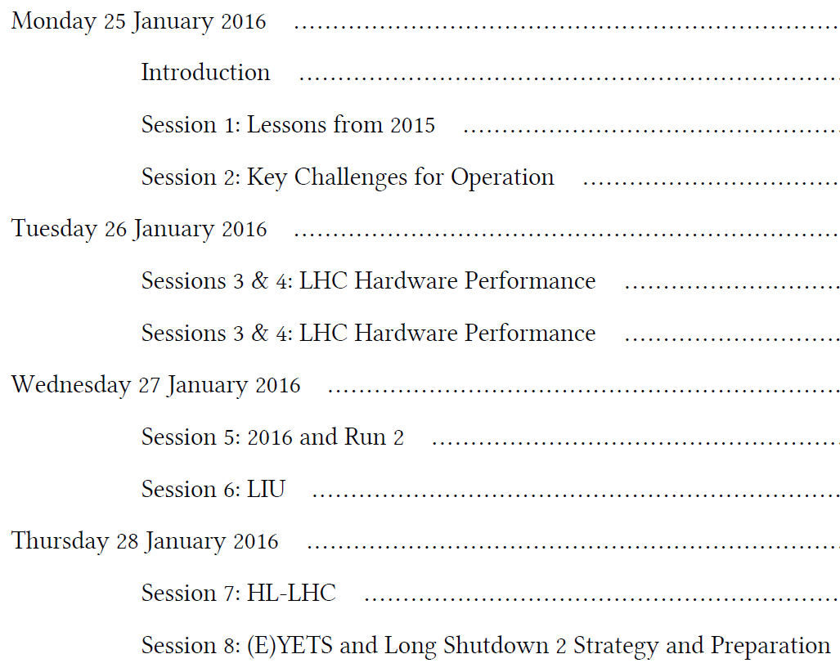

Slide 3
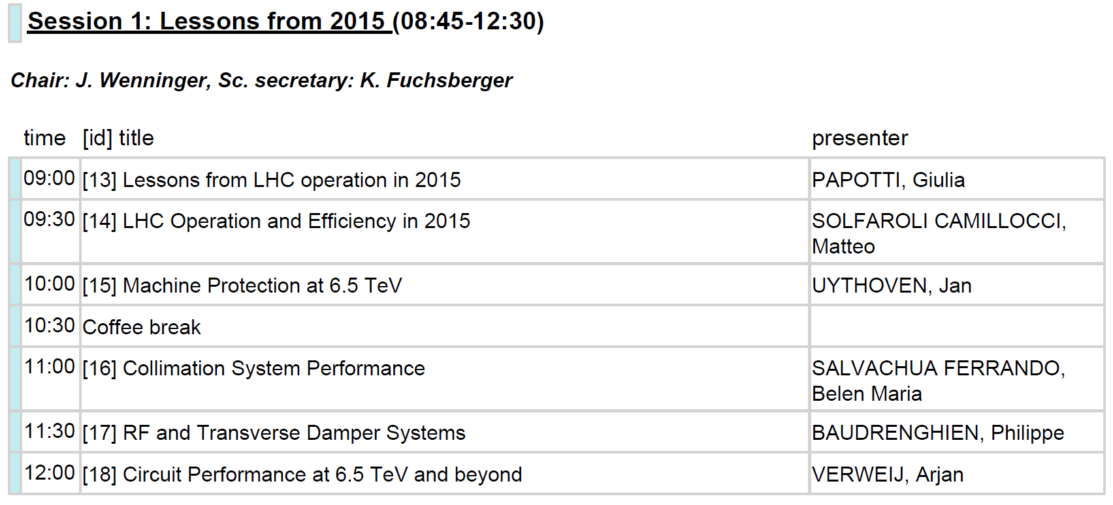

Slide 4
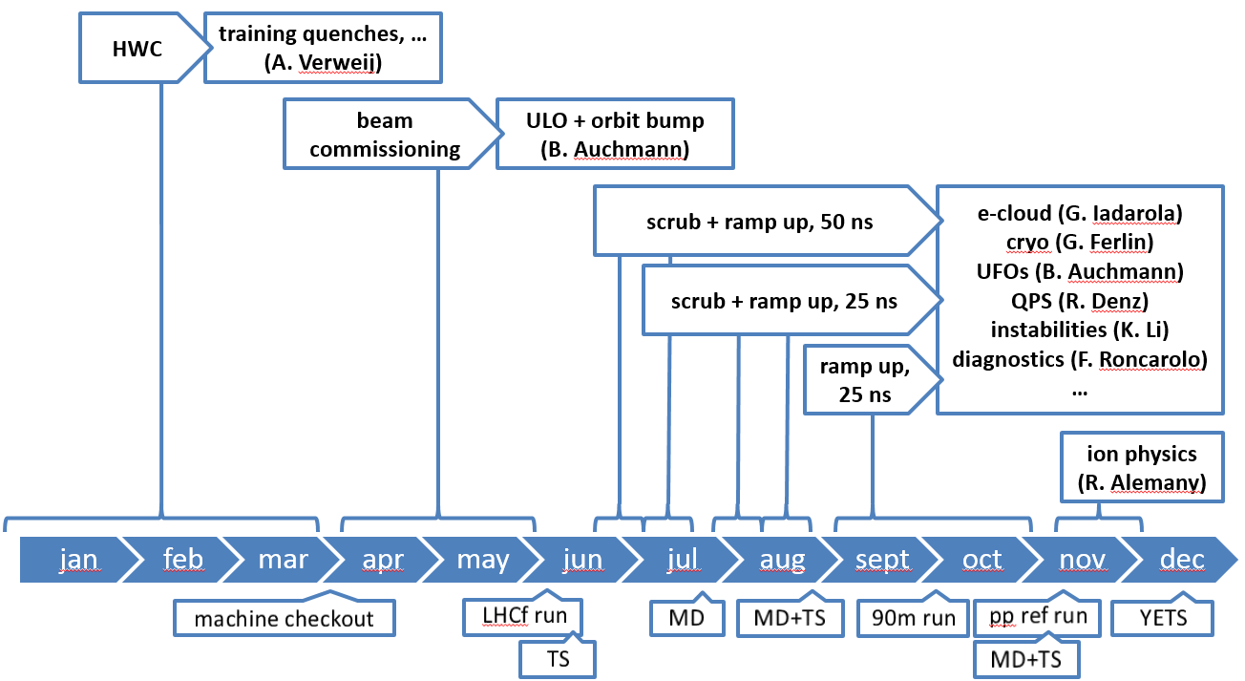
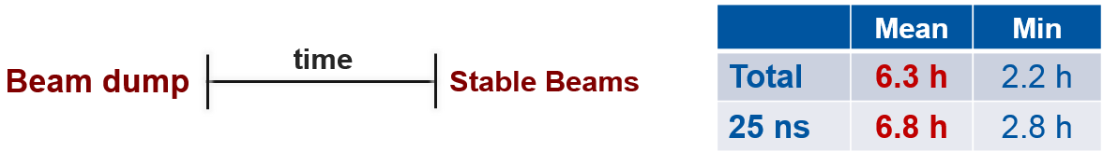
Giulia Papotti: Lessons from LHC operation in 2015
6.5 TeV, 25 ns, 2244 bunches in physics, 80 cm β*
abundant e-cloud and heat-load for cryo (2016!)
much improvement gained in the understanding
excellent performance from all systems
excellent luminosity lifetime
Matteo Solfaroli C.: LHC operation and efficiency in 2015
Review the injection process - large gain (optimum: 37 min, actually spent: 90 min)
Strategy for SB declaration - (~8 hours)
Use Combined Ramp & Squeeze as baseline for 2016 – (up to 33 hours)
Review precycle strategy - (~5 days)

Slide 5
Jan Uythoven: Machine protection at 6.5 TeV
  AccTesting is the way forward.
  Points which need constant attention and surveillance: QPS, interlocked BPMs, asynchronous dumps, new TDI, changes of BLM thresholds
  Improve our safety net
  Beam Current Change Monitor to be put in operation
  CIBDS full automatic check after each dump
  Check again full procedures in case of a non-working dump
  In 2016 we will have an increased safety risk:
  Most likely smaller beta*
  Less aperture margin and less margin in collimator hierarchy
  Beam-Beam and other instabilities can kick in again
Belen Salvachua F.: Collimation system performance
  System in good shape for Run 2 after important changes in LS1
  Excellent performance: good cleaning/stability and availability (System with 2nd least contribution to LHC downtime).
  Embedded BPM collimators operational from July 2015.
  Detailed collimator orbit monitoring since TS2.

Slide 6
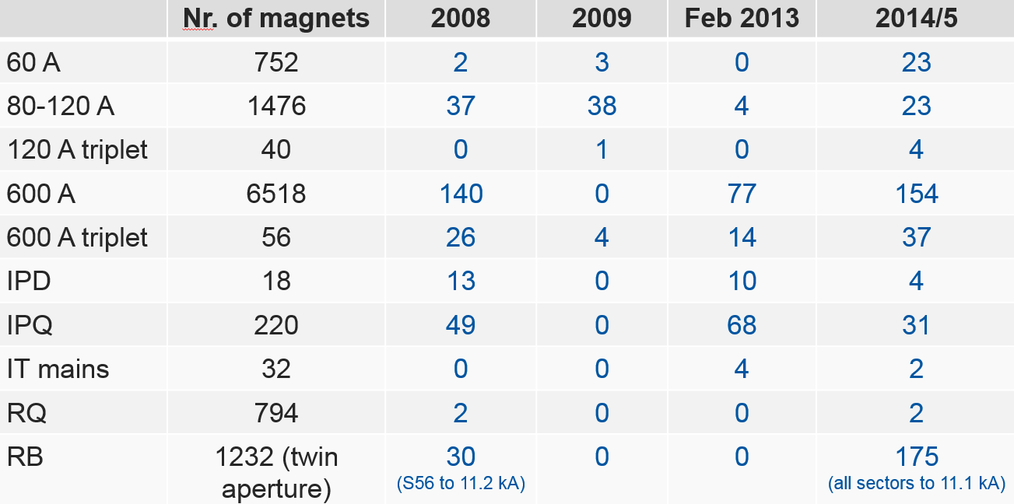
Philippe Baudrenghien: RF and Transverse Damper Systems
  Interesting fact: In physics, 2 MW RF power for <3 kW passed to the beam…. But no fundamental need for power, besides compensation for the synchrotron radiation.
  For the rest: see the slides on indico if you are interested in RF.
Arjan Verweij: Magnet circuit performance at 6.5 TeV… and beyond
Training quenches during various HWC campaigns:
Significant training in many circuits after LS1.
Some circuits seem to degrade…
MQM magnets working at 4.5 K seem to quench much more than those working at 1.9 K (although forces are much smaller)…
No showstopper to go to 7 TeV. However, training the main dipoles is expected to be a long exercise: 3-4 weeks with about 400 quenches.
To improve this estimate, 1 or 2 sectors might be trained before the next EYETS.

Slide 7
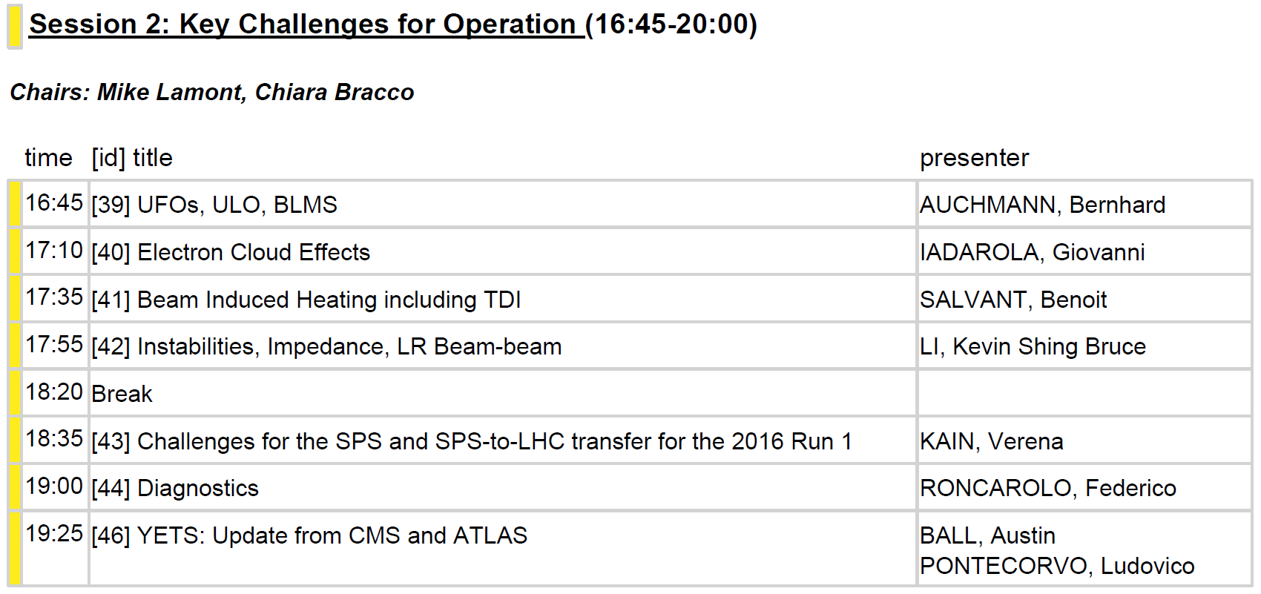

Slide 8
Session II: Key Challenges for Operation
UFO, ULO
  The ULO was not removed in YETS. It changes shape vertically on occasion. The orbit bump can be increased x2 before reaching an aperture limitation.
  Experience of the last months shows that UFO rates are low enough to make magnet-quenches a rare event. In this light, the best BLM-threshold strategy is to avoid dumping on UFOs.
  We have learned more about the ms-time-range quench levels (about where we expected them after 2013 quench test, i.e., 4x above QP3 model), as well as steady-state quench levels (3x lower than one-sided cooling observed in 10-stack experiment).
e-Cloud
  Initial scrubbing at 450 GeV is very effective. After that, evolution is slow, i.e., scrubbing is best done parasitically to physics runs, with heat-load defining the max. possible intensity.
  After YETS only a few “re-fresh” scrubbing fills, then continued intensity ram—up. When secondary-emission yield is sufficiently low, one could try scrubbing with doublet-beams (currently they are so effective that beam gets immediately unstable).

Slide 9
Session II: Key Challenges for Operation
Beam-Induced Heating
  No limitations are expected after the replacement of the TDI8.
  Bunch lengthening might be necessary for stability and heating reasons.
Instabilities
  Sources of coherent bunch motion: e-Cloud, impedances, beam-beam.
  Feedback systems (to attenuate coherent motion) and introduction of incoherent tune-spread can mitigate instabilities.
  Diagnostics tools are steadily improving and overall no limitations are expected once e-cloud effects are low enough.
Challenges for SPS and SPS-to-LHC transfer
  Transmission (ratio of intensity injected/extracted to/from the SPS) decreases with bunch intensity (values in 2015 range between 88% and 96%.
  Bunch intensity and emittance are both limited and cannot evolve by much in 2016. Better diagnostic tools will improve the situation on the long term.
Diagnostics
  Too many systems to provide a meaningful overview here!

Slide 10
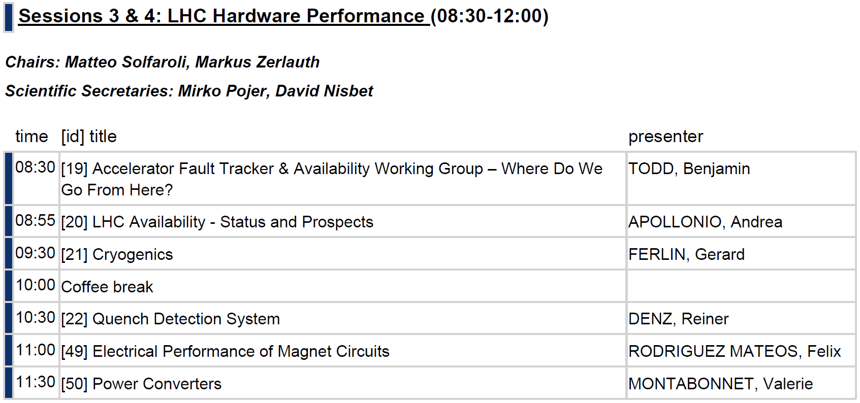
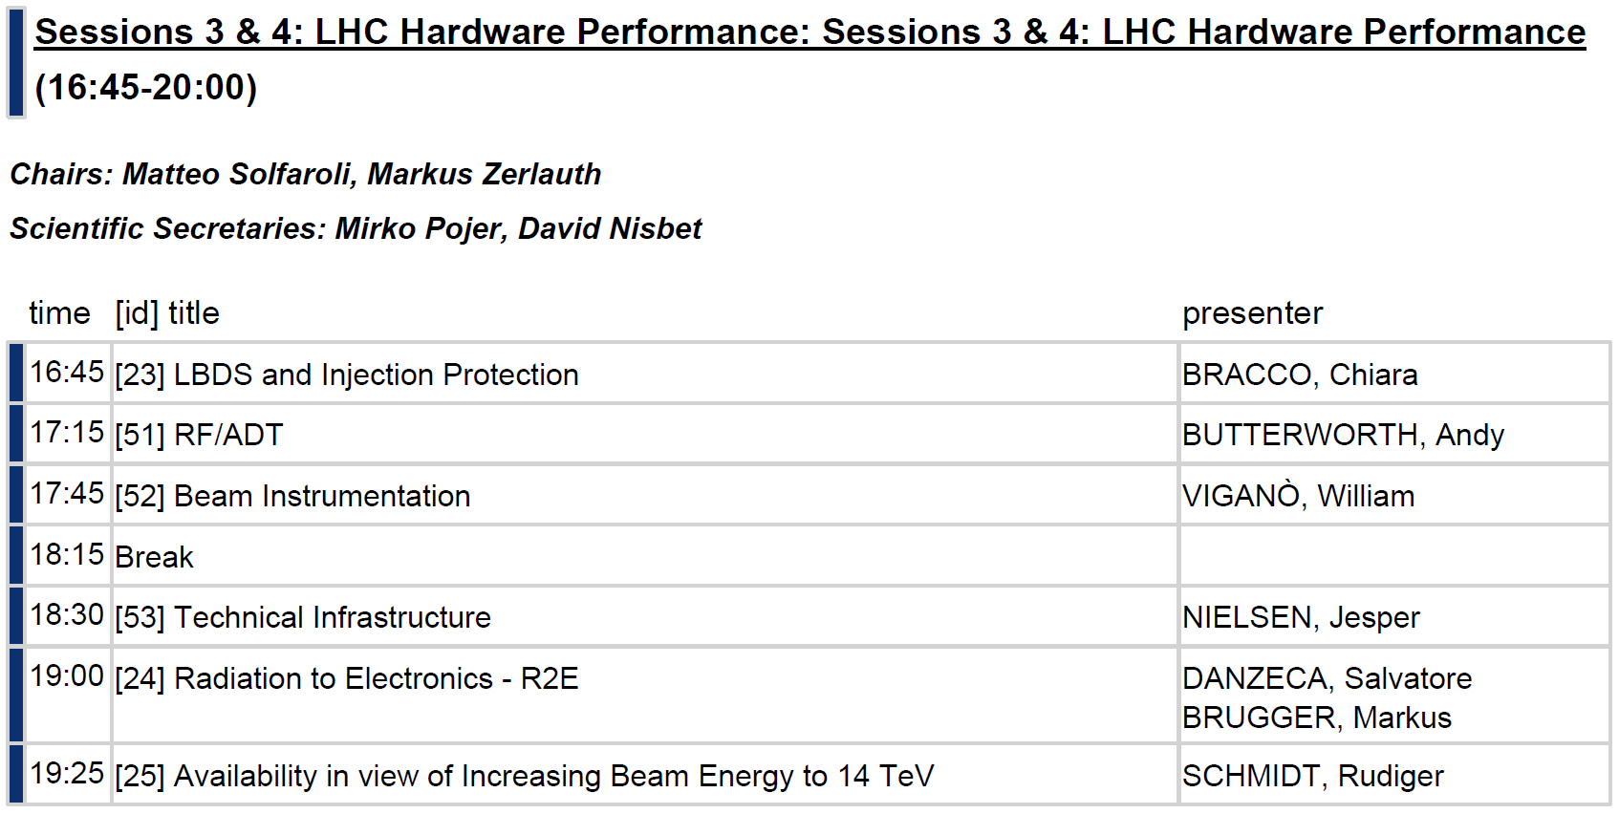

Slide 11
Summary Session 3
AFT & AWG (B. Todd):
  AFT operational in 2015 → consolidated capture of availability data
  Future, 2 directions:
    Extension of AFT to capture equipment data (up to AMMS)
    Extension of AFT to injectors
    A lot of feedback and interest → a lot of work in 2016!
  Enforce the role of AWG beyond development of AFT
LHC Availability – Status and Prospects (A. Apollonio)
  Good availability during 25 ns Run (70 %), Excellent during Ion Run (80 %)
  Ion Run sets a reference for the LHC hardware system performance
  Predictions for integrated lumi in 2016: ~30 fb-1
  Significant efforts required to meet HL targets
Cryogenics (G. Ferlin)
  Run2 configuration: two 4.5 K cold boxes + one 1.9 K pumping unit, lower failure rate
  Problems with BS cooling due to high heat loads in 2015, feed-forward system in 2016

Slide 12
Summary Session 3
Quench Detection System (R. Denz):
  Availability before TS2 limited by SEUs
  Very good availability after TS2, following replacement of mBS boards (98 %)
  Firmware upgrade for nQPS DAQ and rad-tol QDS for 600 A
  Expected performance in 2016: same as after TS2 in 2015, even with higher R2E
Electrical Performance of LHC Magnet Circuits (F. Rodriguez Mateos)
  Overall behaviour in good shape
  Improve understanding of earth faults (procedures + diagnostics)
  Many activities for consolidation and preventive maintenance
Power Converters (V. Montabonnet)
  LS1 activities very effective – known faults mitigated
  No reduction of availability even with higher power @6.5 TeV
  Main worry related to R2E (FGC in 2016-17 EYETS + new Power Part in LS2)

Slide 13
Summary Session 4
LBDS and Injection System (C. Bracco):
  LS1 activities effective (MKI HV, heating and UFO rate, TCDQ, etc.)
  …but non conformities observed (TDI, MKD switches)
RF and ADT (A. Butterworth)
  LS1 activities effective (HV and klystron failures mitigated)
  Beam intensity related issues with peak klystron power: condition to nominal 300kW for 2016
  Arc detector trips not understood (R2E?)
  LLRF spares start to become important
Beam Instrumentation (W. Vigano)
  Distinction safety-critical/non safety-critical systems, implication on design
  Fault categories (external, system, design and installation, human factor)
  BI faults mainly due to BLMs (biggest and most distributed system)

Slide 14
Summary Session 4
Technical Infrastructure (J. Nielsen - ?):
  LS1 activities effective → fewer major events due to electrical perturbations
  Established process to analyse major events
Radiation to Electronics – R2E (S. Danzeca)
  Around 1-2 R2E dumps/fb-1 are foreseen in 2016
  FGClite → 0.5 dumps/fb-1 (in 2017)
  Long term TID will become an issue (rotation of exposed equipment)
Availability in View of Operation at 7 TeV (R. Schmidt)
  LHC ‘young machine’ → benefit from more experience over the years
  Optimization of Run schedule
  Revise MPS strategy, optimizing for availability
  Magnet training for 7 TeV takes time, evaluate risk/benefit in the long term
  Explore new ideas (e.g. faster ramps, reduce precycles,…)
  HL game changer (FCC even more…)
  Proposal for additional working group on availability/reliability modelling

Slide 15
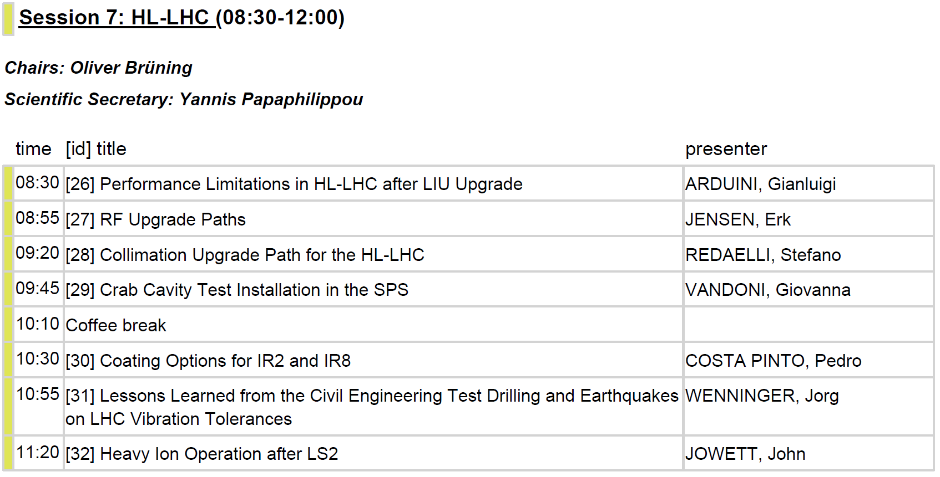

Slide 16
Performance Limitations in LHC after LIU Upgrade – G. Arduini
The availability of LIU beams during Run 3 will allow validating important design choices for HL-LHC w.r.t.:
      Electron cloud build-up
      Longitudinal and transverse beam stability
      Beam-beam parameters
Triplets in IR1 and IR5 will limit maximum luminosity (1.7e34cm⁻²s⁻¹) and maximum total intensity (provided that impedance reduction campaign starts in LS2) in collision (not at injection). Modifications of the cryo- valves are proposed (EYETS?) to mitigate the intensity limitation.
Luminosity production will profit of the higher brightness and allow exploring operation with higher brightness/intensity beams (UFO, losses, radiation..). It will require b* leveling.
Parameter | Before LIU (2016) | After LIU
Bunch population N_{b} [10¹¹] | 1.3 | 2.3
Max. number of bunches per SPS ext. | 288 | 288
Normalized emittance e_{n} [mm] | 2.7 | 2.0
e_{L} [eVs] | 0.66 | 0.66
r.m.s. bunch length [cm] | 12 | 12

Slide 17
RF upgrade paths – E. Jensen
RF baseline is valid:
ACS400: actual 400MHz acceleration cavities (8 cavities per beam) → one spare module [recovered from tunnel and reconditioned], production of second spare module ongoing → available ~2020/21
Crab Cavities
ADT (damper)
But …

Slide 18


Effect of Crab Cavity
Crab Cavity
Crab Cavity
IP
$$600 μrad$$
Crab Cavity
Crab Cavity

Slide 19
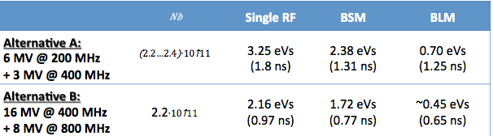
RF upgrade paths – E. Jensen
But:
  Higher beam intensities will require to go from half to full detuning to reduce beam loading power → variation of bunch arrival time +-50ps → not yet fully validated in physics run! 2016!
  Limit of single bunch stability is in reach especially for shorter bunches (<1ns), and will come closer with increasing LHC impedance (crab cavities, IT, … )
  Controlled emittance blow-up with single harmonic RF is touchy.
Therefore alternative options with harmonic systems:
A wideband (3 GHz BW) feedback seems in reach – its potential is tremendous – the study should be continued!

Slide 20
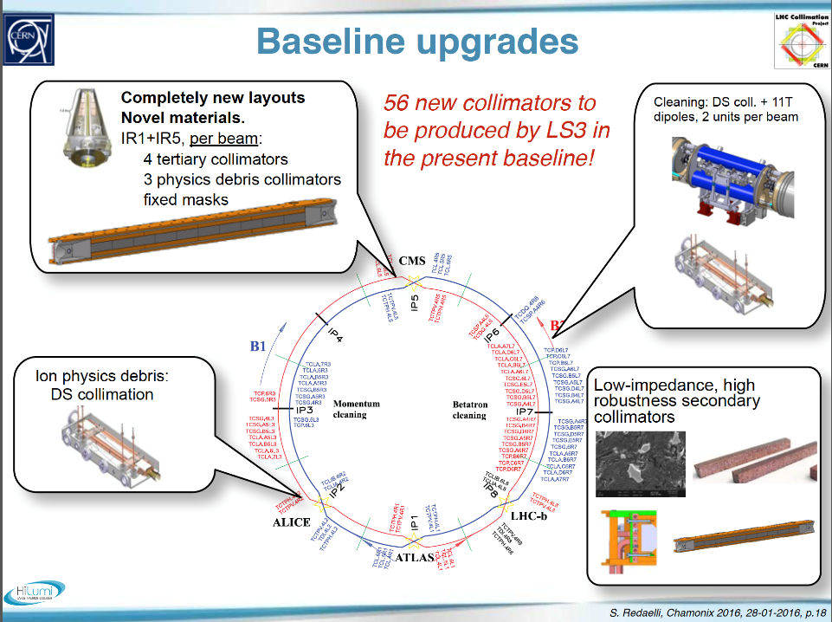
Collimation upgrade path for HL-LHC – S. Redaelli in pictures

Slide 21
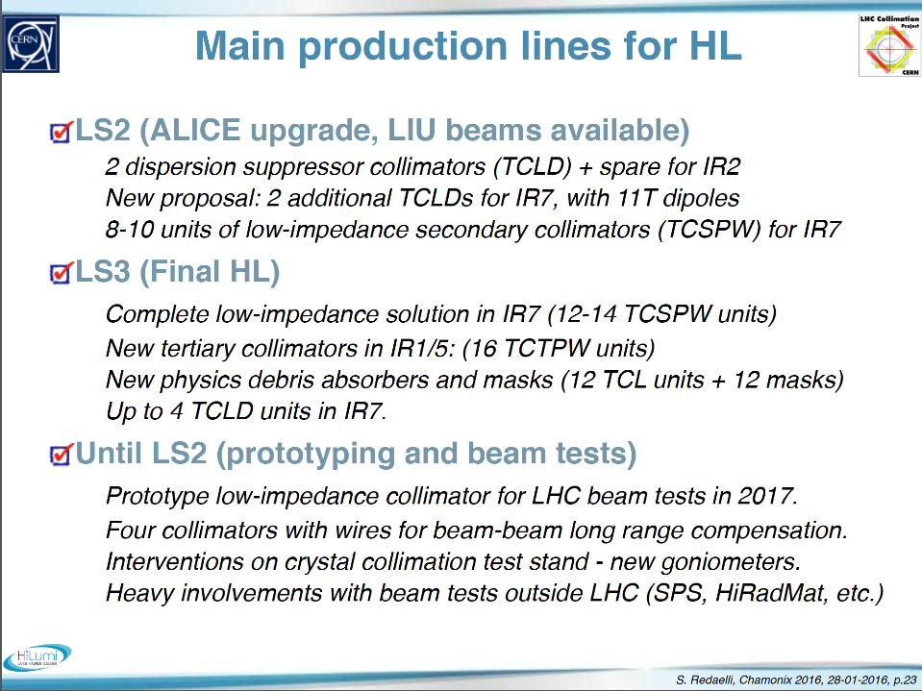
Collimation upgrade path for HL-LHC – S. Redaelli in words

Slide 22
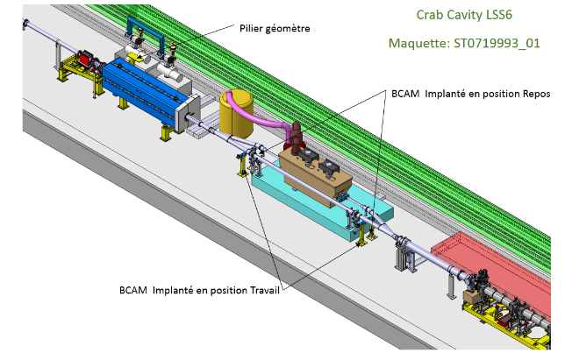
Crab cavity test installation in SPS – G. Vandoni

Slide 23
Crab cavity test installation in SPS – G. Vandoni

Slide 24
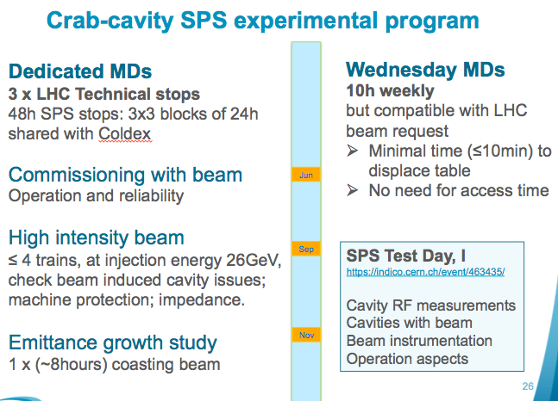
Crab cavity test installation in SPS – G. Vandoni
LHC beam extraction in LSS6
CCCM

Slide 25
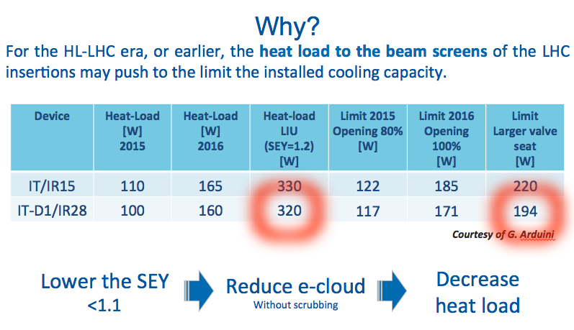
Coating options for IR2 and IR8 – P. Costa Pinto

Slide 26
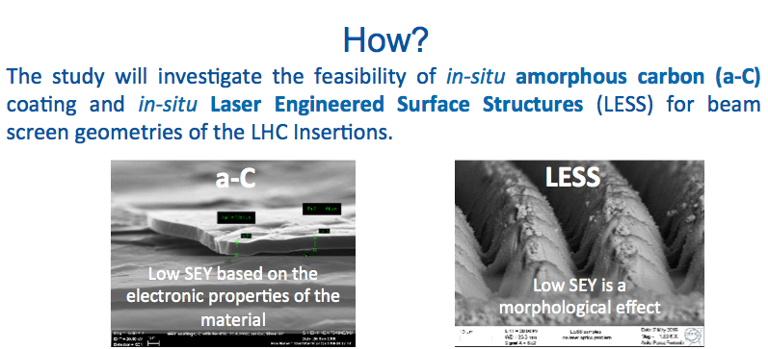
Coating options for IR2 and IR8 – P. Costa Pinto
COLDEX results are very encouraging for a-C @cryogenic temperature.
LESS is promising: very low SEY and robustness against air exposure.
Both techniques potentially applicable to LHC arcs in case of need

Slide 27
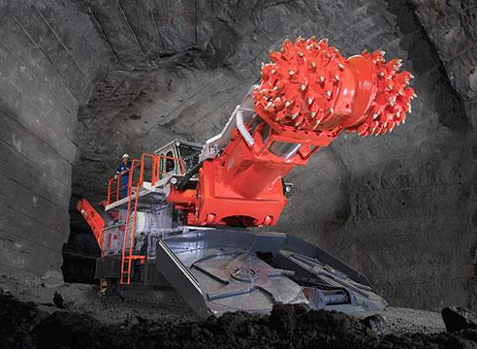
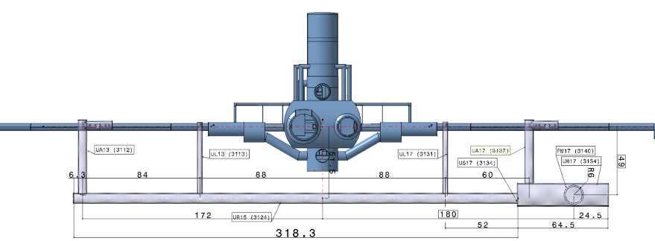

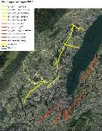
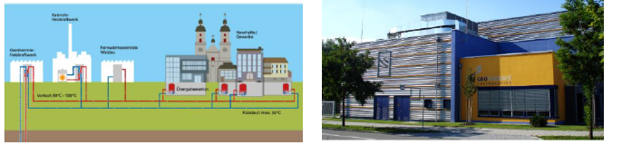
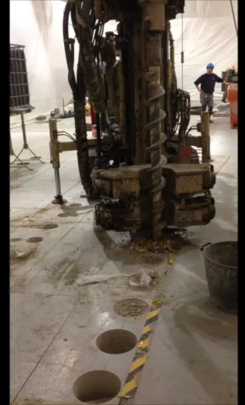
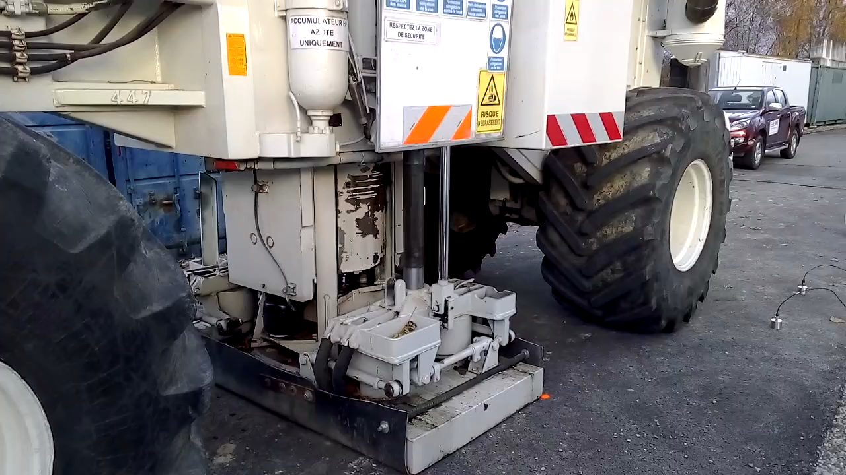

Lessons Learned from the Civil Engineering Test Drilling and Earthquakes on LHC Vibration Tolerances – J. Wenninger
Motivation:
Study effects of civil engineering & Geothermie 2020 project on LHC operation
Experiments drills, hammer, and truck

Slide 28
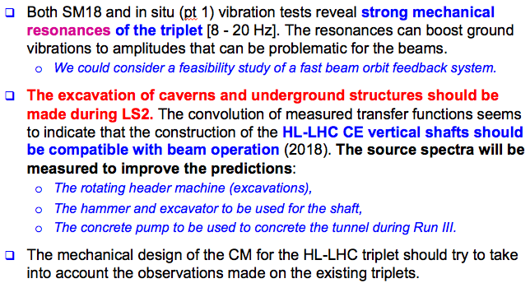
Lessons Learned from the Civil Engineering Test Drilling and Earthquakes on LHC Vibration Tolerances – J. Wenninger

Slide 29
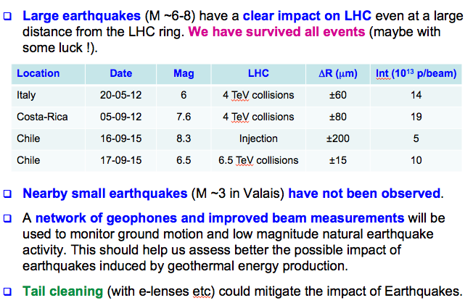
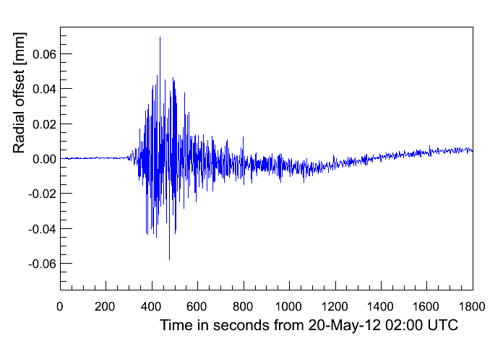
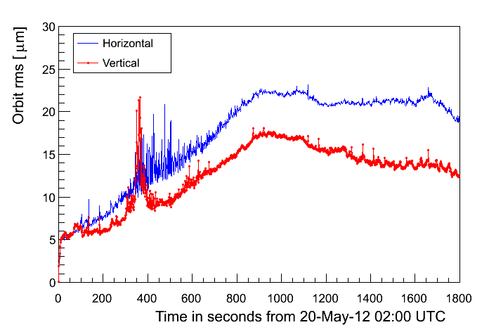
Lessons Learned from the Civil Engineering Test Drilling and Earthquakes on LHC Vibration Tolerances – J. Wenninger
Radial change
Transverse change

Slide 30
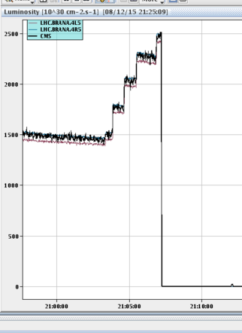
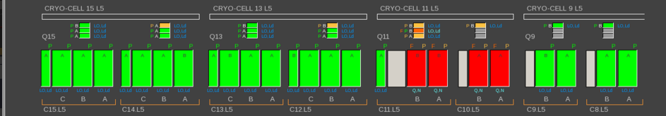
Heavy Ion Operation after LS2 - J. Jowett
We learned a lot in the Pb-Pb run at the end of 2015
  Resolved long-standing uncertainty on steady-state quench limit
  Pb-Pb operation well predicted by luminosity model
  New collimators needed in connection cryostats around ALICE, must be installed in LS2
  Very strong case for (collimators + 11 T dipoles) in IR7

