Slide 2
CERN Reliability Training
Andrea Apollonio, TE-MPE-PE
Acknowledgements: J. Gutleber, R. Schmidt

Slide 3
Scope of the Training
Raise awareness on the importance of RAMS studies in the domain of particle accelerators
Provide basics for performing reliability analyses to CERN staff members
Train 120-150 people from CERN over 4 years
2 People from IMA Stuttgart
1 from RAMENTOR

Slide 4
First Training - Test
Validate contents (quantity, complexity,...)
Tailor contents to the accelerator domain
Participants (total ~20):
CERN staff members WITH previous experience with reliability analyses
CERN staff members WITHOUT previous experience with reliability analyses
Students from IMA Stuttgart

Slide 5
Contents
Days 1-3 (29th Feb – 2nd Mar):
Introduction
Mathematical Treatment of Reliability
Determination of System Reliability
Failure Mode and Effects Analysis
Fault Tree Analysis
Evaluation of Lifetime Tests and Failure Statistics
Availability
Modeling and Simulation of Availability
Day 4 (3rd Mar):
Hands-on training with ELMAS

Slide 6
External and Internal Influences on Reliability
Reduced
development costs
Greater
complexity
Shorter
development
time
-
Greater
functionality
-
-
-
Reliability
+
+
+
Increasing
product liability
Increased
customer demands
Minimization of
fault costs

Slide 7
Power of Ten Rule:
Relationship Between Fault Costs and Product Lifetime
Fault prevention Fault detection
Opportunity for action Necessary reaction
Development
and
purchasing
Purchasing
and
manufacture
Field
use
100.00
Costs per fault
Influence on fault
10.00
0.10
1.00
Concept
phase
Design,
product development
Planning,
purchasing
Production
Product utilization
Development
Production
Field

Slide 8
Reliability Methods in the Product Life Cycle
Quality
Management
- Audits
- ....
Field Data
Collection
Early
Warning
- ....
- Recycling
Potential
- ....
- ABC-Analysis
- Design Review
- FMEA
- FTA
- ....
Qualitative
- Know-How
- ...
Specifi-
cations
time
Planning
Conception
Layout
Design
Production
Field
Usage
Recycling
Reliability
Goal
Fuzzy Data
Calculation
- Weibull-Distr., exponential...
- Testplanning
- Boolean Theory
- Markov Model
- ....
- Statistical
Process
Planning
- ...
Field Data Analysis
- ......
- Remaining Lifetime
- ....
Quantitative

Slide 9
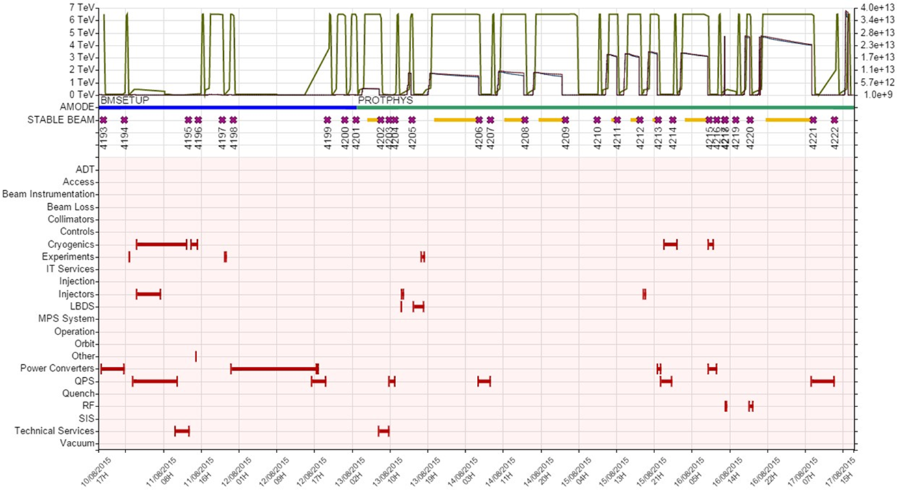
Accelerator Operation
[Source: CERN]
Result of equipment reliability, maintenance actions and protection requirements
Tradeoff: Availability Protection

Slide 10
Survival Probability and Failure Probability
Survival probability R(t) as complement of failure probability F(t)
Density function f(t)
Failure time t

Slide 11
Classification of Reliability Methods
Qualitative methods
Quantitative methods
Employ methodical, systematic procedures to determine possible faults/failures and their effects
Provide evaluation by way of estimation and classification
(not by calculation)
Aim: (Qualitative) ranking of weak points
Methods:
FMEA (FMECA)
Fault tree analysis
Event tree analysis
Check lists / Design review
Make use of terms and processes from statistics and probability theory
Provide (quantitative) probability values for reliability by way of calculation
Methods:
Fault tree analysis
Boolean system theory
Markov's theory
Monte-Carlo method

Slide 12
FMEA Form VDA 4.2
 |  | Failure mode and effect analysis (FMEA) System |  |  |  |  |  |  |  |  |  | FMEA-No.:
 |  |  |  |  |  |  |  |  |  |  |  | Page:
Type/Model/Fabrication/Load: |  |  |  |  |  | Item Code: State: |  | Responsible: Company: |  |  |  | Compartment: Date:
System-No./System Element: Function/Task: |  |  |  |  |  | Item Code: State: |  | Responsible: Company: |  |  |  | Compartment: Date:
Potential Effects | S | Potential Failure | C | Potential Causes |  | Preventive Actions | O | Detection Actions |  | D | RPN | Responsibility/Date
S = Assessment value for the severity |  |  |  |  | O = Assessment value for the occurrence |  |  |  | D = Assessment value for the detection
RPN = Risk priority number
University of Stuttgart
System element,
System structure
and functions
Risk
Analysis and assessment
Optimization
12

Slide 13

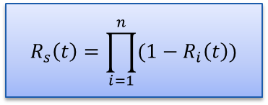
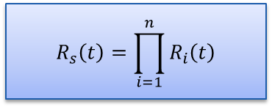


Boolean System Theory
$R\left(t\right)$≤1
Serial structure
Parallel structure
$$R_{s}\left(t\right)=R_{1}\left(t\right)∙R_{2}\left(t\right)∙{…∙R}_{n}\left(t\right)$$
$$F_{S}\left(t\right)=1−\left(1−F_{1}\left(t\right)\right)∙\left(1−F_{2}\left(t\right)\right)∙\text{…}∙(1−F_{n}\left(t\right))$$
$$F_{s}(t)=F_{1}(t)∙F_{2}(t)∙{…∙F}_{n}(t)$$
$$R_{s}(t)={1−(1−R}_{1}(t))∙(1−R_{2}\left(t\right)∙{…∙(1−R}_{n}(t))$$
$$R_{s}\left(t\right)=\prod_{i=1}^{n}{R_{i}\left(t\right)}$$
$$R_{s}\left(t\right)=\prod_{i=1}^{n}{(1−R_{i}\left(t\right))}$$
Example:
Example:
System limit
System limit

Slide 14
Top-down-method (deductive procedure)
TOP
= undesired result
system failure
vehicle failure
failure of the partial system
≥ 1
…
transmission failure
…
failure of the assembly group
≥ 1
…
failure of the bearing
output failure
failure of the housing
…
failure of the component
≥ 1
…
failure of the synchronization
failure of gear 1
failure of gear 2
…
≥ 1
failure modes
…
fretting
breakage
pittings
…
≥ 1
component characteristic,
design flaw
…
overload
false calculations
incorrect operation
…
DOWN
= basic event (causes)

Slide 15
Exercise 5.4: Task
Create the system structure of the given simplified system for the top event “Safety Critical Fault”. Consider only the safety critical failure modes.
Add functions, malfunctions and failure modes.
Create a qualitative Fault Tree based on a)-b).
Primary Fault to be detected
(rate 10^-4 / h)
MPS
Accelerator (i.e. LHC)
Sensor
(e.g. voltage measurement)
Decision logics (electronics board)
Actuator (e.g. Beam Dumping System, …)
Communication link 1
Communication link 2
Functionality:
Measure a given quantity to detect possible failures
Transmit information to the rule-based process
Decide if an emergency action has to be undertaken
Transmit information to the actuator
Execute the requested emergency action

Slide 16
Exercise 5.6: Task
Create a Fault Tree of the given redundant MPS system and evaluate its failure probability after one production year (t = 5000h).
LHC
String 1
Primary Fault to be detected
(rate 10^-4 / h)
Sensor
(e.g. voltage measurement)
Decision logics (electronics board)
Actuator (e.g. Beam Dumping System, …)
Communication link 1
Communication link 2
String 2

Slide 17
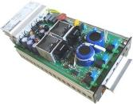
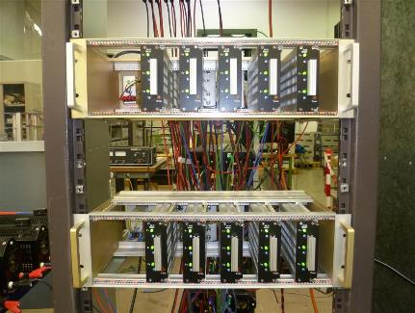
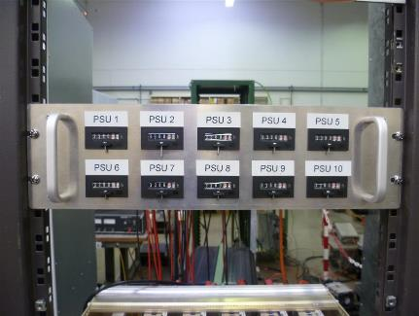
Demonstrating Reliability: Test overview
Real Case: 113 PSU units (same ref) delivered @ CERN
  A PSU-LAB is in charge of the qualification / reception
  2 different tests were organized to check units reliability
        1st test: All units running during 24 hours (nominal conditions)
        2nd test: 5 units – only - running during 6 months.
Test duration counters
(1 per unit under test)
Up to 10 units under test conditions

Slide 18
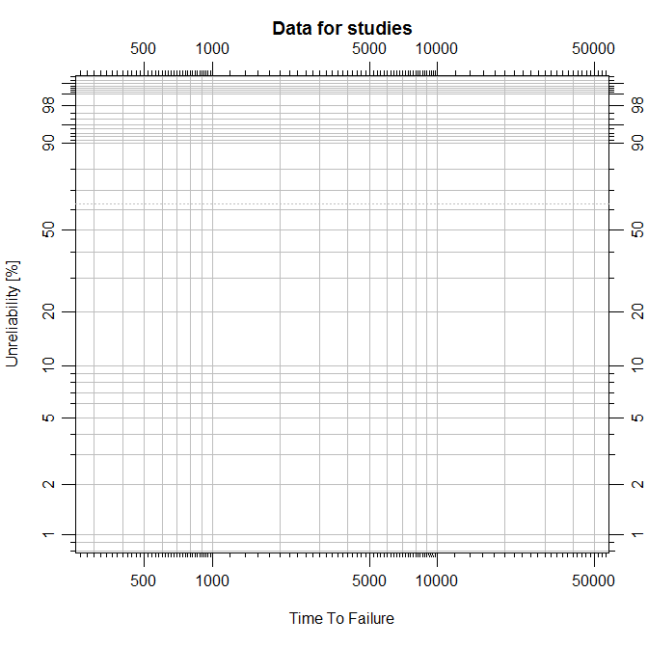
Re-Testing reworked units, with clear goal!
The 0-failure test was successful
(done on reworked units)
  Even if testing only
  10 units makes the
  1st failure heavier
  in the distribution
  test duration was
  long and exclusion
  of steep beta
  Cumulative
  Distribution Function
  becomes possible.
These distributions are still possible
This point was reached without any failure
(34 000 hours in total)
(1 failure over 10 tested units = 7 %, using Benard’s approximation)
34 000 hours both in total
Compare to 100 units running 340 hours !
(1 failure over 100 tested units would represent 1 %, but exclusion of high beta is very poor)
3 400

Slide 19
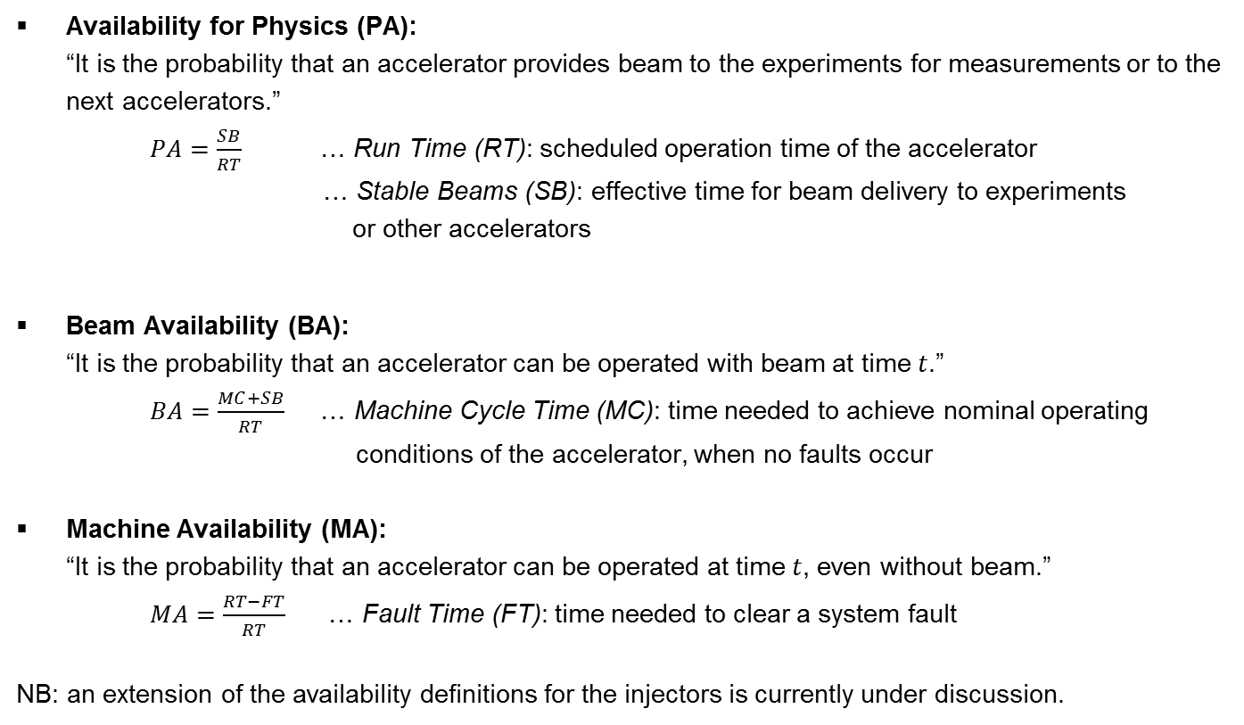
Definition of availability (accelerator specific, adaption of availability definition from literature)
[Source: Diss. Apollonio & CERN]
Availability for Physics (PA):
“It is the probability that an accelerator provides beam to the experiments for measurements or to the next accelerators.”
$PA=\frac{SB}{RT}$ … Run Time (RT): scheduled operation time of the accelerator
… Stable Beams (SB): effective time for beam delivery to experiments
or other accelerators
Beam Availability (BA):
“It is the probability that an accelerator can be operated with beam at time $t$.”
$BA=\frac{MC+SB}{RT}$ … Machine Cycle Time (MC): time needed to achieve nominal operating
conditions of the accelerator, when no faults occur
Machine Availability (MA):
“It is the probability that an accelerator can be operated at time $t$, even without beam.”
$MA=\frac{RT−FT}{RT}$ … Fault Time (FT): time needed to clear a system fault
NB: an extension of the availability definitions for the injectors is currently under discussion.

Slide 20
The role of injectors – simple sketch
[Source: CERN]
7 TeV
LHC
Beam to different destination
450 GeV (EP to LHC)
SPS
Beam to different destination
PS
26 GeV (EP to SPS)

Slide 21
Step 2: Construction of the transition matrix and of the system of differential equations
Row-wise
Transition probability:
  Product of status probability and transition rate
  Arrows towards a state: positive
  Arrows away from state: negative
System of differential equations
λ
1
2
µ
Summary:
Based on the transition graph, possible state transitions and their related transition rates will be arranged in a transition matrix.
Hint
21

Slide 22
ELMAS – Hands On Training

Slide 23
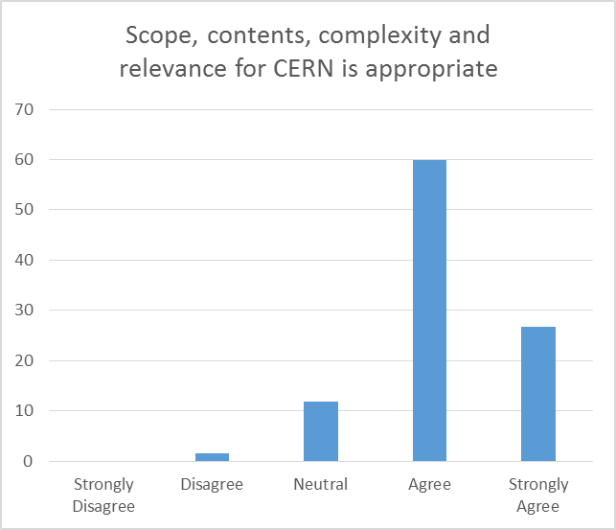

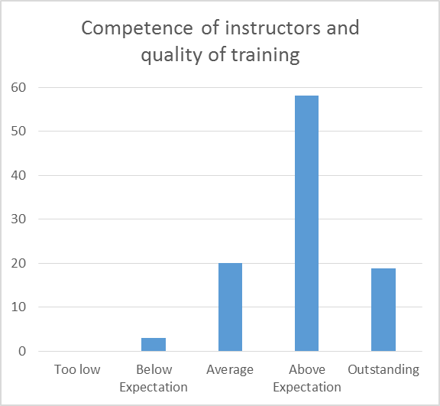
Feedback

Slide 24
Thanks a lot for your attention!

