Slide 1
PS Booster RF system
Availability model
Odei Rey Orozko
MPE-PE Section Meeting
10/03/2016

Slide 2
Index
  The PSB RF System
  Isograph model
    Isograph Availability Workbench
    PSB RF System model
    Input data
    Assumptions
    Results
  Analytical model
    Basic formulas
    Reliability model
      Results and sensitivity to failure rates
      System MTBF and sensitivity to failure rates
  Further steps

Slide 3
Index
  The PSB RF System
  Isograph model
    Isograph Availability Workbench
    PSB RF System model
    Input data
    Assumptions
    Results
  Analytical model
    Basic formulas
    Reliability model
      Results and sensitivity to failure rates
      System MTBF and sensitivity to failure rates
  Further steps

Slide 4
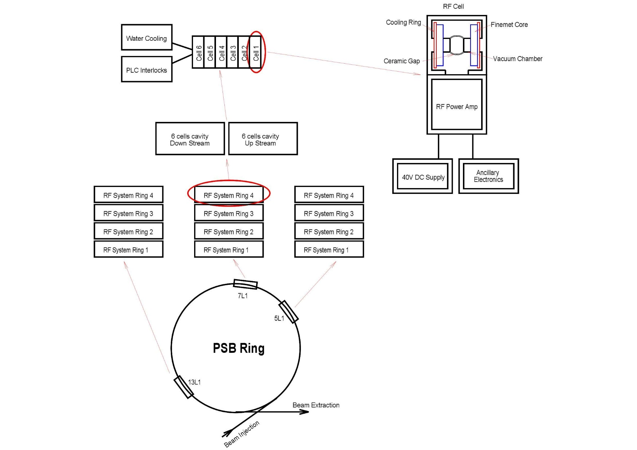
PSB RF SYSTEM
PSB RF SYSTEM:
The Proton Synchrotron Booster (PSB) is made up of four superimposed synchrotron rings that receive beams of protons from the linear accelerator.
Each synchrotron ring has its independent RF system.
The PSB RF system is upgraded in the framework of the LIU (LHC Injectors Upgrade) project.
Scope: Dependability studies to assess the achieved RF system availability.
  Availability model based on Isograph commercial software.
  Analytical Reliability model.

Slide 5
Index
  The PSB RF System
  Isograph model
    Isograph Availability Workbench
    PSB RF System model
    Input data
    Assumptions
    Results
  Analytical model
    Basic formulas
    Reliability model
      Results and sensitivity to failure rates
      System MTBF and sensitivity to failure rates
  Next steps

Slide 6
ISOGRAPH® AVAILABILITY WORKBENCH
Availability simulation software.
Performs Monte Carlo Simulations.
Used to optimize maintenance and spares policies and predict system availability.
Reliability Block Diagrams (RBD) are used to model system dependencies and behaviour in case of failures.
The RBD is made of blocks and nodes connected in parallel or series.
A voting strategy is defined in case of redundant components (blocks).
A Failure mode is assigned to each block.
Different Maintenance Strategies can be defined.

Slide 7

ISOGRAPH AVAILABILITY MODEL
PSB RF rings
Water Cooling
PLC
AE
RF Cell
Cell
DC Supply
Ceramic Gaps (36)
RF Power Amplifier
Cooling Ring
Finemet Core

Slide 8
INPUT DATA - MTBF
Component | No. of components in the system | MTBF (years) | MTBF (h) | Data source
Water Cooling | 24 | 10x24 | 2102400 | Expert experience. Machine made up of 24 components failed ones in 10 years.
PLC Interlocks | 24 | 22 | 200000 | PLC MTTF=Its Power Supply MTTF Manufacturer data: Values from 200.000 to 980.000 hours
DC Supply | 144 | 5 | 43800 | Expert experience.
Ancillary Electronics | 144 | 5 | 43800 | Expert experience.
Cooling Ring | 144 | 40x10x50 | 175200000 | Expert experience. 1 ring failed in 40 years, 50 rings per cavity, 10 cavities
Finemet Core | 144 | 10000/2 | 43800000 | Expert experience. One Finemet Core failed once each 10.000 years. The component is made up of two Finemet Cores
Ceramic Gaps (36) | 4 (144/36) | 20000/36 | 4866666.667 | Expert experience. One Ceramic Gaps fails ones each 20.000 years
Mosfets pair | 4608/2 | 18600000/2 | 8.15E+10 | Manufacturer data
Mosfets Driver | 144 | 18600000 | 1.63E+11 | Manufacturer data

Slide 9
INPUT DATA – MANTENANCE TIMES
Component | Corrective Maintenance(h) | Spares Available
 |  | Best Case (100%) | Worst Case
Water Cooling | 2+4 | 24 | 2 (10%)
PLC Interlocks | 2+4 | 24 | 2 (10%)
DC Supply | 2+4 | 144 | 36 (25%)
Ancillary Electronics | 2+4 | 144 | 4 (3%)
Cooling Ring | 72 | 144 | 24 (17%)
Finemet Core | 72 | 144 | 26 (18%)
Ceramic Gaps | 72 | -Not possible- | 1 (%25) – (28/36)
Mosfets pairs/Drivers | 6 | 10000 | 1382 (%30)
Operation / Planned Maintenance period | 3 months (2190h)
Planned Maintenance time | 48 hours
Lifetime | 1 year (8760 h)
Operation
3 months
PM 48h
Operation
3 months
PM 48h
Operation
3 months
PM 48h
Operation
3 months

Slide 10
ASSUMPTIONS
CORRECTIVE MAINTENANCE:
Maintenance done when the RF system is not available any more due to components failures.
CM in all the failed components
Components are non-operational* when doing CM
PLANNED MAINTENANCE:
Scheduled maintenance at predefined time.
Components are non-operational* when doing PM.
* Non-operational : The component can not experience failures

Slide 11
RESULTS – PSB RF SYSTEM AVAILABILITY PREDICTIONS
Availability = Availability is defined as the ratio between the operational time and total time.
No. of outages | Downtime (h) | MTBO(h) | MTTR(h) | Mean Availability | Availability at Lifetime
3 + 1.34 | 144 + 80.45 | 2017.3 | 51.7 | 97.4% | 99.9%
Outages = PMs + failures
3 PMs during lifetime
MTBO | Mean time between consecutive outages
MTTR | Mean time to restore the system after an outage
Mean Avail. | Expected fractional time the system will be in service
Avail. at lifetime | Prob. the system will be in service at the end of each lifetime.
1 run | 1000 simulations of 1 year
System failure due to components failures
No. of failures | Failures Downtime(h)
1.34 | 80.45
* PM considered as an outage and Downtime of the system

Slide 12
RESULTS - PSB RF SYSTEM COMPONENTS AVAILABILITY PREDICTIONS
* PM considered as DT. PM down time related to the time to repair of each component.
* Note that 36 Ceramic Gaps are modelled in one Block

Slide 13
RESULTS - PSB RF SYSTEM COMPONENTS AVAILABILITY PREDICTIONS
Water Cooling | 0.024
PLC Interlocks | 0.4
DC Supply | 1.62
Ancillary Electronics | 1.62
Cooling Ring | 0.0004
Finemet Core | 0.002
Ceramic Gaps | 0.002
Mosfet | 0
Expected number of failures for one component in lifetime

Slide 14
RESULTS - PSB RF SYSTEM COMPONENTS AVAILABILITY PREDICTIONS
System downtime contributors
Number of spares used for Corrective Maintenance
Ancillary Electronics | 19
Dc Supply | 19
PLC Interlocks | 0.992
Water Cooling | 0.0935
Finemet Core | 0.019
Ceramic Gaps | 0.005
Cooling Ring | 0.004
Mosfet | 0
* Number needed for PM not included because the Isograph model considers PM an outage

Slide 15
Index
  The PSB RF System
  Isograph model
    Isograph Availability Workbench
    PSB RF System model
    Input data
    Assumptions
    Results
  Analytical model
    Basic formulas
    Reliability model
      Results and sensitivity to failure rates
      System MTBF and sensitivity to failure rates
  Further steps

Slide 16
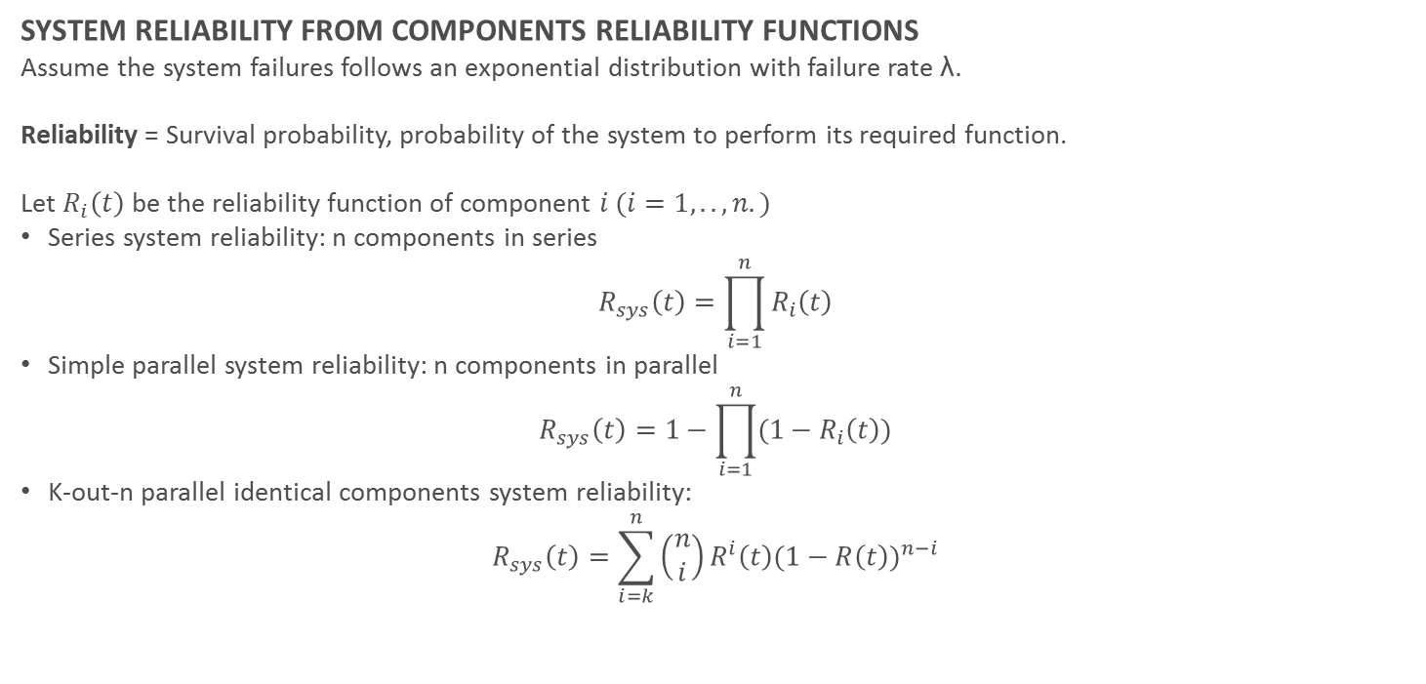
ANALYTICAL MODEL – BASIC FORMULAS
SYSTEM RELIABILITY FROM COMPONENTS RELIABILITY FUNCTIONS
Assume the system failures follows an exponential distribution with failure rate λ.
Reliability = Survival probability, probability of the system to perform its required function.
Let $R_{i}\left(t\right)$ be the reliability function of component $i (i=1,..,n.)$
Series system reliability: n components in series
$$R_{sys}\left(t\right)=\prod_{i=1}^{n}{R_{i}\left(t\right)}$$
Simple parallel system reliability: n components in parallel
$$R_{sys}\left(t\right)=1−\prod_{i=1}^{n}{{(1−R}_{i}\left(t\right)})$$
K-out-n parallel identical components system reliability:
$$R_{sys}\left(t\right)=\sum_{i=k}^{n}{\left(\begin{aligned}n \\ i\end{aligned}\right)}R^{i}\left(t\right){(1−R\left(t\right))}^{n−i}$$

Slide 17
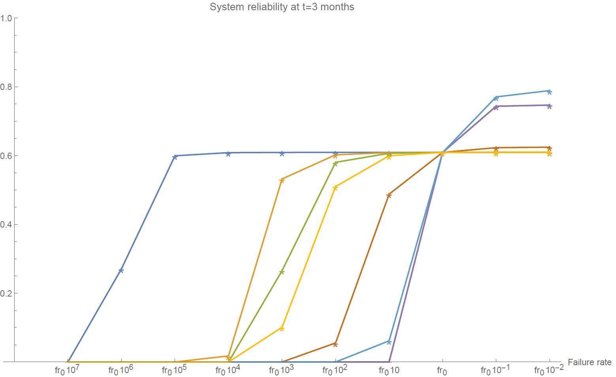
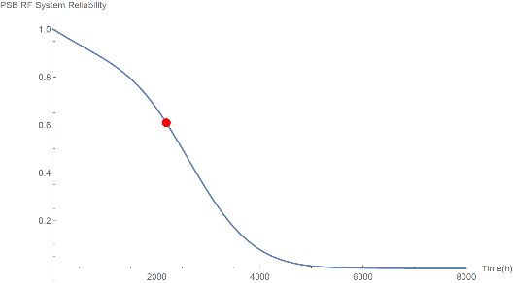
RELIABILITY MODEL – RESULTS
SYSTEM RELIABILITY AT TIME PLANNED MAINTENANCE (3 months)
Reliability = Survival probability, probability of the system to perform its required function.
At time Planned Maintenance the probability of the system to perform its function is %61.
PLC
Mosfets
Components with more impact in System Reliability:
- Ancillary Electronics
- DC Supply
- PLC Interlocks
- Water Cooling
Mosfets have very small impact
Increase in AE, DC and PLC MTBF, increases System Reliability significantly .
Cooling Ring
Ceramic Gaps
Finemet Core
Water
Cooling
AE and DC Supply

Slide 18
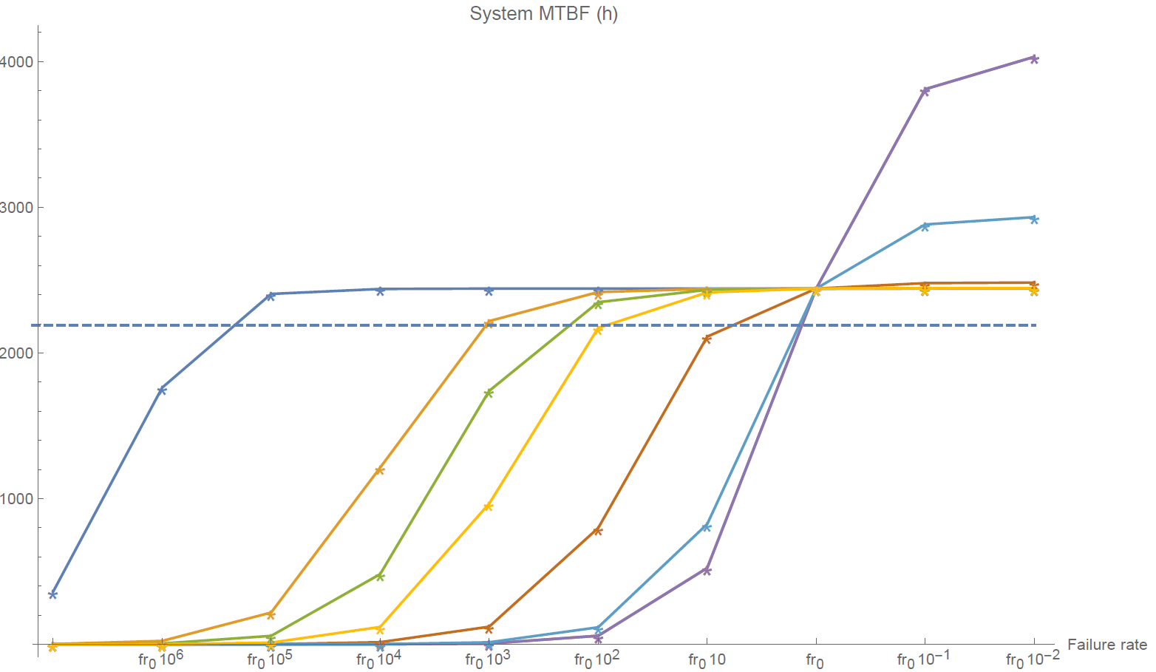
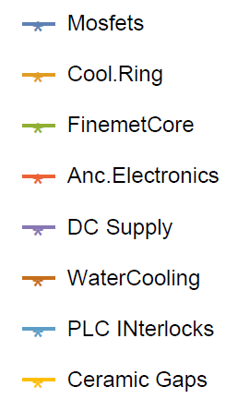
RELIABILITY MODEL –RESULTS
SYSTEM MEAN TIME TO FAILURE
MTTF of the System is 2442h
The system will probably fail almost each 102 days. (After PM)

Slide 19
Index
  The PSB RF System
  Isograph model
    Isograph Availability Workbench
    PSB RF System model
    Input data
    Assumptions
    Results
  Analytical model
    Basic formulas
    Reliability model
      Results and sensitivity to failure rates
      System MTBF and sensitivity to failure rates
  Further steps

Slide 20
FURTHER STEPS AND TIMELINE
PSB RF SYSTEM RELIABILITY STUDIES:
Finish on-going simulations and studies.
Presentation of results at the LIU PSB meeting.
Preparation of a conference publication.
                Expected deadline: Middle April
LINAC 4 AVAILABILITY STUDIES:
Within the Linac 4 - MIRA Project:
Work on the Proposal for the Linac4 Accelerator Fault Tracker (ATF) .
  AFT requirements
  Availability definition
                Time-scale: 6 months
Maintenance of Linac 4 failure catalogue.
Definition of Linac 4 availability model.
  Data collection, documentation and analysis.
CLIC RELIABILITY STUDIES
In parallel to Linac4 availability studies:
Further development of CLIC Failure Catalogue.
Definition of CLIC availability model.
Data collection, documentation and analysis.

Slide 21
Thank you!
Comments? Questions?

