Slide 2
Losses during Dumps in the 2015 run
M. Valette

Slide 3
Goal:
Study the trends of losses during along a run:
  Identify the machine setting influencing dump quality
  Improve dump quality
  Check for decommissioning effects
  Prevent future “dirty” dumps
  Confirm we have a good understanding of what is going on during a dump
Follow up on Abort Gap population
  Confirm AG cleaning efficiency
  Understand machine parameters influencing AG population

Slide 4
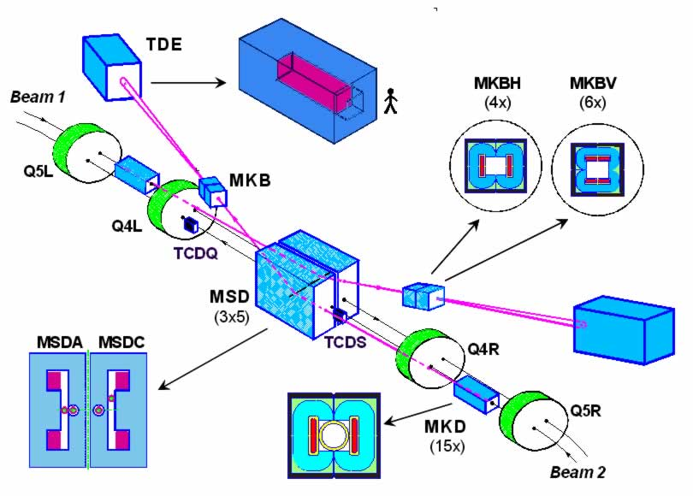
Dump Channel Layout

Slide 5
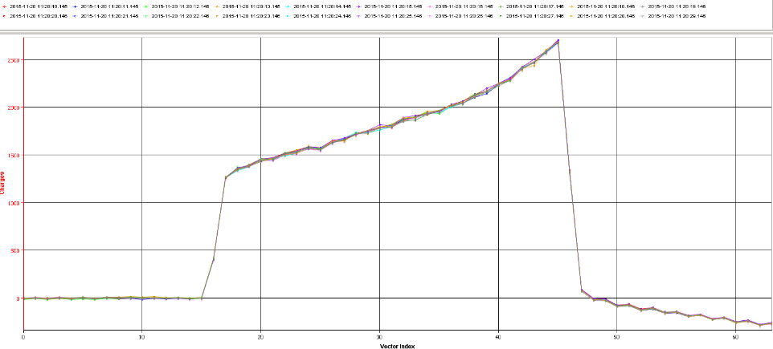

Abort Gap population
~90% particles leaking from the last bunch
depends on filling pattern and intensity
$$τ_{1/2}\sim 1.75μs$$
Depends on RF noise or something else
~10% unbunched beam from injection

Slide 6
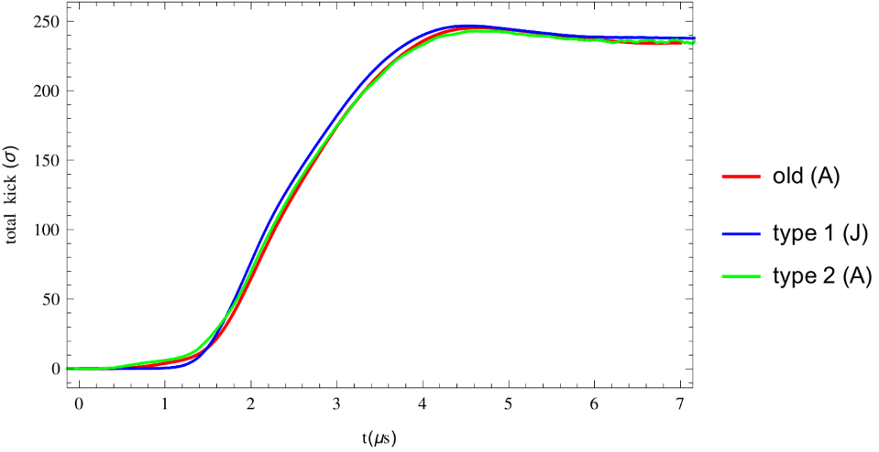
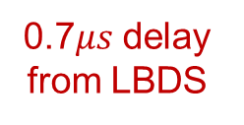
Extraction Kicker waveform
Dump channel
TCDS
Abort gap starts here
TCDQ
Collimated or dangerous
Stays in the ring
0.7$μs$ delay from LBDS

Slide 7
Abort Gap slice hitting the dampers
TCDS (~40% of particles)
Ring
Collimated
TCDQ

Slide 8
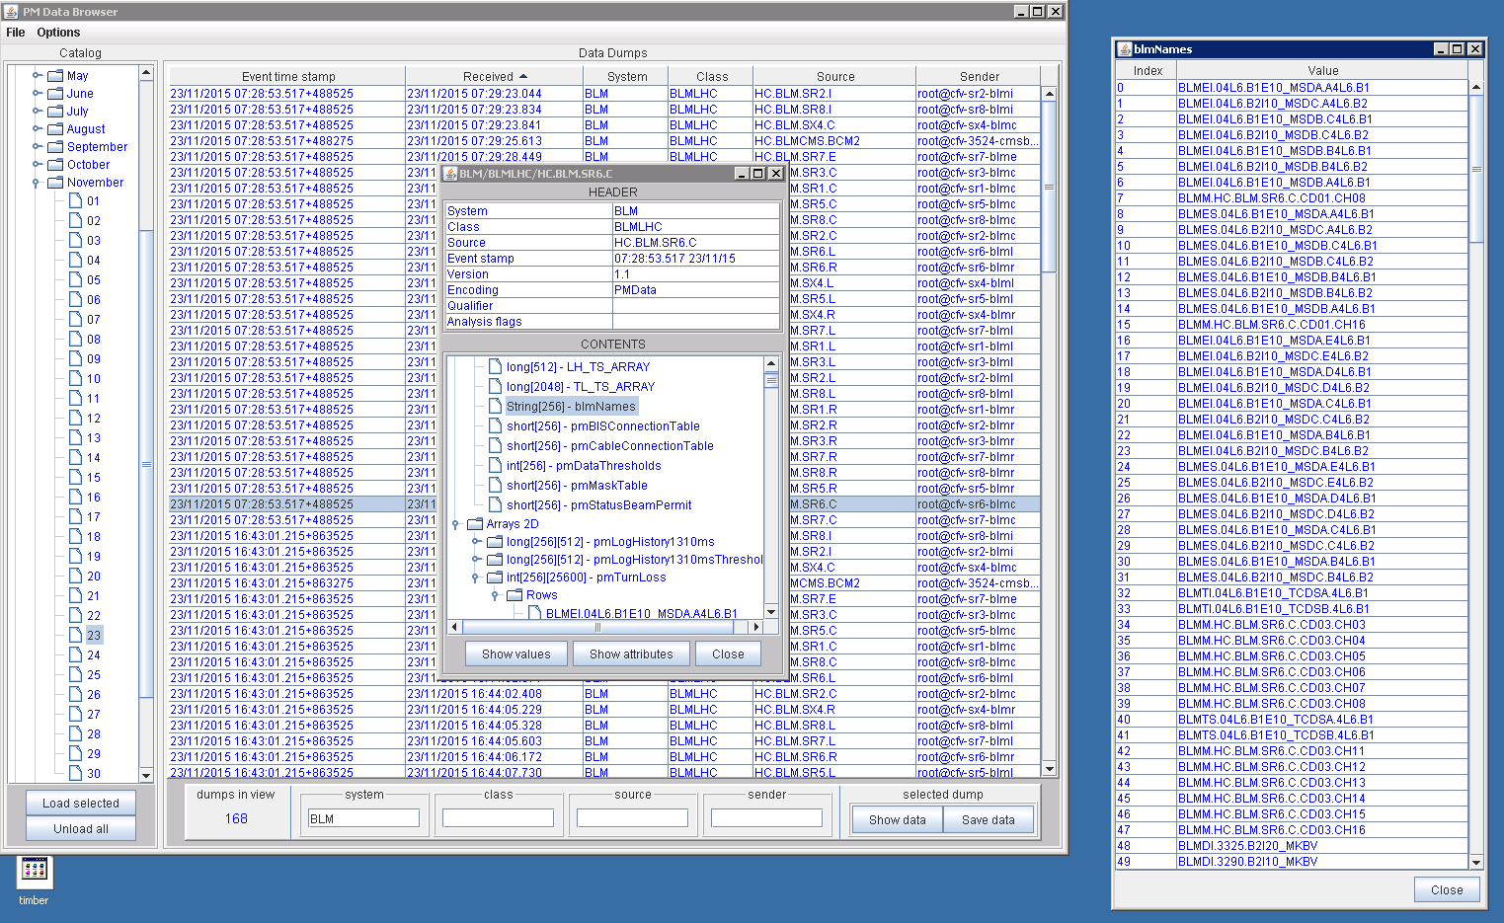
PostMortem Data: before: DataBrowser

Slide 9
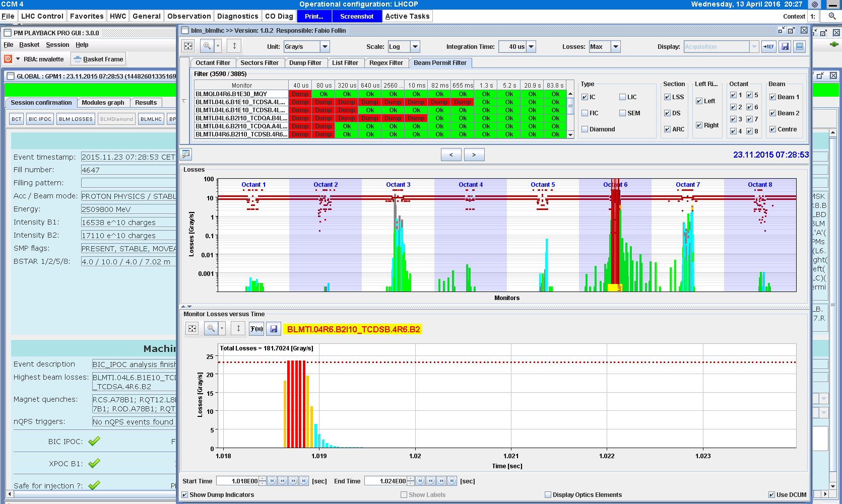
PostMortem Data: before: PM playback

Slide 10
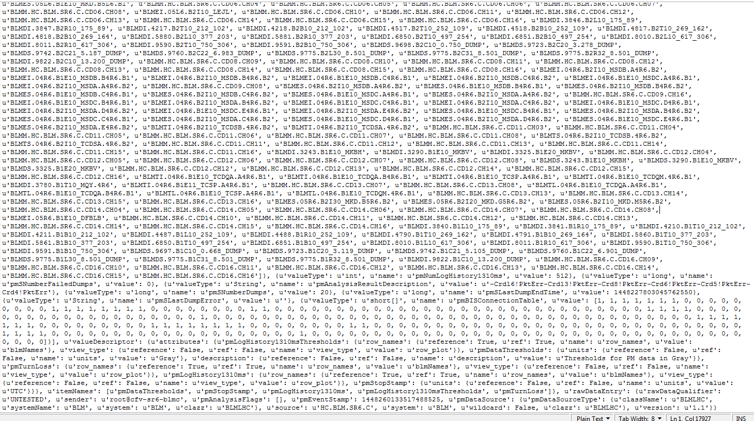
PostMortem Data: json: scary at first

Slide 11
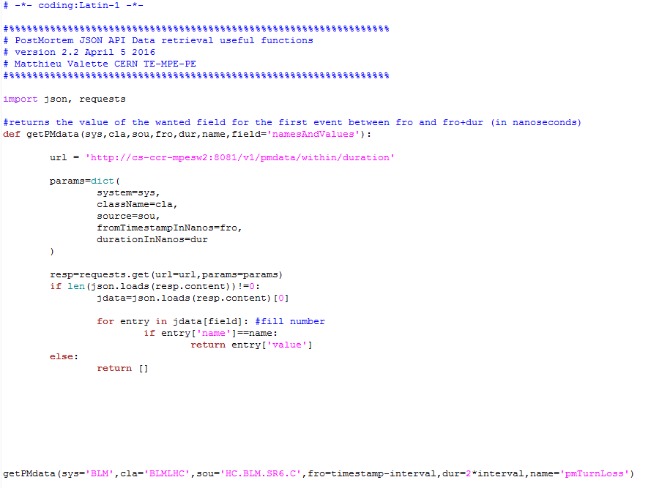
PostMortem Data: python
Point and click GUI: 80 events in 8 hours
Python terminal scripts: 800 events in 3 hours
Speedup: ~27

Slide 12
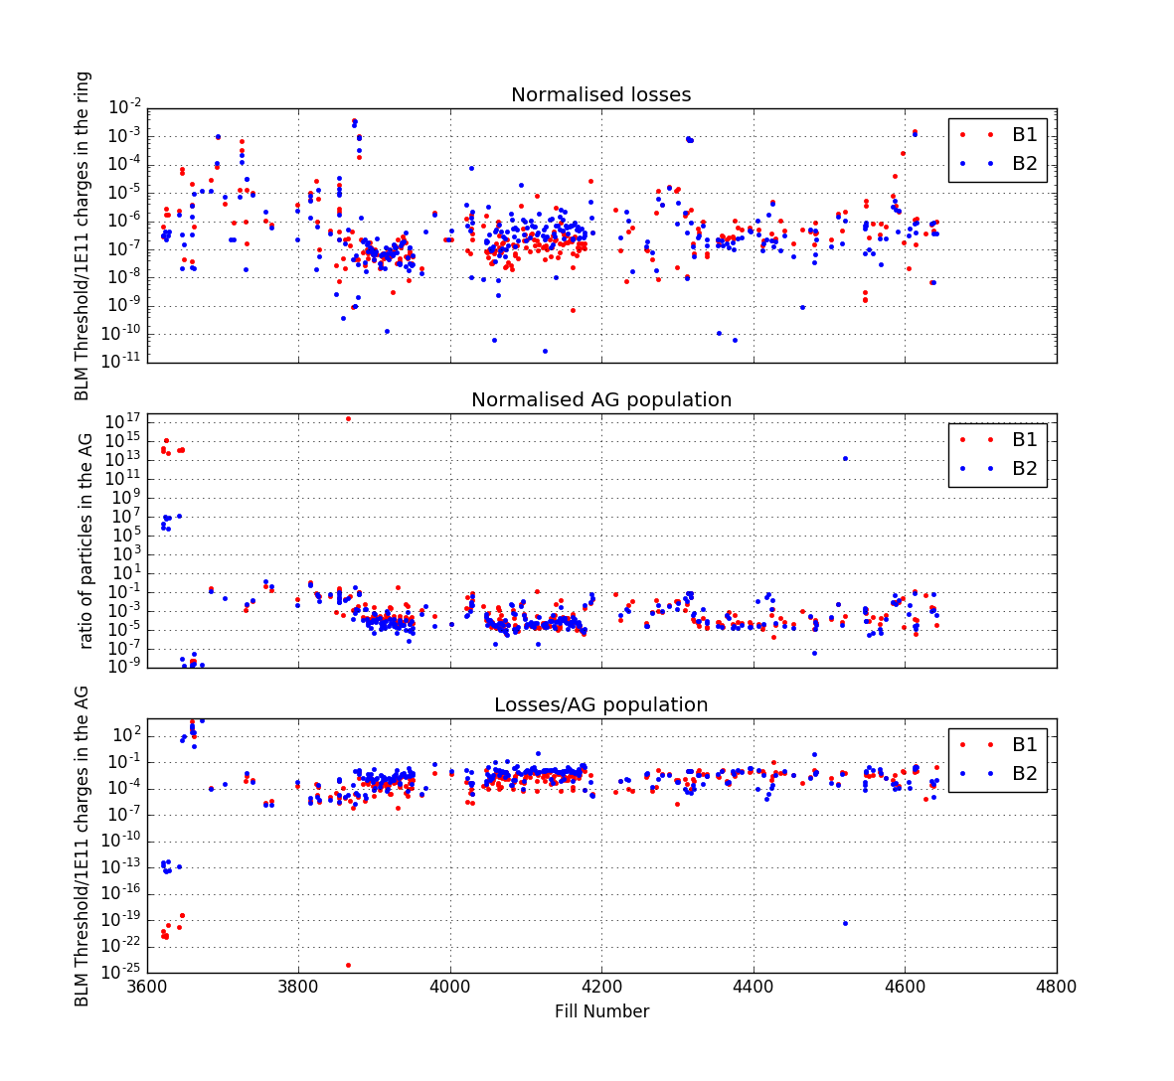
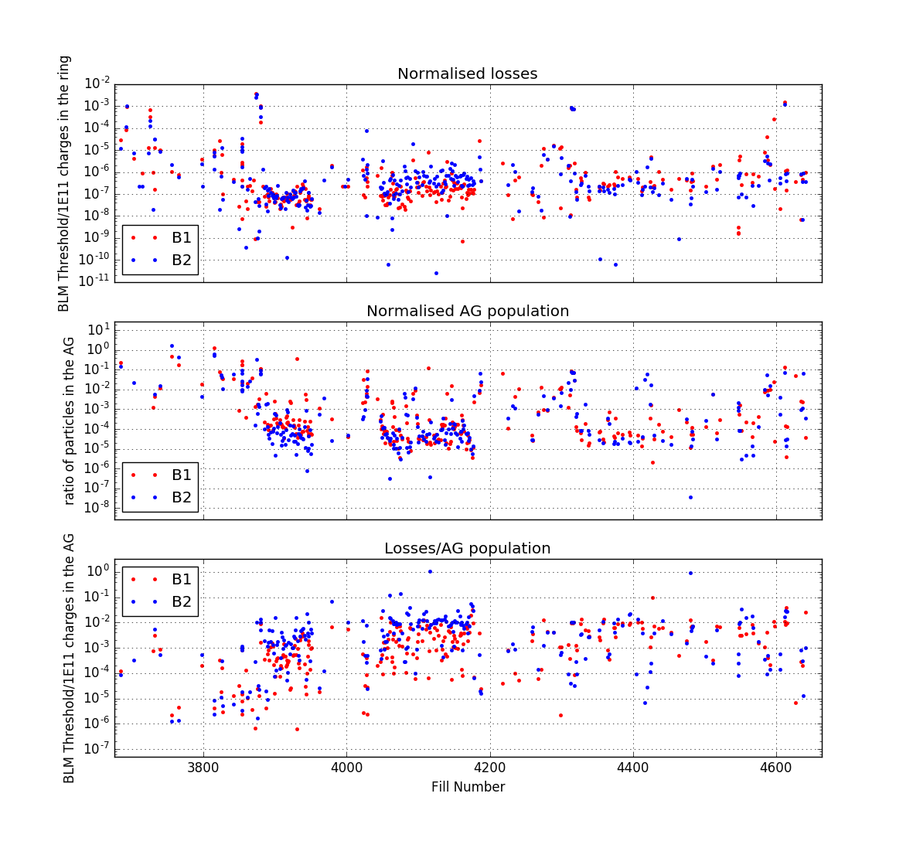
Proton Run - Injection
MKI softstart
MKI softstart

Slide 13
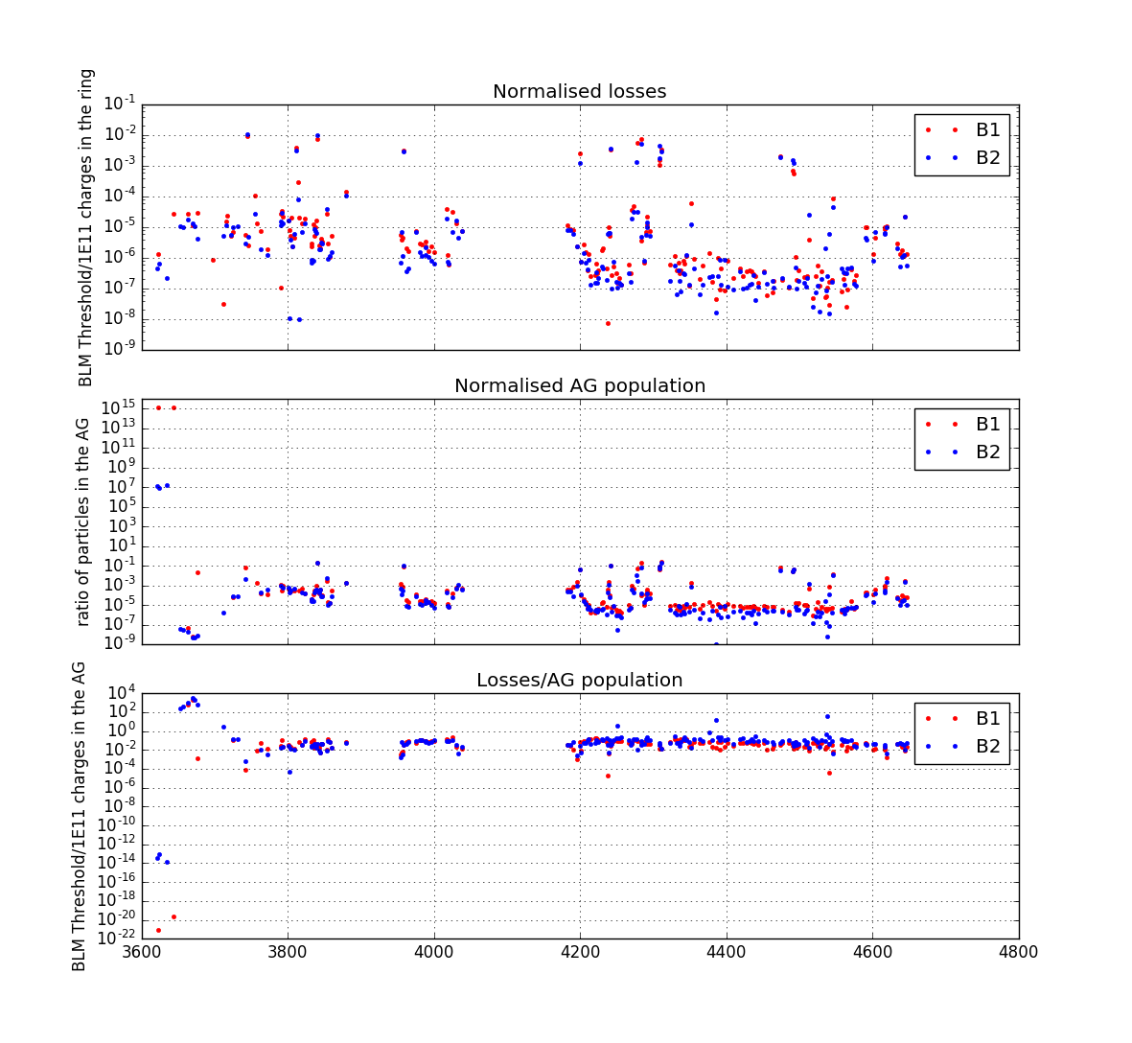
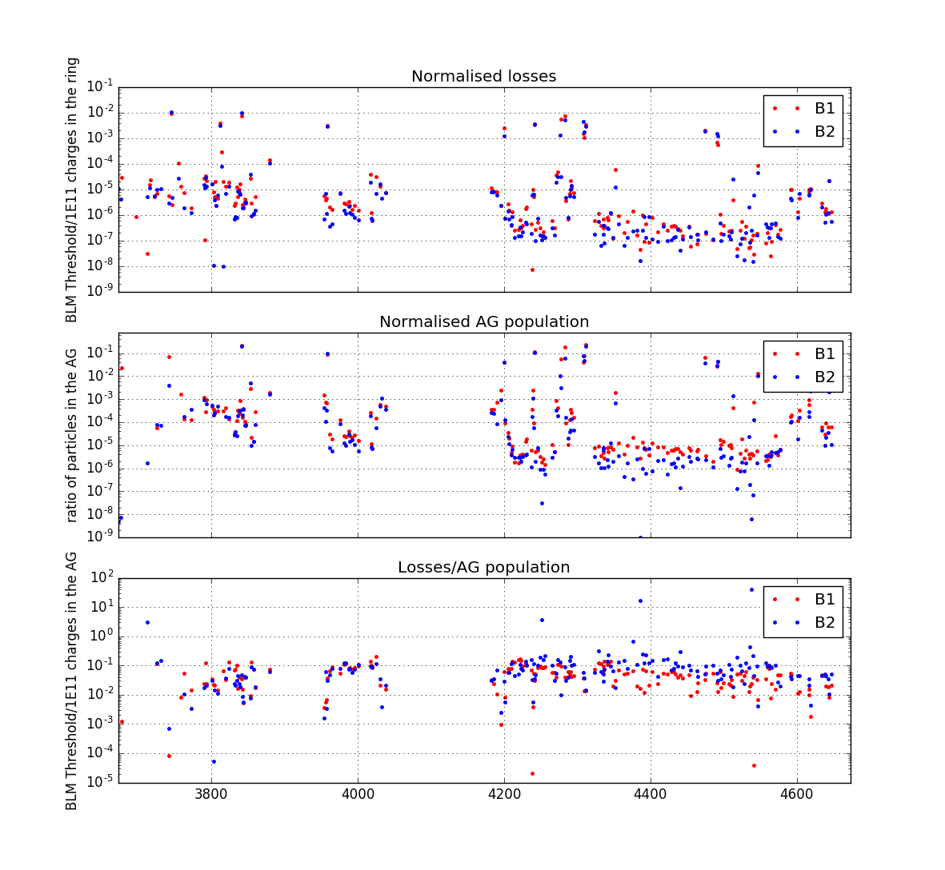
Proton Run – Flat Top
???
TCDQ moved during operation
MKI fault during injection

Slide 14
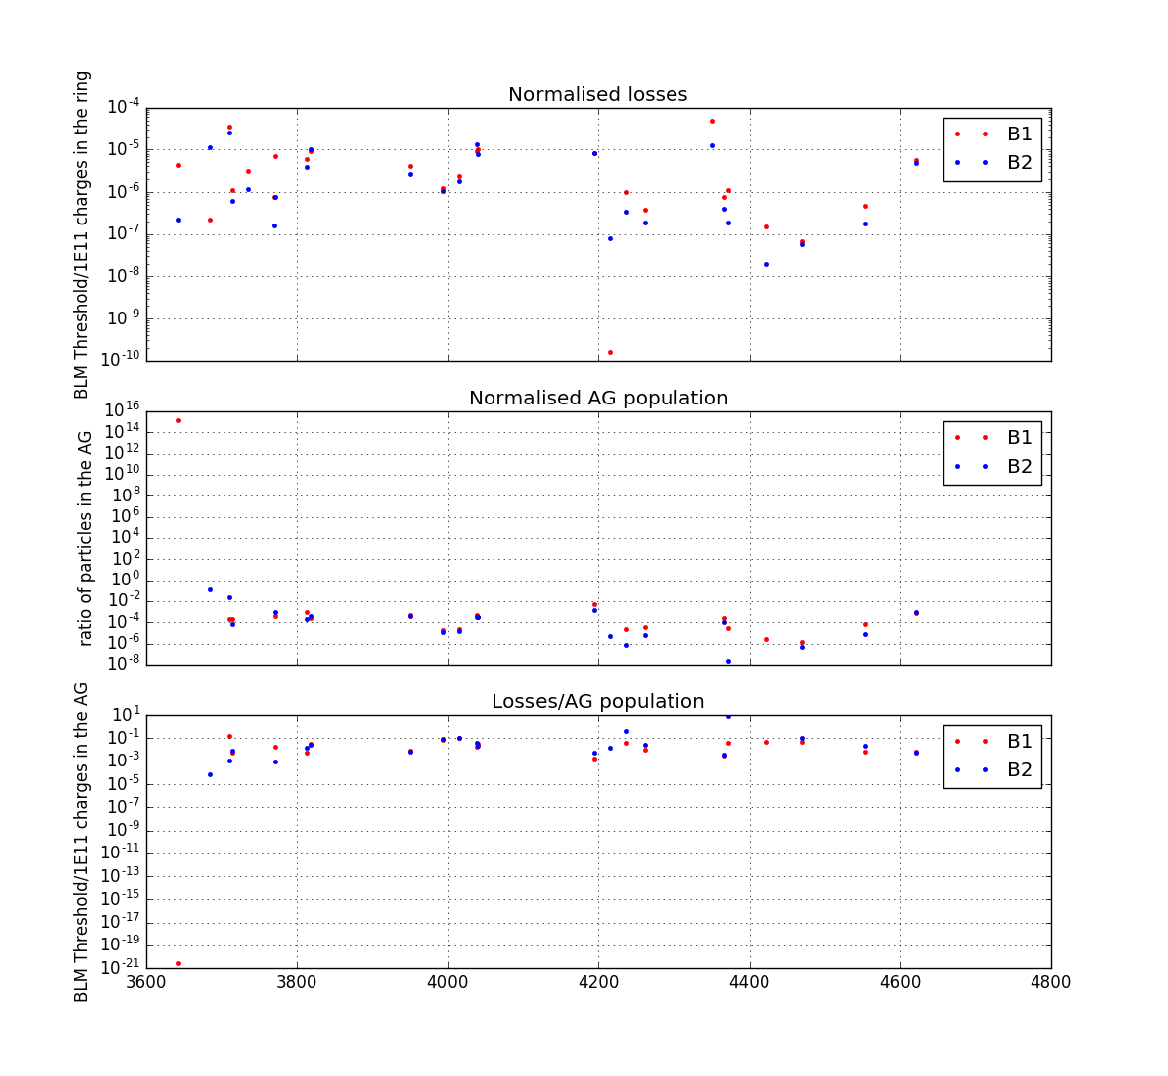
Proton Run – Ramp Up

Slide 15
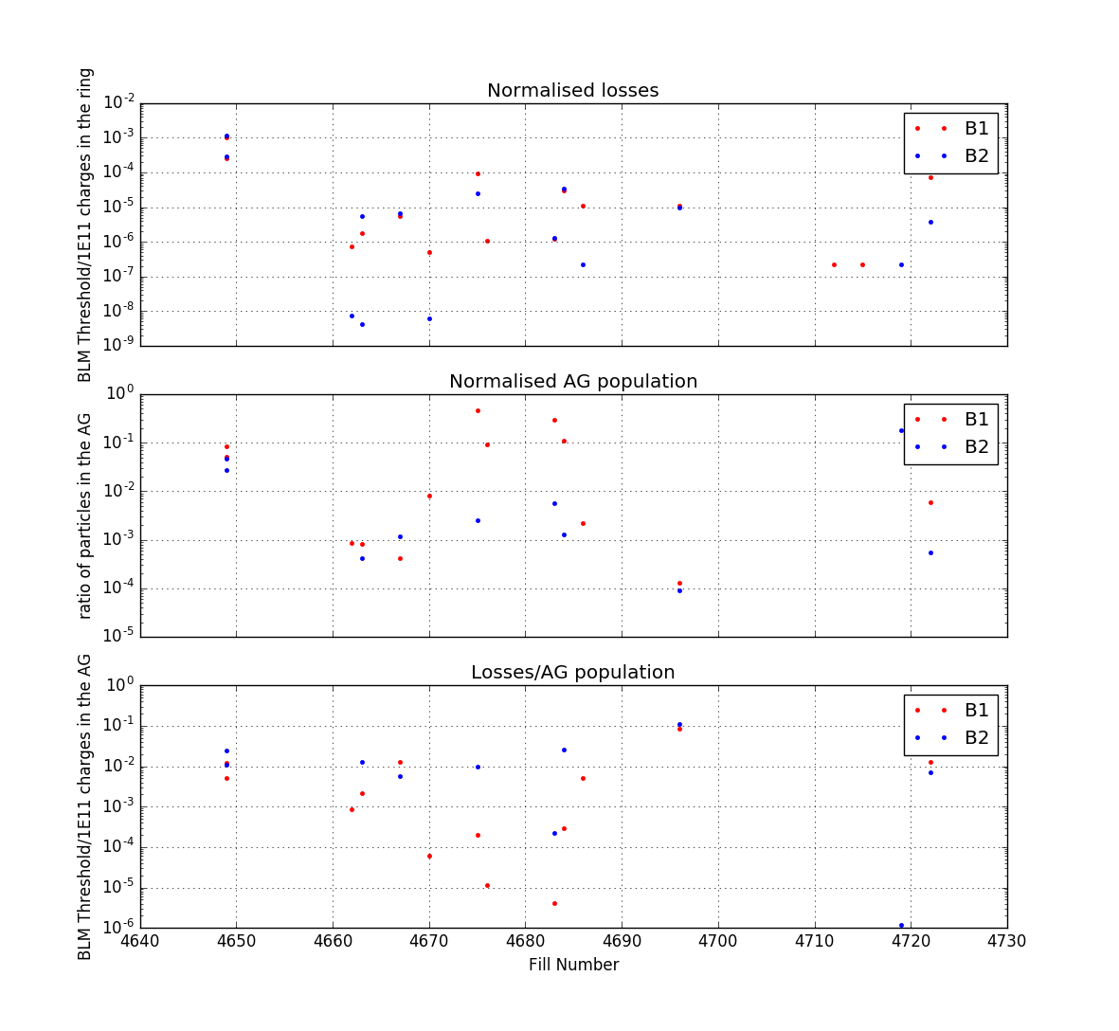
Ion Run - Injection

Slide 16
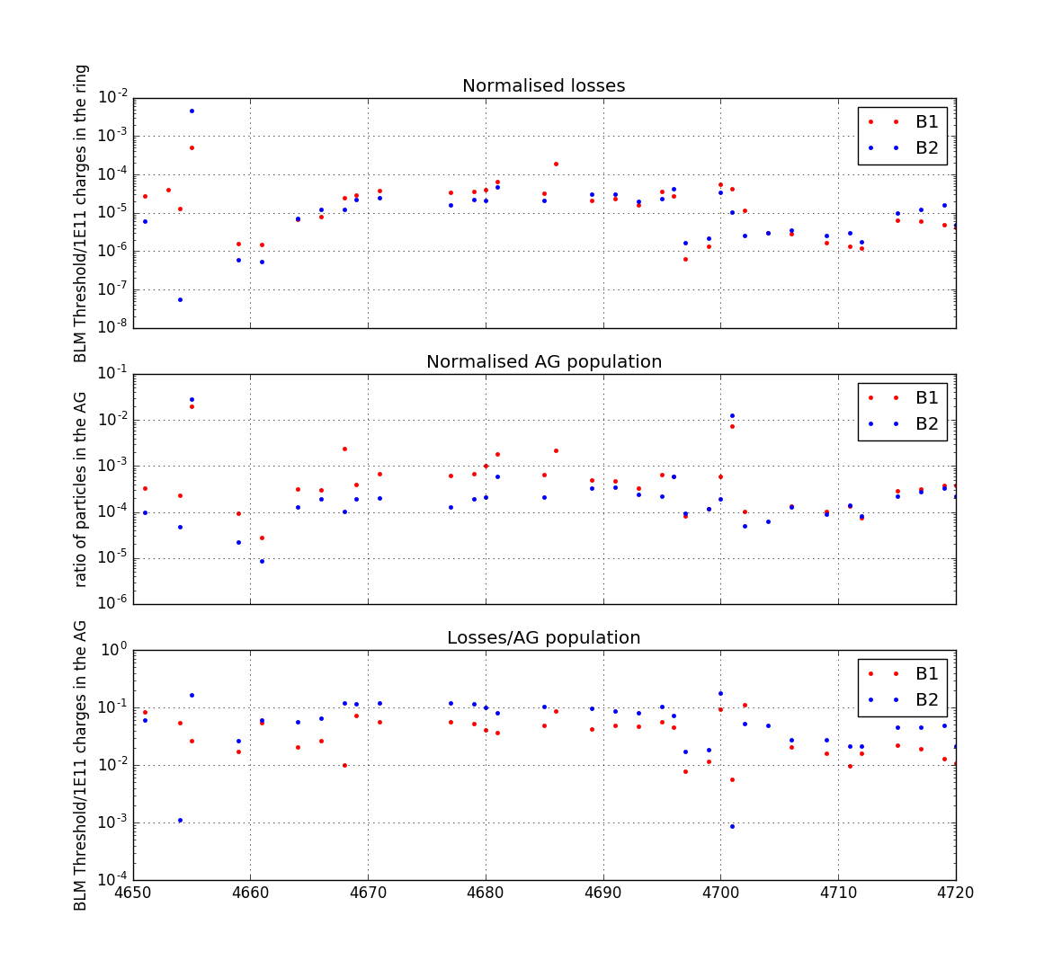
Ion Run – Flat Top
Fix in SPS/LHC frequency mismatch
FGC lost
Async BD test
Very long fills
Async BD test

Slide 17
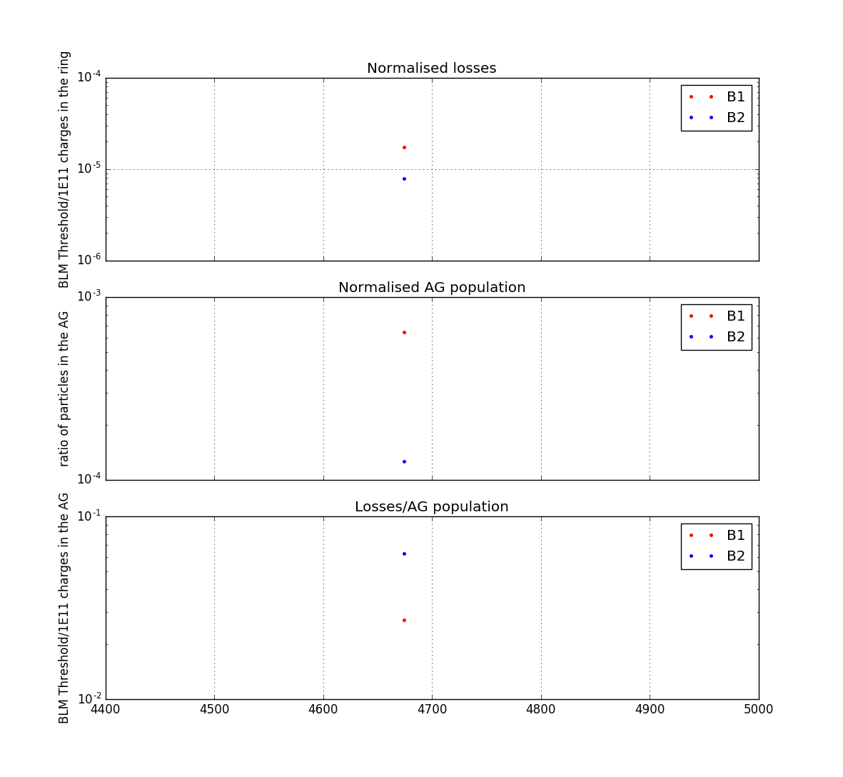
Ion Run – Ramp Up

Slide 18
Conclusion and Outlook
The correlation of losses with the studied slice of AG population is good
In the future:
  Change normalization of the losses
    Now: based on ratio to threshold
    New: absolute losses in Gray
      Show ramp events with Flat Top
  Check for BSRA calibration
Correlate with other variables like:
  RF noise
  Injection quality
  AG cleaning

