Slide 2
Summer School and Workshop
Energy Based Modelling, Simulation, and Control of Complex Physical Systems
Michał Maciejewski
Bernhard Auchmann
Lorenzo Bortot
Jonas Blomberg Ghini
TE-MPE-PE
20.04.2016

Slide 3




Summer School
Goal: introduction to energy based modelling, simulation, and control of complex physical systems with particular emphasis on port-Hamiltonian systems.
Period: 4/04-6/04
Place: Technical University of Berlin
Lecturers: prof. Arjan van der Schaft, University of Groningen
Peter Breedveld, PhD, University of Twente

Slide 4
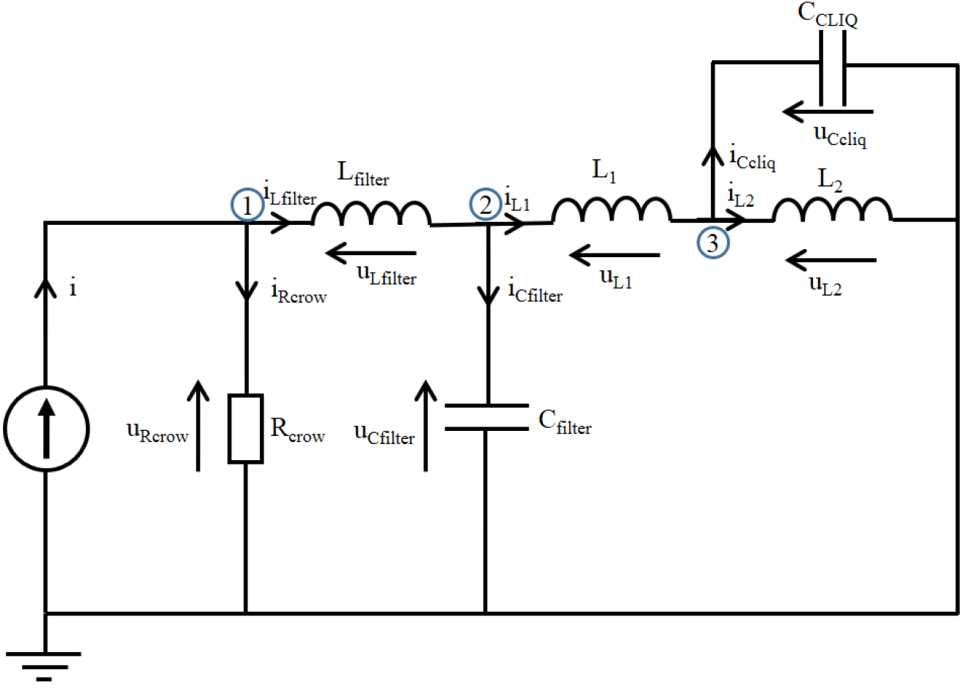
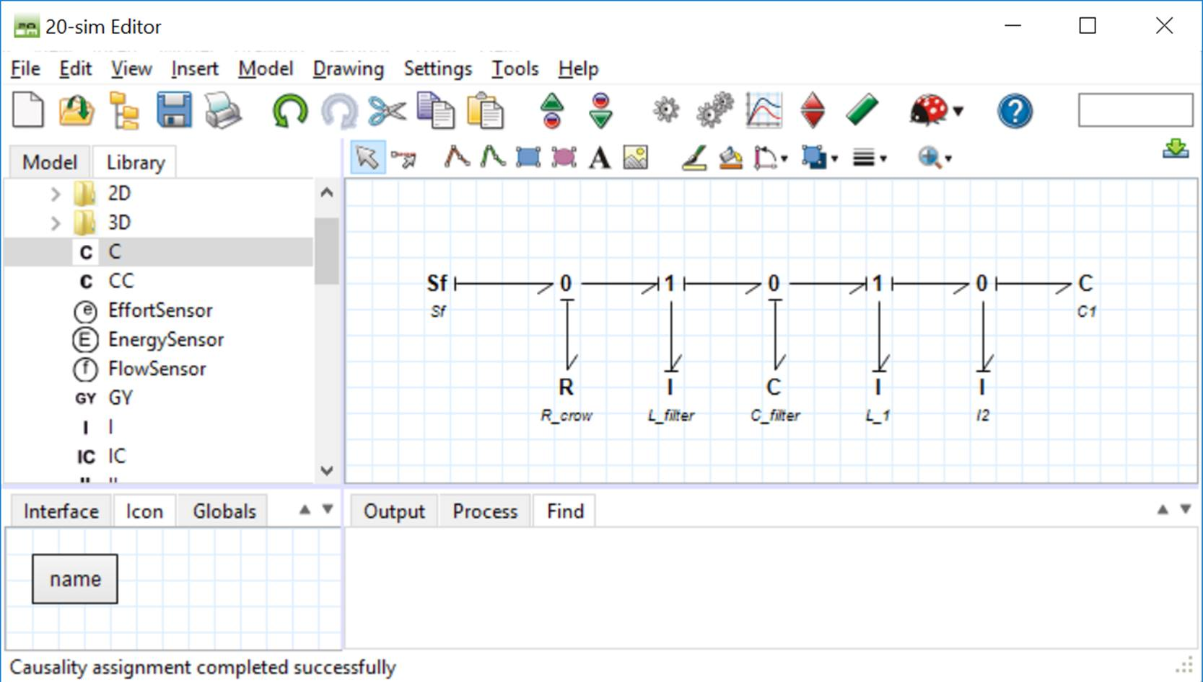
Bond graph modelling
effort
effort*flow = Power
flow
R-type element
I-type element
C-type element
0-junction – common effort
1-junction – common flow
Se - source of effort
Sf – source of flow
domain | effort | flow
electromagnetic | voltage | current
mechanical | force | velocity
hydraulic | pressure | volume flow
thermal | temperature | entropy flow

Slide 5
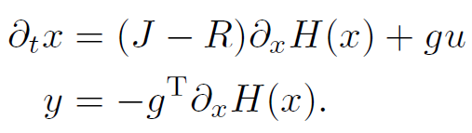
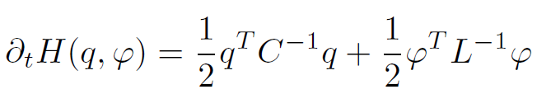
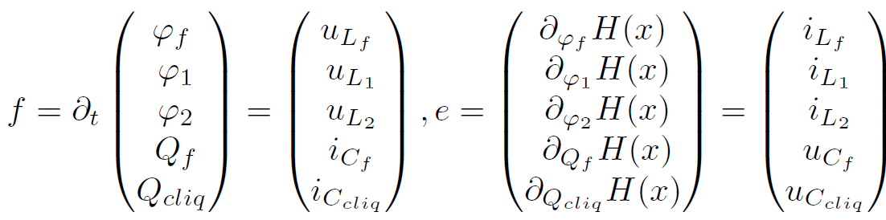
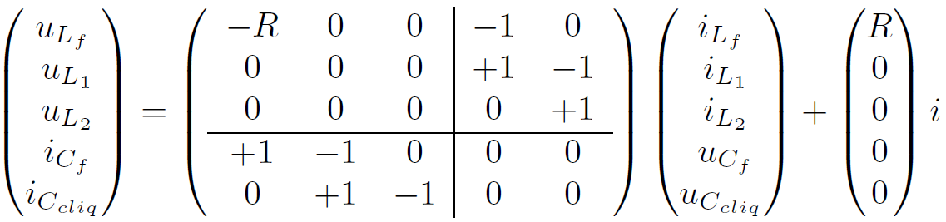
Port-Hamiltonian systems
Port-Hamiltonian system
with energy function
For presented example flow and effort variables are given as
resulting in a set of equations

Slide 6
Workshop
Goal: The workshop fosters the opportunity that the young researchers participating in the summer school can learn about current research directions in the field of energy based modelling, simulation, and control.
Period: 7/04-8/04
Place: Technical University of Berlin

Slide 7
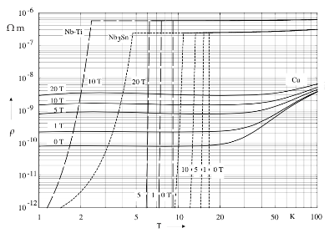
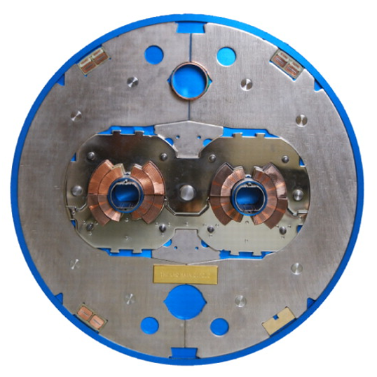
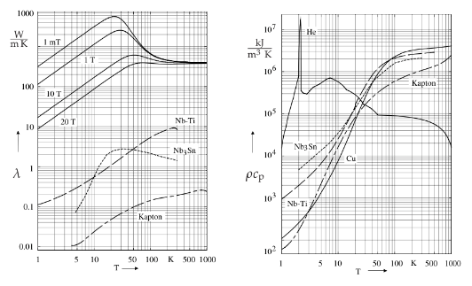
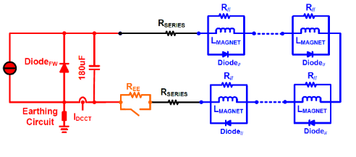
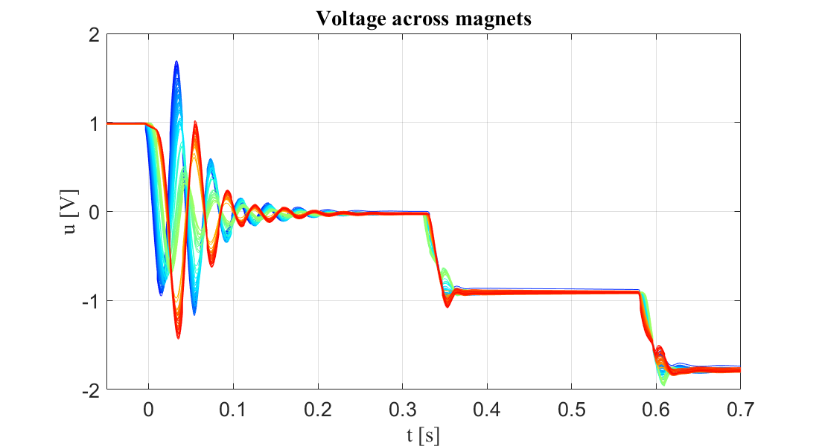
Challenges
Fluid dynamics
Superfluid Helium
Phase transition
Material properties
Extreme non-linearity within few Kelvin
Electrodynamics
Inductive Couplings
Saturation
IFCC-ISCC
Mechanics
Lorentz forces
Thermal strain
Thermal
IFCL-ISCL
Joule losses
Quench propagation
Components
Diodes
Thyristors
Properties as f(T, B)
Coupling
Information exchange
Stability of solution
Performance
Measurements
Circuit
154 Magnets
~7 km length
~1e4 net components
Switch
Appropriate model
Numerical discontinuity
EM waves

Slide 8

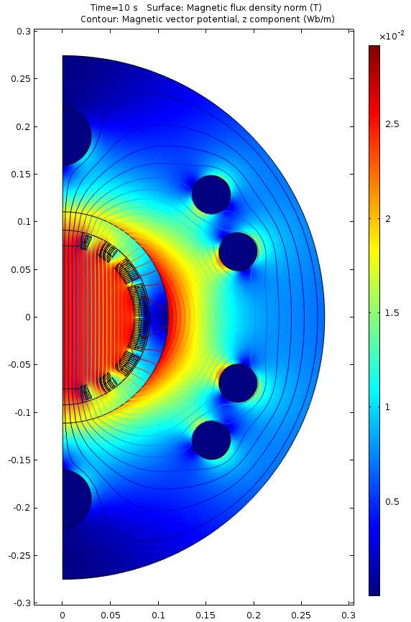
Status
Co-simulation field-network coupling
COMSOL for electro-thermal problem
PSPICE for electrical network analysis
Benefits
Full electro-thermal dynamic phenomena
Full electro-dynamic circuital analysis
Nodal structure suitable for parallelism

Slide 9
Challenges
Consistent representation of various domains
Selection of a coupling scheme (coupling strength)
Convergence study for field-circuit coupling

Slide 10
Order of talks
Fields of study
Michał Maciejewski –
Port-Hamiltonian Modelling of Electro-Thermal Coupling
in Superconducting Magnets
Jonas Blomberg-Ghini –
Towards a Port–Hamiltonian Description
of Superfluid Helium in LHC Magnets
Bernhard Auchmann –
Port-Hamiltonian Representation
of RLC Network Equations
Lorenzo Bortot –
Port-Hamiltonian Formulation of Circuit-FEM Coupling
for Superconducting Magnet Circuits
FEM
modelling
COUPLING
interface
NETWORK
modelling
Electrodynamics
Coupling Strength
Transient Phenomena
Thermal
Interface
Nonlinear components
Mechanics
Solvers Benchmark
Fluid-Dynamics
Modularity
Materials
Stability
Scalability
Performance

Slide 11






































Port-Hamiltonian Modelling of Electro-Thermal Coupling in Superconducting Magnets
$$Electrical Network$$
$$C$$
$$L$$
$$R$$
$${\left.H\right|}_{∂V}$$
$${\left.∂_{t}A \right|}_{∂V}$$
$$j_{s}$$
$$∂_{t}A$$
$$H$$
$$H−M$$
$$U$$
D_{Network}
0
D_{EM}
1
C::H(B)
$$∂_{t}A$$
$$dH=j$$
$$∂_{t}B$$
$$∂_{t}B$$
$$R_{q}$$
$$j−j_{s}$$
$$∂_{t}A$$
$$Eddy currents$$
$$M$$
$$∂_{t}B$$
$$Coupling loss$$
$$Joule losses$$
$$j_{s}$$
$$Rj_{s}$$
Resistive field
$$T$$
$$σ_{s}$$
-$\frac{J_{Q}}{T}$
$$dT$$
$${\left.\frac{J_{Q}}{T}\right|}_{∂V}$$
$$T$$
$$T$$
$$e.g. heaters$$
0
D_{Th}
$$\frac{dJ_{Q}}{T}$$
$$dJ_{S}$$
$${\left.T\right|}_{∂V}$$
$$\frac{ds}{dt}$$
$$T$$
C::H[u(s)]

Slide 12
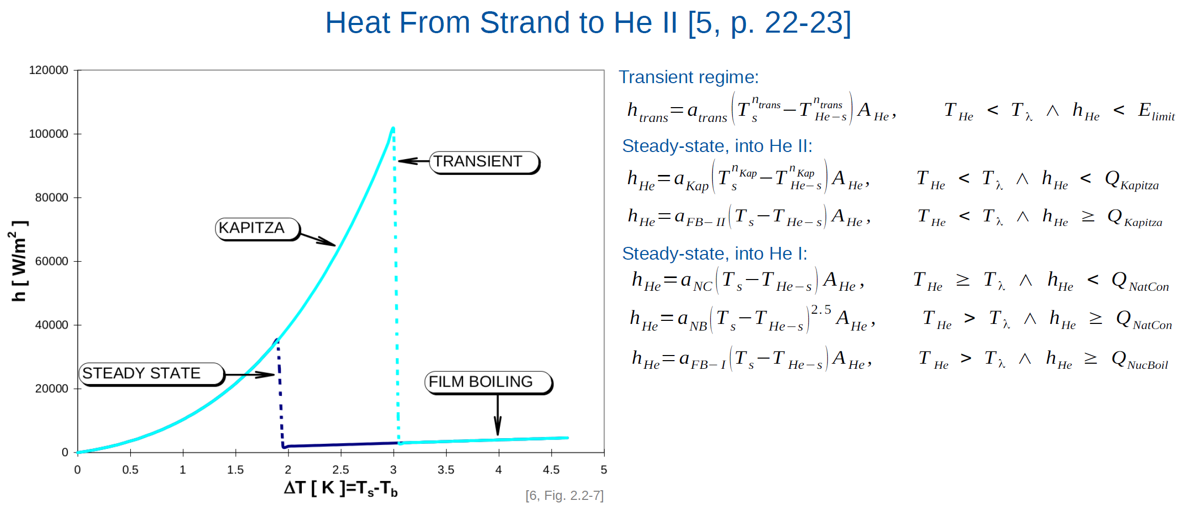
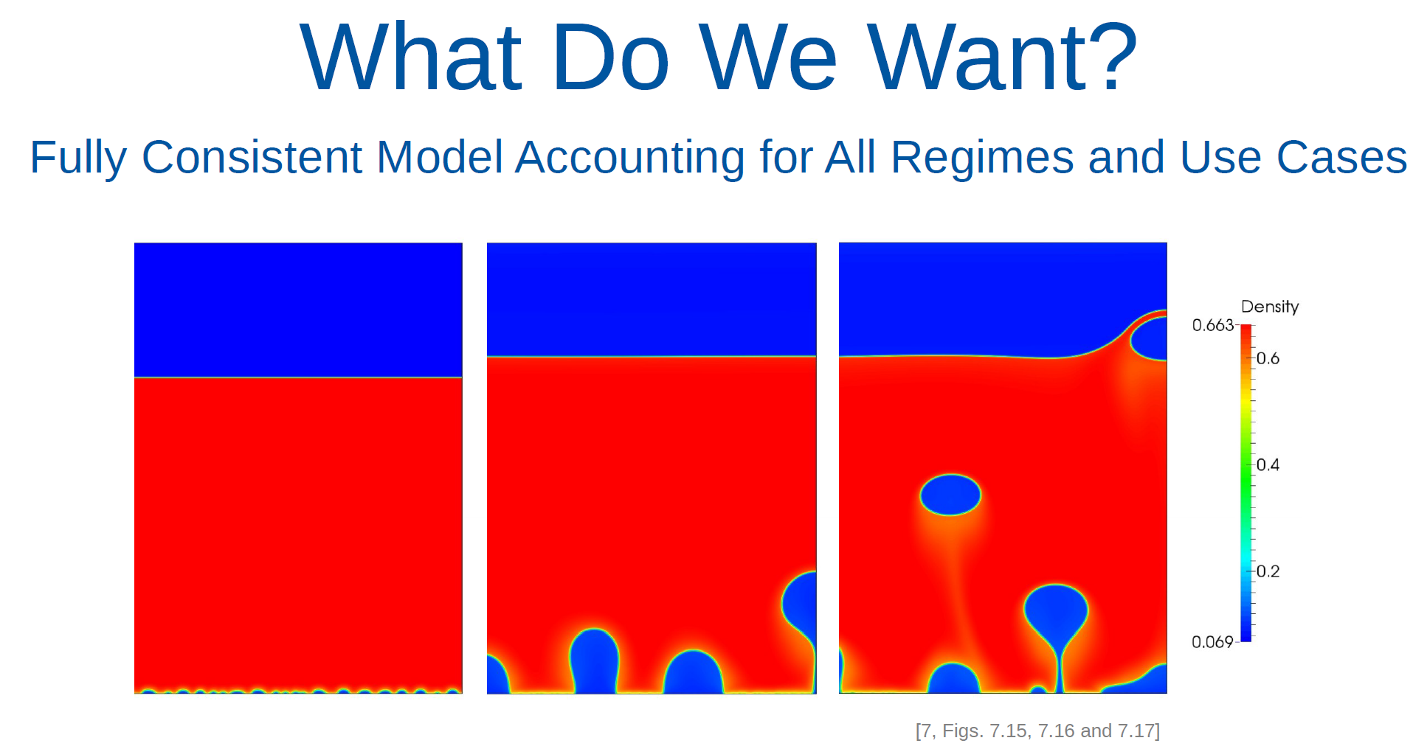
Towards a Port–Hamiltonian Description of Superfluid Helium in LHC Magnets

Slide 13
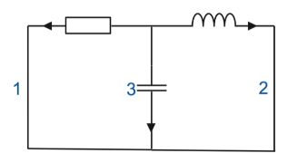
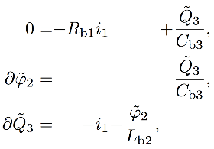



Port-Hamiltonian Representation of RLC Network Equations
PH Representation of the Combination of Loop-Current and Cut-Set-Voltage Method
For the example (right) the equations
read in terms of fluxes and charges
We compare to the dissipative constrained port-Hamiltonian system
with and
III
I
II

Slide 14
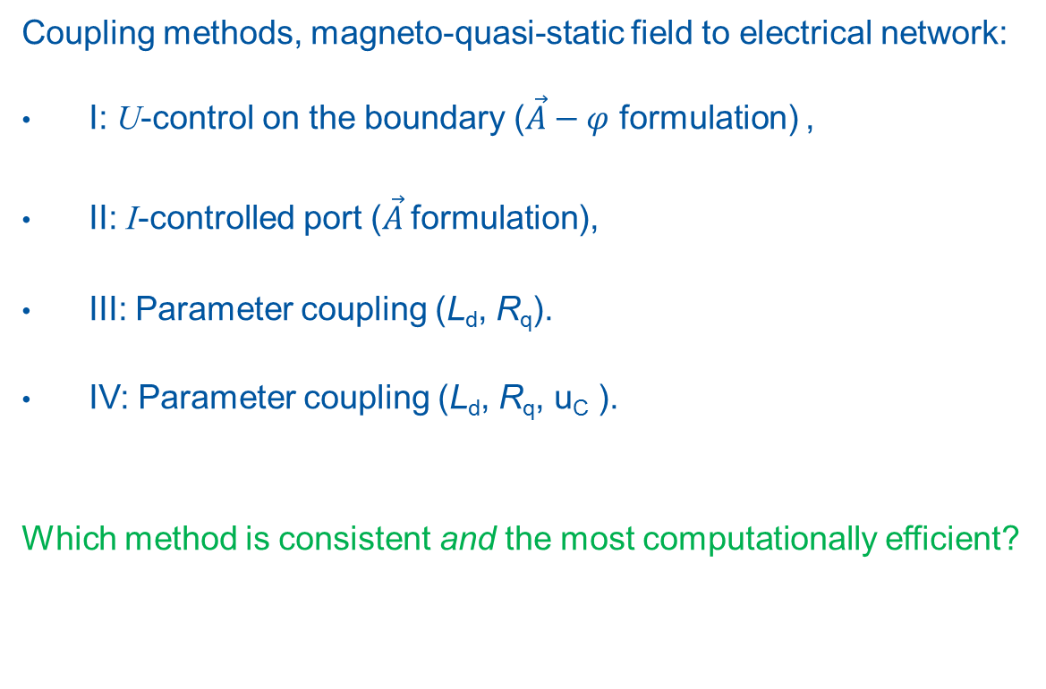
Port-Hamiltonian Formulation of Circuit-FEM Coupling for Superconducting Magnet Circuits
I
R
Coupling methods, magneto-quasi-static field to electrical network:
I: U-control on the boundary ($\vec{A}−φ$ formulation) ,
II: I-controlled port ($\vec{A}$formulation),
III: Parameter coupling (L_{d}, R_{q}).
IV: Parameter coupling (L_{d}, R_{q}, u_{C} ).
Which method is consistent and the most computationally efficient?
II
R
III
L_{d}
R
L_{d}
IV
R
+
-

Slide 15
Co-simulation of superconducting magnets - Open questions
Coupling strength between physical domains
  Sensitivity bond graph?
  Dirac structure analysis?
Order of execution of simulations
  Computational causality.
Convergence of various co-simulation schemes
  Stability analysis based on Hamiltonian function as a Lyapunov function candidate for time-delay systems?

Slide 17
Field-circuit coupling – Implementation (1)
I Voltage Source Coupling Interface
Circuit: Inductor as a voltage source
Field: Inductor driven by the current obtained from circuit
No Convergence
III Parameter Coupling Interface
Conceptually wrong: energy is not conserved, unless Ld = L
In the trivial scenario where Ld = L no coupling is needed
Not meaningful
Circuit
Field
Circuit
Field
i(t)
i_{R}(t)
i_{M}(t)
i(t)
i_{R}(t)
i_{L}(t)
u_{L}(t)
?
+
-
i_{M}(t)
u_{R}(t)
u_{M}(t)
u_{M}(t)
u_{R}(t)
R
L_{d}
u_{M}(t)
L
R
$$i_{M}\left(t\right)=i\left(t\right)−i_{R}\left(t\right)$$
$$u_{M}\left(t\right)=L\frac{di_{M}\left(t\right)}{dt}$$

Slide 18
Field-circuit coupling – Implementation (2)
IV Parameter Coupling Interface
Circuit: Inductor as a differential inductance
Field: Differential inductance calculated from magnetic flux
The effect of the difference between the two differential inductances is represented as a voltage source u_{c}.
II Current Source Coupling Interface
Circuit: Inductor as current source
Inductor is driven by a voltage source obtained from the circuit
Circuit
i_{L}(t)
Field
Circuit
Field
i(t)
i_{R}(t)
i_{L}(t)
i_{L}(t)
i(t)
i_{R}(t)
i_{M}(t)
u_{R}(t)
u_{L}(t)
L_{d}
+
-
u_{R}(t)
R
u_{M}(t)
L
u_{R}(t)
i_{M}(t)
+
-
u_{M}(t)
L
R
u_{C}(t)
+
-
u_{C}(t)=u_{M}(t)-u_{L}(t)
i_{M}(t)
i_{M}(t)
$$u_{C}\left(t\right)=u_{M}\left(t\right)−u_{L}\left(t\right) \\ u_{C}\left(t\right)= (L−L_{d})\frac{di_{L}}{dt}$$
$$u_{M}\left(t\right)=L\frac{di_{L}\left(t\right)}{dt}$$
$$i_{L}\left(t\right)=\frac{1}{L}\int{u_{R}\left(t\right)+i_{0}}$$
$$Ri_{L}\left(t\right)=u_{C}\left(t\right)+L_{d}\frac{di_{L}\left(t\right)}{dt}$$
$$u_{R}\left(t\right)=R(i\left(t\right)−i_{L}\left(t\right))$$
$$L_{d}\frac{di_{L}\left(t\right)}{dt}+Ri_{L}\left(t\right)=Ri\left(t\right)−u_{C}(t)$$
$$u_{C}\left(t\right)=u_{M}\left(t\right)−u_{L}\left(t\right) \\ u_{C}\left(t\right)=u_{M}\left(t\right)−L_{d}\frac{di_{L}}{dt}$$

Slide 19
Linear inductor coupling - convergence
Parameter Coupling Interface
Source Coupling Interface
$$error=\sum_{h}{{\left(i_{L}^{k−1}−i_{L}^{k}\right)}^{2}}$$

