Slide 1
Observation from LHC operation
UFO quenched a magnet, 9/6/2016, 1:55
Asynchronous beam dump test quenched several magnets, 15-MAY-2016 12:08

Slide 2
Fill 4896: UFO quenched magnet, 9/6/2016, 1:55
UFO came up, maximum amplitude at 975 ms at BLMBI.27R6.B0T20_MBA-MBB_27R6, beam loss for about 0.5 ms
Magnets quenched
Quench was detected, quench heaters were fired
Recording of time of QPS is not synchronised to beam events on a level at a ms or better
Beam dump 1019.1 ms
Sudden orbit change 1014 ms
Acknowledgement to Matti Kalliokoski, Anton Lechner, Jorg Wenninger, Lorenzo Bortot

Slide 3
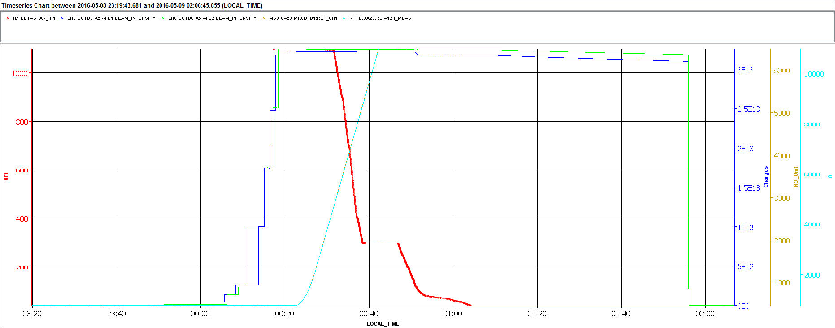

Slide 4
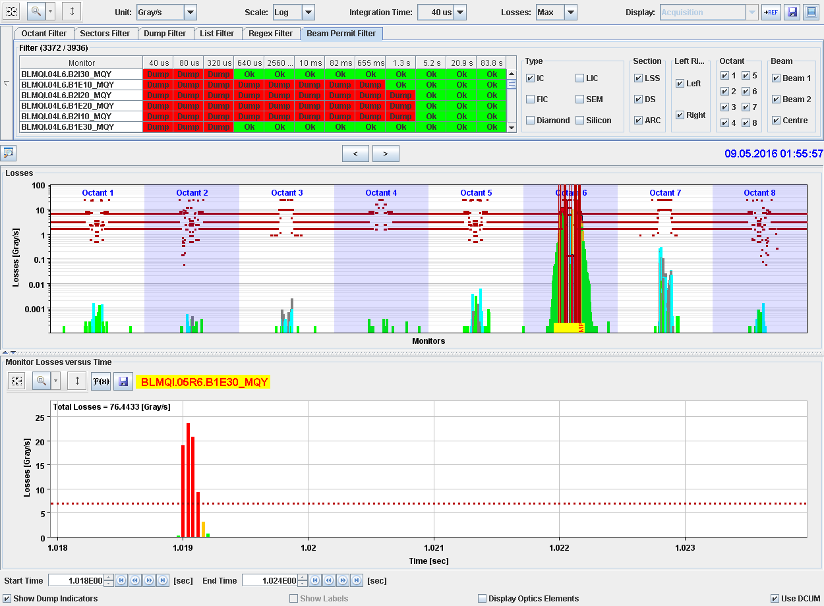

Slide 5
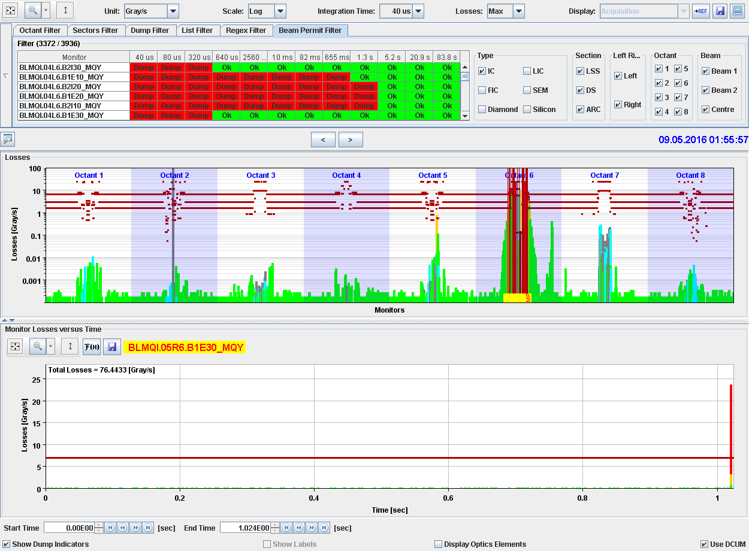

Slide 6
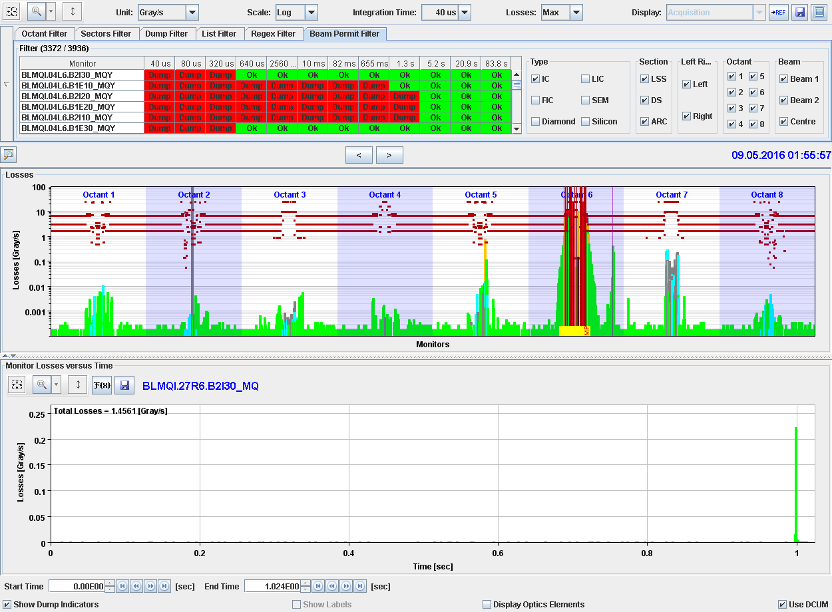

Slide 7
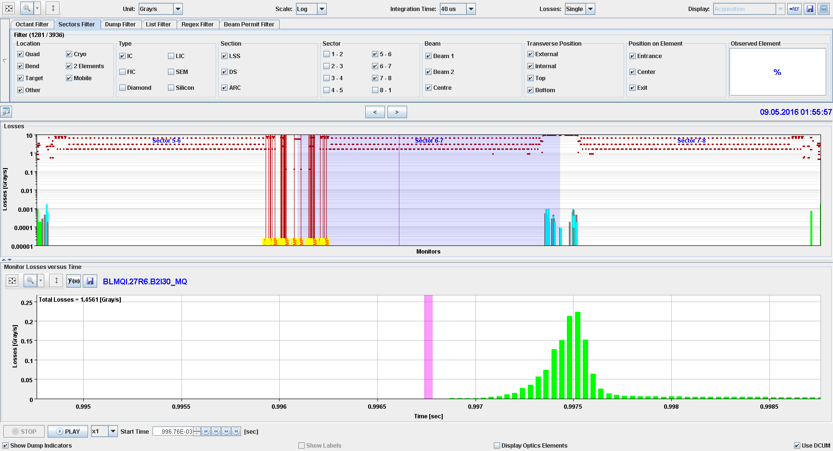
UFO that quenched, 9/6/2016, 1:55:57, before UFO

Slide 8
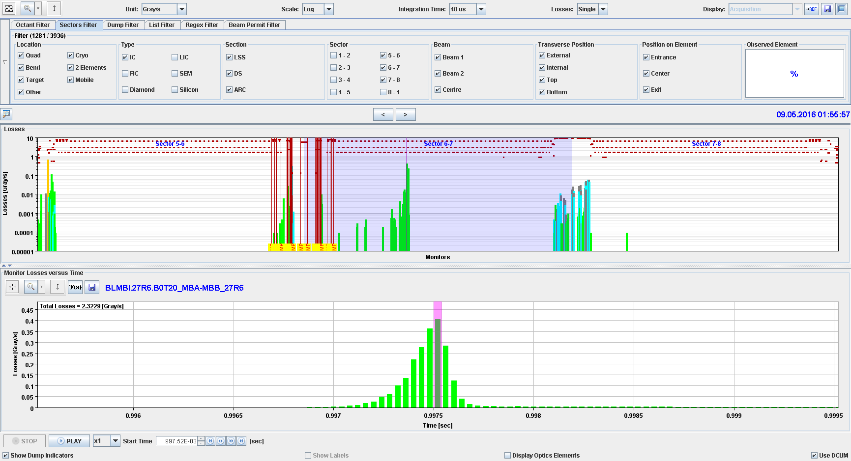
UFO on Beam 2
UFO that quenched, 9/6/2016, 1:55:57, UFO maximum in arc

Slide 9
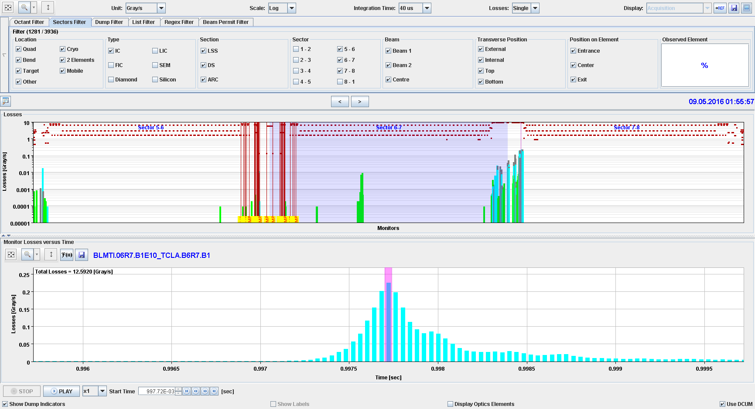
UFO that quenched, 9/6/2016, 1:55:57, UFO maximum in IR7

Slide 10
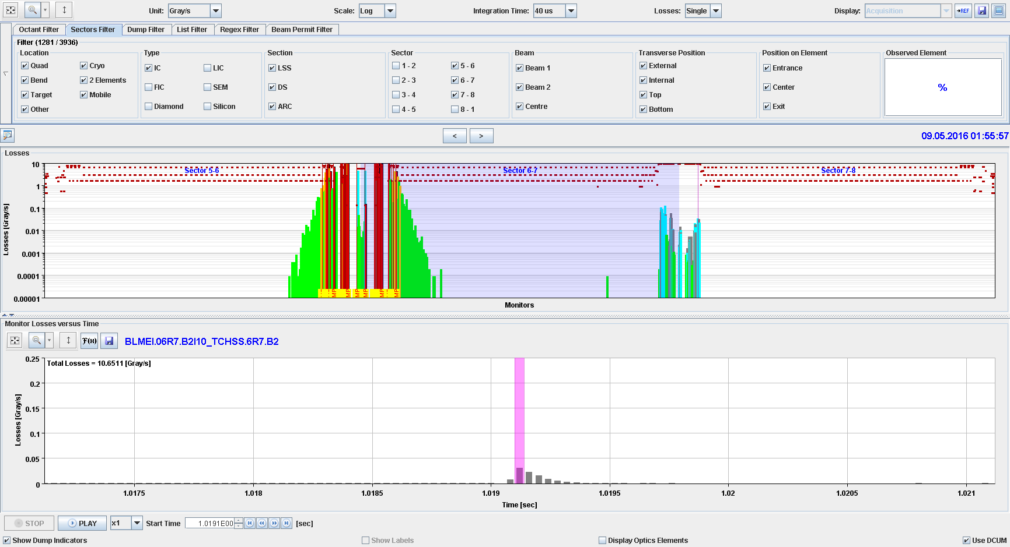
UFO that quenched, 9/6/2016, 1:55:57, during dump

Slide 11
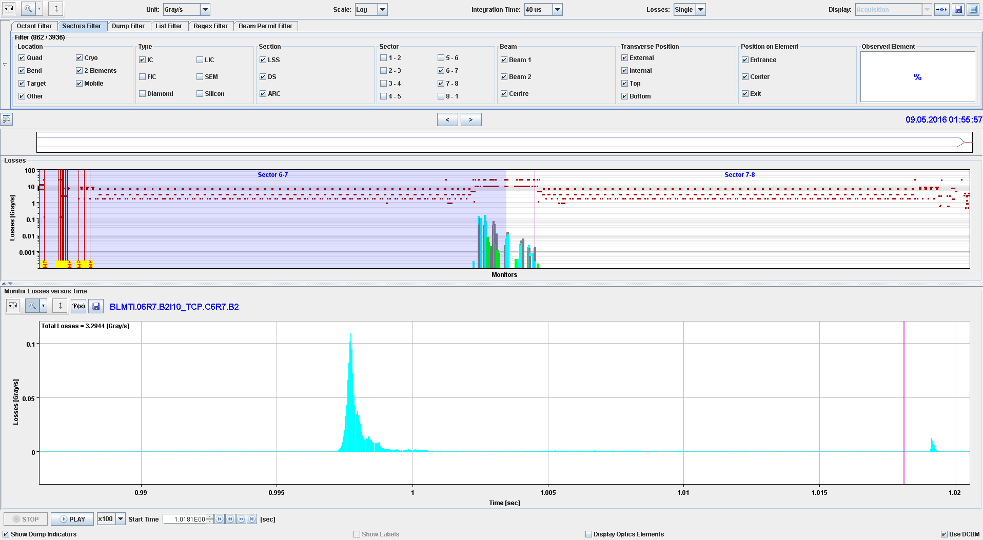

Slide 12
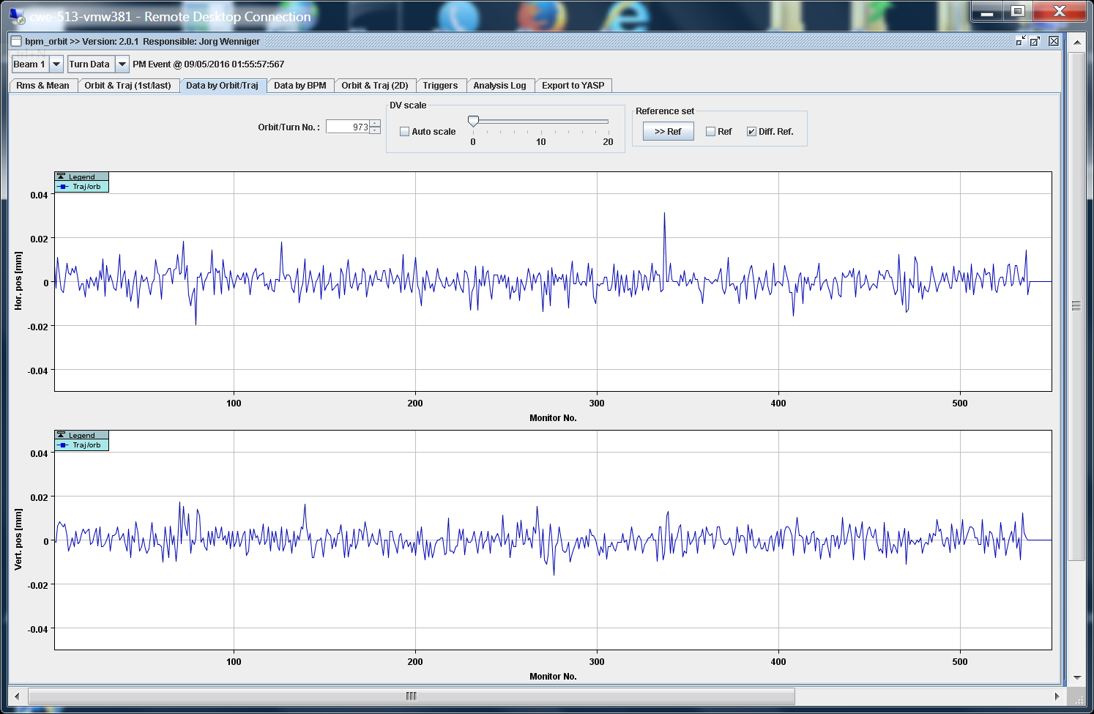
Trajectory Beam 1

Slide 13
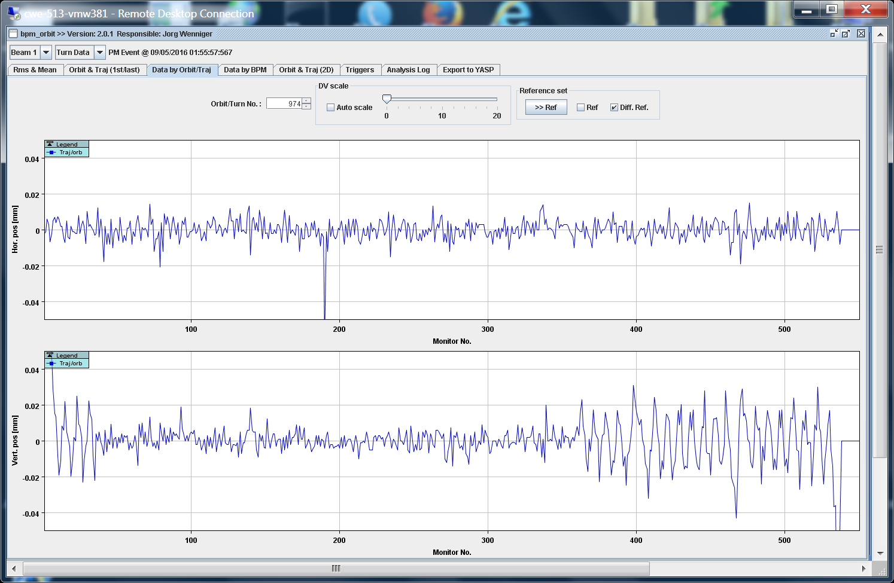

Slide 14
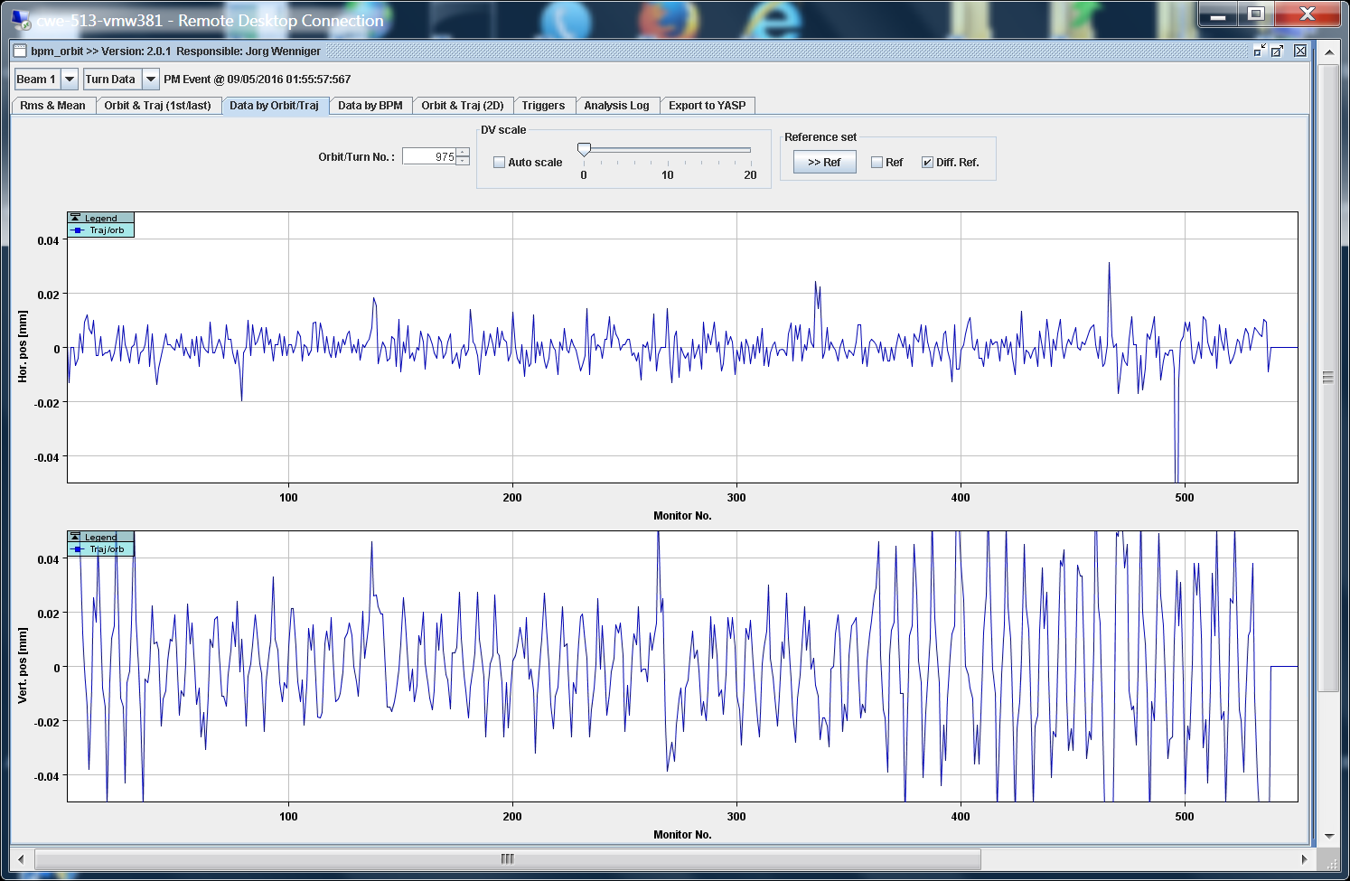

Slide 15
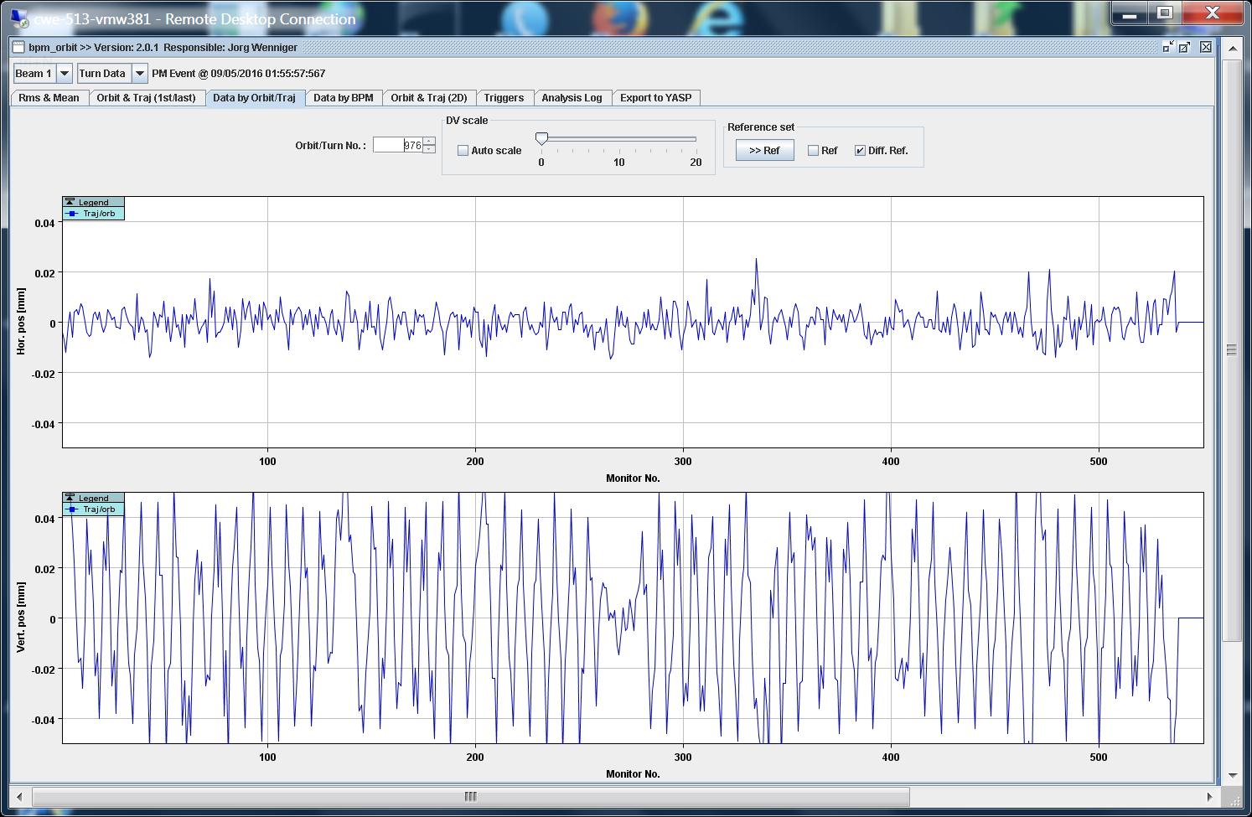

Slide 16
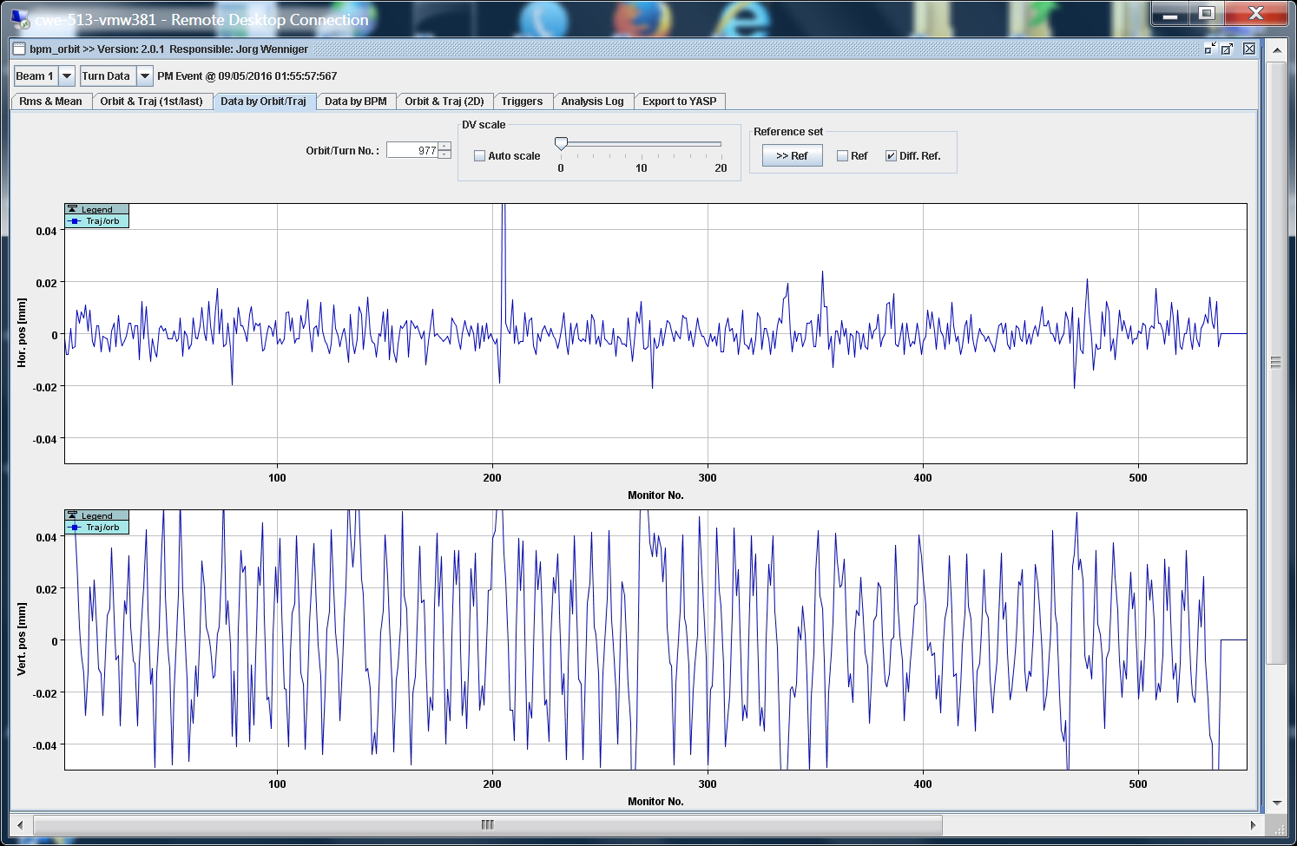

Slide 17
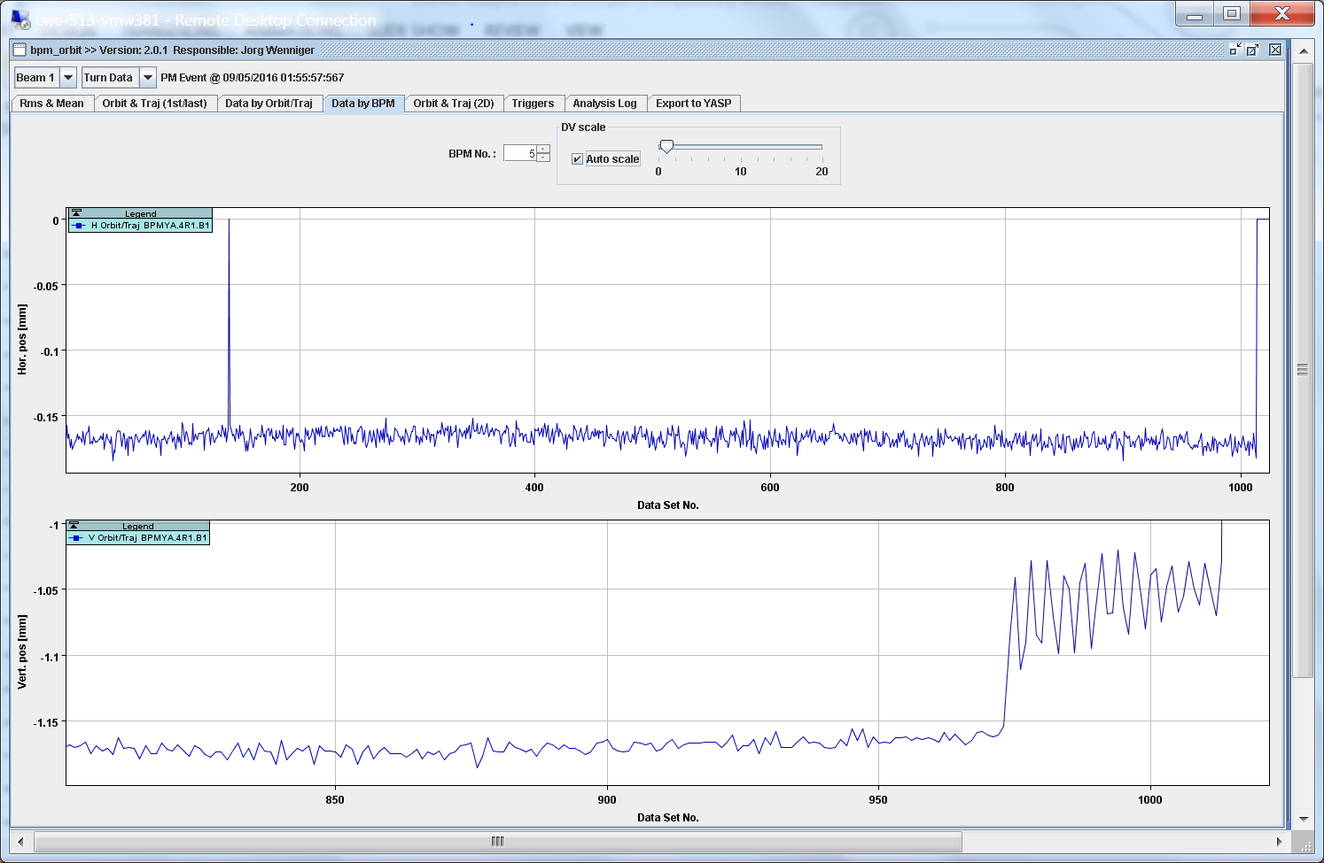

Slide 18
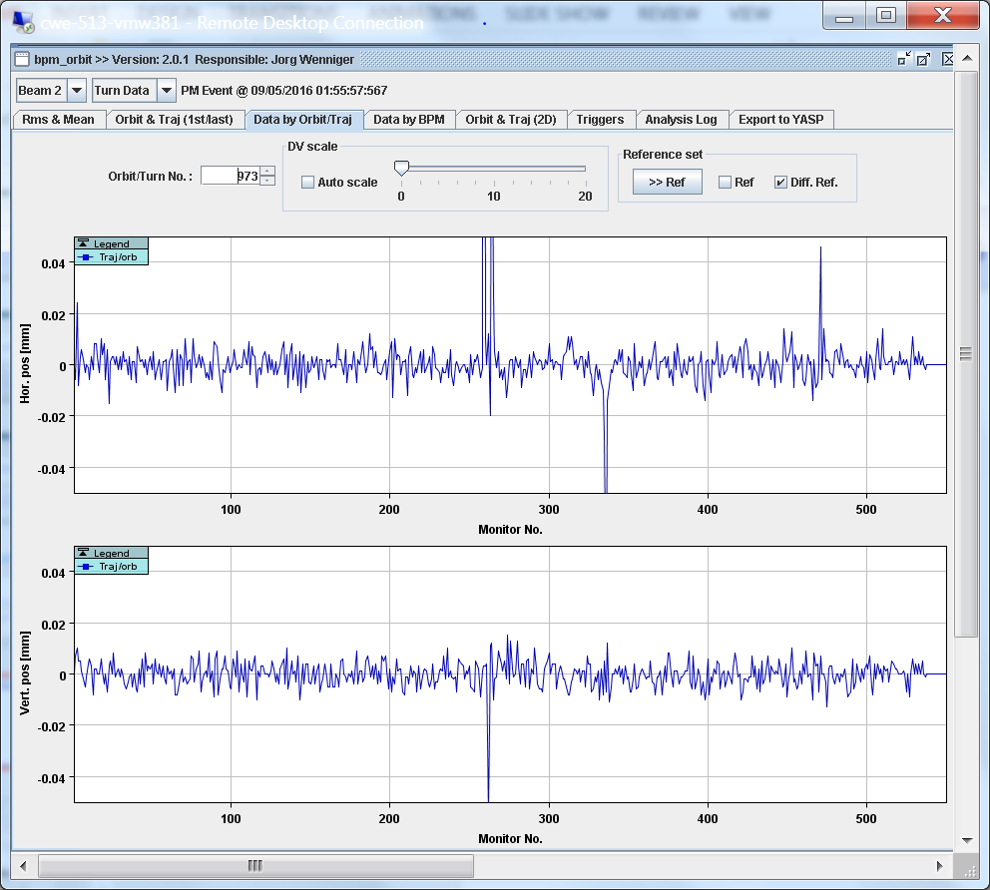

Slide 19
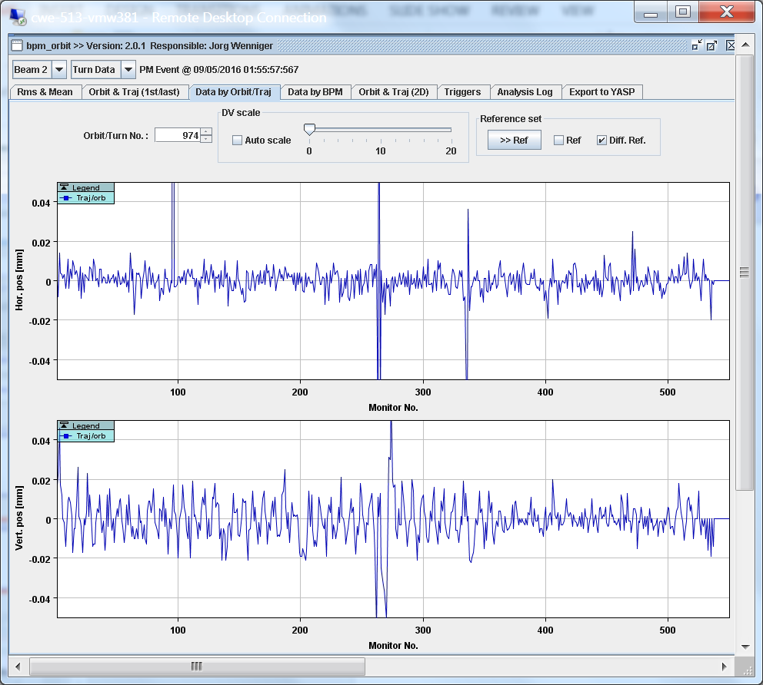

Slide 20
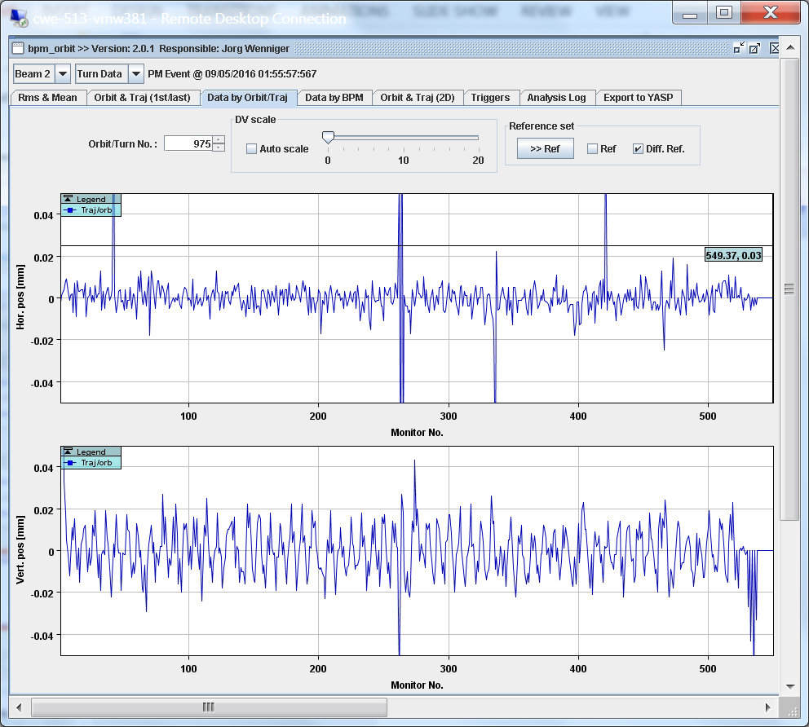

Slide 21
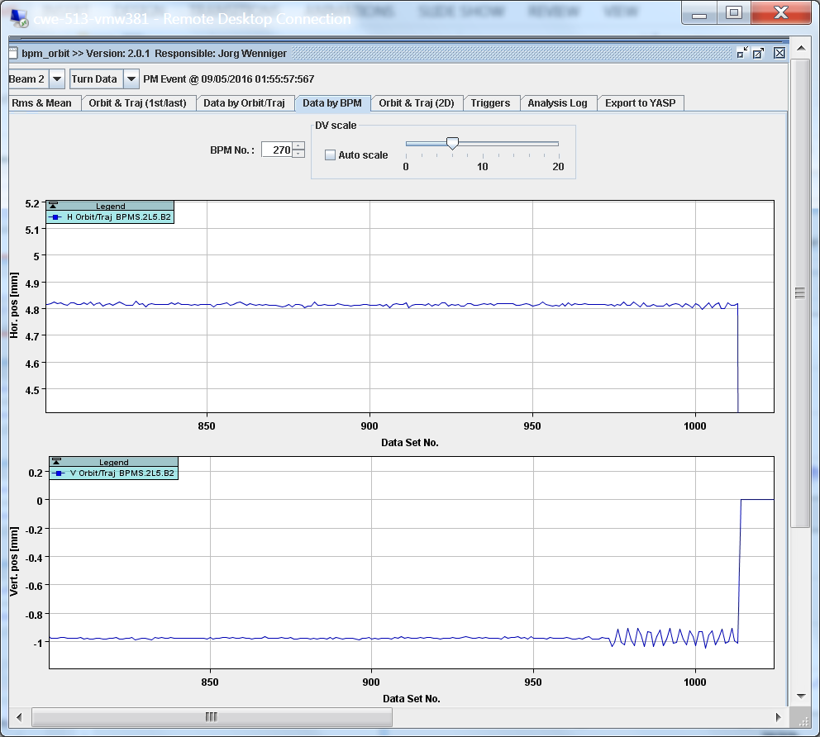

Slide 22
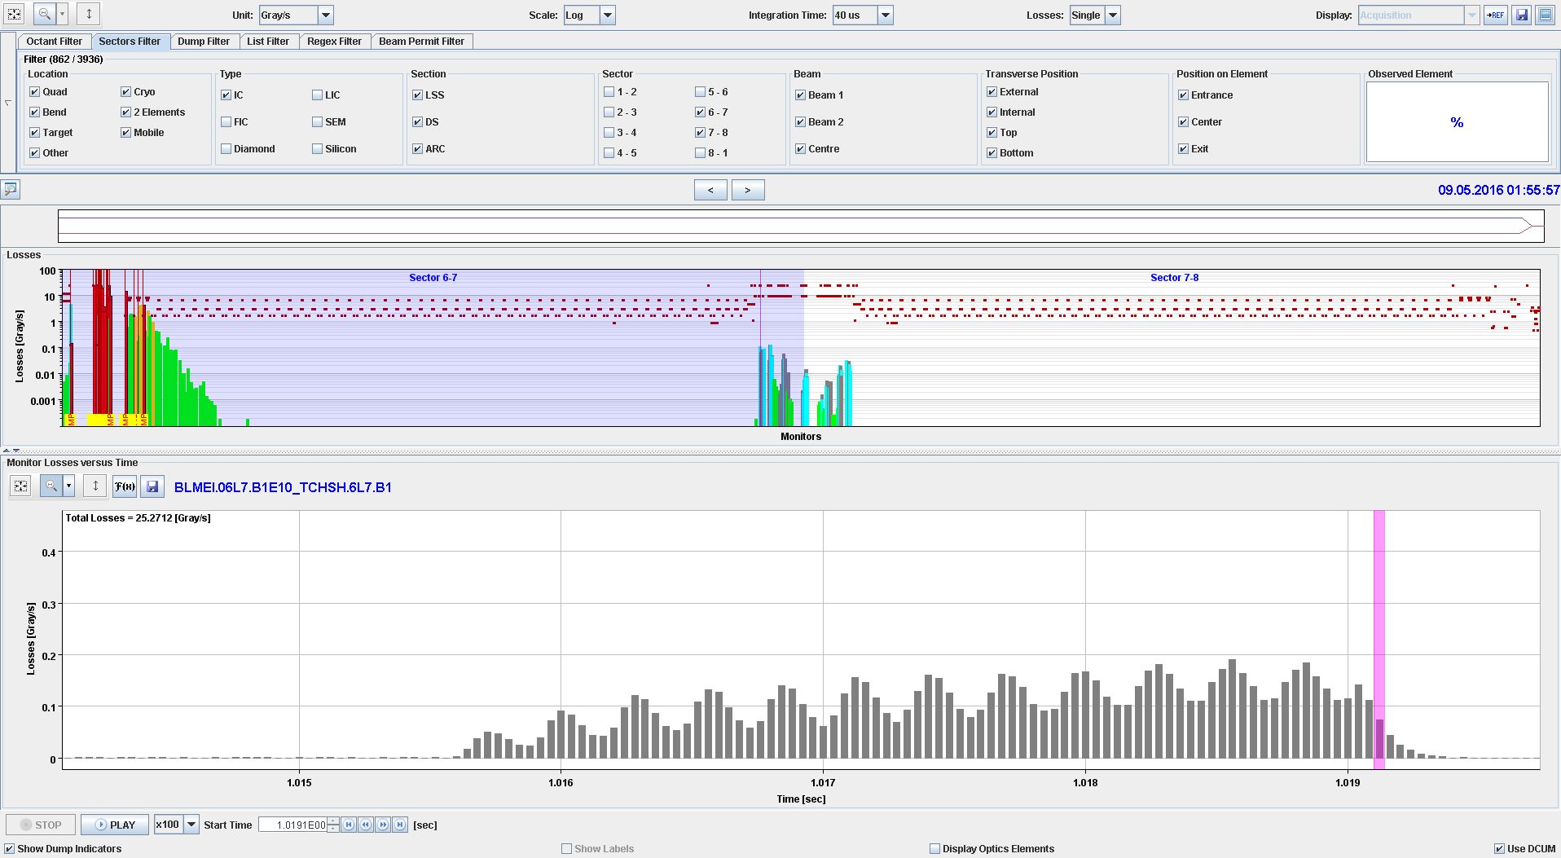

Slide 23
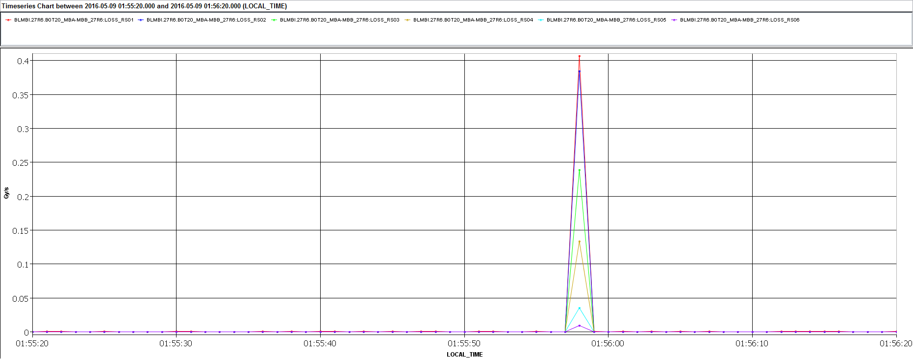

Slide 24
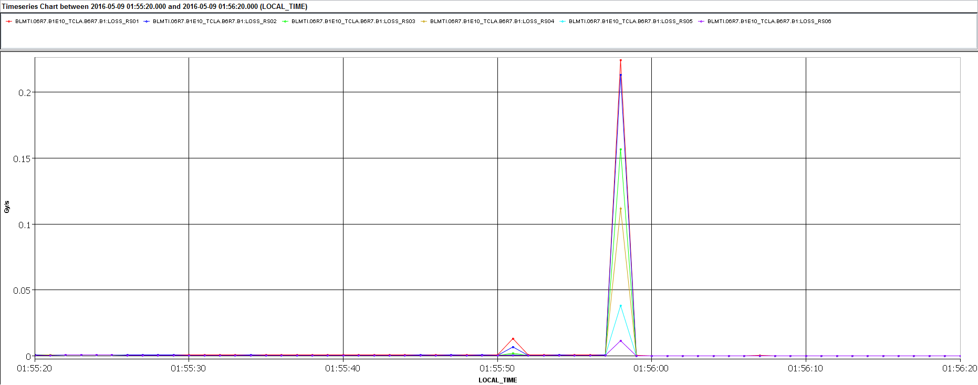

Slide 25
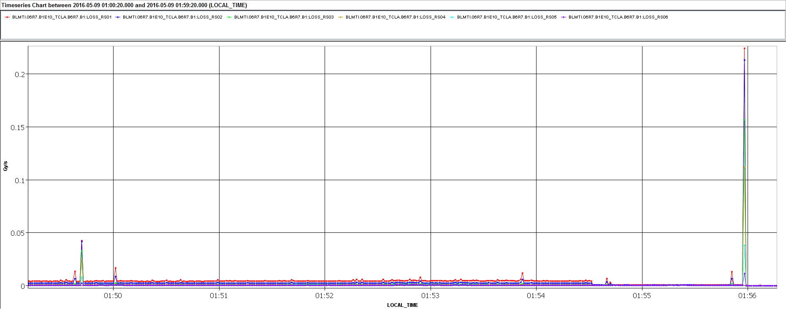

Slide 26
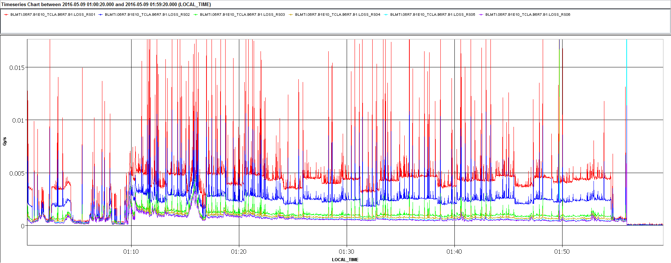

Slide 27
Training quench 03-NOV-2015 07.25.49
During a luminosity fill, a training quench happened on 3/11/2015
The beams were dumped correctly, triggered by the QPS via the PIC and the BIC
Training quench of MB.A32L2 after nearly 12h at flat top.

Slide 28
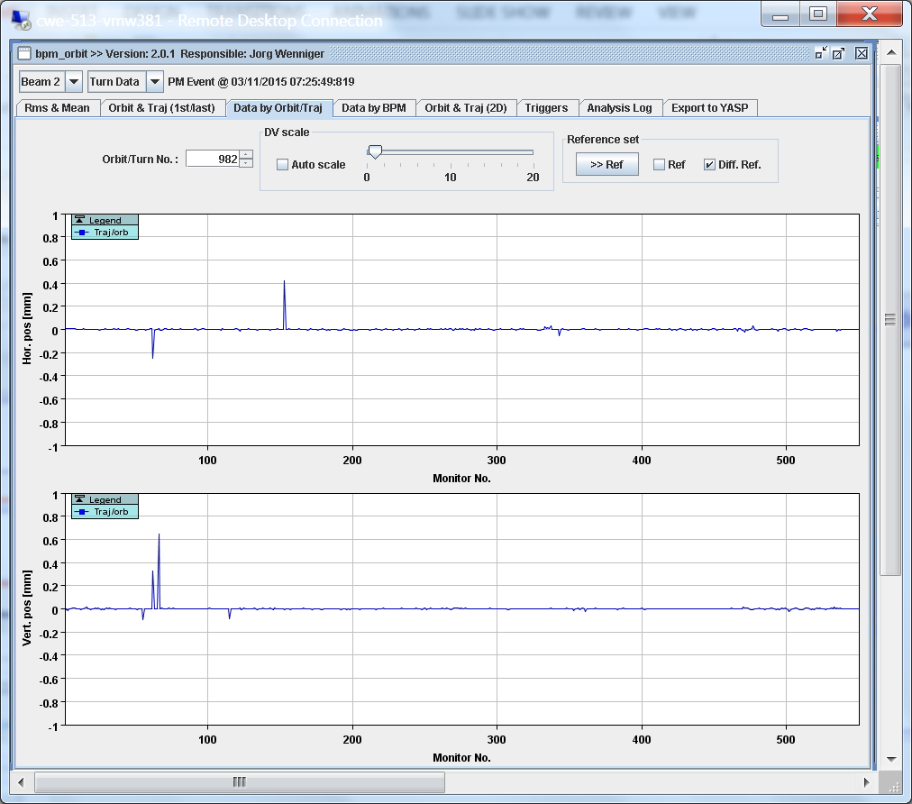

Slide 29
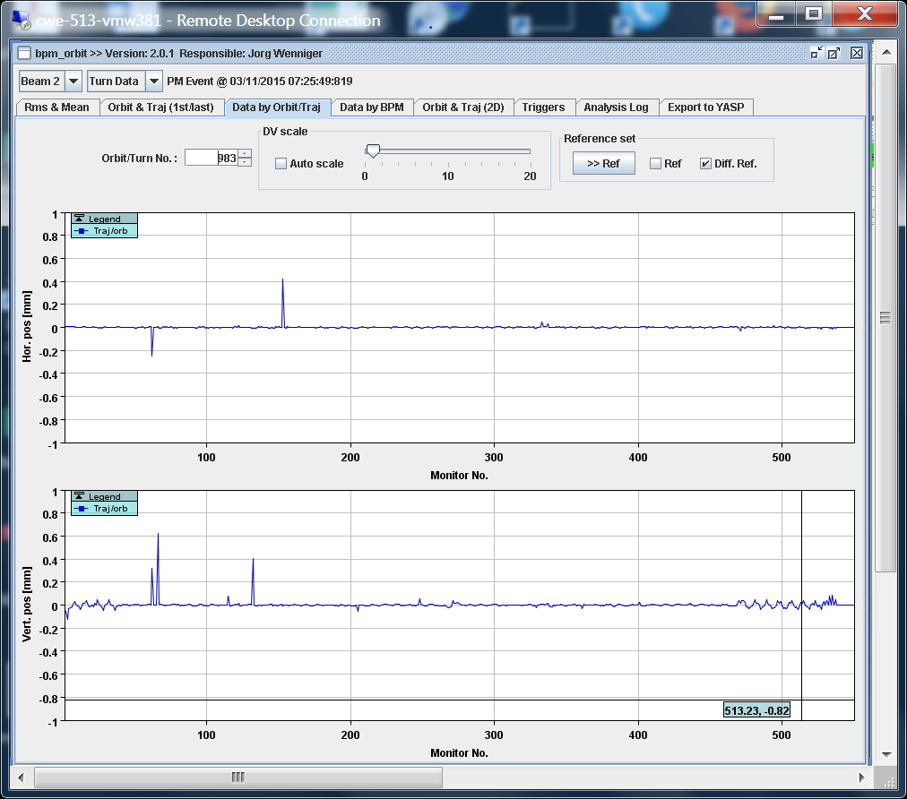
B32.L2

Slide 30
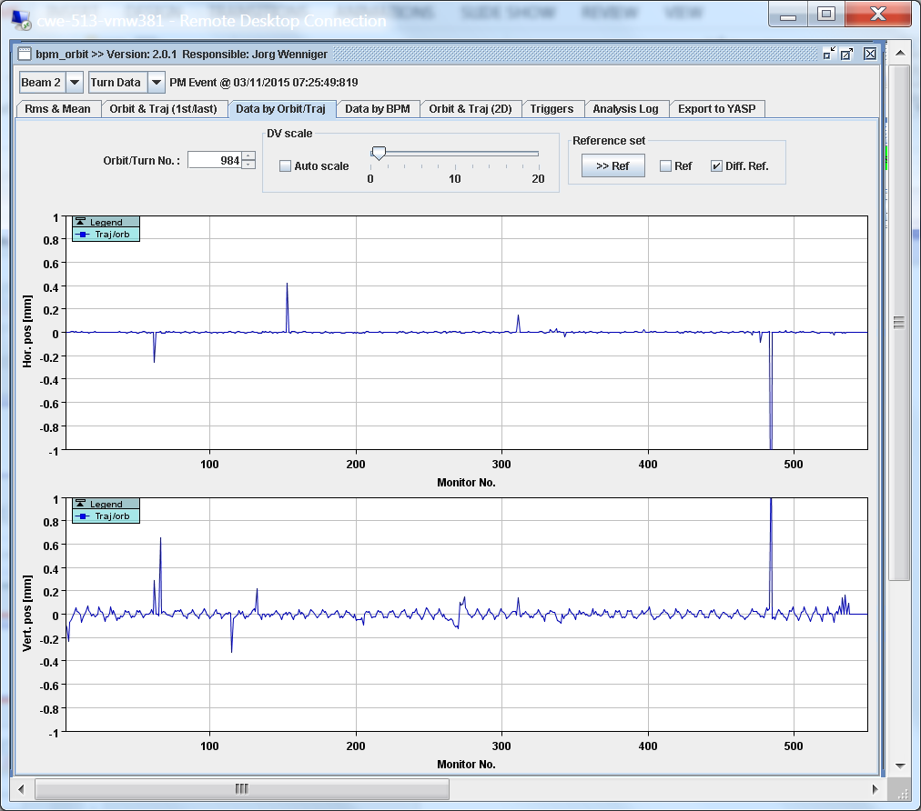

Slide 31
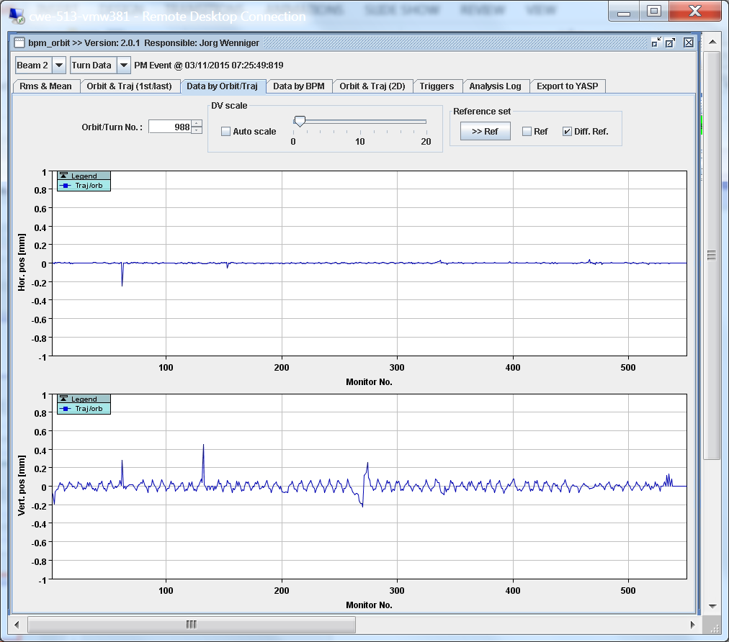

Slide 32
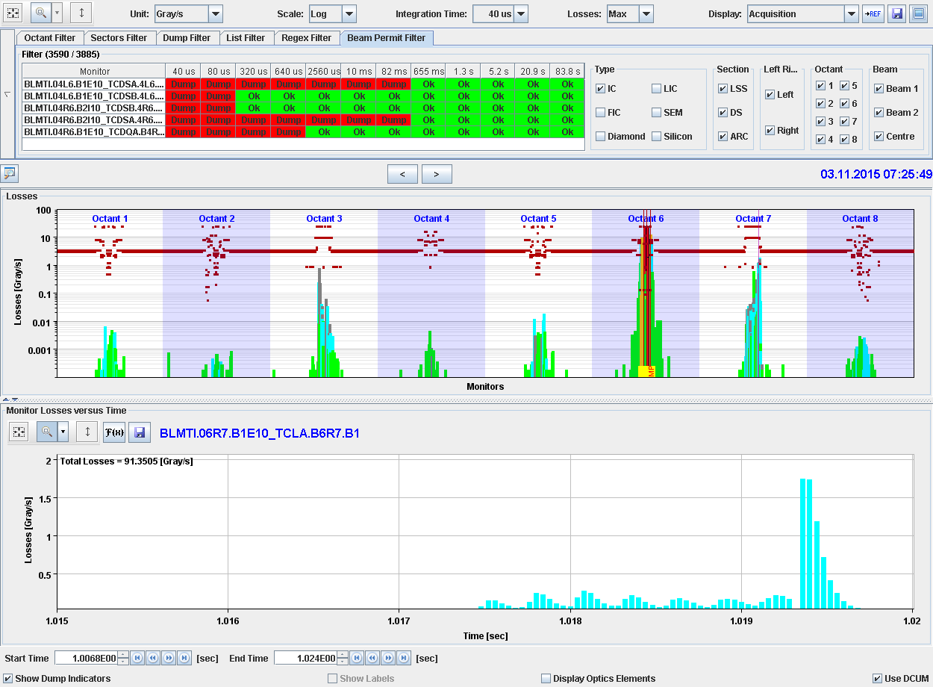

Slide 33
Reiner
C26R7 DQHDS trigger relay is: Δt_{HDS} = 4.943 ms (measured by DQHSU, raise time 320 μs); from the relay datasheets one can deduce Δt_{MAX-HDS} = 6 ms
QPS interlock loop opening time delay is: Δt_{MAX-DQQLC} = 5.5 ms
QPS timing is coherent (nQPS/iQPS) but not in sync with PIC history buffer (Δt ≈ 5 ms odd, Δt ≈ 7 ms even)
PIC history buffer is also off with respect to dump time (Δt ≈ 3 ms)
One can conclude that it is indeed possible that heaters are fired with beam still in the machine (for about 1 ms …).

Slide 34

Remarks
When a dipole magnet quenches, the beam is dumped about 2-3 ms later
A few ms before the beam dump, the vertical orbit changes slightly, a horizontal orbit change has not been observed
The source of the orbit change is a fast deflection (in the order to 100 us) at the location of the quenching magnet
The orbit changes, the beam tail touches the collimators in IR7, and losses are observed. The amplitude of the losses changes with the betatron tune
What kicks the beam ?

