Slide 1
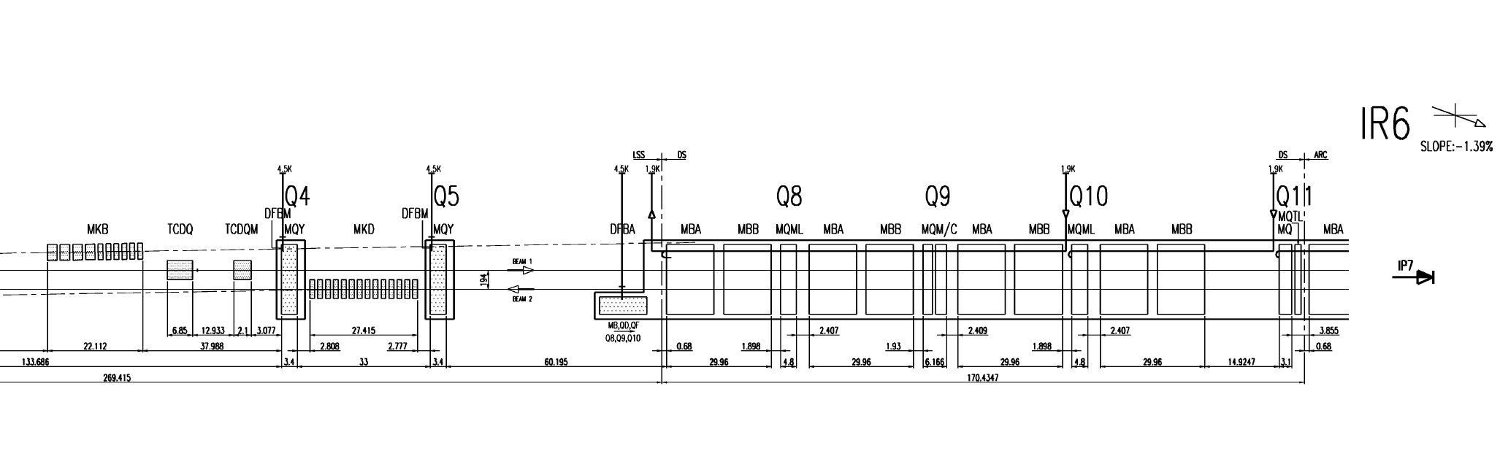
A8R6: Beam Induced Quench at 15/05/2016 (1)
A8R6
B8R6
A9R6
B9R6
A10R6
B10R6
A11R6
B11R6
A12R6
160515-120845.820_RPTE.UA67.RB.A67
160515-120845.788_A8R6
160515-120919.897_B8R6
160515-120845.820_RPTE.UA67.RB.A67 [2]
160515-120845.788_A8R6 [1]
160515-120919.897_B8R6 [5]
160515-120845.829_RPHGA.UJ67.RQ8.R6B1/B2
160515-120845.829_RPHGA.UJ67.RQ9.R6B1/B2
160515-120845.829_RPHGA.UJ67.RQ10.R6B1/B2
160515-120845.895_RQ8.R6
160515-120845.884_RQ9.R6
160515-120845.???_RQ10.R5 (NO PM ☹)
160515-120845.820_RPHGA.UJ67.RQ8.R6B1/B2 [2]
160515-120845.820_RPHGA.UJ67.RQ9.R6B1/B2 [2]
160515-120845.820_RPHGA.UJ67.RQ10.R6B1/B2 [2]
160515-120845.895_RQ8.R6 [4]
160515-120845.884_RQ9.R6 [3]
160515-120845.???_RQ10.R5 (NO PM ☹) [3]
160515-120845.829_RPHGA.UJ67.RQ8.R6B1/B2
160515-120845.829_RPHGA.UJ67.RQ9.R6B1/B2
160515-120845.829_RPHGA.UJ67.RQ10.R6B1/B2
160515-120845.895_RQ8.R6
160515-120845.884_RQ9.R6
160515-120845.???_RQ10.R5 (NO PM ☹)

Slide 2
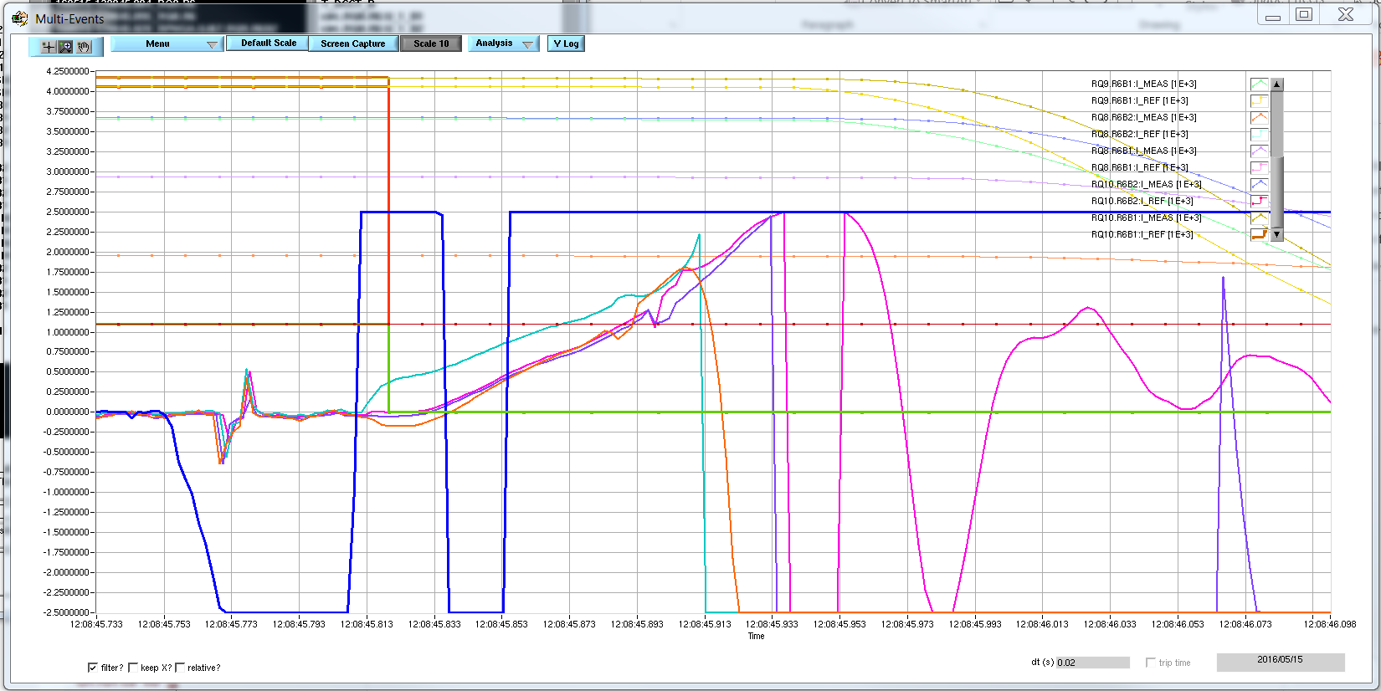
A8R6: Beam Induced Quench at 15/05/2016 (2)
FPA
20 ms
U_RES_B1/B2*10E-1
A8R6:U_QS0*10E-1 (10V/s)

Slide 3
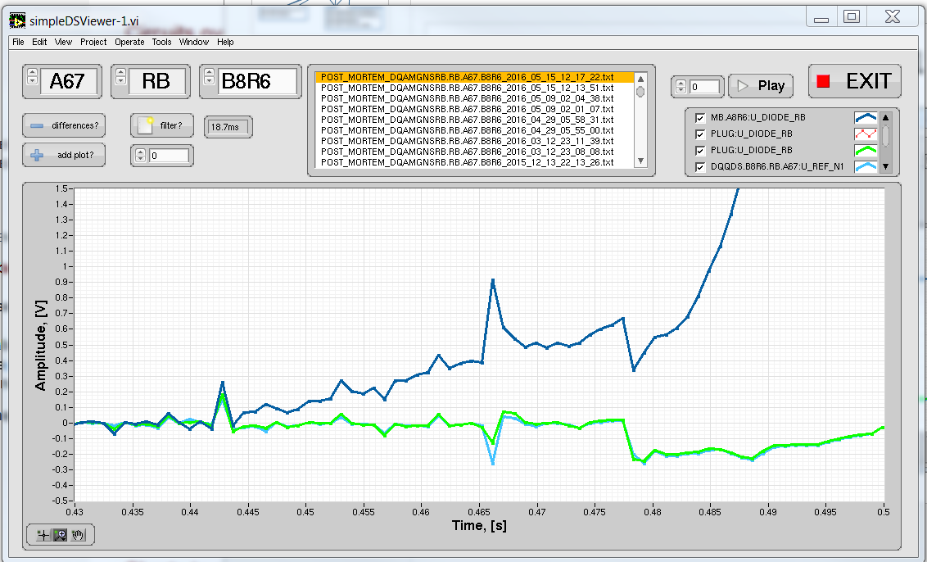
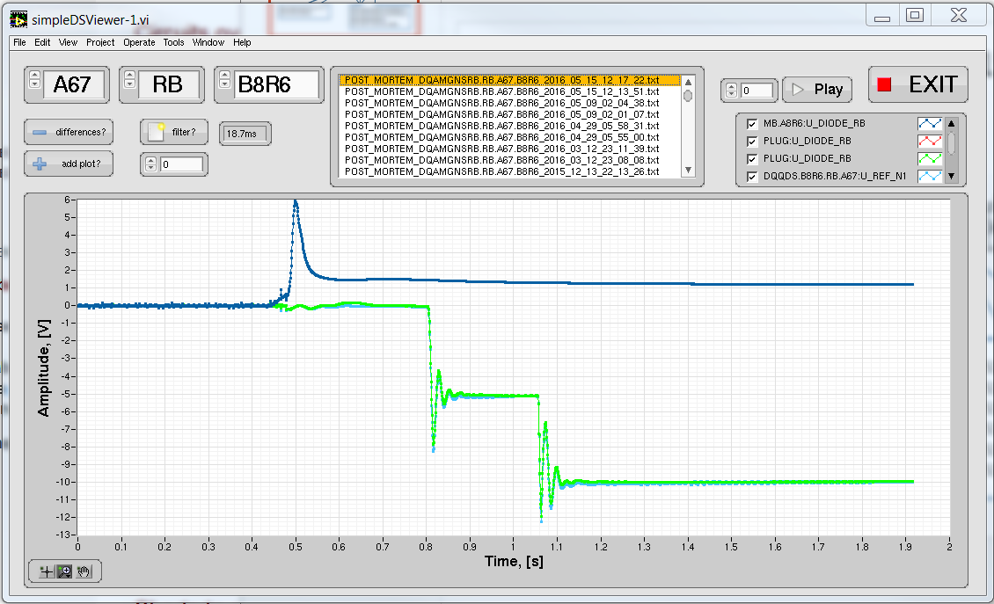
A8R6: Beam Induced Quench at 15/05/2016 (3)

