Slide 2

Failure Modes and Effects Analysis of a CLIQ-based protection of D1 of HL-LHC
Alejandro Fernandez
With inputs from: Knud Dahlerup, Bernhard Auchmann, Joaquim Mourao, Andrea Apollonio and Emmanuele Ravaioli
TE-MPE-PE
09.06.2016
FMEA of a CLIQ-based protection of D1
A. Fernandez

Slide 3
CLIQ connection scheme: D1 independently powered, two CLIQ units attached (redundant system)
FMEA of a CLIQ-based protection of D1
A. Fernandez

Slide 4
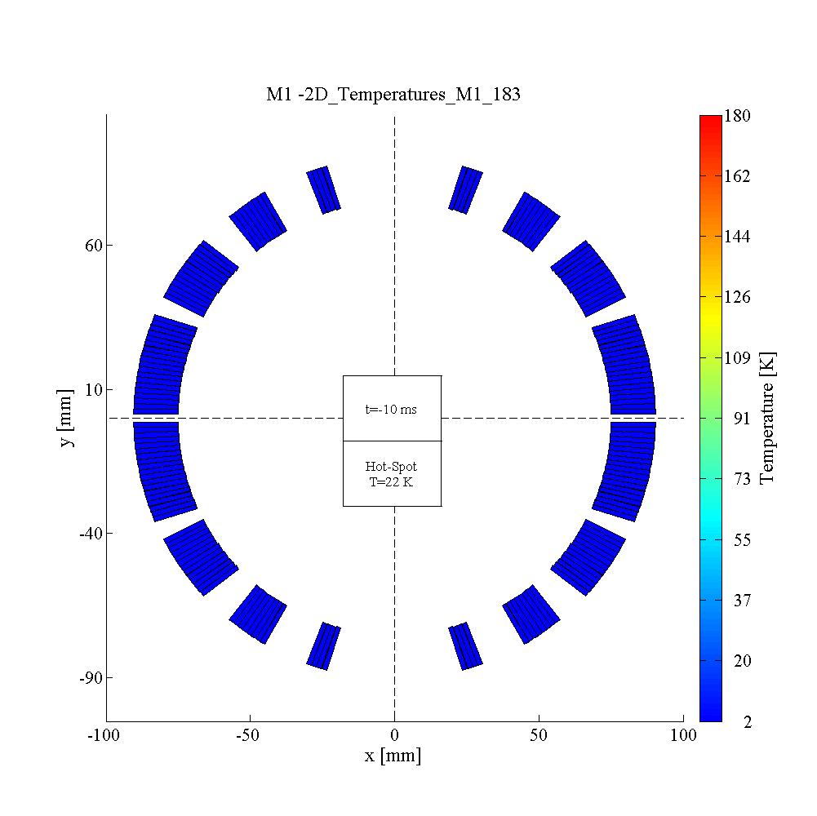

D1 independent circuit.
Currents and temperature profile (GIF)
2 CLIQ units at 600 V / 40 mF. Nominal conditions at 13 kA
$$T_{hotspot}=268 K; U_{maxground}=600 V$$
FMEA of a CLIQ-based protection of D1
A. Fernandez

Slide 5
FMEA procedure
Definition
Failure Modes and Effects Analysis (FMEA) is a methodology for analyzing potential reliability problems early in the development of a system where it is easier to take actions to overcome these issues, thereby enhancing reliability through design. FMEA is used to identify potential failure modes, determine their effect on the operation of the product, and identify actions to mitigate the failures.
Goal
To identify reliability problems in a CLIQ system and to assess the appropriate level of redundancy of the internal CLIQ components.
Risk Priority Number (RPN)
RPN=Severity * Probability * Detectability
Severity: Scaled from 1 to 10 according to the hotspot temperature and maximum voltage to ground of the failure cases.
Probability: Scaled for 1 to 10 according to the failure rate of the failure modes.
Detectability: Inversely scaled fro 10 to 1 according to the implemented mechanisms of detection of the failure cases.
FMEA of a CLIQ-based protection of D1
A. Fernandez

Slide 6
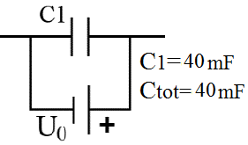
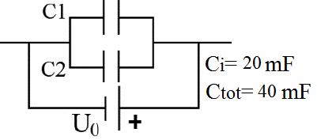
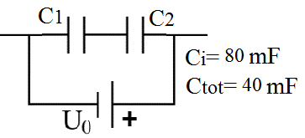
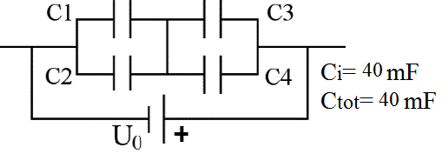
General failure scenarios
Triggering delay of 1 ms of one CLIQ unit with respect to the other
Spurious triggering of one CLIQ unit
One CLIQ unit not firing
Specific failure scenarios
Non-nominal discharge due to one/several capacitors in open/short circuit (depending on the capacitor bank configuration)
Short-circuit of the capacitor bank of one CLIQ unit
FMEA of a CLIQ-based protection of D1
A. Fernandez

Slide 7




D1. Two CLIQ units at 600V, 40 mF
Main failure scenarios for different capacitor bank configurations
(Negligible differences between failures in the first or second CLIQ unit)
FMEA of a CLIQ-based protection of D1
A. Fernandez

Slide 8
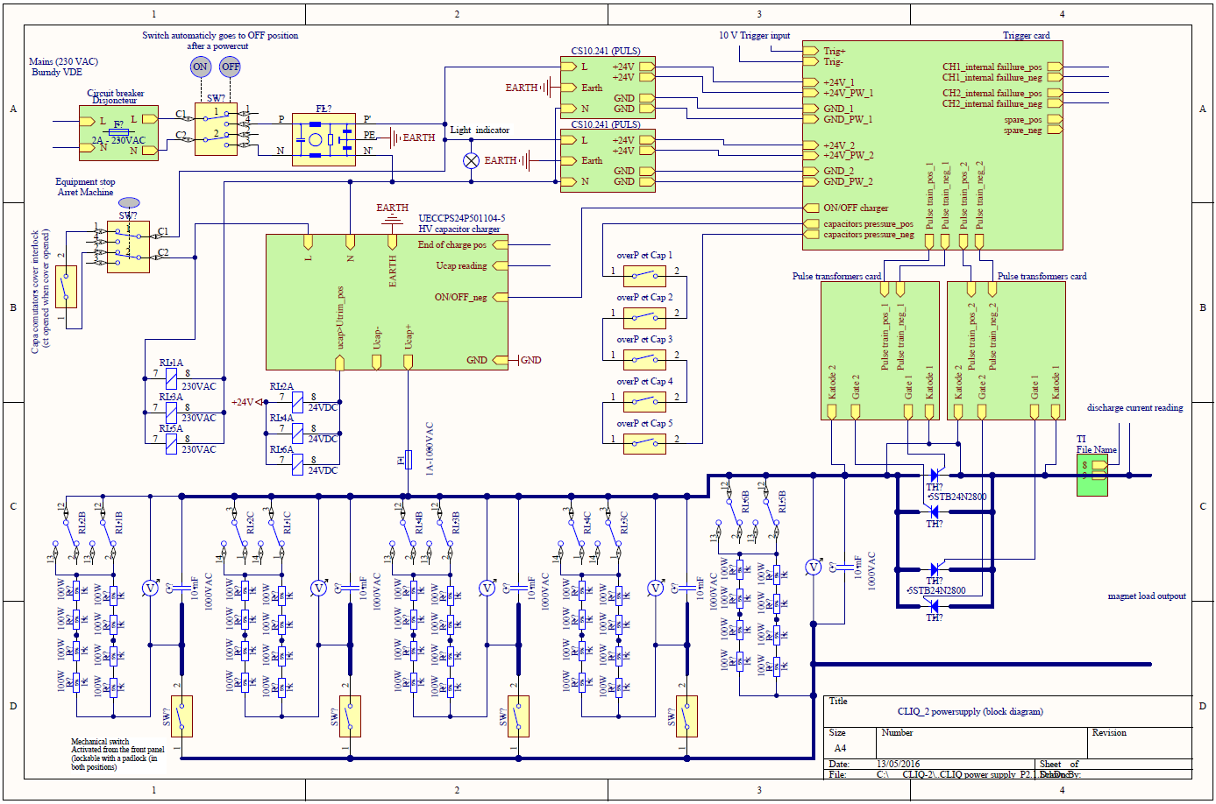
Circuit schematic of a CLIQ unit
TC power supply
Redundant power supply (?)
Trigger card
Redundant circuit (?)
Capacitor charger
Pulse transformer
Redundant transformer (?)
Capacitor bank
(1,2 parallel/series,4?)
Bi-directional thyristor
Redundant thyristor (?)
Courtesy of Joaquim Mourao
FMEA of a CLIQ-based protection of D1
A. Fernandez

Slide 9
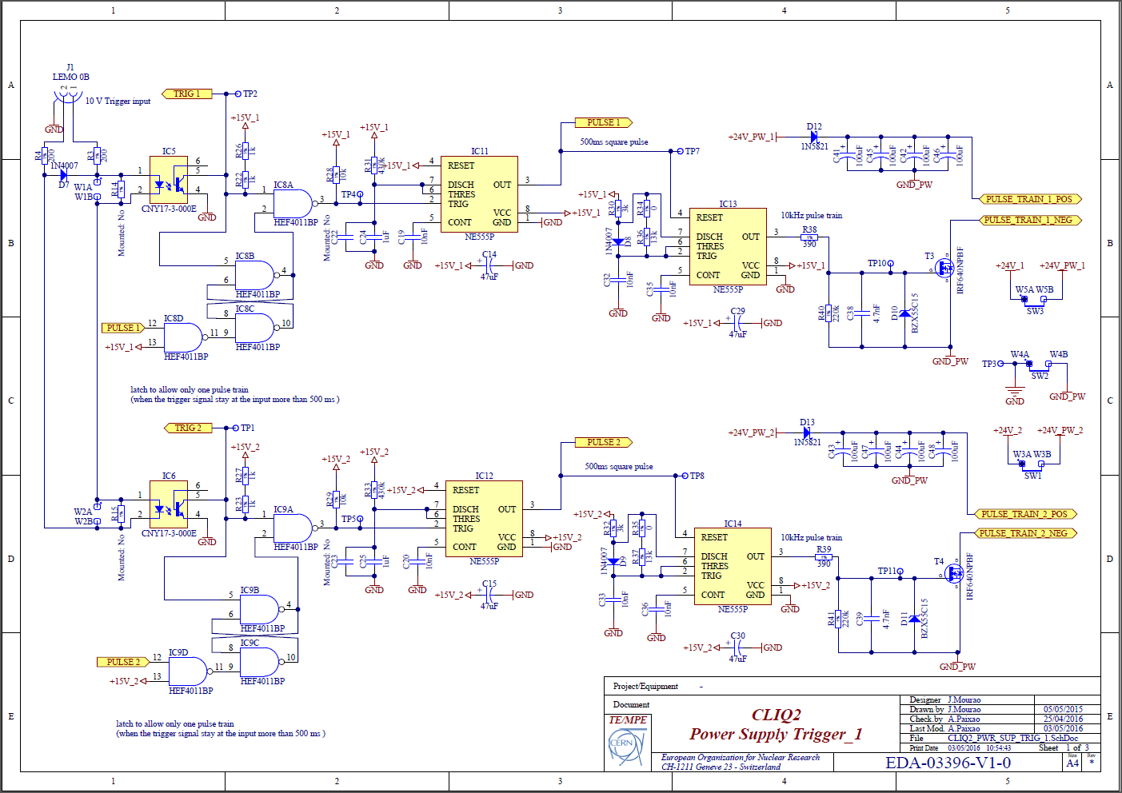
Trigger card circuit schematic
Courtesy of Joaquim Mourao
FMEA of a CLIQ-based protection of D1
A. Fernandez

Slide 10
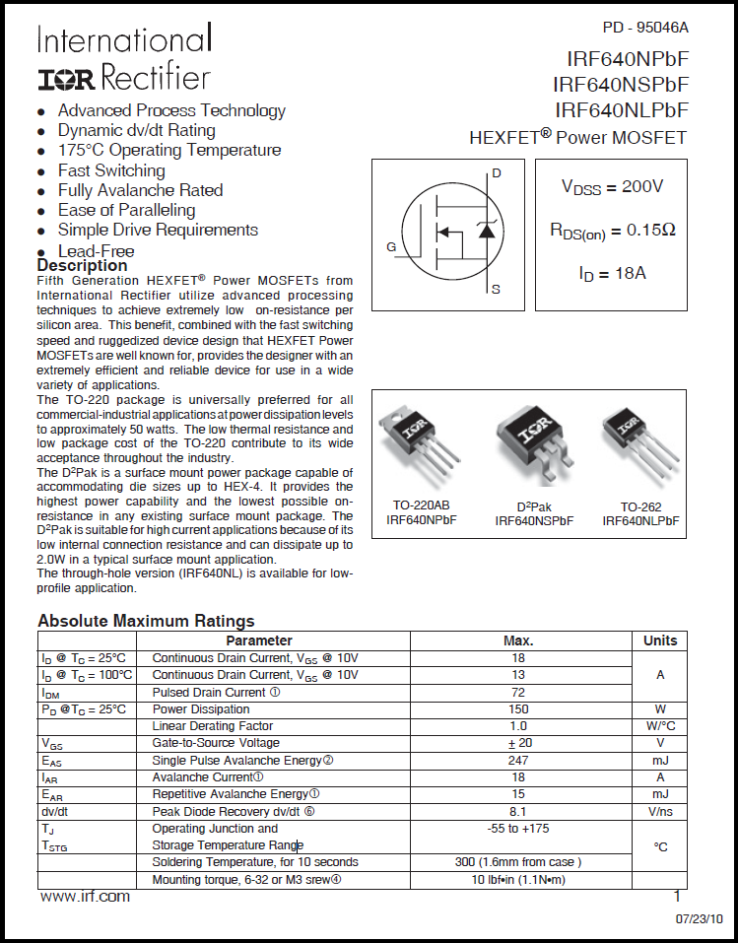
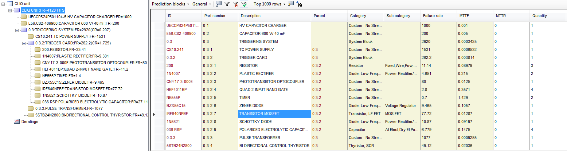
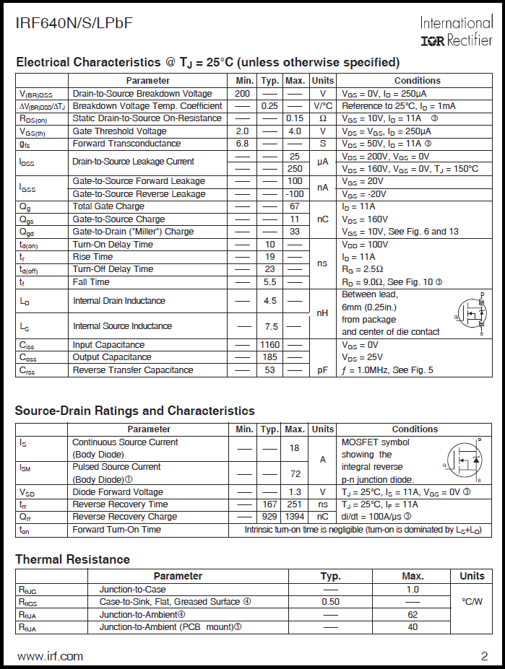
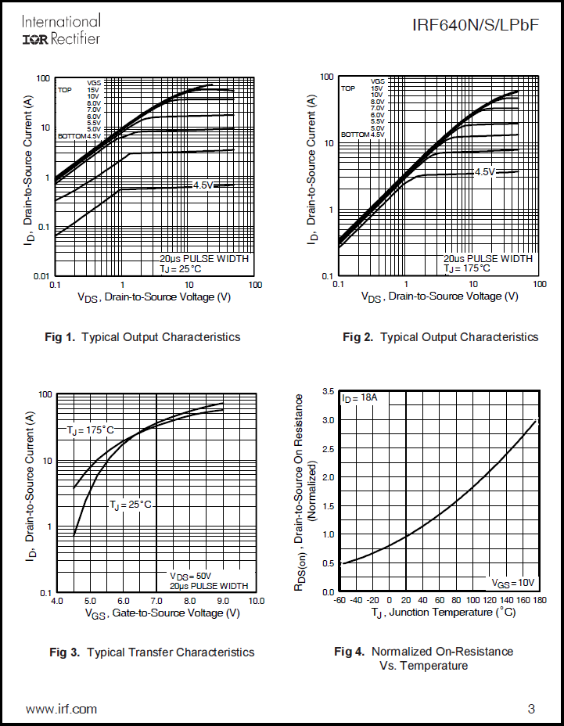
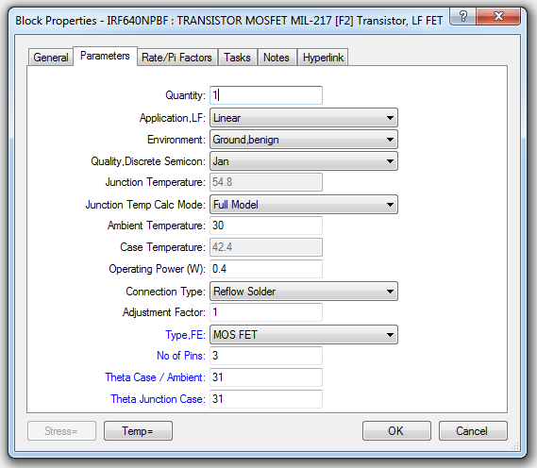
Failure rates for the CLIQ components
Isograph Reliability Workbench
FMEA of a CLIQ-based protection of D1
A. Fernandez

Slide 11
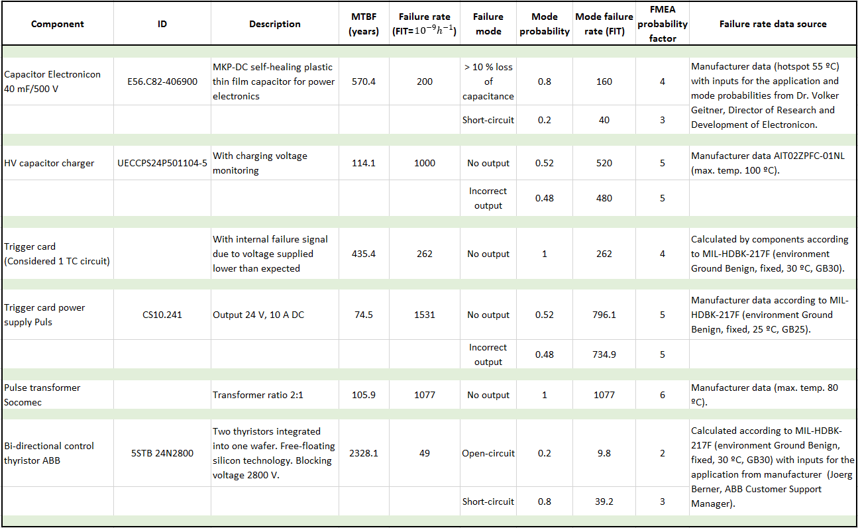
Failure rates and failure modes for the CLIQ components
FMEA of a CLIQ-based protection of D1
A. Fernandez

Slide 12

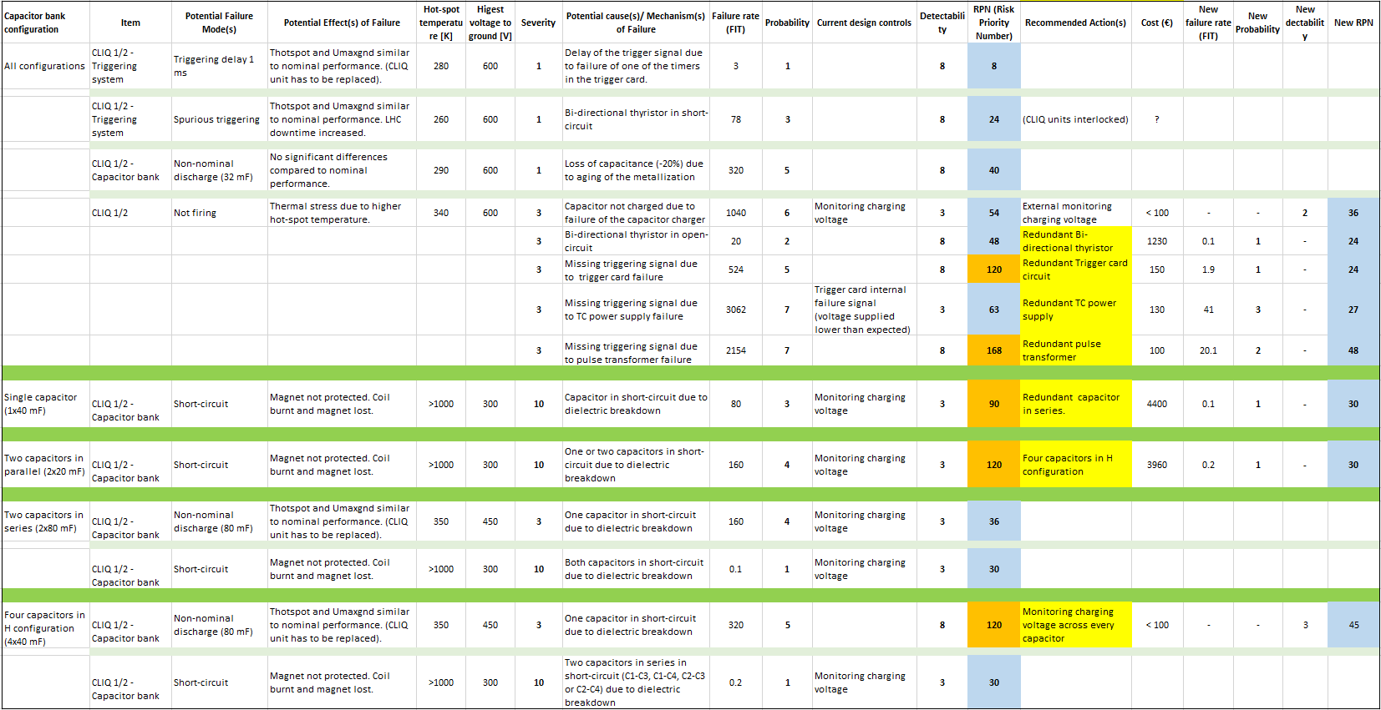
FMEA study
FMEA of a CLIQ-based protection of D1
A. Fernandez

Slide 13
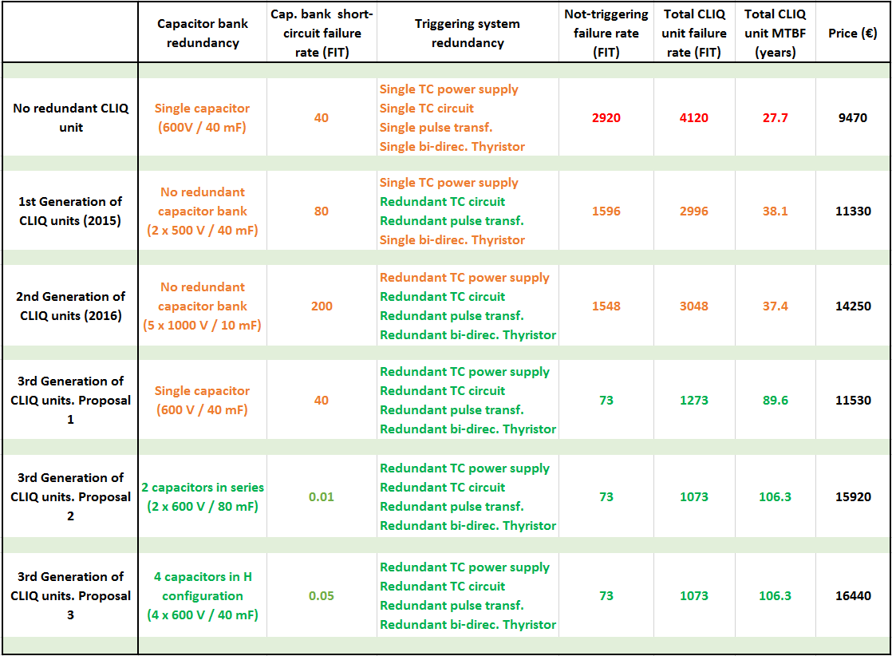
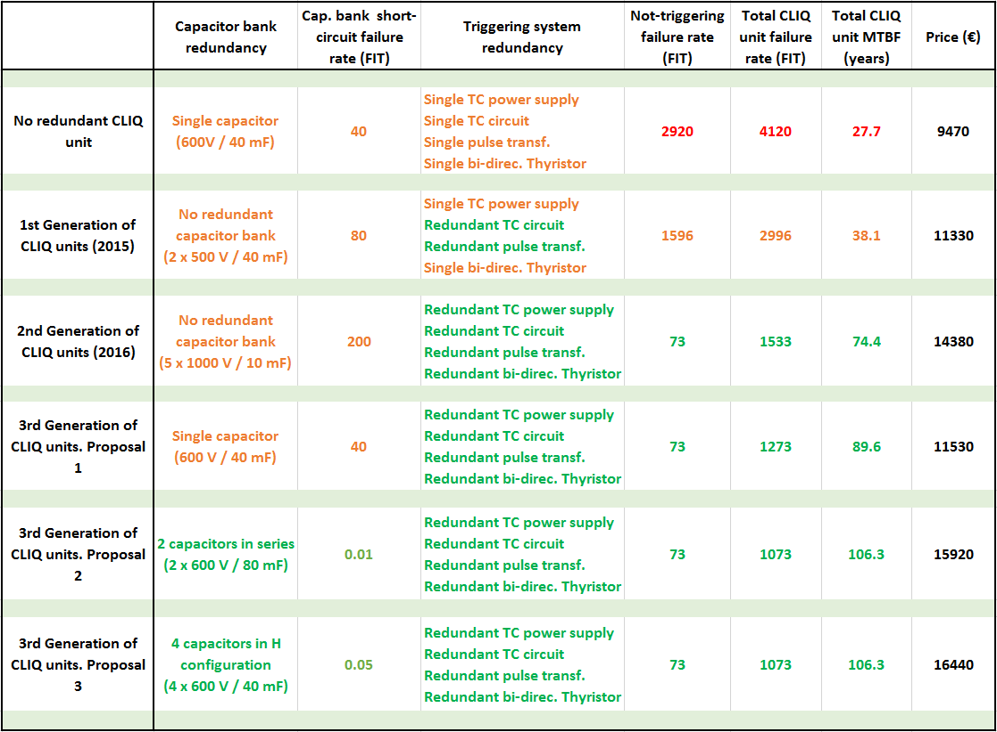
Total CLIQ failure rate a price depending on redundancy level
FMEA of a CLIQ-based protection of D1
A. Fernandez

Slide 14
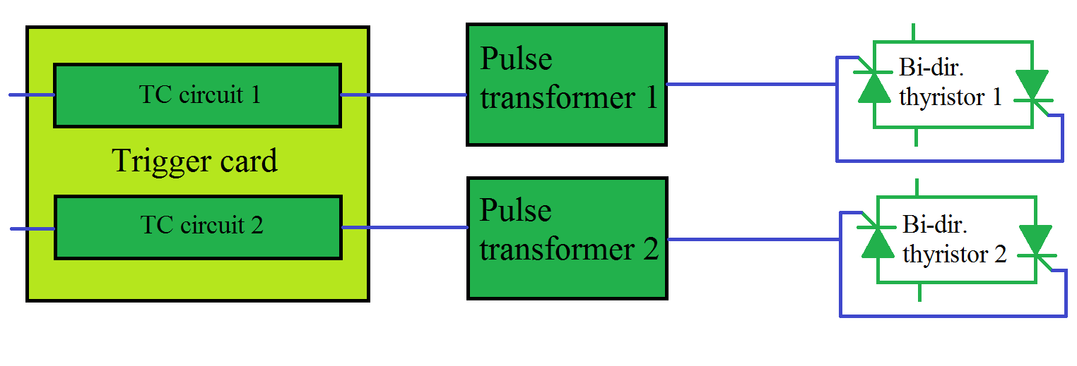
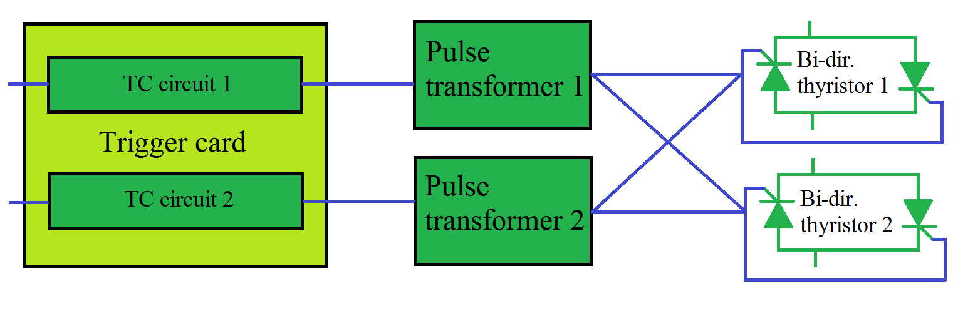


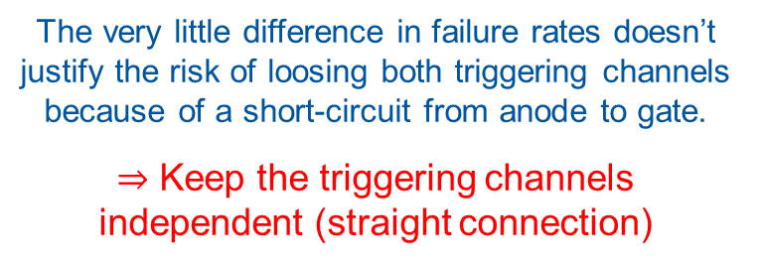

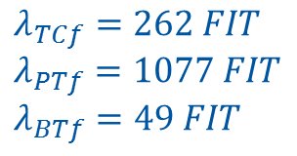
Thyristors, straight Vs. cross connection
$$λ_{TCf}=262 FIT$$
$$λ_{PTf}=1077 FIT$$
$$λ_{BTf}=49 FIT$$
$$P_{if}=1−e^{{−λ}_{if}t}$$
$$P_{notTrigg}=P_{TCf}^{2}+P_{PTf}^{2}+P_{BTf}^{2}+2P_{TCf}P_{PTf}+{2P}_{TCf}P_{BTf}+{2P}_{PTf}P_{BTf}=1−e^{{−λ}_{notTrigg}t}$$
$$λ_{notTrigg}=16.7 FIT$$
The very little difference in failure rates doesn’t justify the risk of loosing both triggering channels because of a short-circuit from anode to gate.
$⇒$ Keep the triggering channels independent (straight connection)
~0
~0
$$P_{notTrigg}=P_{TCf}^{2}+P_{PTf}^{2}+P_{BTf}^{2}+2P_{TCf}P_{PTf}+{2P}_{TCf}P_{BTf}^{2}+{2P}_{PTf}P_{BTf}^{2}=1−e^{−λ_{notTrigg}t}$$
$$λ_{notTrigg}=15.6 FIT$$
FMEA of a CLIQ-based protection of D1
A. Fernandez

Slide 15
Conclusions
FMEA methodology successfully implemented for first time to a QPS at CERN. (Room for improvement).
The FMEA study shows that all the redundancies of CLIQ components under discussion and the ones already implemented are justified.
For the capacitor bank, both configurations, 2 capacitors in series and 4 in H connection show the same reliability and similar volume and price.
We recommend the choice of the capacitor bank in H configuration due to its more robust design (redundancy against open-circuit in the connection points).
We recommend the independent straight connection of the thyristors.
Next steps
On going further adaptation of the FMEA methodology to the QPS technology of LHC (taking into account the propability of quench, periodic inspections of the QPS, calculating the probability of failure of monitoring systems, down time…).
To perform a sensitivity analysis.
To apply the FMEA methodology to other QPS: QH-QPS in the MQM of LHC, CLIQ+QH-QPS for the Triplets of HL-LHC.
FMEA of a CLIQ-based protection of D1
A. Fernandez

Slide 16
Annex
FMEA of a CLIQ-based protection of D1
A. Fernandez

Slide 17
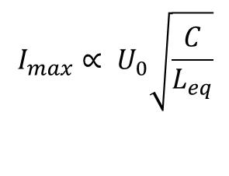

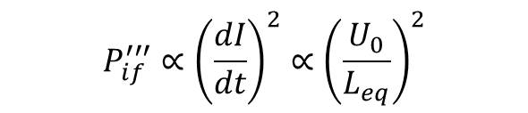
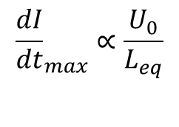
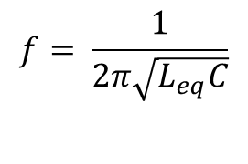
CLIQ behaviour
$$P_{if}^{′′′}∝{\left(\frac{dI}{dt}\right)}^{2}∝{\left(\frac{U_{0}}{L_{eq}}\right)}^{2}$$
$$E_{CLIQ}=N_{C} \frac{1}{2}CU_{0}^{2}$$
$$I_{max}∝ U_{0}\sqrt{\frac{C}{L_{eq}}}$$
$$f= \frac{1}{2π\sqrt{L_{eq}C}}$$
$${\frac{dI}{dt}}_{max}∝\frac{U_{0}}{L_{eq}}$$
FMEA of a CLIQ-based protection of D1
A. Fernandez

Slide 18
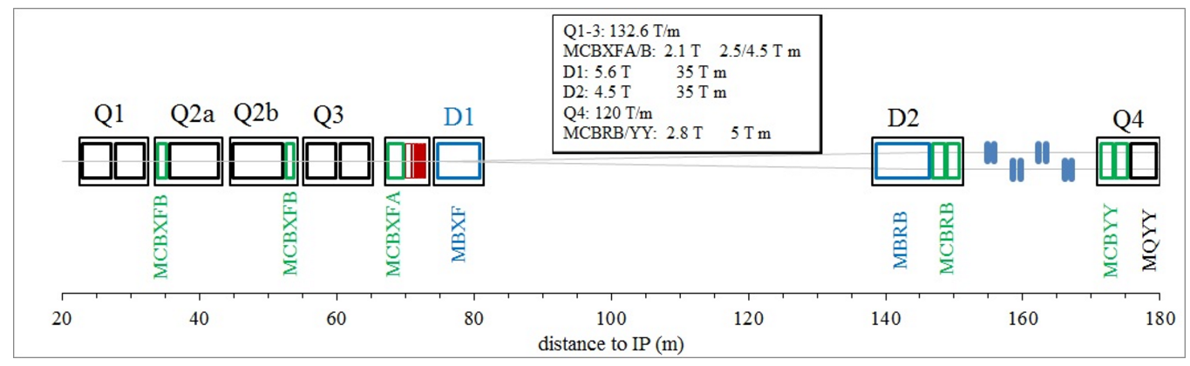
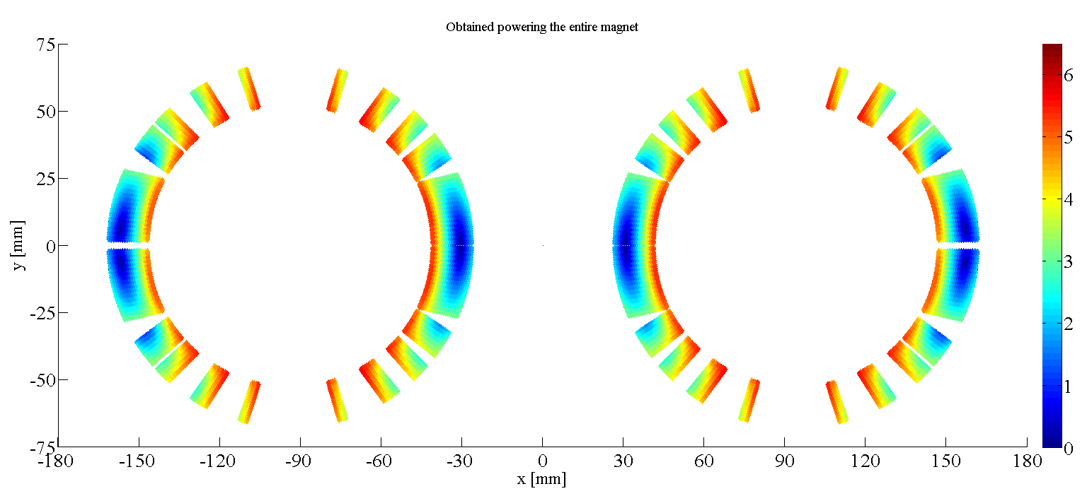
Layout of the Insertion Region of
HL-LHC
Separation Dipole
Recombination Dipole
FMEA of a CLIQ-based protection of D1
A. Fernandez

Slide 19
D1 and D2 characteristics
FMEA of a CLIQ-based protection of D1
A. Fernandez

Slide 20

CLIQ (Coupling-Loss Induced Quench)
Current change
Magnetic field change
Coupling losses (Heat)
Temperature rise
QUENCH
FMEA of a CLIQ-based protection of D1
A. Fernandez

Slide 21
Typical magnet discharge induced by CLIQ
FMEA of a CLIQ-based protection of D1
A. Fernandez

Slide 22
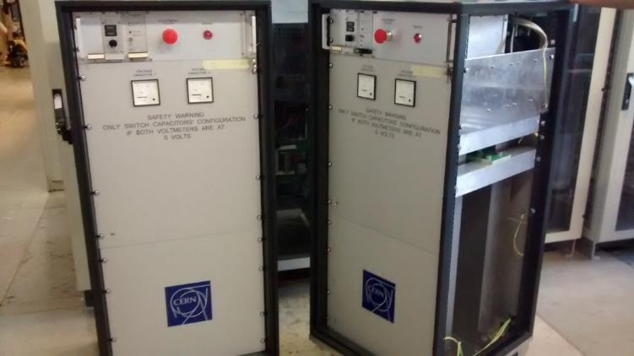
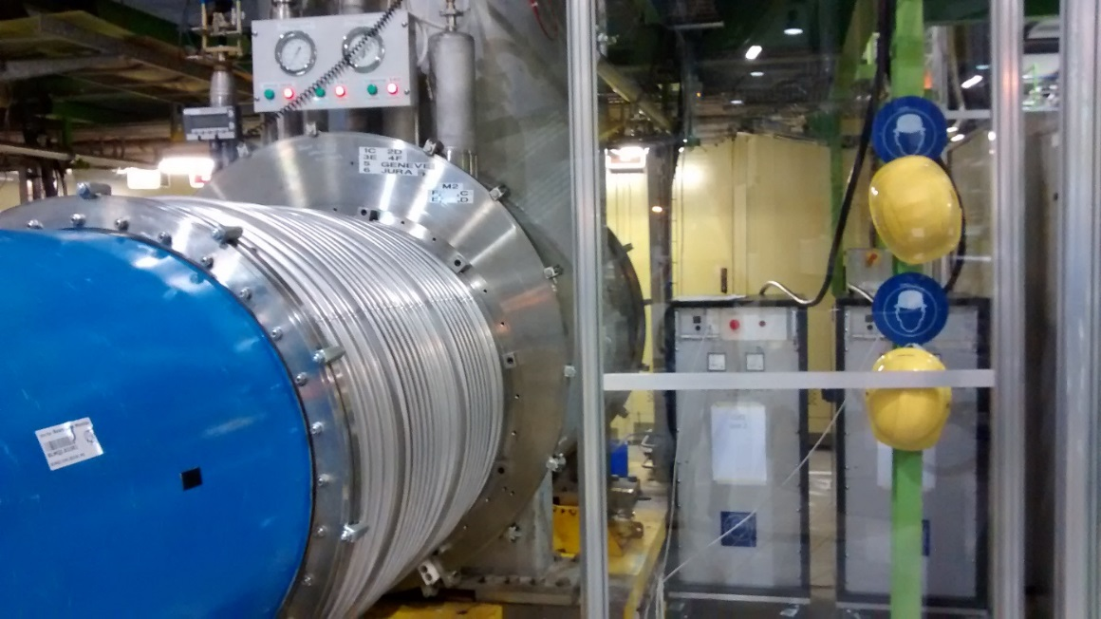
CLIQ units manufactured at CERN in 2015
FMEA of a CLIQ-based protection of D1
A. Fernandez

Slide 23
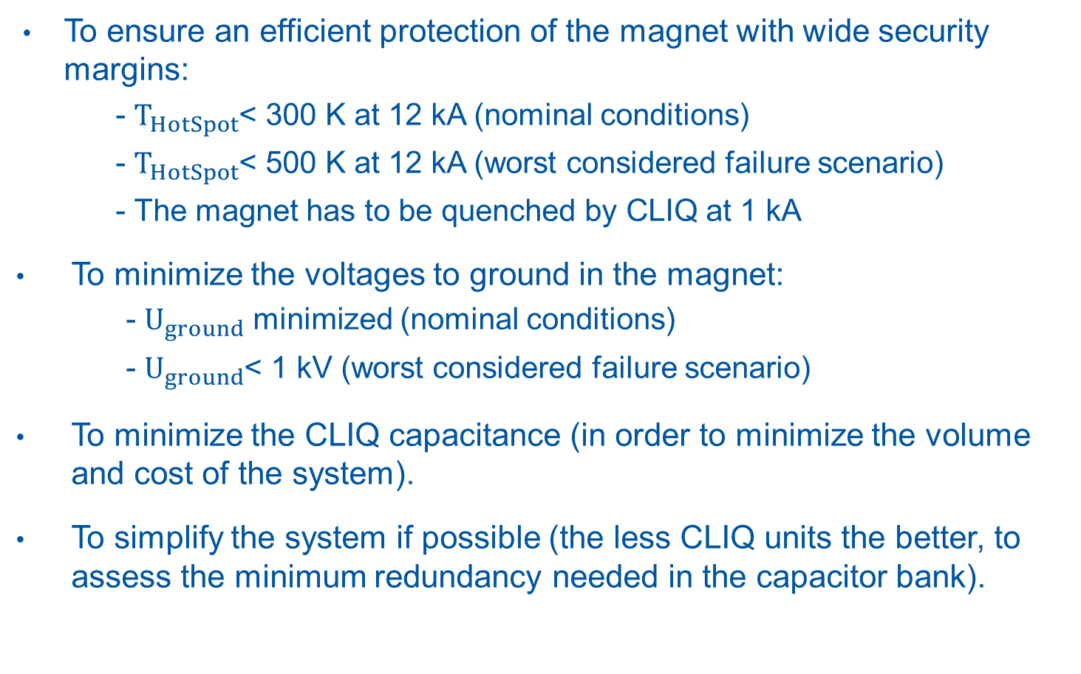
CLIQ-based protection system design criteria
To ensure an efficient protection of the magnet with wide security margins:
- $T_{HotSpot}$< 300 K at 12 kA (nominal conditions)
- $T_{HotSpot}$< 500 K at 12 kA (worst considered failure scenario)
- The magnet has to be quenched by CLIQ at 1 kA
To minimize the voltages to ground in the magnet:
- $U_{ground}$ minimized (nominal conditions)
- $U_{ground}$< 1 kV (worst considered failure scenario)
To minimize the CLIQ capacitance (in order to minimize the volume and cost of the system).
To simplify the system if possible (the less CLIQ units the better, to assess the minimum redundancy needed in the capacitor bank).
FMEA of a CLIQ-based protection of D1
A. Fernandez

