Slide 2
Summary of Joint HiLumi/LARP Meeting at SLAC
Apollonio 9/06/2016
Selection of slides from L. Rossi, G. Arduini, P. Ferracin, R. Calaga, D. Perini and others
Link to indico event

Slide 3

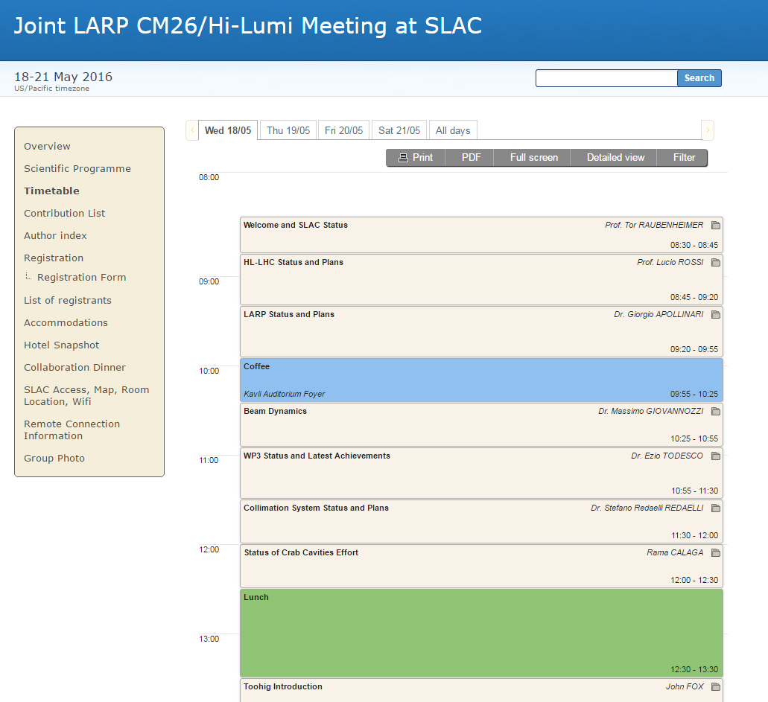
HiLumi/LARP - Agenda

Slide 4

FP7-HiLumi classified as «success story» by EC

Slide 5
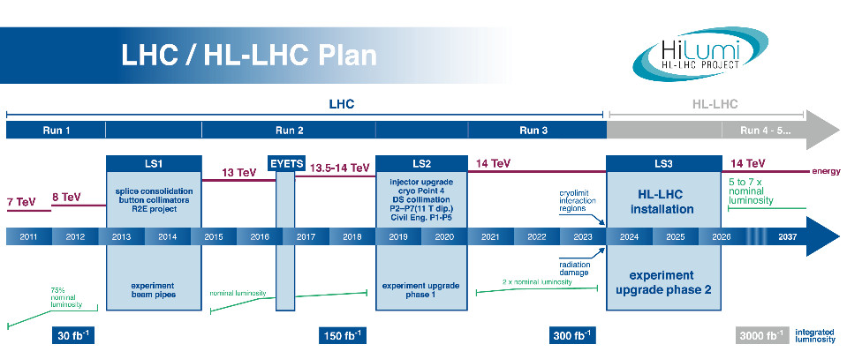
Timeline & Goal:
Commissioning 2026; 3 ab⁻¹ by 2037 (250 fb⁻¹/y)

Slide 6
Reviews 2016
10 March: (internal) management review of CC plan for SPS
21-23 March: Conceptual Design Review of the HL-LHC Magnet Circuits
6-8 April: 11T dipole for DS Collimator HL-LHC
27 May : (Internal) Tech. Infr. C&S review
7-10 June: MQXF review
30June-1Jul: D1 review (KEK)
August/Sept. : Review of the need for Halo control via e-lens.
17-19 Oct: C&SR-II

Slide 7
The boat is (near) full steam…
Time for changes is narrowing plan must be frozen
(LS4 becoming part of HL-LHC: CC and…)

Slide 8
200 MHz option
G. Iadarola, K. Li
Advantages:
  Potentially allowing to inject higher bunch populations with longer bunches ➔ needs to be confirmed by LIU
  Minimization of electron cloud effects if scrubbing not sufficient to suppress electron cloud in the dipoles (SEY=1.4) , intra-beam scattering and heating
  Possibility of luminosity leveling with bunch length
Drawbacks:
  Co-existence with 400 MHz crab-cavities, in particular, potential DA restrictions ➔ no sign so far
  Longitudinal stability limits are lower
  Lower TMCI threshold but always well beyond the operational bunch parameters

Slide 9
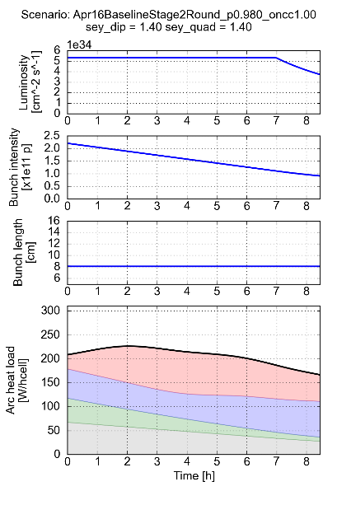
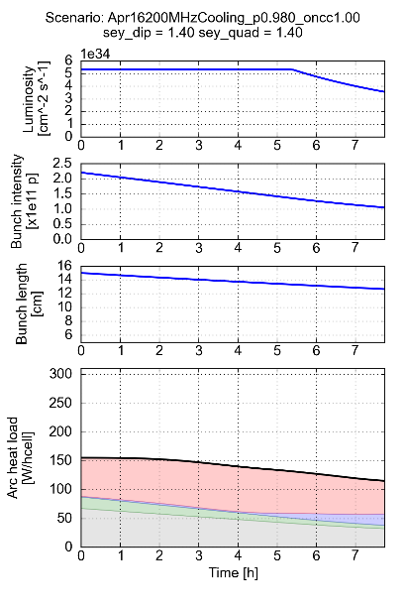
200 MHz
G. Iadarola
HL-LHC baseline (400 MHz)
200 MHz option, “natural” shortening
SEY=1.4
256 fb⁻¹/year
243 fb⁻¹/year (-5% w.r.t. 400 MHz)
e-cloud quad.
e-cloud dip.
Impedance
Syn. radiation

Slide 10
J. Fox

Slide 13
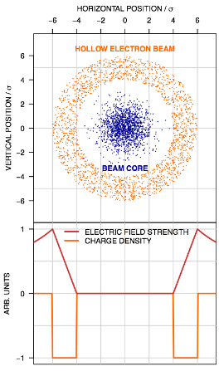
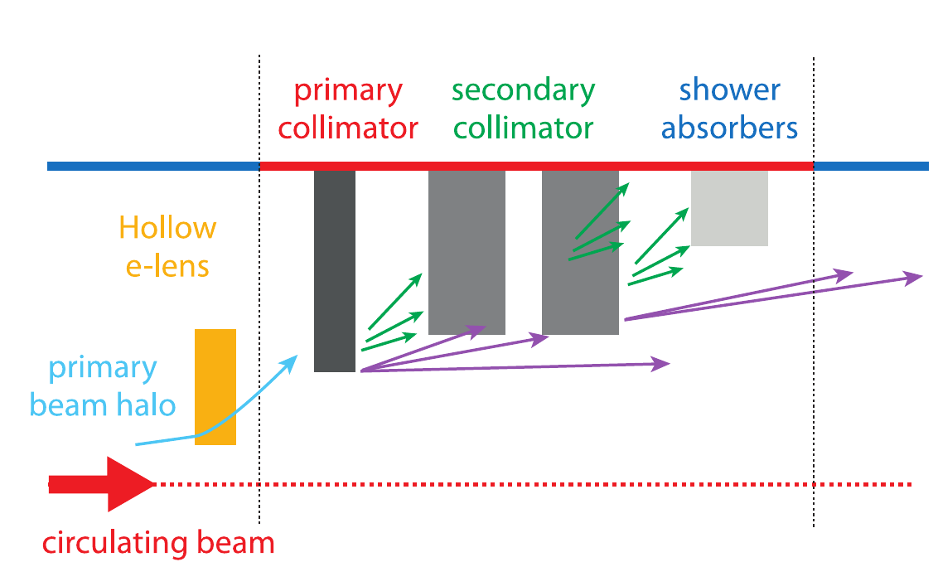
Hollow e- lens
With axisymmetric electron distribution the beam core is unperturbed whereas the halo gets a smooth tuneable transverse kick. This device is a complement of the collimation system and will increase its efficiency.
G. Stancari, V. Previtali, A. Valishev, R. Bruce, S. Redaelli, A. Rossi, and B. Salvachua Ferrando “Conceptual design of hollow electron lenses for beam halo control in the Large Hadron Collider”.

Slide 14
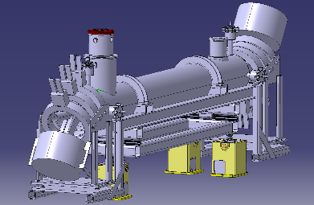
Functional main requirements
Beam-to-beam distance 420 mm
Other devices around
We need a set of magnets to drive the electrons, an e-gun, a collector, instrumentation and all services and power supplies.
Robust and reasonably simple ( an often quenching 5 T solenoid is not a good idea).
Easy installation, maintenance, modifications.
Compact construction.

Slide 15
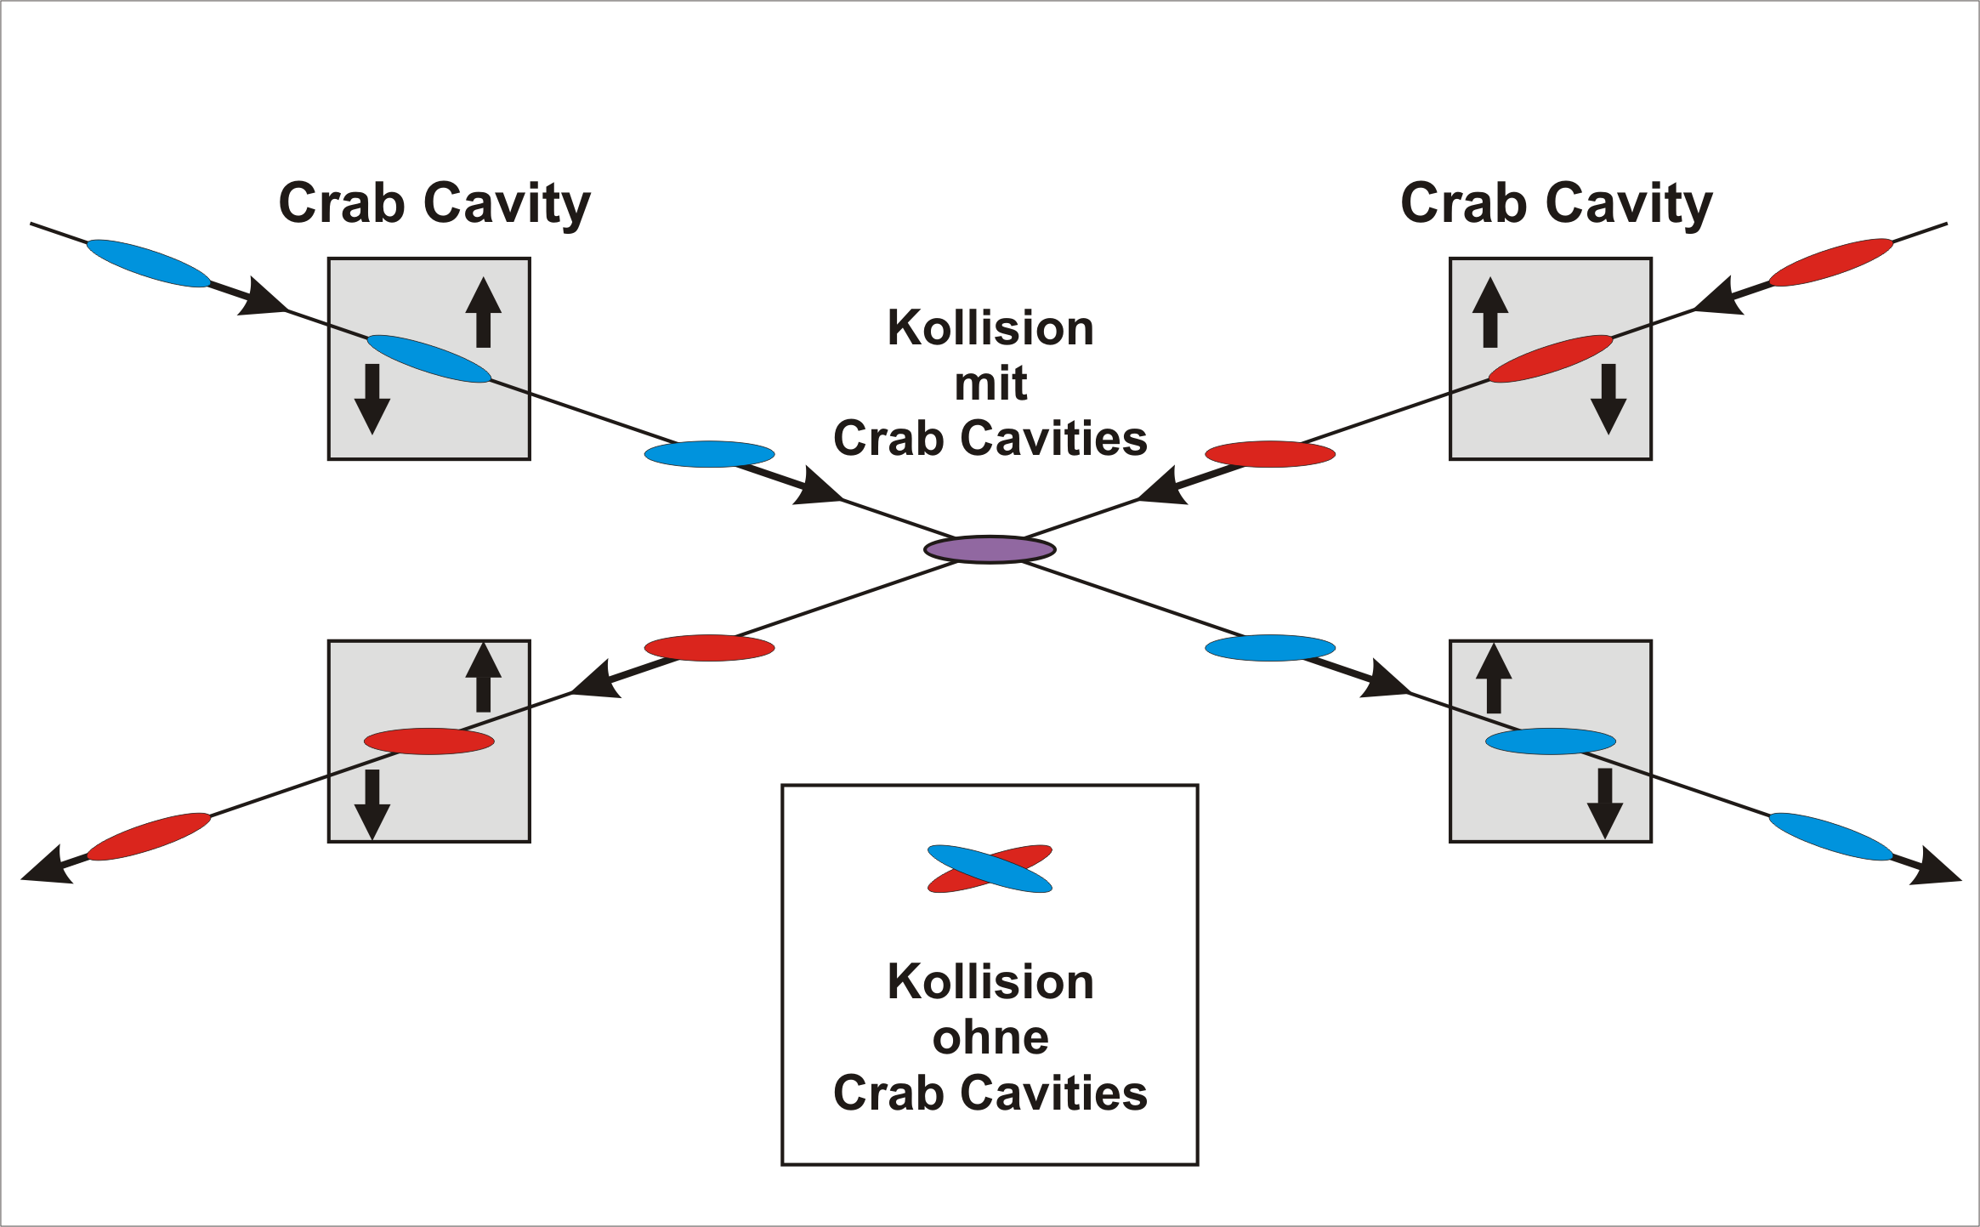
Crab Cavities – Ongoing Activities
Notes:
Design per SPS, lo stesso concetto da tenere per LHC. DQW: vertical kick

Slide 16
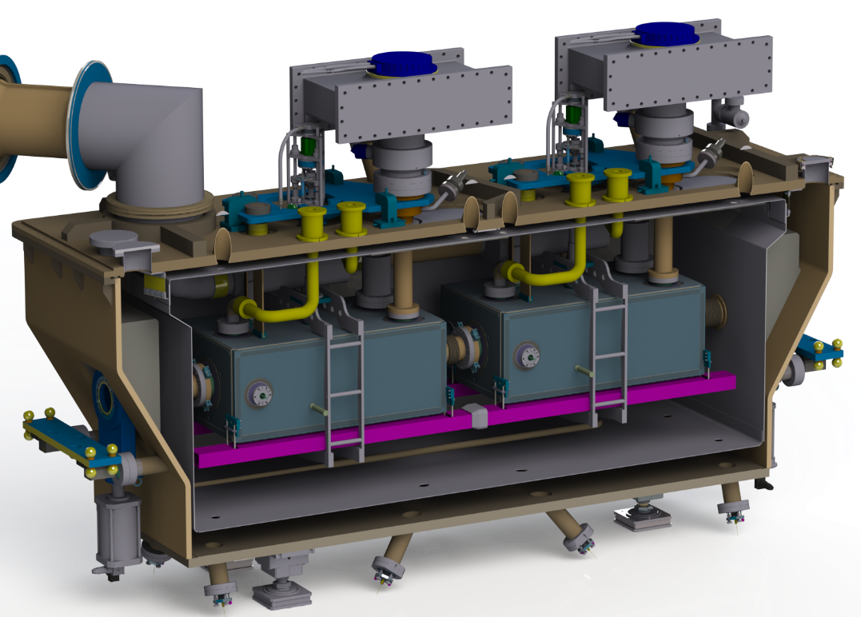
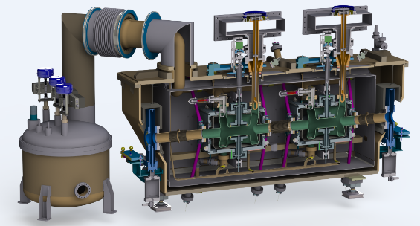
Crab Cavities – Ongoing Activities
Update on the Cavity + CM production
SPS Test preparation
RFD
DQW
Cost & Schedule Review (New Baseline)
CM Review, Nov 2015 (Basic design choices approved)
SPS Test Day I
Notes:
Design per SPS, lo stesso concetto da tenere per LHC. DQW: vertical kick

Slide 17
Revised Planning
First Re-Baselining after C&S Review I
    US cavities delayed (+ unresolved “conformity standards”)
    CERN cavity production (DQW) for SPS is adopted as baseline
Impact on SPS is significant
YETS – 8 weeks
EYETS – 14 weeks
2015
2016
2017
2018
2019
2020
2021
2022
2023
2024
2025
2026
YETS
EYETS
YETS
Run 2
LS2
Run 3
LS3
Run 4
SPS test prototype (2 CM)
preparation
Tests (DQW)
Tests (RFD)
LHC pre-series (2 CM)
LHC series production (8 Mod)
Fabrication & tests
Installation

Slide 18
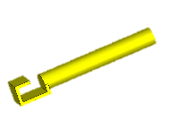
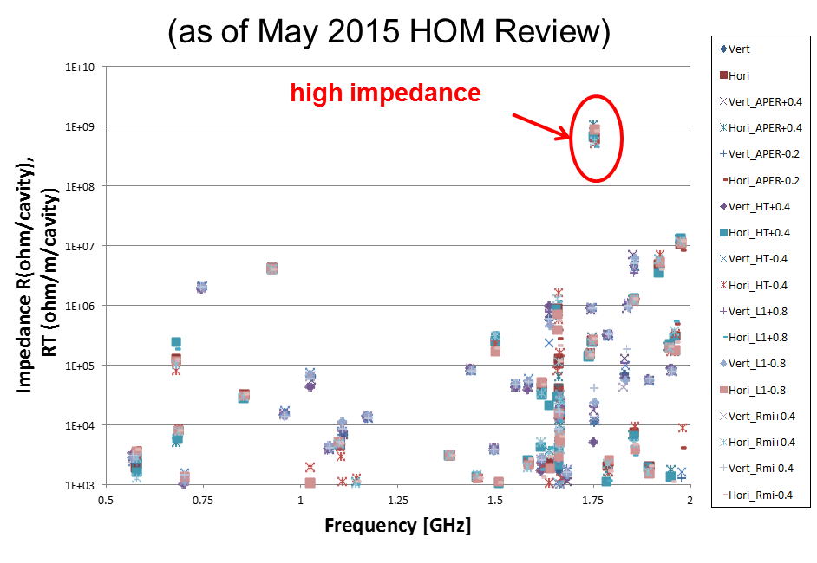
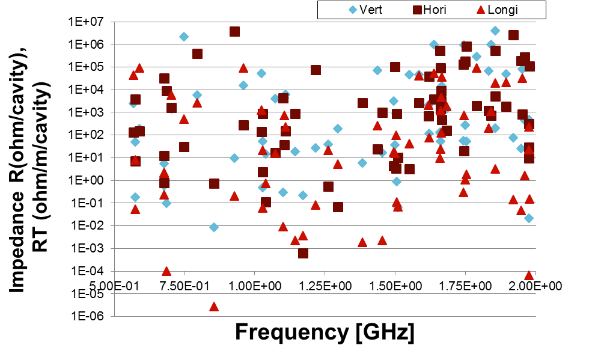
Impedance (crab cavities)
Impressive progress in the impedance reduction of crab cavities!
Pick up antenna (5/2015)
modified to lower Q_{ext} of 1.75 GHz mode
DQW cavity
Z. Li
Before
After
Remaining HOM mode at 920 MHz for DQW cavities to be damped

Slide 19
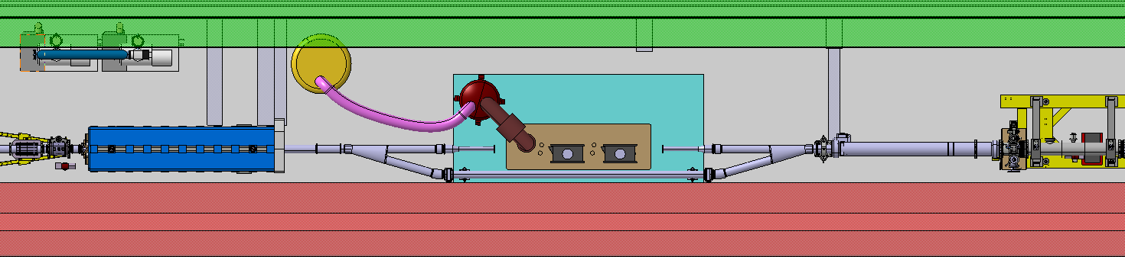
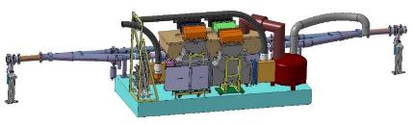

SPS-LSS6 Implantation
11.5m overall space, CM installed in a by-pass & motorized transfer table
Movable Table
TPSG 61773
QDA 61710
Cryo-module
CC
RF & Cryo on movable table with liquid Helium
Multiple Vacuum sectorization to accommodate bypass & module replacement

Slide 20
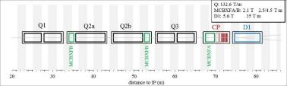
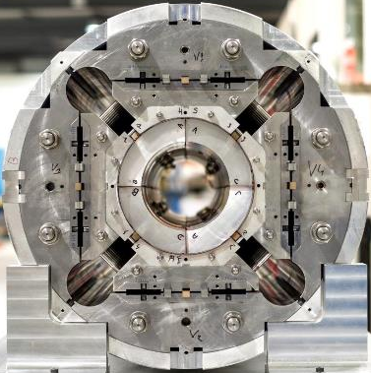
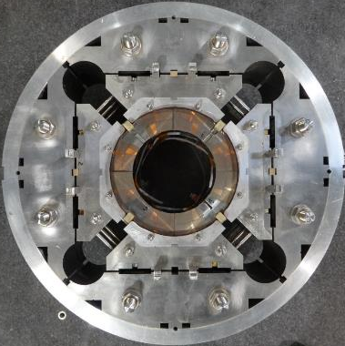
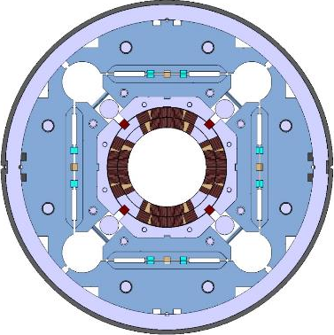
HiLumi low-β quadrupole MQXF
Target: 132.6 T/m
  150 mm aperture, 11.4 T B_{peak}
Q1/Q3 (by US-HiLumi Project)
  2 magnets MQXFA with 4.2 m
Q2a/Q2b (by CERN)
  1 magnet MQXFB with 7.15 m
Different lengths, same design

Slide 21
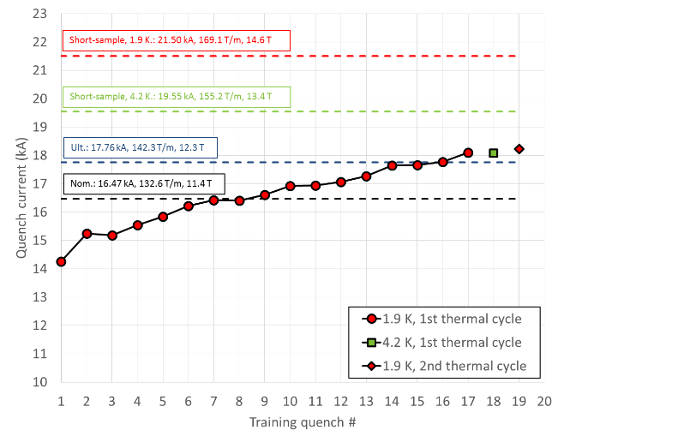
MQXFS1 test
Quench performance
By G. Chlachidzei
Ultimate reached both at 1.9 K and 4.5 K
Reached 85% of current limits at 1.9 K and 93% at 4.5 K
  Significant margin confirmed by ramp-rate
Full memory
8 hours at ultimate without quenches

Slide 22
Powering requirements - ripple
R. De Maria, M. Fitterer
Tight requirements on triplet powering from:
  Accuracy in the measurement of β* (low frequency regime – O(Hz))
  Dynamic aperture considerations (10 Hz – 1 kHz)
Class 1 power converter mandatory
Triplet powering scheme with 1 main power converter (recommended by Powering review) minimizes tune ripple but still marginal
  pending update on power converter performance WP6b (ongoing)
Higher frequency performance marginal for 300-600 Hz frequencies but pending:
  Evaluation of the transfer function B(I) (f) taking into account beam screen and cold bore ➔ WP3
  Reduction of the noise at thee frequencies should be possible. Updated performance expectations ➔ WP6b
  D1s, D2s, and Q4s ±1 ppm accuracy is adequate
  MDs to evaluate the possible impact of low frequency ripple/vibrations to be pursued

Slide 23
Thanks a lot for your attention!

Slide 24
SPS Revised Planning
 | 2016 |  |  |  | 2017 |  |  |  |  |  | 2018
 | Qtr1 | Qtr2 | Qtr3 | Qtr4 | Qtr1 | Qtr2 |  | Qtr3 | Qtr4 |  | Jan
RF Power | 2 IOTs SM18 2 IOTs in BA6 (FPC Conditioning)
LLRF/Controls | SM18-Vertical Tests Setup |  |  | Deploy for VTA | BA6-SM18 Setup High Power & deployment
Dressed Cavities | Cavity 1 Fabrication (Treatment + Cleanroom tooling) |  |  |  | Cav 2 Fabrication + Cav 1 & 2 Treatment/Testing + Clean room assembly
FPCs | 2xFPCs in SM18 Cleanroom |  |  |  | FPC Conditioning (TB)
Cryomodule | Cryostat & Tooling Design/Procurement |  |  | Cryomodule/Tooling Preparation |  |  |  | CM Assembly |  | Cold Tests | SPS
Cryogenics | Cryogenic Distribution & Valve Box SM18/SPS |  |  |  |  |  |  |  |  | CM + VB
Movable Table | Design & Manufacturing |  |  |  |  |  |  | Tests at CERN

Slide 25
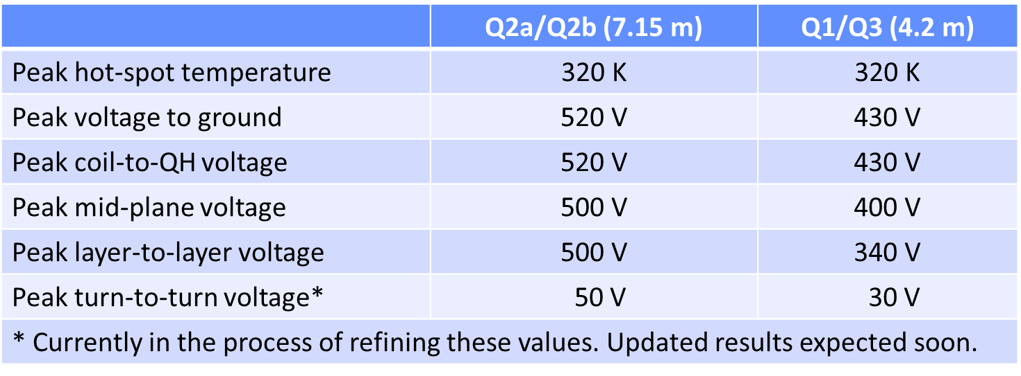
Voltage Withstand Levels
By F. Rodriguez-Mateos
Update of table peak temperature and voltages
Data used to define voltage level of electrical acceptance test (work in progress)

