Slide 1
FMCM thresholds
& dBLM update
Matthieu Valette
Acknowledgements: I. Romera for the LMC slides
PE section meeting – 23rd June 2016

Slide 2
Outline
Introduction and purpose of Fast Magnet Current change Monitors (FMCM)
Operational dumps and observations in 2016
Failure simulations
Conclusions

Slide 3
Introduction to the FMCM
Failures in the magnet powering system are generally slow and beams can be (easily) dumped by magnet interlocks before starting to extract energy
Exception are failures in some of the nc magnets, which can generate high losses after some few turns only (MSE, MSI, D1, MBW, MBWXWT)
Cannot be caught in time by converter controls or WIC (TL incident in 2004)
Introduced Fast Magnet Current change Monitors (FMCM) as redundancy to BLMs
FMCMs interlock on fast changes of current, no absolute current
Interlock the beam but do not stop magnet powering
Intended to protect against ANY failure in magnet powering, leading to changes of the magnetic field, ie:
  Power converter failures
  Failures of electrical supply chain (network perturbation, AUG…) => common cause failures!!
  Short circuits in DC part

Slide 4
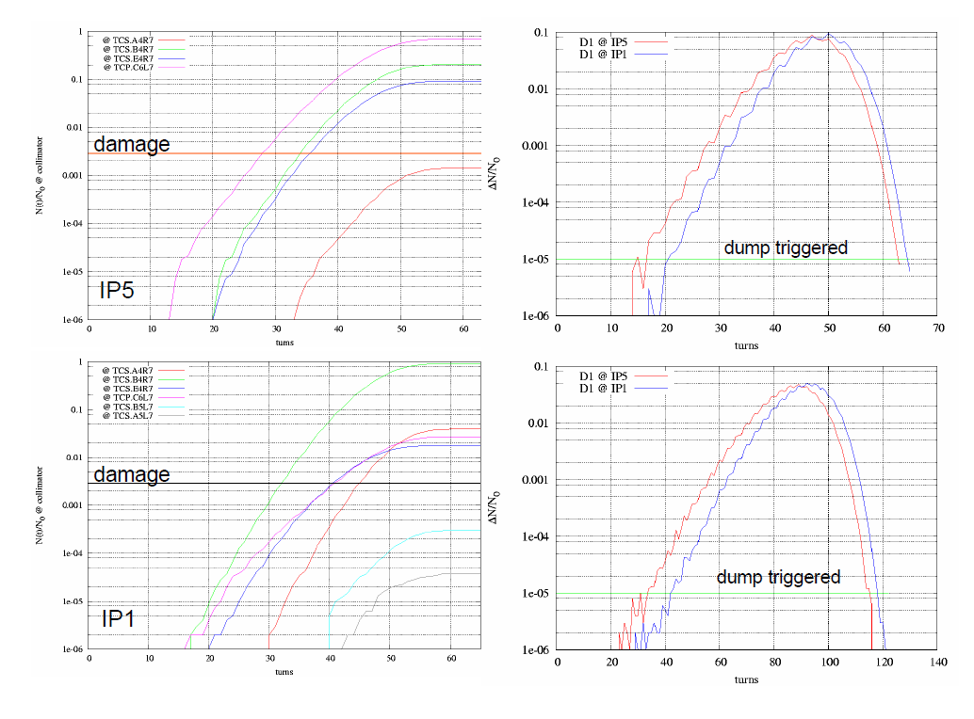
Studies of fast(est) LHC failures
Courtesy of V.Kain, 2003

Slide 5
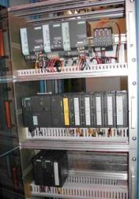

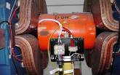
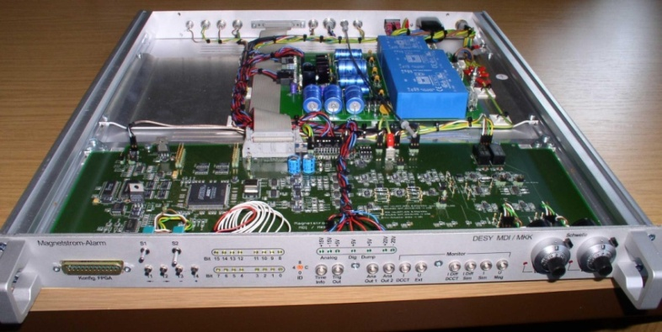
Protection of normal conducting circuits
Beam Dump to BIS
Power Converter
Status info
WIC
Power Permit
Thermo-switches @ 60°C + Water Flow
Thermo-switches @ 60°C + Water Flow
RQ4.LR3/7
RQ5.LR3/7
RD34.LR3/7
Machine Interlock Systems
5 of 5
12 LHC devices and 16 in SPS-LHC TLs
Detection level in the order of 5e-4 of nominal current in <100us
RD1.LR1/5
RMSD.LR6B1/2
RBXWTV.R2/L2
FMCM
Beam Dump to BIS

Slide 6
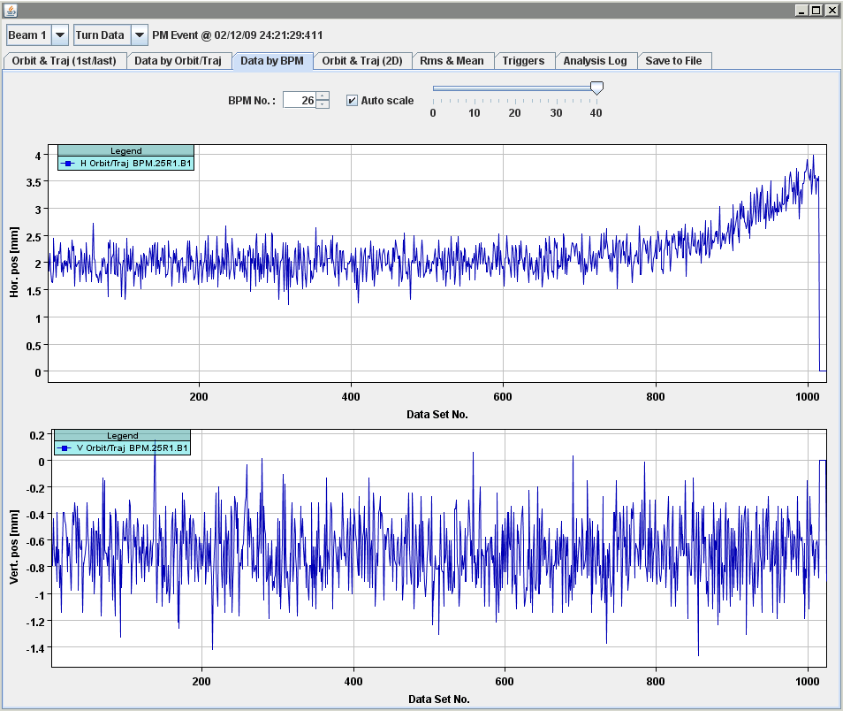
FMCM beam test @ 3.5TeV
Low intensity beam test.
Trajectory evolution after OFF send to RD1.LR1, with FMCM masked
Beam dumped by BLMs in IR7
Trajectory over 1000 turns at a BPM
Position change of ~1.5 mm over last 250 turns

Slide 7
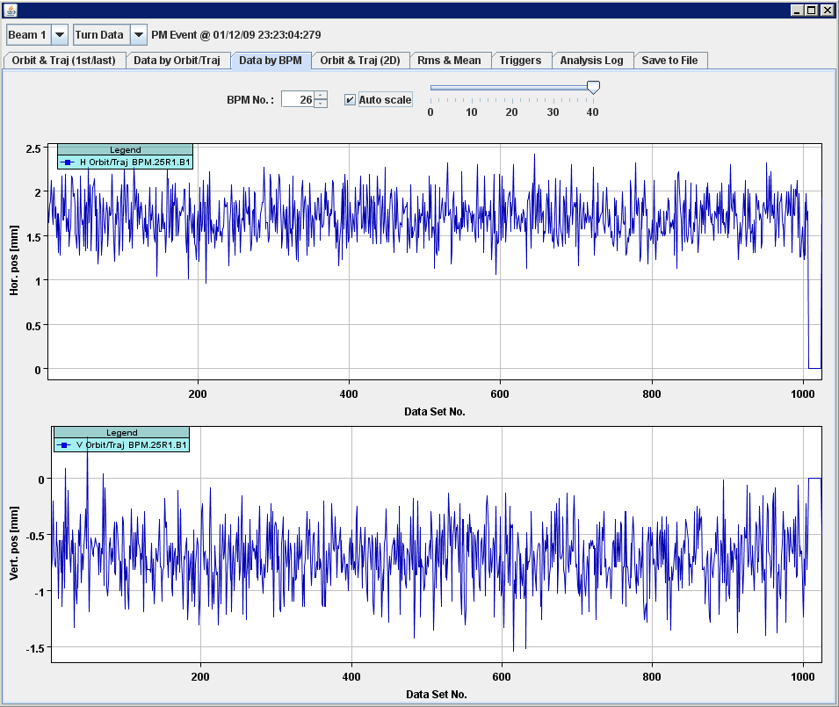
FMCM beam test @ 3.5TeV
Low intensity beam test
Trajectory evolution after OFF send to RD1.LR1, with FMCM active
Beam dumped by FMCM
Trajectory over 1000 turns at a the same BPM
No position change visible within resolution
>> The redundant protection is working

Slide 8
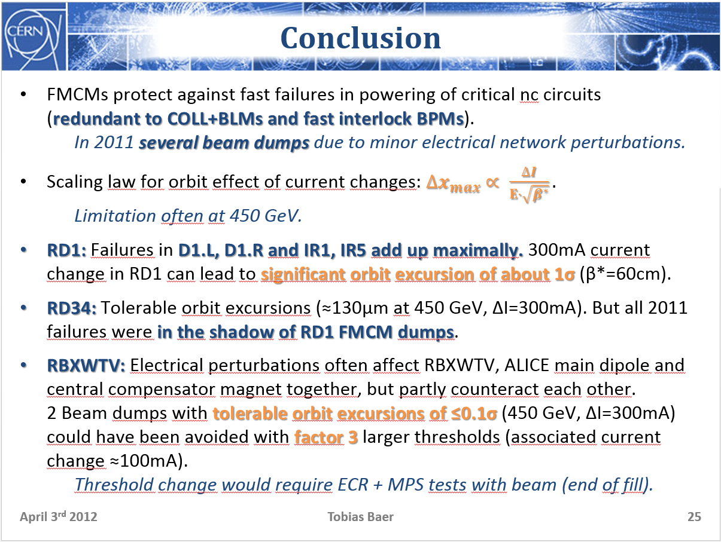
Outcome of the FMCM threshold review in 2012
Required thresholds slightly vary with optics and energy
Situation was closely monitored and optimized during Run1
Topic presented at the 46th TE-Technical Meeting in April 2012
Several solutions were proposed:
  FMCM Threshold relaxation (RD1, RD34 and RBXWTVL/R)
  Replacement of RPTG by 4 quadrant switch mode power converters
  Adding a superconducting inductance
Outcome:
  RBXWTVL/R were relaxed by factor 3 and RD34 by factor 1.5 (ECR)
  Recommendation to replace the 4x RPTG converters for D1 and D34 circuits which will be carried out during EYETS 2016 (i.e. ECR approved at the 264th LMC)

Slide 9
Operational dumps in 2016
Date | Energy | Signal / Threshold |  |  |  | Remarks
 |  | RD1.LR1 | RD1.LR5 | RD34.LR3 | RD34.LR7
2016-04-10 | 450000 |  | 4.3 |  | 1.9 | Electrical glitch, FMCM dumped the beams at injection
2016-04-17 | 6499680 |  | 4.1 | 1.7 | 2.6 | 18kV Electrical glitch triggering FMCMs all around the machine
2016-04-18 | 6499680 |  | 17.8 | 5 | 7.8 | Electrical glitch
2016-04-19 | 4747440 |  | 14.9 | 4.2 | 3.2 | Beam lost around IP6 before reaching the dump due to electrical glitch affecting RD34.LR3, RD34.LR7, and RD1.LR5
2016-04-23 | 6499560 |  | 6.7 |  | 1.6 | Dump of first stable beams with 3x3b by electrical perturbation seen by FMCM in IR5 and IR7 (power conveter RD34.LR7 tripped completely during event)
2016-04-29 | 6499440 | 9.1 | 36.5 | 10.2 | 12.7 | Foreign object (weasel) found on the 66kV transformer in P8, causing severe electrical disturbance throughout the complex
2016-05-13 | 2599560 |  | 3.1 |  |  | Electrical distribution perturbation recorded by D1.LR5 FMCM
2016-05-28 | 6499560 |  | 3.6 |  |  | FMCM trigger probably caused by electrical perturbations due to thunderstorms
2016-05-29 | 6499560 |  | 15 | 5.6 | 6 | Electrical perturbation (stormy night...), clean dump.
2016-06-01 | 6499560 |  | 2.1 | 1.5 | 7 | FMCM trigger after electrical glitch
2016-06-05 | 6499560 |  | 4.1 |  |  | FMCM on RD1.LR5, no electrical perturbation seen by TI
2016-06-12 | 6499560 |  | 5.3 | 1.6 | 2.7 | FMCM RD1 – electrical perturbation seen by several FMCMs no circuit tripped, TI does not measure any electrical perturbation
2016-06-18 | 6499440 |  | 21 | 6.7 | 9.2 | Electrical perturbation from the network.
2016-06-19 | 6499560 | 15 | 36 |  |  | Electrical glitch, FMCM, RD1.LR5 and RD34.LR7, RF M2B2 tripped, possibly some minor orbit variation
14 FMCM triggers in 2016, 1 @ injection, 11 @ 6.5TeV and 2 during ramp
All triggers were as a consequence of electrical network perturbations

Slide 10
Operational dumps in 2016
Date | Energy | Signal / Threshold |  |  |  | Remarks
 |  | RD1.LR1 | RD1.LR5 | RD34.LR3 | RD34.LR7
2016-04-10 | 450000 |  | 4.3 |  | 1.9 | Electrical glitch, FMCM dumped the beams at injection
2016-04-17 | 6499680 |  | 4.1 | 1.7 | 2.6 | 18kV Electrical glitch triggering FMCMs all around the machine
2016-04-18 | 6499680 |  | 17.8 | 5 | 7.8 | Electrical glitch
2016-04-19 | 4747440 |  | 14.9 | 4.2 | 3.2 | Beam lost around IP6 before reaching the dump due to electrical glitch affecting RD34.LR3, RD34.LR7, and RD1.LR5
2016-04-23 | 6499560 |  | 6.7 |  | 1.6 | Dump of first stable beams with 3x3b by electrical perturbation seen by FMCM in IR5 and IR7 (power conveter RD34.LR7 tripped completely during event)
2016-04-29 | 6499440 | 9.1 | 36.5 | 10.2 | 12.7 | Foreign object (weasel) found on the 66kV transformer in P8, causing severe electrical disturbance throughout the complex
2016-05-13 | 2599560 |  | 3.1 |  |  | Electrical distribution perturbation recorded by D1.LR5 FMCM
2016-05-28 | 6499560 |  | 3.6 |  |  | FMCM trigger probably caused by electrical perturbations due to thunderstorms
2016-05-29 | 6499560 |  | 15 | 5.6 | 6 | Electrical perturbation (stormy night...), clean dump.
2016-06-01 | 6499560 |  | 2.1 | 1.5 | 7 | FMCM trigger after electrical glitch
2016-06-05 | 6499560 |  | 4.1 |  |  | FMCM on RD1.LR5, no electrical perturbation seen by TI
2016-06-12 | 6499560 |  | 5.3 | 1.6 | 2.7 | FMCM RD1 – electrical perturbation seen by several FMCMs no circuit tripped, TI does not measure any electrical perturbation
2016-06-18 | 6499440 |  | 21 | 6.7 | 9.2 | Electrical perturbation from the network.
2016-06-19 | 6499560 | 15 | 36 |  |  | Electrical glitch, FMCM, RD1.LR5 and RD34.LR7, RF M2B2 tripped, possibly some minor orbit variation
14 FMCM triggers in 2016, 1 @ injection, 11 @ 6.5TeV and 2 during ramp
All triggers were provoked by electrical network perturbations
At least 7 dumps with other equipment affected (PC, RF, CRYO…)

Slide 11
28.05.2016 21:46
FMCM-RD1.LR5 dump

Slide 12
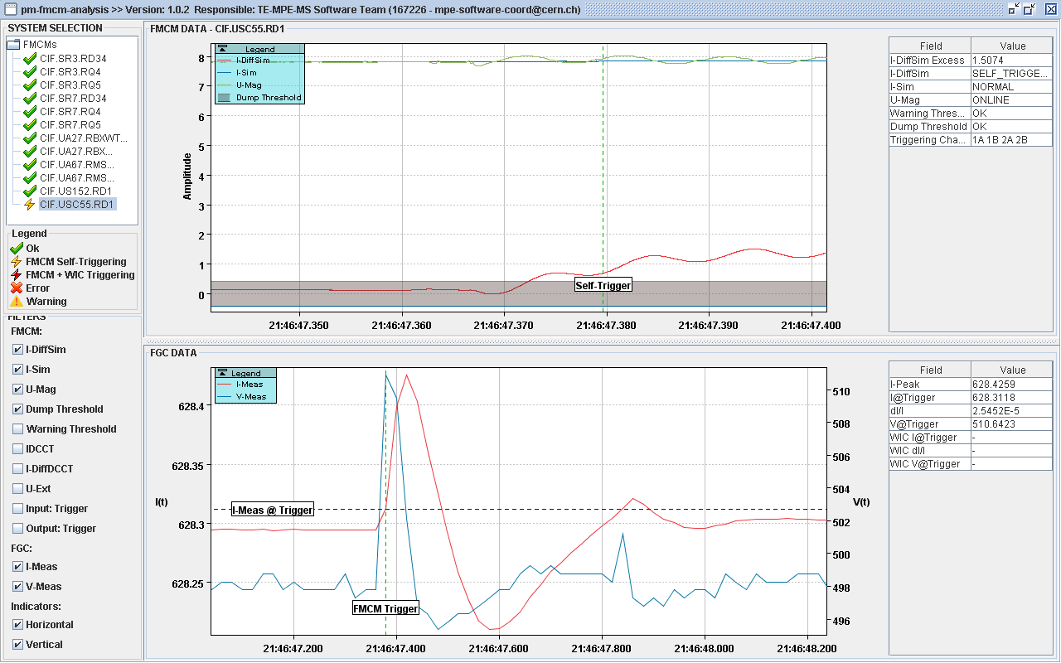
FMCM analysis
Signal/Threshold > 3.5
𝚫I= 130mA
t=500ms

Slide 13
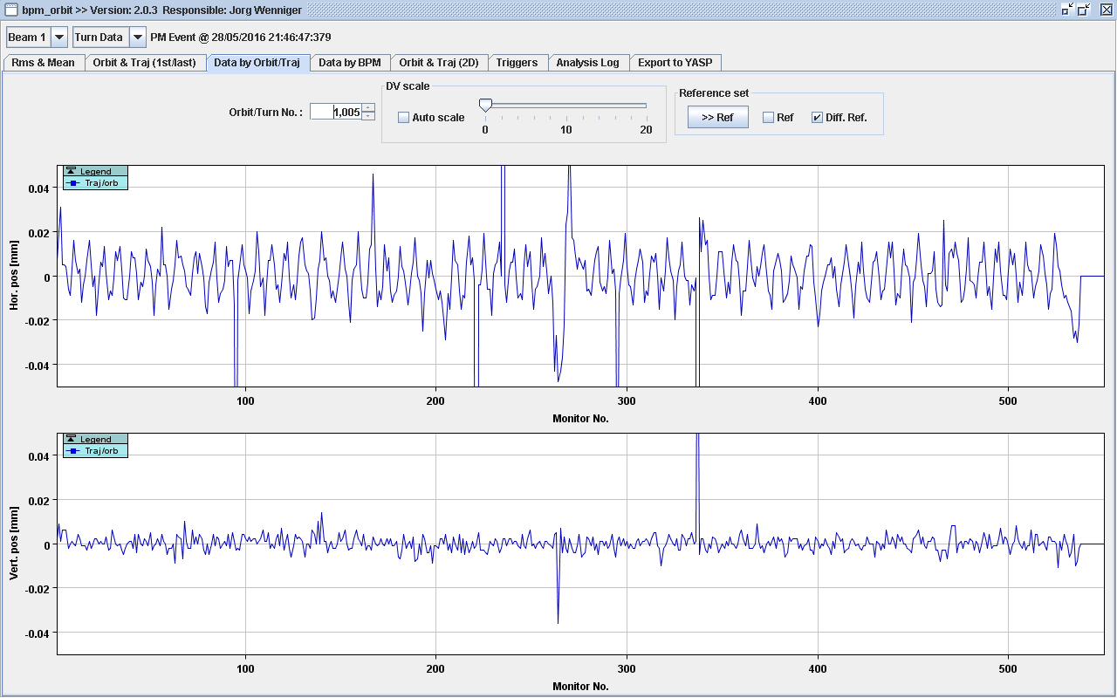
Orbit trajectory in last hundred turns
Difference trajectory 1005-910, 20um difference in arcs

Slide 14
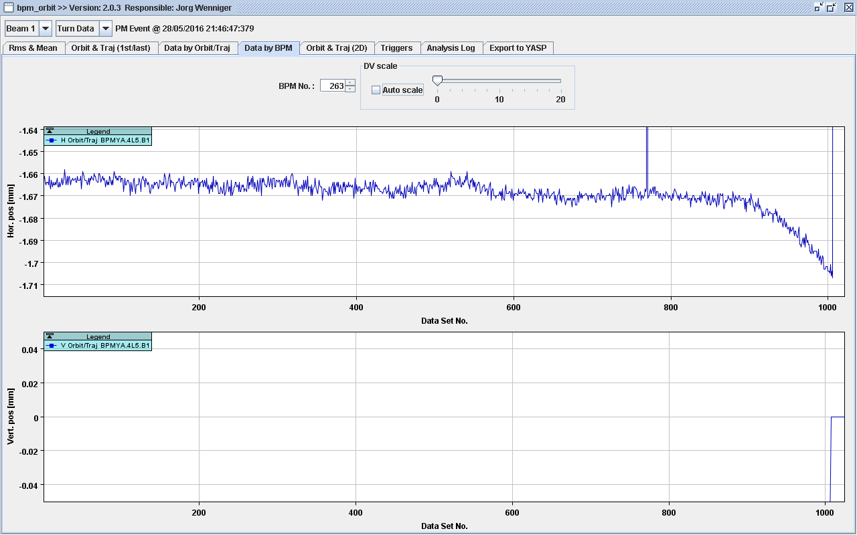
One monitor, BPMYA.4L5.B1
One monitor, BPMYA.4R5.B1, 40um difference

Slide 15
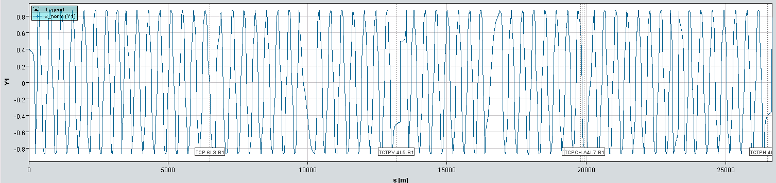
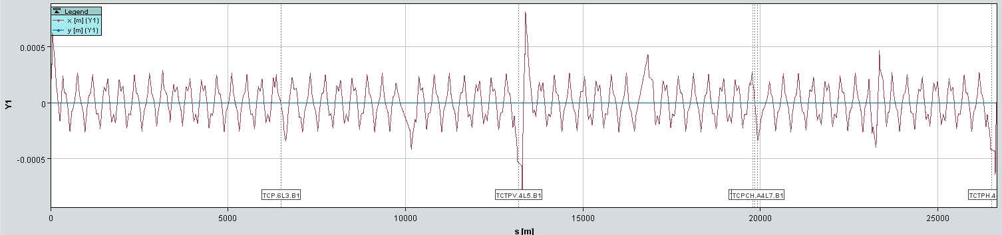
Failure simulations: D1@IP5, +150mA
0.9σ
0.8mm
Courtesy of M.Valette
With threshold relaxed by factor 3.5 => Excursion ≃ 0.9σ
Maximum excursion allowed at TCT (IR1 and IR5) = 1σ

Slide 16
Orbit trajectory in last hundred turns

Slide 17
Failure simulations

Slide 18
Events above FMCM thresholds in 2016
Zoom for next slide

Slide 19
Events above FMCM thresholds without equipment failures in 2016
Minor perturbations of < 250mA => Area of possible improvements
PRESENT THRESHOLD RANGE FOR D1

Slide 20
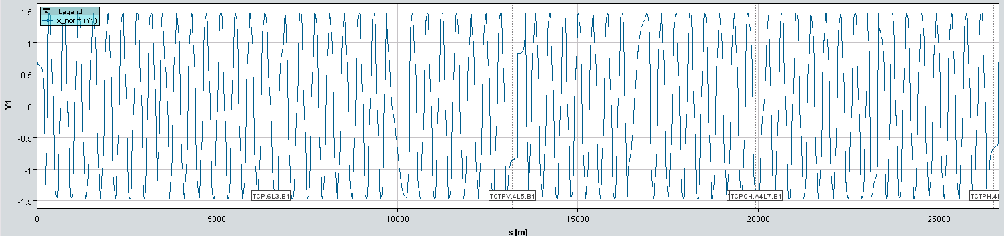
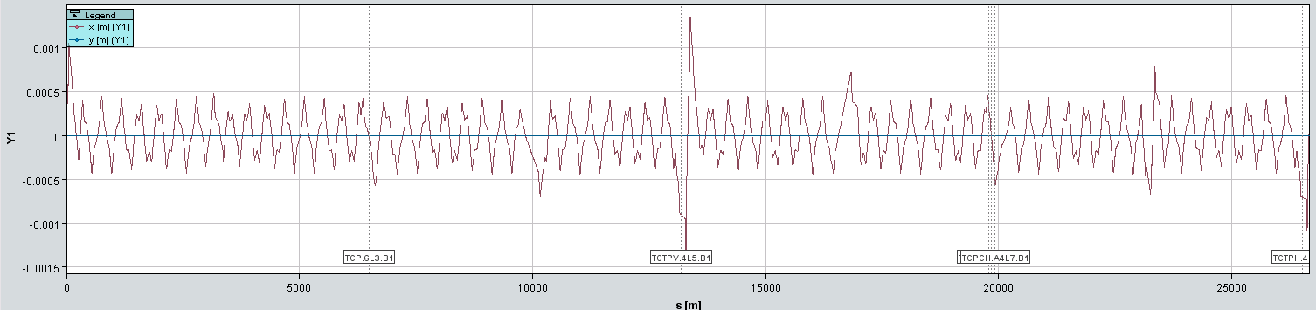
Failure simulations: RD1 failure at 6.5TeV
6.5TeV, β*=0.4m, current change RD1.LR1 +250mA
Maximum excursion ≃ 1.5σ
Maximum excursion allowed at TCT (IR1 and IR5) = 1σ
1.5σ
1.4mm
Courtesy of M.Valette

Slide 21
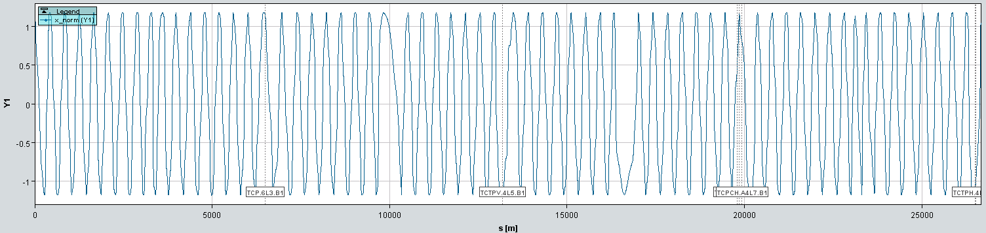
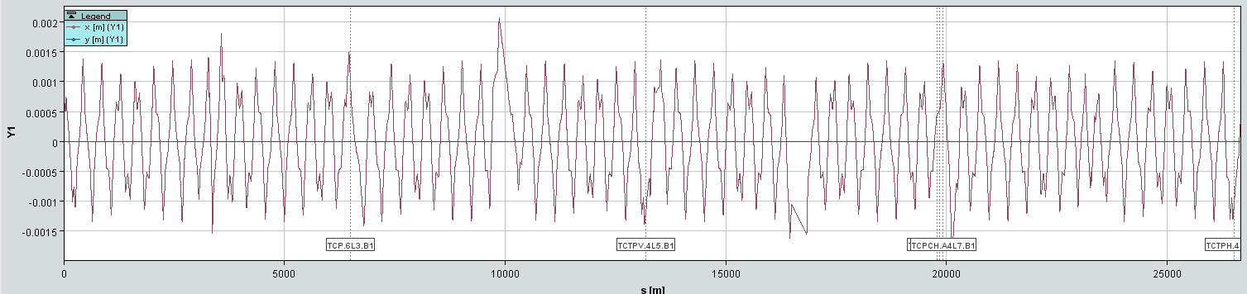
Failure simulations: RD1 failure at injection
450GeV, injection optics, current change RD1.LR1 +250mA
Maximum excursion ≃ 1.2σ
Maximum excursion allowed at TCT (IR1 and IR5) = 4σ
1.2σ
1.4mm
Courtesy of M.Valette

Slide 22
Conclusions
Tight requirements for detection of current changes resulted in 14 FMCM triggers in 2016 following electrical network perturbations
  7 perturbations affected other equipment trips (PC, RF, CRYO…)
Choice of thresholds is a trade-off between protection and availability and so far no unjustified trigger observed in 2016
Simulations with the 2016 optics confirmed that thresholds cannot be relaxed without compromising machine protection (combined failures of RD1 in IP1/IP5 add up to orbit excursions)
The replacement of the 4x RPTG converters for D1&D34 circuits after EYETS will reduce the sensitivity to electrical network perturbations

Slide 23
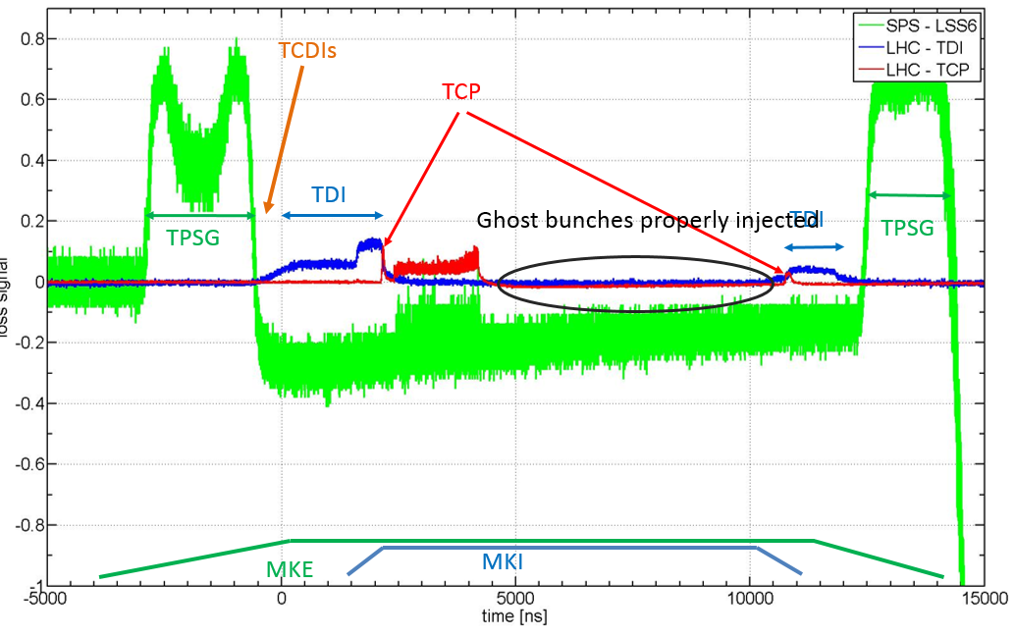
dBLM Update – IP 2, 8, SPS & TL
The data will be included into the IQC once the time window is reduced to 50µs (2 SPS turns) instead of 10ms.
Allowed explaining the high losses at injection during re-commissioning:
Courtesy of F. Burkart

Slide 24
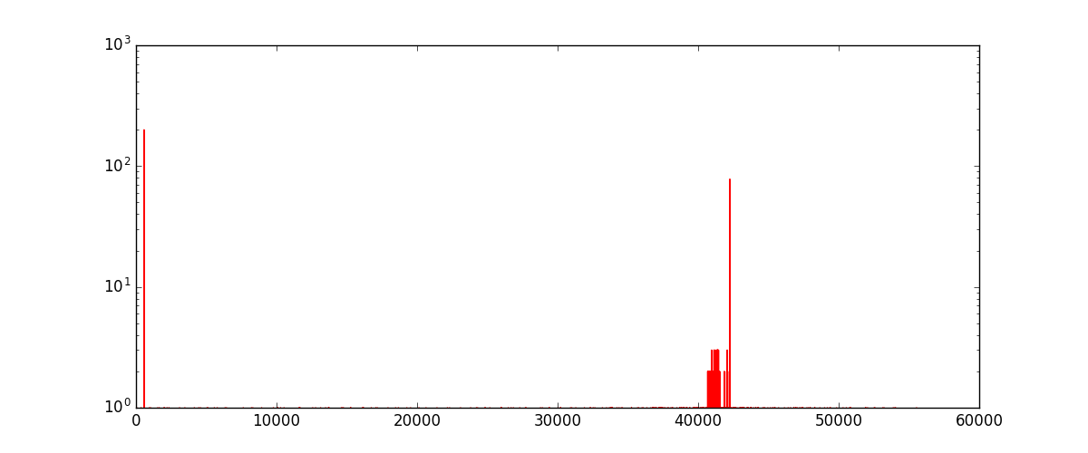
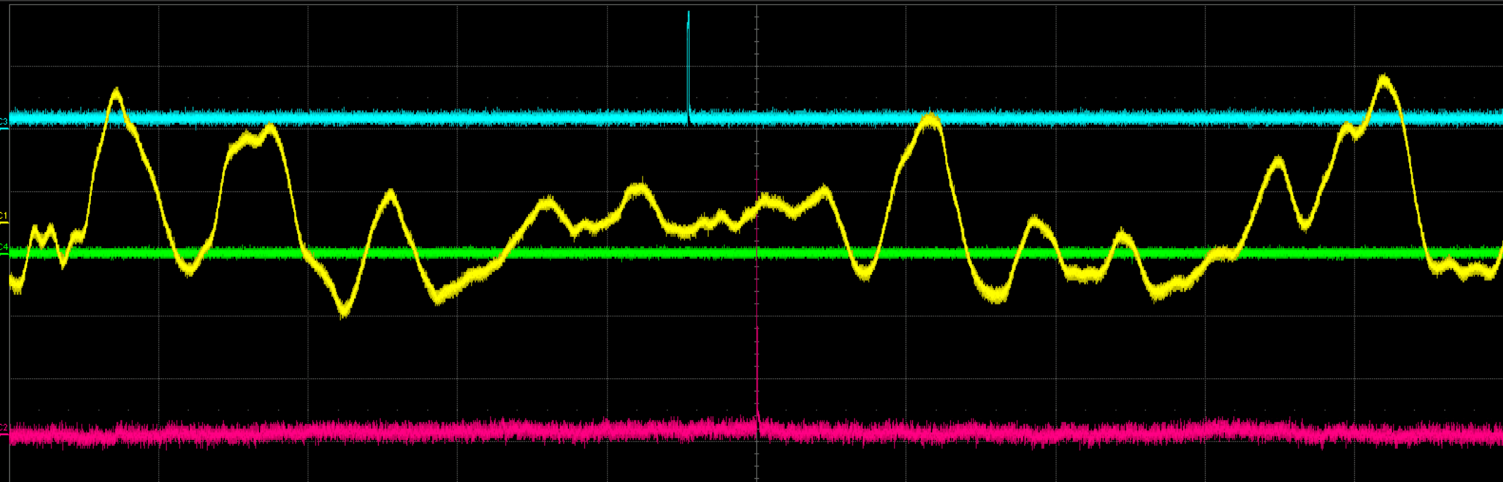
dBLM Update – IP7
The B2 diamond is still non functioning.
  Access yesterday afternoon, waveforms seem to be fine:
  In case it still does not work, some lab-tests with a β- radioactive source are foreseen, to check if the detector is still working.
The Crystal collimation diamonds are working in histogram mode and allow checking for cleaning efficiency.
The continuous recording during Injection and Stable beams was finalized thanks to the use of the pyjapc library: (24h timeout problem) https://gitlab.cern.ch/scripting-tools/pyjapc
The data from the ROSY is automatically stored on EOS: (/eos/project/dblm/TZ76/ROSY1/)
To be implemented, offline post-processing to delete ‘useless’ waveforms.

Slide 25
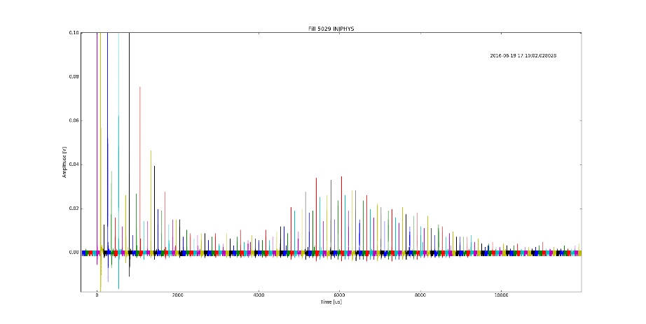
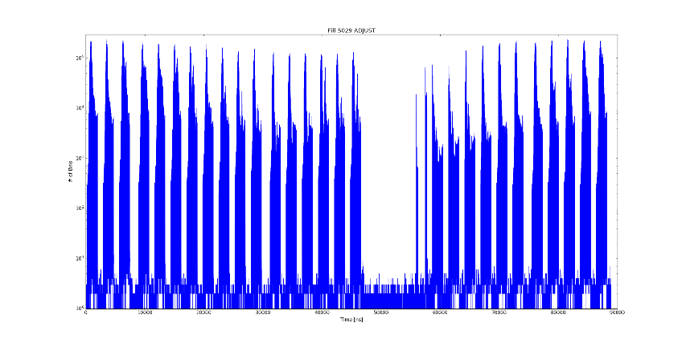
dBLM Update – IP7
The B1 diamond is working fine and allowed observation of injection oscillation losses, filling pattern:
Courtesy of C. Xu

Slide 26
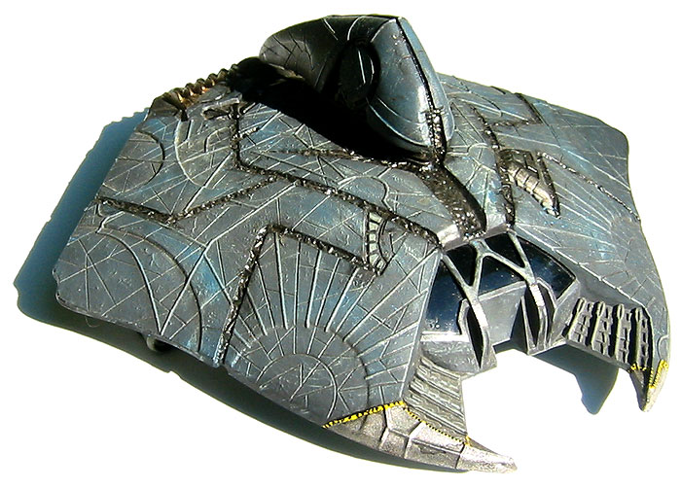
dBLM Update – IP7
We get some waveforms a few turns before some UFO events, probably from losses due to halo interaction with the UFO, the real event starting more than 10 turns later.
We switched the B1 diamond to UFO lookout mode, sampling rate was reduced to 6.4ns and recording window is now 143 turns. We’re waiting…
In search of a simple integrator system to trigger on large enough multi-turn losses. A capacitor was first considered but the DC channel of the splitter might do, to be checked once an event is recorded.

Slide 27
dBLM Update – IP6
The detectors saturated during the large asynchronous Beam Dump test on 15th May:
  B1: from BSRA data: ~3e10 p+ hit the TCDQ
    13Gy of integrated signal on the TCDQA IC BLM
    an estimated 160V on the diamond
  B2: from BSRA data:~2e10 p+ hit the TCDQ
    10Gy of integrated signal on the TCDQA IC BLM
    an estimated 110V on the diamond
  A full asynchronous BD would lead to 600V+ signals.
    10V max signal on the scope and 500V voltage on the diamond

Slide 28
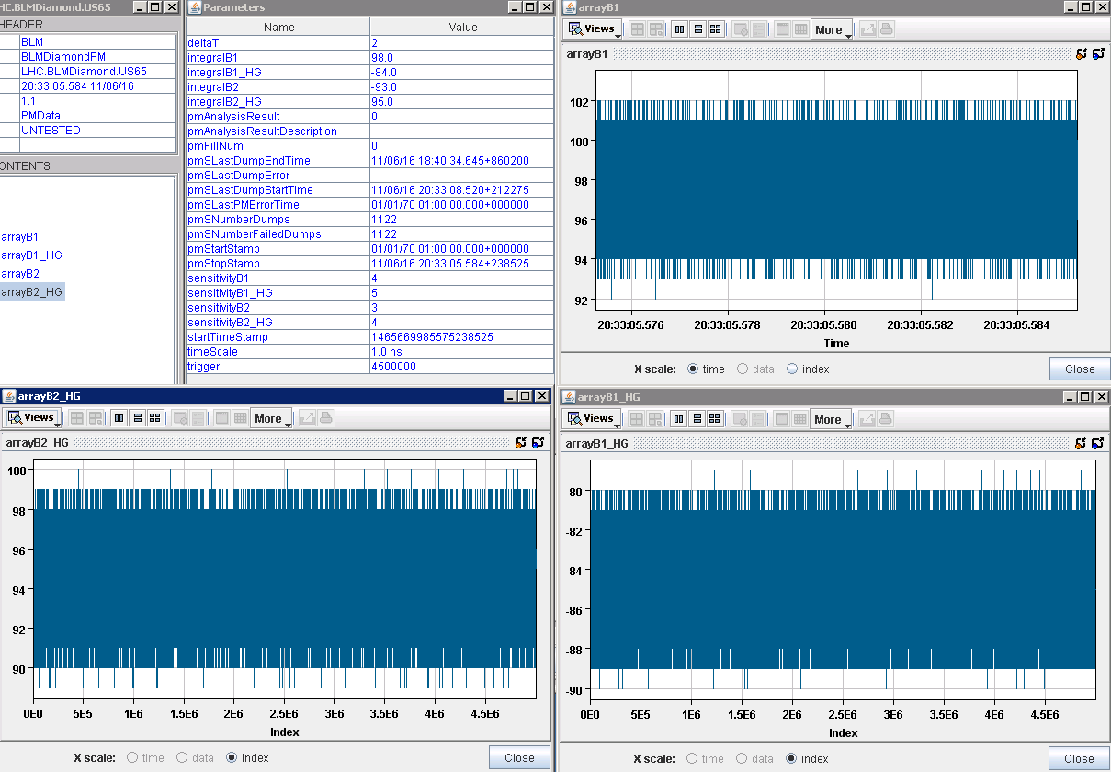
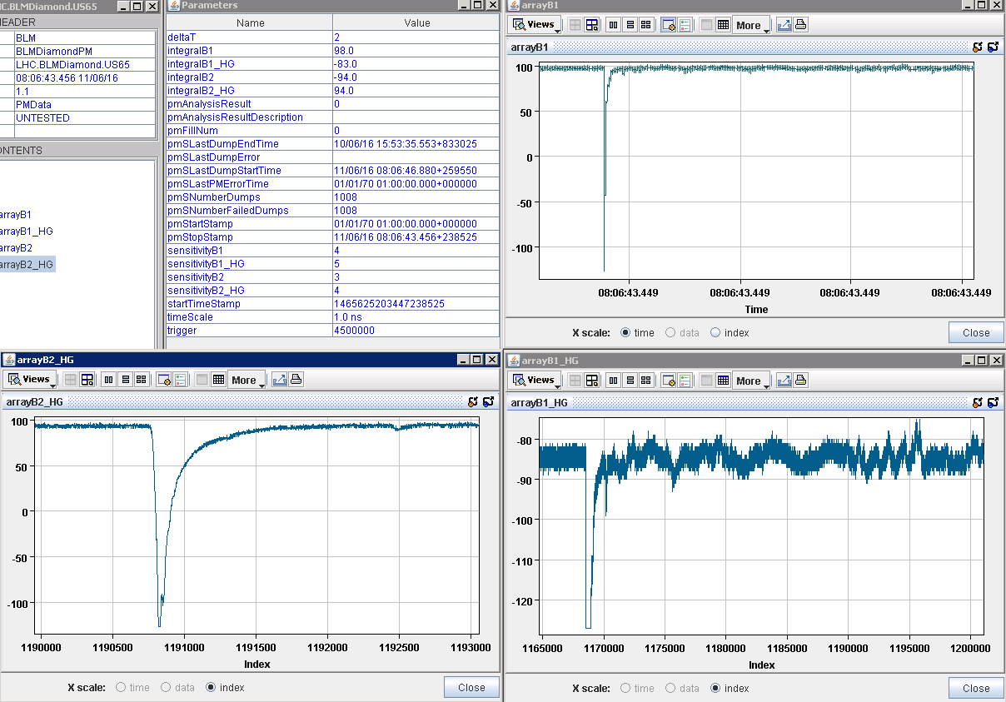
dBLM Update – IP6
The 100µm thick detectors were installed with 100V voltage.
During the async BD tests on the 11th of June:
At injection: (nothing, Md1182?) At top energy: (just saturated)
A -20B attenuator was installed yesterday, should lead to 10V max signals.
If saturation is still possible the diamond will be moved to a position with lower fluence.

