Slide 2
- WORKSHOP –
AVAILABILITY MODELLING TOOLS AND SYNERGIES FOR COLLABORATION
CERN, July 7, 2016
Odei Rey Orozko
TE-MPE-PE Section Meeting
13/05/2016

Slide 3







PARTICIPANTS

Slide 4
OBJECTIVES AND AGENDA
Morning session
Introduction, R. Schmidt
Increasing interest and effort invested into reliability and availability studies
RAMI STUDIES
The performed and on-going RAMI studies in the accelerator domain were presented
Identify the needs that arise when performing such a study in different projects.
LUNCH BREAK
Afternoon session
SOFTWARE PACKAGES & SYNERGIES
Understand the functionality of each software, advantages and limitations.
Discussion
Discuss synergies for collaboration

Slide 5
RAMI STUDIES
Availability Studies for FCC, Arto Niemi (CERN)
The approach taken for the LHC model was presented.
Elmas simulation software is used to model the LHC and its operational modes.
State based chain model together with Faults trees.
Cryogenics FT can be used for other accelerators…. MYRRHA
The model reproduces the 2012 integrated luminosity production closely.
Future work: the study of the FCC based on scaling up the LHC and injector chain.
Measure value to cost ratio, e.g. produced in Luminosity versus operational cost.
Concept of availability simulation infrastructure.
Use model to define availability budgets for sub-systems.

Slide 6
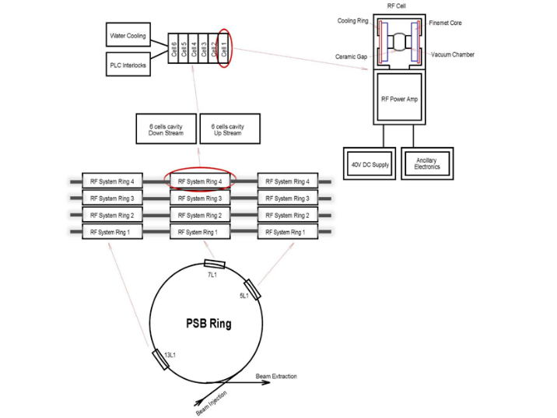
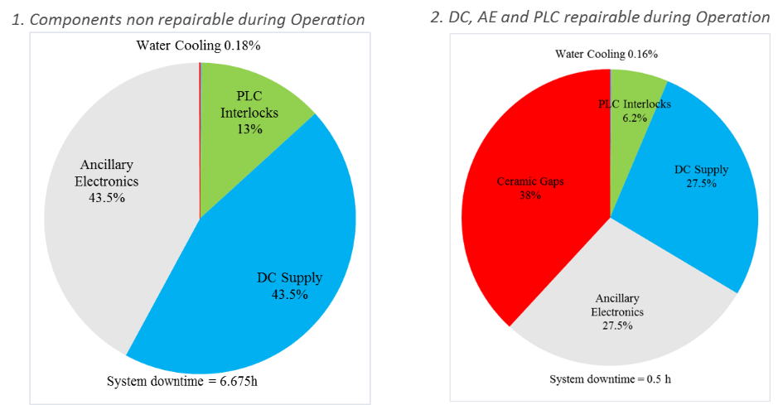
RAMI STUDIES
PSB RF System Upgrade Availability studies, Odei Rey Orozko (CERN)
An overview of the PSB RF System was given.
Two dependability studies were performed and compared: Monte Carlo Simulations and Analytical methods.
The PSB RF System is modelled in Isograph by Reliability Block Diagrams (more than 5000 components).
Two maintenance strategies are considered: Corrective and Planned.
The results obtained from the simulations in two different scenarios were presented.
The impact of components failures on the system is minor due to the implemented redundancy.
Predictions on maintenance cost and required personal could be done based on the results.
Interesting to compare the execution time of the simulations in different tools.
Common failures need to be considered to get correct results.
Extension using ISOGRAPH to a large machine (CLIC) difficult, since so many components.

Slide 7
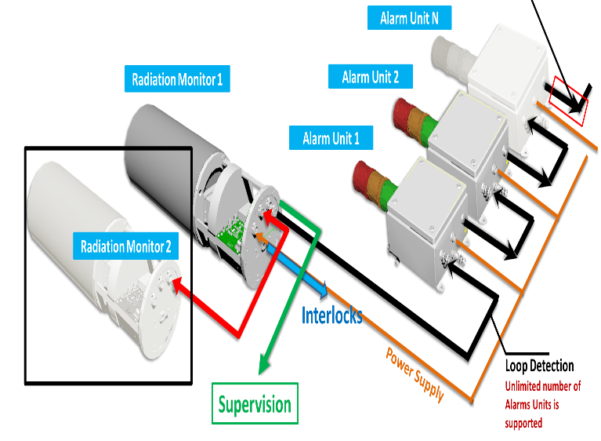
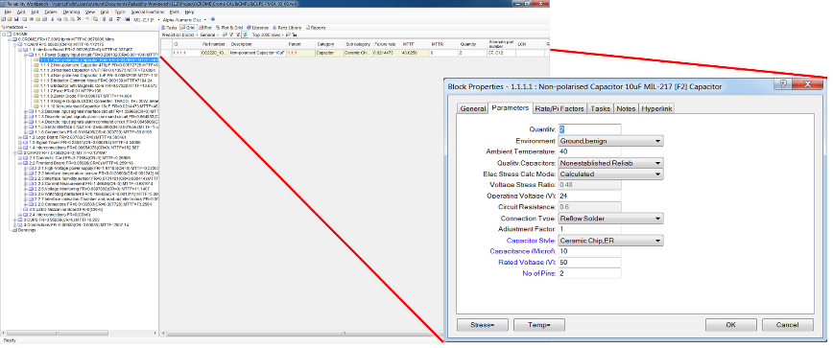
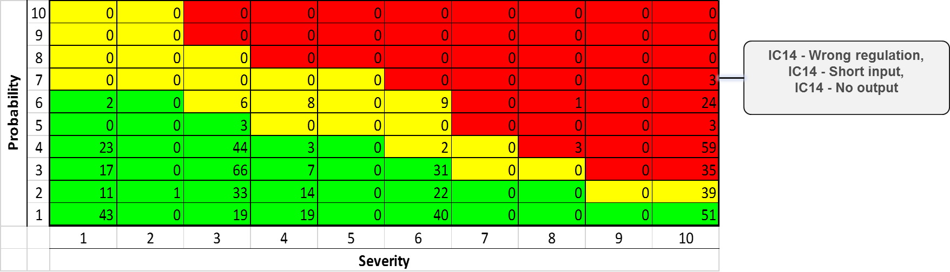
RAMI STUDIES
Reliability analysis of radiation protection models, Saskia Hurst (DE)
CROME radiation Monitoring System structure and functional analysis was presented.
The study aims to assess if the required SIL2 for CROME is achieved.
CROME system MTTF calculated with Isograph Prediction tool.
Calculation of standard components with the Mil-Standard 217.
Calculation of non standard components with given MTTF or FIT
values of the manufacturer.
Calculation accounts for specific environmental conditions and specific usage.
Highest system block and components failure rates were shown.
Possible reliability improvements were proposed.
An FMEA had been performed in Isograph and RPN assigned to each component.
The calculated MTTF and assigned RPN for each component were presented in a Risk matrix.
Focus not only on components also on interfaces between components ( cabling, connectivity)

Slide 8
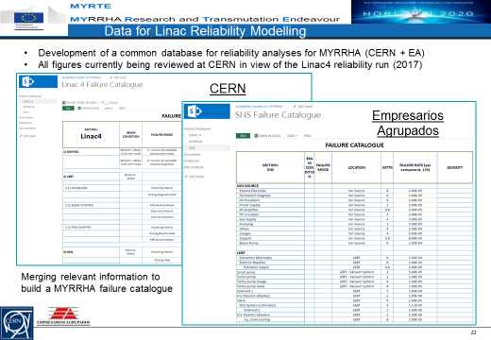
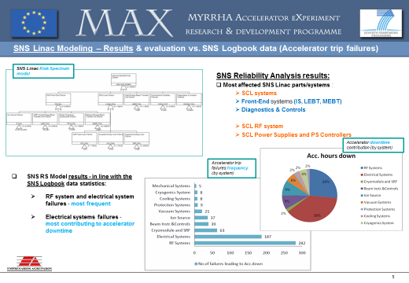
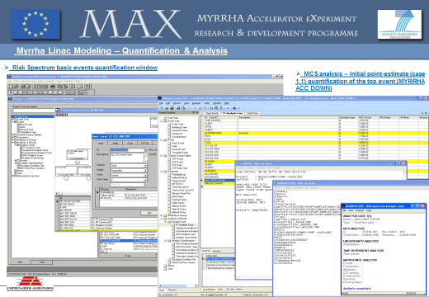
RAMI STUDIES
Availability Studies for MYRRHA, Adrian Pitigoi (Empresarios Agrupados)
MYRRHA – long term supporting research facility for Accelerator Driven Spallation System.
SNS Linac modelled in RiskSpectrum. Results in line with the SNS logbook.
Used as a reference for MYRRHA design and RAMI studies.
MYRRHA reliability model built in Risk Spectrum (Fault Tree solved analytically).
Results obtained from the RiskSpectrum model were presented.
Maintenance phases not possible to model in RiskSpectrum.
Reliasoft’s BlockSim software tool will be used for further RAMI studies of MYRRTHA.
Failure database for MYRRHA developed from SNS and Linac4 failure catalogue.
Ideas for most dependable architecture to be discussed.

Slide 9
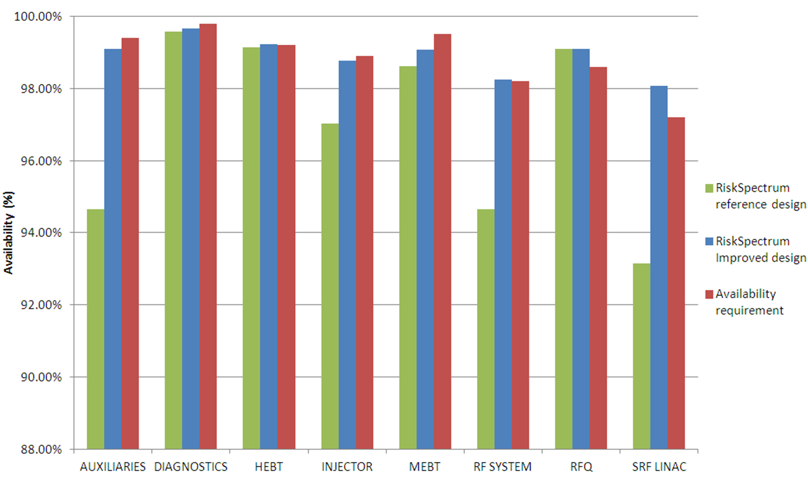
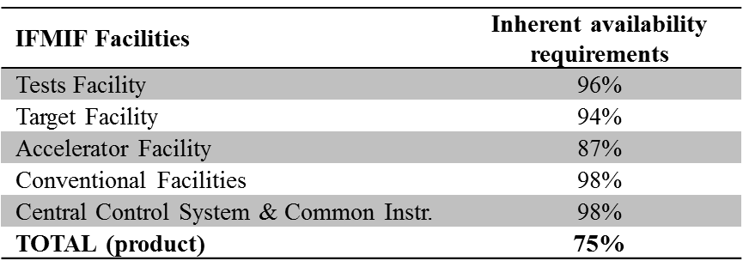
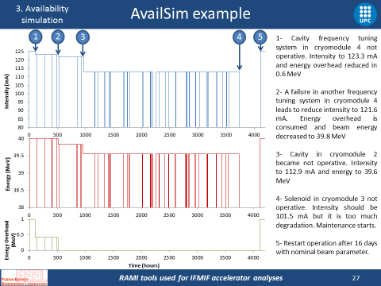
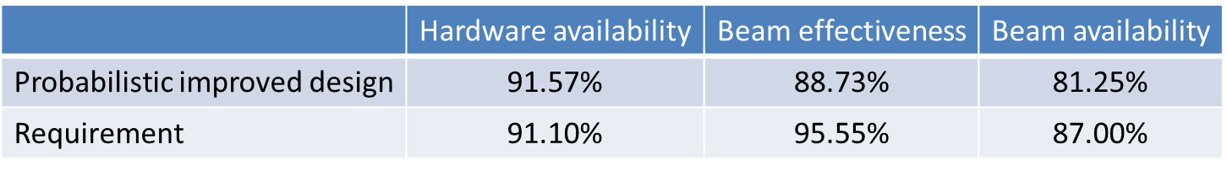
RAMI STUDIES
IFMIF Accelerator Facility RAMI analyses and the tools used, Enric Bargalló (ESS)
International Fusion Materials Irradiation Facility challenges and requirements presented.
Many design characteristics challenging to achieve high availability.
IFMIF allows for degraded operation exploiting design margins.
RAMI studies performed to analyse different design options and propose changes in the machine.
Definitions of terms needed for availability allocation: Hardware Avail, Beam Effectiveness and Beam Avail.
Analytical calculations were done using RiskSpectrum (Fault trees). Results compared to HA requirements.
Decision to adopt AvailSim 2.0 software for availability modelling.
Some components failures and degraded operation can be modelled.

Slide 10
SOFTWARE PACKAGES
Isograph, Andrea Apollonio (CERN)
ELMAS, Jussi-Pekka Penttinen (Ramentor)
AvailSim, Enric Bargalló (ESS)
Realist IMA Modelling tool, Thomas Herzig (DE)
Software-features matrix
(under development)

Slide 11
SOFTWARE PACKAGES
Software-features matrix I (under development)
First version sent to presenters for feedback

Slide 12
SOFTWARE PACKAGES
Software-features matrix II (under development)
First version sent to presenters for feedback

Slide 13
SOFTWARE PACKAGES
Software-features matrix III (under development)
First version sent to presenters for feedback

Slide 14
SYNERGIES FOR COLLABORATION
Software-features matrix development.
Use Linac 4 as a use-case for AvailSim 3.0.
Collaboration with ESS under discussion.
Possibility to model Linac 4 with the different software packages (under discussion):
  Input data: Linac 4 reliability run.
  Compare modelling process.
  Compare results and performance.
  Find similarities.
Activity possibly followed up in the RASWG.
Proposal for a common input format of the models.
Technical student coming in October.
( interface which generates correctly structured XML files or csv files which used as Isograph input define the system
model completely. )
Isograph
Results
Elmas
Results
Common format
Intermediate Translators
Compare and validate
AvailSim
Results
Realist
Results

Slide 15
Thanks a lot for your attention!
14/07/2016

