Slide 2

Field-Circuit Coupling - update
B. Auchmann, L. Bortot, J. B. Ghini, T. Griesemer, M. Maciejewski,
A. Fernandez, M. Prioli, A. P. Verweij, S.Schöps
TE-MPE-PE CERN
TEMF TU Darmstadt

Slide 3
Outline
Motivation
Field-circuit coupling
Co-Simulation
Numerical Results
Summary and Outlook

Slide 4
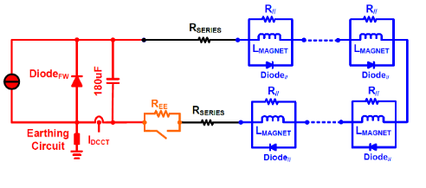
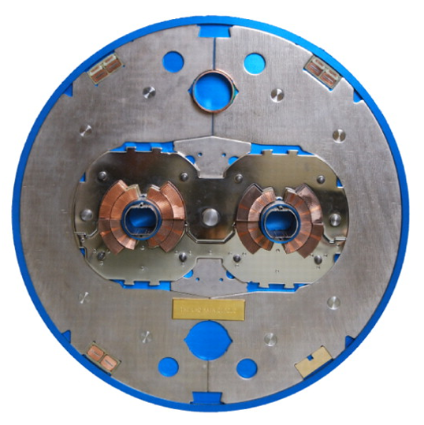
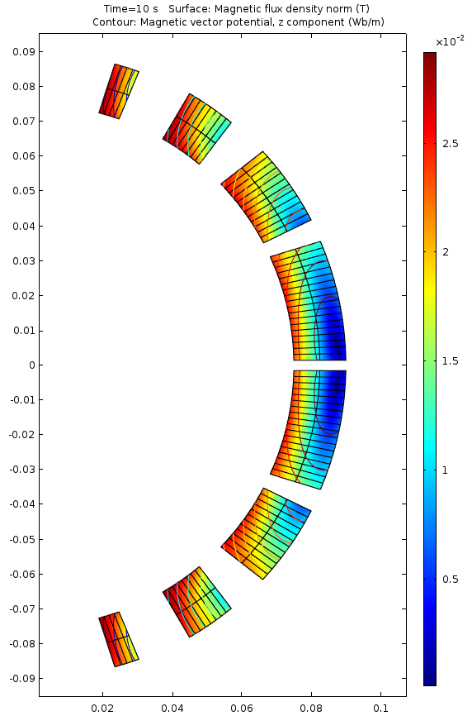
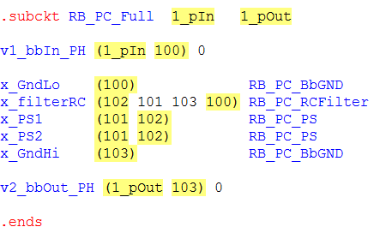
The Challenge: Coupling Circuit and FEM models
Waveform relaxation (dynamic iteration) co-simulation scheme allows controlling the convergence error between two consecutive iterations. If the error is smaller than the desired one, the next iteration starts.
The problem can be described as:
Multi-Physics
Multi-Rate
Multi-Scale
Question 1: how to represent a field model on circuit side?
Question 2: how to couple the two together?

Slide 5

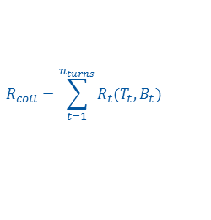
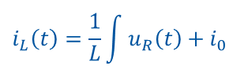
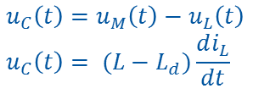


Q1: Field-circuit coupling – Field Model Approximation
Source Coupling Interface
Field: Coil driven by voltage source
Circuit: Coil represented as a current source
Inductor is driven by a voltage source obtained from the circuit
Parameter Coupling Interface
Field: Differential inductance calculated from magnetic flux
Circuit: Inductor as a differential inductance
The effect of the difference between the two differential inductances is represented as a voltage source u_{c}.
Circuit
Field
Circuit
Field
i_{L}(t)
i_{L}(t)
i_{L}(t)
i(t)
i_{R}(t)
i_{M}(t)
i(t)
i_{R}(t)
u_{R}(t)
u_{L}(t)
L_{d}
+
-
i_{M}(t)
+
-
u_{M}(t)
L
u_{R}(t)
R
+
-
u_{M}(t)
L
u_{R}(t)
R
u_{C}(t)
i_{M}(t)
u_{C}(t)
i_{M}(t)
$$R_{coil}=\sum_{t=1}^{n_{turns}}{R_{t}(T_{t},B_{t})}$$
$$i_{L}\left(t\right)=\frac{1}{L}\int{u_{R}\left(t\right)+i_{0}}$$
$$Ri_{L}\left(t\right)=u_{C}\left(t\right)+L_{d}\frac{di_{L}\left(t\right)}{dt}$$
$$u_{C}\left(t\right)=u_{M}\left(t\right)−u_{L}\left(t\right) \\ u_{C}\left(t\right)= (L−L_{d})\frac{di_{L}}{dt}$$
$$u_{M}\left(t\right)=L\frac{di_{L}\left(t\right)}{dt}$$
$$u_{R}\left(t\right)=R(i\left(t\right)−i_{L}\left(t\right))$$
$$L_{d}\frac{di_{L}\left(t\right)}{dt}+Ri_{L}\left(t\right)=Ri\left(t\right)−u_{C}(t)$$
$$u_{C}\left(t\right)=u_{M}\left(t\right)−u_{L}\left(t\right) \\ u_{C}\left(t\right)=u_{M}\left(t\right)−L_{d}\frac{di_{L}}{dt}$$

Slide 6

Q2: Coupling in Time Domain Between Two Systems
One-way Coupling/Parameter Extraction
„Strong” Coupling
S1
S1
t
t_{end}
t
t_{end}
S2
S2
(S1) Field map from ROXIE → (S2) TALES
(S1) TALES thermal→ (S2) TALES electrical
Multirate systems
Fast System → small steps
Slow System → large steps
„Weak” Coupling
Dynamic Iteration / Waveform Relaxation
S1
S1
t
t_{end}
t
t_{end}
S2
S2
*Courtesy
S.Schöps
Notes:
Good example is better than one hour lecture ;)

Slide 7
The Solution: Waveform Relaxation
Waveform relaxation (dynamic iteration) co-simulation scheme allows controlling the convergence error between two consecutive iterations. If the error is smaller than the desired one, the next iteration starts.
In order to determine which model should execute first the computational causality representing the problem is analyzed.
Parallel vs Serial Execution
circuit
Gauss-Seidel
t
t_{end}
field
circuit
Jacobi
t
t_{end}
field

Slide 8

The Solution: Waveform Relaxation
Waveform relaxation (dynamic iteration) co-simulation scheme allows controlling the convergence error between two consecutive iterations. If the error is smaller than the desired one, the next iteration starts.
Outer iterations
Circuit
Field
t+2*dt
t_{end}
t
t+dt
R⁰_{q}, u⁰_{C}
i¹_{mag}
i¹_{mag}
R¹_{q}, u¹_{C}
i
R¹_{q}, u¹_{C}
i²_{mag}
Inner iterations
$$tol=\frac{\sum_{h}{\left|i^{2}−i^{1}\right|}}{\sum_{h}{\left|i^{2}\right|}}$$
i²_{mag}
R²_{q}, u²_{C}
i
t
R²_{q}, u²_{C}
i³_{mag}
I³_{mag}
R³_{q}, u³_{C}
t

Slide 9
The Solution: Waveform Relaxation
START
Set Initial Conditions
The waveform relaxation algorithm has the following main
subroutines:
t == t_{end}?
Yes
Initial Conditions:
  Calculate differential inductance
  Ramp-up FEM model
  Set initial conditions for circuit model
  Set-up co-simulation parameters
Run Circuit
Check Convergence
  In case co-simulation converged, field computation
  can be avoided
Run Field
  Increase solution accuracy after each inner iteration
Adaptive algorithm
  Outer iteration time window is adjusted based on
  convergence of previous iteration
No
R(t), u(t) → Run Circuit → i(t)
Current
converged?
Yes
No
i(t) → Run Field → R(t), u(t)
Adaptive algorithm → dt
t = t + dt
END

Slide 10
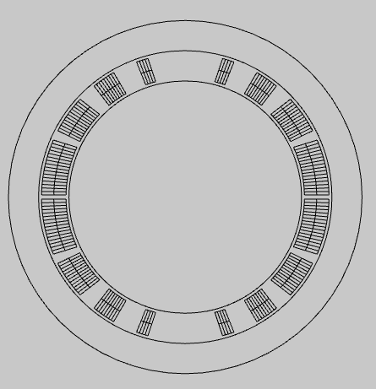
Numerical experiments: D1 magnet
D1 beam separation magnet was selected to carry out numerical studies. It is a single layer Nb-Ti magnet. We consider the following three numerical scenarios:
Quadrant of D1 magnet with 100 mΩ energy extraction resistance
Quadrant of D1 magnet with CLIQ in parrallel and remaining three quadrants as lumped inductance
Full D1 magnet divided into upper and lower pole with CLIQ in parallel to lower pole
Parameter | Value
L_{magnet} | 36.082 mH
l_{magnet} | 6.27 m
n_{turns} | 4x44
I₀ | 5000 A
R_{crowbar} | 10e-6 Ω
 | L1[mH] | L2[mH]
L1[mH] | 12 | 6.2
L2[mH] | 6.2 | 12
T. Nakamoto, et al.: Model Magnet Development of D1 Beam Separation Dipole for the HL-LHC Upgrade, IEEE Trans. on Applied Superconductivity, 25(3), 2015

Slide 11
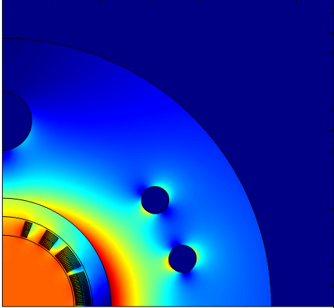
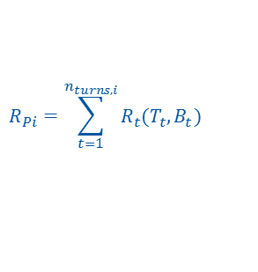
D1 Quadrant Protected by EE (0.1 Ω): Configuration
The FEM model is driven by external current density. Thus as a solution one obtains flux linkage that includes
effect of coupling currents. In order to obtain calculate induced coupling currents an external circuit is needed.
L_{Field}
u_{c}(t)
R_{q}
R_{EE} = 0.1 Ω
+
-
i_{Li}(t)
u_{Ci}(t)=u_{M}(t)-u_{L}(t)
i_{magnet}
R_{crowbar}
$$R_{Pi}=\sum_{t=1}^{n_{turns,i}}{R_{t}(T_{t},B_{t})}$$
i(t)
Circuit schematic
Single quadrant geometry

Slide 12
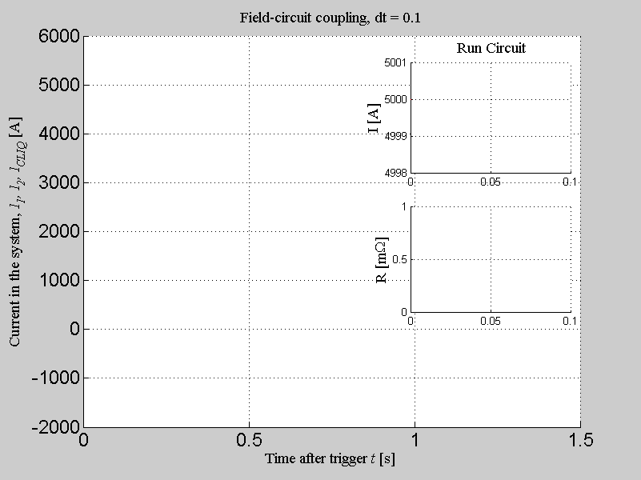







$$i\left(t\right)=I_{0}e^{−\frac{t}{L/R}}$$
$$i_{inner}=1$$
$$i_{magnet}(t)$$
$$i_{inner}=2$$
$$R_{q}(t)$$
$$i_{inner}=3$$
$$i_{inner}=4$$

Slide 13
$$i\left(t\right)=I_{0}e^{−\frac{t}{L/R}}$$
$$i_{magnet}(t)$$
$$R_{q}(t)$$

Slide 14
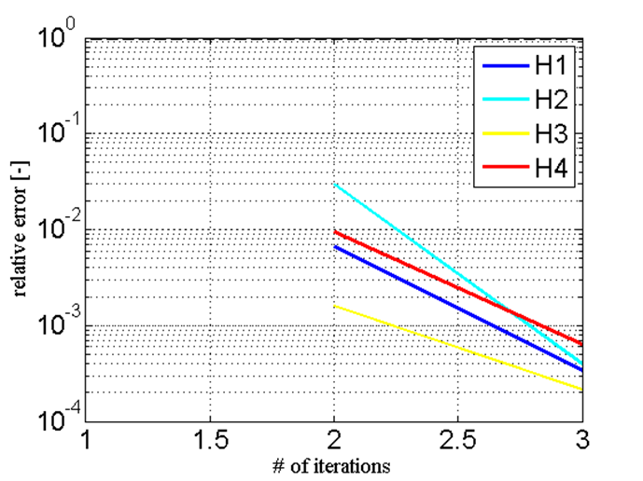

D1 Quadrant Protected by EE (0.1 Ω): Convergence Rate
$$tol={10}^{−3}$$

Slide 15
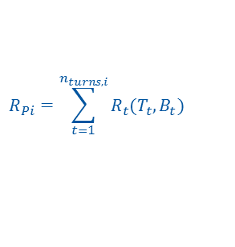
D1 Quadrant protected by CLIQ (500 V, 50 mF): Configuration
In this scenario only a single quadrant of the D1 magnet is considered. Therefore, the circuit contains a lumped inductance accounting for ¾ of differential inductance and approximated field model containing ¼ of differential inductance. A CLIQ unit (500 V, 50 mF) is connected across the approximated field model.
L_{Circuit}
L_{Field}
u_{c}(t)
R_{q}
+
-
i_{Li}(t)
i₂(t)
u_{Ci}(t)=u_{M}(t)-u_{L}(t)
i₁(t)
CLIQ
i_{CLIQ}(t)
$$R_{Pi}=\sum_{t=1}^{n_{turns,i}}{R_{t}(T_{t},B_{t})}$$
R_{crowbar}
i(t)
Circuit schematic
Single quadrant geometry

Slide 16
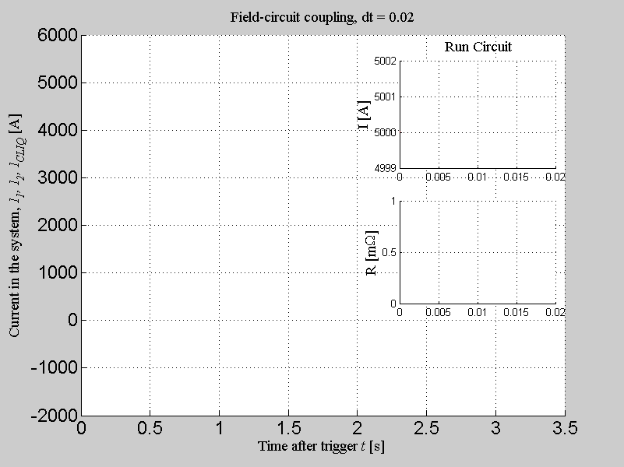




$$i_{upper}(t)$$
$$i_{lower}(t)$$
$$i_{inner}=1$$
$$i_{CLIQ}(t)$$
$$i_{inner}=2$$
$$R_{q}(t)$$
$$i_{inner}=3$$
$$i_{inner}=4$$

Slide 17
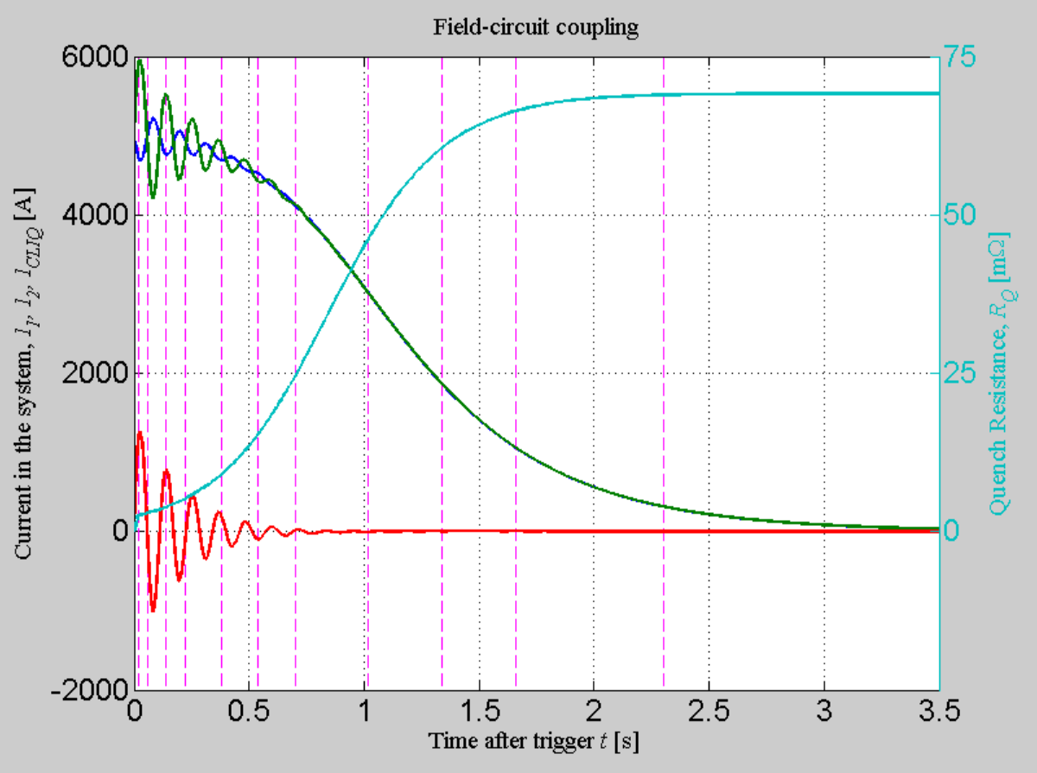
$$i_{upper}(t)$$
$$i_{lower}(t)$$
$$i_{CLIQ}(t)$$
$$R_{q}(t)$$

Slide 18
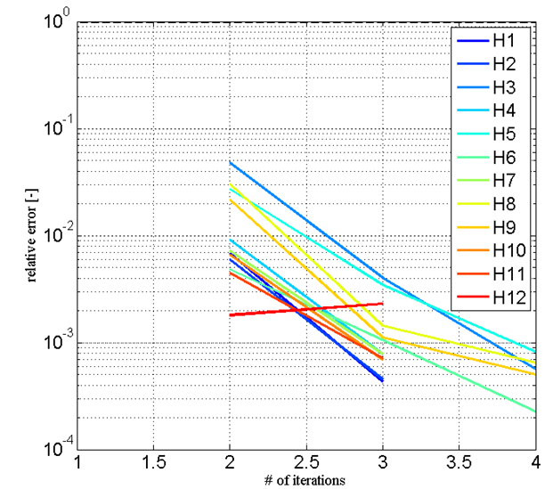

Quench-back: Convergence Rate
$$tol={10}^{−3}$$

Slide 19
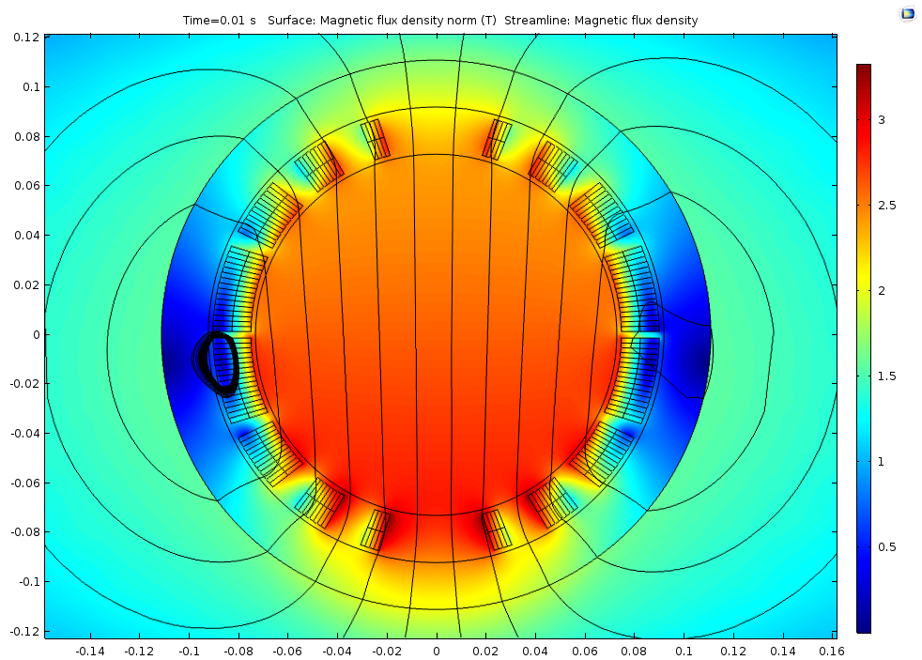
Full D1 protected by CLIQ (500 V, 50 mF): Configuration
In final case we consider a full D1 magnet (80 turns) divided into 2 parts: upper and lower pole. A CLIQ unit (500 V, 50 mF) is connected across the approximated field model of lower pole.
Equivalent circuit model
Equivalent circuit model
M_{P21,P2}
L_{field,1}
u_{c,1}(t)
R_{q,1}
L_{field,2}
u_{c,2}(t)
R_{q,2}
i_{Li}(t)
+
-
+
-
i₂(t)
u_{Ci}(t)=u_{M}(t)-u_{L}(t)
CLIQ
$$R_{Pi}=\sum_{t=1}^{n_{turns,i}}{R_{t}(T_{t},B_{t})}$$
i_{CLIQ}(t)
i₁(t)
R_{crowbar}
i(t)
Circuit schematic
Full magnet geometry

Slide 20
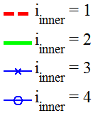
Full D1 protected by CLIQ (500 V, 50 mF): Current evolution

Slide 21
Conclusions
Field-circuit coupling allows using solvers optimized towards a given problem: FEM and circuit solvers.
Approximated field model on the circuit side composed of a differential inductance, voltage source and resistance proves to be most performant out of analysed field representations.
Waveform relaxation co-simulation scheme allows controlling convergence error
The coupling interface contains core features and can be integrated with STEAM framework
Next steps include validation against measured data (MB test campaign?)

Slide 22
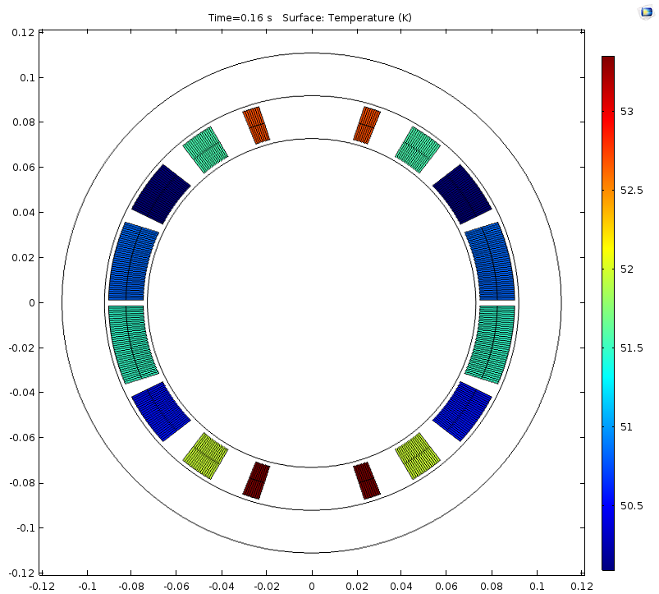




Towards thermo-mechanical analysis of unbalanced currents…
$$i_{upper}(t)$$
$$i_{lower}(t)$$
$$i_{CLIQ}(t)$$
$$R_{q}(t)$$

Slide 23
Thank you for your attention!

