Slide 2
Towards 2D Thermo-Mechanical Analysis
Tina Griesemer
07/14/2016
Supervisors:
Michal Maciejewski
Lorenzo Bortot

Slide 3
Overview
Motivation
Introduction in mechanics
How the coupling is done
Results
Next steps

Slide 4
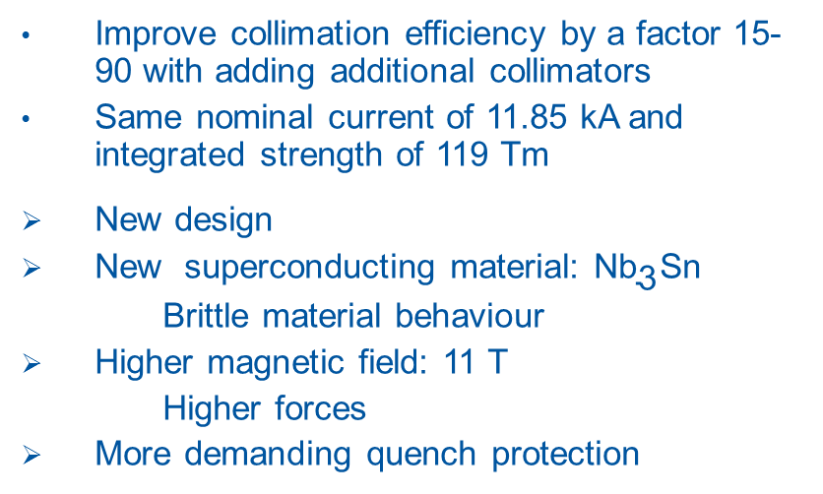
11T Twin-Aperture ${\text{Nb}}_{\text{3}}$Sn Dipole for LHC Upgrades
Improve collimation efficiency by a factor 15-90 with adding additional collimators
Same nominal current of 11.85 kA and integrated strength of 119 Tm
New design
New superconducting material: ${\text{Nb}}_{\text{3}}$Sn
  Brittle material behaviour
Higher magnetic field: 11 T
  Higher forces
More demanding quench protection
8.33T main dipole (MB)
14.3 m
11T dipole
Colli-mator
11T dipole
5.5 m
3.5 m
5.5 m

Slide 5
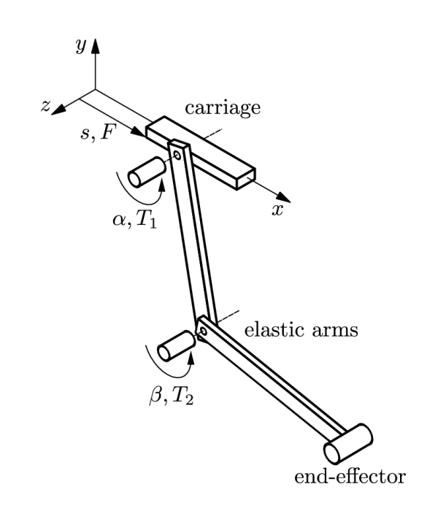
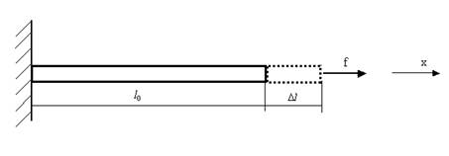
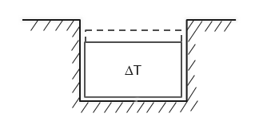
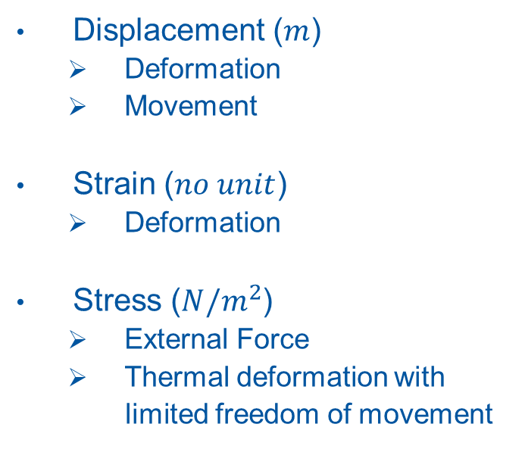
Introduction in mechanics
Displacement ($m$)
  Deformation
  Movement
Strain ($no unit$)
  Deformation
Stress (${N/m}^{2}$)
  External Force
  Thermal deformation with
  limited freedom of movement
Deformation/External force
Movement
Thermal
deformation

Slide 6
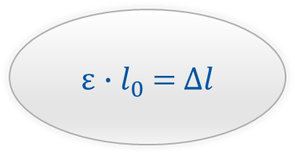
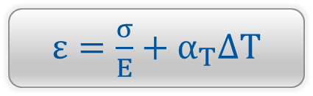
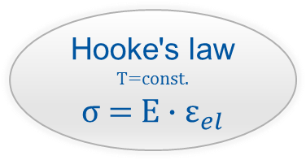

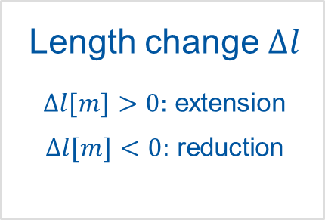

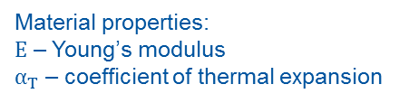
Stress σ
Strain ε
Length change $∆l$
$∆l[m]>0:$ extension
$∆l[m]<0:$ reduction
$$σ[\frac{N}{m^{2}}]=\frac{F[N]}{A[m^{2}]}$$
$ε[1]=\frac{F[N]}{E[\frac{N}{m^{2}}]A[m^{2}]}+α_{T}$[$\frac{1}{K}$]∆T[K]
Hooke's law
T=const.
σ = E $∙$ ${\text{ε}}_{el}$
ε$∙l_{0}$=$∆l$
Material properties:
$E$ – Young’s modulus
$α_{T}$ – coefficient of thermal expansion
$ε=\frac{σ}{E}+α_{T}$∆T

Slide 7
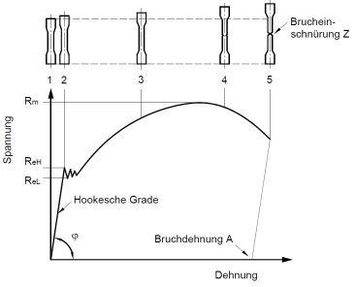
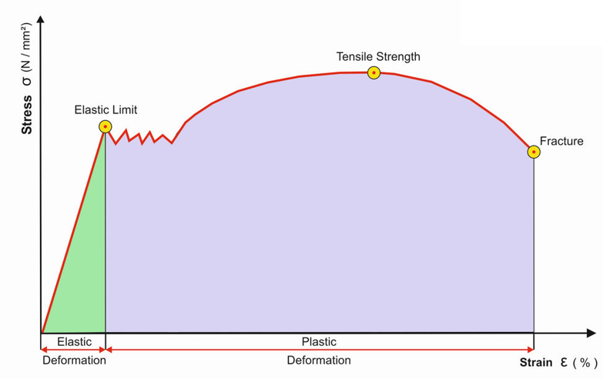

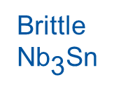
Material behaviour: stress strain curve
Fracture
1
2
3
4
5
4
Constriction
2
3
Elastic limit
5
Hook’s Straight
Fracture
σ = E $∙$ ${\text{ε}}_{el}$
Brittle
${\text{Nb}}_{\text{3}}$Sn
Ductile
Nb-Ti
stiff
elastic
1

Slide 8

${\text{B}\text{ehaviour} \text{of} \text{Nb}}_{\text{3}}$Sn
A. Nijhuis, PhD thesis, UTwente 2016
A. Nijhuis, PhD thesis, UTwente 2016

Slide 9
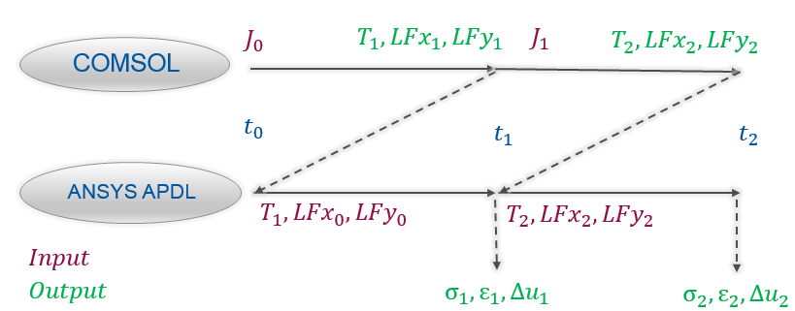
Summary of two coupling steps
A lot of models are already existing in ANSYS Mechanical APDL
It would be a lot of time consumption to recreate all this geometry
COMSOL models are created with macro from STEAM (not 100% same geometry)

Slide 10
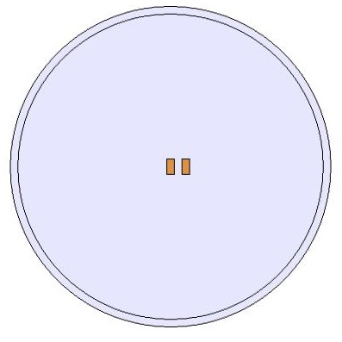
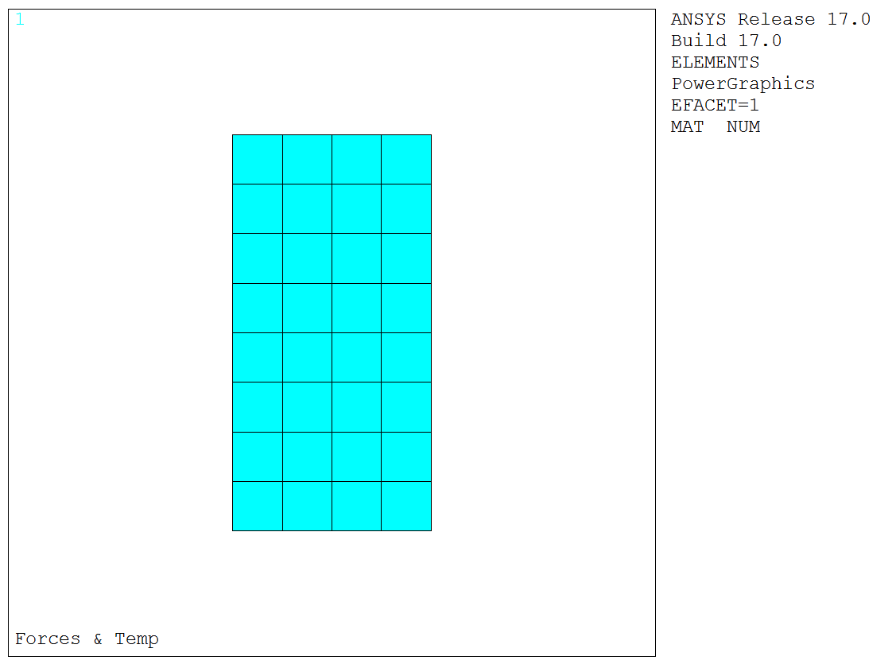
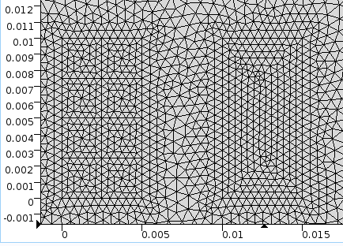
COMSOL
Proof of concept: simple geometry (Busbar)
Different Mesh
ANSYS

Slide 11
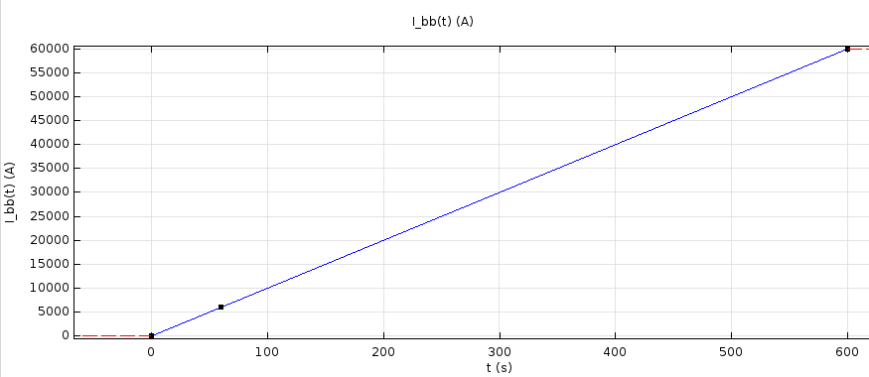
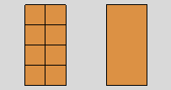
COMSOL em-th model
Material Busbars: Copper
Applied Current:

Slide 12
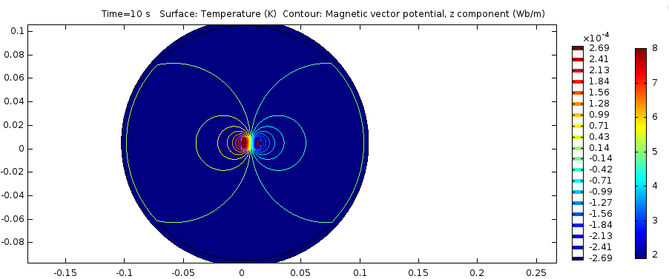
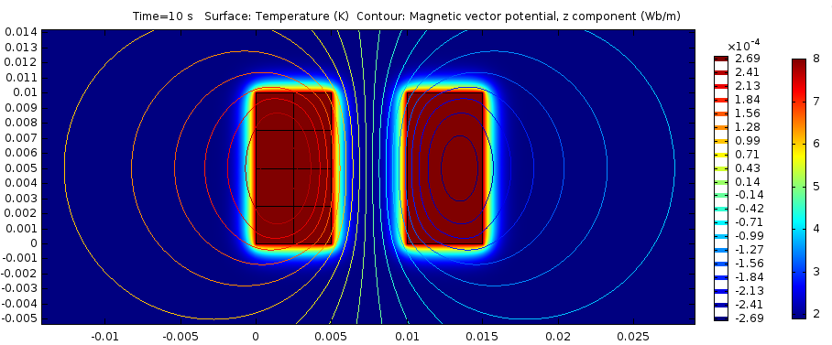
COMSOL em-th model

Slide 13
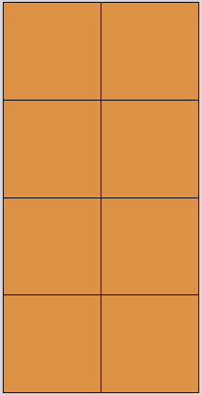
Coupling between COMSOL and ANSYS
Execute COMSOL model
Get surface average results from COMSOL:
  T
  F_L
Write to ANSYS text file
Apply to selected surfaces of ANSYS model
7
8
5
6
3
4
1
2

Slide 14
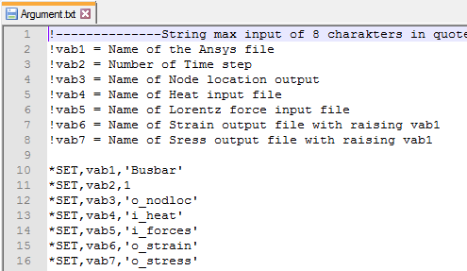
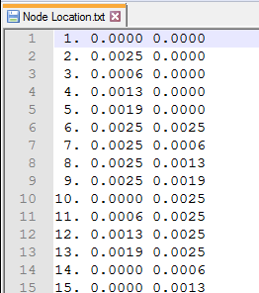
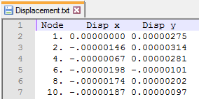
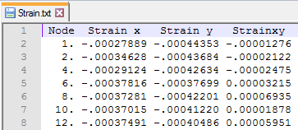
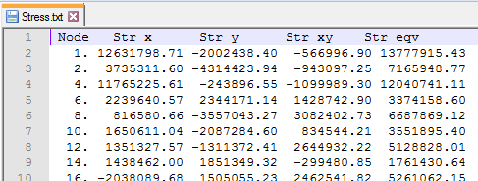
Workflow in ANSYS
Input
Output
ANSYS APDL

Slide 15
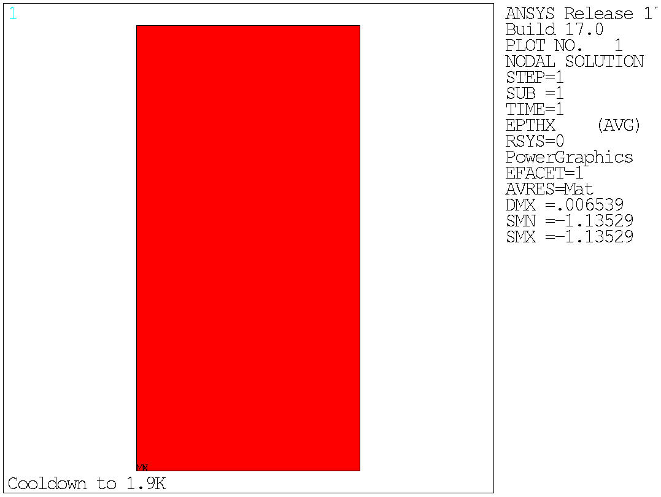
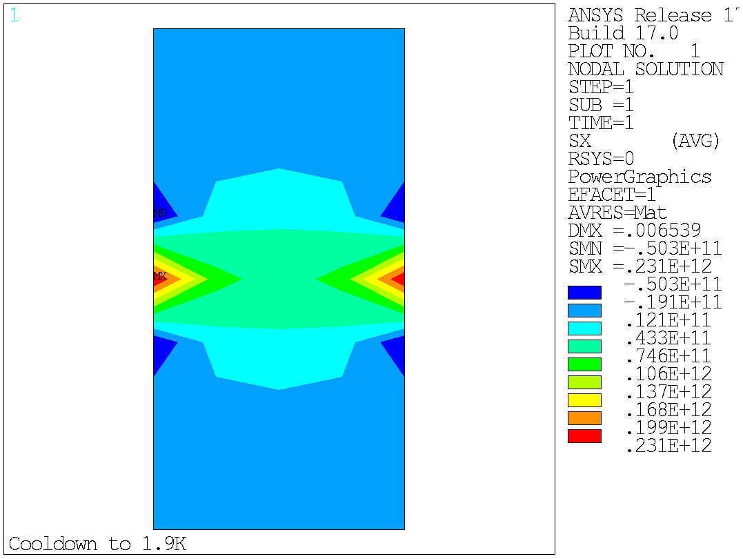
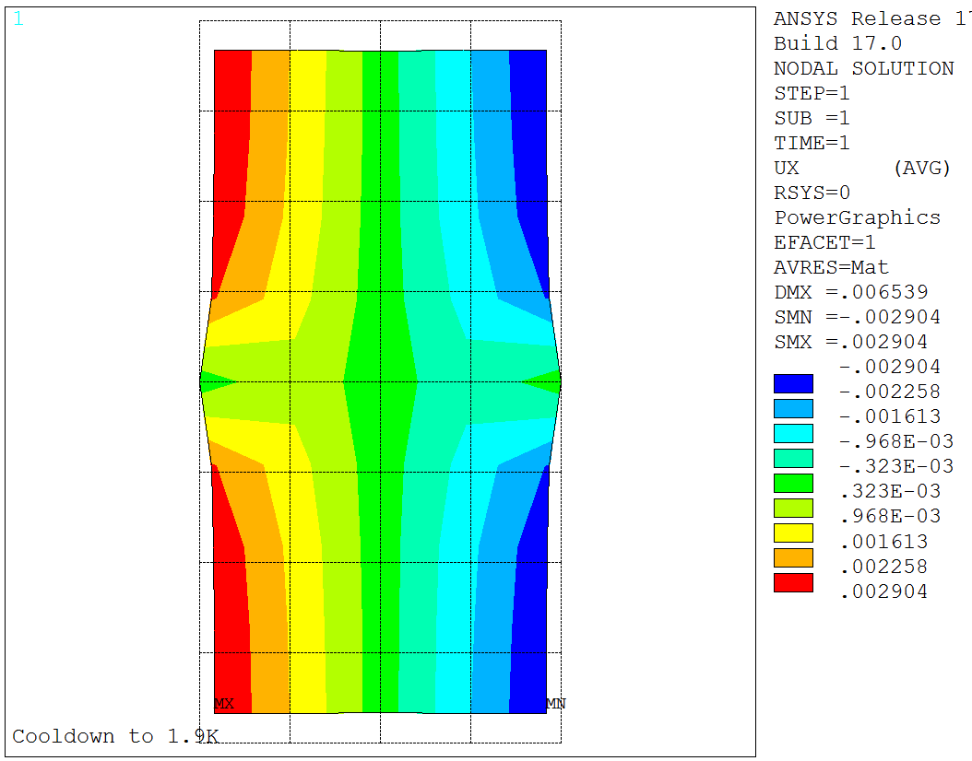
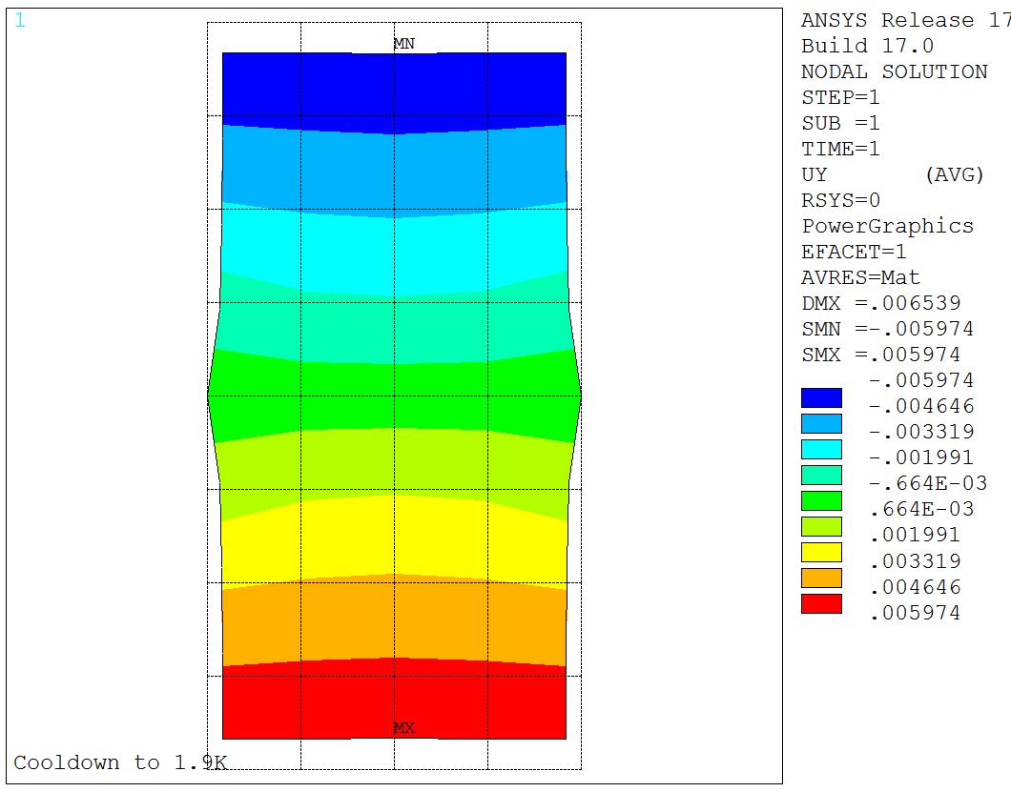
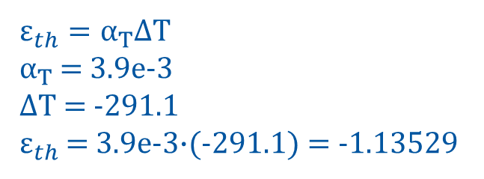
Results: Cooldown
$ε_{th}=α_{T}$∆T
$α_{T}$ = 3.9e-3
∆T = -291.1
$ε_{th}$ = 3.9e-3$∙$(-291.1) = -1.13529

Slide 16
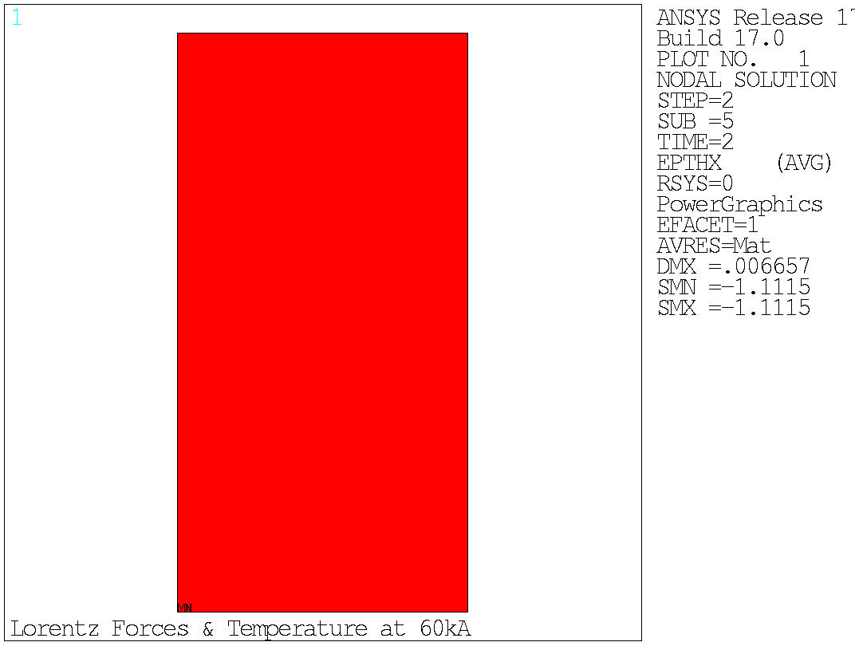
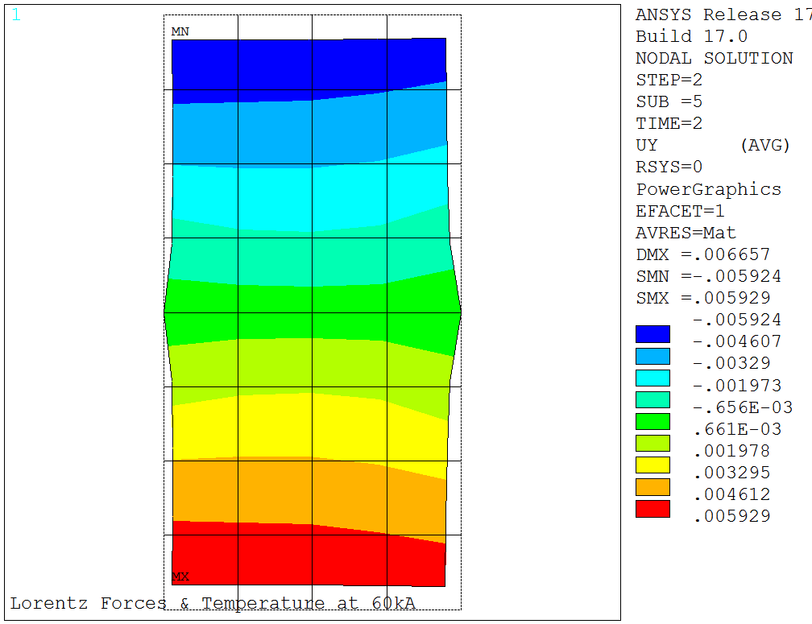
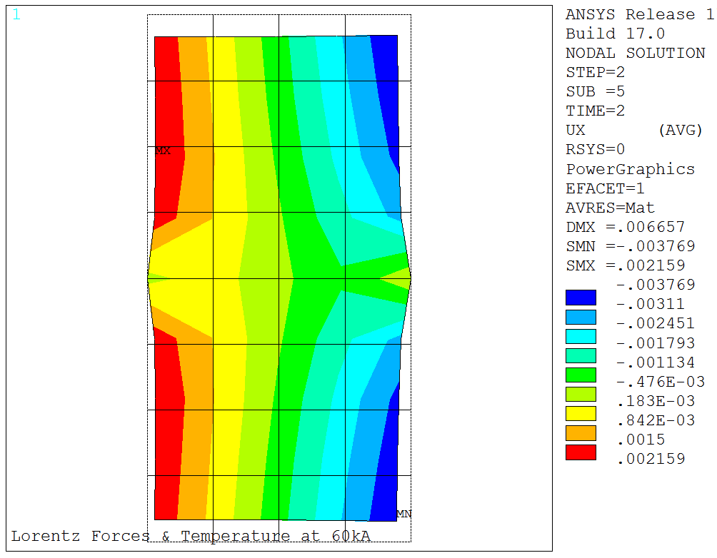
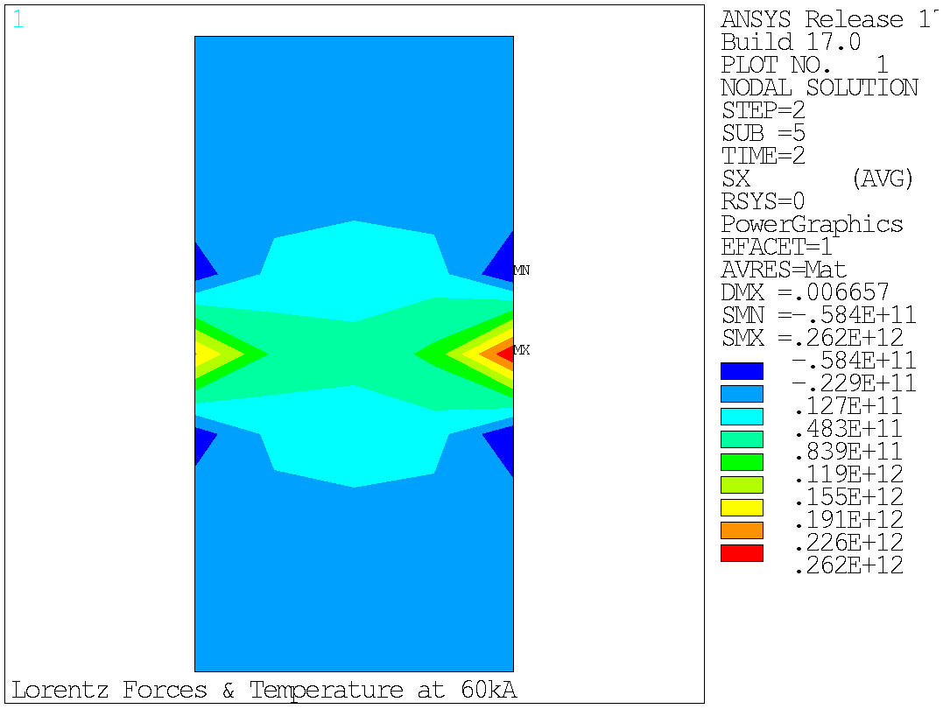
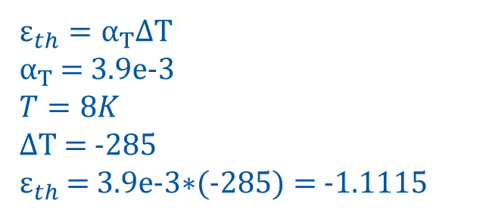
Results: Lorentz Forces & Temperature at 60kA
$ε_{th}=α_{T}$∆T
$α_{T}$ = 3.9e-3
$$T=8K$$
∆T = -285
$ε_{th}$ = 3.9e-3$∗$(-285) = -1.1115

Slide 17
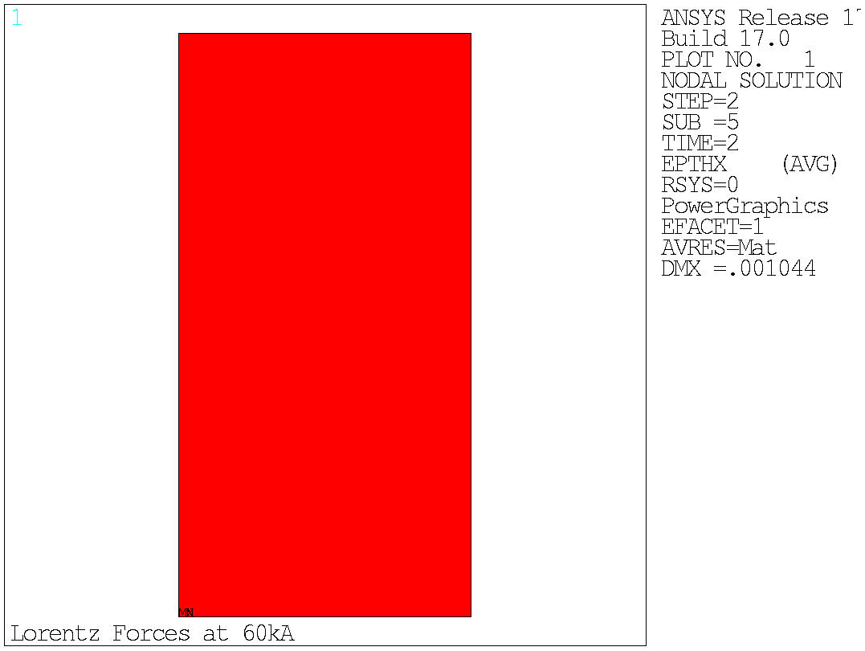
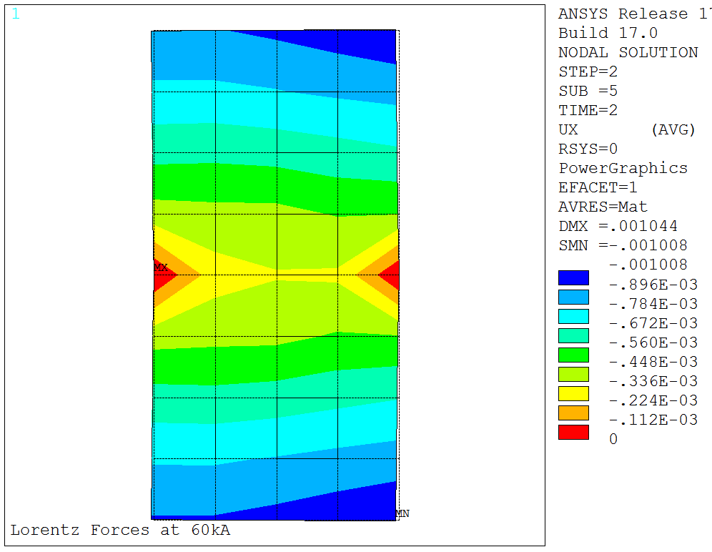
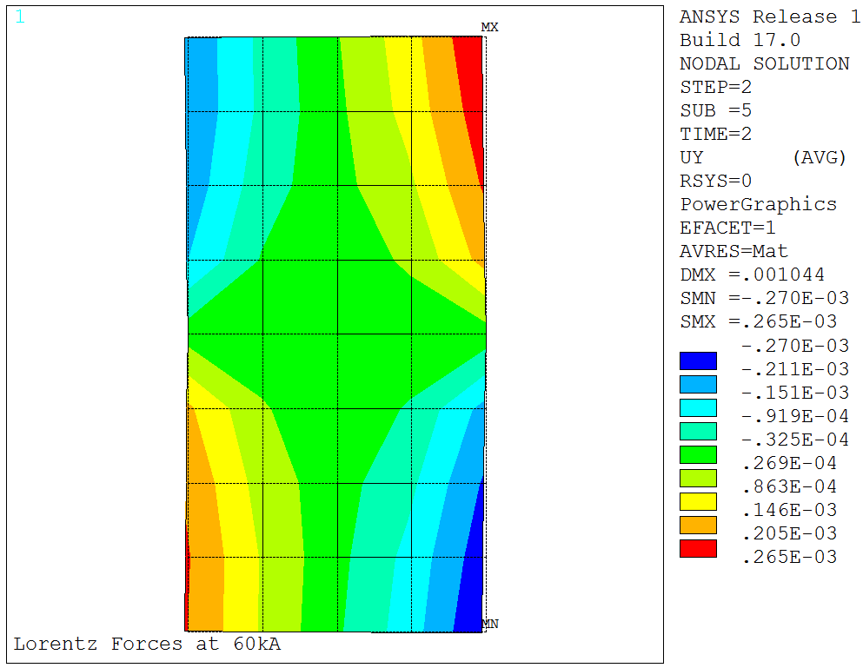
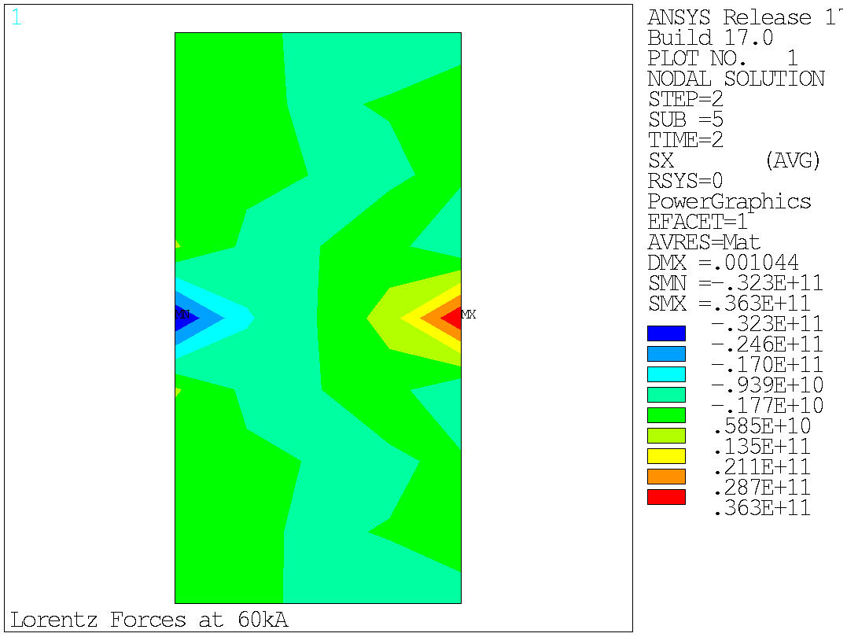
Results: Only Lorentz Forces at 60kA
No SMN and SMX

Slide 18
Conclusions
Different User Interface
Different node storage
Different mesh
Not way found to update the COMSOL geometry with displacement results

Slide 19
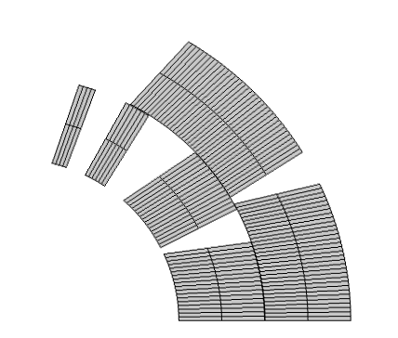
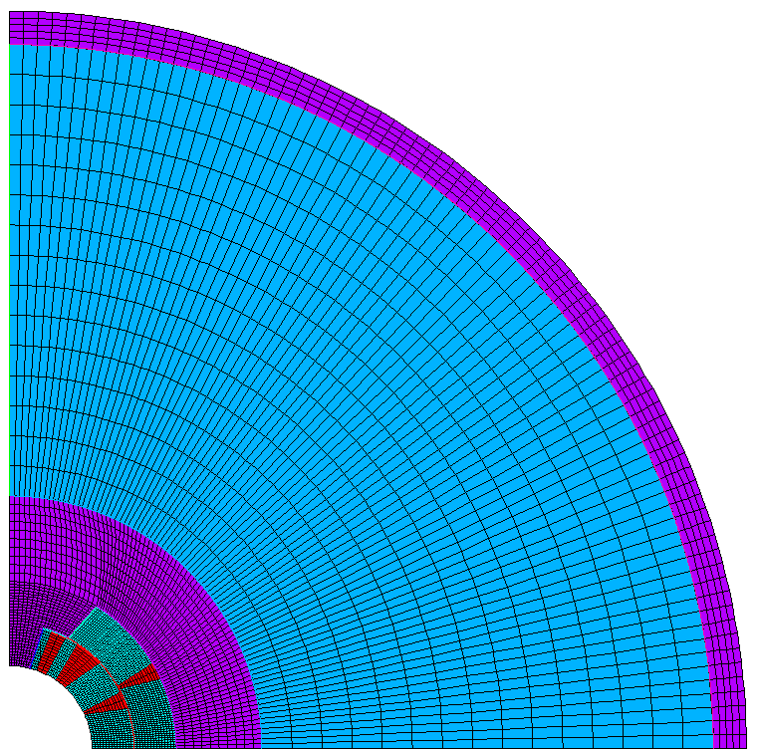
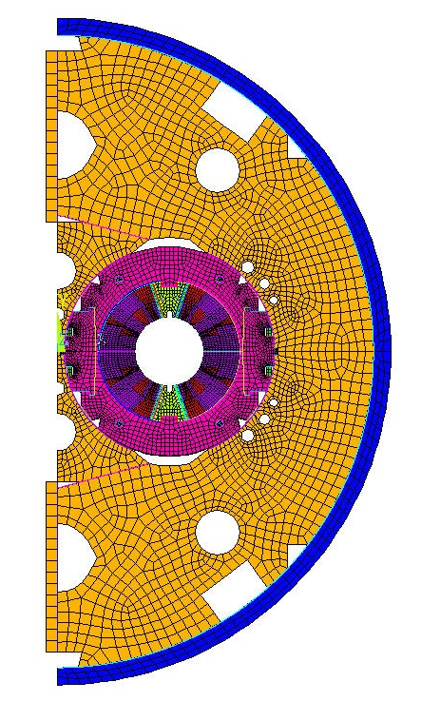
Future plans
Finish Code for Busbar Coupling
Transfer ANSYS code modifications to a simplified 11T model (single quadrant)
Finish 2D COMSOL model of 11 T (single quadrant)
Develop models to be coupled via
MpCCI (mesh-based coupling)
Develop models for full 11 T geometry (ANSYS model from Bernhard)

