Slide 1
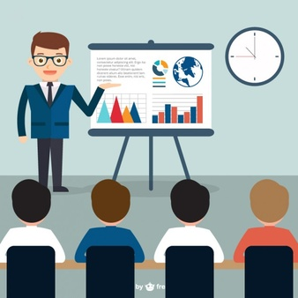
Some guidelines & hints for technical presentations especially for conferences, workshops, schools, etc
Arjan Verweij, TE-MPE-PE, July 2016

Slide 2
You work a few hundred days a year...
You present your work in less than one hour ...
...so prepare and present your work well.
Many people only get to know you and your work during your talk...
Arjan Verweij, TE-MPE-PE, July 2016
2

Slide 3
Before preparing the talk make sure that you know:
  the purpose of the talk and the expectations of the organiser, (talk needed for learning / input for something else / decision making / ...)
  the duration of the talk
  your audience
  one or a few key messages that people should remember
Prepare a draft of the talk a few days in advance. Let it rest a day, and look at it again and finish it. If important, do a rehearsal.
Arjan Verweij, TE-MPE-PE, July 2016
3

Slide 4
Don’t forget...
... that your talk is one of the rare occasions for the audience to:
  Get to know you, and possibly see if you are suitable for a future job/project/...
... and one of the rare occasions for you to:
  Try to get more resources (money, people)
  Find out if other people have experience that could be useful for you
  Get feed-back on your work
  Convince the audience of your ideas
  Show your skills/know-how/experience
Arjan Verweij, TE-MPE-PE, July 2016
4

Slide 5
Know your audience
Adapt your presentation to the audience. A presentation has to be tailor-made for each situation with its specific audience.
Experts: Less time for introduction. More time on results.
Non-experts: More time for introduction. Less time on results.
Mix of experts and non-experts: The technical details do not need to be fully understood by all. However, make sure that the background, purpose, the red line, and the key message/conclusions are clear to all.
“Physically non-present” audience (more and more frequent)
Try to make the slides as self-explainatory as possible.
Arjan Verweij, TE-MPE-PE, July 2016
5

Slide 6
Know your audience
People best remember the beginning and the end of a talk!
Pay attention to the reponse from the audience. Do they listen or not?, do they understand or not?, do they ask questions or not?
You can no longer change the slides during the talk, but you can still adapt the way you present them (faster, slower, more/less details, more/less explanations).
Many people in the audience see hundreds of presentations per year. Make sure that they will remember the key message(s) from your talk.
A blind person listening to your talk should get a reasonably good idea of what the talk is about.
Arjan Verweij, TE-MPE-PE, July 2016
6

Slide 7
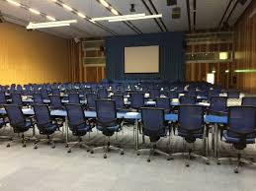
Know the venue
(conferences/workshops/large meeting/school)
Small or large room.
Dark or light room.
Flat or sloped room.
Large or small screen.
Microphone or not.
One or multiple screens. (you can’t use a laser pointer with multiple screens).
Private computer or General one. Take care that animations not always work properly if you don’t use your own computer.
Arjan Verweij, TE-MPE-PE, July 2016
7

Slide 8
Slide structure (guideline)
Title (with acknowledgment or “input from …”) - 1 slide
Contents / structure of the talk (can sometimes be merged on the title slide) – 1 slide
Introduction to the “big picture” – 10% (experts) – 20% (non-experts)
Introduction to your work – 10% (experts) – 20% (non-experts)
Results - 40% (non-experts) – 60% (experts)
Conclusions – 1 slide
Future work – 1 slide
Arjan Verweij, TE-MPE-PE, July 2016
8

Slide 9
Intro to “the big picture”
  Big picture
  Background
  Importance
  Motivation
  Problem description
  Sub-problem
  Roadmap
Try to catch the audience. Convince them that the subject is important and that they should care (and listen).
If people don’t understand the ultimate goal, they will be much less interested.
Arjan Verweij, TE-MPE-PE, July 2016
9

Slide 10
Intro to your work
  Previous work
  Possible solutions
  Chosen solution
  Your personal contribution
  Model
  Definitions
Arjan Verweij, TE-MPE-PE, July 2016
10

Slide 11
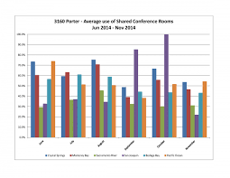
The results
  Simulations/measurements,
  Graphs, Tables,
  Proof, correlation/validation/cross-check with other work
Present enough results to support your argument(s)
but...
do not present so much results that the message is lost in the clutter.
In general: CLEAR, SIMPLE, RELEVANT. The audience needs time to absorb the results! Break-down a complex message so that the audience understands.
1 graph/table and a few lines per slide works usually rather well.
Arjan Verweij, TE-MPE-PE, July 2016
11

Slide 12
Conclusion / Outlook
The conclusion should reflect the purpose of the talk.
Use the conclusions (or outlook) as last slide since this may trigger questions. Do not use a “Questions” or “Thank you” slide as the last slide.
Arjan Verweij, TE-MPE-PE, July 2016
12

Slide 13
Practical hints
All text and figures should be readible (>16 pt), including the axis and legend of plots.
Limit the use of abbreviations, acronyms, jargon, and slang. Only use well-known ones and those that appear very often in the talk.
Use coherent format, fonts, font size, colors, axis, ...
Use SI units (unless the alternative is the standard, e.g. fb⁻¹)
Include page numbers (useful for questions at the end)
Take care while copying/pasting figures and graphs from others. They often contain different naming, different axis, unknown abbreviations, too much information.
Arjan Verweij, TE-MPE-PE, July 2016
13

Slide 14
Practical hints
A few animations can be nice, but never exaggerate.
A quote or a joke can be nice (if you are experienced), but take care: it can be perceived differently by the audience...
Only show text, figures, graphs that you actually present. If not, put them in the annex slides.
Do not put too much info on one slide. Slides are for free.
Clearly mark intermediate conclusions/key messages (different color, colored box, etc).
Talk to the audience instead of reading to them. This works better if you don’t use full sentences on your slides.
Arjan Verweij, TE-MPE-PE, July 2016
14

Slide 15
Practical hints
Make sure that the ‘red line’ of the talk is clear. In longer talks you can repeate the contents/chapter headings to better structure the talk.
You should do the reasoning and draw the conclusions. Don’t leave it up to the audience.
On average you should spend 1-2 minutes per slide. Have a back-up strategy in case you run out of time. It is better to skip a few slides than to go through them in hyper-speed.
If the audience is small, you can give them handouts (2-3 slides per page).
Ask feed-back after the meeting if you want to know how your talk was perceived or how it could be improved.
Arjan Verweij, TE-MPE-PE, July 2016
15

