Slide 1
UFO Buster 2.0
Status-Quo of automized UFO detection and future optimizations
L. Grob, R. Schmidt

Slide 2
Outline
Brief UFO summary
Introduction of the UFO Buster application
Limitations of the UFO Buster
Strategy to obtain improved UFO event database

Slide 3
Outline
Brief UFO summary
Introduction of the UFO Buster application
Limitations of the UFO Buster
Strategy to obtain improved UFO event database

Slide 4
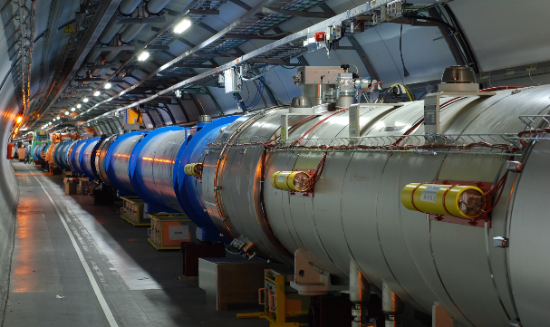
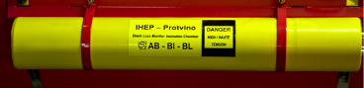
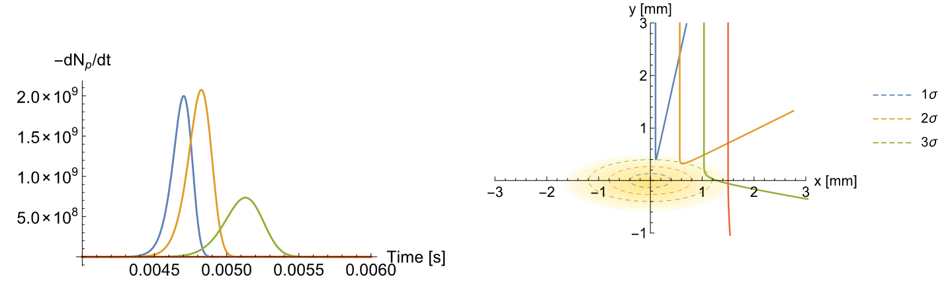
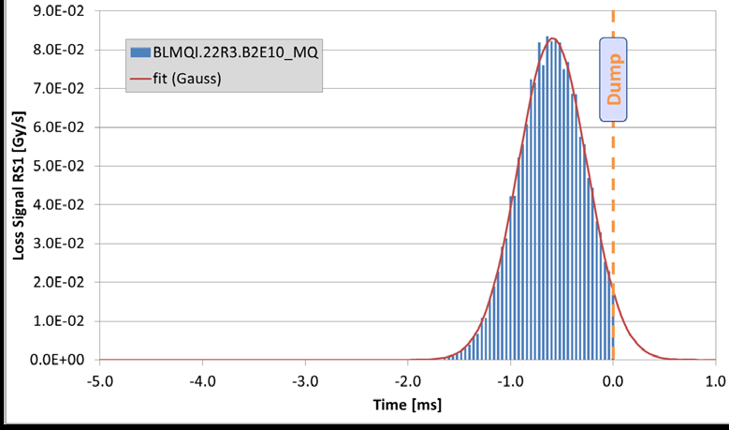
Basic facts about UFOs in LHC
Intro
UFOs in other accelerators
MKI UFOs
ARC UFOs
END
Backup Slides
[18], [19]
UFO characteristics:
Very fast (microsecond time regime) beam losses
Localized beam losses
Gaussian signal shape (asymmetric)
Measured UFO signal

Slide 5
Outline
Brief UFO summary
Introduction of the UFO Buster application
Limitations of the UFO Buster
Strategy to obtain improved UFO event database

Slide 6
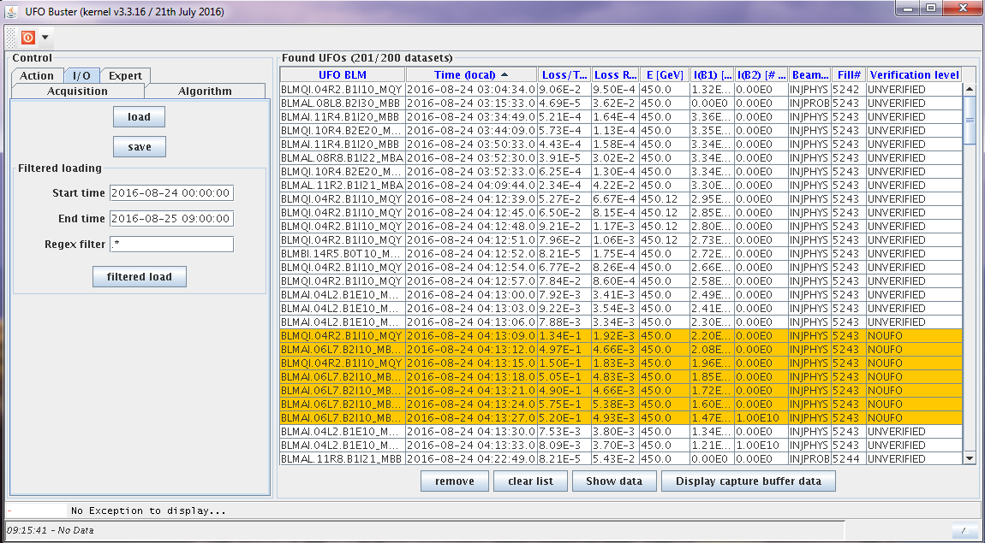
UFO Buster Online UFO detection
UFO Buster (2011, developed by T. Bär):
Software automatically stores BLM data
if UFO-like beam loss was registered
Based on BLM integration times
(RS1 40 µs, RS2 80 µs, RS 3 320 µs, RS 4 640 µs…)

Slide 7
UFO Buster Online UFO detection
UFO Buster (2011, developed by T. Bär):
Software automatically stores BLM data
if UFO-like beam loss was registered
Based on BLM integration times
(RS1 40 µs, RS2 80 µs, RS 3 320 µs, RS 4 640 µs…)
Algorithm based on the following assumption:
  Min. 2 BLMs within 40 m distance detect the UFO
  Losses in RS 4 > 1∙10⁻⁴ Gy/s (noise level about 2∙10⁻⁵ Gy/s)
  Additional noise filters:
    RS2/RS1 > 0.55
    RS3/RS1 > 0.30*
    *For MKI studies and 2011 data: RS1 > 1∙10⁻² Gy/s

Slide 8
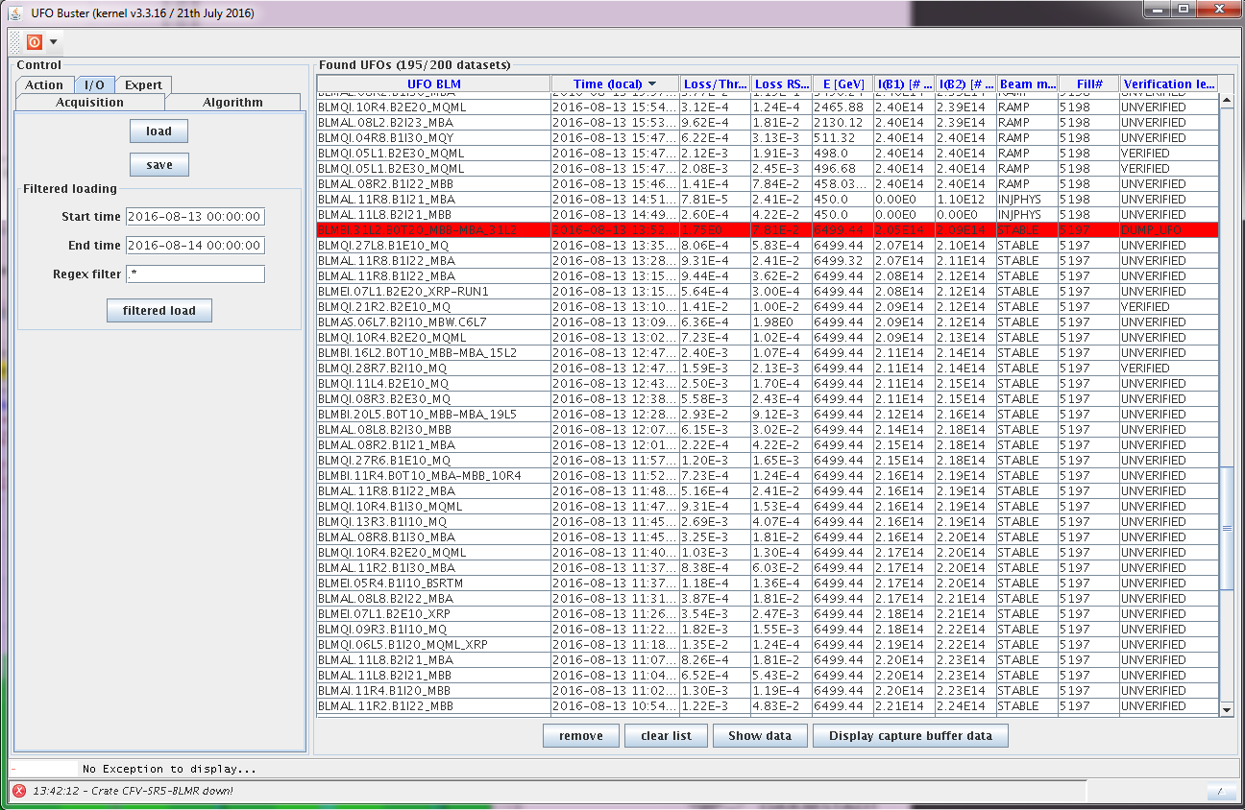
UFO Buster Features
Display of 200 full data sets
of recorded UFO events
Containing:
UFO timestamp
Triggering BLM
Loss/Threshold ratio
Losses in RS4 (640 µs)
Beam parameters
Fill number
Event label

Slide 9
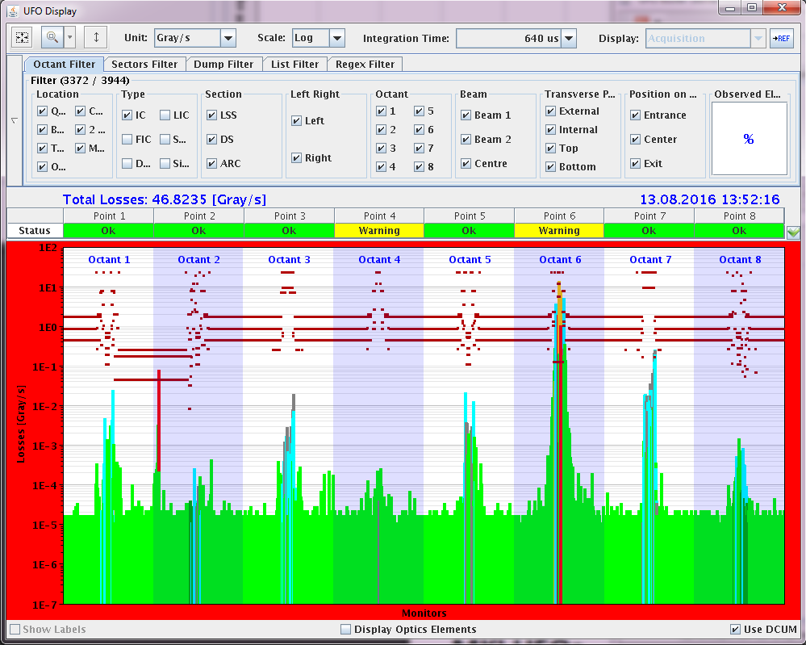
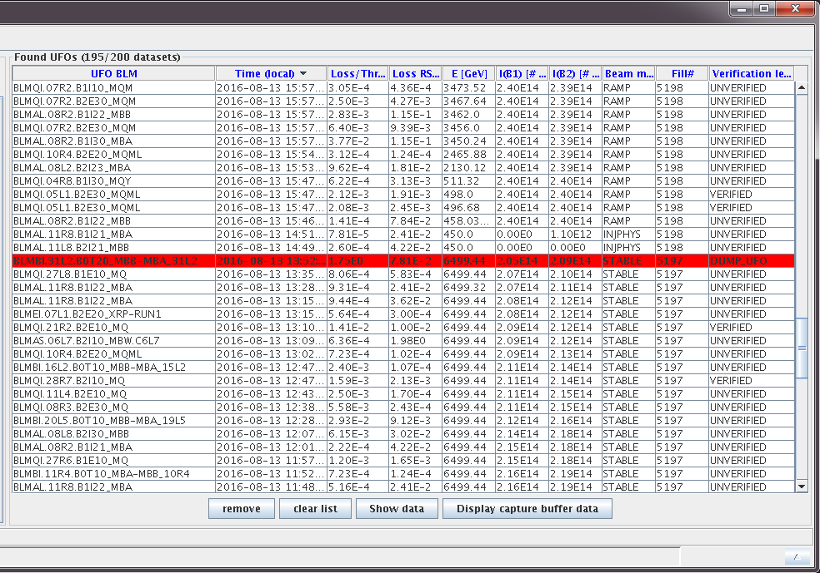
UFO Buster Features
Display of 200 full data sets of recorded UFO events
Full BLM data available
Dumping BLM

Slide 10
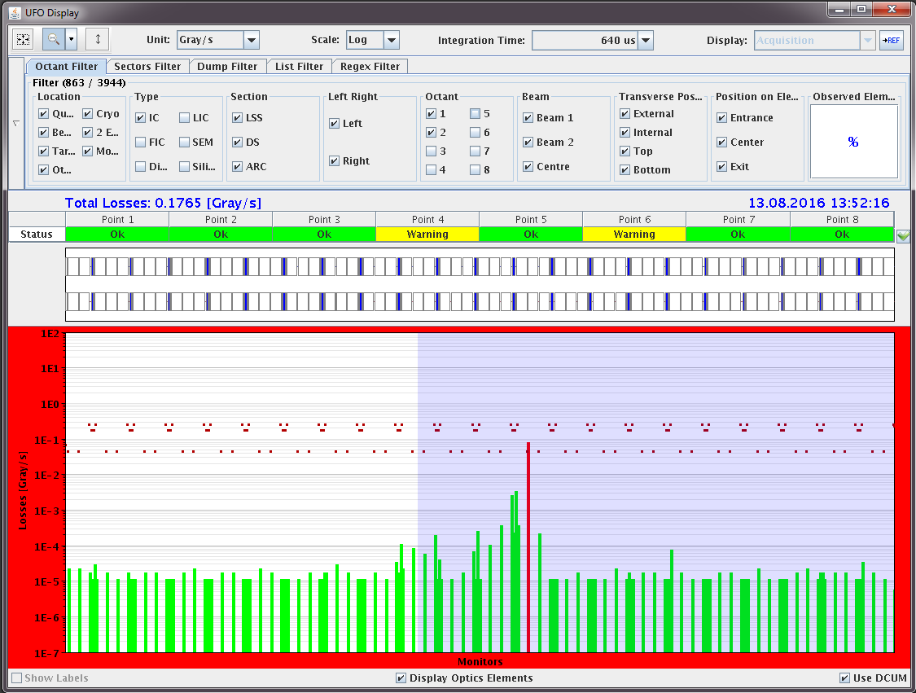
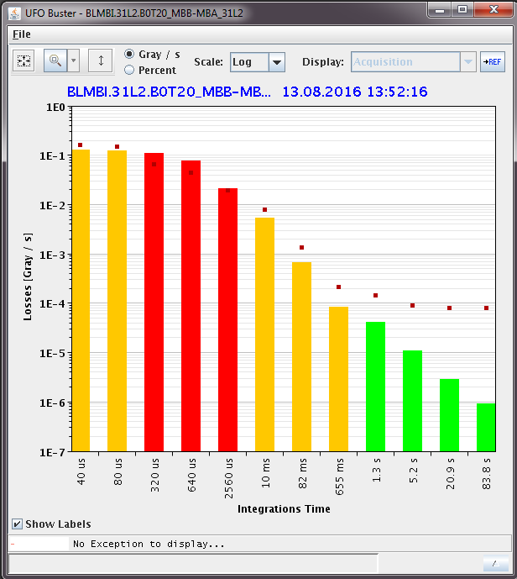
UFO Buster Features
Display of 200 full data sets
of recorded UFO events
Full BLM data available
Dumping BLM

Slide 11
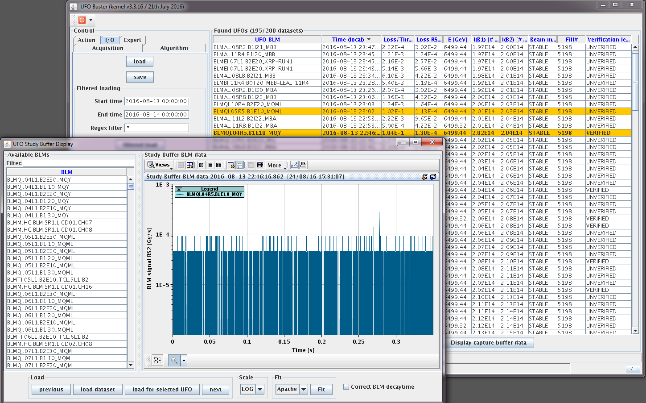
UFO Buster Features
Display of 200 full data sets
of recorded UFO events
Full BLM data available
Capture buffer to provide
highly resolved UFO data

Slide 12
Outline
Brief UFO summary
Introduction of the UFO Buster application
Limitations of the UFO Buster
Strategy to obtain improved UFO event database

Slide 13
UFO Buster Limitations
Limited amount of data set display counteracts an easy data analysis:
previous data sets are overwritten, if there were more than 200 UFOs in the chosen time range

Slide 14
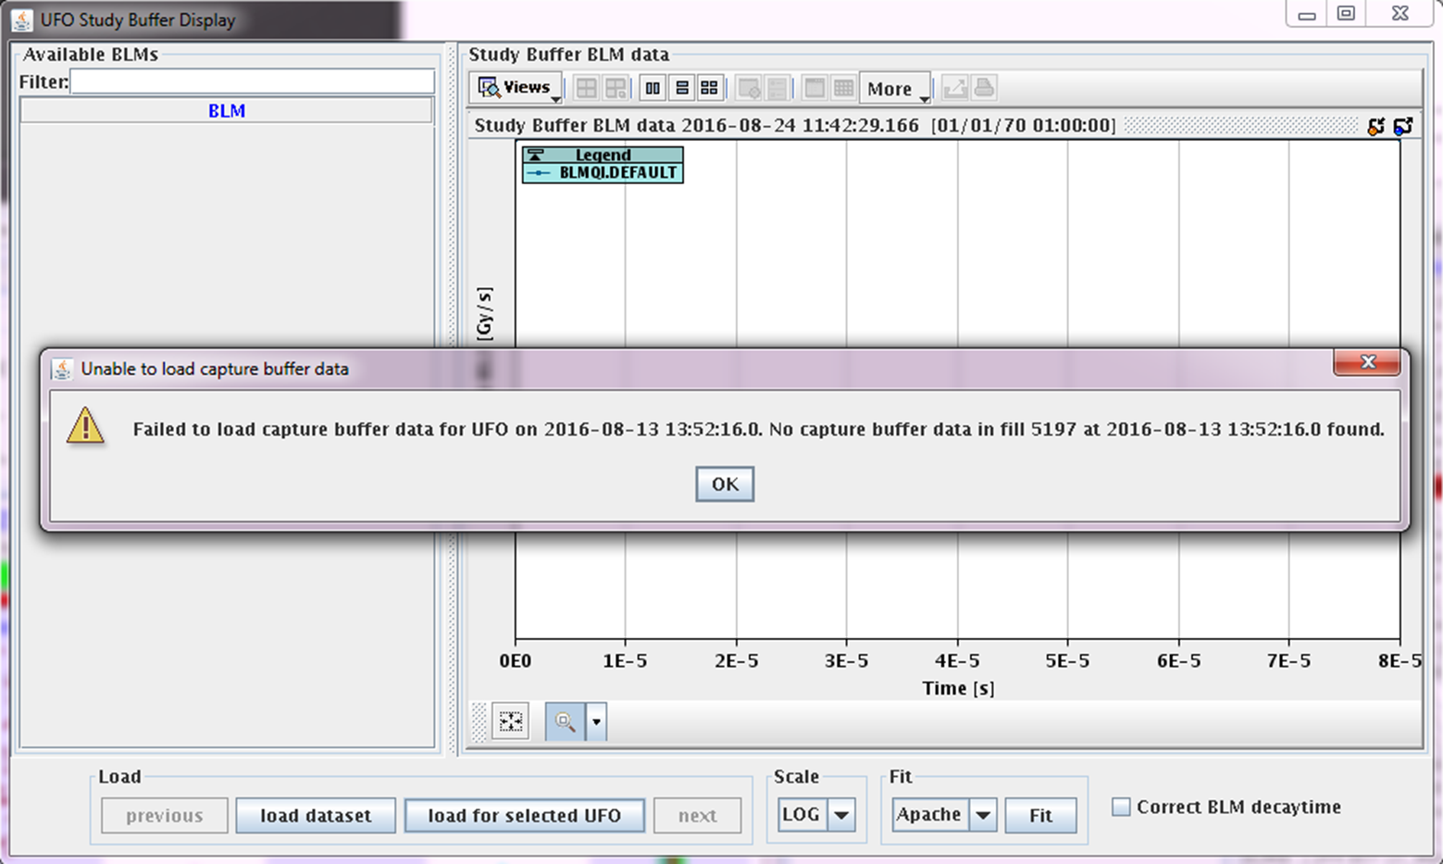
UFO Buster Limitations
Limited amount of data set display counteracts an easy data analysis:
previous data sets are overwritten, if there were more than 200 UFOs in the chosen time range
UFO capture buffer not sufficiently large. Only a third of all events have actual data

Slide 15
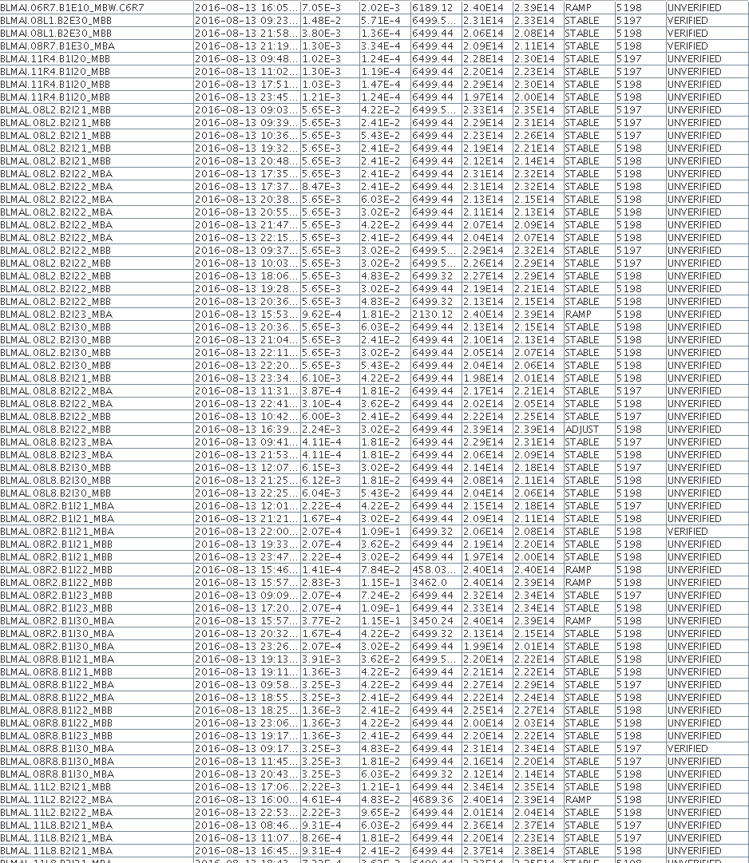
UFO Buster Limitations
Limited amount of data set display counteracts an easy data analysis:
previous data sets are overwritten, if there were more than 200 UFOs in the chosen time range
UFO capture buffer not sufficiently large. Only a third of all events have actual data
Fishy UFO events fill up UFO database!
Today‘s search through 200 sets from
2016-08-24 03:04 till 2016-08-25 05:05
gave:
47x BLMAL.08R8…
8x BLMAL.08L8…
20x BLMAL.08L2…
26x BLMQI.10R4…

Slide 16
Outline
Brief UFO summary
Introduction of the UFO Buster application
Limitations of the UFO Buster
Strategy to obtain improved UFO event database

Slide 17
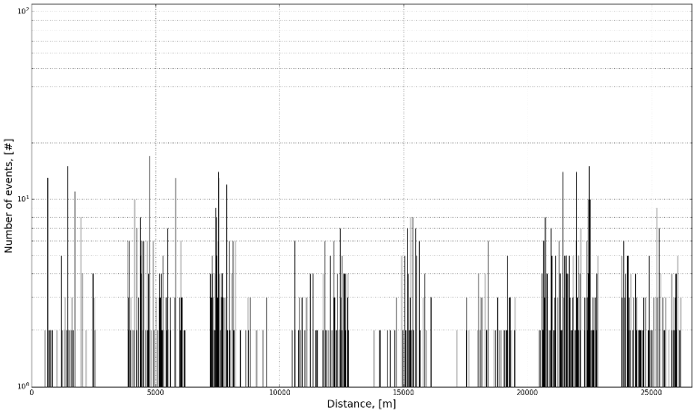
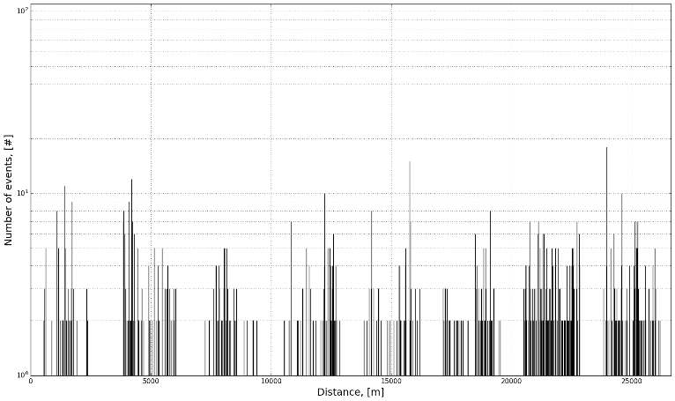
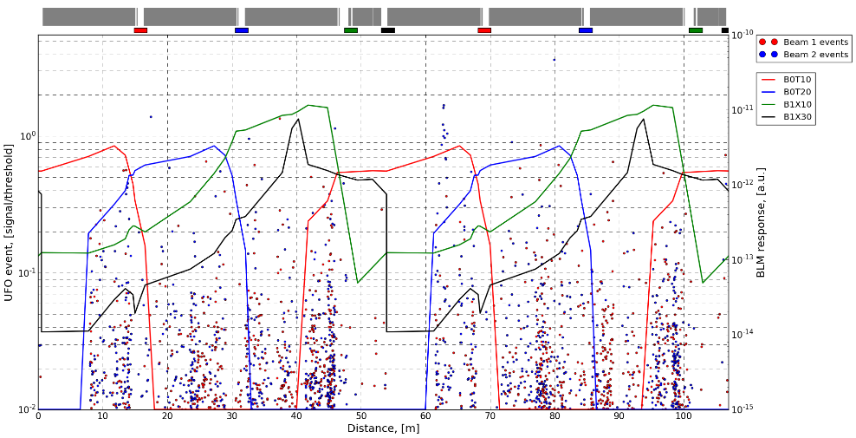
UFO Buster 2.0 Planned Features
Automized statistical analysis to generate standardized plots:
    e.g. UFO locations along the ring, UFO location projected into arc FODO cell, UFO rate per hour/fill
courtesy of J. Ghini
courtesy of J. Ghini
Beam 1 UFO rate along LHC
Beam 2 UFO rate along LHC
courtesy of J. Ghini

Slide 18
UFO Buster 2.0 Planned Features
Python scripts to retrieve UFO data sets and to generate standardized plots:
    e.g. UFO locations along the ring, UFO location projected into arc FODO cell, UFO rate per hour/fill
UFO confirmation algorithm based on physics:
    each UFO event consists of inelastic and elastic collisions
    The elastically scattered protons are part of the beam halo
    The elastic beam losses can be seen at aperture restrictions (e.g. in IR 7, IR 6 and IR 3)
    UFO flag only if triggering UFO signal coincides with elastic losses

Slide 19
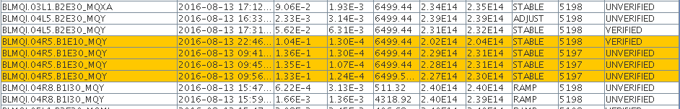
UFO Buster 2.0 Planned Features
Python scripts to retrieve UFO data sets and to generate standardized plots:
    e.g. UFO locations along the ring, UFO location projected into arc FODO cell, UFO rate per hour/fill
UFO confirmation algorithm based on physics:
    each UFO event consists of inelastic and elastic collisions
    The elastically scattered protons are part of the beam halo
    The elastic beam losses can be seen at aperture restrictions (e.g. in IR 7, IR 6 and IR 3)
    UFO flag only if triggering UFO signal coincides with elastic losses
Elimination of fishy BLMs:
    UFO triggering BLMs without physics confirmation should be flagged for follow-up investigation

Slide 20
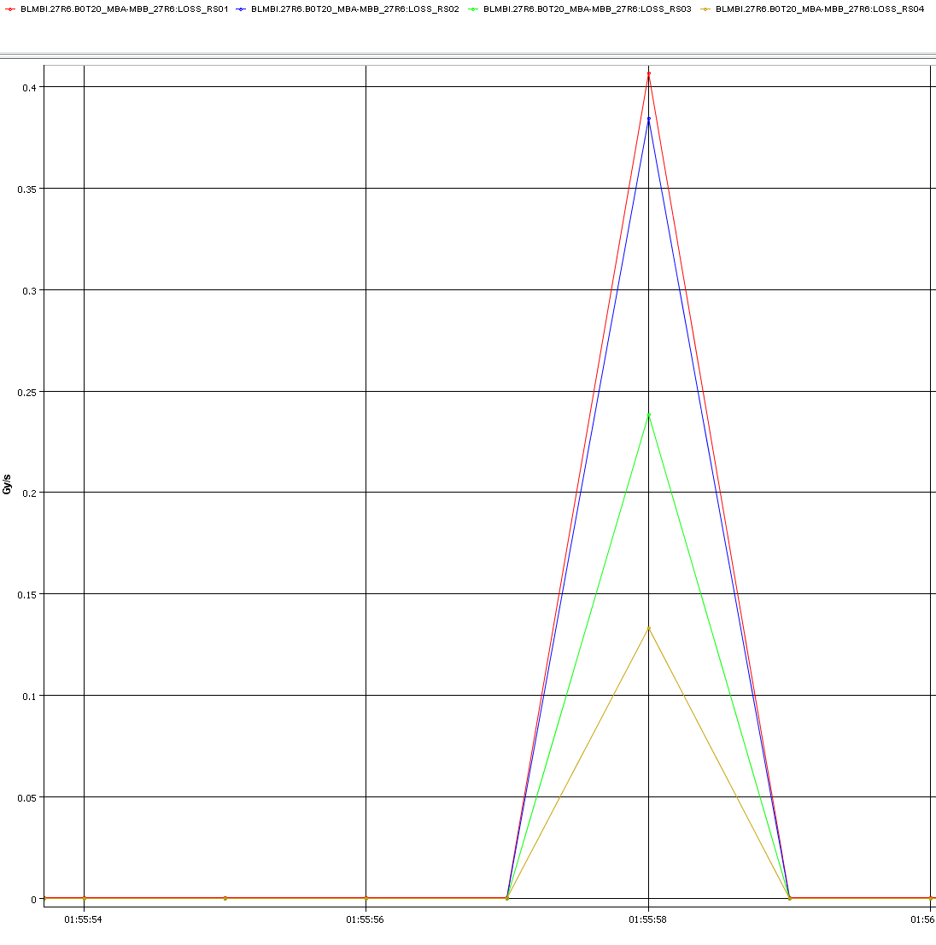
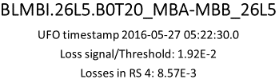
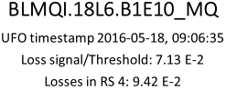
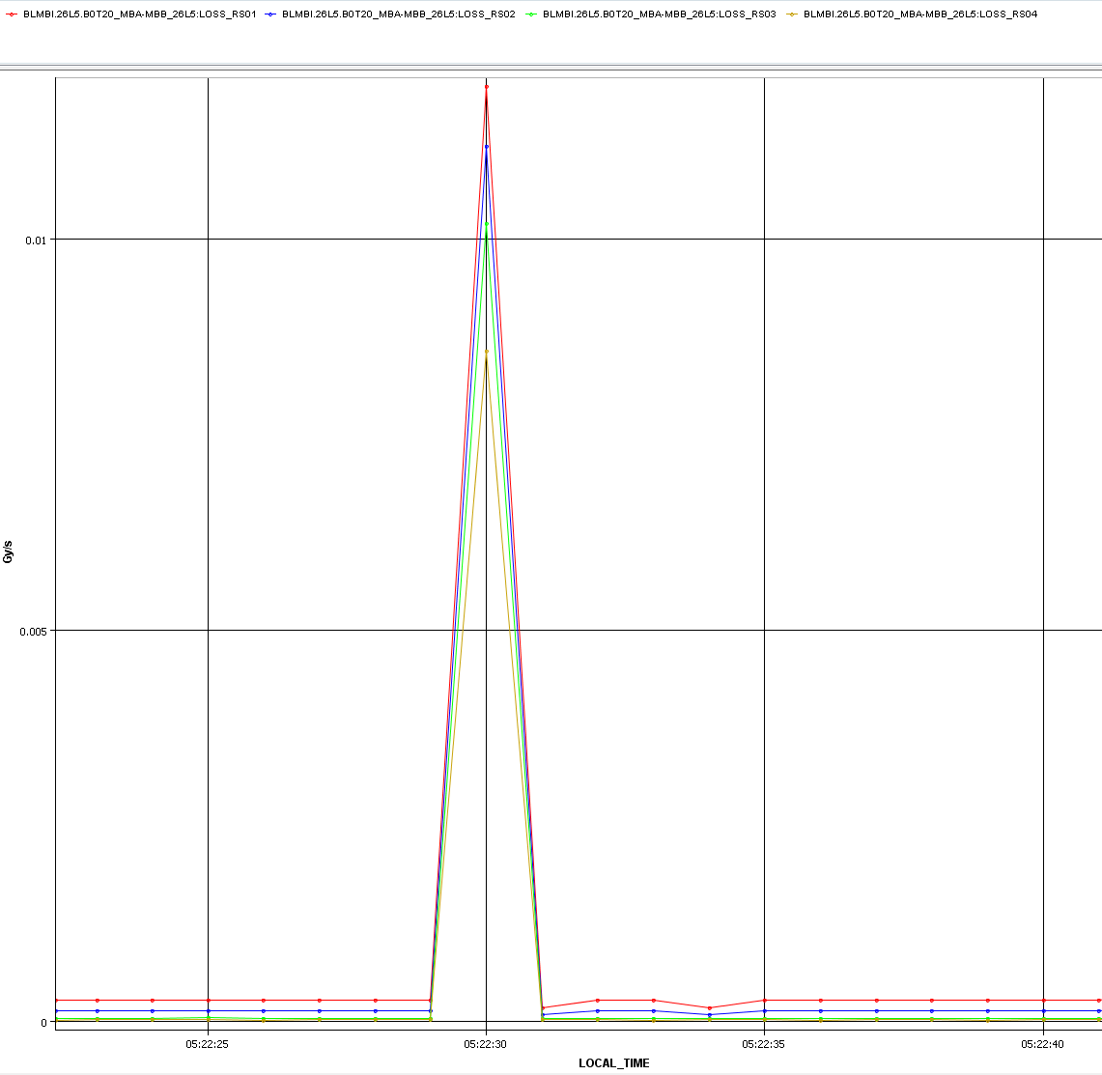
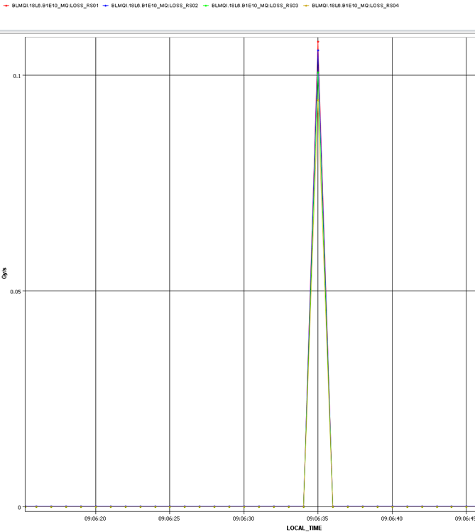
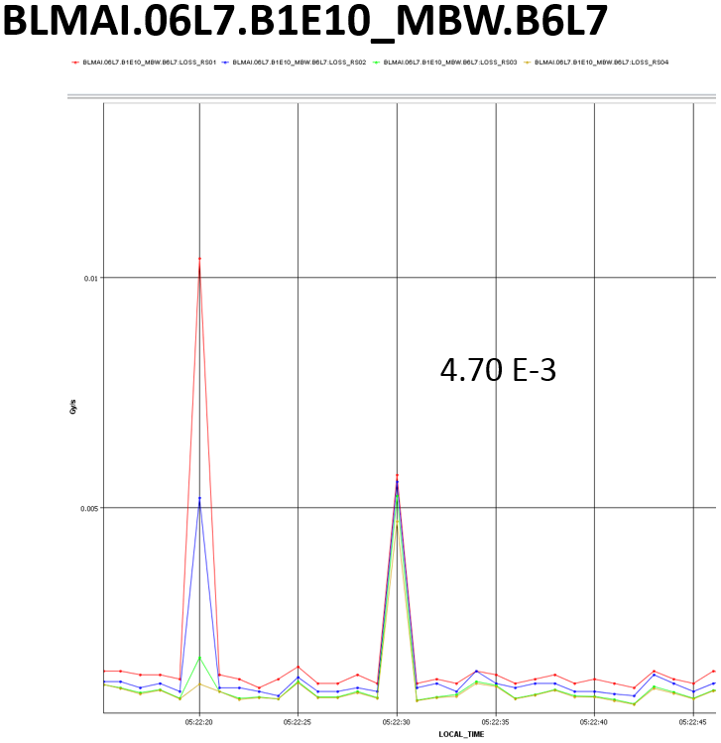
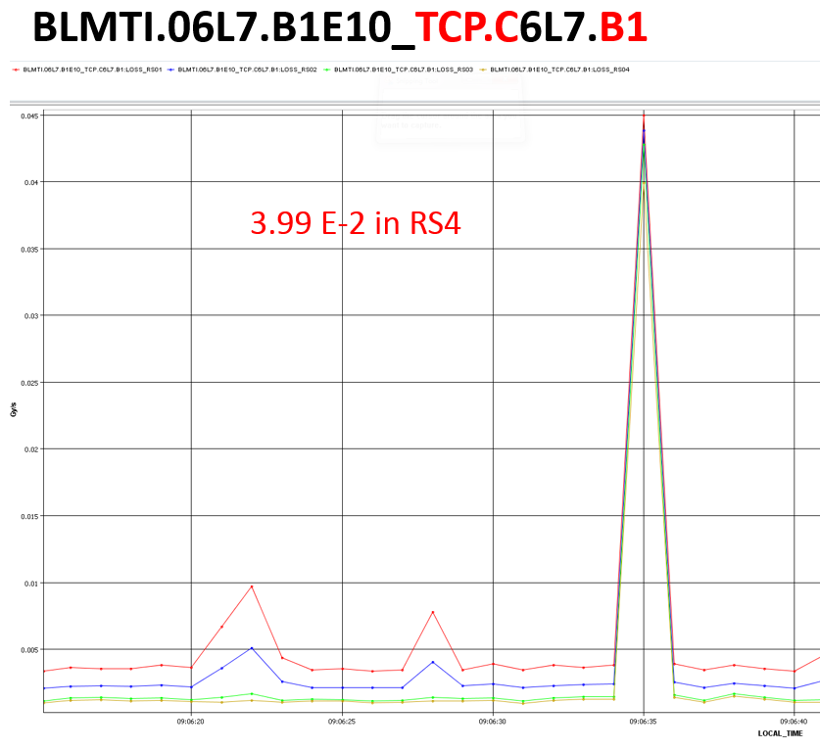
Example 1: correlated UFO losses in IP 7
Proof of principle done for some UFOs with high RS4 losses
Procedure: searching TIMBER logging database for BLM signals with UFO timestamp → tedious work…
RS4_{IP7 BLM}/RS4_{triggering BLM}= 0.42
0.01
RS4_{IP7 BLM}/RS4_{triggering BLM}= 0.55
Gy/s
0.005
t_{UFO}

Slide 21
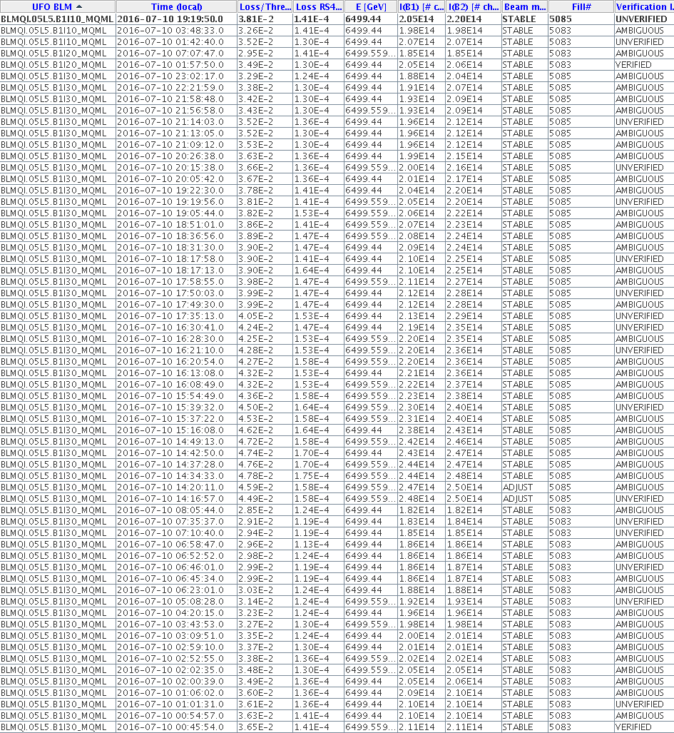
Example 1: first fishy BLM eliminated
BLMQI.05L5…. Showed up really often (see exemplary screenshot)

Slide 22
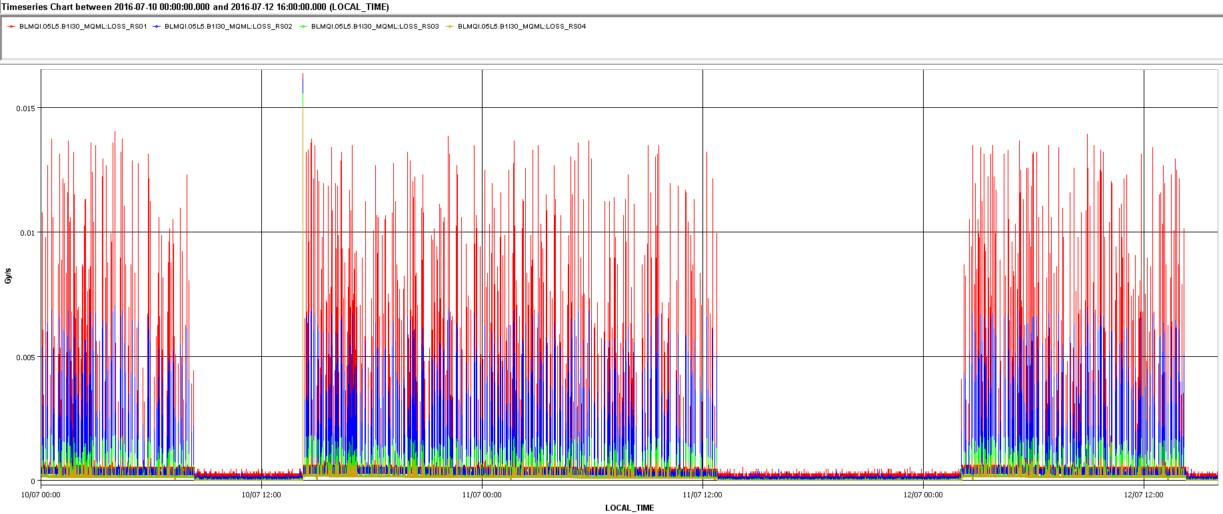
Example 1: first fishy BLM eliminated
BLMQI.05L5…. Showed up really often (see exemplary screenshot)
Cross check in TIMBER revealed this:

Slide 23
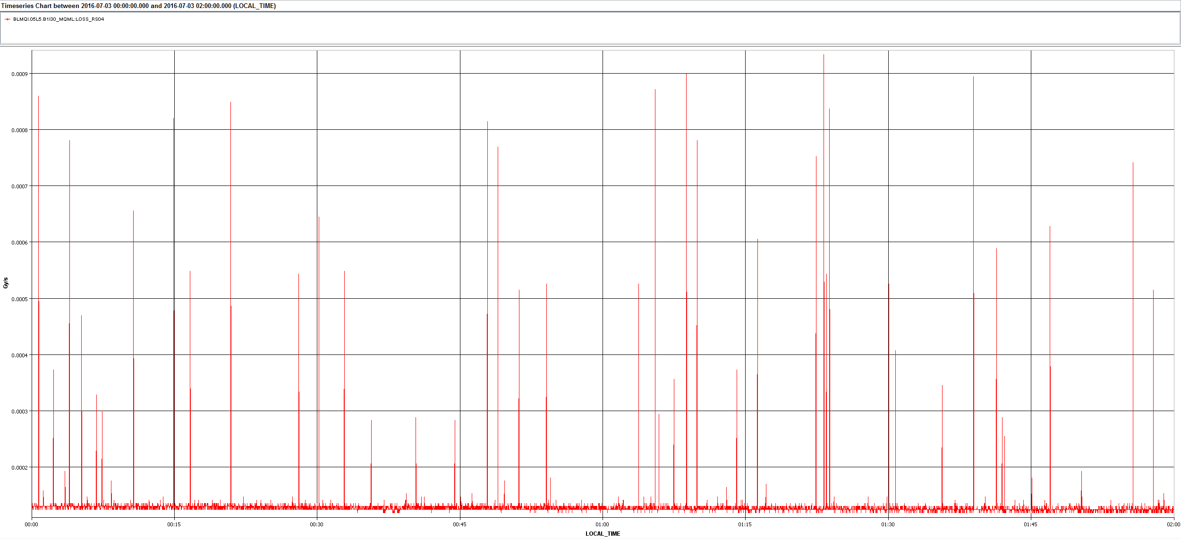
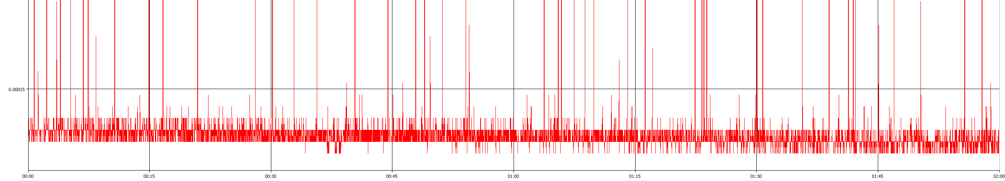
Example 1: first fishy BLM eliminated
The comparison of TIMBER data and UFO time stamps confirms the suspicion of fake UFOs:
UFO Buster time stamp:
03/07/2016 01:29:55.0
1.24E-04 in RS4
UFO Buster time stamp:
03/07/2016 01:53:47.0
1.24E-04 in RS4
UFO Buster time stamp:
03/07/2016 00:18:38
1.30E-04 in RS4
UFO Buster time stamp:
03/07/2016 00:44:011.30
1.30E-04 in RS4
UFO Buster time stamp:
03/07/2016 01:12:37.0
1.30E-04 in RS4
UFO Buster time stamp:
03/07/2016 01:55:03.0
1.19E-04 in RS4

Slide 24
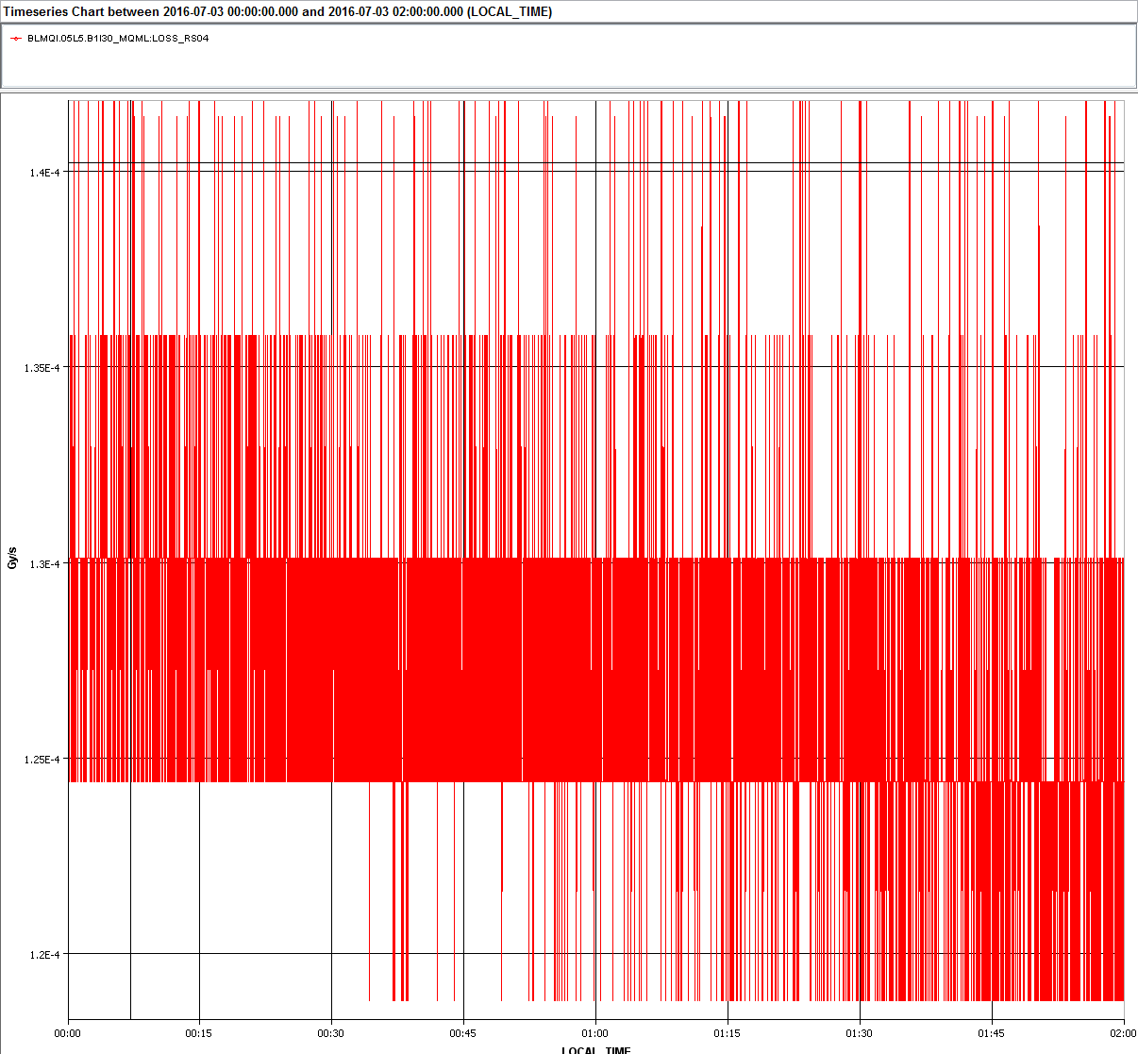
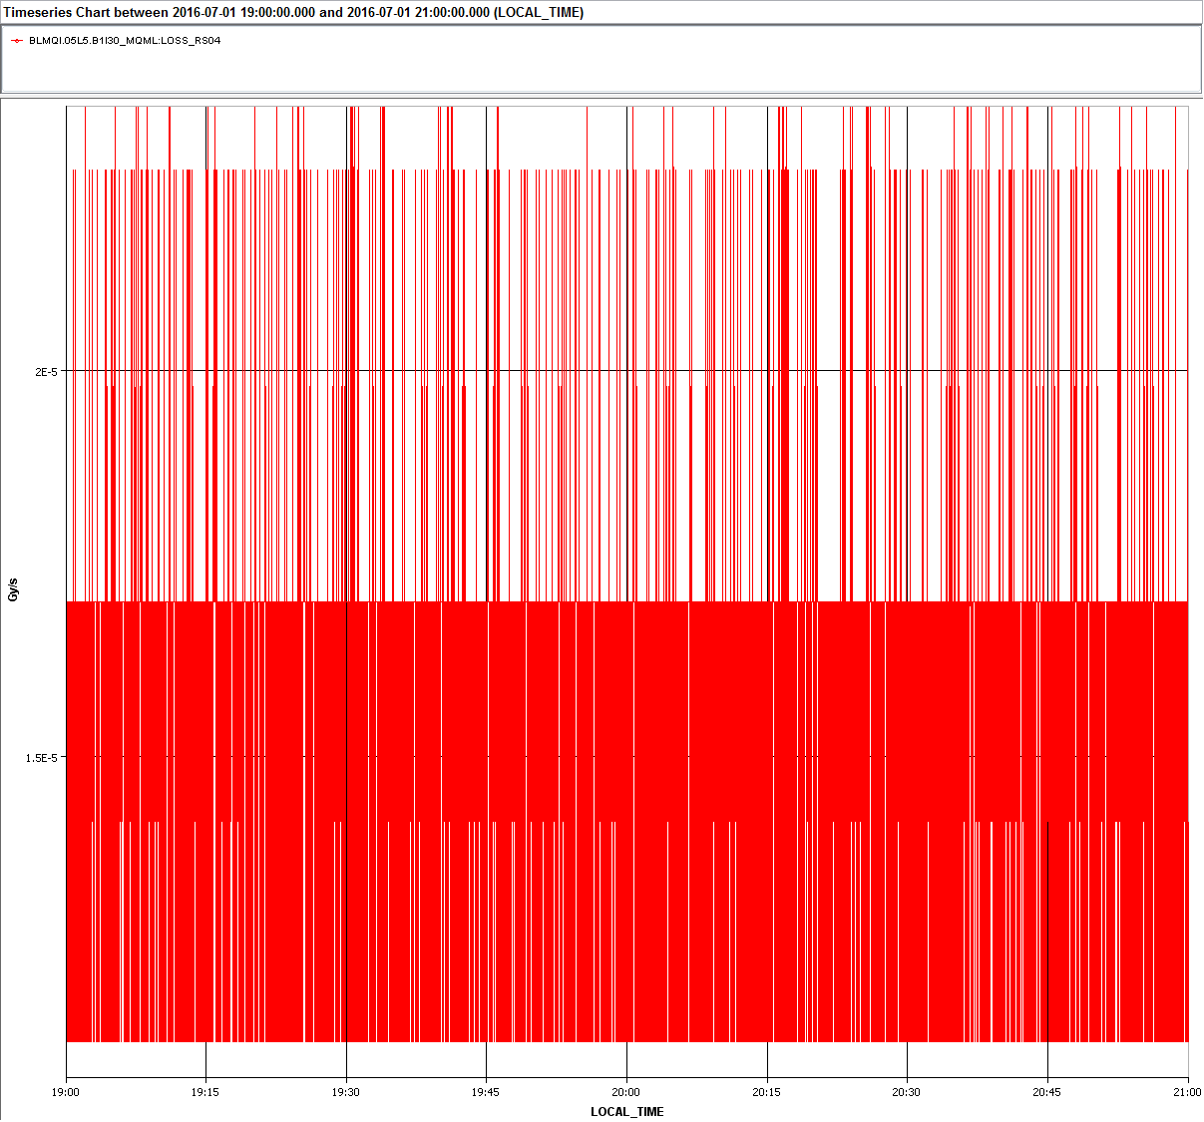
Example 1: first fishy BLM eliminated
Closer investigation of the BLM signal (e.g. during different beam modes) fortifies „fake-UFO“ hypothesis
Most likely electronic noise as fake UFO source
1.3E-4 @ stable beam
1.7E-5 @ no beam, top energy

Slide 25
Example 1: first fishy BLM eliminated
After Markus Albert and Giulia Papotti discovered strange UFO capture buffer data, an official investigation started.
When I reported the observations Rüdiger and me had made, this helped to find the reason:
Apparently the FPGA board of this specific BLM crate was indeed faulty and generated high electronic noise on the whole
BLM 05L5-group. This involves 6 neighboring BLMs, which artficially created UFOs by coinciding spikes.
The card was checked and repaired
First fishy BLM eliminated, surely more to come. Candidates: BLMQI.04L5...MQY, BLMAL.08L2…,

Slide 26
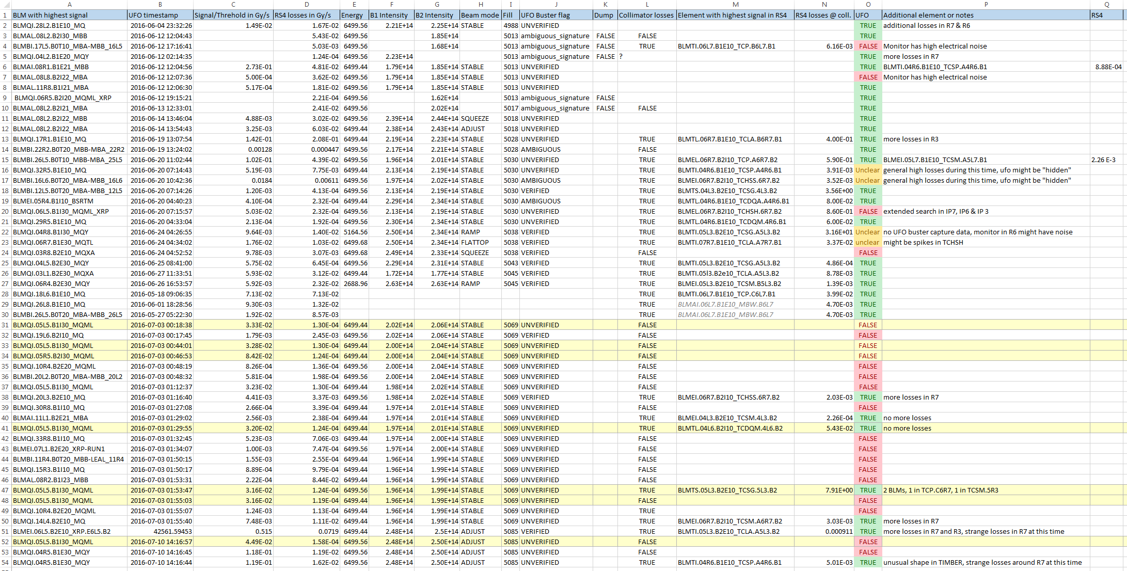
Testing the algorithm manually…

Slide 27
Testing the algorithm manually…
... Was time-consuming, but proved the value of the additional UFO post-selection
An automized programm based on he UFO Buster online application and the tested algorithm will be developed to:
  Reduce the size of the relevant UFO database
  Identify faulty BLMs
  Correlate inelastic and elastic beam loss signals
  Hopefully gain furher insight into the physics of the UFO process
  Improve the significance of the statistical analysis
In autumn a new Technical Student will take care of the software development under the direct supervision of Laura.
This might be a new era of UFO Busting ;)

Slide 28

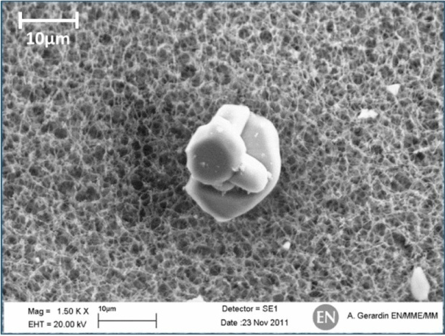
THANK YOU FOR YOUR ATTENTION

Slide 30
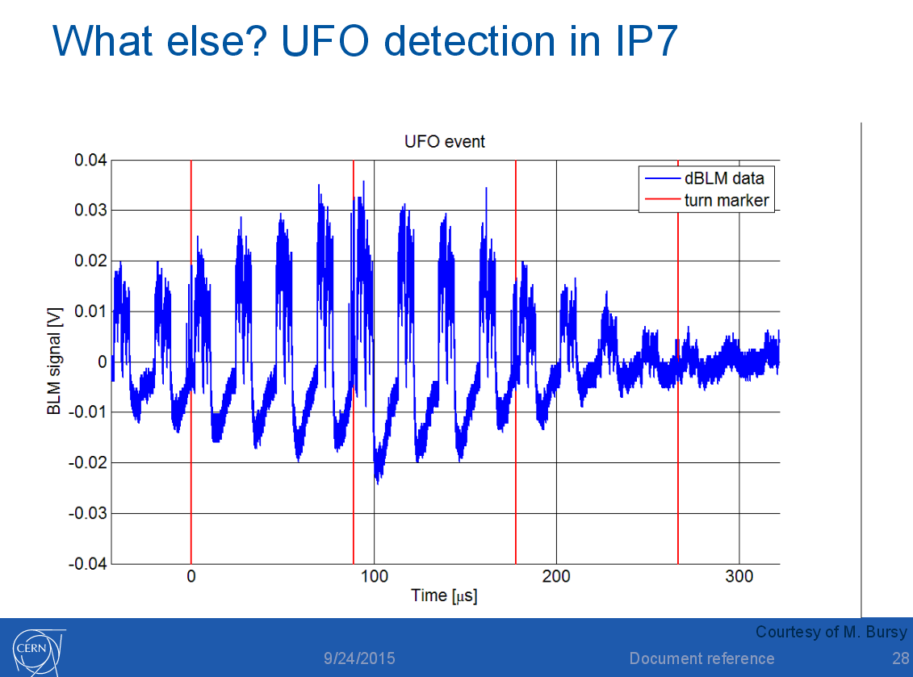
Open questions regarding UFO detection
Lowest detection limit for UFO event in IP7
Signal height in IP7, IP6 and IP3 wrt to triggering BLM
Dependency on beta function
    Potential tool to simulate elastic losses and IP7 UFO signal
Additional dBLM data with ns time resolution
(the plot shows that the bunch structure
can be fully resolved)

Slide 31
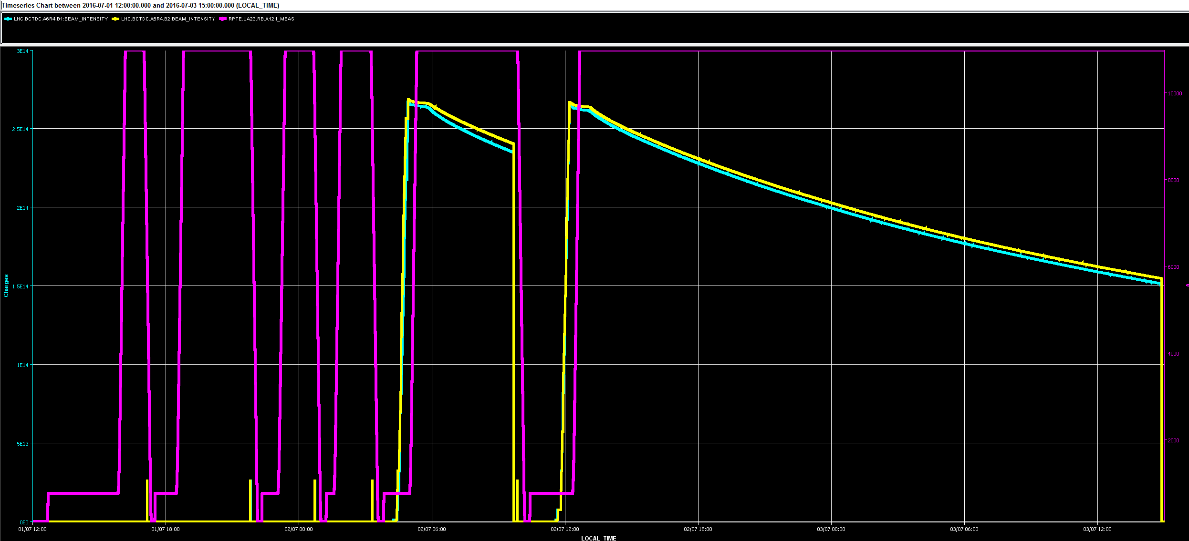
BLMQI.05L5.B1I30_MQML

Slide 32
BLMQI.05L5.B1I30_MQML
1.7.2016, 13-15 h: no beam, injection energy
1.7.2016, 19-21 h: no beam, top energy
3.7.2016, 0-2 h: stable beams
1
2
3
1
2
3

Slide 33
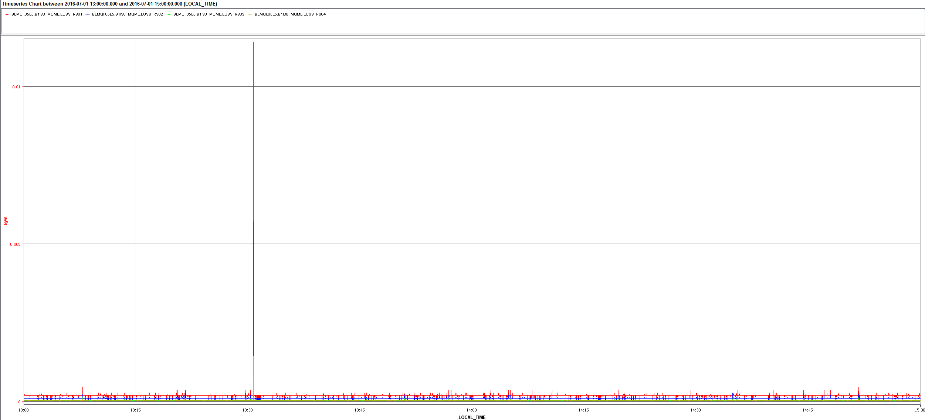
BLMQI.05L5.B1I30_MQML
1

Slide 34
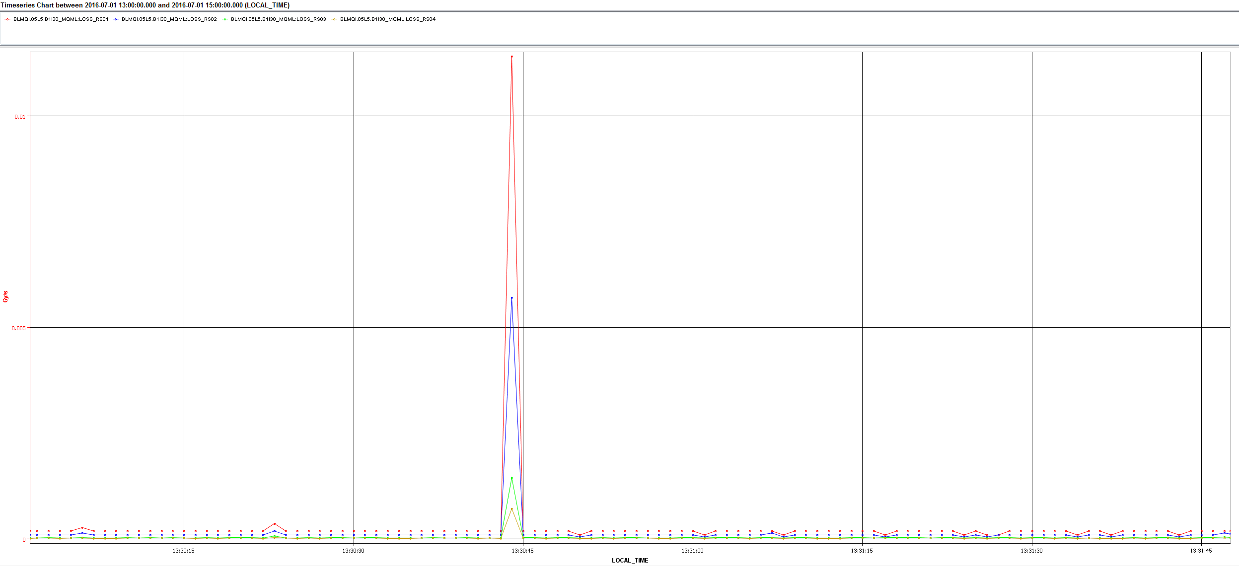
BLMQI.05L5.B1I30_MQML
1

Slide 35
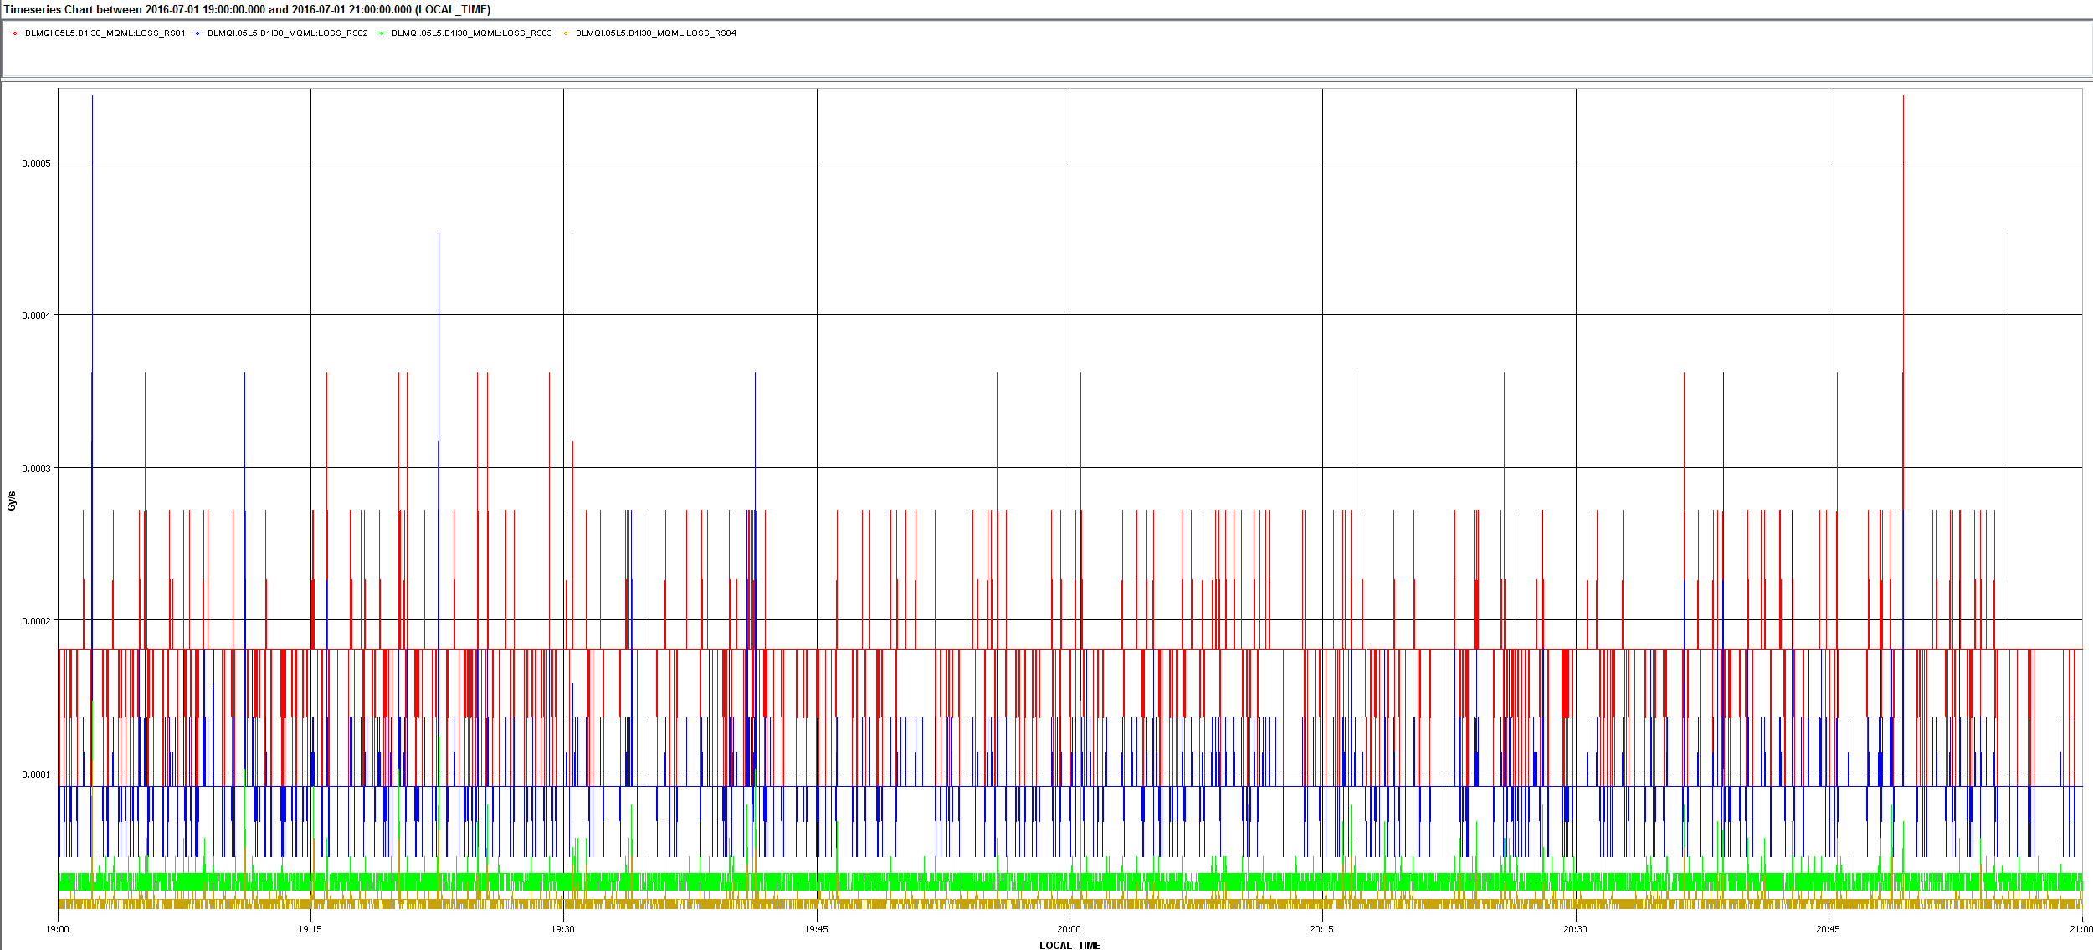
BLMQI.05L5.B1I30_MQML
2

Slide 36
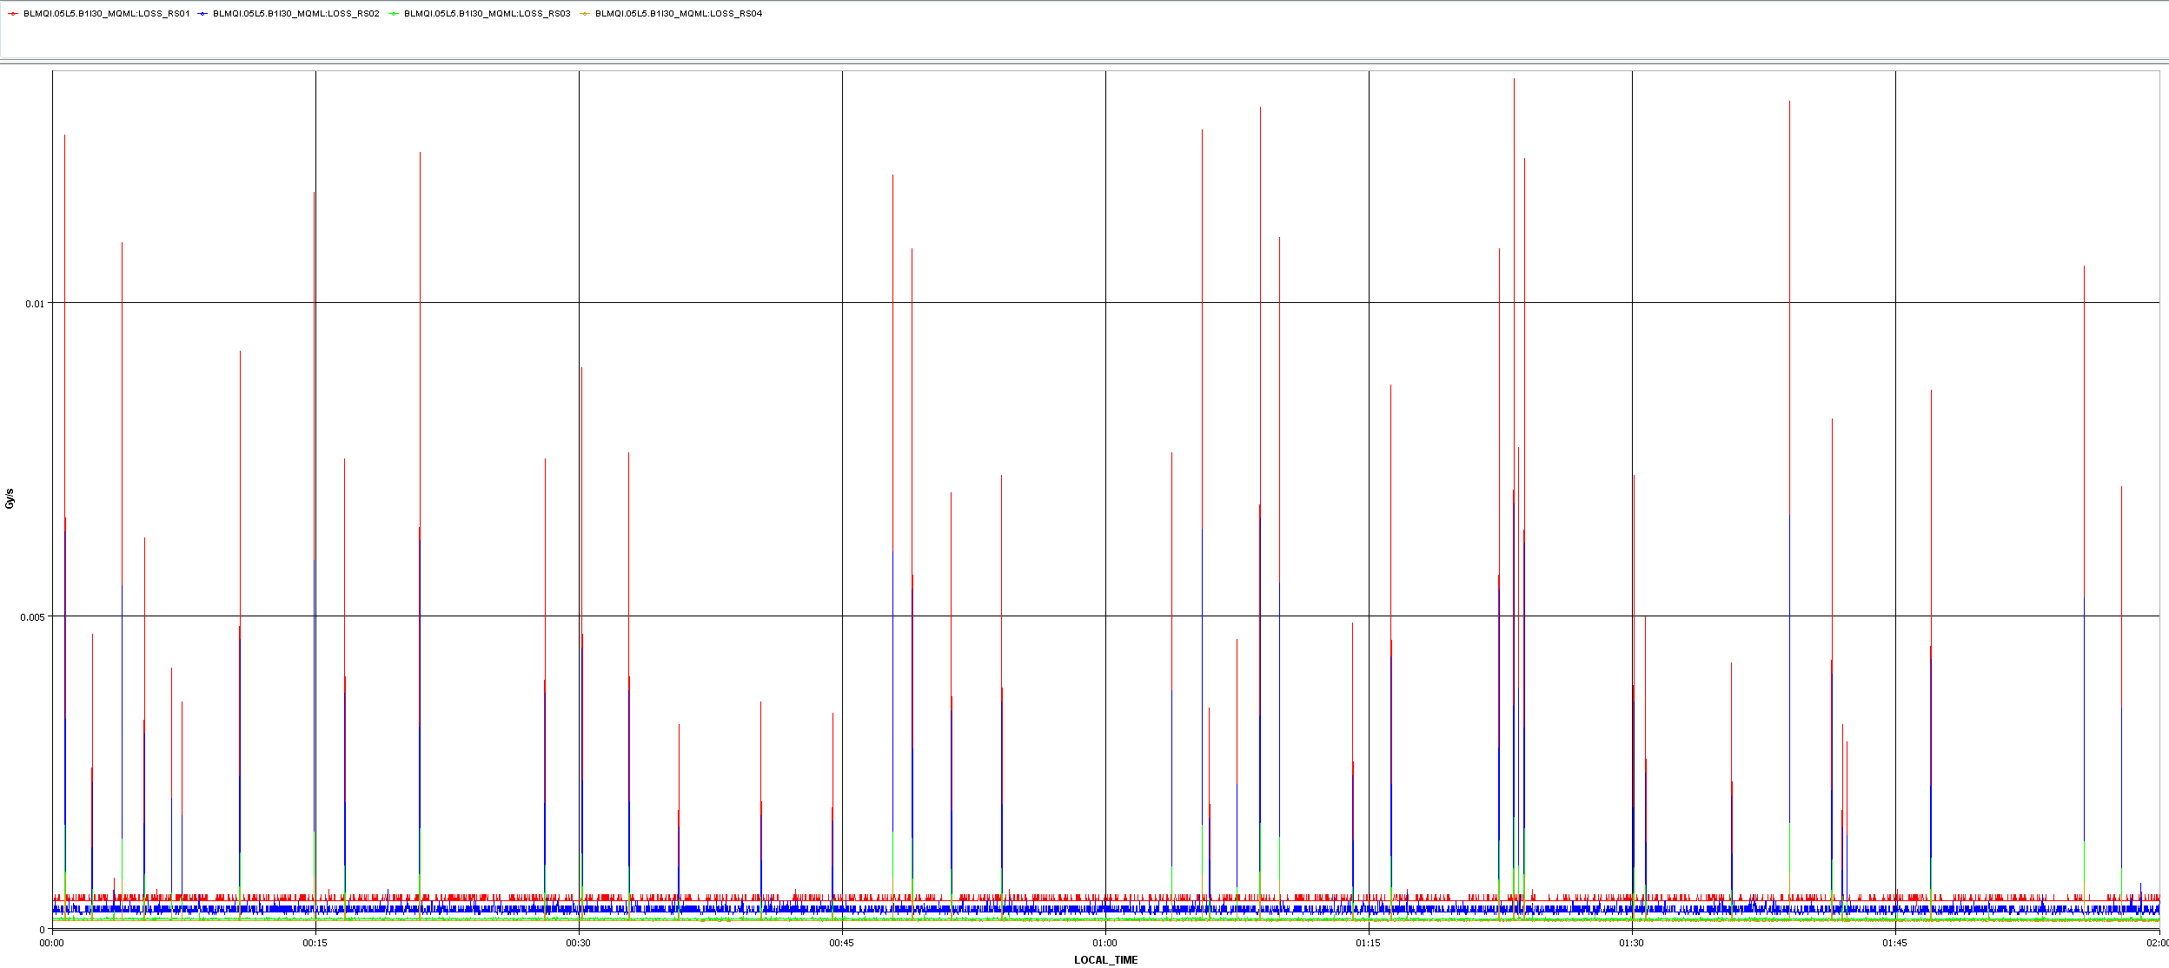
BLMQI.05L5.B1I30_MQML
3

Slide 37
Comparison with UFOs during
3

Slide 38
Comparison with UFOs during
3

Slide 39
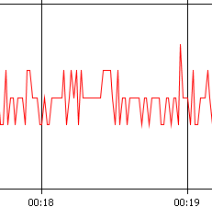
Comparison with UFOs during
3
UFO Buster time stamp:
03/07/2016 00:18:38
1.30E-04 in RS4

Slide 40
Comparison with UFOs during
3
UFO Buster time stamp:
03/07/2016 00:18:38
1.30E-04 in RS4
UFO Buster time stamp:
03/07/2016 00:44:011.30
1.30E-04 in RS4

Slide 41
Comparison with UFOs during
3
UFO Buster time stamp:
03/07/2016 00:18:38
1.30E-04 in RS4
UFO Buster time stamp:
03/07/2016 00:44:011.30
1.30E-04 in RS4
UFO Buster time stamp:
03/07/2016 01:12:37.0
1.30E-04 in RS4

Slide 42
Comparison with UFOs during
3
UFO Buster time stamp:
03/07/2016 01:29:55.0
1.30E-04 in RS4
UFO Buster time stamp:
03/07/2016 00:18:38
1.30E-04 in RS4
UFO Buster time stamp:
03/07/2016 00:44:011.30
1.30E-04 in RS4
UFO Buster time stamp:
03/07/2016 01:12:37.0
1.30E-04 in RS4

Slide 43
Comparison with UFOs during
3
UFO Buster time stamp:
03/07/2016 01:29:55.0
1.24E-04 in RS4
UFO Buster time stamp:
03/07/2016 01:53:47.0
1.24E-04 in RS4
UFO Buster time stamp:
03/07/2016 00:18:38
1.30E-04 in RS4
UFO Buster time stamp:
03/07/2016 00:44:011.30
1.30E-04 in RS4
UFO Buster time stamp:
03/07/2016 01:12:37.0
1.30E-04 in RS4

Slide 44
Comparison with UFOs during
3
UFO Buster time stamp:
03/07/2016 01:29:55.0
1.24E-04 in RS4
UFO Buster time stamp:
03/07/2016 01:53:47.0
1.24E-04 in RS4
UFO Buster time stamp:
03/07/2016 00:18:38
1.30E-04 in RS4
UFO Buster time stamp:
03/07/2016 00:44:011.30
1.30E-04 in RS4
UFO Buster time stamp:
03/07/2016 01:12:37.0
1.30E-04 in RS4
UFO Buster time stamp:
03/07/2016 01:55:03.0
1.19E-04 in RS4

Slide 45
None of the high spikes in BLMQI.05L5.B1I30_MQML were UFOs, they were always triggered from within the noise level!
3
2
1.3E-4 @ stable beam
1.7E-5 @ no beam, top energy

Slide 46
Collimator losses for UFOs in BLMQI.05L5.B1I30_MQML

