Slide 1
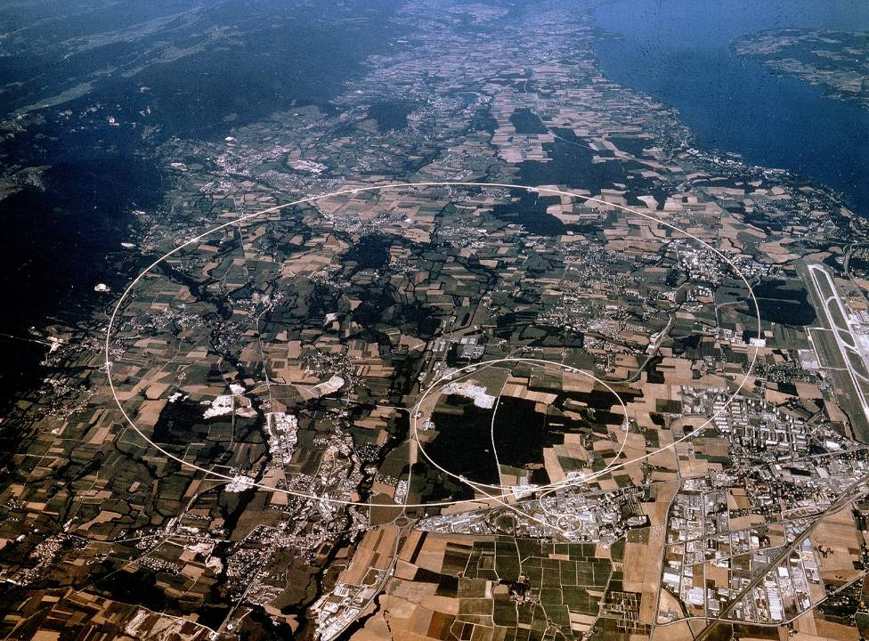
STPA FOR LINAC4 AVAILABILITY REQUIREMENTS
A. Apollonio, R. Schmidt
4th European STAMP Workshop, Zurich, 2016

Slide 2
CERN: Accelerators and Experiments
CERN provides the world’s largest and most complex scientific instruments to study the elementary particles
These instruments are particle accelerators and experiments
Accelerators boost beams of elementary particles to high energies before they are made to collide with each other
Experiments observe and record the results of these collisions
LHC relies on the reliable operation of the injectors, e.g. LINAC4
Our flag-ship project is the Large Hadron Collider…

Slide 3
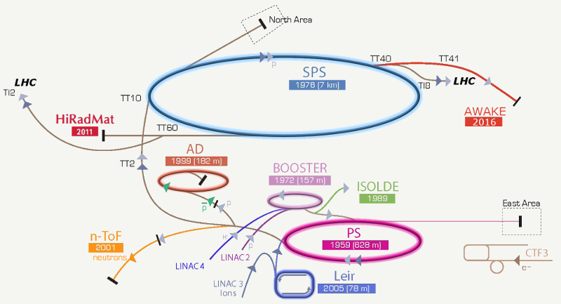
CERN: Injector Chain
LINAC4

Slide 4

Risks for High-Power Accelerators
Not to complete the construction of the accelerator
  Happened to other projects, the most expensive was the Superconducting Super Collider in Texas / USA with a length of ~80 km
  Cost increase from 4.4 Billion US$ to 12 Billion US$, US congress stopped the project in 1993 after having invested more the 2 Billion US$
Not to be able to operate the accelerator
Damage to the accelerator beyond repair due to an accident
NO LHC: Future of particle Physics compromised
SSC

Slide 5
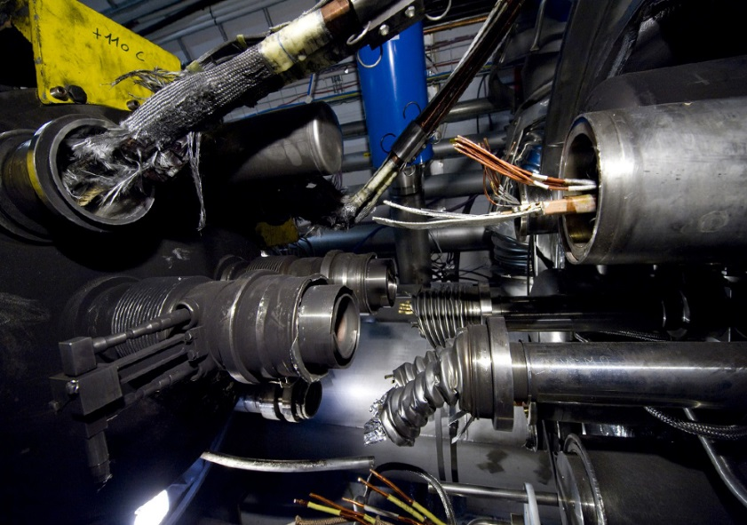
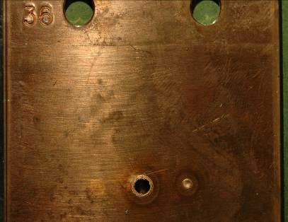
LHC: Hazards and Machine Protection
Safety-critical:
  362 MJ stored beam energy
  9 GJ energy stored in the magnet powering system
Complex:
  Many 10000s interlocks
  Mix of hardware, software, human interventions, procedures, etc.
Need for an efficient method to address protection requirements consistently
STPA was not used to develop the LHC MPS
Arcing in the interconnection, in 2008 at LHC
Effect of 0.1% of the LHC beam energy (Experiment at SPS)

Slide 6
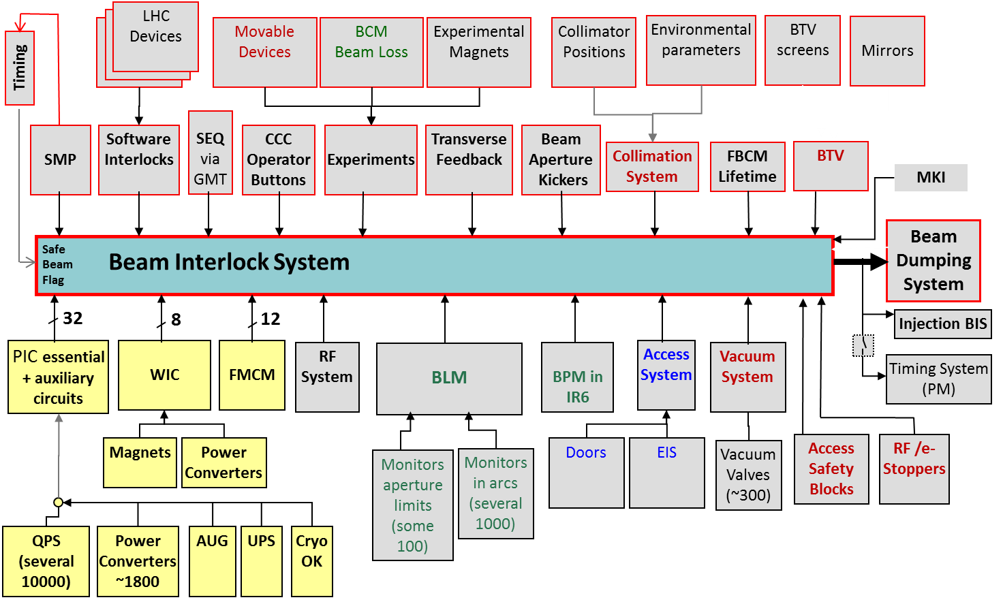
LHC MPS to prevent beam accidents
  Many 10000s interlocks, across more than 20 subsystems

Slide 7
Design principles for protection systems
Efficient accelerator operation
  Priority 1: Avoid accidents (reducing availability and introducing repair cost)
  Priority 2: Operate with high availability
Failsafe design
  detect internal faults
  if the protection system does not work, better stop operation rather than damage equipment (affecting availability)
Excellent diagnostics
  recording all failures
Flexibility: managing interlocks
  disabling of interlocks is common practice (keep track!)
  LHC: masking of some interlocks possible for low intensity / low energy beams

Slide 8
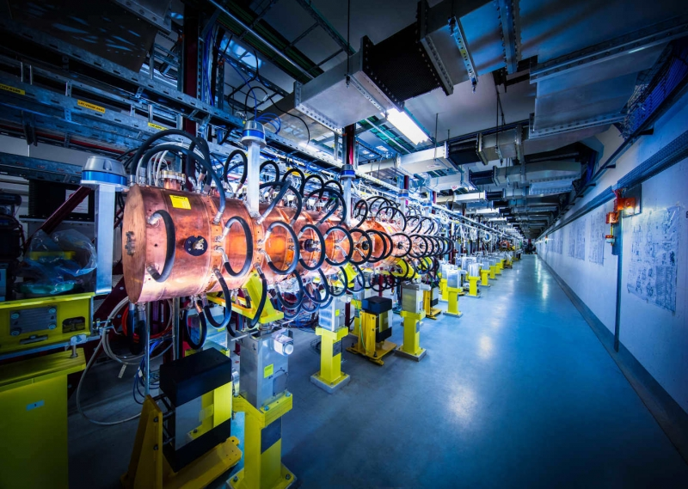
LINAC 4
New injector for the CERN accelerator complex
Being commissioned, regular operation starting in the next years

Slide 9
Motivation for the use of STPA
Increasing accelerator complexity requires a systematic approach for identification of machine protection requirements
  Address and optimize contradictory requirements (safety vs availability)
  Applicable from early design stages (not applied to a given design)
  Results should not regard only the system architecture, but also provide recommendations for correct operation and management of the accelerator
Long-term goal
  Identify suitable method for the design of machine protection systems for the next generation of particle accelerators
As a start…
  Apply method for the first time to a small accelerator to verify its suitability → Linac4

Slide 10
STPA steps
Step 1: Identify accidents and hazards
Step 2: Draw the control structure
  Controller + controlled process
  Control actions + feedback
Step 3: Identify Unsafe Control Actions
Step 4: Identify Causal Factors
(Step 5: Iterate 1 to 4 until suitable mitigation is found)
Controller
Control Action
Feedback
Controlled Process
J. Thomas, RSRA2015

Slide 11
Step 1: Linac4 Accidents and Hazards
ACCIDENTS:
A1: Lack of beam for other accelerators
A2: Damage to accelerator equipment
A3: Injuries to staff members
A4: Release of radioactive material in the environment
HAZARDS (only related to A1):
H1: Accelerator equipment is not ready for operation [A1, A2]
H2: Beam is lost before reaching the transfer line [A1, A2]
H3: Beam is stopped before reaching the transfer line when it is not necessary [A1]
H4: Beam doesn’t have the required quality for following accelerators
LINAC
REQUIREMENTS:
R1: Accelerator equipment must be operational [H1]
R2: The beam must not be lost before reaching the transfer line [H2]
R3: The beam must not be stopped when it is not necessary [H3]
R4: The beam must have the required quality for following accelerators [H4]
Transfer-Line for delivery

Slide 12
Step 2: Linac4 Control Structure
CONTROL SYSTEM
PERSONEL
ACCESS CONTROL
EQUIPMENT CONTROL
Technical level
Operational level
(humans + software)
Controls level
BEAM DELIVERY CONTROL
BEAM PARAMETER CONTROL
REGULATION PARAMETERS
BEAM STOP
TRIGGER
LINAC operators
PERSONNEL
Technical Personnel
System under control: LINAC
SENSORS AND INSTRUMENTATION
PROTECTION ACTUATORS
BEAM STOP
Electrical supplies
Cooling
BEAM GENERATION
BEAM BUNCHING AND FOCUSING
BEAM ACCELERATION
BEAM DELIVERY
Vacuum
LINAC

Slide 13
Step 3: Unsafe Control Actions
Control Action | Not providing causes hazard | Providing causes hazard | Too early/too late, wrong order | Stopped too soon/applied too long
Beam stop | UCA2, UCA4, UCA5, UCA2 | UCA1 | UCA3 | -
UCA1: The beam is stopped when it is not necessary (automatically or by an operator)
UCA2: The beam is not stopped in a detected emergency situation (automatically or by an operator) due to the unavailability of an actuator
UCA3: The beam is not stopped while personnel has access to the linac
UCA4: The beam is not stopped following the missed detection of an undesirable accelerator configuration
UCA5: The beam is not stopped when the beam quality is not sufficient for following accelerators

Slide 14
Identify Causal Factors
J. Thomas, RSRA2015

Slide 15
Step 4: Causal Factors
UCA: a beam stop is executed when it is not necessary
Scenario | Associated Causal Factors | Notes | Requirements
Control input or external information wrong or missing: Operator trigger an unnecessary beam stop | Operator accidentally act on the physical device connected to the controller | The emergency button in the control room is accidentally pushed | Protect the physical device from accidental contact
 | Operator misinterprets feedback from instrumentation and trigger the beam stop. | The operator misinterprets a signal judging it as relevant deviation from nominal configuration and decides to stop the beam for safety reasons. | Train operators to use software and processes running in the control room. Consider improving GUI.
 | Operator executes a command that triggers a dangerous situation and thus a beam stop. | Operator tries to compensate a beam or hardware setting but this leads to a dangerous state that requires a beam stop. | Train operators to use software and processes running in the control room. Consider software that is providing limits / warnings.
 | Technical personnel tries to access the linac while it is working, causing a beam stop. | Technical personnel is unaware that the machine is running and tries to access it. | Require authorization from the control room for machine access.
Sensor - Inadequate or missing feedback: The sensor feedback is wrong and automatically triggers a beam stop. | Sensor is faulty and causes a beam stop. | A sensor gives wrong information and determines that a beam stopi s needed, even if no direct machine harm exists. | A dedicated reliability analysis can assess number and type of sensors to minimize the occurrence of false detection.
 | Spurious trigger of a sensor causing a beam stop. | A sensor signals a hazardous operating condition due to a spurious failure (e.g. radiation- induced). | Consider adding redundancy. When possible, locate sensors and instrumentation far from radiation-exposed areas.
‘Practical’ measures
Managerial and organizational measures
Procedural measures
Technical requirements: trigger further analyses with traditional methods

Slide 16
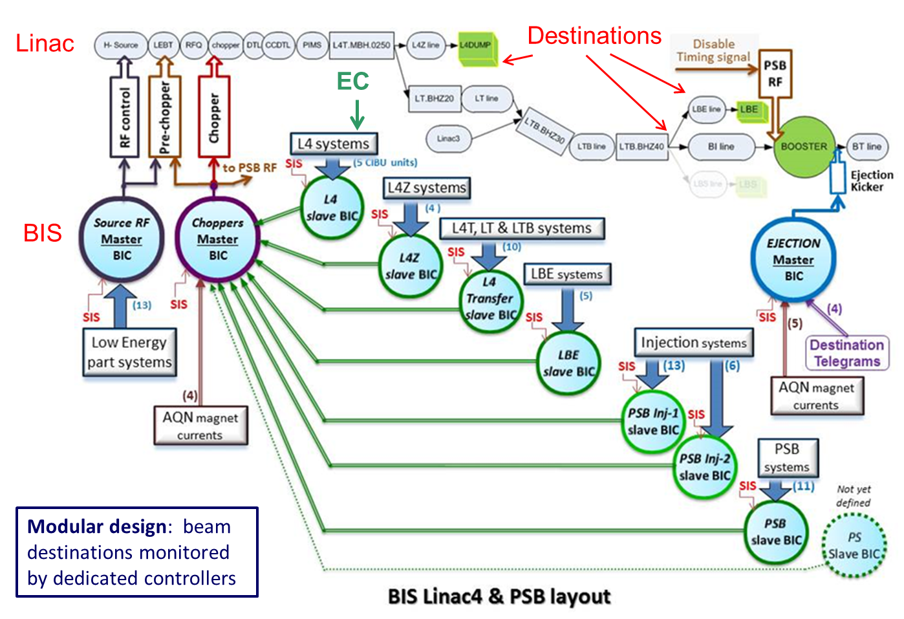
Linac4 Machine Protection

Slide 17
Main Outcomes of Linac4 STPA
Availability-oriented design of the Machine Protection System
  Modular design of MPS → Tree-like Architecture
  Management of beam destinations → External conditions
  Flexibility of MPS → Software Interlock System
Procedural/managerial measures
  Definition of a MPS responsible for approval of changes/settings of the MPS
  Document for MPS requirements during Linac4 commissioning

Slide 18
Summary
STPA: suitable tool for hazard analysis of safety-critical systems in accelerators
  Allows dealing with increasing system complexity
  Results go beyond requirements for hardware design
Successful application to Linac4 MPS
  Set of availability requirements
  Impact on Linac4 architecture design
Needs to be complemented by other tools (e.g. fault trees etc.)
  In particular for sub-systems / components
Independently from the method: spread safety culture for particle accelerators

Slide 19
Thanks a lot for your attention
References:
J. Thomas, “The Reliability and System Risk Analysis (RSRA) Workshop”, CERN, 2015 (link)
N. Leveson, “An STPA primer” (link)
A. Apollonio, “Machine Protection: Availability for Particle Accelerators” (link)
A-STPA, University of Stuttgart (link)

Slide 20
Safety vs Reliability
Reliability component failures (bottom-up)
Safety system accidents (top-down)
Extreme: accidents can occur even in case of reliable behaviour of all components in the system (examples: wrong requirements, change of boundary conditions, etc.)
J. Thomas, RSRA2015

Slide 21
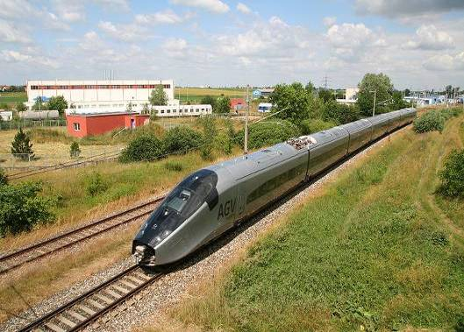
Energy stored in one LHC beam
3⋅10¹⁴ protons in each beam
Kinetic Energy of 200 m Train at 155 km/h ≈ 360 MJoule
Stored energy per beam is 360 MJoule
Picture source: http://en.wikipedia.org/wiki/File:Alstom_AGV_Cerhenice_img_0365.jpg
Shared as: http://creativecommons.org/licenses/by-sa/3.0/deed.en
[11]

Slide 22

Energy stored in the LHC magnet system
Stored energy in the magnet circuits is 9 GJoule
Kinetic Energy of Aircraft Carrier at 50 km/h ≈ 9 GJoule
….can melt 14 tons of copper
[11]
Picture source: http://militarytimes.com/blogs/scoopdeck/2010/07/07/the-airstrike-that-never-happened/
Shared as: public domain

Slide 23
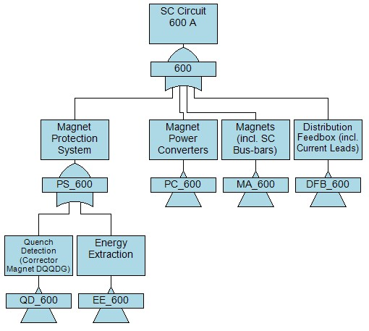
Traditional Reliability Methods
Qualitative
  FMECA
  Fault-Tree
  …
Quantitative
  RBD
  Fault-Tree
  Markov-models
  …

Slide 24
STPA compared to traditional methods
Qualitative method
It can be used from early design stages
  Top-down
  ‘Design independent’
Suitable to handle increasing system complexity
Guidelines provided to follow method steps (see references)
Produces tables with Unsafe Control Actions (UCAs) and associated Causal Factors
  Readability similar to FMECA

Slide 25
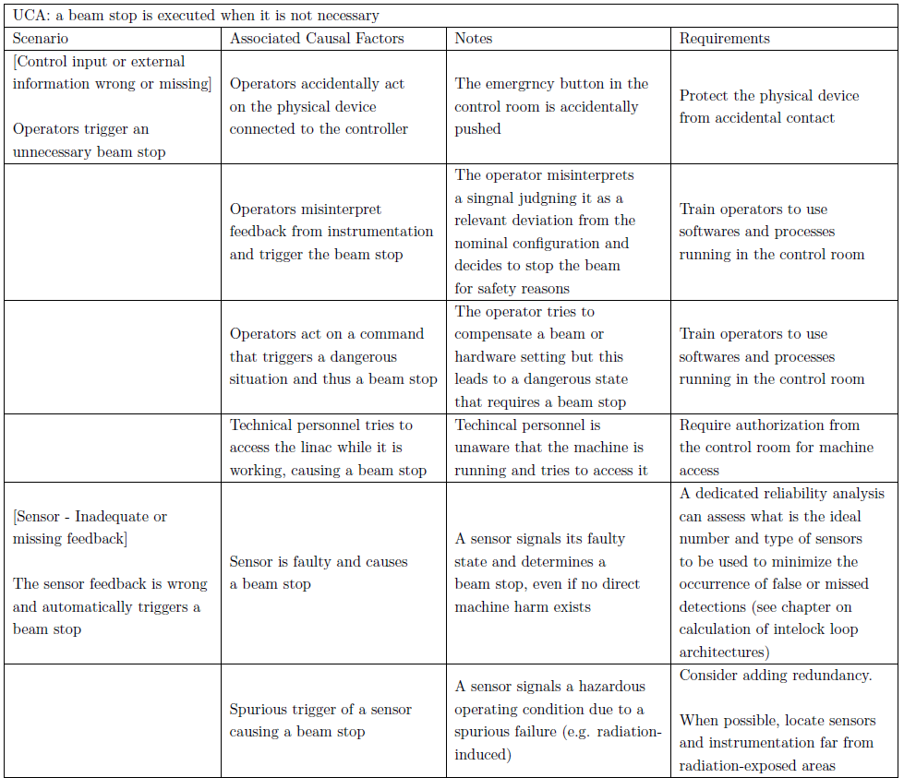
OLD Step 4: Causal Factors
‘Practical’ measures
Managerial and organizational measures
Procedural measures
Technical requirements: trigger further analyses with traditional methods

Slide 26
OLD
CONTROL SYSTEM
PERSONEL
ACCESS CONTROL
EQUIPMENT CONTROL
BEAM DELIVERY CONTROL
Technical level
Operational level
(humans + software)
Controls level
BEAM PARAMETER CONTROL
BEAM TRAJECTORY CONTROL
REGULATION PARAMETERS
BEAM STOP
TRIGGER
LINAC operators
PERSONNEL
Technical Personnel
System under control: LINAC
SENSORS AND INSTRUMENTATION
PROTECTION ACTUATORS
BEAM STOP
Electrical supplies
Cooling
BEAM GENERATION
BEAM BUNCHING AND FOCUSING
BEAM ACCELERATION
BEAM DELIVERY
Vacuum
LINAC

