Slide 1

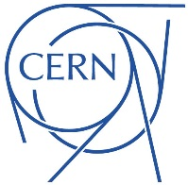
Co-Simulation Framework of Transient Effects
in Superconducting Accelerator Circuits
L. Bortot, M. Maciejewski, M. Prioli, A.M. Fernandez Navarro,
J.B. Ghini, B. Auchmann, A.P. Verweij
Acknowledgement
Sebastian Schoeps, Idoia Cortes Garcia, Emmanuele Ravaioli, Tina Griesemer
Notes:
Good afternoon,
Today I speak on behalf of a several people belonging to CERN that all together are developing a Co-Sim…

Slide 2
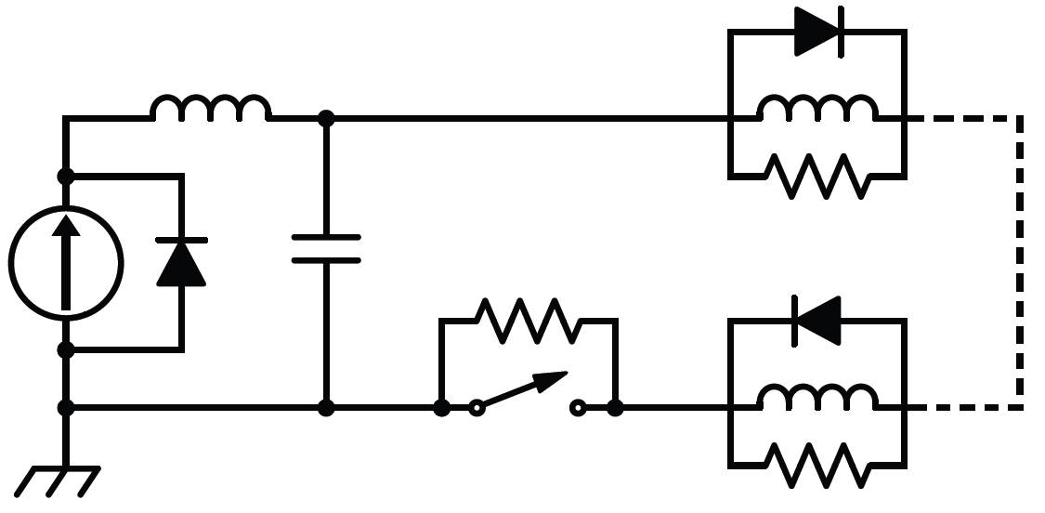
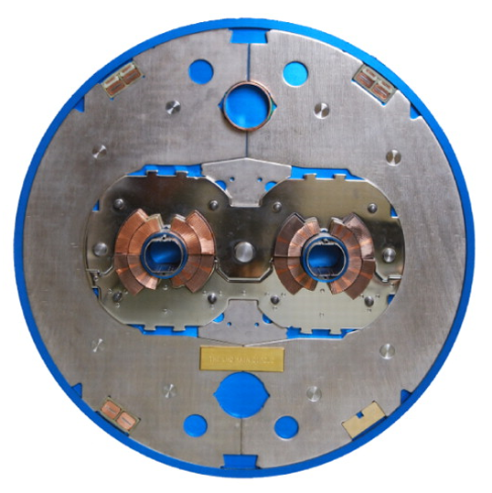
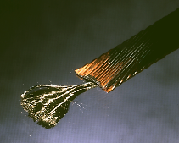
The challenge
m
1e3
1
1e-3
1e-6
Mechanics
Thermal
Multi-Physics
Multi-Rate
Multi-Scale
Fluid dynamics
Electrodynamics
…
Notes:
deeply-entangled and complex systems whose components combine technologies from several engineering fields, which show strong mutual interactions.
Magnets contain coils wound from superconductors, subject to parasitic capacitance as well as cable coupling currents and eddy currents in the wedges, collars, yokes,

Slide 3





In-house VS commercial software
TALES
SPQR
ROXIE
THEA
…
CUDI
QP3
Quaber
Coodi
Qlasa
Solutions for partial problems
Codes likely to grow
Maintenance
General-purpose GUIs
Performance and capabilities
License vs development
The fastest transient phenomenon leads the solver time-stepping
None can accurately model complex circuits!
Notes:
In-House:
Code from ‘90s, Fortran
Code maintainability related to the creator’s availability
This makes maintenance and development difficult to ensure for longer periods
numerical solver has to be selected according to the fastest transient phenomena
While it is desirable to solve this type of multi-physics, multi-scale, and multi-rate problem using an intrinsically consistent monolithic approach,
this leads potentially to non-acceptable computational times since the time step of the single numerical solver has to be
selected according to the fastest transient phenomena.

Slide 4

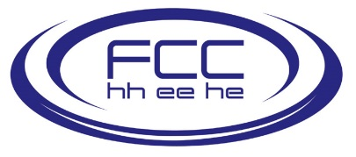






The STEAM architecture
1D
Electro-
Thermal
2D
Electro-
Thermal
2D
Mechanical
Electrical
Controller
Simulations Coupling
Simulation of Transient Effects in Accelerator Magnets
Notes:
The transient phenomena occurring in the circuit can be consistently captured only if the simulation includes the domains’ reciprocal influences.
Starting from these considerations, we have developed a framework based on simulator coupling, or co-simulation.
This allows to deconstruct complex systems into simpler parts, simulated by domain-specific models refined with expert knowledge.
The co-simulation algorithm ensures the consistency between the simulations, and the efficient use of computational resources is ensured by the choice of suitable solvers for each subsystem.
Sub-models are generally developed with appropriate commercial tools, in order to ensure maintainability, scalability, and longevity that are more difficult to achieve with in-house written code.

Slide 5
Field-Circuit coupling
1D
Electro-
Thermal
2D
Mechanical
Controller
2D
Electro-
Thermal
Electrical
Simulations Coupling

Slide 6
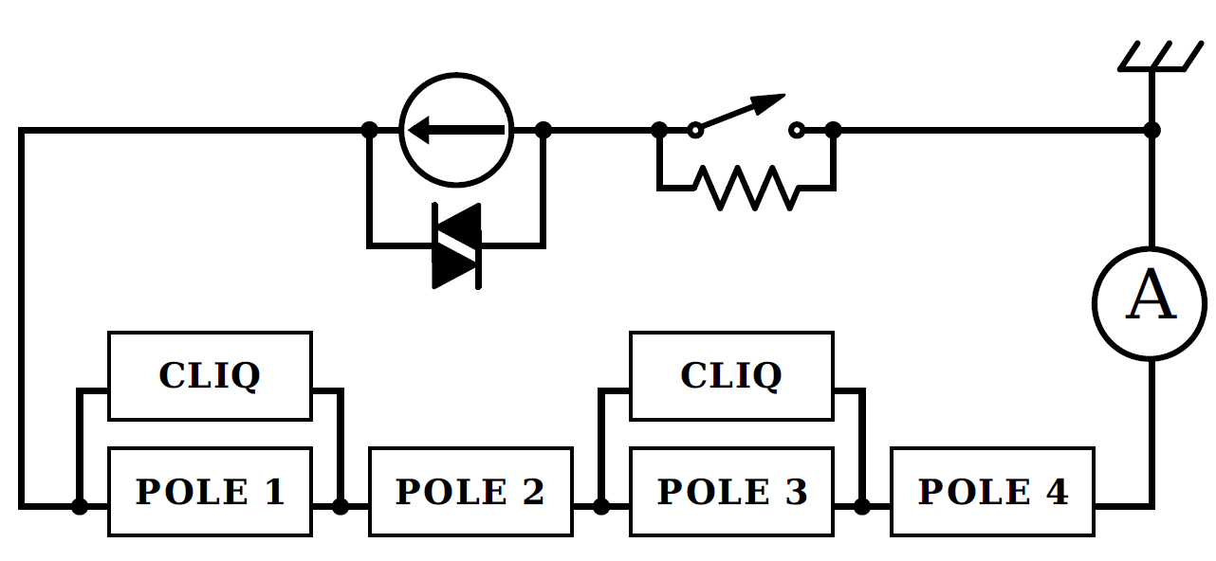
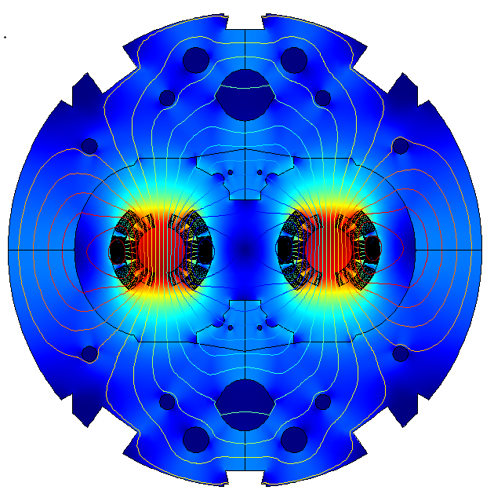
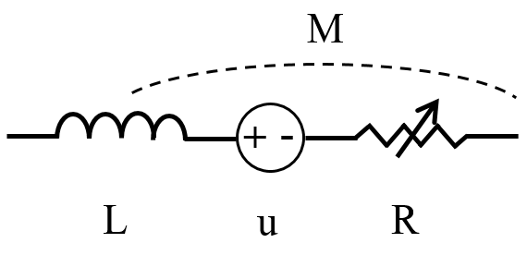
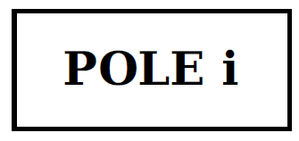
Strategy
The network resolves the current driving the FEM model.
The FEM solution controls the magnet equivalent parameters
The two numerical solvers are couple through the waveform relaxation method

Slide 7
Coupling scheme
Waveform Relaxation – Gauss-Siedel serial scheme
Circuit solver
Field solver
The network resolves the current driving the FEM model.
The FEM solution controls the magnet equivalent parameters
The two numerical solvers are couple through the waveform relaxation method
t
t + Δt
t_{end}

Slide 8
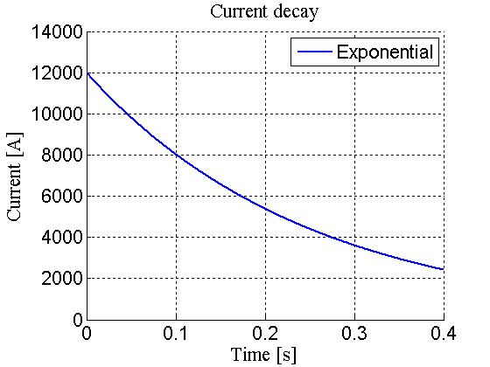
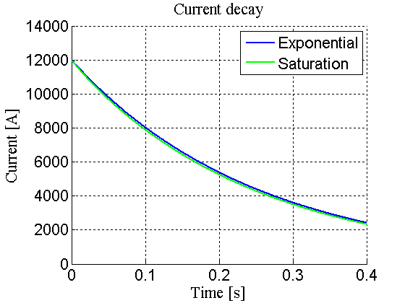
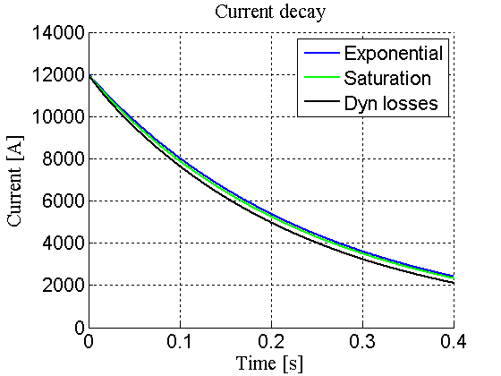
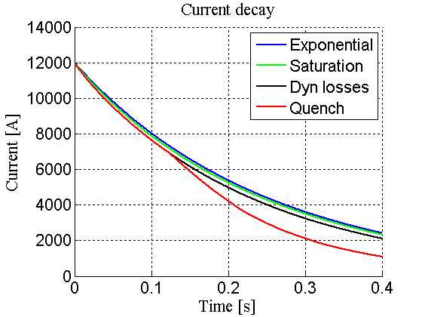
Results: Quench-back
The network resolves the current driving the FEM model.
The FEM solution controls the magnet equivalent parameters
The two numerical solvers are couple through the waveform relaxation method
Approximations must be compatible with the goals of the analysis
Nevertheless, wrong field assumptions lead to wrong results

Slide 9
Results: CLIQ discharge
Circuit solver
Field solver
The network resolves the current driving the FEM model.
The FEM solution controls the magnet equivalent parameters
The two numerical solvers are couple through the waveform relaxation method

Slide 10
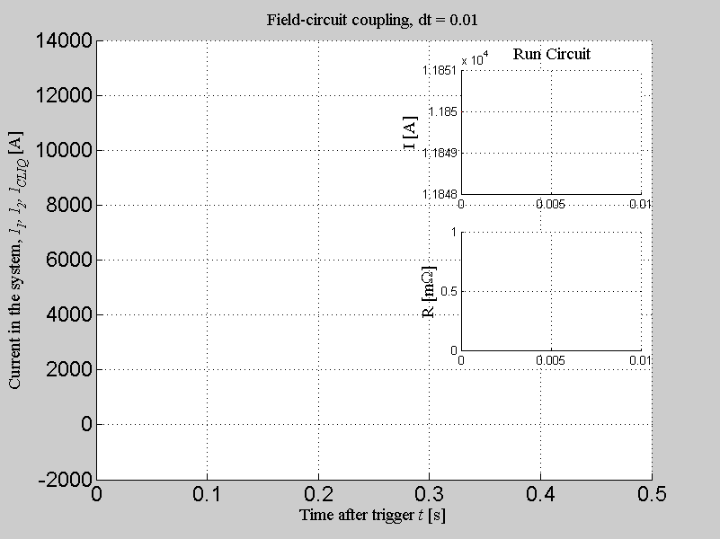
Results: CLIQ discharge
Circuit solver
Field solver
The network resolves the current driving the FEM model.
The FEM solution controls the magnet equivalent parameters
The two numerical solvers are couple through the waveform relaxation method

Slide 11
Results: CLIQ discharge
The network resolves the current driving the FEM model.
The FEM solution controls the magnet equivalent parameters
The two numerical solvers are couple through the waveform relaxation method

Slide 12
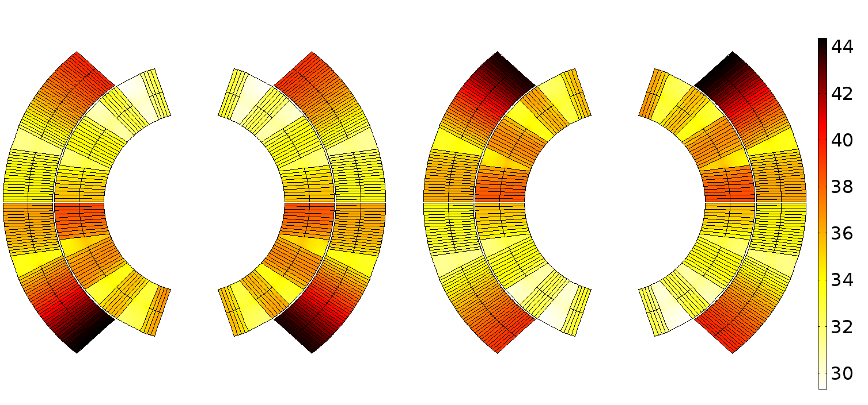
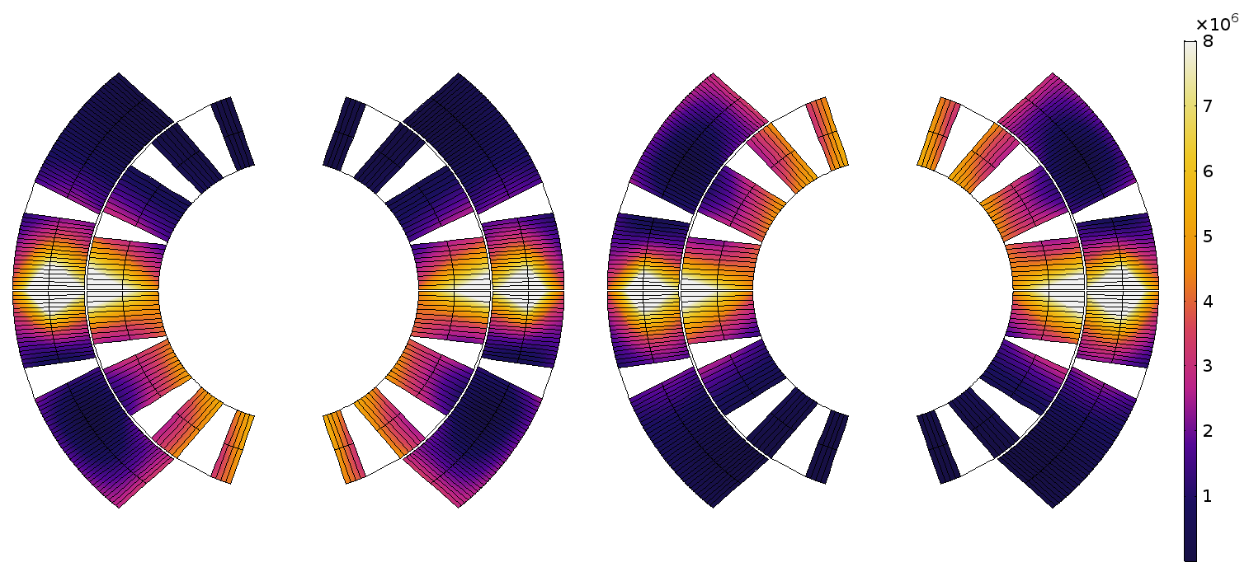
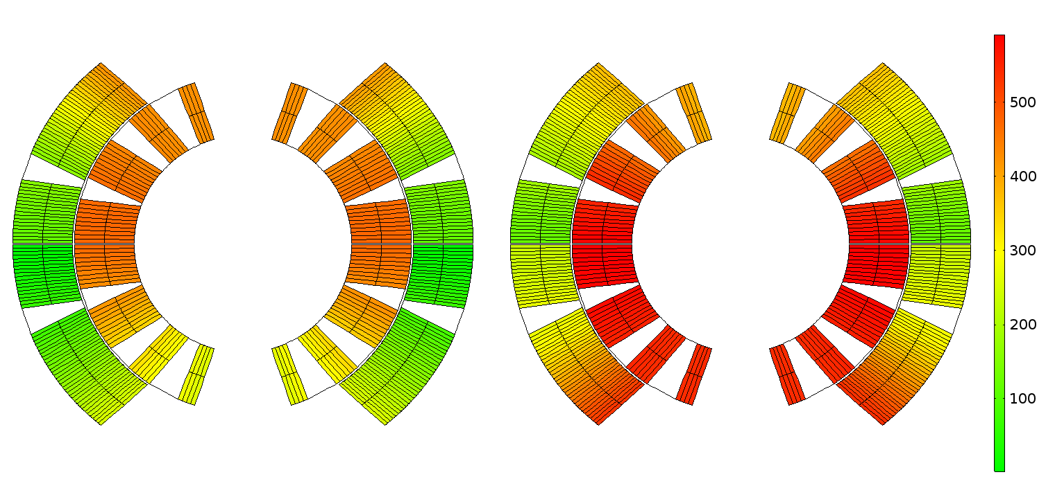
Results: CLIQ discharge
Inter-filament coupling losses [W/m^3]
Voltage-to-ground distribution [V]
The network resolves the current driving the FEM model.
The FEM solution controls the magnet equivalent parameters
The two numerical solvers are couple through the waveform relaxation method
(@ 40 ms)

Slide 13
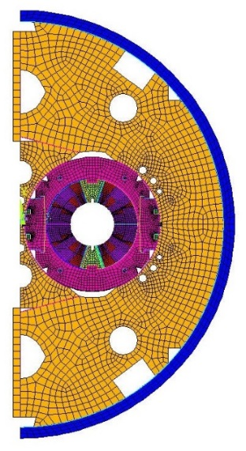
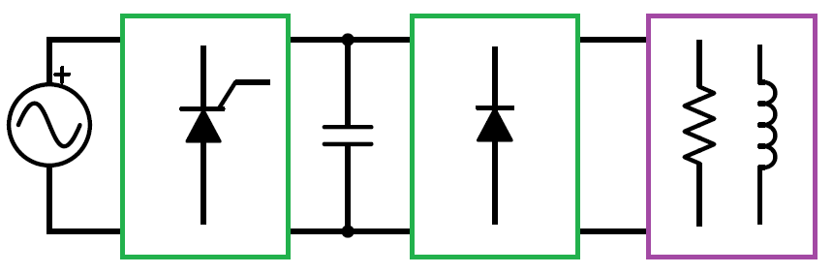
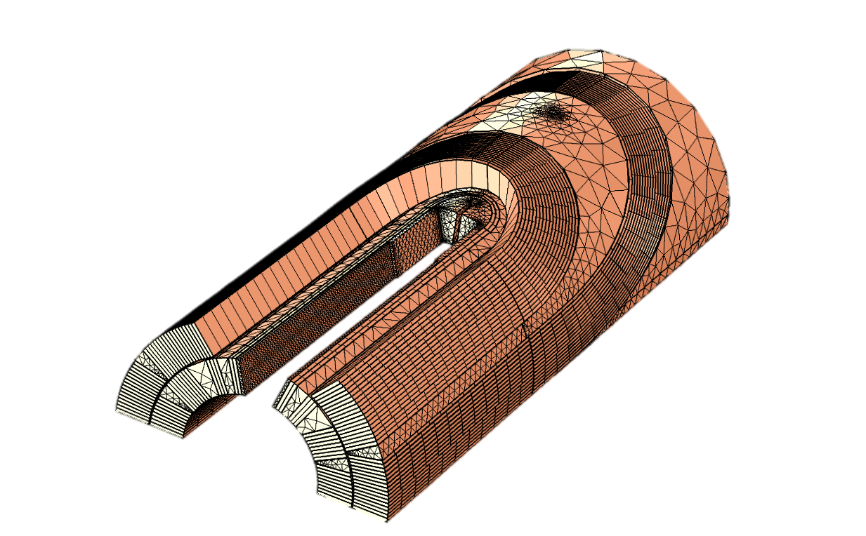
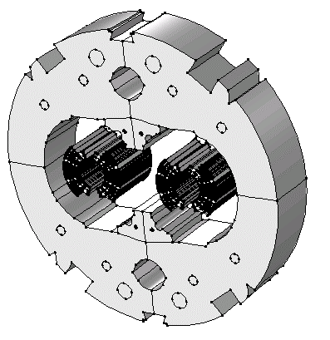
Outlook
Ongoing activities
Short term future plans
2D
Electro-
Thermal
2D
Mechanical
Controller
Electrical
The network resolves the current driving the FEM model.
The FEM solution controls the magnet equivalent parameters
The two numerical solvers are couple through the waveform relaxation method
… And beyond
Hardware
in-the-loop
Fluid dynamics
1D Quench
propagation
3D modelling

Slide 14
Conclusions
A multi-3 scaling system cannot be simulated within one tool
Partial models do not guarantee consistency of results
A Co-simulation framework as solution:
Common coupling interface, for information exchange;
Commercial tools, specialized on their domain of competence.
Efficiency through modularity, a suitable solver for each analysis.
Proof of concept
Field-circuit co-simulation
of an LHC main dipole magnet protected by CLIQ.
The network resolves the current driving the FEM model.
The FEM solution controls the magnet equivalent parameters
The two numerical solvers are couple through the waveform relaxation method

