Slide 2
My introduction to TE/MPE-PE
-Sara Ambjørndalen

Slide 3
Agenda
Background
Why CERN?
What will I be doing?

Slide 4

Background
From: Oslo, Norway
Hobbies: tea, hiking and travelling
Integrated master’s in Energy and Environmental Engineering
  Norwegian University of Science and Technology (NTNU) in Trondheim
  5-year program
Specialization: electric power engineering (high voltage)
Notes:
My name is Sara and I’m from Oslo.
I’m studying an integrated masters (5 year program) called energy and environmental engineering at NTNU in Trondheim. Like many engineering programs it is more generic in the beginning, touching upon many energy related themes. Third year you choose specialization, and I’m specializing in electric power engineering. My main interests are electrical machines and power electronics.
Although I’m still a student, I have some work experience from JPV and Statnett (transmissions system operator in Norway)

Slide 5
Main interests: electrical machines and power electronics
Tools
  Matlab, Simulink, PowerFactory, COMSOL and C++
Laboratory work:
  Machine, power electronics and high voltage lab
Previous experience:
  Norwegian National Rail Administration
  Statnett (TSO in Norway)

Slide 6
Why CERN?
Went to a CERN company presentation at NTNU
Excited about:
  using engineering for the advancement of physics
  research using state of the art technology
    superconducting magnets
  working in an international environment
Notes:
A few years ago I went to a company presentation and realized that cern is not only for physicists, and that they were also interested in people with my background and competence

Slide 7
What will I be doing?
Writing my master’s thesis as a Technical Student for 10 months
Topic: “Study of the transfer functions of superconducting magnets and their circuital representation”
Notes:
So far it has been interesting to work here, and I’m excited about the project I’ll be working on

Slide 8




STEAM project
1D
Electrothermal
2D
Electromagnetic
Thermal
2D
Mechanical
Electrical
Controller
PSpice
Simulations Coupling (Java/MpCCI)

Slide 9
My part in the STEAM project
User
Developer
1D
Electrothermal
2D
Electromagnetic
Thermal
Electrical
PSpice
Simulations Coupling (Java/MpCCI)

Slide 10
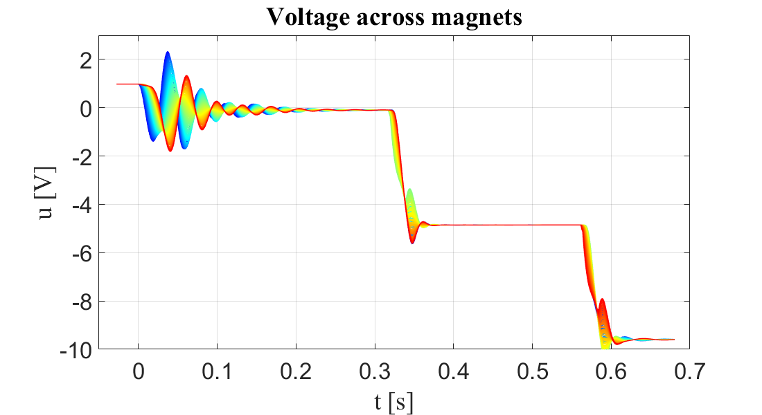
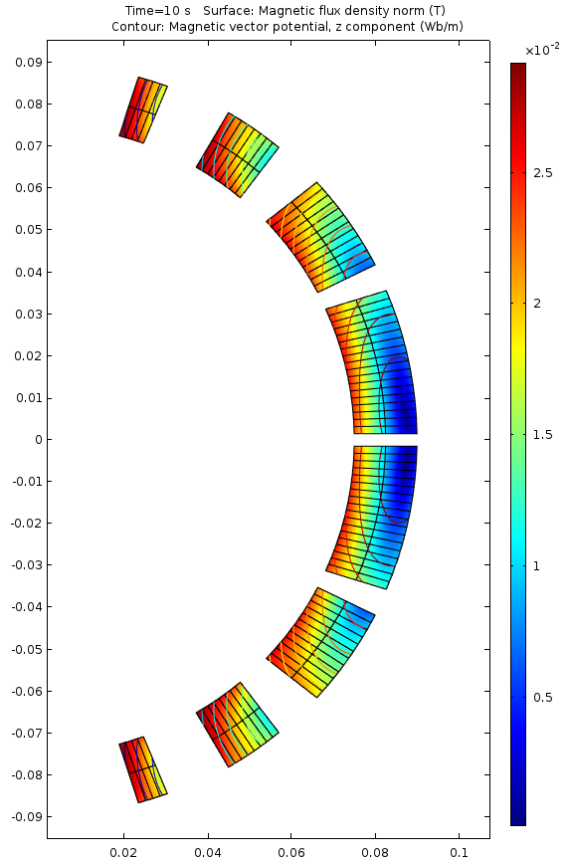
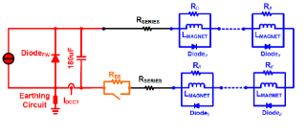
What will I be doing?
6
Run circuit model to get current profile
Excite 2D FEM EM model to get operating point
Run 1D FEM Thermal model to study quench propagation
Detect and validate a quench
Trigger Fast Power Abort in the circuit
Study Magnet Transfer Functions to improve modelling of superconducting circuit
2
3
Magnets
PC filter
1-D FEM for quench propagation.
1
B, I
V
QPS controller
and actuator.
4
u(t)
Energy extraction
5
t
Notes:
During the operation a high-energy superconducting magnet goes through the following cycle:
current ramp-up;
steady state operation, so called current plateau;
current ramp-down;
in case of a quench, it is detected and quench protection system is triggered;
current discharge.

Slide 11
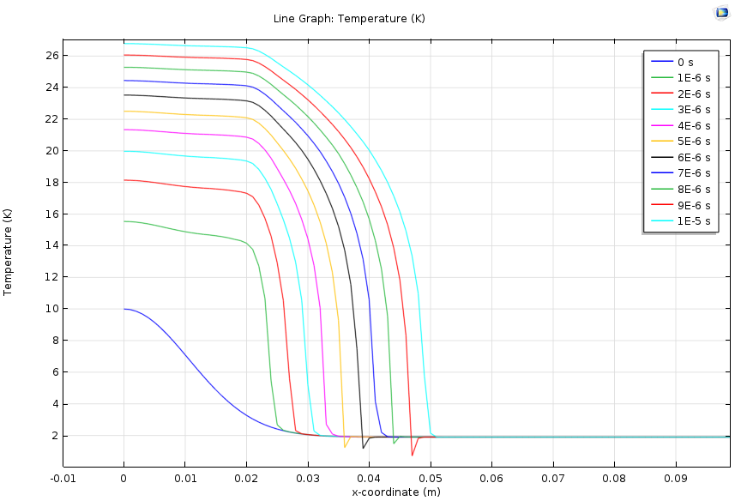
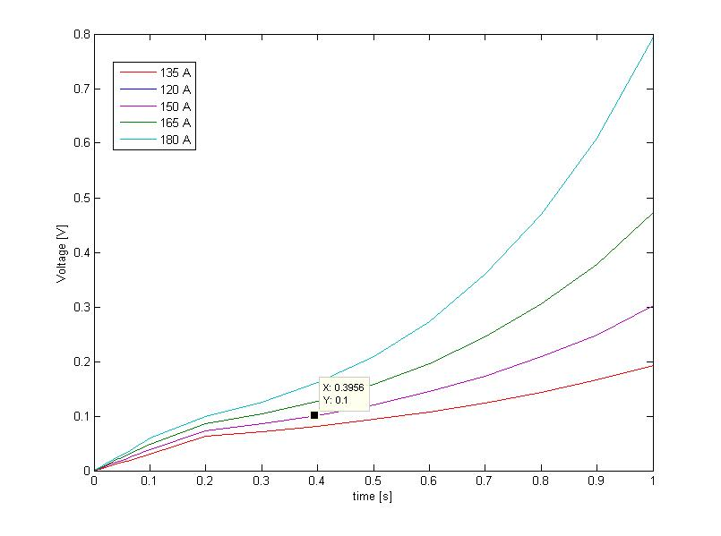
So far…
1D thermal model
Adiabatic conditions
Nb-Ti superconductor
1 m length
Operating point (B,I)
Initial temperature profile
1-D FEM for quench propagation.
V
QPS controller
and actuator.
u(t)
t
D. Paudel, "Quench Simulation of Superconducting Magnets with Commercial Multiphysics Software",
Aalto University, Espoo, 2015
Notes:
During the operation a high-energy superconducting magnet goes through the following cycle:
current ramp-up;
steady state operation, so called current plateau;
current ramp-down;
in case of a quench, it is detected and quench protection system is triggered;
current discharge.

Slide 12
What will I be doing?
6
Run circuit model to get current profile
Excite 2D FEM EM model to get operating point
Run 1D FEM Thermal model to study quench propagation
Detect and validate a quench
Trigger Fast Power Abort in the circuit
Study Magnet Transfer Functions to improve modelling of superconducting circuit
2
3
Magnets
PC filter
1-D FEM for quench propagation.
1
B, I
V
QPS controller
and actuator.
4
u(t)
Energy extraction
5
t
Notes:
During the operation a high-energy superconducting magnet goes through the following cycle:
current ramp-up;
steady state operation, so called current plateau;
current ramp-down;
in case of a quench, it is detected and quench protection system is triggered;
current discharge.

