Slide 2
Damage levels of superconducting magnet components
Status of studies and first experimental results
V. Raginel, D. Kleiven, K. Kulesz, D. Wollmann

Slide 3
Outline
Motivations and goals
Damage mechanisms and consequences
Experimental road map
Experimental Results
Next experiments

Slide 4
Motivations from HL-LHC ultra-fast failure
Ultra-fast failure < 270 us (3 LHC turns)
Studies of injection and extraction failures with HL-LHC bunch intensities show that despite beam absorber a peak energy density up to ~ 100 J/cm³ in sc. magnets can be reached. Is it safe?
What is the damage limit of sc. magnets in case of ultra-fast beam losses?
What are the damage mechanisms?

Slide 5
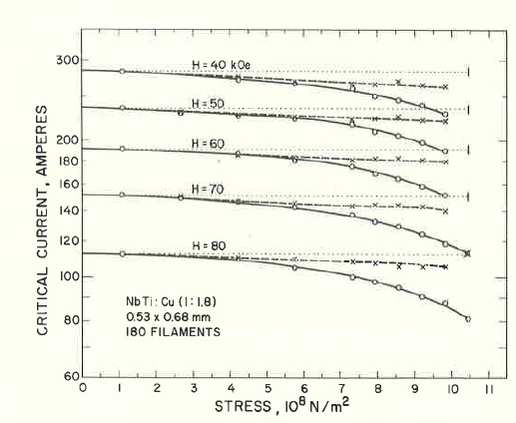
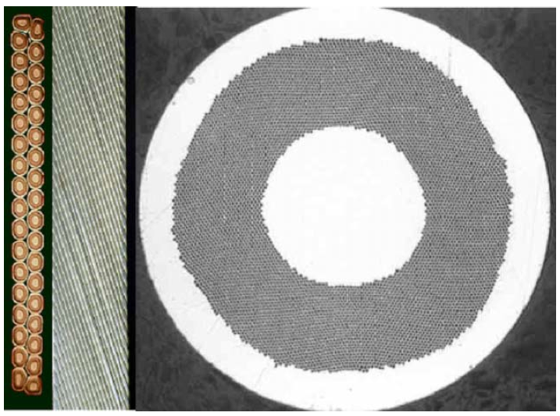
Reduction of cable I_{c} due to thermo-mechanical stress
  Beam losses → Fast heating → Mechanical stress
  Plastic deformation of Copper Matrix inducing permanent stress on the Nb-Ti filaments. Critical current (I_{c}) of Nb-Ti has a low dependency to stress.
  Nb-Ti filaments breaking leading to a reduction of the I_{c} of the sc. cable
Sc. strands
Sc. cable
Sc. Filaments
* J.W. Ekin, F.R. Fickett, A. F. Clark, Effect of Stress on the Critical Current of NbTi Multifilamentary composite wire, Proc. Int. Cryogenic Materials Conf., 1975; (1977), Adv. Cryog. Eng., 22:449
Notes:
When do we break NbTi filaments due to energy depositions?

Slide 6
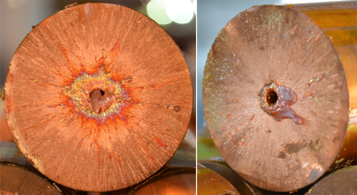
Reduction of cable I_{c} induced by temperature
Melting of copper matrix (~6 kJ/cm³).
Variation of the α-Ti precipitate size (T>400 °C for several minutes).
C. Scheuerlein
Variation of the Nb-Ti/Cu strand magnetization (ΔM) at 4.2 K in magnetic field up to 6 T after different HT’s (a) and relative flux pinning reduction vs. annealing temperature at different magnetic field (b).
Notes:
When do we break NbTi filaments due to energy depositions?

Slide 7
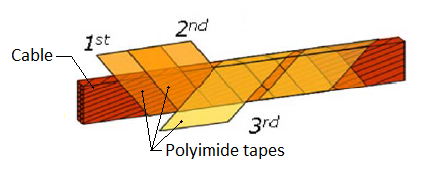
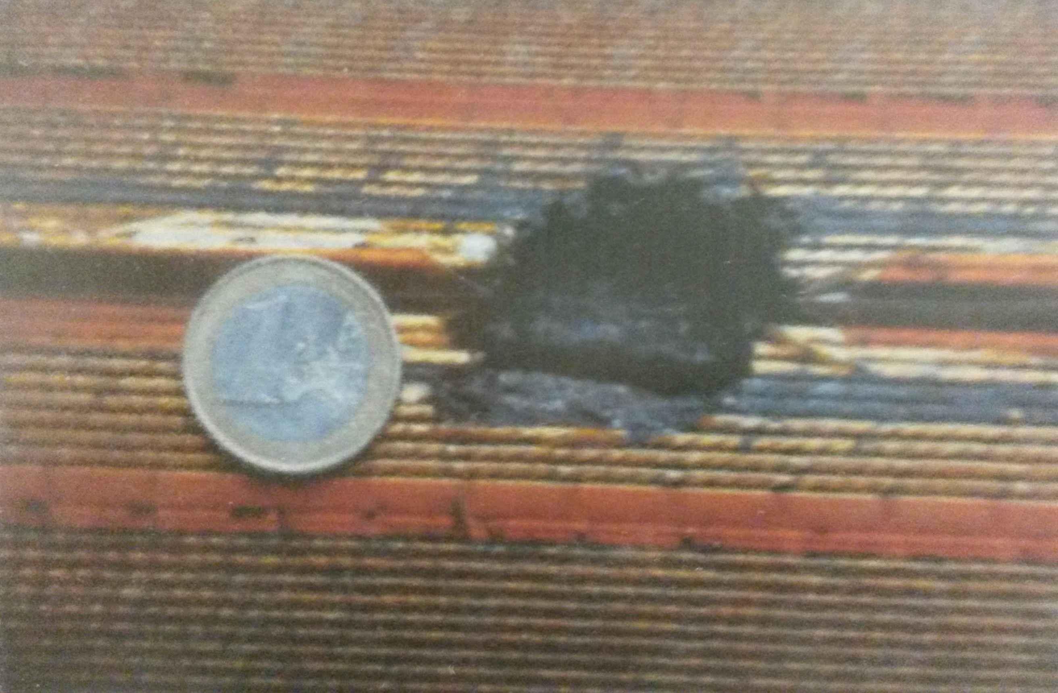
Insulation degradation due to temperature
Reduction of the dielectric strength of polyimide films for T > ~400°C
Failure modes:
  inter-turn short (fatal for magnet in case of quench)
  short to ground (prevent
  operation and require most
  probably a replacement
  of the damage magnet)
Courtesy A. Siemko
Notes:
When do we break NbTi filaments due to energy depositions?

Slide 8
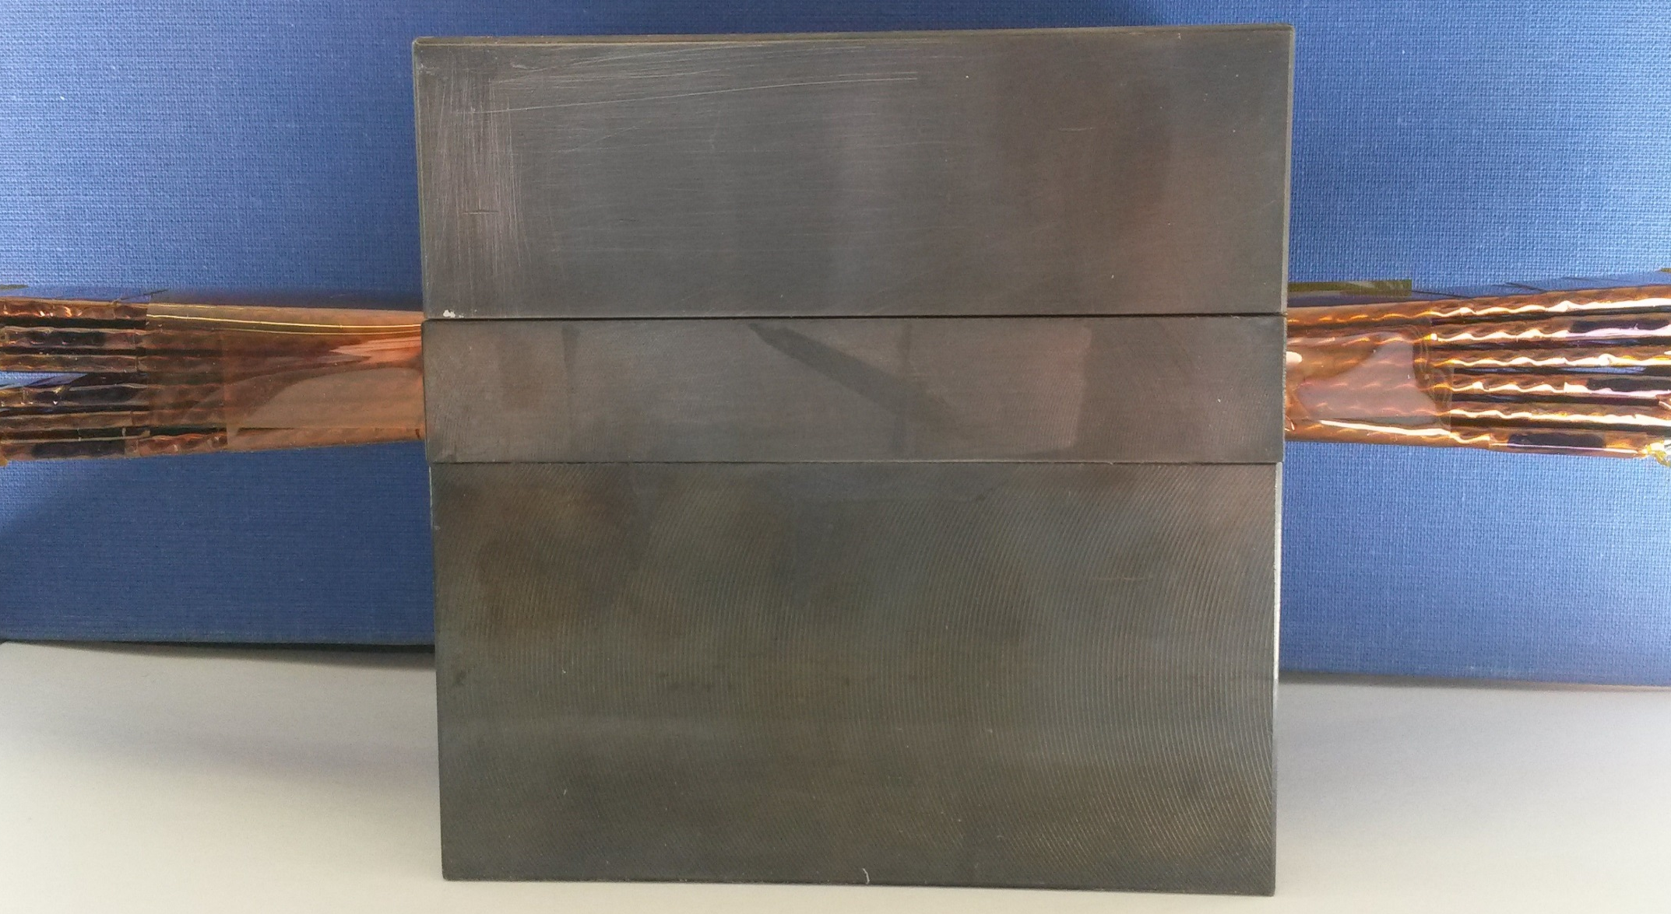
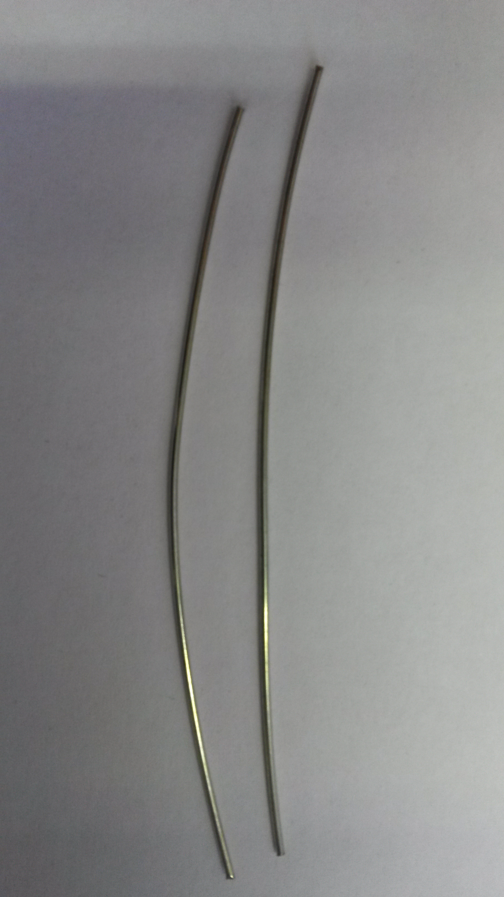
Experimental plan
Insulation degradation due to temperature
  Heat stacks of cables in furnace (hours)
  Heat insulation by a short current pulse in a heater (ms)
Sc. strand degradation due to temperature
  Heat a single strand by a current pulse and measure critical current. (ms)
  Experiments with beam (all degradation mechanisms – μs to ms)
  Expose stacks of cables and strands to a proton beam, at room temperature.
  Expose stacks of cables and coils to a proton beam at cryogenic temperatures.
25 cm
10 cm
Nb-Ti strands (1 mm ø)
Stack of 6 Nb-Ti cables

Slide 9
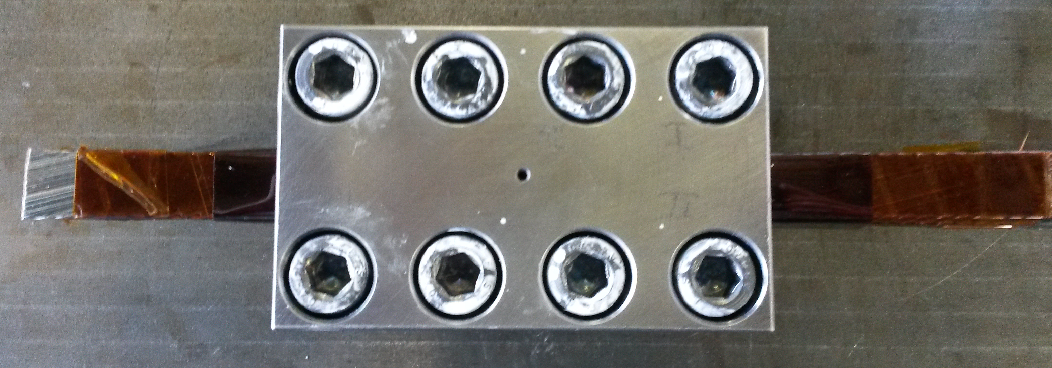
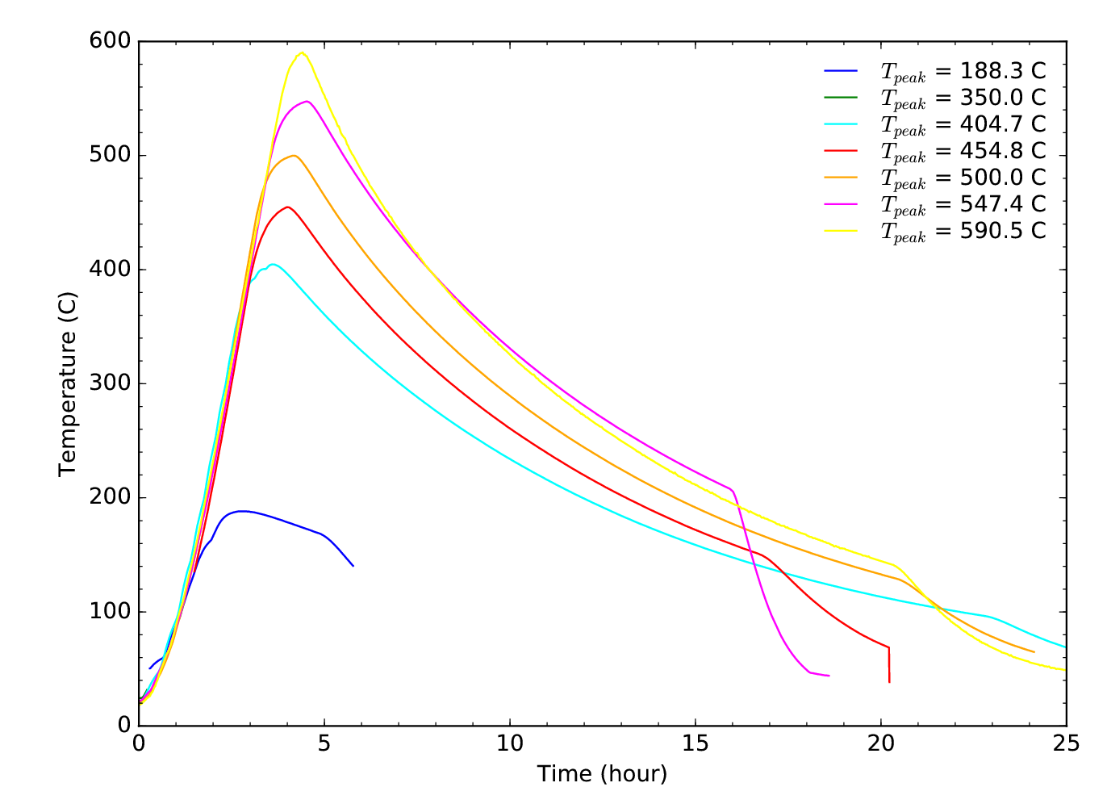
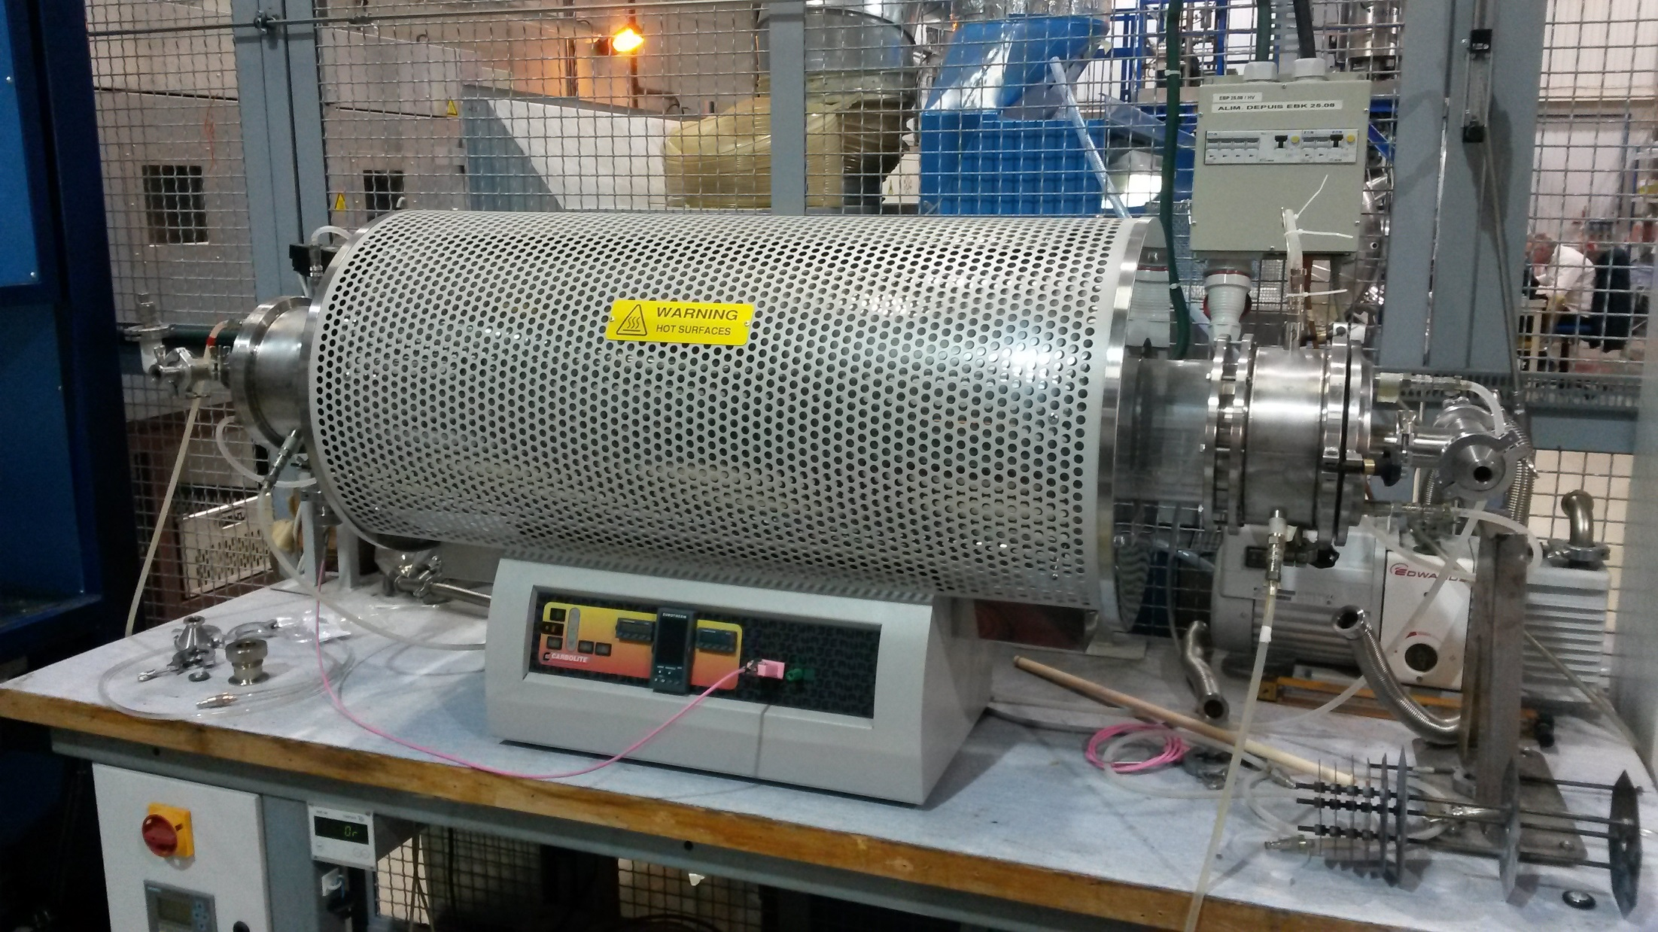
Degradation of insulation due to temperature
Cable stacks heated in furnace between 200 C and 600 C in an inert atmosphere.
Measurement of the breakthrough voltage cable to cable after heat treatment
5 hours
Temperature profiles of the cable stacks during
the heat treatment in an oven filled with Argon

Slide 10
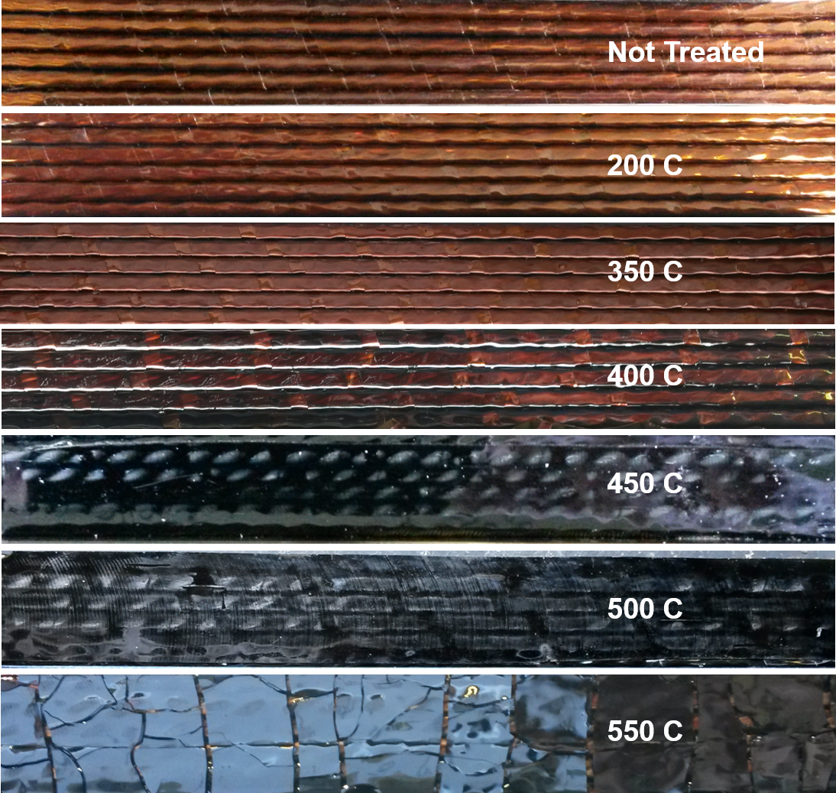
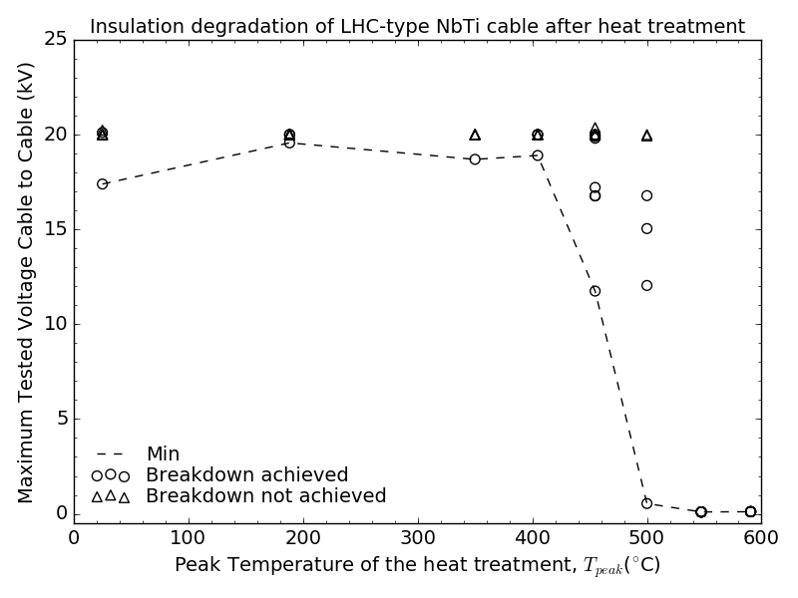
Experimental results
Significant degradation of polyimide insulation when heating > 400 C
Lowest breakthrough voltage considered as worst case scenario.
Results of the dielectric strength measurements
after heat treatments at different peak temperature
Side view of the cable stacks before and after the heat treatment with different peak temperatures

Slide 11

Correlation of dielectric strength degradation and weight loss
A model of the weight loss model has been developed:
$$\frac{dω}{dt}=k_{0} e^{−\left({E_{a}}/{RT}\right)}{\left(1−\frac{ω}{ω_{f}}\right)}^{n}ω_{f}$$
$\frac{dω}{dt}$ is the reaction rate
$ω_{f}$ is the weight loss after a full degradation,
$R$ is the ideal gas constant,
$T$ is the temperature in Kelvin
$k_{0}$, $E﷮a$ and $n$ are fitting parameters
Extrapolation from long heating time (hours) to short heating time (us, ms)
950°C heating for ms time scale is equivalent to heating at 500°C for several hours.

Slide 12
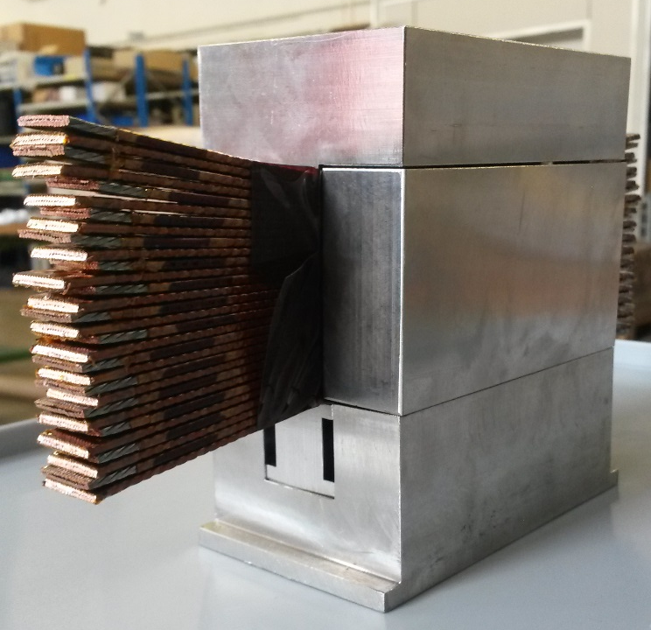
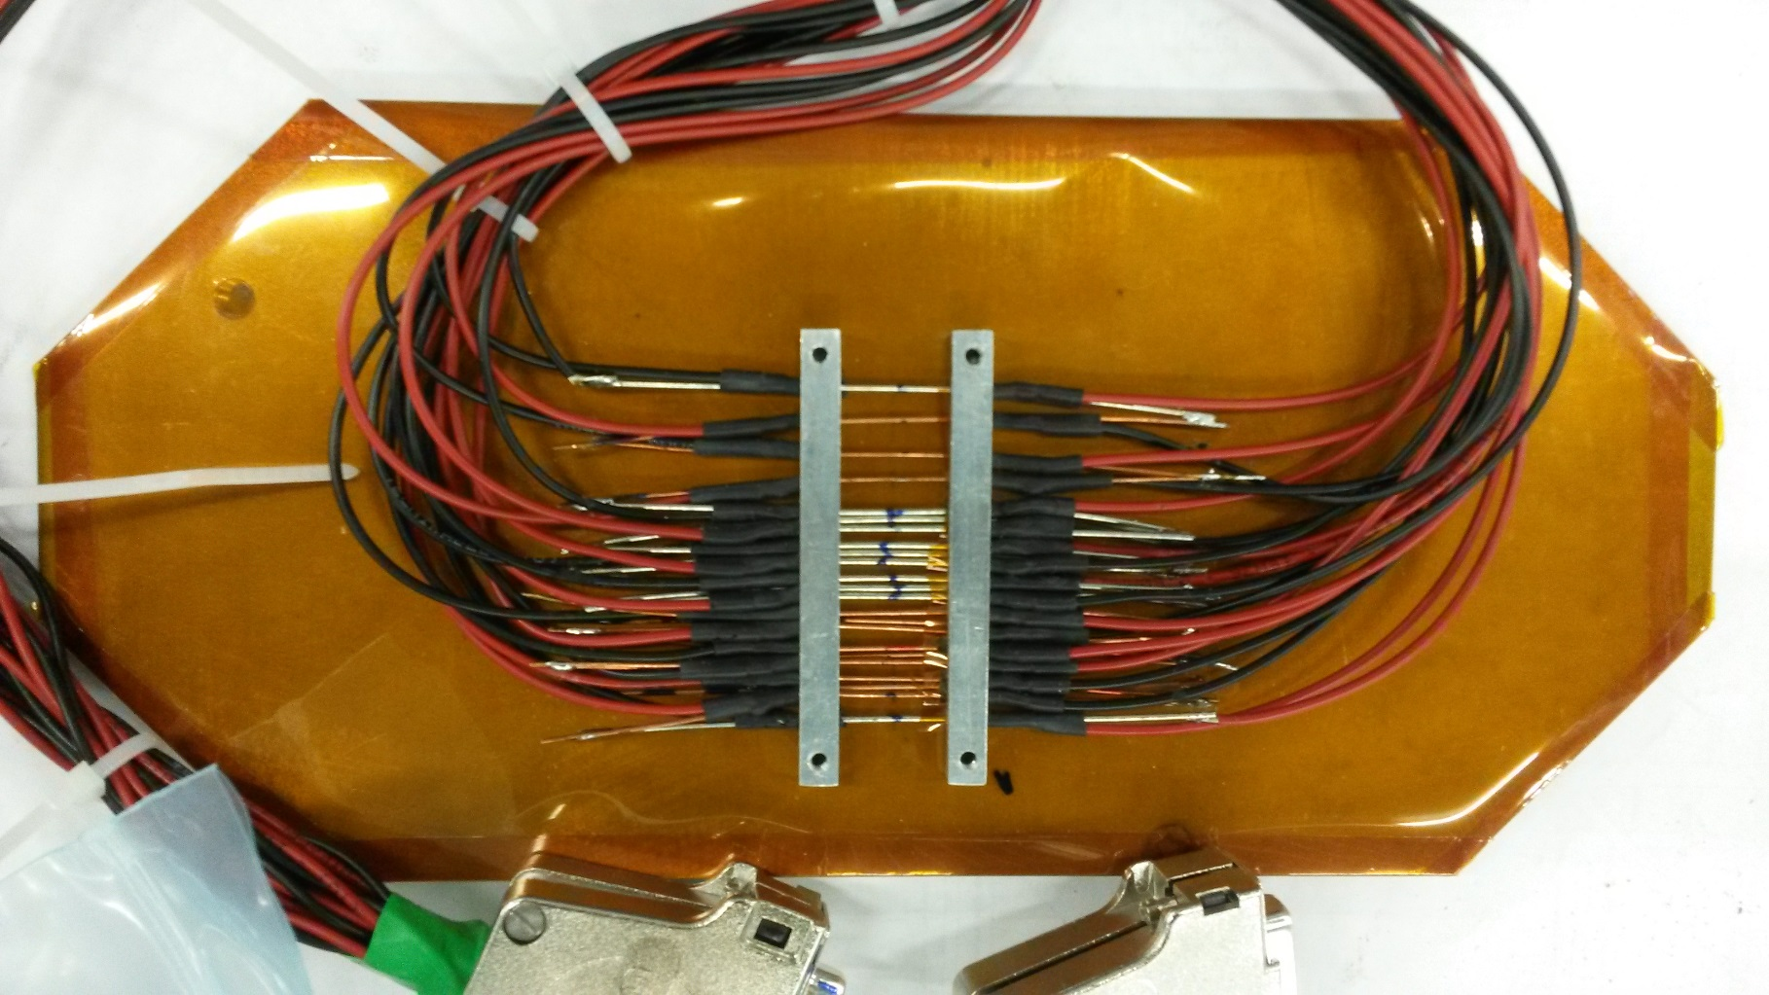
Beam experiment at room temperature
In the HiRadMat facility shooting a 440 GeV proton beam on:
  LHC Nb-Ti Cable stacks to study the degradation of the insulation
  Nb-Ti and Nb₃Sn strands to study the degradation of sc. properties
  Samples are within an inert atmosphere.
Nb-Ti & Nb3Sn strands
30 Nb-Ti cables
~ 5 cm

Slide 13
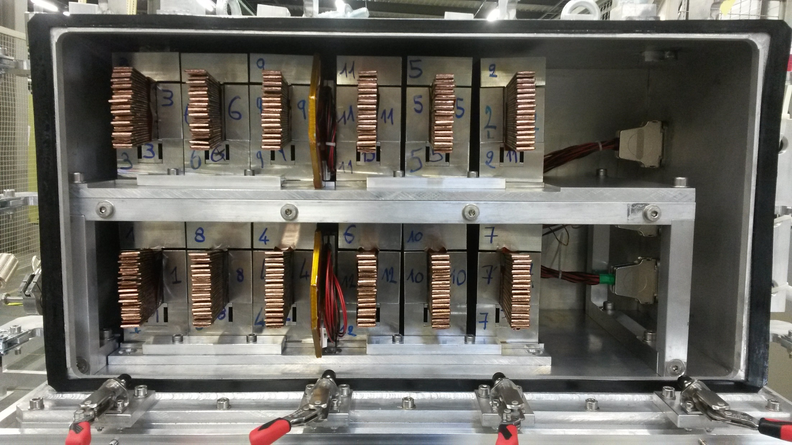
Experimental setup and peak temperatures
Beam pulse list: 6 x 6x10¹¹ protons, 6 x 1.3x10¹¹ protons, 6 x 2.6x10¹² protons
Nb-Ti cable stacks
in steels moulds
6x10¹¹ p
p+
70°C
180°C
250°C
230°C
220°C
200°C
150°C
110°C
320°C
450°C
460°C
410°C
370°C
285°C
Second Picture with the tank open
1.3x10¹¹ p
p+
800°C – Nb₃Sn
620°C - Nb₃Sn
2.6x10¹² p
p+
150°C
510°C
725°C
630°C
675°C
630°C
410°C
Nb-Ti and Nb3Sn strands fixed on a steel plate

Slide 14
Post irradiation analysis
From December 2016
High voltage tests on the cables stacks – degradation of insulation (CERN – b.112)
Magnetization measurements on the single strands – degradation of the sc. properties. (University of Geneva)

Slide 15
Conclusions
The project aims to identify critical magnet component, to understand the damage mechanisms and to measure the damage limit of superconducting magnet components.
Furnace experiment show a clear degradation of the insulation above 400°C in the hours timescale
The beam experiment at room temperature had successfully been performed.
  Peak temperature of 750°C in cable stacks and 630°C/ 800°C in the strands.
  Analysis on the results on going. Measurements on the sample to be done in the coming months.
More experiments are planned:
  Current discharge experiments to measure degradation of insulation and critical current in the ms timescale – (end 2016/beginning 2017)
  Beam experiment at 4 K with coil samples (end 2017)

Slide 16
Extra slides

Slide 17
Superconducting magnets ? Instantaneous beam impact ?
LHC Nb-Ti magnets: Main Dipoles, Quadrupoles, Correctors… but also Nb₃Sn
Instantaneous beam impact: ultra-fast beam losses in µs time (e.g. injection and extraction failure cases).
Despite efficient absorber, beam can impact sc. magnets leading to temperature rise and thermo-mechanical stresses.

Slide 18
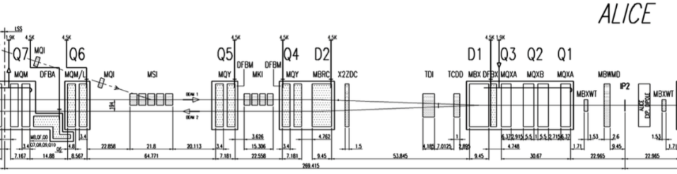
Example of failure cases - injection
Injection Kicker (MKI) kicks the circulating beam
Beam intensity : 2.2x10¹¹ p per bunch (HL-LHC
Maximum energy density ~100 J/cm³ (> 100 K – include design margins) in separation dipole (D1)
B1 (inj)
B1 (circ)
A. Lechner et all, Protection of superconducting magnets in case of accidental beam losses during HL-LHC injection, In Proceedings of IPAC15

Slide 19
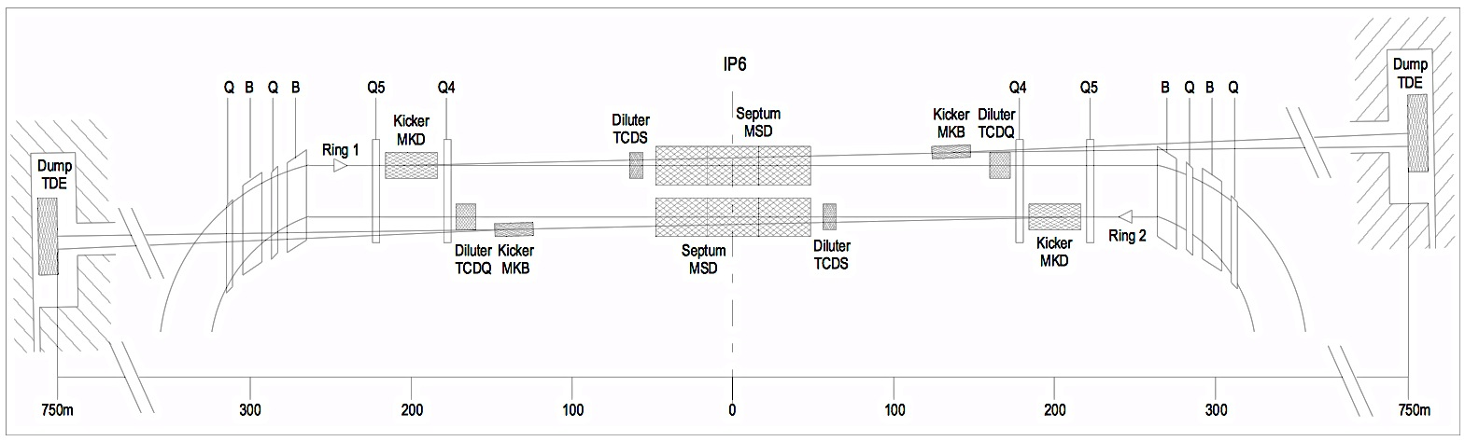
Example of failure cases – extraction
Asynchronous beam dumps
Beam intensity : 2.2x10¹¹ p per bunch (HL-LHC
Maximum energy density ~100 J/cm3 in Q5
B1
B2
B. Auchmann et all, Quench and Damage Levels for Q4 and Q5 Magnets near Point 6, CERN EDMS 1355063, 2014

Slide 20
Known limits
Courtesy A. Lechner
Lower bound
Accidental beam losses during injection in 2011.
Peak energy density in D1 coils ~ 6 J/cm³
Upper bound
Disintegration of polyimide insulation foils for T > ~400°C
Melting of copper with energy densities of 6 kJ/cm³
Beam
D1
Q3
Q2
Q1

Slide 21
Degradation of sc. properties due to temperature
- ms timescale
    Current discharge (t~ 20 ms) in sc. strands to achieve peak temperature rise from 250°C to 1000°C
    Magnetization measurement on ~18 strands (before and after discharge)
    Experiment planned for December 2016
CLIQ, 40 mF
Nb-Ti strand

Slide 22
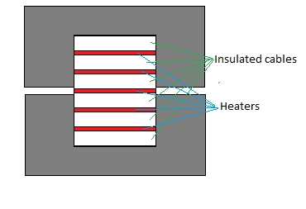
Degradation of insulation due to temperature
- ms timescale
Stack of cable with a steel strip inserted between cable.
Fast current discharge (~100 ms) in strip inducing a fast heat pulse into the insulation in inert atmosphere.
    Measure I and V during the discharge to deduce the temperature of the strip
High voltage tests after the discharge to measure the degradation of the insulation.

Slide 23
Beam experiment in cryogenic environment
Instrumentation:
Voltage tabs, temperature probes, hall probes
At the HiRadMat facility shooting a 440 GeV proton beam on cable stacks, strands and test coils.
  Cryogenic conditions (4.2K)
  On-line monitoring of the coils (electrical integrity and critical current)
Goals:
  Extend the results of the previous beam experiment to cryogenic temperature (LHC environment).
  Test on sample coils to investigate other damage mechanisms (mechanical stability, ...)
Liquid He
Cable stacks
p⁺
Test Coils
Heater
Insulation vacuum
Support Table

Slide 24
Cable stacks as pre-experiment for SextSc
The experiment at room temperature will give essential inputs to optimize the following experiment planned to be done at cryogenic temperature.
Simpler setup at room temperature.
Energy deposition in μs time scales and verification of damage models.
Optimization (number of shots and samples).
Extension to environment as in LHC (cryogenic) required.

