Slide 2
Martyna Dziadosz
Personal introduction to TE-MPE-PE section

Slide 3
AGENDA
Background
Realized projects
Prospective project

Slide 4

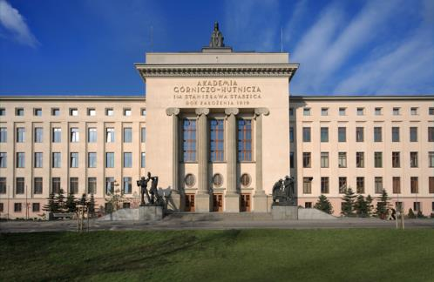
Background
From: Zwoleń, Poland
AGH University of Science and Technology in Cracow
Faculty of Physics and Applied Computer Science
1st cycle studies (Bachelor of Engineering degree):
Medical Physics
Dissertation: Project of Permanent Magnet for Magnetic Drug Targeting.

Slide 5

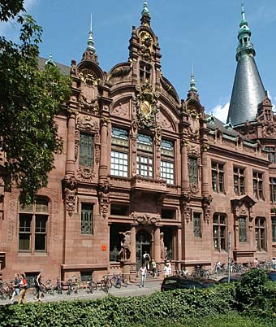
2nd cycle studies (Master degree):
Medical Physics with specialization: Imaging and Biometrics
University of Heidelberg, GERMANY
Department of Physics and Astronomy
Physics (2nd and 3rd semester) – Erasmus
Dissertation: Implementation of pseudo-continuous Arterial Spin Labeling (pCASL) Perfusion MRI with a 3D Echo Planar Readout at 3 Tesla.

Slide 6
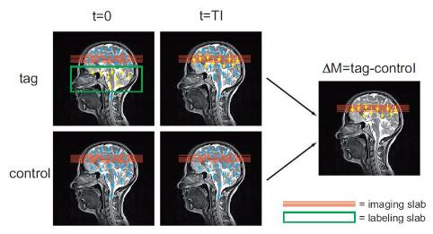




Master Thesis
Magnetic Resonance Imaging (MRI)
implementation of the non-invasive sequence to measure the human brain perfusion
development of 2 simulation
(Python & Matlab software)
parameters optimization
data evaluation:
  image post-processing
  perfusion and cerebral blood flow (CBF) estimations
  statistical assessment
$∆$M=control-tag
The general concept of Arterial Spin Labeling (ASL) utilizing a brain perfusion experiment as an example.
uninverted spin
inverted spin
An exemplary perfusion-weighted image (right-hand side) obtained by subtraction the tag image (in the middle) from the control one (right-hand side).

Slide 7
Other projects
The impact of the humidity on TLD (termoluminescent) detectors (Cracow, 2013)
Iris recognition from the image using Java software (Cracow, 2014)
Electroencephalography (EEG) experiment preparation and analysis within Matlab software (Cracow, 2015)
Grasp & Lift EEG detection using Python software and machine learning approaches. (Heidelberg, 2016)

Slide 8


Previous experience:
Institute of Nuclear Physics Polish Academy of Science, Cracow
traineeship in Magnetic Resonance Imaging (Cracow, 2014)
CERN (Conseil Européen pour la Recherche Nucléaire), Meyrin
traineeship (Meyrin, 2015)

Slide 9
TSP project
Task: The development of the analysis tools for
the UFO data.
12-month-long research under supervision of
  Rudiger Schmidt
  Laura Katharina Grob

Slide 10
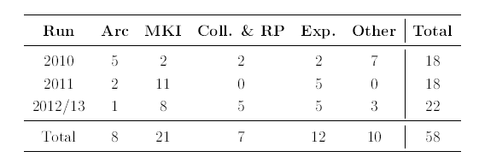
Unidentified Falling Objects (UFOs)
firstly observed in June 2010
most likely micrometer-sized dust particle, which lead to very fast beam losses caused by their interactions with the beam
Number of beam dumps due to UFOs in the arcs, at the injection kicker magnets (MKIs), at collimators and roman pots, experiments, and other locations
From Bar et al. 2013

Slide 11
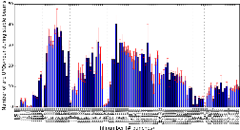
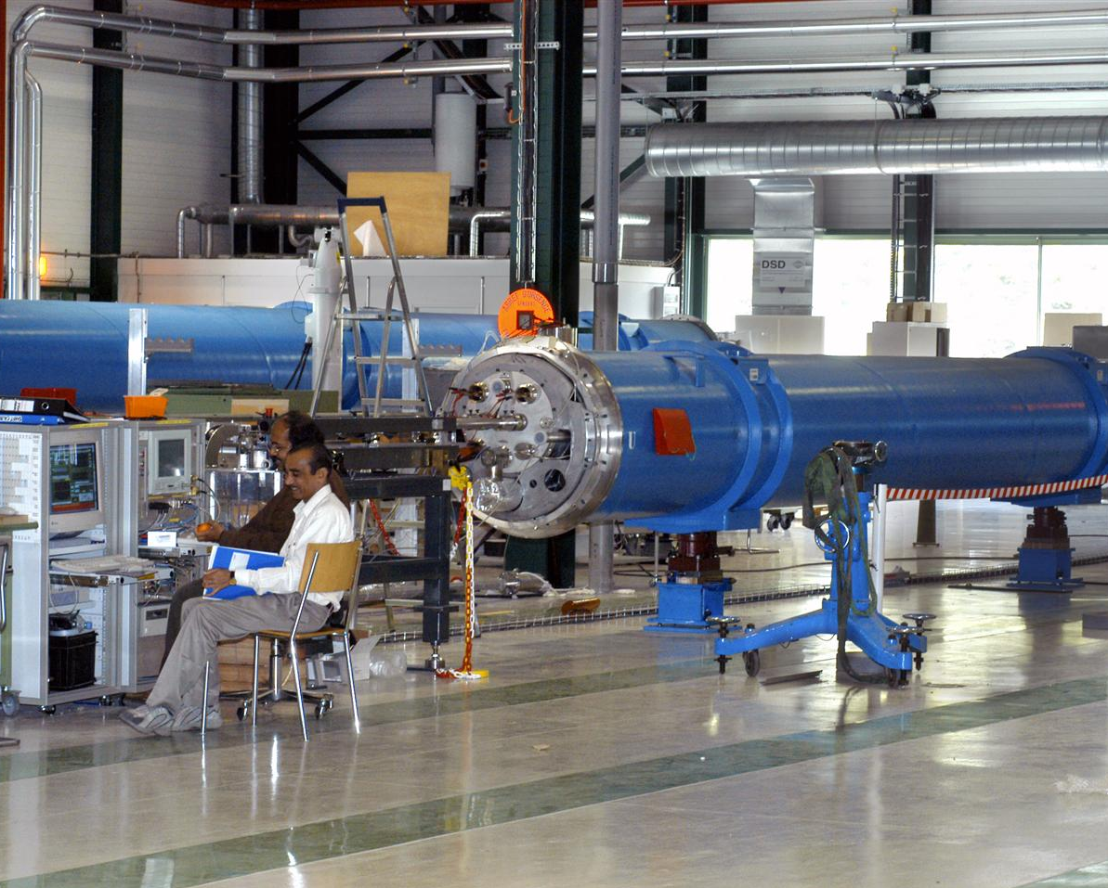




Multidirectional approach to the UFO problem
Numbers of arc UFO events per hour
Statistical
Analysis
Experimental Studies
Detection &
Analysis
Simulation &
model

Slide 12
1st step of software development
BEAM LOSS DATA
- beam loss monitors (ionization chambers)
2nd step
3rd step
- stored in .sdds files -> import to Python to make all variables
available

Slide 13
1st step
GROUPING OF SIMILAR EVENTS,
SORTING BY:
- symmetry of the Gaussian
- peak beam loss
- total beam loss
- duration (FWHM)
- exotic shapes (e.g. prolonged tails multiple UFO)
2nd step of software development
3rd step

Slide 14
1st step
STATISTICAL ANALYSIS
- correlations between beam parameters and UFO
event (e.g. shape, elastic losses near collimators)
! additional idea: use machine learning to automates the data
analysis
2nd step
3rd step of software development

Slide 15
www.cern.ch

Slide 16
Motivation for TSP
opportunity to work in the largest research centre for fundamental physics in the world
possibility to gain and expand knowledge, skills in programming and machine learning for the LHC machine protection problems
broadening horizons
international interdisciplinary research group

