Slide 1



FCC protection studies within the EuroCirCol project
Marco Prioli, L. Bortot, M. Maciejewski, A. Fernandez
B. Auchmann, A. Verweij
CERN, TE-MPE

Slide 2
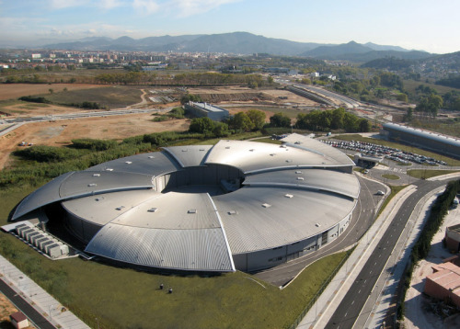
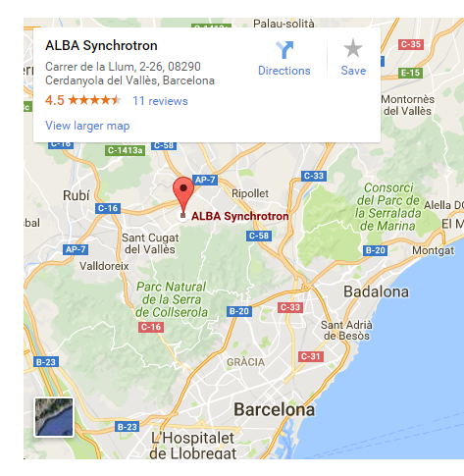
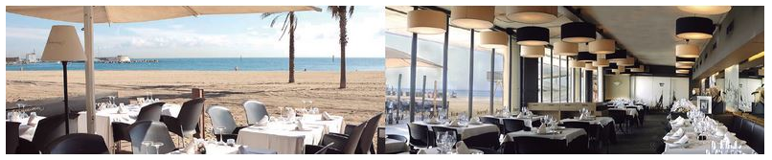
EuroCirCol workshop 2016
7-9 November 2016, ALBA Synchrotron
Link to the EuroCirCol web page

Slide 3
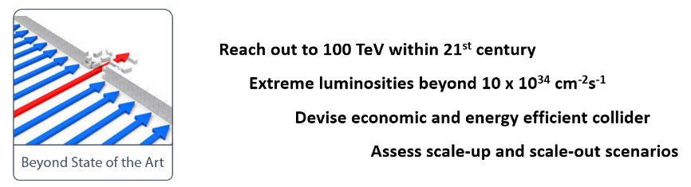
EuroCirCol project
WP1: management and coordination (M. Benedikt, CERN)
WP2: arc design (A. Chance, CEA)
WP3: experimental insertion region design (A. Seryi, UOXF)
WP4: cryogenic beam vacuum system (P. Francis, ALBA)
WP5: high-field accelerator magnet design (D. Tommasini, CERN)
  5.6: Devise quench protection concept (TUT, INFN, CERN)
Link to the EuroCirCol web page

Slide 4
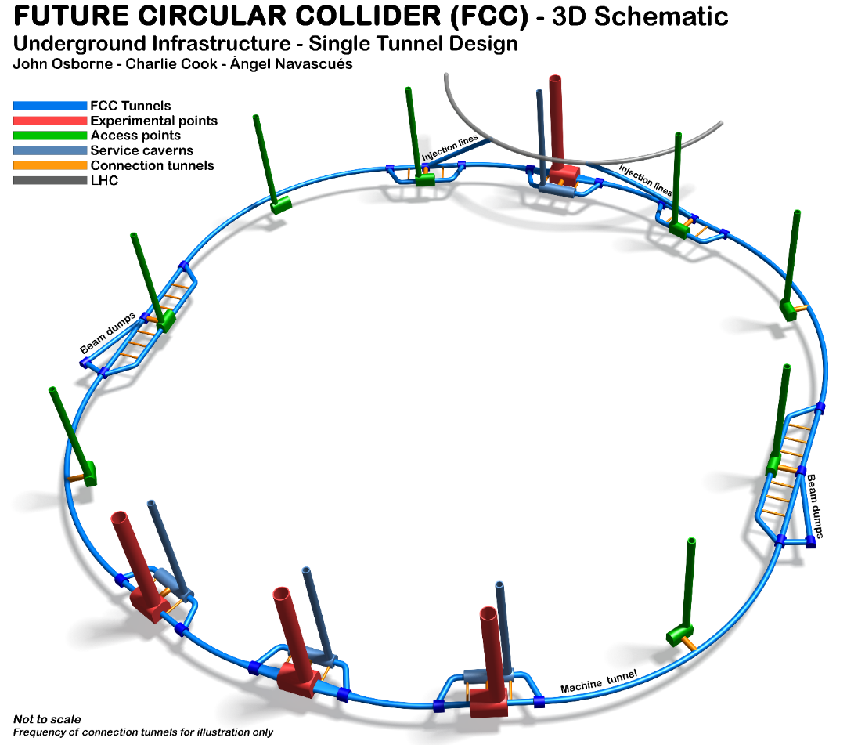
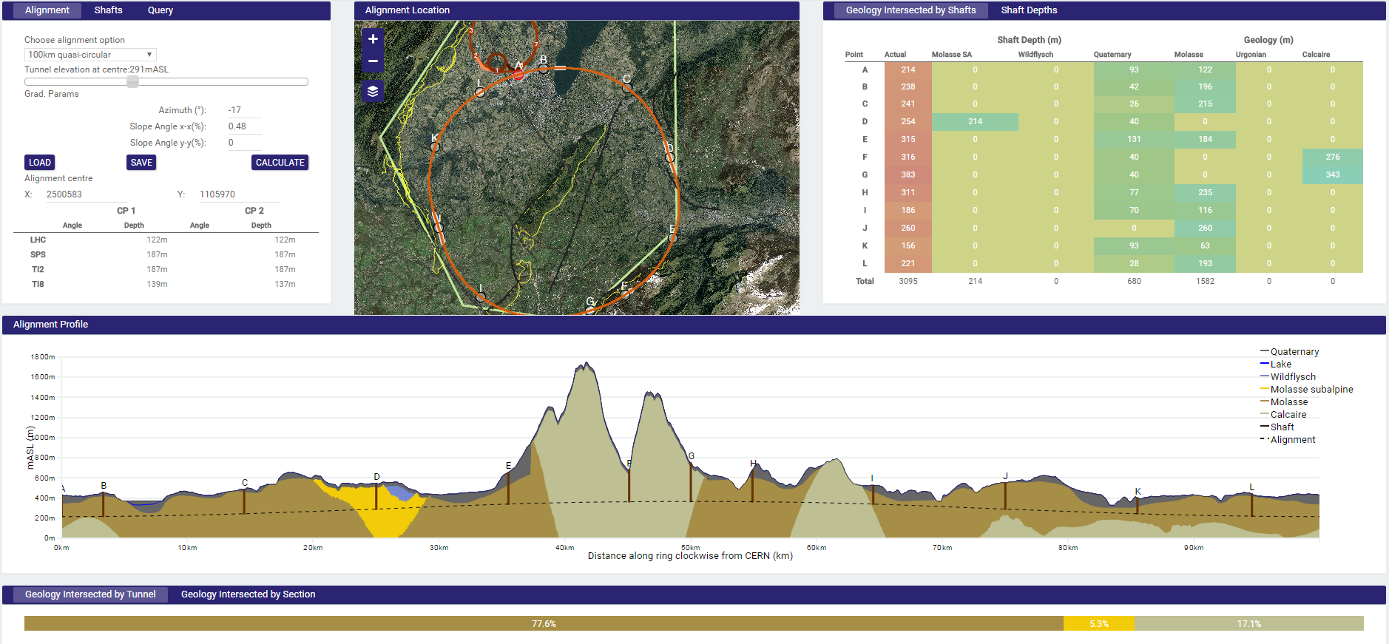
The FCC layout
Half arc (L=8km)
From C. Cook, FCC week 2016 (link)

Slide 5

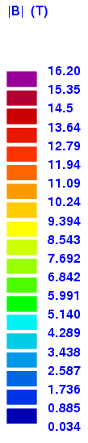
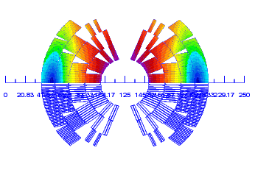
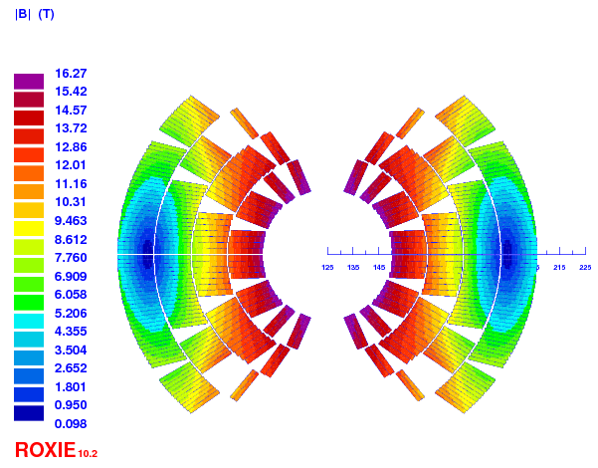
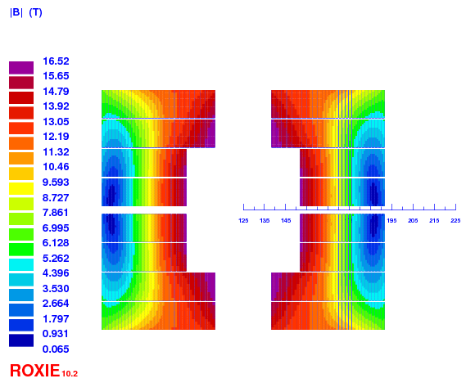
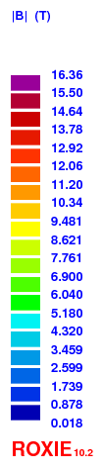
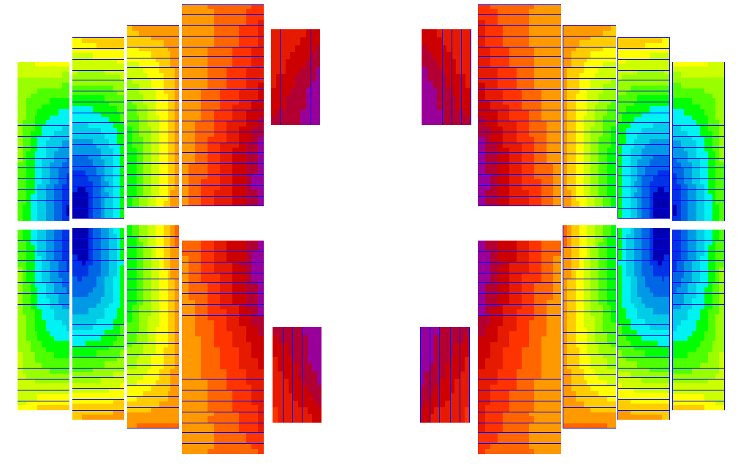

Dipole magnet designs
Cos-theta 18% LL, 4.2K
Block coil 18% LL, 4.2K
Common coil 18% LL, 4.2K
Cos-theta 14% LL, 1.9K
Block coil 14% LL, 1.9K
Common coil 14% LL, 1.9K

Slide 6
Effect of load line margin and temperature
LL margin, 1.9K
LL margin, 4.2K

Slide 7
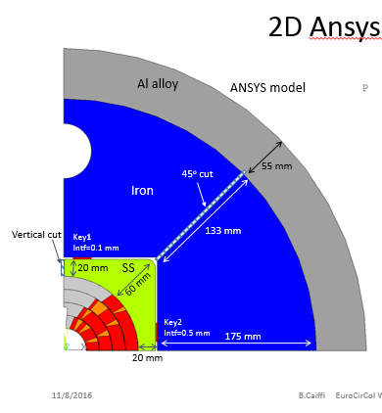
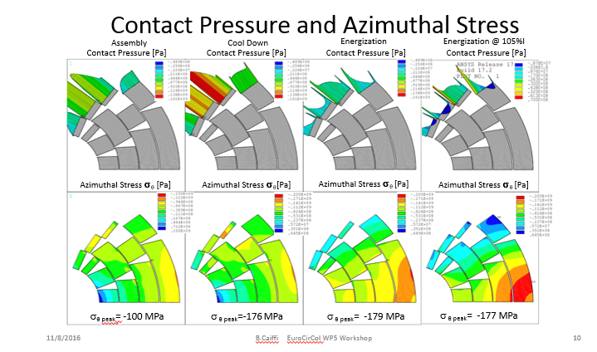
Main achievements: cos-theta
Bladder & key configuration
Rectangular steel pad, cut vertically, 20-60 mm thick.
Circular iron yoke, cut at 45º, 133-175 mm thick.
Rectangular shaped steel pad and horizontal and vertical keys allow to decouple x and y component of pre-stress.
Courtesy of Barbara Caiffi. Link to the presentations

Slide 8
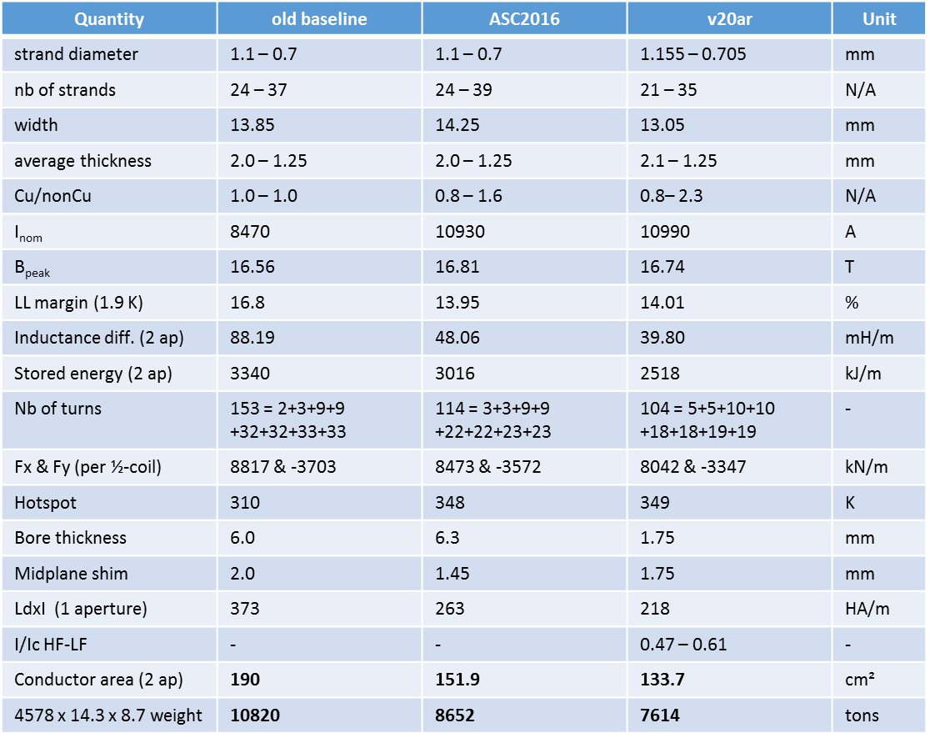
Main achievements: block coil
= v20ar
margin drop
bore tip decrease
Courtesy of Clement Lorin. Link to the presentations

Slide 9
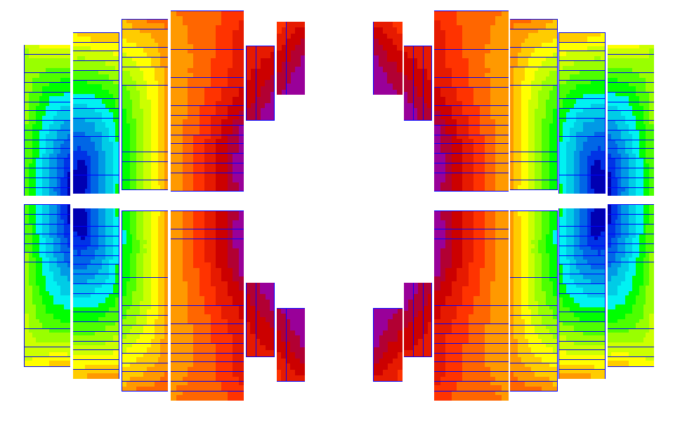
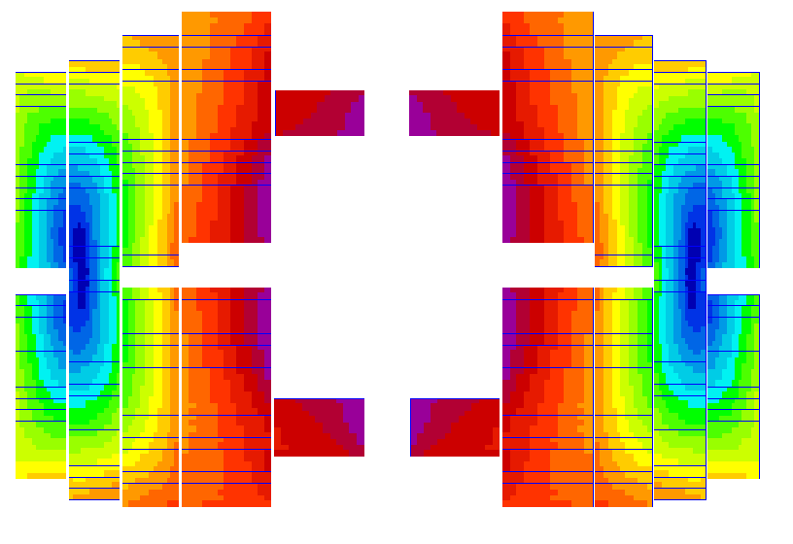
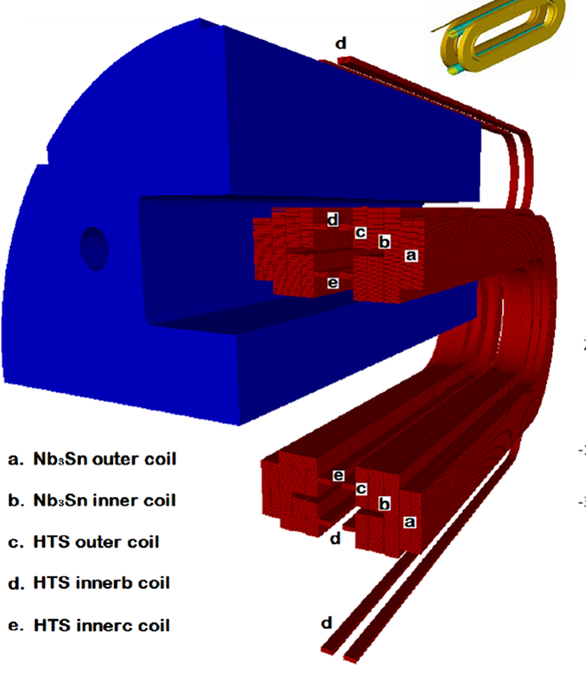
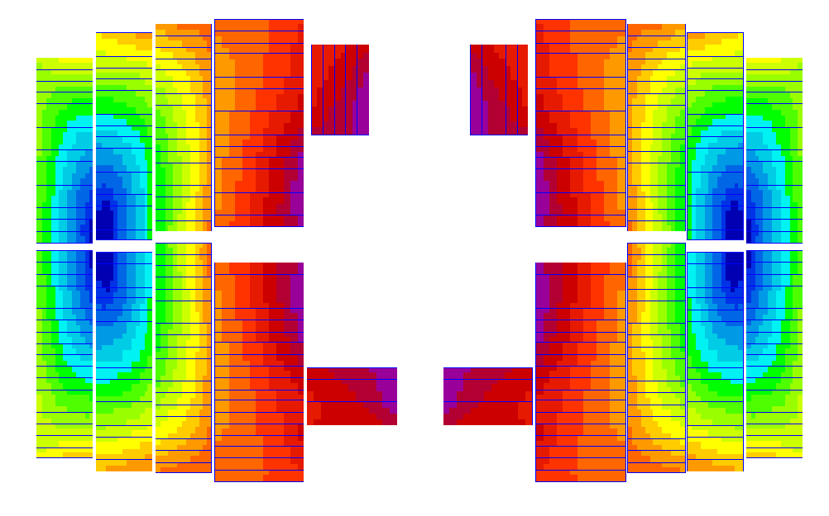
Main achievements: common coil
We have studied different configurations of the ancillary coils.
Courtesy of Fernando Toral. Link to the presentations

Slide 10
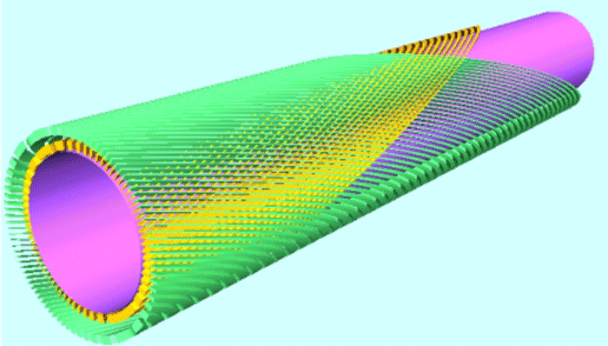
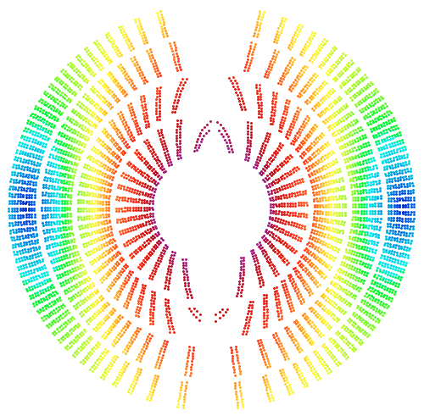
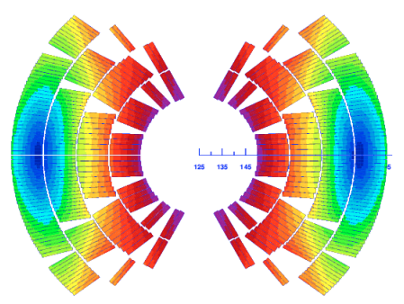
Main achievements: canted cos-theta
Cos-theta can pack more x-section “turns” on the innermost layer.
CCT has to use higher currents to achieve similar ampere-turns.
CCT outer-layer conductor length grows with radial position.
CCT tilted-helix winding increases SC use by ~10%.
CCT has larger stored energy → needs more copper.
  Note the field pattern. CT field lines more compact → lower energy.
  Roughly same peak fields.
Rendering taken from Berkeley Lab
Courtesy of Bernhard Auchmann. Link to the presentations

Slide 11

Magnet protection
Circuit protection aspects
  Circuit protection @ FCC week 2016
  Circuit layouts for the latest magnet designs
The STEAM project
  New perspectives for circuit and quench simulations
  Main STEAM features
  First results of CLIQ simulations
Simulation of Transient Effects in Accelerator Magnets

Slide 12
Magnet protection
Circuit protection aspects
  Circuit protection @ FCC week 2016
  Circuit layouts for the latest magnet designs
The STEAM project
  New perspectives for circuit and quench simulations
  Main STEAM features
  First results of CLIQ simulations
  Simulation of Transient Effects in Accelerator Magnets

Slide 13
Circuit protection @ FCC week 2016*
Definition of the FCC powering sector (PS)
LHC
PS 1
FCC
PS 1
PC 1
PC 1
PS 2
Sector 1
3km
HalfArc 1
8km
Description | LHC PS | FCC PS | FCC MiniArc | Units
Powering sector (PS) length | 3000 | 4000 | 3200 | [m]
Number of PS in the accelerator | 8 | 16 | 4 | -
Filling factor | 74% | 77% | 77% | -
Number of dipole magnets per PS | 154 | 215 | 172 | -
Inductance per PS | 15 | 272 | 218 | [H]
Stored energy per PS | 1 | 10 | 8 | [GJ]
PC 2
20 PS in total
*Concepts for magnet circuit powering and protection (M. Prioli)
(Link)

Slide 14
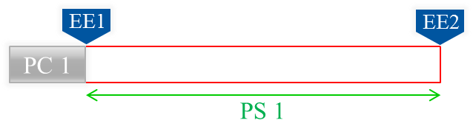
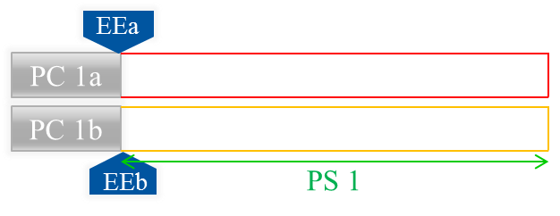
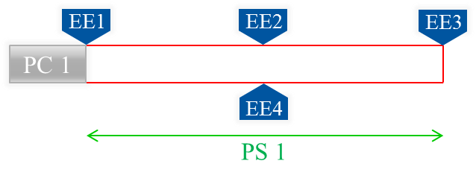
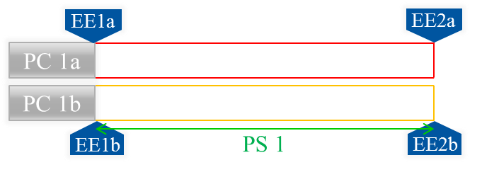
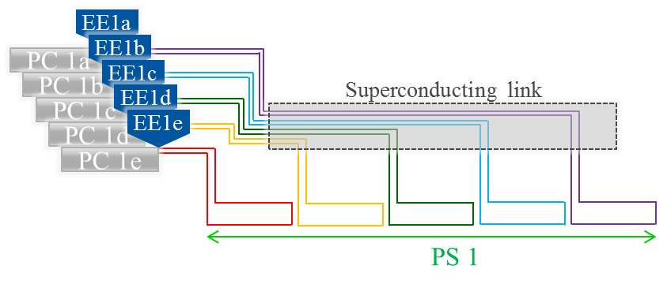



Circuit protection @ FCC week 2016*
A
B
C
D
Option | τ_{discharge} | Energy | EE position | Circuit complexity
A
B
C
D
E
Example for N=5
E
*Concepts for magnet circuit powering and protection (M. Prioli)
(Link)

Slide 15
Circuit protection @ FCC week 2016*
A string of magnets can always be protected, for any magnet design and given constraints, by adapting the number of circuits, so by subdividing a powering sector in multiple circuits
Magnets can be compared analysing the resulting circuit complexity
  Number of circuits N in one Powering Sector (PS)
  20N circuits for the entire machine
Example for N=5
*Comparison of magnet designs from a circuit protection point of view (A. Verweij)
(Link)

Slide 16
New magnets parameters
 | Load line margin | Current @ B_{nom} [kA] | Differential inductance (2 apertures) [mH] | Stored energy @ I_{nom} (2 apertures) [MJ]
Cos-theta 28b38 v.5 | 18% | 10.275 | 734 | 39
Cos-theta v22b | 14% | 11.23 | 566 | 38
Block coil v26cmag | 18% | 8.47 | 1265 | 45
Block coil v20ar | 14% | 10.99 | 571 | 36
Common coil v1h_intgrad | 18% | 9.025 | 1824 | 74
Common coil v1h2_1ac1 | 14% | 16.80 | 287 | 43
Canted cos-theta | 14% | 18 | 254 | 44
Cos-theta v22b
Block coil v20ar
Common coil v1h2_1ac1

Slide 17
Circuits layouts for Cos-theta 18% LL*
N. of circuits per PS | 1 | 2 | 3 | 4 | 6 | 8
N. of circuits entire FCC | 20 | 40 | 60 | 80 | 120 | 160
Magnets per circuit | 215 | 108 | 72 | 54 | 36 | 27
Inductance per circuit [H] | 158 | 79 | 53 | 39 | 26 | 20
Stored energy per circuit [GJ] (<1.6) (>3) | 8.3 | 4.2 | 2.8 | 2.1 | 1.4 | 1.0
Ramp time [min] | 20 | 20 | 20 | 20 | 20 | 20
V_{PC} [V] (<500) (>1000) | 1352 | 676 | 451 | 338 | 225 | 169
V_{FPA,max} [kV] | 1.0 | 1.0 | 1.0 | 1.0 | 1.0 | 1.0
V_{FPA,max,fault} [kV] | 3.3 | 2.6 | 2.4 | 2.3 | 2.2 | 2.2
τ_{circ} [s] (<150) (>250) | 811 | 406 | 270 | 203 | 135 | 101
MIITS [A²s]*10⁹ (<10) (>20) | 43 | 21 | 14 | 11 | 7 | 5
A_{busbar} [mm²], ΔT=300K | 550 | 390 | 310 | 270 | 220 | 190
*Comparison of magnet designs from a circuit protection point of view (A. Verweij)
(Link)

Slide 18
Circuits layouts for Cos-theta 14% LL
N. of circuits per PS | 1 | 2 | 3 | 4 | 6 | 8
N. of circuits entire FCC | 20 | 40 | 60 | 80 | 120 | 160
Magnets per circuit | 215 | 108 | 72 | 54 | 36 | 27
Inductance per circuit [H] | 122 | 61 | 41 | 30 | 20 | 15
Stored energy per circuit [GJ] (<1.6) (>3) | 8.1 | 4.1 | 2.7 | 2.0 | 1.4 | 1.0
Ramp time [min] | 20 | 20 | 20 | 20 | 20 | 20
V_{PC} [V] (<500) (>1000) | 1139 | 570 | 380 | 285 | 190 | 142
V_{FPA,max} [kV] | 1.0 | 1.0 | 1.0 | 1.0 | 1.0 | 1.0
V_{FPA,max,fault} [kV] | 3.3 | 2.6 | 2.4 | 2.3 | 2.2 | 2.2
τ_{circ} [s] (<150) (>250) | 684 | 342 | 228 | 171 | 114 | 85
MIITS [A²s]*10⁹ (<10) (>20) | 43 | 22 | 14 | 10 | 7 | 5
A_{busbar} [mm²], ΔT=300K | 550 | 390 | 320 | 270 | 220 | 190

Slide 19
Circuits layouts for Block coil 18% LL*
N. of circuits per PS | 1 | 2 | 3 | 4 | 6 | 8
N. of circuits entire FCC | 20 | 40 | 60 | 80 | 120 | 160
Magnets per circuit | 215 | 108 | 72 | 54 | 36 | 27
Inductance per circuit [H] | 272 | 136 | 91 | 68 | 45 | 34
Stored energy per circuit [GJ] (<1.6) (>3) | 9.7 | 4.9 | 3.2 | 2.4 | 1.6 | 1.2
Ramp time [min] | 20 | 20 | 20 | 20 | 20 | 20
V_{PC} [V] (<500) (>1000) | 1920 | 960 | 640 | 480 | 320 | 240
V_{FPA,max} [kV] | 1.0 | 1.0 | 1.0 | 1.0 | 1.0 | 1.0
V_{FPA,max,fault} [kV] | 3.3 | 2.6 | 2.4 | 2.3 | 2.2 | 2.2
τ_{circ} [s] (<150) (>250) | 1152 | 576 | 384 | 288 | 192 | 144
MIITS [A²s]*10⁹ (<10) (>20) | 41 | 21 | 14 | 10 | 7 | 5
A_{busbar} [mm²], ΔT=300K | 540 | 380 | 310 | 270 | 220 | 190
*Comparison of magnet designs from a circuit protection point of view (A. Verweij)
(Link)

Slide 20
Circuits layouts for Block coil 14% LL
N. of circuits per PS | 1 | 2 | 3 | 4 | 6 | 8
N. of circuits entire FCC | 20 | 40 | 60 | 80 | 120 | 160
Magnets per circuit | 215 | 108 | 72 | 54 | 36 | 27
Inductance per circuit [H] | 123 | 61 | 41 | 31 | 20 | 15
Stored energy per circuit [GJ] (<1.6) (>3) | 7.8 | 3.9 | 2.6 | 1.9 | 1.3 | 1.0
Ramp time [min] | 20 | 20 | 20 | 20 | 20 | 20
V_{PC} [V] (<500) (>1000) | 1124 | 562 | 375 | 281 | 187 | 141
V_{FPA,max} [kV] | 1.0 | 1.0 | 1.0 | 1.0 | 1.0 | 1.0
V_{FPA,max,fault} [kV] | 3.3 | 2.6 | 2.4 | 2.3 | 2.2 | 2.2
τ_{circ} [s] (<150) (>250) | 674 | 337 | 225 | 169 | 112 | 84
MIITS [A²s]*10⁹ (<10) (>20) | 41 | 20 | 14 | 10 | 7 | 5
A_{busbar} [mm²], ΔT=300K | 540 | 380 | 310 | 270 | 220 | 190

Slide 21
Circuits layouts for Common c. 18% LL*
N. of circuits per PS | 1 | 2 | 3 | 4 | 6 | 8
N. of circuits entire FCC | 20 | 40 | 60 | 80 | 120 | 160
Magnets per circuit | 215 | 108 | 72 | 54 | 36 | 27
Inductance per circuit [H] | 392 | 196 | 131 | 98 | 65 | 49
Stored energy per circuit [GJ] (<1.6) (>3) | 16.0 | 8.0 | 5.3 | 4.0 | 2.7 | 2.0
Ramp time [min] | 20 | 20 | 20 | 20 | 20 | 20
V_{PC} [V] (<500) (>1000) | 2952 | 1476 | 984 | 738 | 492 | 369
V_{FPA,max} [kV] | 1.0 | 1.0 | 1.0 | 1.0 | 1.0 | 1.0
V_{FPA,max,fault} [kV] | 3.3 | 2.6 | 2.4 | 2.3 | 2.2 | 2.2
τ_{circ} [s] (<150) (>250) | 1771 | 886 | 590 | 443 | 295 | 221
MIITS [A²s]*10⁹ (<10) (>20) | 72 | 36 | 24 | 18 | 12 | 9
A_{busbar} [mm²], ΔT=300K | 710 | 500 | 410 | 360 | 290 | 250
*Comparison of magnet designs from a circuit protection point of view (A. Verweij)
(Link)

Slide 22
Circuits layouts for Common c. 14% LL
N. of circuits per PS | 1 | 2 | 3 | 4 | 6 | 8
N. of circuits entire FCC | 20 | 40 | 60 | 80 | 120 | 160
Magnets per circuit | 215 | 108 | 72 | 54 | 36 | 27
Inductance per circuit [H] | 62 | 31 | 21 | 15 | 10 | 8
Stored energy per circuit [GJ] (<1.6) (>3) | 9.2 | 4.6 | 3.1 | 2.3 | 1.5 | 1.1
Ramp time [min] | 20 | 20 | 20 | 20 | 20 | 20
V_{PC} [V] (<500) (>1000) | 863 | 432 | 288 | 216 | 144 | 108
V_{FPA,max} [kV] | 1.0 | 1.0 | 1.0 | 1.0 | 1.0 | 1.0
V_{FPA,max,fault} [kV] | 3.3 | 2.6 | 2.4 | 2.3 | 2.2 | 2.2
τ_{circ} [s] (<150) (>250) | 518 | 259 | 173 | 130 | 86 | 65
MIITS [A²s]*10⁹ (<10) (>20) | 73 | 37 | 24 | 18 | 12 | 9
A_{busbar} [mm²], ΔT=300K | 720 | 510 | 410 | 360 | 290 | 250

Slide 23
Circuits layouts for CCT 14% LL
N. of circuits per PS | 1 | 2 | 3 | 4 | 6 | 8
N. of circuits entire FCC | 20 | 40 | 60 | 80 | 120 | 160
Magnets per circuit | 215 | 108 | 72 | 54 | 36 | 27
Inductance per circuit [H] | 55 | 27 | 18 | 14 | 9 | 7
Stored energy per circuit [GJ] (<1.6) (>3) | 9.6 | 4.8 | 3.2 | 2.4 | 1.6 | 1.2
Ramp time [min] | 20 | 20 | 20 | 20 | 20 | 20
V_{PC} [V] (<500) (>1000) | 819 | 409 | 273 | 205 | 136 | 102
V_{FPA,max} [kV] | 1.0 | 1.0 | 1.0 | 1.0 | 1.0 | 1.0
V_{FPA,max,fault} [kV] | 3.3 | 2.6 | 2.4 | 2.3 | 2.2 | 2.2
τ_{circ} [s] (<150) (>250) | 491 | 246 | 164 | 123 | 82 | 61
MIITS [A²s]*10⁹ (<10) (>20) | 80 | 40 | 27 | 20 | 13 | 10
A_{busbar} [mm²], ΔT=300K | 750 | 530 | 430 | 370 | 300 | 260

Slide 24



Circuit protection aspects: conclusions
For all magnet designs:
  Reduction in the circuit complexity
  The layout with 6 circuits per powering sector fulfils the largest number of constraints
 | Cos-theta | Block coil | Common coil | Canted cos-theta
Circuit complexity
Circuit energy
Ramp-up, V_{PC}
FPA, τ_{circ}
FPA, MIITS

Slide 25
Magnet protection
Circuit protection aspects
  Circuit protection @ FCC week 2016
  Circuit layouts for the latest magnet designs
The STEAM project
  New perspectives for circuit and quench simulations
  Main STEAM features
  First results of CLIQ simulations
  Simulation of Transient Effects in Accelerator Magnets

Slide 26
Outlook for circuit and quench simulations
L_{filt}
M₁
M₂
M₁₈
C_{filt}
PC
R_{EE}
R_{filt}
M₃₆
M₃₅
M_{n}
M₁₉
Example: magnets powered with N_{circuits per PS} = 6
CLIQ
To understand if this proposal is feasible, circuit simulations are needed
  Quenching magnet
  CLIQ protection system
  Lumped element model of the other magnets in the chain
  Other components (e.g. Power Converter (PC), nonlinear switches)
  … Quench protection system, controller of Power Converter
CLIQ introduces a coupling between circuit and quench simulations

Slide 27

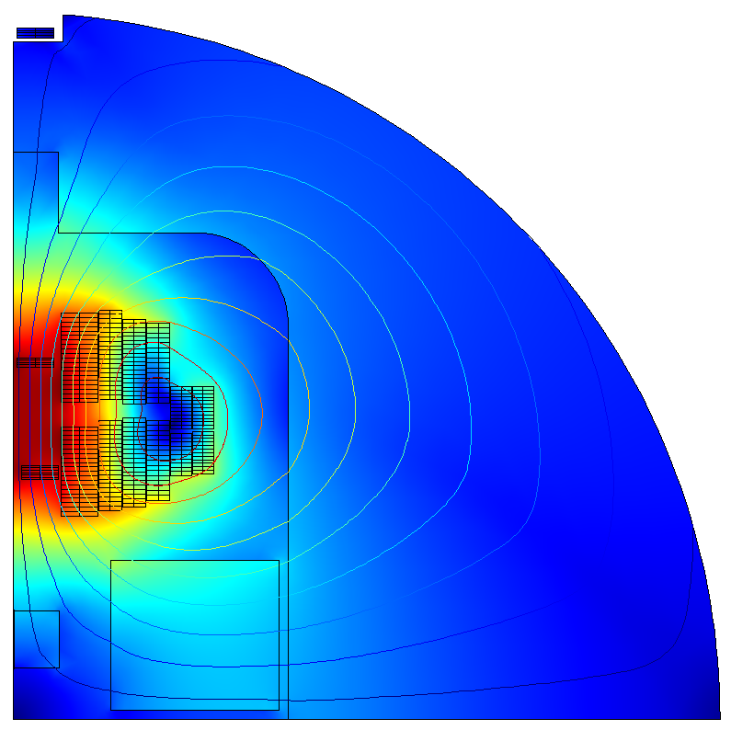
Field-circuit coupling
Circuit model
L_{filt}
Cadence PSpice
C_{CLIQ}
C_{filt}
M₁
M₂
M_{n}
M₁₈
PC
R_{EE}
R_{filt}
M
M₃₆
M₃₅
M₁₉
L₁
ΔU₁
R₁
L₂
ΔU₂
R₂
φ, R
2D Electro-thermal
Field model
I

Slide 28
Field-circuit coupling
Coupling scheme: Waveform Relaxation – Gauss-Siedel scheme
Advantages
  Multiple solvers with individual adaptive time stepping
  No assumptions about current decay
  No assumptions about field and inductance evolution
  Convergence error under control
*
Circuit solver
φ, R
φ, R
I
I
Field solver
t
t + Δt
t_{end}
* Courtesy of M. Maciejewski

Slide 29







Field and Circuit automated workflows
400 FEM domains* for common coil
Potentially 5000 elements for circuit (slide 15)
User’s Input
Magnet features
User’s Input
List of elements
Model Builder
Model Builder
API
Material Properties
C-functions
FEM
model
Circuit
model
Circuit Libraries
Netlist
Solver
(COMSOL)
Solver
(PSpice)
* Element with assigned geometry, materials and physical laws

Slide 30

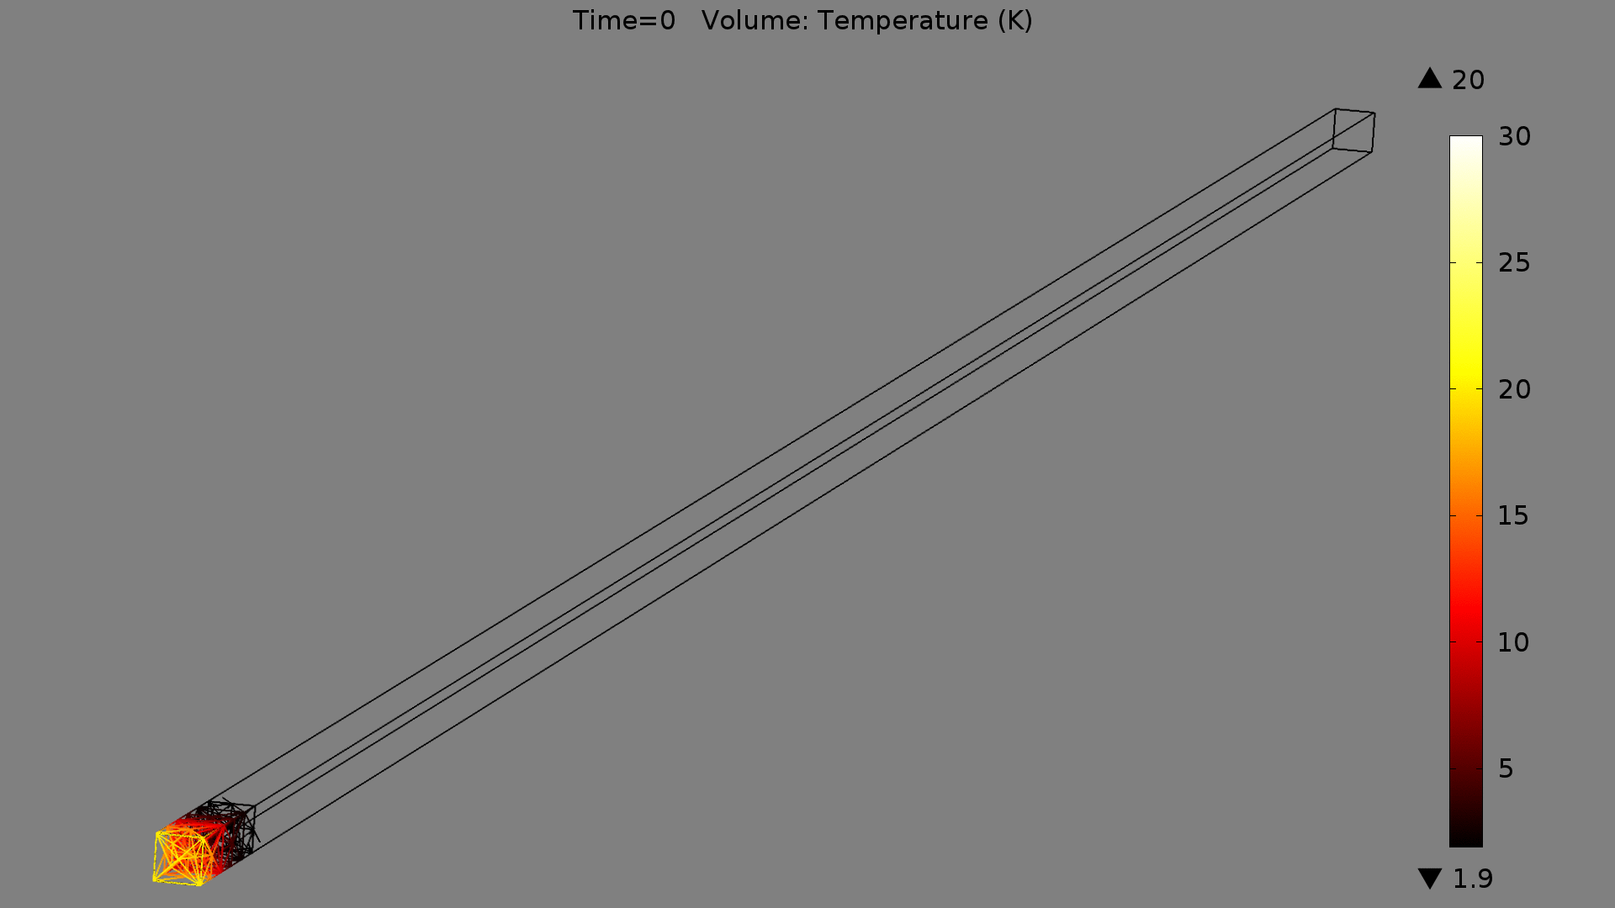
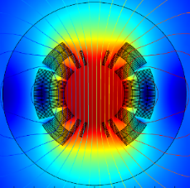
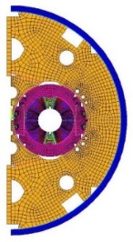


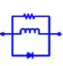
STEAM architecture
1D Electrothermal
2D Electrothermal
2D Mechanical
Motivation for simulation coupling:
Multi-physics
  Multiple coupled physical domains
Multi-rate
  Time constants ranging from μs to minutes
Multi-scale
  Geometrical dimensions differ by several orders of magnitude μm to km
  FEM solvers
Simulations Coupling Interface (Java / MpCCI)
PSpice
PSIM
Electrical Circuit
Power Converter Controller
Network solvers
y_{ref}
+
PID
-

Slide 31
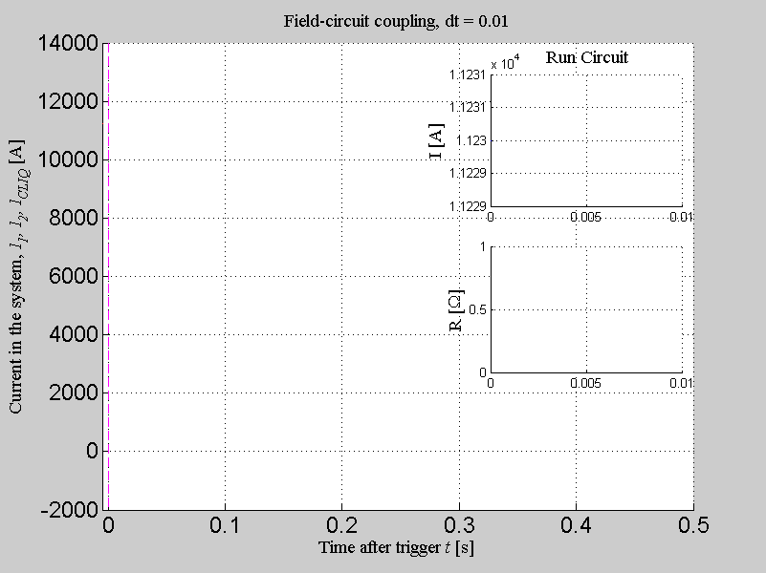
CLIQ simulations
Cos-theta v22b
l_{tp} [mm] | 14
ρ₀ [ohm*m] | 1.334e-10
ρ₁ [ohm*m/T] | 4.2e-11
R₂
ΔU₂
C_{CLIQ}
L₂
R₁
PC
ΔU₁
L₁
C_{CLIQ}=20 mF, U_{CLIQ}=2 kV

Slide 32
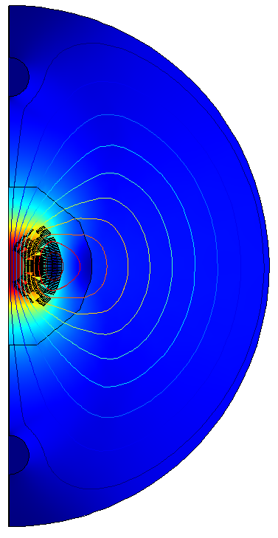
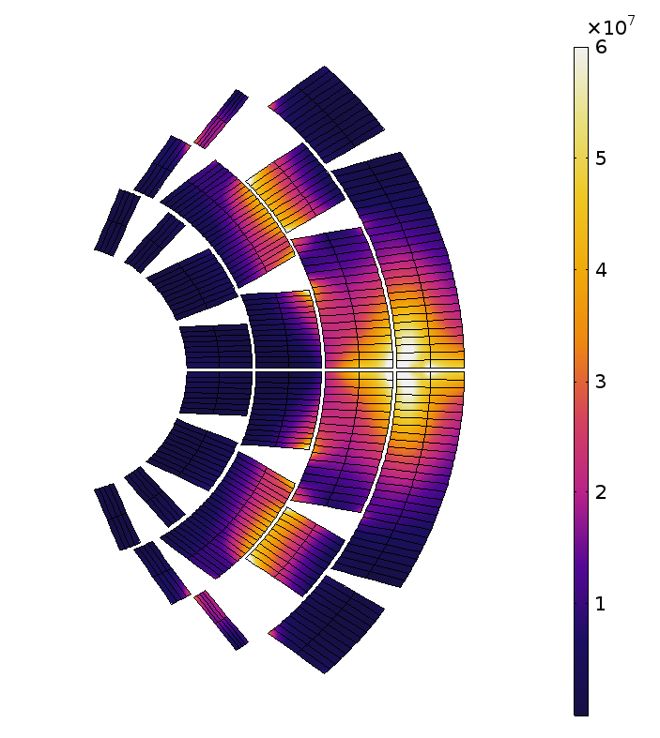
CLIQ simulations
Cos-theta v22b
C_{CLIQ}=20 mF, U_{CLIQ}=2 kV
−
−
+
+
−
−
+
+
Current [A] and resistance [Ω] evolution
Coupling losses [W/m³]

Slide 33
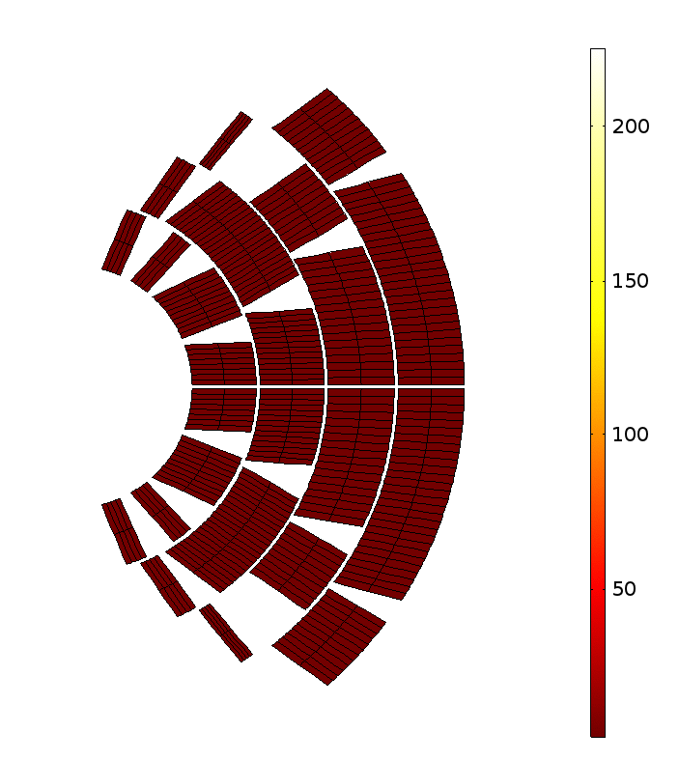
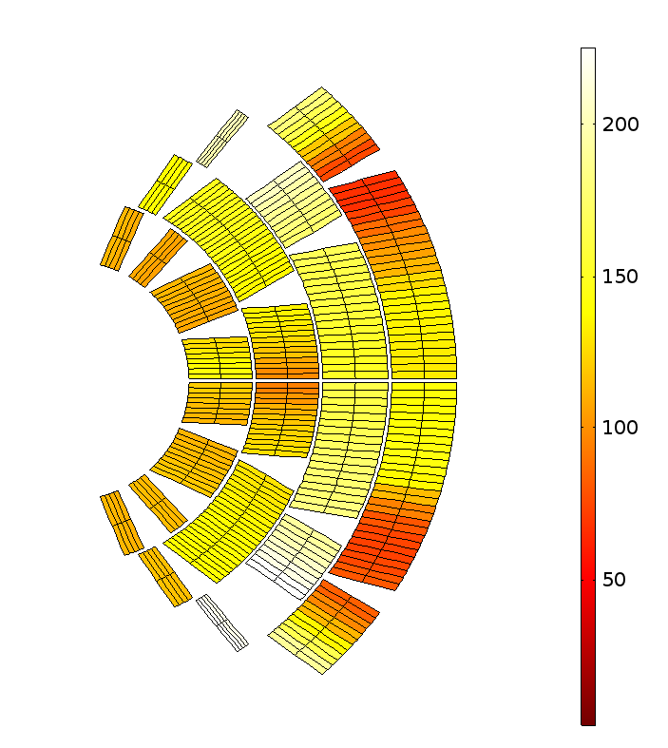
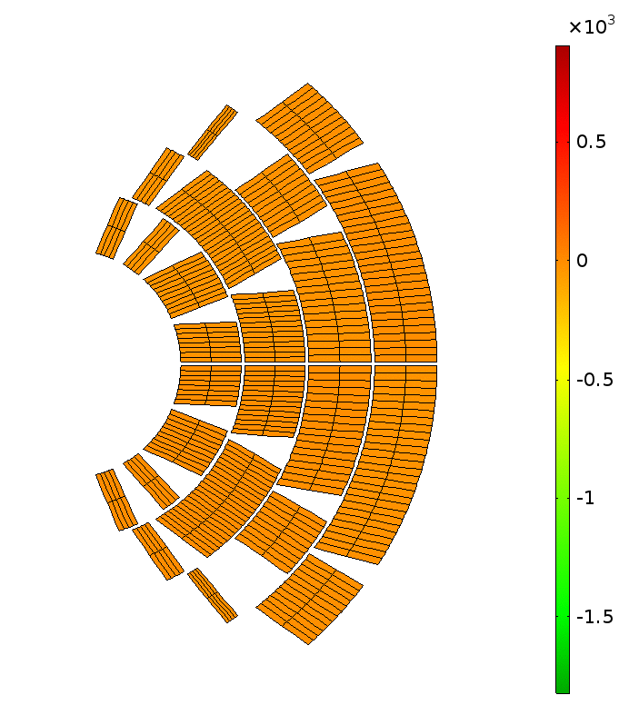
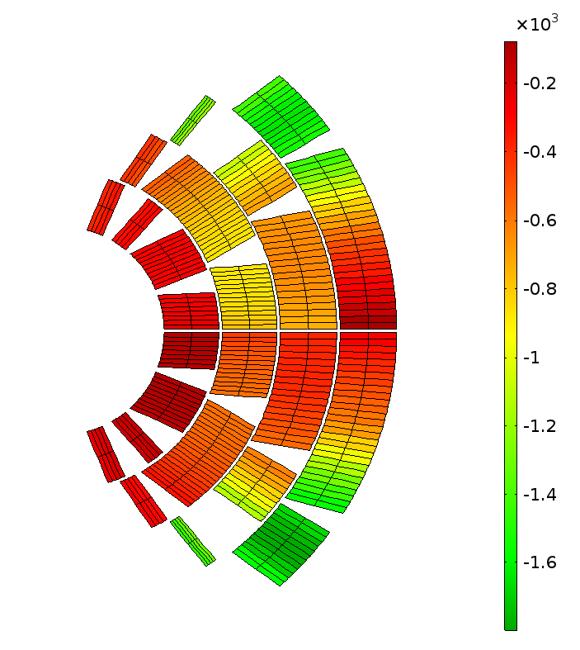
CLIQ simulations
Cos-theta v22b
C_{CLIQ}=20 mF, U_{CLIQ}=2 kV
Hot-spot 312 K
Peak voltage to ground @ 120ms
Temperature [K]
Voltage to ground [V]

Slide 34
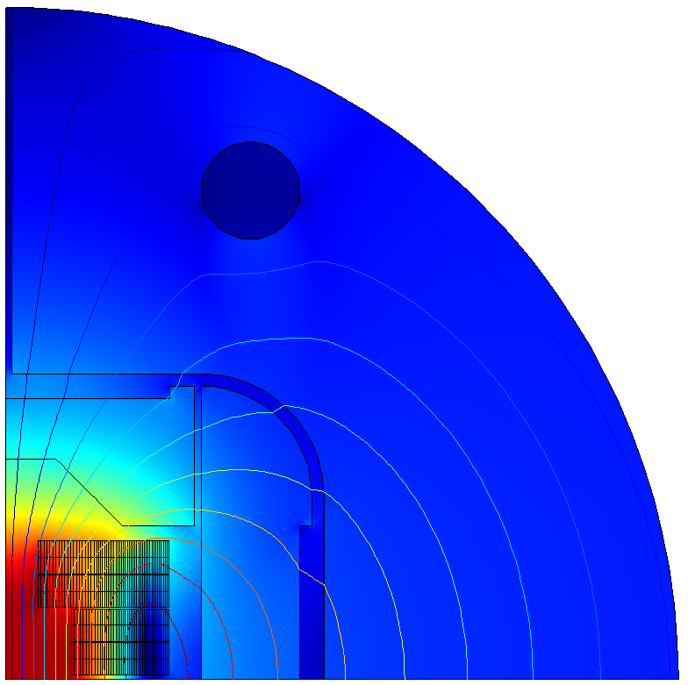
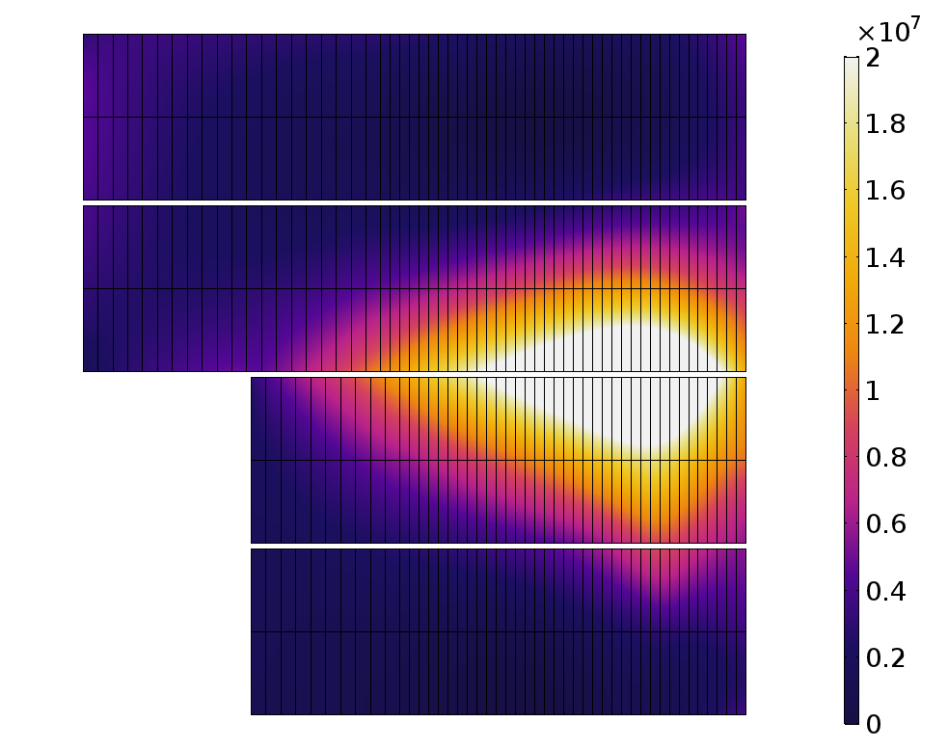
CLIQ simulations
Block coil v20ar
C_{CLIQ}=20 mF, U_{CLIQ}=2 kV
+
+
−
−
Current [A] and resistance [Ω] evolution
Coupling losses [W/m³]

Slide 35
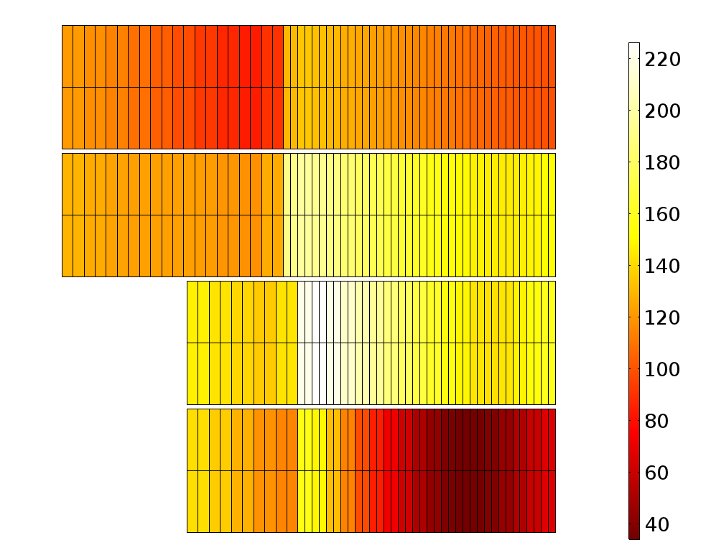
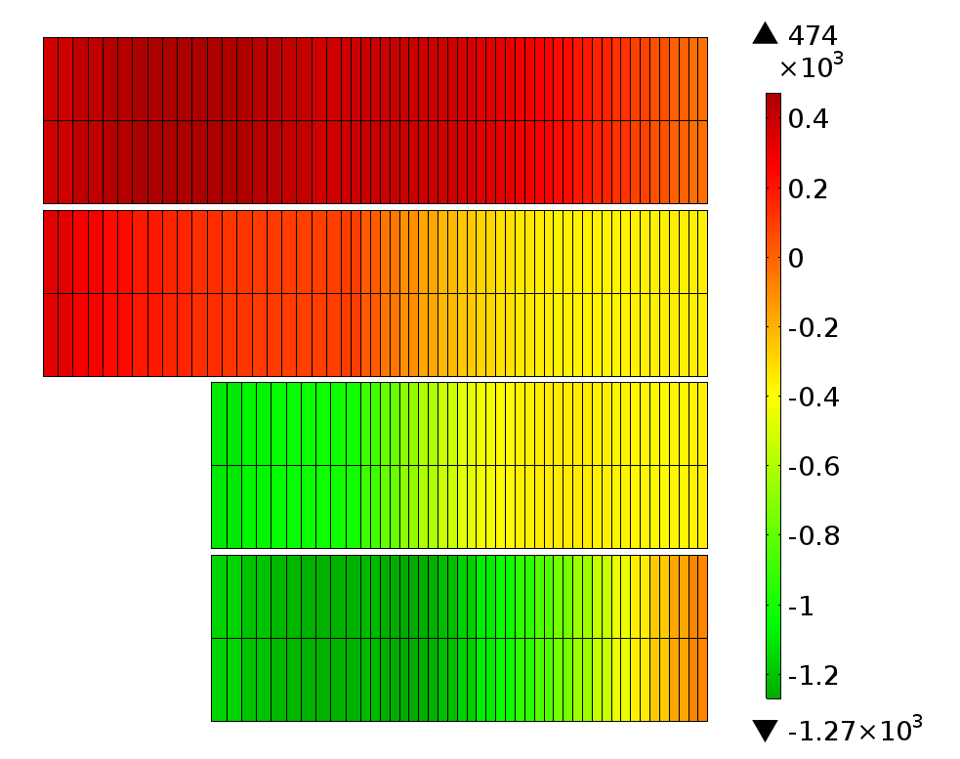
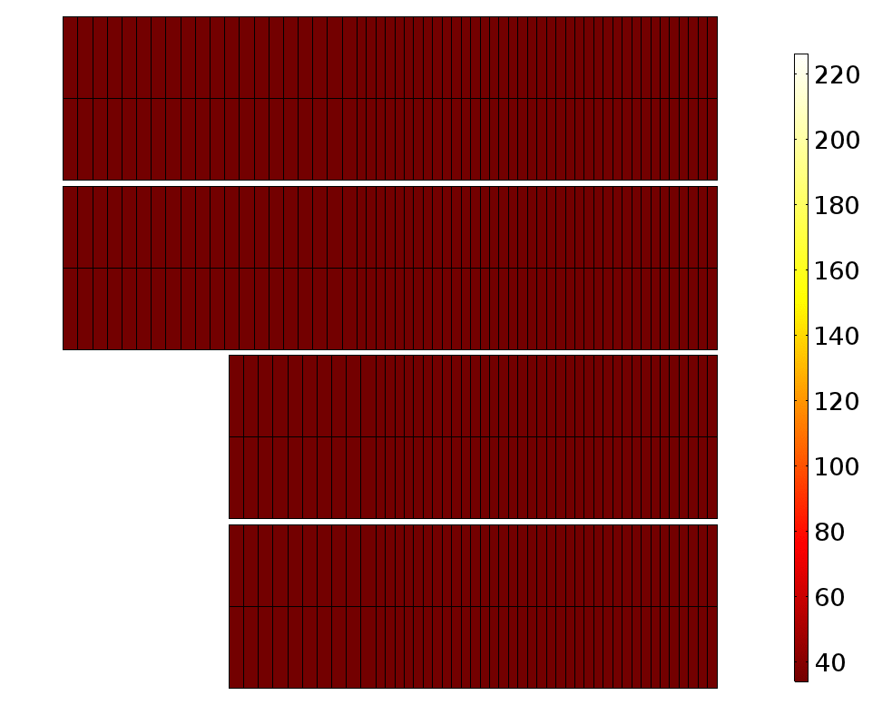
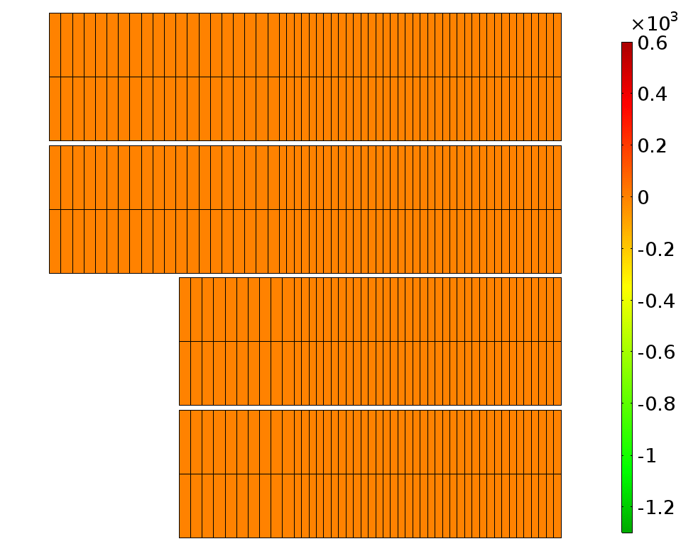
CLIQ simulations
Block coil v20ar
C_{CLIQ}=20 mF, U_{CLIQ}=2 kV
Hot-spot 338 K
Peak voltage to ground @ 110ms
Temperature [K]
Voltage to ground [V]

Slide 36
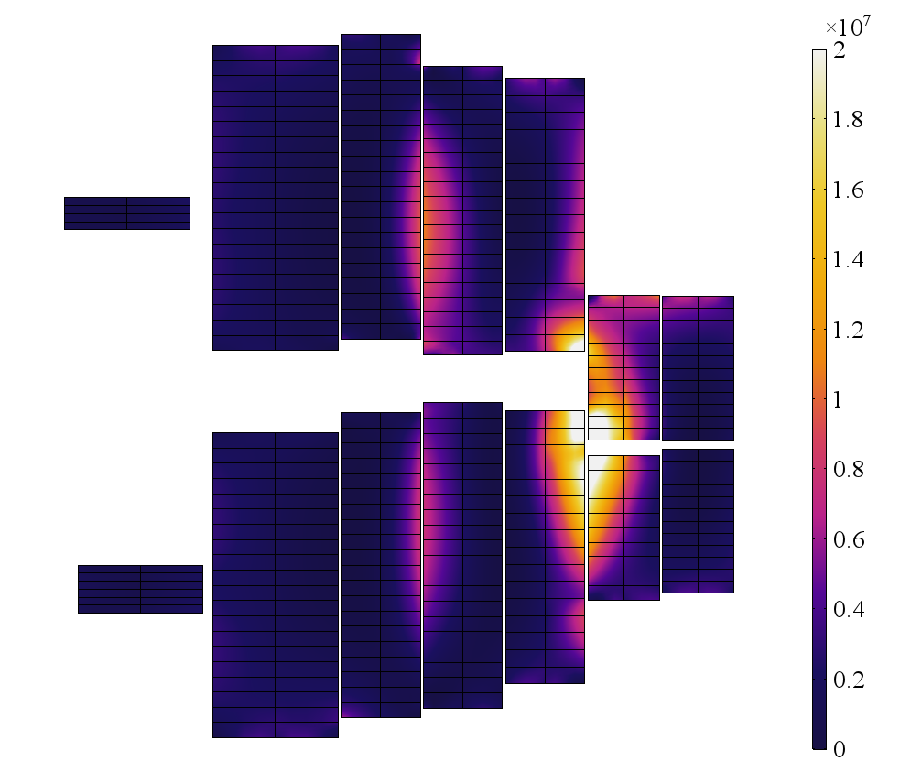
CLIQ simulations
Common coil v1h2
2 × C_{CLIQ}=20 mF, U_{CLIQ}=2 kV
−
−
+
+
−
−
−
Current [A] and resistance [Ω] evolution
Coupling losses [W/m³]

Slide 37
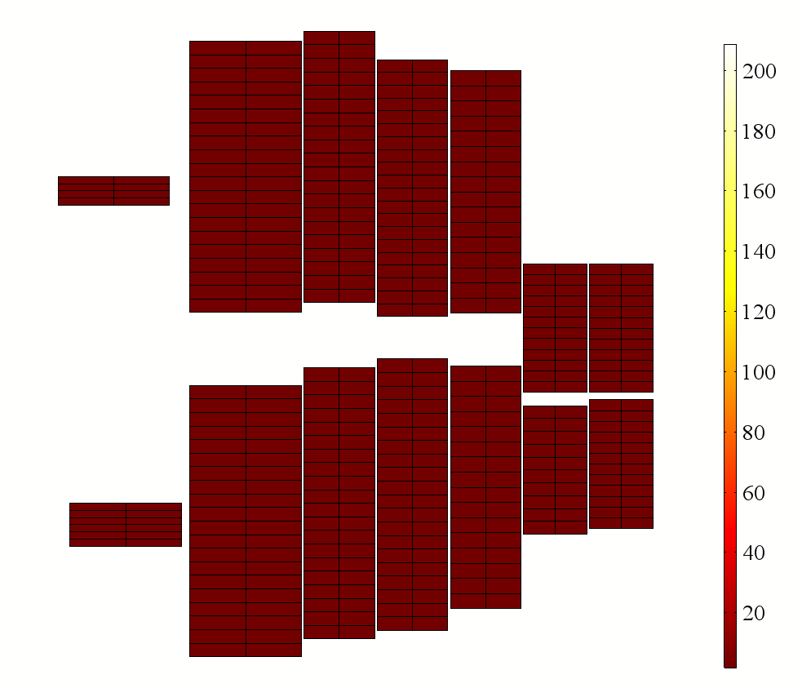
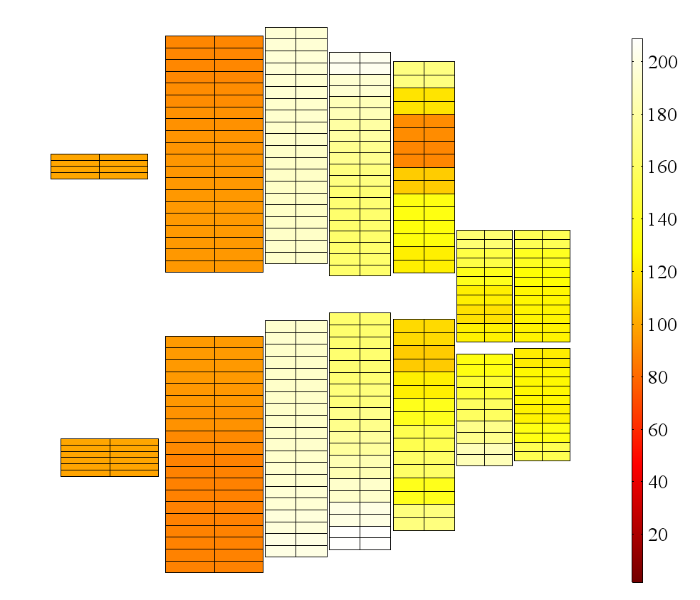
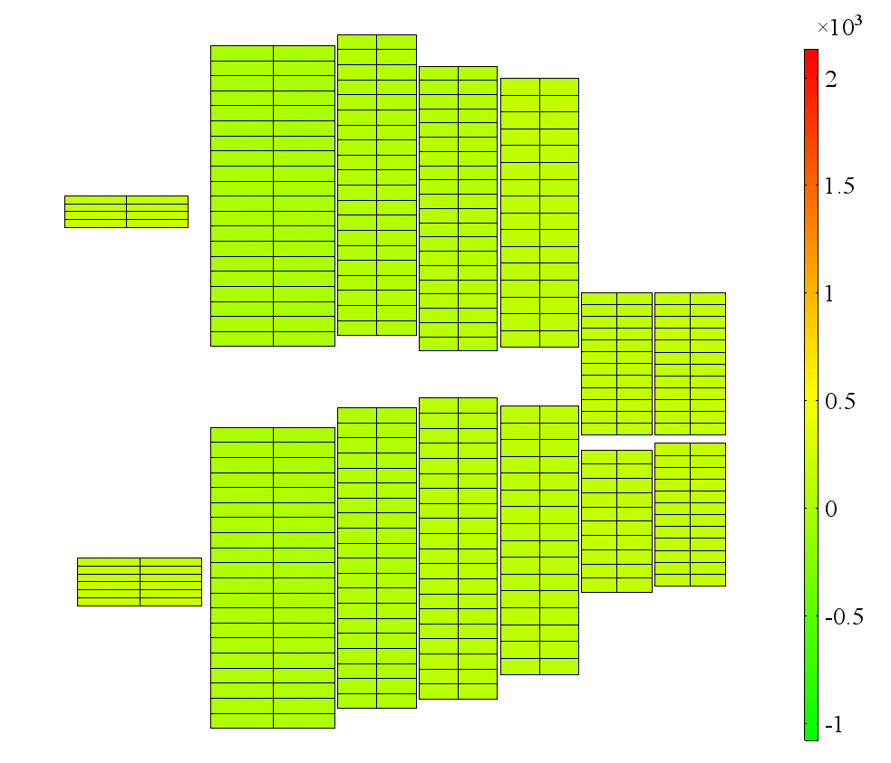
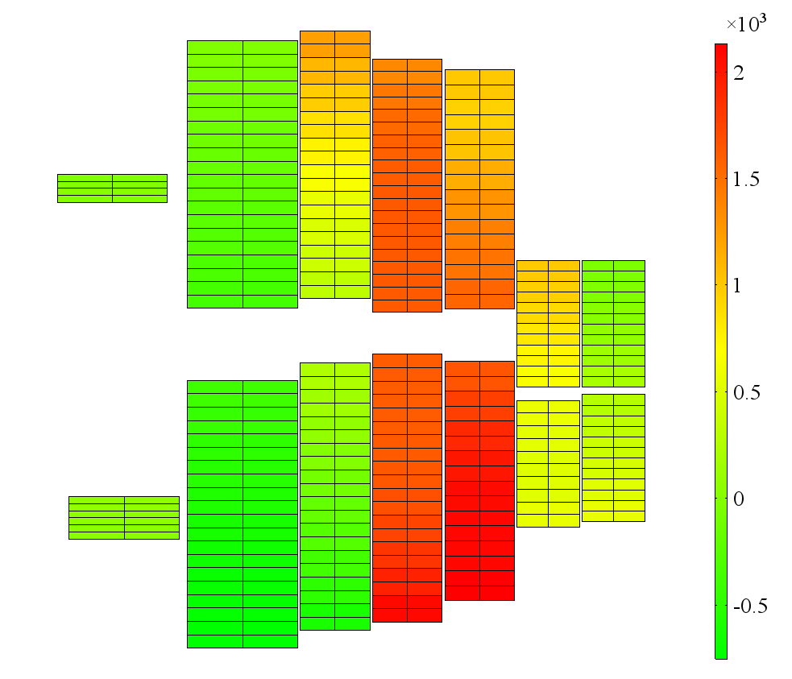
CLIQ simulations
Common coil v1h2
2 × C_{CLIQ}=20 mF, U_{CLIQ}=2 kV
Hot-spot 354 K
Peak voltage to ground @ 130ms
Temperature [K]
Voltage to ground [V]

Slide 38

Conclusions and future work
A new tool for circuit and quench protection simulations
First fully consistent CLIQ simulations
Flexibility enables study of complex circuits/magnets without additional effort
Next steps
  Analyse a magnet quench in the full FCC circuit
  Test new ideas for magnet powering: e.g. separate circuits for inner and outer layers, or subdivision diodes
  Build two apertures model for all magnet designs
  Optimize CLIQ configuration considering different current levels
  Include heaters model
  Share the tool with TAMPERE colleagues

