Slide 1
Degradation of critical current in NbTi superconductor due to heat pulse
Use a CLIQ unit to discharge a current pulse in NbTi sc. strands.
Peak temperature in strands from 400°C to 1000°C
Measure the magnetization degradation (ΔM ∝ I_{c})

Slide 2
Experimental setup
Copper plates
Nb-Ti strand
Copper plates
Fibre glass plate (insulation)
2 x 10.5 m long cables
-
+
CLIQ
CLIQ characteristics:
  Capacitor 40 or 80 mF
  Voltage up to 500 V
  Maximum output current 6kA (limitation of the thyristor)
  Up to 20 kJ stored energy
NbTi sc. strands (10 cm long) = 3 mΩ at RT
2 x 10.5 m of 10 mm2 copper cables act as a resistance in series with the strand to limit the CLIC output current: 35 mΩ
Temperature derived from the current measured by CLIQ unit and the strand voltage.

Slide 3
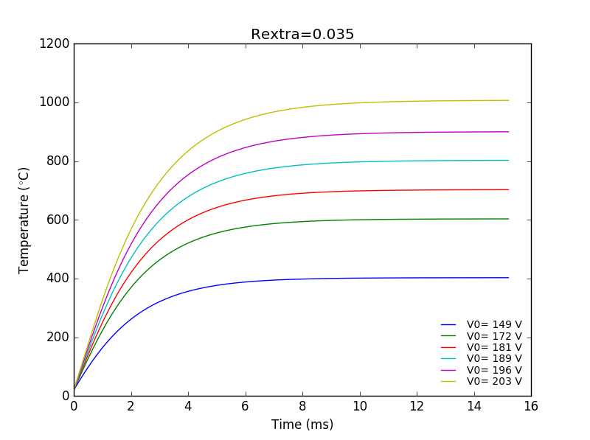
Experimental parameters
CLIQ, C = 80 mF
Discharge time (5 τ) = ~ 15 ms
ΔT in 10 m cable between 1 and 2 °C
CLIQ Voltage (V) | Energy density in strand (J/cm3) | Max Current (kA)
149 | 1277 | 4.2
172 | 1991 | 4.9
181 | 2356 | 5.2
189 | 2731 | 5.4
196 | 3103 | 5.6
203 | 3521 | 5.8

Slide 4
Experimental planning
Discharge tests (next week):
  Dummy test at low voltage (~50V) to test set up and measurement system.
  Experimental test : start with the lowest voltages and go to the higher voltages.
  Magnetization measurements:
    Start with reference samples and the samples which have reached the highest temperature.

Slide 5
Questions ?

Slide 6
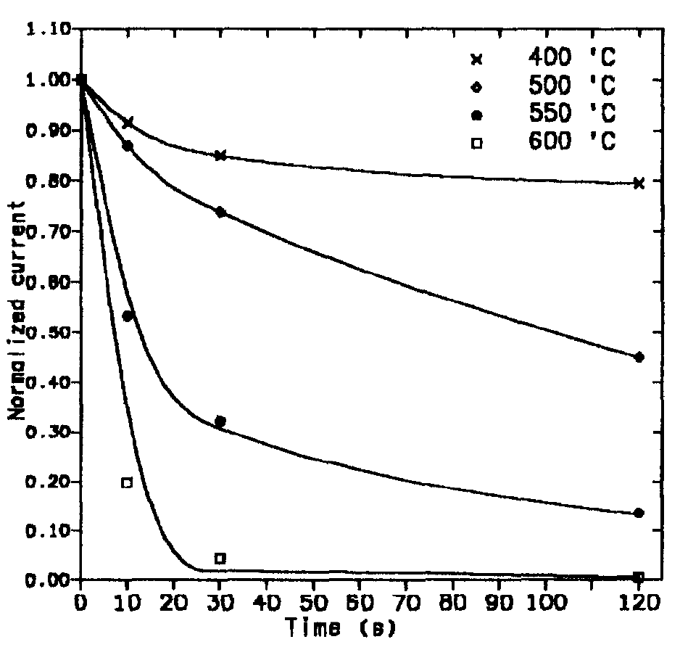
Reduction of cable I_{c} induced by temperature
Variation of the α-Ti precipitate size (from T=400°C for more than 30 seconds)
B = 6T
C. Scheuerlein
ΔM ∝ I_{c}
Variation of the NbTi/Cu strand magnetization (ΔM) at 4.2 K in magnetic field up to 6 T after different HT’s.
* Critical current degradation of a NbTi-Multifilament Conductor due to Heat Treatment, Th. Schneider, P. Turowski
** Temperature induced degradation of Nb-Ti/Cu composite superconductors, C. Scheuerlein et al.
Notes:
When do we break NbTi filaments due to energy depositions?

Slide 7
C = 80 mF,
### Rextra=0.035 mOhm
### Loaded voltage (V) | Strand Temperature (C) | Energy strand (J) | Energy Resistance(J) | Delta T cable | Energy total (J) | Max Current (A)
149 | 402.8092003 | 113.7342939 | 800.1781631 | 1.097387195 | 913.912457 | 4257.142857
172 | 603.1502841 | 177.3397216 | 1057.627266 | 1.45046025 | 1234.966988 | 4914.285714
181 | 702.5614896 | 209.9021514 | 1166.816023 | 1.600204832 | 1376.718175 | 5171.428571
189 | 802.5516878 | 243.3186017 | 1267.598285 | 1.738420505 | 1510.916886 | 5400
196 | 899.7936643 | 276.4566543 | 1358.510595 | 1.863100245 | 1634.96725 | 5600
203 | 1006.802206 | 313.6527494 | 1451.81372 | 1.991058816 | 1765.466469 | 5800

Slide 8
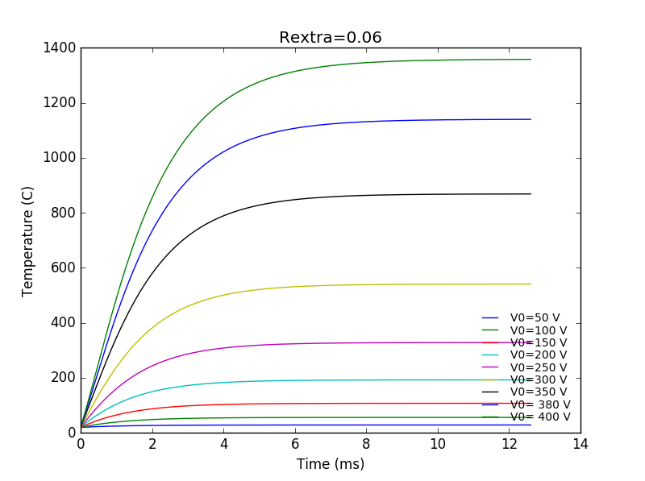
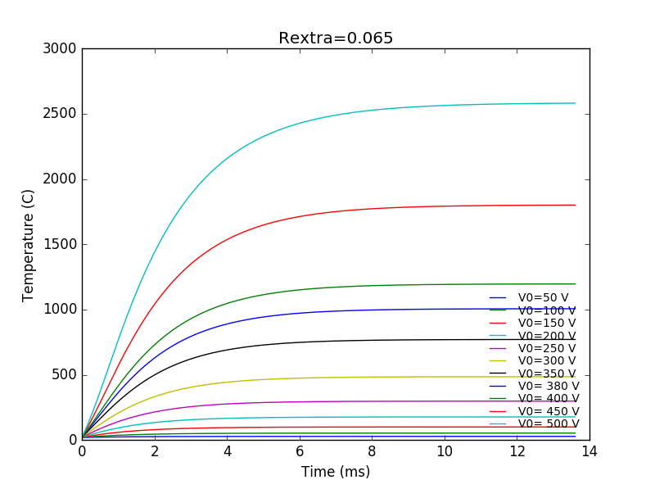
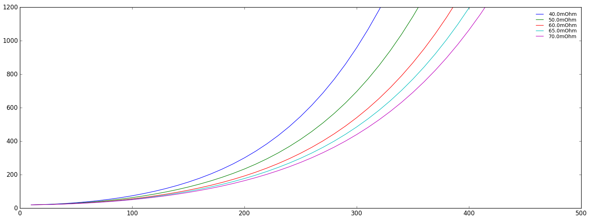
40 mF
Max V | 320 | 350 | 380 | 400
C (mF) | 40 | 40 | 40 | 40
Energy Tot CLIQ (J) | 2048 | 2450 | 2888 | 3200
R (Ohm) | 0.04 | 0.05 | 0.06 | 0.065
Section (m2) | 6.00E-06 | 6.00E-06 | 6.00E-06 | 6.00E-06
Length(m) | 14.29 | 17.86 | 21.43 | 23.21
Volume (cm3) | 85.71 | 107.14 | 128.57 | 139.29
Energy density (J/cm3) | 23.89333 | 22.86667 | 22.46222 | 22.97436
Delta T (°C) | 6.826667 | 6.533333 | 6.417778 | 6.564103
I max | 7441.86 | 6603.774 | 6031.746 | 5882.353

Slide 9
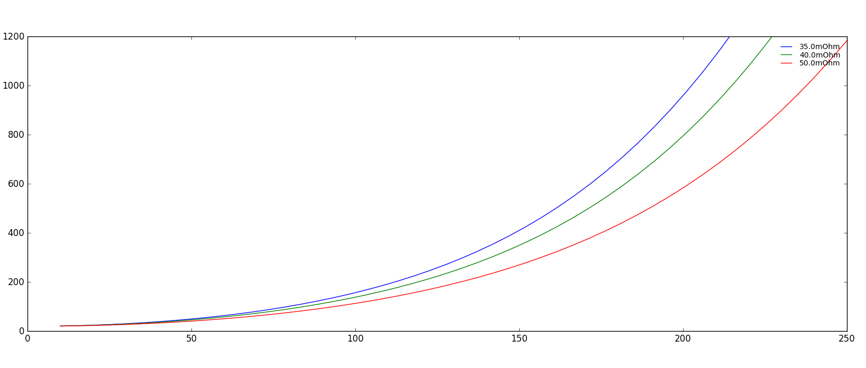
80 mF
Max V | 220 | 220 | 230 | 250
C | 0.08 | 0.08 | 0.08 | 0.08
Energy Tot CLIQ (J) | 1936 | 1936 | 2116 | 2500
R (Ohm) | 0.035 | 0.035 | 0.04 | 0.05
Section (m2) | 6.00E-06 | 1.00E-05 | 6.00E-06 | 6.00E-06
Length(m) | 12.50 | 20.83 | 14.29 | 17.86
Volume (cm3) | 75.00 | 208.33 | 85.71 | 107.14
Energy density (J/cm3) | 25.81333 | 9.2928 | 24.68667 | 23.33333
Delta T (°C) | 7.375238 | 2.655086 | 7.053333 | 6.666667
I max | 5789.474 | 5789.474 | 5348.837 | 4716.981

