Slide 1


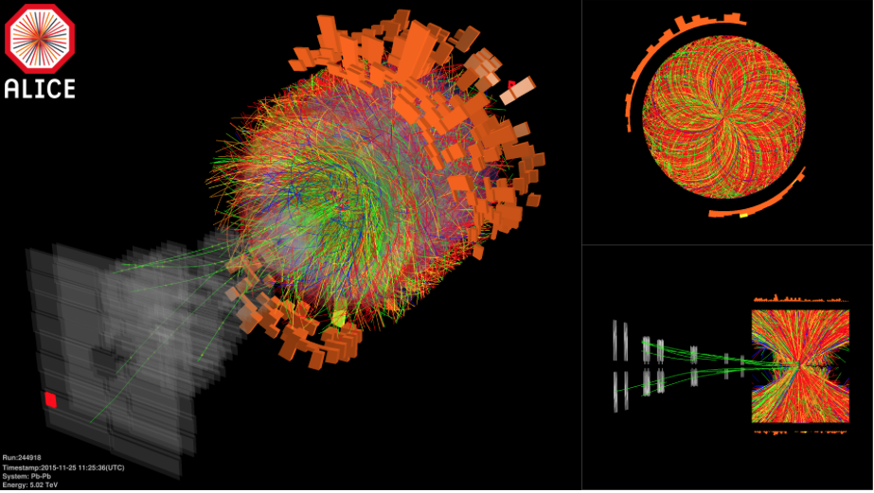

A Bayesian approach to particle identification in ALICE
Pb-Pb $√sNN$ = 5.02 TeV
P. Antonioli
INFN – Bologna
For the ALICE Collaboration

Slide 2
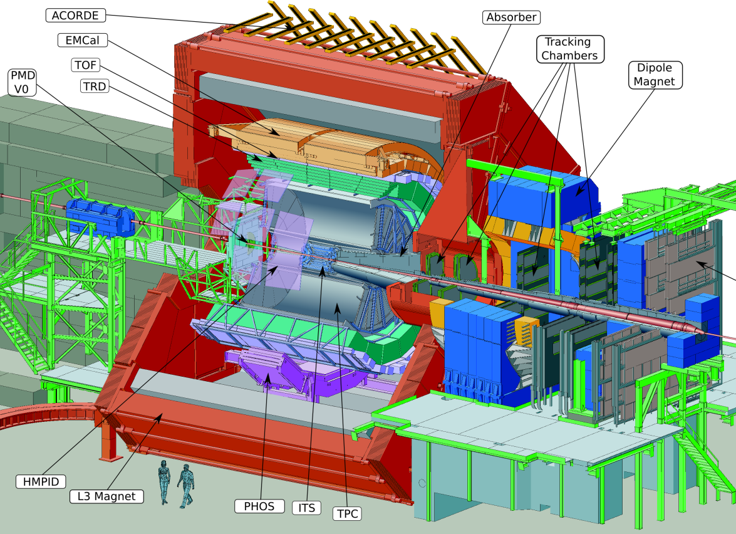
The ALICE detector
Central barrel
|η|<0.9
B=0.5 T
Muon spectrometer:
-4.0<η<-2.5
B=0.7 T (3 Tm integral)
+ ZDC
Extended PID capabilities in the barrel

Slide 3


Slide 4
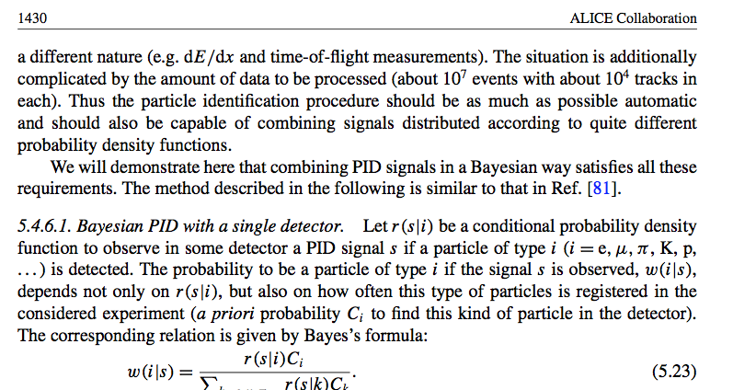
Motivations (I)
A Bayesian approach to PID is part of ‘ALICE history’
First reference in ALICE
I. Belikov, P. Hristov et al., “Bayesian approach for PID in ALICE experiment at the LHC”, CHEP04, Interlaken, Switzerland (2004)
http://indico.cern.ch/event/0/session/4/contribution/445
ALICE PPR II (2006) presents ”virtual” (as any PPR) results with Bayesian approach
J. Phys. G: Nucl. Part. Phys. 32 1295 doi:10.1088/0954-3899/32/10/001
pag: 1429-1435 for combining PID
[PPR/Ref. 81]: M. Aguilar-Benitez et al., Z. Phys. C. 50 (1991) 405
http://dx.doi.org/10.1007/BF01551452
(LEBC-EHS experiment NA27@CERN)

Slide 5
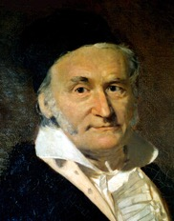
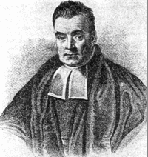
Motivations (II)
K.F. Gauss
T. Bayes
But RUN1 was hectic! And the most commonly used technique is a “Gaussian” approach based on n_{σ} cut…
So... effort to make fully available this tool:
set-up a ‘framework’ to support Bayesian approach within the ALICE analyzers community
compare Bayesian/Gaussian approaches and provide guidance
assess uncertainties of the methods (in particular about PID efficiencies)
validate Bayesian approach with real data/real (published) analysis
prepare for RUN2

Slide 6


The main ideas of this work
Some formalism to describe PID in a HEP experiment
Have fun in RUN2
Handling the priors
Check them
with data
Compare performance of different methods
Compare output of analyses
Use high purity samples to check PID performance

Slide 7

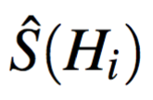
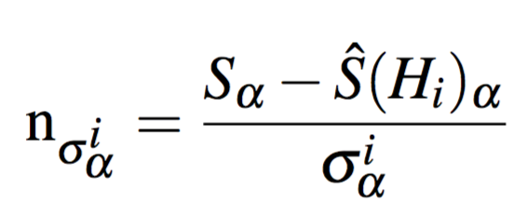
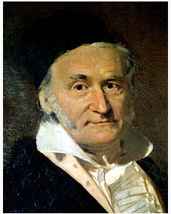
Some PID formalism
Functional form of ξ depends on detector
Given a raw signal S from a detector → cut on S
Or use a discriminating variable ξ
PID discriminating
variable
Response function: to embed detector specifics
For a detector with a Gaussian response, R is given by
the expected average signal for a given species H_{i}:
“n_{σ}” variable
α= ITS, TPC, TRD, TOF, HMPID, EMCAL,….

Slide 8
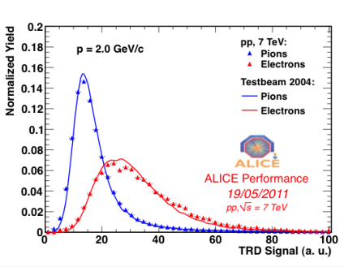
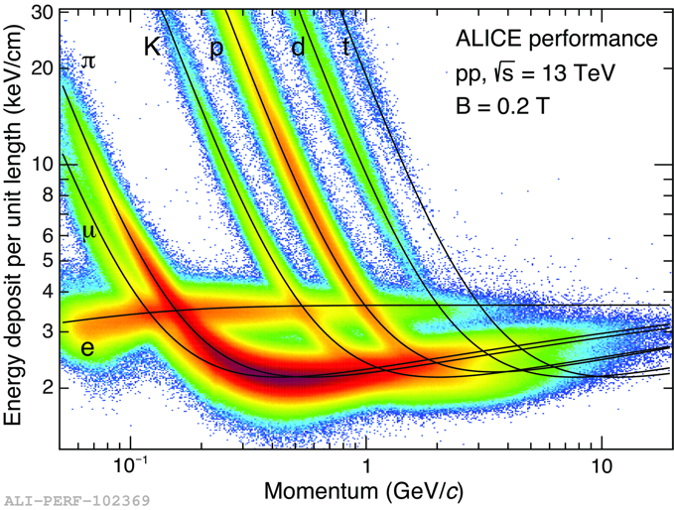
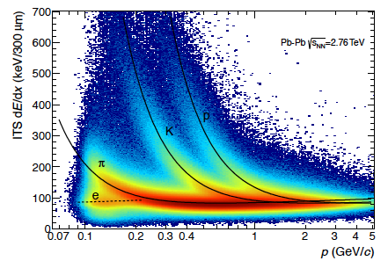
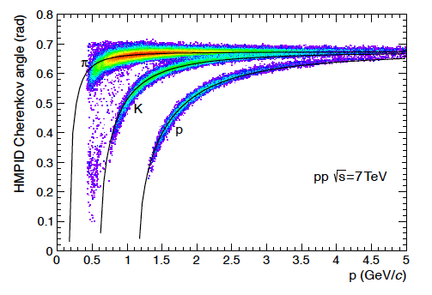
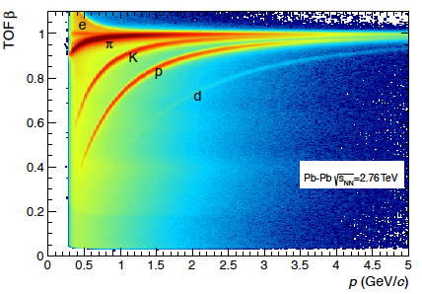
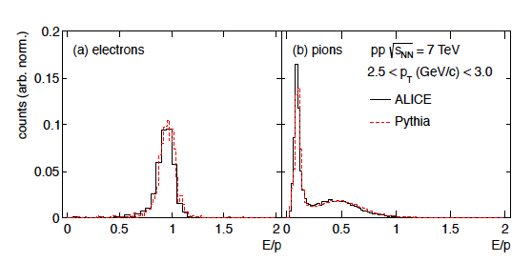

What is S_{α} in ALICE?
Detector | Observable/technique
ITS | dE/dx
TPC | dE/dx
TRD | dE/dx + transition radiation
TOF | β via time of flight
EMCAL | E/p
HMPID | β via Cerenkov angle
For an overview of PID detectors/techniques in ALICE:
(slides) C. Zampolli at PLHC 2012:
https://indico.cern.ch/getFile.py/access?contribId=127&sessionId=4&resId=3&materialId=slides&confId=164272
(paper) IJMPA 29 (2014) 1430044 ALICE Performance arXiv:1402.4476
Please note (not discussed in this talk):
- T0 detector is part of time-of-flight measurement (collision event time)
- Secondary vertices (K₀, Λ, ...) and kinks for K are PID... (“topological PID”)
- MUON is PID (hadron absorber etc...)

Slide 9


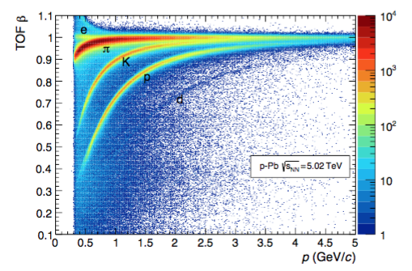
A practical example of a ξ: the TOF case
Arrival time at the detector
Collision event time
Expected time for a particle belonging to species “i” (i=e,μ,π,K,p,d,t,…)
R
(response function)
Include tracking contribution
And similarly for ITS/TPC where the expected value is dE/dx modelling (Bethe-Bloch) for species “i”, etc.

Slide 10

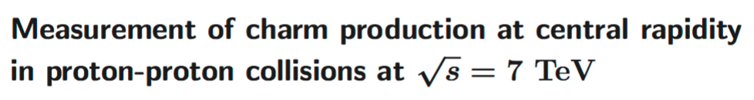
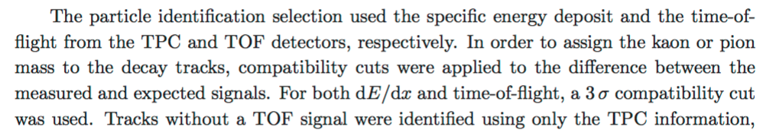
Using individually PID detectors to make selections….
JHEP 01 (2012) 128
→ Event selection
→ topological cuts
→ PID selection
“Combine cuts on different PID detectors”

Slide 11
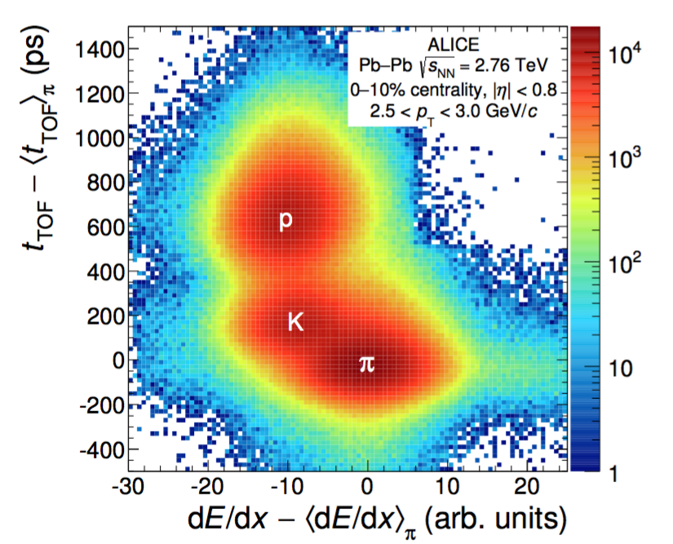
or exploiting combination of PID information
arXiv:1602.01392
Separation in 2D larger than individual 1D separation

Slide 12
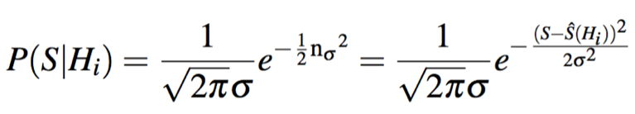
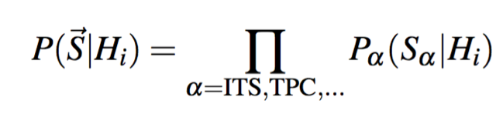


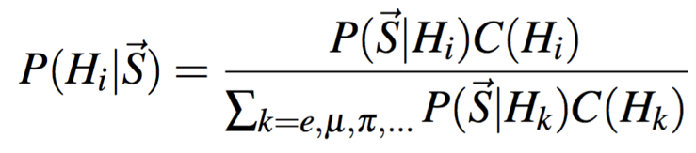
combining PID detectors
Combination is natural
via probability
One detector
Conditional probability that a particle of species H_{i} produces a signal S (in this case expressed with a Gaussian response)
Many detectors
The conditional probability that a particle of species H_{i} produces the set of signals
But…. we are interested to know which is the probability that the particle is of species H_{i}, given
A priori probability
for H_{i}
posterior
probability
Bayes’ theorem!

Slide 13

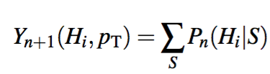
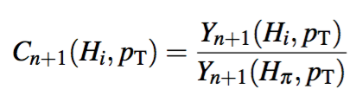
Extracting the prior from data (I)
Iterative procedure data-driven, based on a
set of unidentified tracks (raw yield Y (p_{T}))
1) Start with “flat” priors (= equal probability for each species)
2) Bayesian posterior P_{n}(H_{i}|S) at step n obtained from unidentified raw yield
3) Obtain identified raw yields at step n+1
using posteriors as weights
4) Obtain a new set of priors from the relative ratios of identified spectra
https://www.countbayesie.com/blog/2015/2/18/hans-solo-and-bayesian-priors
The algorithm converges quickly and it doesn’t make special assumptions.

Slide 14
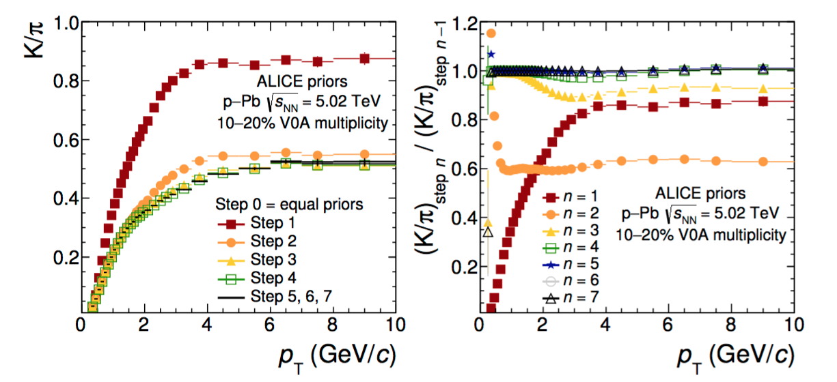
Extracting the priors from data (II)
arXiv:1602.01392
Priors/abundances relative to pions
Obtained as a function of p_{T}
Example of convergence of the algorithm here for p-Pb
Separate set of priors for collision system (pp, p-Pb, Pb-Pb) and multiplicity/centrality class (p-Pb/Pb-Pb)

Slide 15
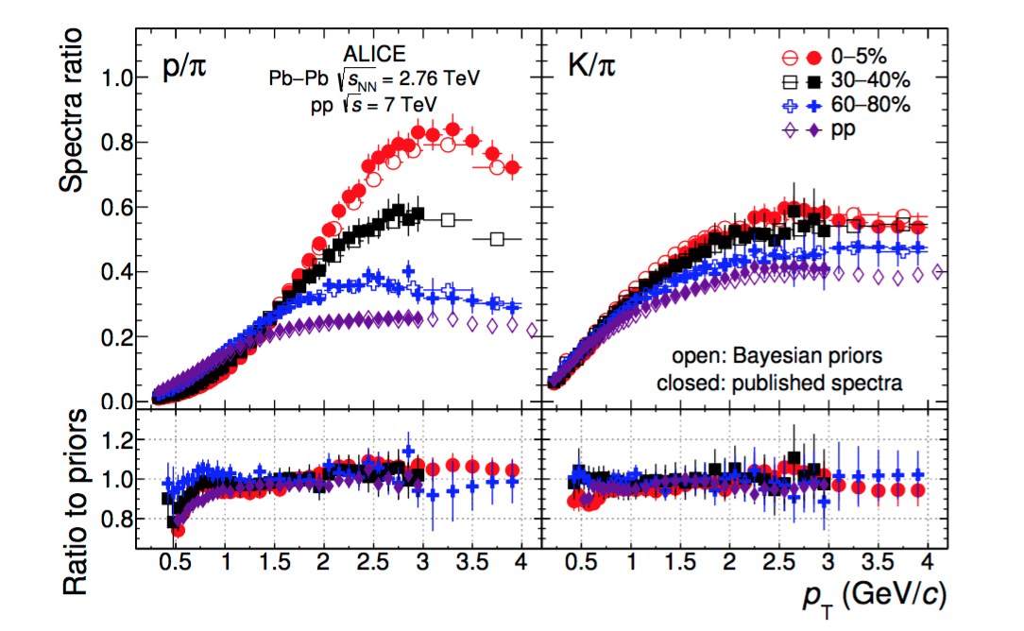
Comparing priors with measured abundances
arXiv:1602.01392
In a PID experiment priors correspond to the measured abundances → compare with published results for all the collision systems (ALICE Eur. Phys. J C75 (2015) 226, Phys. Lett. B736 (2014) 196, PRL 109 (2012) 252301)
Found consistent within roughly 10% over a wide momentum / centrality range

Slide 16
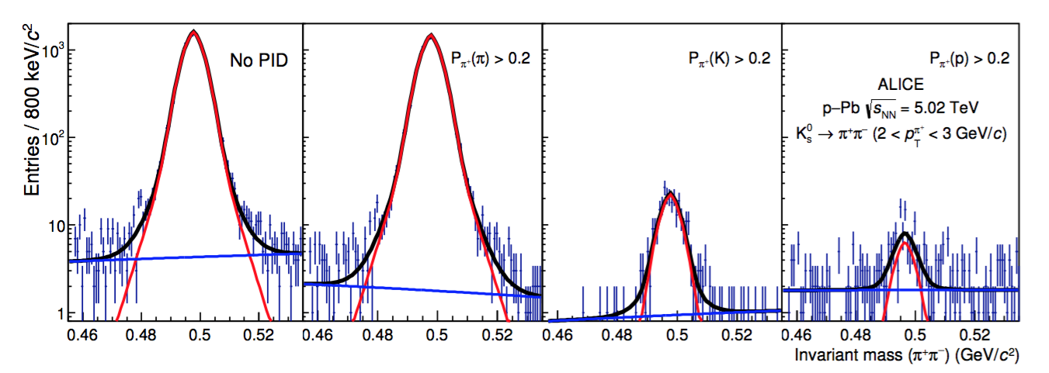
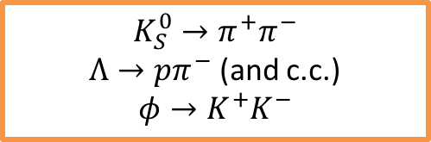
Benchmark PID with two-prong decay channels
$$K_{S}^{0}→π^{+}π^{−}$$
$Λ→pπ^{−}$ (and c.c.)
$$φ→K^{+}K^{−}$$
High purity samples via invariant mass selection
Fixed probability threshold
arXiv:1602.01392
How many pions we have
Identification probability: how many times we identify a pion as a pion
Misidentification probability: how many times we identify a pion as kaon or as a proton
TPC and TOF used for PID selection

Slide 17
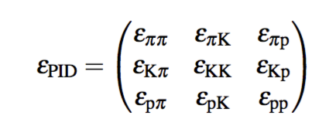
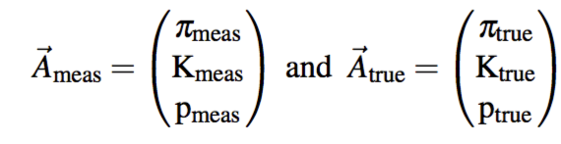


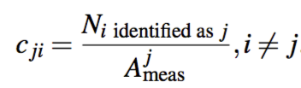
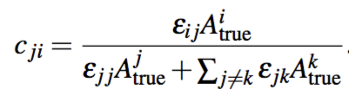
PID matrix and some definitions
Diagonal elements: PID efficiencies
Non-diag. elements: misidentification probabilities
Abundances vectors can be defined for hadrons:
Where:
The relation between A_{meas} and A_{true} is then:
Contamination of species j due to a different species i (c_{ji})
Connection between contaminations and misidentification probabilities:

Slide 18
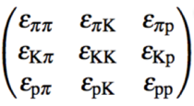
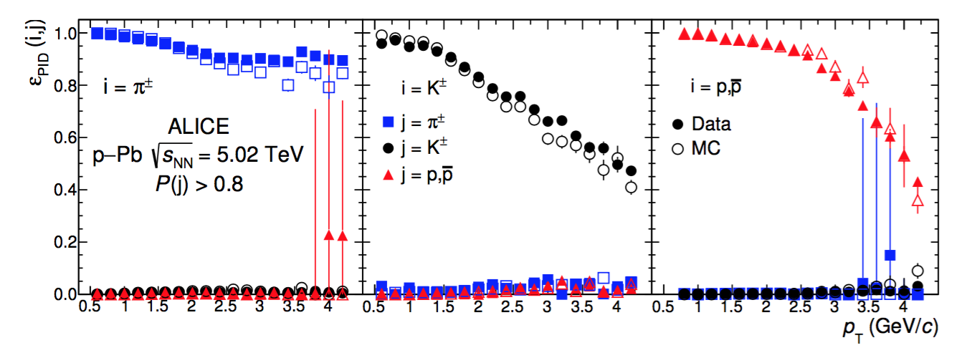
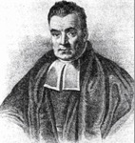
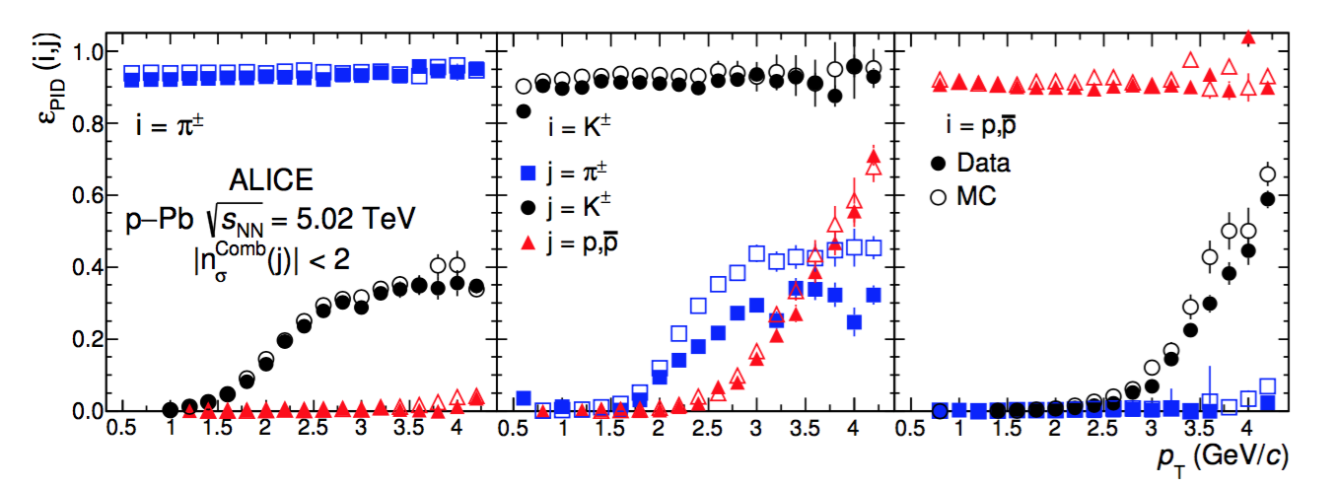

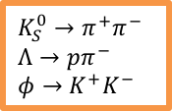

PID efficiencies: data and Monte Carlo
$$K_{S}^{0}→π^{+}π^{−}$$
$$Λ→pπ^{−}$$
$$φ→K^{+}K^{−}$$
arXiv:1602.01392
“high purity”
T.B.
2σ cut
$$n_{σ}^{Comb}\left(j\right)=\sqrt{{(n}_{σ}^{TPC}{(j)}^{2}+n_{σ}^{TOF}{(j)}^{2})}$$
K.F. G.
TPC and TOF used for PID selection

Slide 19
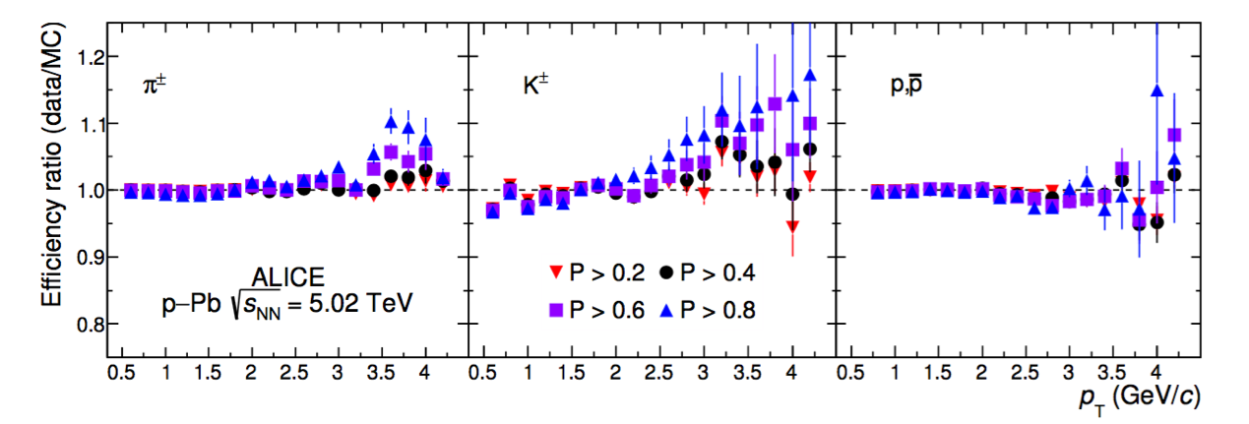
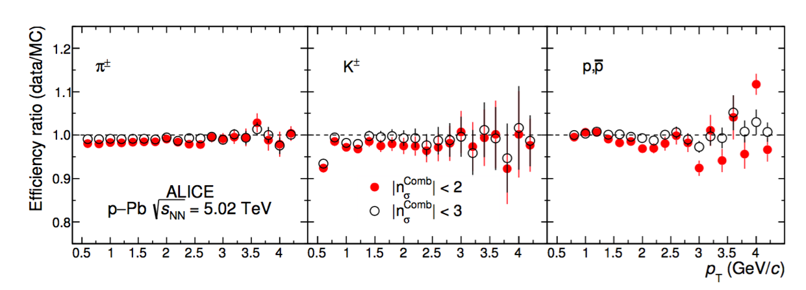
PID efficiencies: data and Monte Carlo (II)
$$K_{S}^{0}→π^{+}π^{−}$$
$$Λ→pπ^{−}$$
$$φ→K^{+}K^{−}$$
arXiv:1602.01392
Agreement within 5% for both methods
A larger discrepancy (10%) seen in high purity strategy
Systematic uncertainties under control
TPC and TOF used for PID selection

Slide 20
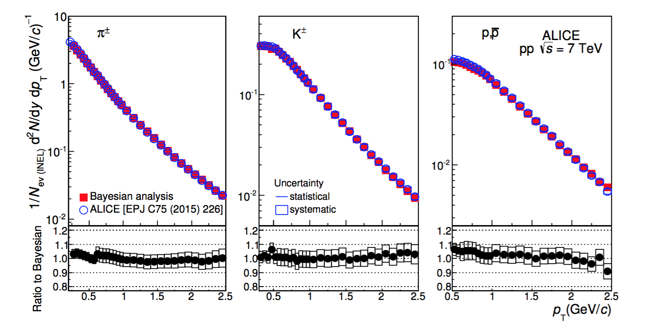
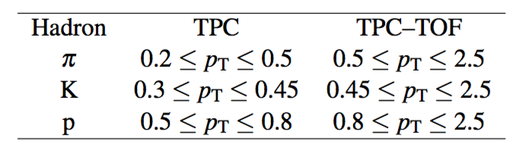
Compare physics analysis: identified hadron spectra
arXiv:1602.01392
Identification with maximum probability using only TPC and TOF
Published analysis uses various PID detectors (ITS, TPC, TOF, HMPID) and techniques
Agreement within 5%

Slide 21

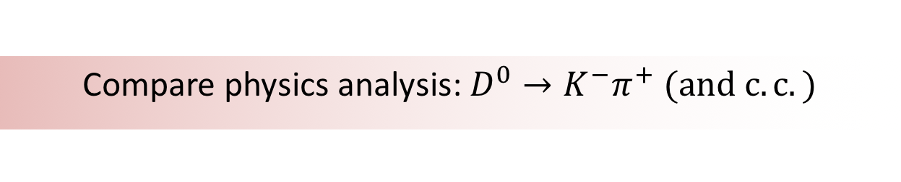
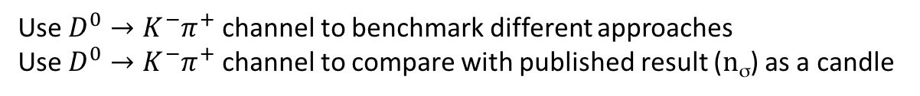
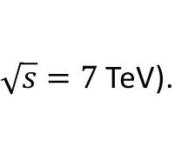
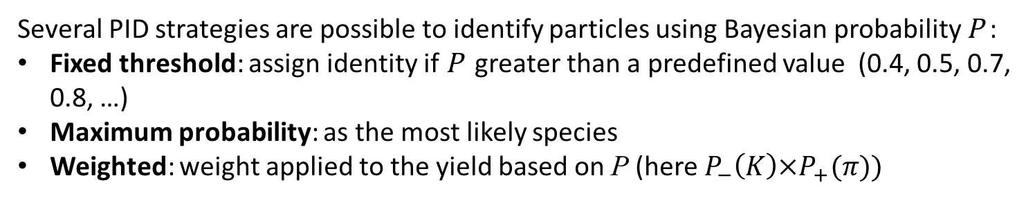
Compare physics analysis: $D^{0}→K^{−}π^{+} (and c.c.)$
Several PID strategies are possible to identify particles using Bayesian probability P :
Fixed threshold: assign identity if P greater than a predefined value (0.4, 0.5, 0.7, 0.8, …)
Maximum probability: as the most likely species
Weighted: weight applied to the yield based on P (here $P_{−}\left(K\right)×P_{+}(π))$
Use $D^{0}→K^{−}π^{+}$ channel to benchmark different approaches
Use $D^{0}→K^{−}π^{+}$ channel to compare with published result (n_{σ}) as a candle
ALICE, JHEP 1201 (2012) 128 arXiv:1111.1553
Same trigger, event selection, topological cuts as in published analysis based on a 3 x 10⁸ events sample collected in 2010 (pp collisions at
$\sqrt{s}=7$TeV).
Comparison of yields, S/B, significance, efficiencies, corrected yields….

Slide 22
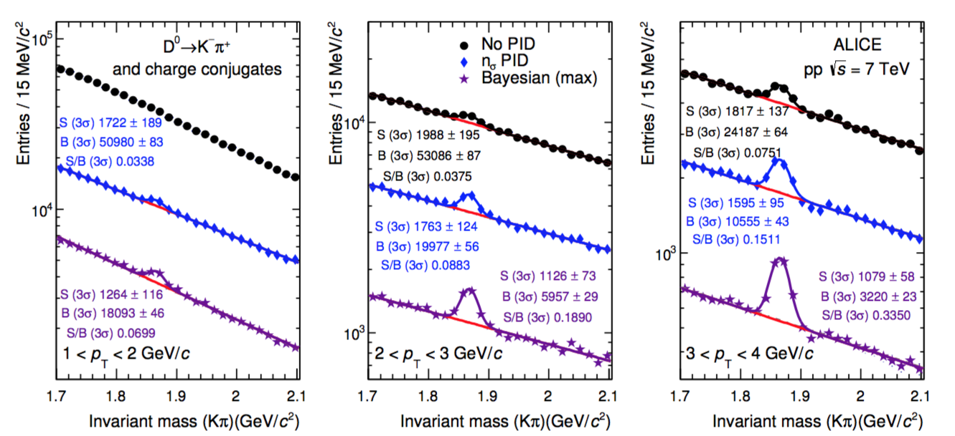
D⁰ : raw yields
arXiv:1602.01392
No PID
n_{σ} PID
Bayesian
Without PID no extraction of signal possible in bin 1 < p_{T} < 2 GeV/c
Increase of S/B ratio moving from no PID → n_{σ} → maximum probability
(note “3σ” in the figures refers to definition of S and B evaluation in invariant mass plots not to n_{σ} cut for PID!)

Slide 23
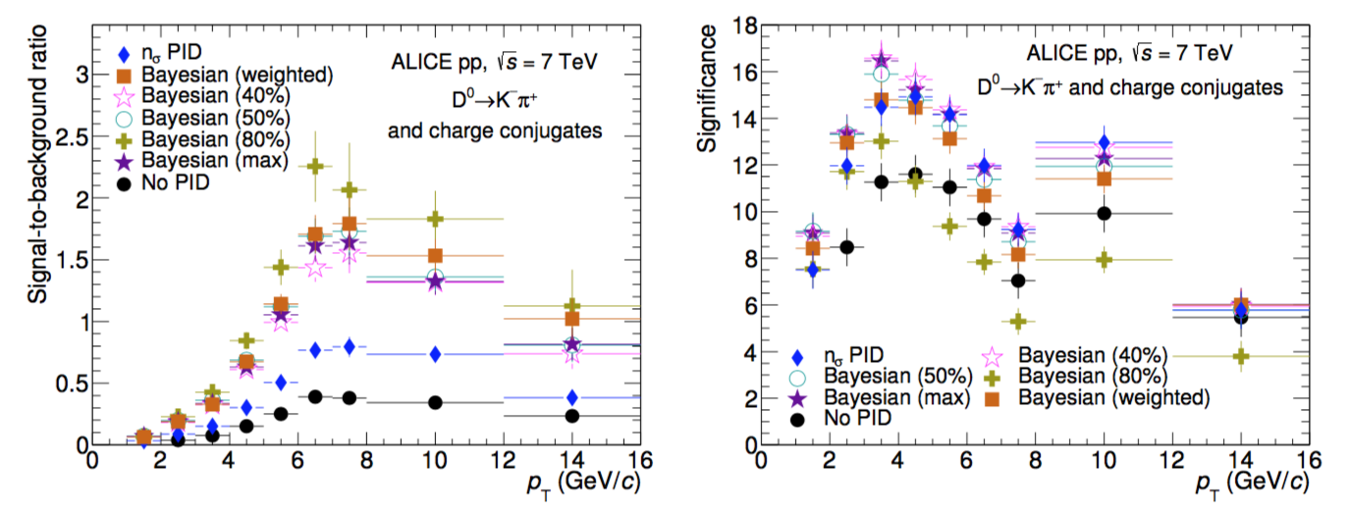
D⁰ : S/B ratio and significance
Many PID strategies compared!
arXiv:1602.01392
From S/B we see importance of PID selection: Bayesian with respect to n_{σ} → factor 2 increase
Significance is higher for Bayesian at low p_{T} and similar at higher p_{T} with respect to n_{σ}, except for the “high purity” (P>0.8) selection

Slide 24
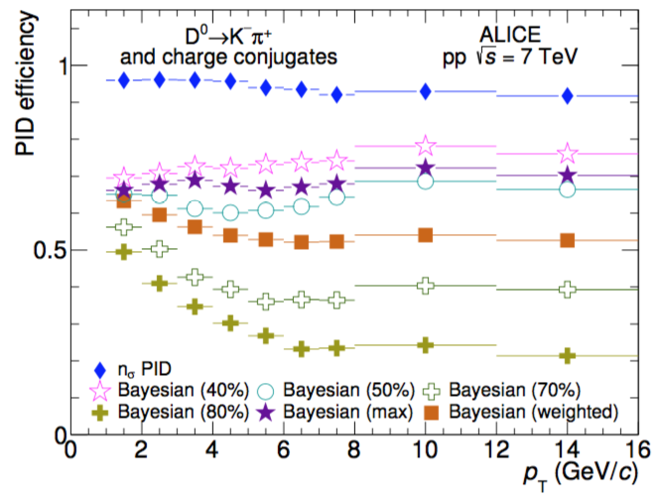
D⁰ : efficiency
arXiv:1602.01392
PID efficiency = proportion of D mesons in Monte Carlo that passed PID selection, having already passed other criteria
All Bayesian methods give an efficiency lower than n_{σ}
Benefit / potential drawback: stricter PID selection: higher purity, greater reliance on MC for efficiency correction (but this is not specific to Bayesian methods)

Slide 25
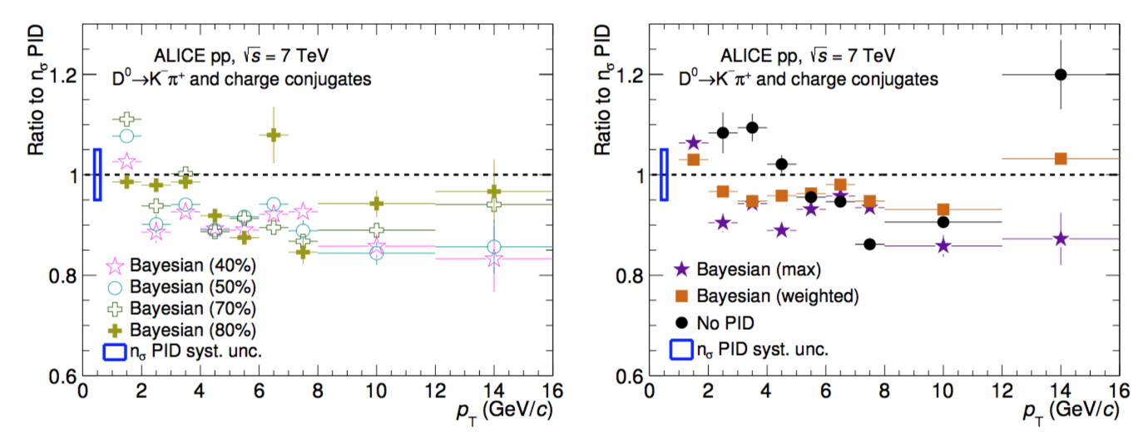
D⁰ : corrected yields
arXiv:1602.01392
Relative good agreement between Bayesian PID method and n_{σ}
Averaging over p_{T} the fixed threshold method gives a systematic between 5% and 9%
For weighted 3%, for max. probability 7%
Difference similar to the systematic uncertainty assigned to n_{σ} (5%)

Slide 26
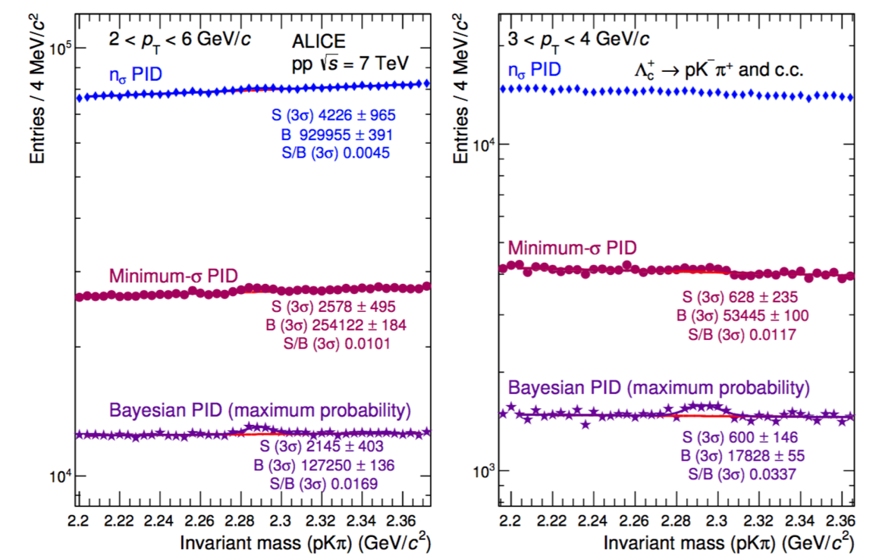
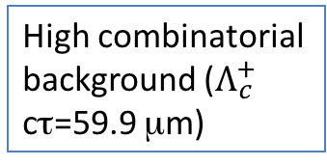



An exploratory study of $Λ_{c}^{+}→pK^{−}π^{+}$
arXiv:1602.01392
High combinatorial
background ($Λ_{c}^{+}$ cτ=59.9 μm)
Robust PID strategy
needed
TPC / TOF combination
n_{σ} uses 2-3 σ cuts
Minimum-σ PID tested as middle-ground (equivalent to max. probability but with ‘flat’ priors)
Factor 3 gain in S/B, factor 7 in B
Significance improves
Bayesian PID good candidate for $Λ_{c}^{+}→pK^{−}π^{+}$
SIGNIFICANCE | 2<p_{T}<6 GeV/c | 3<p_{T}<4 GeV/c
n_{σ} | 4.4 $±1.1$ | -
Minimum-σ | 5.1 $±1.0$ | 2.7 $±1.0$
Max probability | 6.0 $±1.1$ | 4.4 $±1.1$

Slide 27
Some literature and considerations
Bayesian approaches to combine information from different PID detectors have been already used by several experiments (e.g. NA27 [Z. Phys. C50 (1991) 405], HADES [Eur. Phys. J. A40 (2009) 45], BESII [Chin. Phys. C32 (2008) 201]
Bayesian neural networks used also to take decisions on the whole event selection [for example Xu, Ye et al. JINST 3 (2008) P08005]
At LHC (and HEP) is popular the Toolkit for Multi Variate Analysis [A. Hoecker et al. arXiv:physics/0703039 “a nice interface to a large number of algorithms” (quoting BABAR)]. It is used in many analyses by ATLAS/CMS/LHCb. ALICE is also starting to use it, not only combining PID information.
Well established existing trend of combining information for complex (“multivariate”) analysis: the Bayesian approach/results presented here are somehow “in the middle”: still keep PID ‘isolated’ but can be easily factorized in a MVA (a Bayesian PID probability becomes then one of the variables)

Slide 28




Summary and outlook
Bayesian method for PID in ALICE validated for a variety of analyses
In a PID experiment a selection on Bayesian probability is a request on purity →
The main benefit is to increase the purity of the signal combining information
from different detectors via a relatively simple technique
Iterative procedure for priors extraction tested and validated. Tested also the stability of analyses varying input priors.
Ability of Monte Carlo simulations to compute efficiencies and misidentification probabilities tested via high-purity samples (two-prongs decays)
A simple Bayesian approach able to reproduce published identified hadron spectra
Full comparison using D⁰ “candle”:
  Trade-off between between purity / higher dependence on MC
  Increase in S/B with respect to n_{σ}
  Similar or greater significance
  Corrected yield stable against the choice of the PID method
Bayesian PID approach will prove beneficial in future analysis
Analysis limited to TPC and TOF. But we used LS1 not only to make this study,
we completed also TRD….
ALICE Coll., “Particle Identification in ALICE: a Bayesian approach”
[arXiv:1602.01392, CERN-EP-2016-023]
Accepted for publication on EPJPlus

Slide 29

Thanks for your attention!

Slide 30
Backup

Slide 31

PID separation power / ALICE barrel
IJMPA 29 (2014) 1430044

