Slide 1
Some GPU activities at the CMS experiment
Felice Pantaleo
EP-CMG-CO

Slide 2
Outline
Physics and Technologic Motivations
Tracking
HGCAL clustering
CUDA Translation
Conclusion

Slide 3
Physics and Technologic Motivations

Slide 4
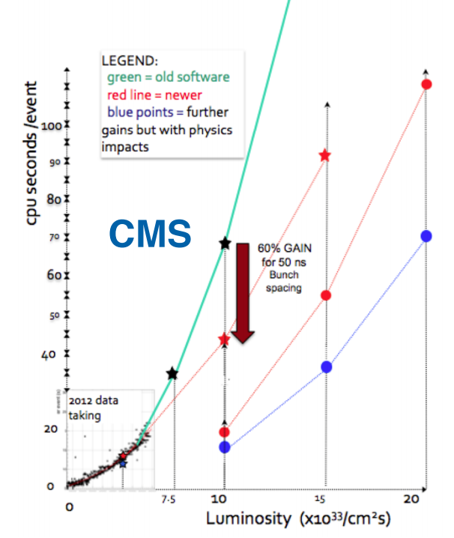
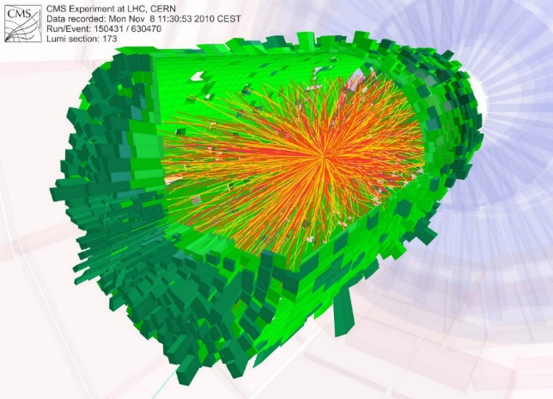
Physics Motivation
Time needed to process LHC events does not scale linearly with Luminosity
  Event complexity dominating ~O(μ!)
Line separating trigger electronics and software becoming thinner allowing improved triggers hence reducing rates
Software development is making continuously big strides

Slide 5
Trends in HEP computing…
Distributed computing is here to stay
Ideal general purpose computing x86 + Linux may be close to the end
More effective to specialize:
  GPUs specialized farms
  HPC platforms
  High Efficiency platforms (ARM, Jetson TX1…)
Used for different purposes
  Loose flexibility but may gain significantly in cost

Slide 6
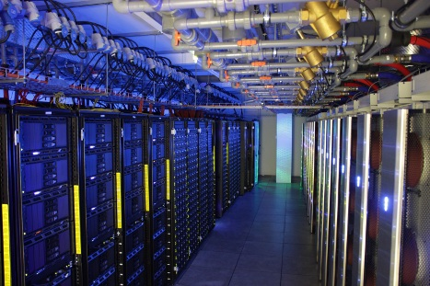
…and at the embedded frontier
Heterogeneous HPC platforms seem to represent a good opportunity, not only for analysis and simulation applications, but also for more “hardware” jobs
Fast test and deployment phases
Possibility to change the trigger on the fly and to run multiple triggers at the same time
Hardware development by Computer Graphics industry

Slide 7
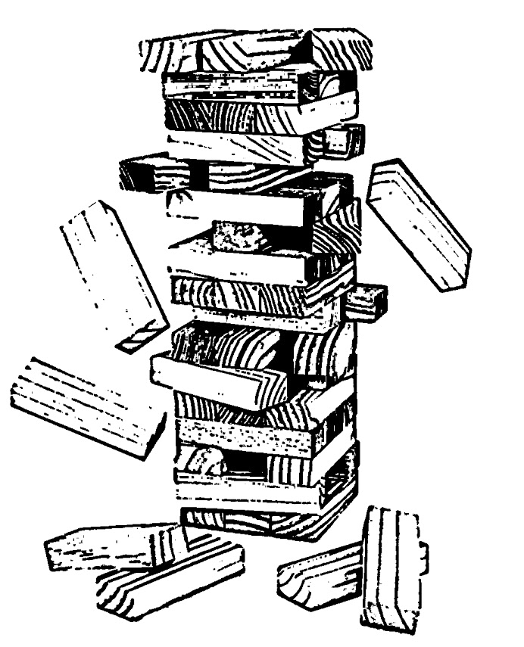
Tracking

Slide 8
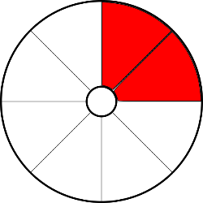
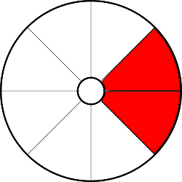
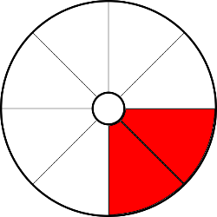

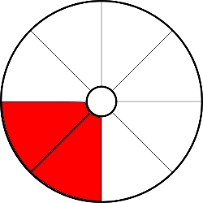
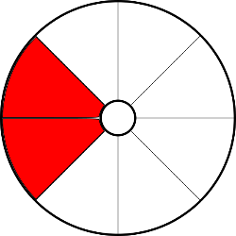
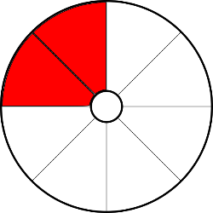

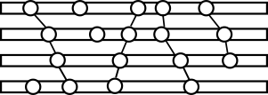
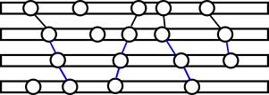
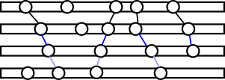
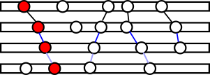
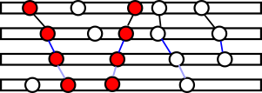
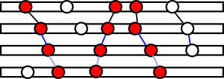
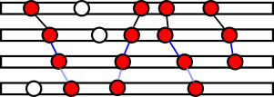

PATATRACK
PATATRACK
  It is a hybrid software to run on heterogeneous HPC platforms for emulating a GPU-based track trigger, data transfer and synchronization
  Preliminary studies, still first demonstrator
Tracker data partitioning
  Fast simulation on fast geometry and uniform magnetic field
  The information produced by the whole tracker cannot be processed by one GPU in a trigger environment
    However this is possible at HLT and Reconstruction stages
Low-latency data transfers between network interfaces and multiple GPUs (GPU Direct)
Cellular Automaton executes in-cache for lowest latency

Slide 9
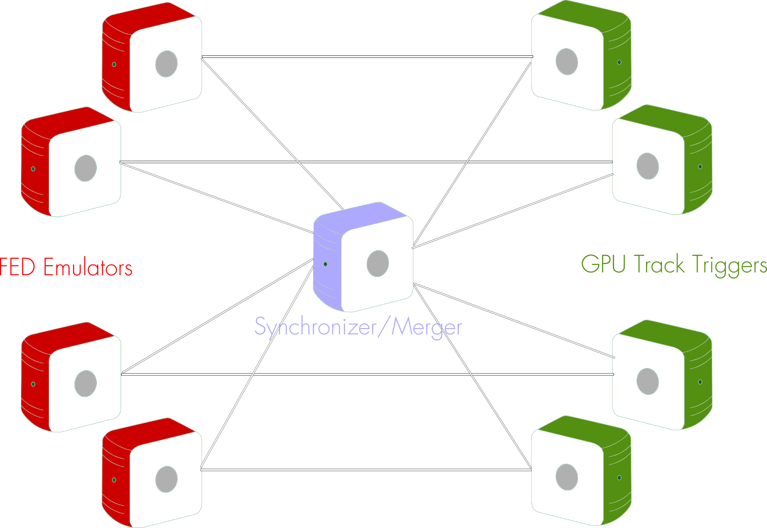

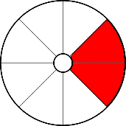

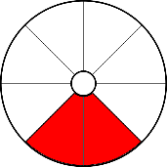
PATATRACK (ctd.)

Slide 10
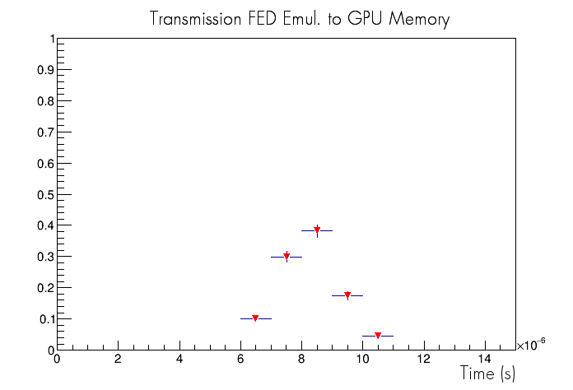
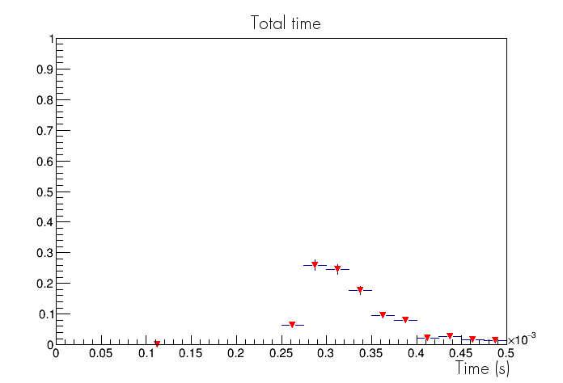
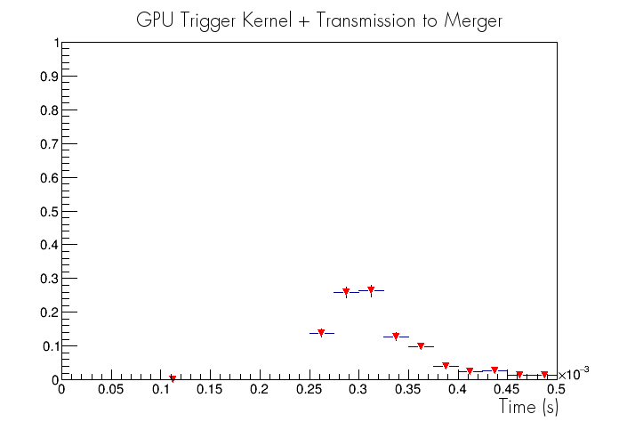
PATATRACK (ctd.)
System tested on Wilkes Supercomputer, at the University of Cambridge
GPU Direct very promising
  Data transmitted between nodes with lowest latency
Track Reconstruction highly dependent on the combinatorics
Ping times are included (t ~3μs)
Full scale tests on Microsoft Azure early access soon

Slide 11
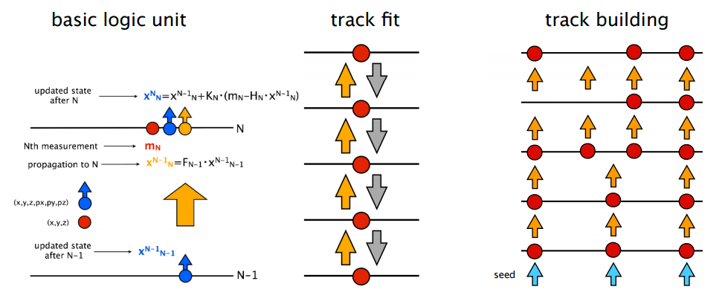
CMS – Vectorised Track Building on Xeon Phi
First version of vectorised and parallelised track building implemented
  Significant speedup achieved both on Xeon and Xeon Phi
  2x from vectorisation
  5x on Xeon and 10x on Xeon Phi from parallelisation
  Ideal scaling indicates a large margin for further improvements
G. Cerati et al.
Notes:
The track reconstruction process can be divided in 3 steps: track seeding, building and fitting.
The track fit is the bare repetition of the basic unit, ideal as a starting point.
Track building is the most time consuming part - it involves branching points of variable size,with the simplest version degenerating into the track fit case.
Track seeding under development but not included yet, for now seeds are defined using MC info.

Slide 12
Clustering at HGCAL

Slide 13
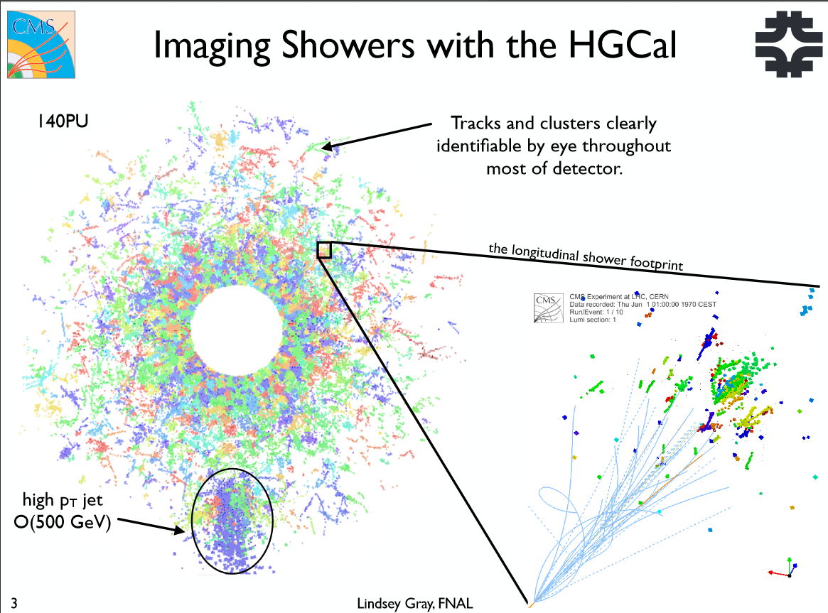
Clustering at HGCAL
CMS is investigating building a silicon based calorimeter for the forward region of the detector

Slide 14
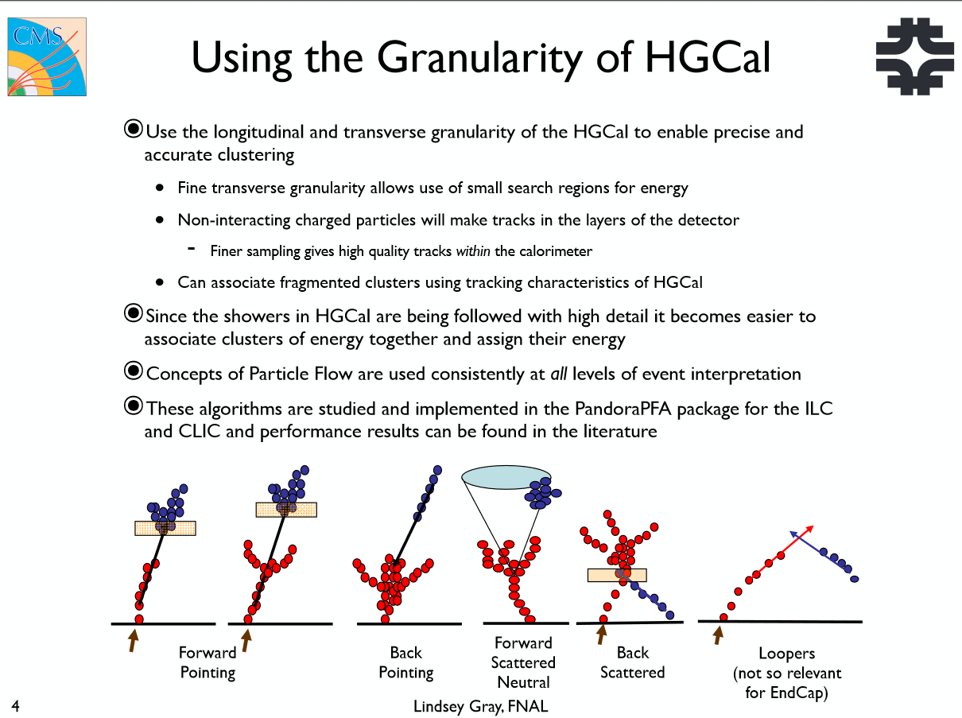
Clustering at HGCAL (ctd.)

Slide 15
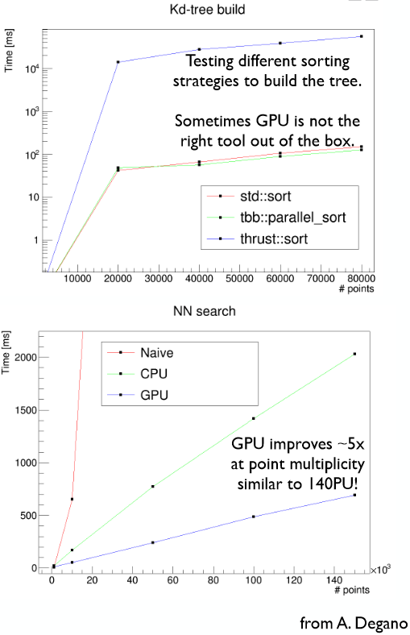
Clustering at HGCAL (ctd.)
Clustering in conditions of high pile-up becomes challenging
  Even more if you want to be ambitious and run this at HLT stage
PandoraPFA out of the box takes 1 hour/evt @140PU
  Can be reduced by factors by using more suitable data structures
The problem is perfectly suitable for running on GPUs
  Rethinking of data structures needed

Slide 16
Translating CUDA

Slide 17
CUDA Translation
What if somebody wants to run the very same CUDA algorithms on a machine that does not come with a GPU?
Translate CUDA to TBB using Clang
  Translating the CUDA program such that the mapping of programming constructs maintains the locality expressed in the programming model with existing operating system and hardware features.
CUDA | C++
block | std::thread / Task | asynchronous
thread | sequential unrolled for loop (can be vectorized) | synchronous (barriers)
Used source code | Time (ms) | Slowdown wrt CUDA
CUDA¹ | 3.41406 | 1
Translated TBB² | 9.41103 | 2.76
Native sequential³ | 22.451 | 6.58
Native TBB² | 14.129 | 4.14
L. Atzori

Slide 18
Conclusion
Heterogeneous computing is going to become the standard
  Actually outside HEP it is already
  Better catch the train, there will be no plug-and-accelerate solution
Current solution consists in throwing more events at the problem
  Fine for increasing throughput, but it’s not enough
  We may run out of memory
HL-LHC luminosity will pose a real challenge for hardware, software engineering, algorithms, parallelism
A careful design of heterogeneous frameworks needs:
  Choose the best device for a job
  Move the data near the execution
  Move the execution near the data
For trigger levels:
  Best possible code on best possible hardware
  Translation for legacy hardware

