Slide 1
LHCb GPU Computing status report
The manycore awakens

Slide 2
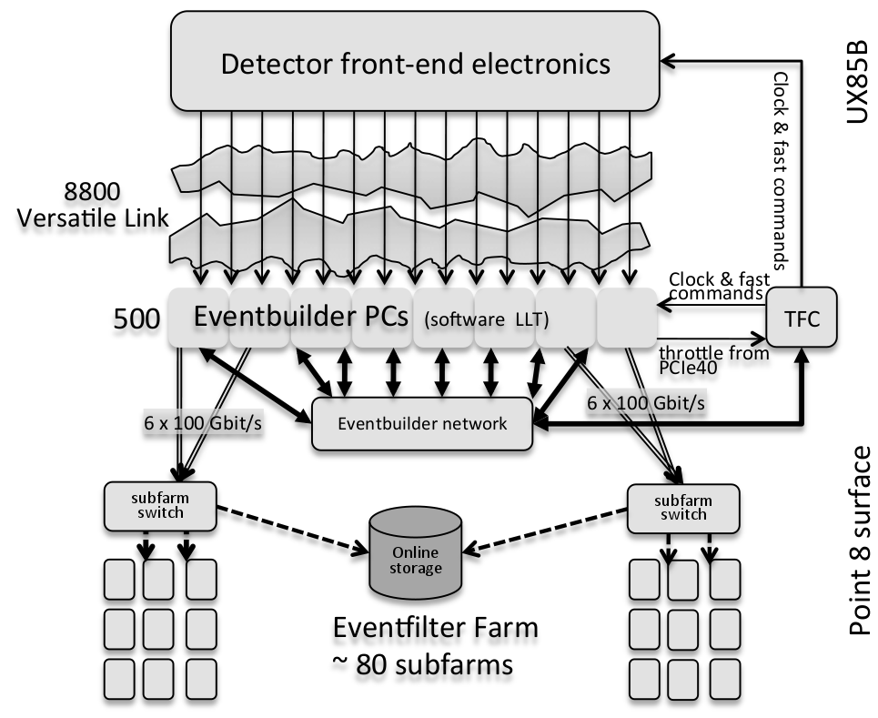
Trigger refurbish in 2020
LHCb is going for a full software trigger in 2020
  The detector will produce 30M events per second
  Each server will have to sustain 10.000 events per second
    20x more than in the current Run2
Direct consequences
  We are evaluating other hardware architectures
  Architecture-aware programming becomes more relevant
  Framework will require deep structural changes

Slide 3
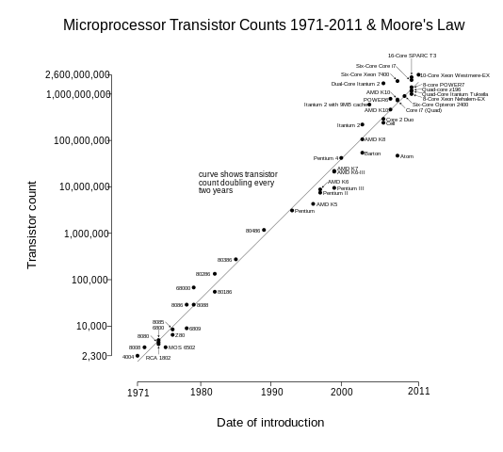
The landscape of processors
Architecture choice is not anymore a no-brainer:
  x86_64, OpenPower, ARM64, GPUs, KNL
The transistors count is not a free meal anymore
  Xeon Phi, KNL: 60+ cores
  NVIDIA: 2000+ (CUDA) cores
"Transistor Count and Moore's Law - 2011" by Wgsimon - Wikipedia

Slide 4
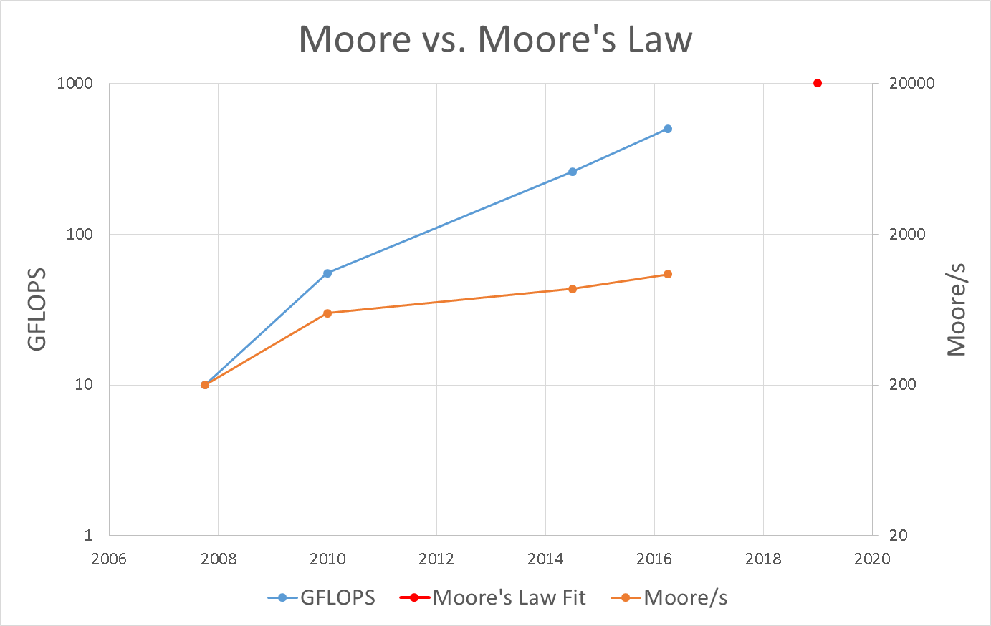
Our reality at present
Software is not fully harnessing current hardware
  x86-centric codebase
  Optimistic Upgrade predictions for 20XX
The usual suspects in software
  Data locality, cache
  AOS vs SOA
  Multi-threading support
This is intrinsically correlated with Hardware
  Memory hierarchy
  SIMD
  Core count
Approximately 80% of
available compute power is
currently unused (vs. 2007)

Slide 5
Projects related to GPU Computing at LHCb
  Completed
  Ongoing
  Starting 2016
  Velopix reconstruction
  GPU server integration
  Coprocessor manager
  Velopix on OpenMP
  Forward tracker on automata
  lhcb-parallelization wg
    Upgrade forward tracker
    Kalman filter
    PID analysis
      RICH reconstruction
      ProbNN

Slide 6
Velopix on OpenCL
  Track forwarding
    Find track seeds and forward them on each sensor consecutively
  Hough transform
    Represent all possible lines crossing a point and find intersections
  Retina algorithm
    Recognise preexisting patterns, match hits against DB
  Other approaches
    Automata approach
    dxdy and segment extrapolation matching

Slide 7
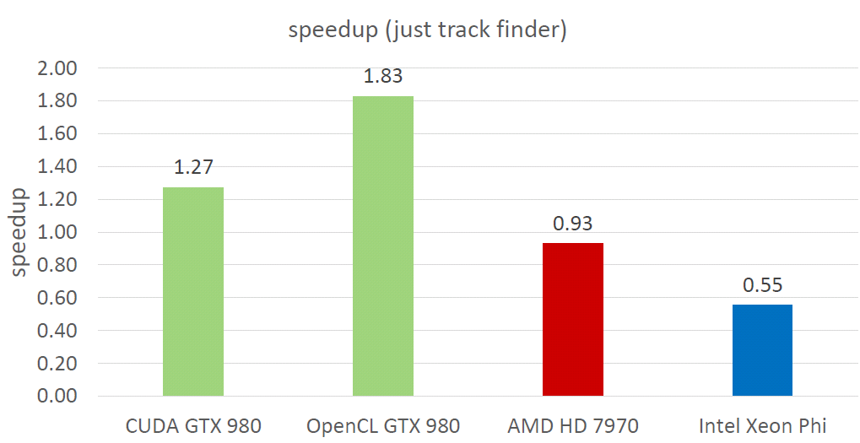
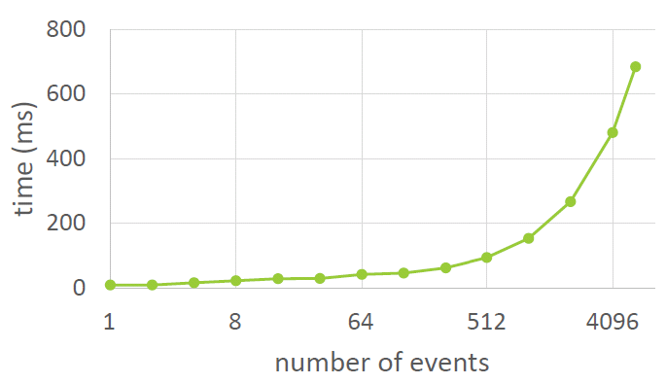
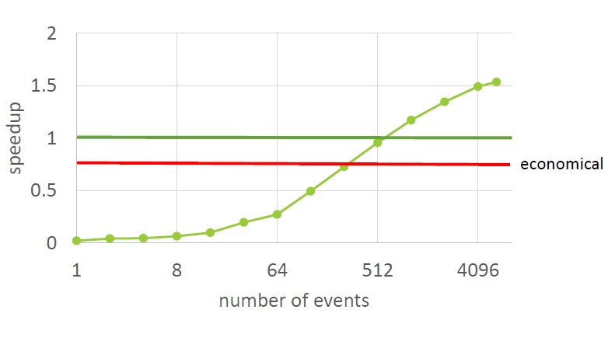
Velopix results
    Sequential is run on a fully loaded one Intel® Xeon® CPU E5/2630 v3 @ 2.40 GHz
    Comparison is done for throughput – events processed per second.
    Note the sequential version is vectorised.
    Results on the right are for the OpenCL GTX 980 implementation.

Slide 8
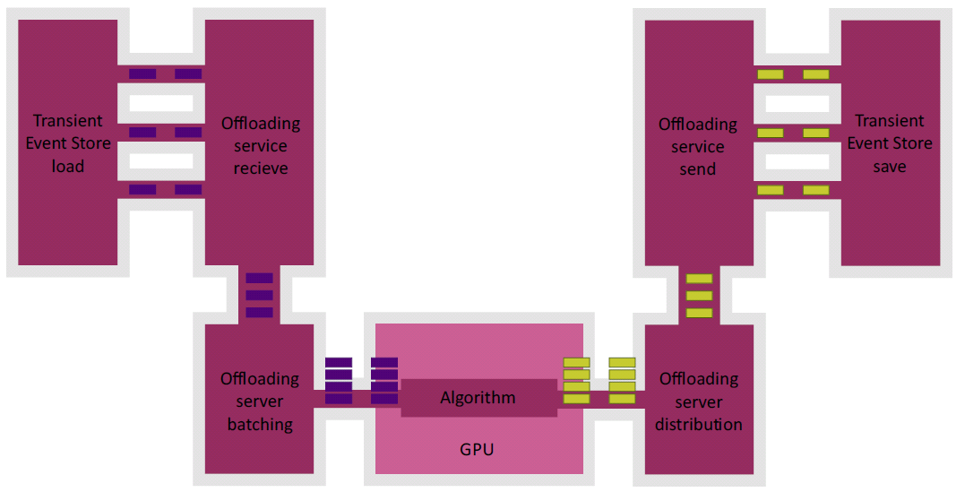
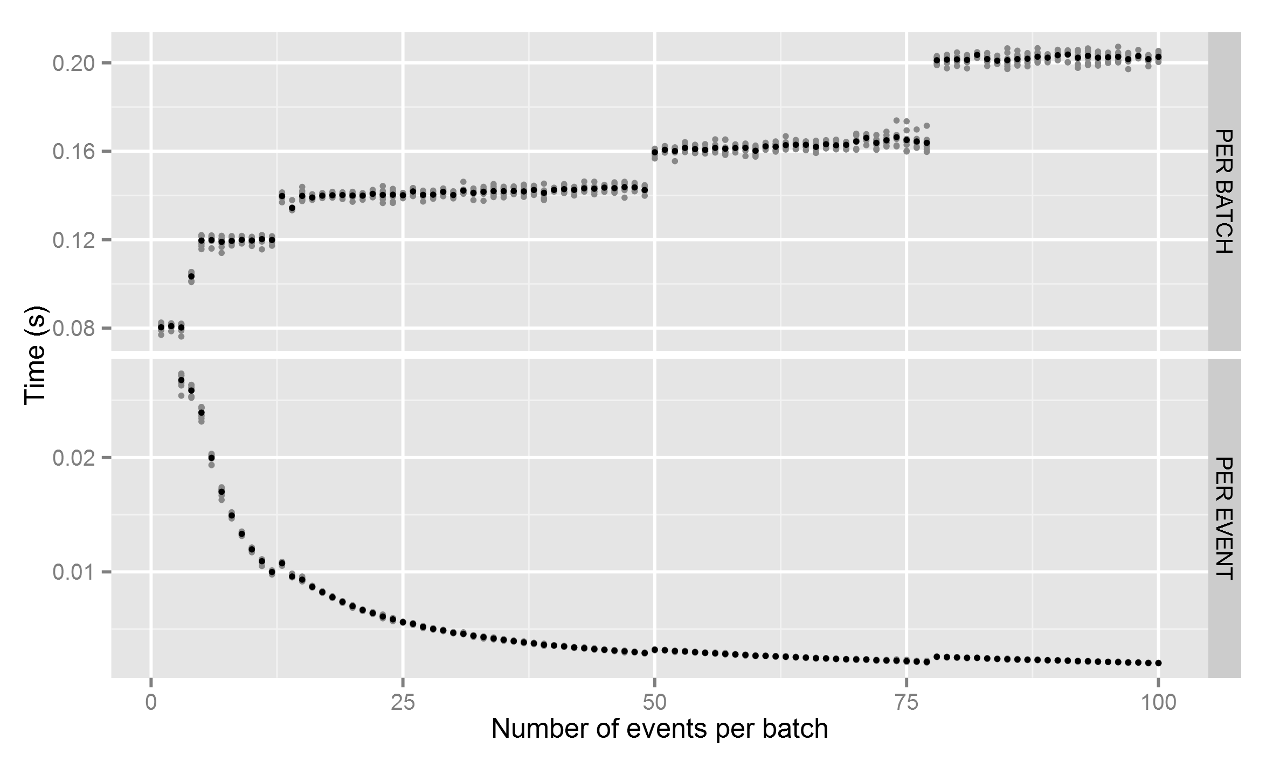
Coprocessor manager
The coprocessor manager allows accelerator hardware usage for massively parallel computation within LHCb’s framework.
Some things the coprocessor manager does
  Automatically batches data
  Schedules algorithms
  Can be used across a network
  Can run GPU and CPU algorithms side by side
  Helps out in algorithm development

Slide 9
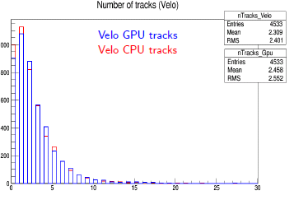
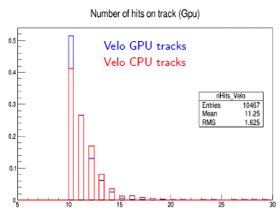
GPU server integration
  Proof of concept GPU server integration
  CPU HLT chain, reconstructing events with GPU-based tracking
  Some early conclusions
  Software chain is not prepared for seamless integration, many tweaks were required
  External hardware is integrated through coprocessor manager

Slide 10
Forward tracking automata implementation
Adapted CA algorithm:
  Automata track finding procedure: tracklet generation – neighbour finding – evolution and track formation
  Do not build “long tracklets” – This reduces combinatorial
  Build tracklets between x-layers
  Add stereo hits to x-tracklets and form a “stub”
  Fit and kill bad tracklets with a cut on chi2
  Evolve and select candidate tracks
Reconstruction efficiencies and ghost rate are reasonable.
Next steps:
  Improve efficiencies and CPU timing
  Study performance on manycore architectures

Slide 11
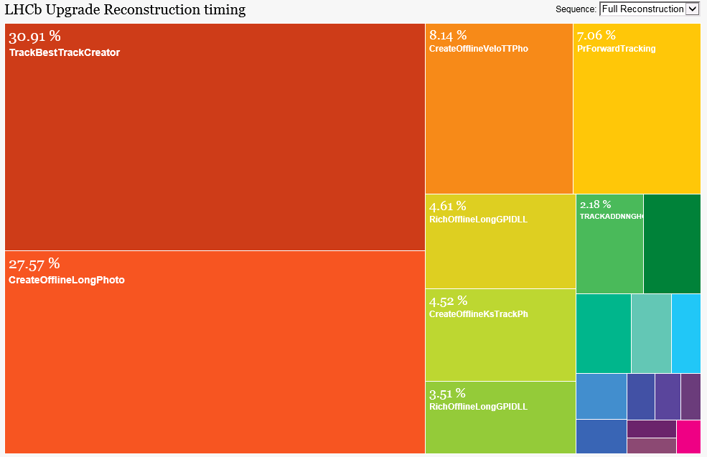
Parallelization is on the rise
  The LHCb community is becoming more aware of the challenges software poses for our Upgrade
  By end of 2016 we want an evaluation of most relevant software algorithms and hardware architectures
    Vectorisation, OpenMP, CUDA, OpenCL, [insert programming model]
    x86_64, NVIDIA, KNL, OpenPower, ARM64
  Based on this study, we will determine what to go for and factor in other as relevant considerations
    Scalability, readability, integration, maintainability
    Hardware failure rate, training, manpower
  Good quality software should not only do Physics!

Slide 12
Resources here and there
  LHCb Upgrade dokuwiki
    https://lbdokuwiki.cern.ch/upgrade:main_page
  6th LHCb Computing workshop
    http://indico.cern.ch/event/337568/session/5/?slotId=0#20151116

