Slide 1
Hardware Support for GPU Computing from IT
Fons Rademakers, CERN openlab Chief Research Officer
GPU Computing Event, CERN, 12-1-2016

Slide 2
Intel Modern Code Developer Challenge

Slide 3
The Challenge - Speedup Brain Development Simulation Code
Original code is 14000 lines of Java
Recoded in C++
CERN openlab provided a summer student to start this task
Intel provided tools and hardware
A 500 line kernel from this program was used for the Challenge
This kernel took 45 hours to run with the target set of parameters

Slide 4
The Prizes
1 Grand Prize: CERN openlab fellowship
3 First Prizes: visit to CERN
3 Second Prizes: visit to SC’16

Slide 5
Contestant Engagement
17000 students reached
2077 students registered for the challenge
  130 universities
  19 countries
Over 1200 code downloads
1000 students accessed free training

Slide 6
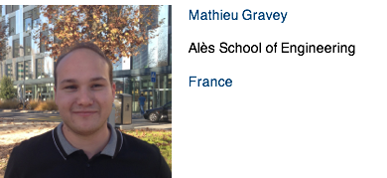
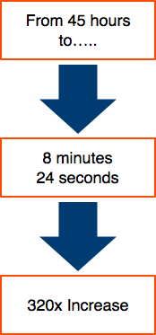
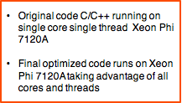
Grand Prize Winner

Slide 7
Mathieu’s Optimisations
Change from AoS to SoA to allow vectorisation and improved cache layout
Custom memory allocator, reuse memory for many small memory allocations
Use OpenMP for parallelisation over all Xeon-Phi cores
Use icc scatter/gather intrinsics
Code Modernisation Can Payoff Big Time

Slide 8
Idea: Create CERN Modern Code Developer Challenge
Find critical pieces of code in CERN programs
Put them up for the acceleration challenge
Keep running scores of fastest times to create competition
Allow students to refine their submissions till end of challenge
Thinks of some nice prizes
Also a perfect requirement tool ;-)

Slide 9
IT GPU and Co-Processor Hardware Support - TechLab

Slide 10
TechLab
TechLab is an IT project providing a test environment aimed at improving the efficiency and performance that can be obtained from modern hardware
TechLab systems are operated, as evolving test systems, on a best effort basis
  Not to be used for production work
  Host are reinstalled on a regular basis and user data is deleted
  Machines can be booked for a limited amount of time
For more on TechLab see: https://twiki.cern.ch/twiki/bin/viewauth/IT/TechLab

Slide 11
Current TechLab Systems

Slide 12
Conclusions
Code modernisation, vectorisation and parallelisation, can result in big performance increases
TechLab has a number of GPU and co-processor systems available
We would like to extend TechLab and make it a real supported service
Need user feedback and requests for more support and hardware
Please use it

