Slide 1
State of discussions in preparation for the HL-LHC Circuits Review
F. Rodriguez-Mateos
with inputs from G. Ambrosio, B. Auchmann, J.-P. Burnet,
A. Fernandez Navarro, E. Ravaioli, G.-L. Sabbi, E. Todesco, A. Verweij, D. Wollmann,
and many other CERN and colleagues outside

Slide 2
Outline
The Review Programme
Rationale for baseline
Main proposals:
  Inner Triplet
  D1/D2

Slide 3
Outline
The Review Programme
Rationale for baseline
Main proposals:
  Inner Triplet
  D1/D2

Slide 4
https://indico.cern.ch/event/477759/
Review panel:
        Akira Yamamoto (CERN & KEK, Chair),
        Guram Chlachidze (FERMILAB),
        Arnaud Devred (ITER),
        Chen-Yu Gung (ITER),
        Davide Tommasini (CERN),
        Rudiger Schmidt (CERN),
        Markus Zerlauth (CERN, Sc. Secretary).
The review is scheduled on 21st to 23rd March 2016 with the close-out on 23rd March at CERN at 16:00
Review Organization Office: Julia Cachet & Cecile Noels

Slide 5
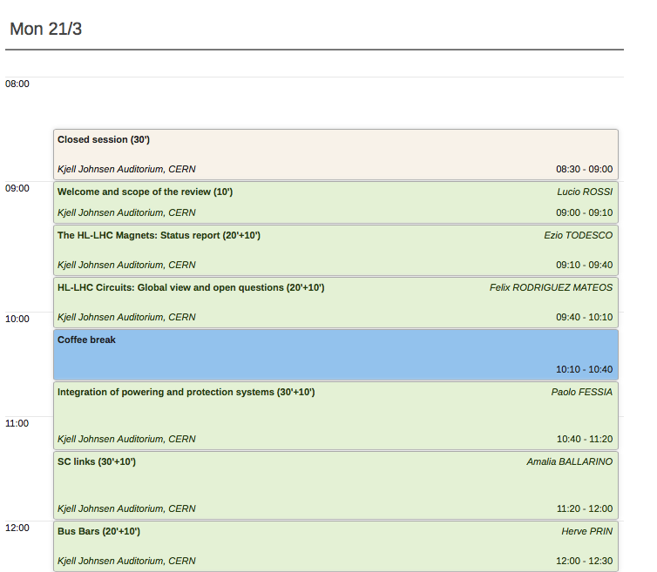

Slide 6
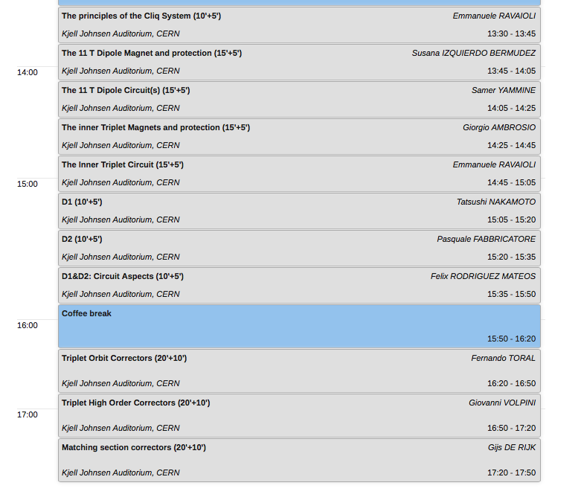
Monday (cont.)

Slide 7
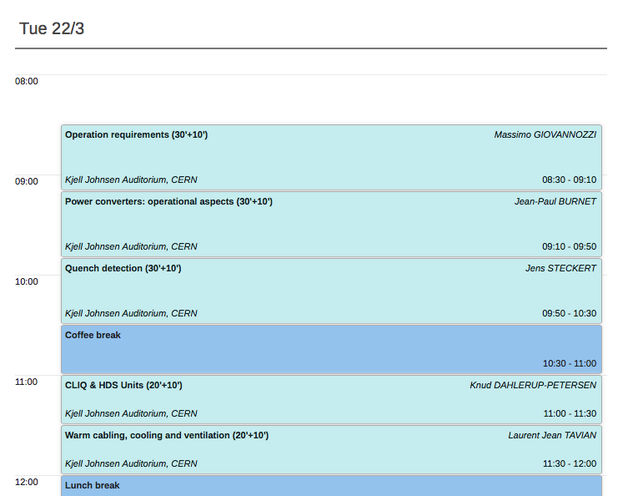

Slide 8
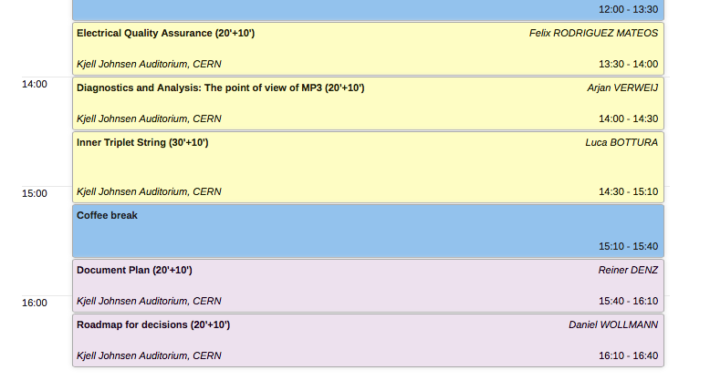
Tuesday cont.

Slide 9
Outline
The Review Programme
Rationale for baseline
Main proposals:
    Inner Triplet
    D1/D2

Slide 10
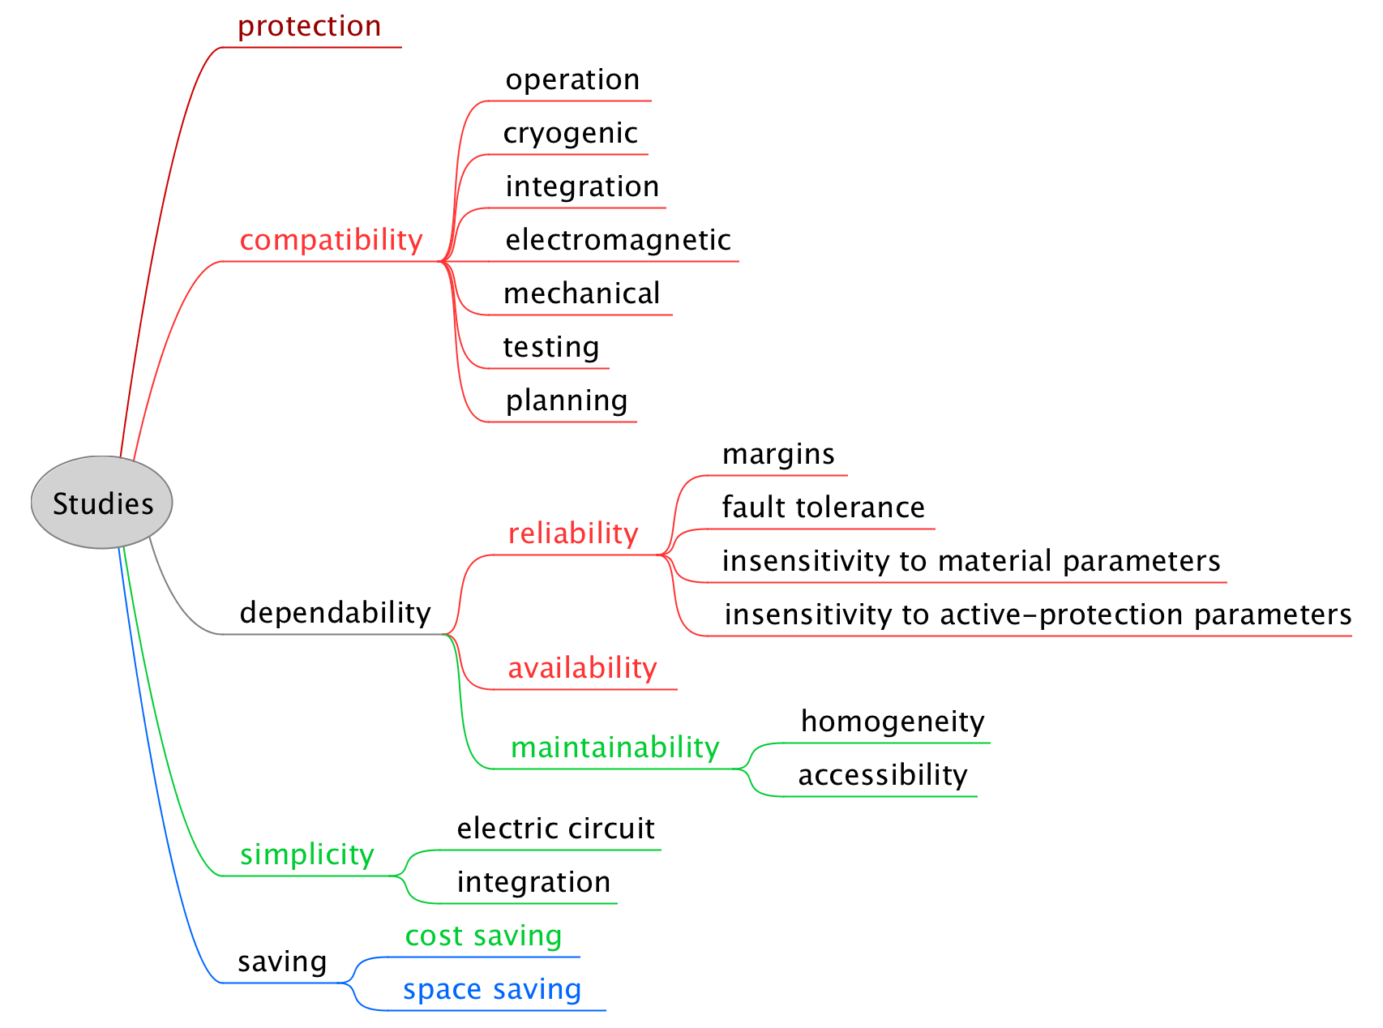
in terms of peak temperature and voltages,
Goals: Tpeak < 350 K, Vpeak < 1.5 kV
in terms of peak temp. and voltages
Goals: Tpeak < 300 K, Vpeak < 1 kV
includes probability analysis:
protection goals for very rare failures;
contingency goals for expected failures.
Mean-time to failure (MTTF)
Mean-time to repair (MTTR)
B. Auchmann, D. Wollmann

Slide 11
Some questions for a new baseline (1/2)
Number of circuits
Ramp-down speed
  Power converter technology issues
  Losses in passive elements
Protection means
  Number of heater strips in active use, how many as spares
  HDS parameters, redundancy (capacity, triggering)
  Number and connection of CLIQ units
  CLIQ parameters, redundancy (capacity, triggering)
  Parallel elements
  Lead design (CLIQ, bypass and heaters)
  Heater & CLIQ polarity assignment

Slide 12
Some questions for a new baseline (2/2)
Detection and related instrumentation
  Taps (incl. symmetric detection)
  Logic (voting, redundancy)
  Variable thresholds
Monitoring
  Online monitoring, interlocking
  Post-mortem data
Test and reception criteria
…

Slide 13
Outline
The Review Programme
Rationale for baseline
Main proposals:
  Inner Triplet
  D1/D2

Slide 14


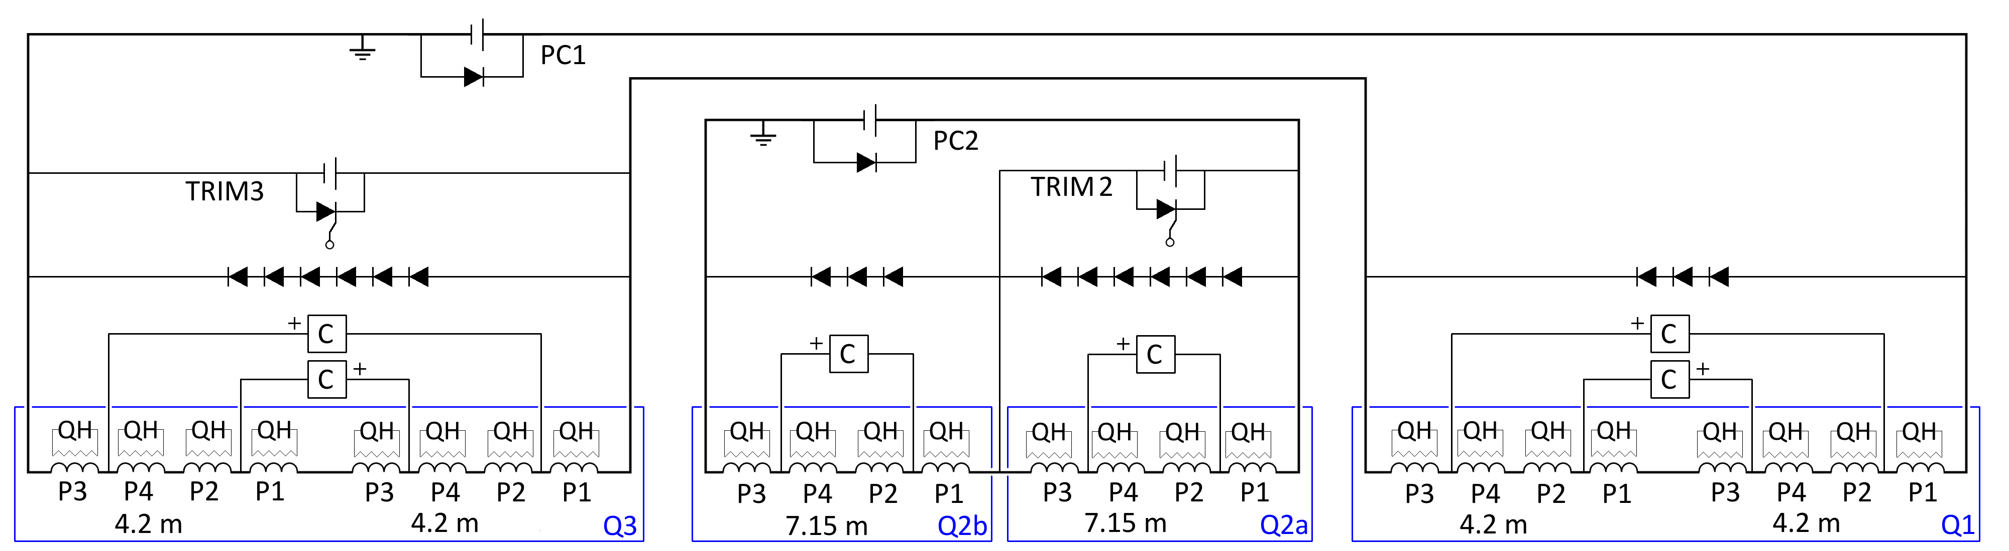
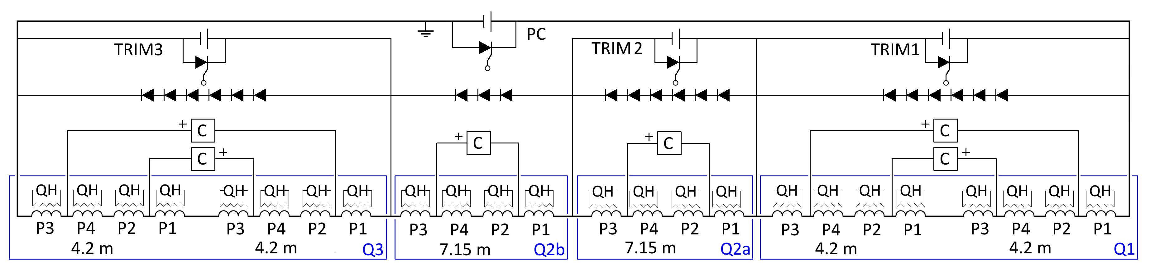
Powering scheme
Baseline: Two main 1-quadrant power supplies + 2 trim power supplies
Slow discharge with free-wheel discharge
Proposal: One main 2-quadrant power supplies + 3 trim power supplies
Slow discharge achieved with 2-quadrant supply

Slide 15
Why do we need parallel elements?
  Voltages to ground reduced by means of parallel elements across parts of the circuit which equalize the voltage distribution
  Avoid very high voltages to ground in several CLIQ failure cases
  Cold parallel diodes are probably incompatible with the very high expected radiation dose in the interaction regions
  Proposed solution: Warm parallel diodes utilizing existing leads of the trim supplies (but needs different connection schemes for Q1/Q3 and Q2a/Q2b)
  Back-up solution: 1Ω parallel resistors (but leakage currents, cryo loads)
No parallel elements
1 Ω resistors
Warm diodes
Q1
Q2a
Q2b
Q3

Slide 16
CLIQ configuration
6 CLIQ units and 4 warm diode strings per triplet
  Electrically equivalent to the previous 6-CLIQ configuration, but voltage to ground greatly reduced in the case of misfiring of one CLIQ unit
  Hence, additional current lead between the 2 magnets of Q1/Q3 not needed
  All parallel elements can be installed to the leads already foreseen for the trim power supplies
  Polarities of the CLIQ units is a key ingredient! (QA, testing at 50 V)
  All CLIQ units have the same capacitance (easier to design, manufacture, maintain the units). Units connected to Q1/Q3 can be charged to a lower voltage (600 V? 800 V?)
  Warm diodes are preferred over resistors (no leakage current during ramps, better control of the voltages to ground in failure cases)

Slide 17
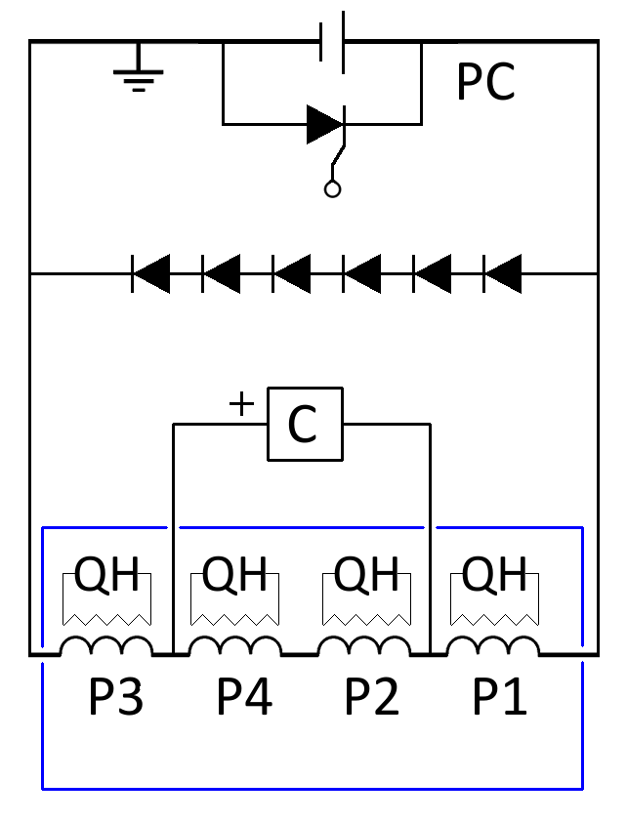
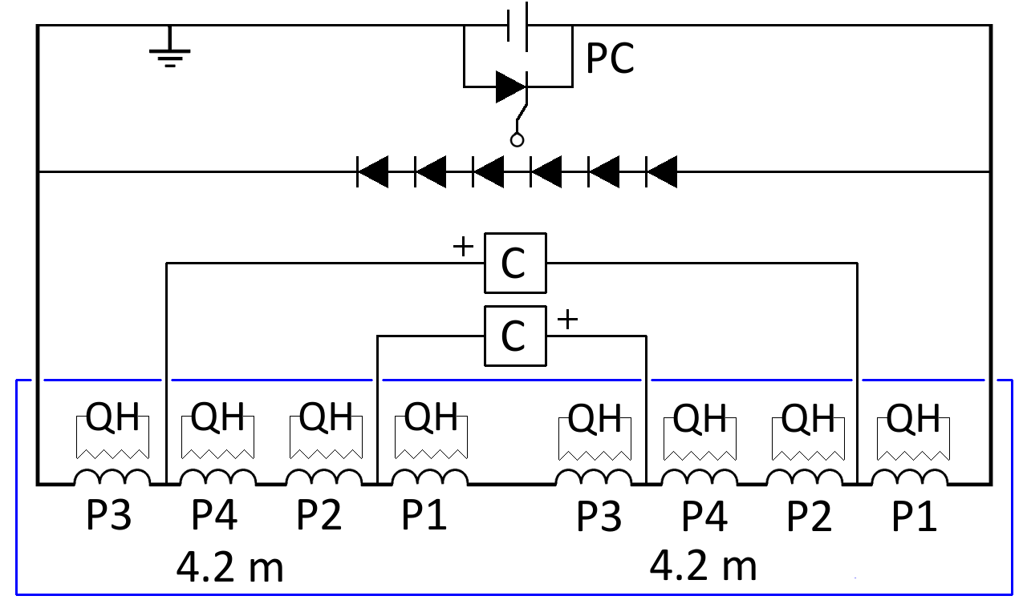
Test of magnets and cold masses
6 CLIQ units and 4 warm diode strings per triplet
Magnet test (7.15 or 4.2 m long)
Cold mass test (2x 4.2 m long)

Slide 18
Replies to open questions
Open question | Option 1 | Option 2 | Option 3
How many main power supplies per triplet? | 2 PC | 1 PC
Slow circuit discharge | Free-wheel | 2-quadrant PC
Energy-extraction system? | YES | NO
CLIQ connection | 6-CLIQ, 6 Diodes | 4-CLIQ, 4 Diodes | 6-CLIQ, 4 Diodes
Type of parallel elements | None | Warm Diodes | Warm Resistors
CLIQ parameters for the units of Q1/Q3 | Same C, Same U0 | Same C, Different U0 | Different C, Different U0
Level of redundancy - CLIQ | Full CLIQ capacitance | Reduced CLIQ capacitance
Level of redundancy - QH | Trigger Out-HF, Out-LF, In QH | Trigger Out-HF, Out-LF | Trigger Out-HF
QH connection scheme | See next
Failure cases to consider | See next
Specifications CLIQ terminals/leads | On going
Modified from a slide by E. Ravaioli/G.L. Sabbi

Slide 19
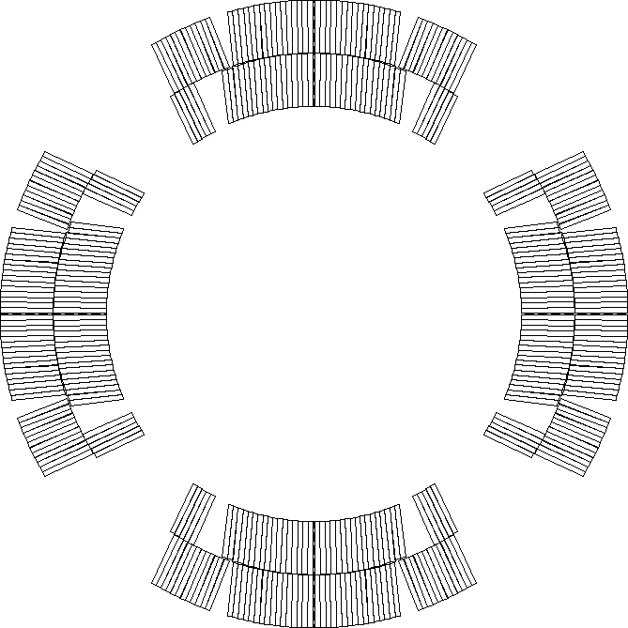
Proposed QH connection scheme
Assuming each QH supply is connected to 2 strips in series (other options are possible)
LF3
LF2
HF3
HF2
  Connection scheme that compensates the voltages induced by CLIQ and QH
  Connecting in series 2 strips attached to different poles reduces the effects of failures (hot-spot temperature, voltage distribution)
HF4
HF1
IN3
IN2
LF4
IN4
IN1
LF1
LF1
IN1
IN4
LF4
IN2
IN3
HF1
HF4
  Only half of the circuits shown
HF2
LF2
LF3
HF3

Slide 20
Worst-case analysis
  The probability of particularly dangerous failure cases can be almost nullified by implementing the proposed mitigations.
  In the remaining “realistic” failure cases, the worst-case analysis yields
  Peak hot-spot temperature: 305 K
  Peak voltage to ground: 520 V
  Peak coil-to-QH voltage: 500 V
  Peak mid-plane voltage: 500 V
  Peak layer-to-layer voltage: 500 V
  Peak turn-to-turn voltage: 50 V

Slide 21
Outline
The Review Programme
Rationale for baseline
Main proposals:
  Inner Triplet
  D1/D2

Slide 22
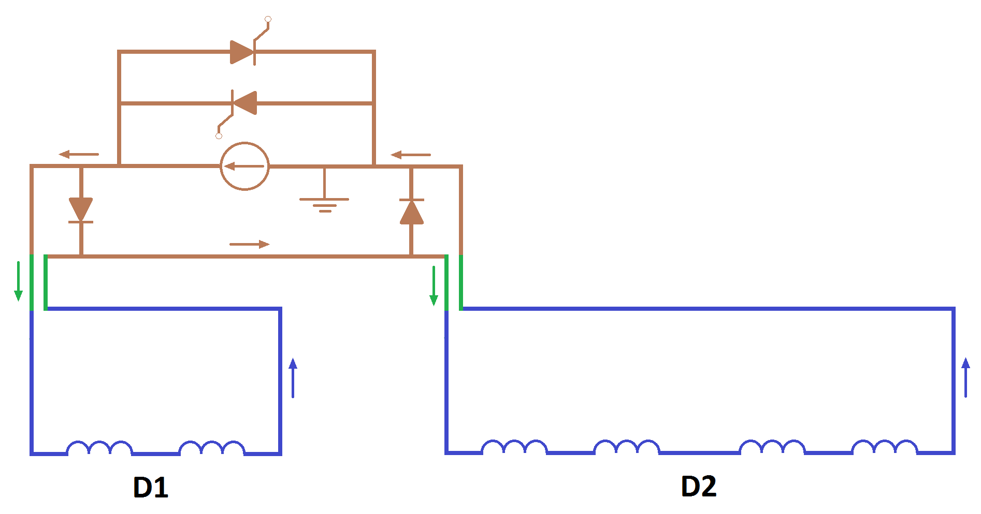
1 or 2 Circuits
The proposed single-circuit configuration differs from a two-circuit solution only on the warm side. A change between configurations is possible.
The powering through a single 13-kA PC brings substantial cost savings.
No trims are necessary (E. Todesco).
Warm bypass diodes decouple the protection of D1 and D2. There are no unprotected cold busbar segments/splices.
The bridge should be done close to the PC, not close to the DFB, in order to avoid creating a large inductive loop, i.e., the circuit should look as closely as possible as the two-circuit solution with only a short bridge on the PC side (J.P. Burnet)
The warm diode must be connected as close as possible to the DFB, otherwise the diode would see the voltage across the warm busbars, i.e., several volts in opening direction (J.P. Burnet)
PC with crowbar
Warm bypass diodes
SC Link D1/Triplet
+ HTS leads
Warm bridge
SC Link D2/Q4 + HTS leads

Slide 23


Warm Bypass Diodes
Warm bypass diodes decouple the protection of D1 and D2.
  Without bypass diodes, small differences in protection efficiency make one magnet absorb stored energy of the other magnet.
In failure scenarios, diodes reduce voltages to ground.
The warm bypass diode represents a new critical protection element that needs to be developed and tested with its heat sink and leads.

Slide 24
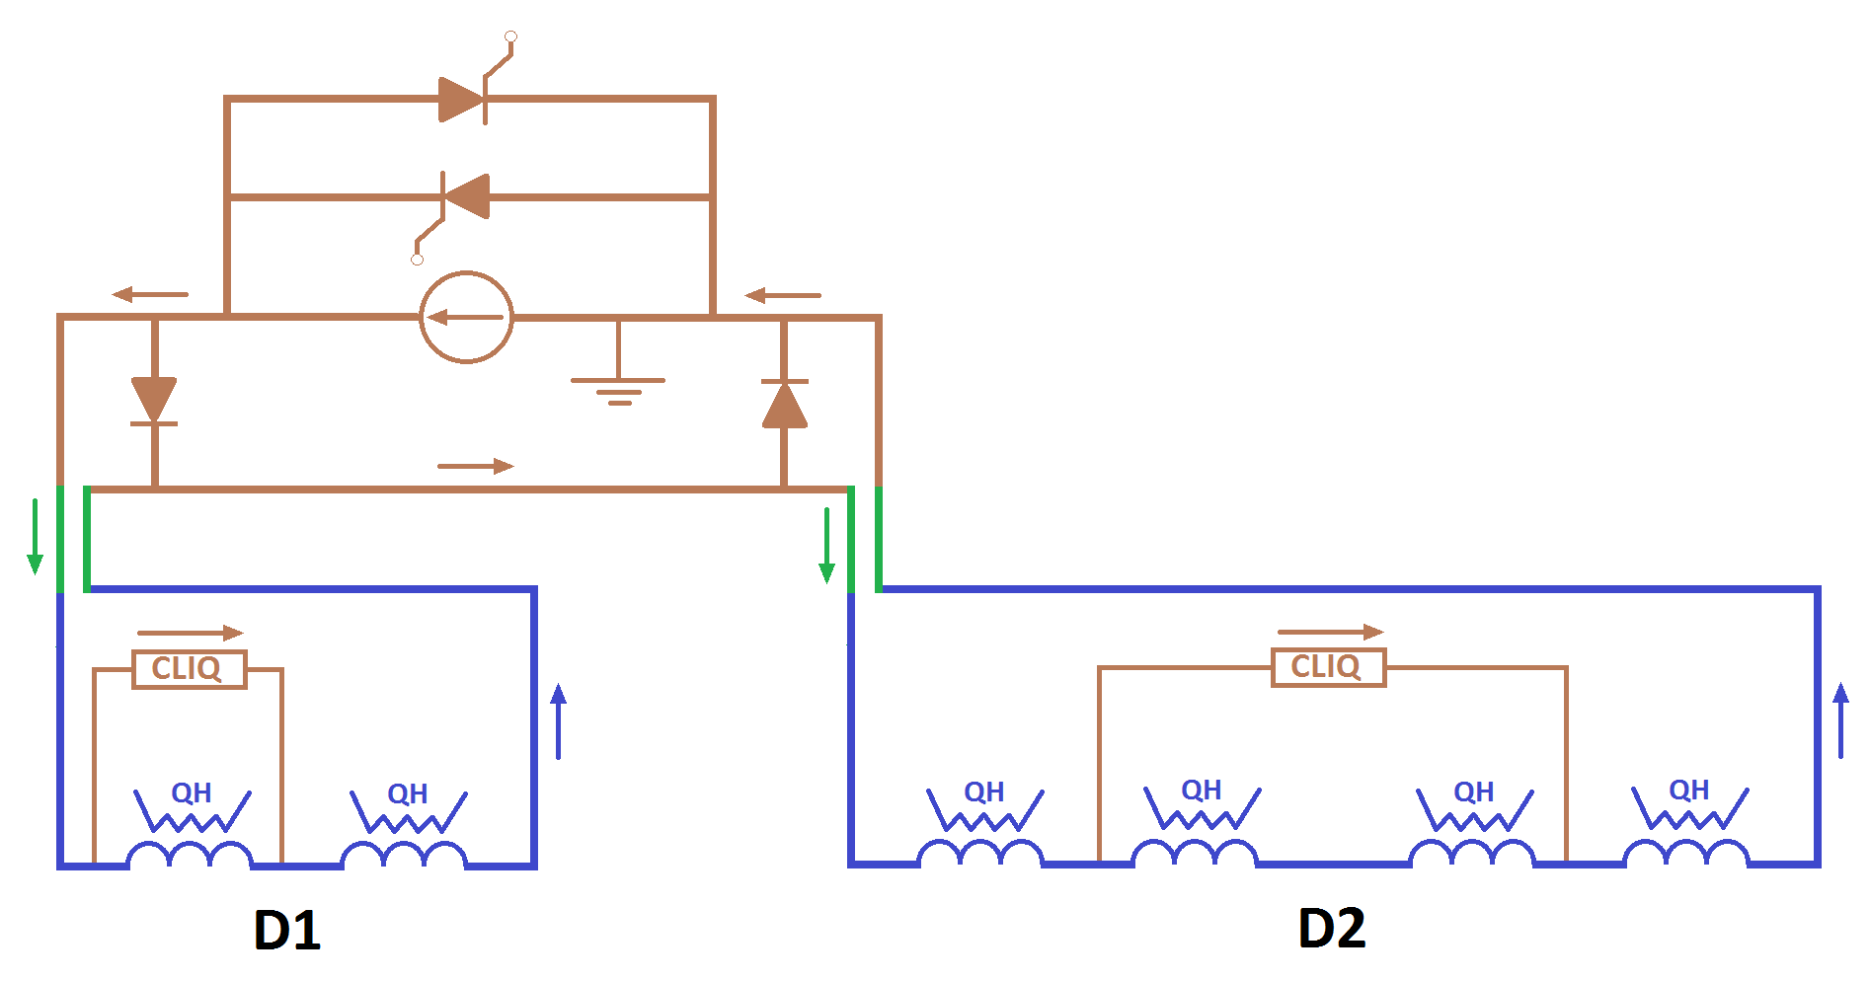
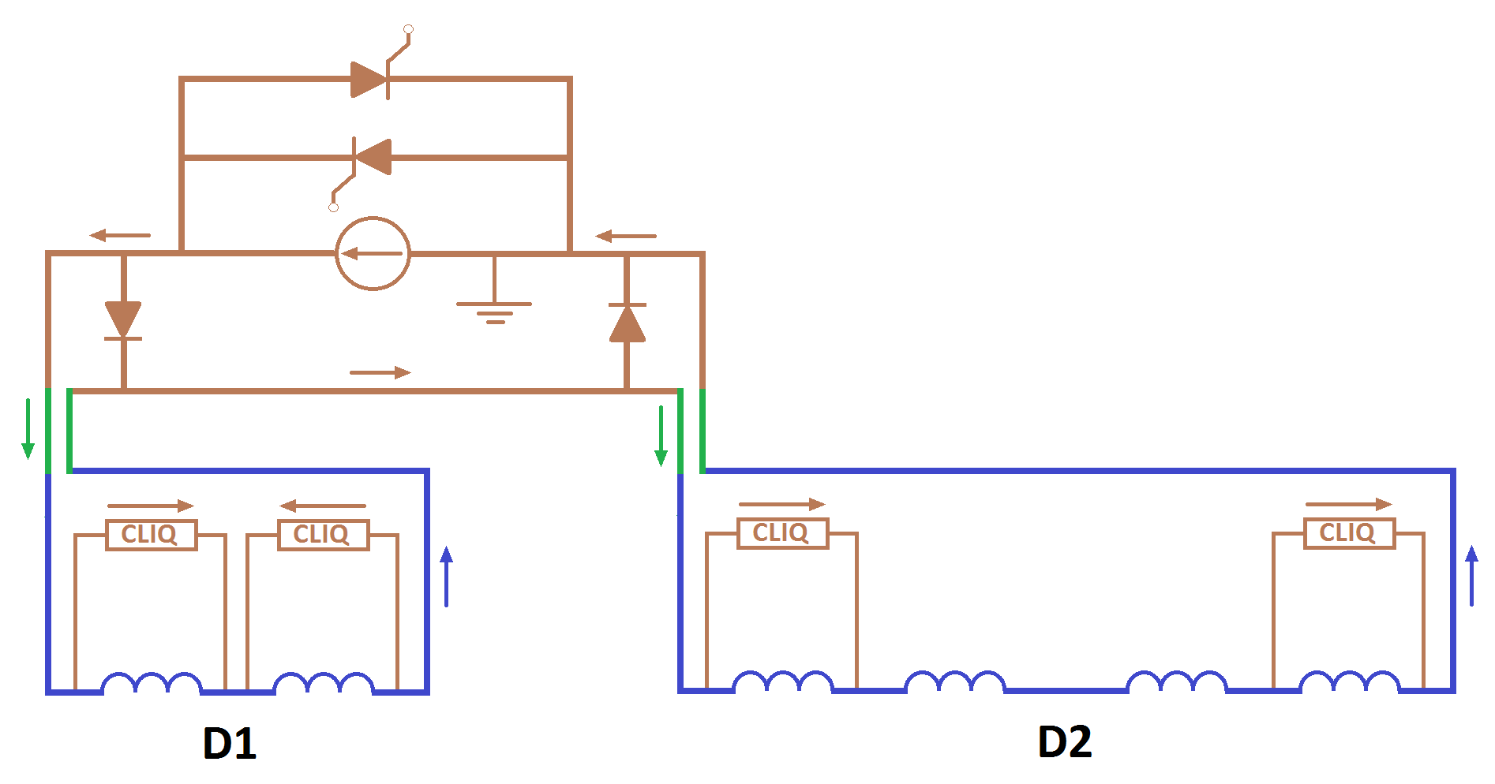
Heaters or CLIQ?
Both systems effectively and redundantly protect the magnet.
Being single-layer coils, the difference between CLIQ and heaters in terms of hot spot temperature is small (~270 K hot spot in D1, lower in D2).
Voltage to ground during nominal operation is higher with CLIQ (~700 V).
Heater power-supply failures lead to comparable voltages to ground.
Main difference between CLIQ and heaters is that CLIQ is a new system.
We propose redundant heater-protection, the installation of CLIQ leads, and high-voltage reception tests compatible with the use of CLIQ.
Heaters with optional non-redundant CLIQ.
Fully redundant CLIQ-only protection

Slide 25
Heater Redundancy
(Very) worst case assumptions:
  up to two heater power-supply per magnet might fail during operation.
  heater strips might fail due to open-circuit or short to ground.
During operation 4 high-field heater circuits per magnet are needed, with 2oo4 enough for protection.
Redundant low-field strips to provide redundancy.
As an alternative (later on if needed) to the low-field circuits, CLIQ could be connected, leads for this required.
Nominal heater-circuit configurations
D1
D2
1 circuit per HF heater or
HF and LF heaters in series.
1 circuit per HF pair of heaters
on either side of each aperture.
(Same as MB.)

Slide 26
Quench Detection
D1 being a single-aperture dipole, it cannot be protected from (top/down-) symmetric quenches by comparison of pole voltages
A combination of pole voltages and a induction-compensated detector are proposed, i.e., two fully independent systems. A high-current dI/dt sensor needs to be developed / procured

Slide 27
Summary for D1/D2
We tend towards
  a single circuit
  with warm bypass diodes (to be developed),
  4(+4 spare) heater circuits per magnet,
  CLIQ leads for unforeseen events on heaters,
  Tests of CLIQ-only protection in an accelerator environment could be considered,
  and a dual quench detection (comparison and active inductive compensation).

Slide 28
Many thanks for your attention!

