Slide 1
CLICpix2 and C3PD Bump Pads
E. Santin, P. Valerio, I. Kremastiotis &
R. Ballabriga Sune
CLICdp Vertex Meeting
CERN, February 12th 2016

Slide 2
Motivation
Define the bump pads layout for the C3PD chip (based on the CLICpix2 bump pads)
Summarize (and get feedback of, if any) the final bump pads layouts for both chips: CLICpix2 & C3PD

Slide 3
Topological cross-section of 1st prototype
C_{px} = undesirable caps
→ crosstalks
C_{p3}
C_{p1}
C3PD bump pad
C_{p4}
C_{p2}
C_{total}
CLICpix1 bump pad
via
Aim: Maximize C_{total} and minimize C_{px}

Slide 4
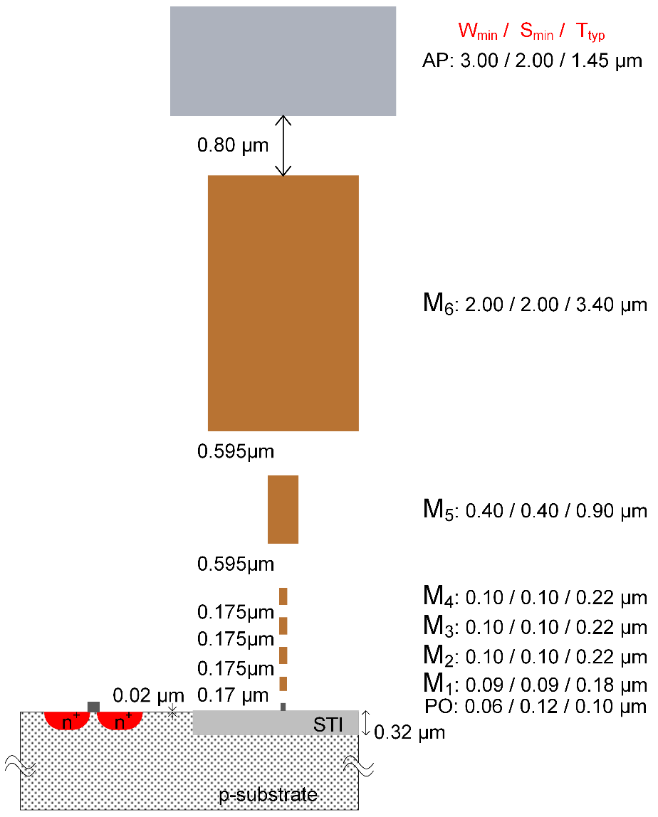
An approximate study…
TSMC 65nm cross-section
ASSUMPTIONS
AP
AP layer of TSMC 65nm as the CLICpix2 bump pad
C_{total}
M6
Assume M6 of TSMC 65nm as the C3PD bump pad
→ some limitations wrt the actual scenario:
Different dielectric height
Different dielectric material
Different (M6-approximated) C3PD pad thickness
→ “absolute” values shown next do not match the reality

Slide 5
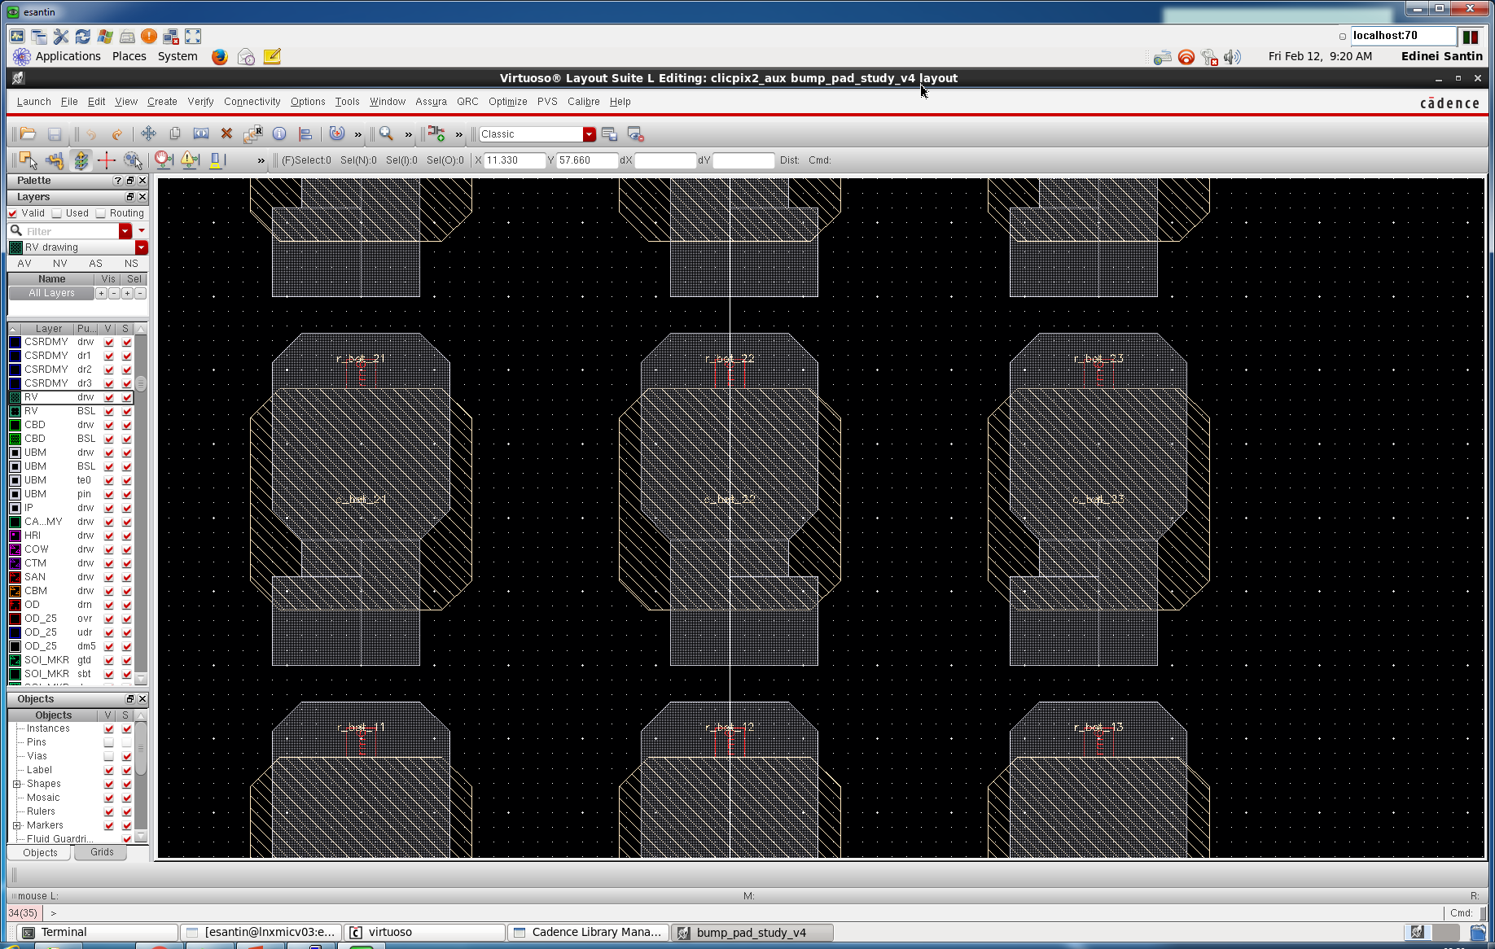
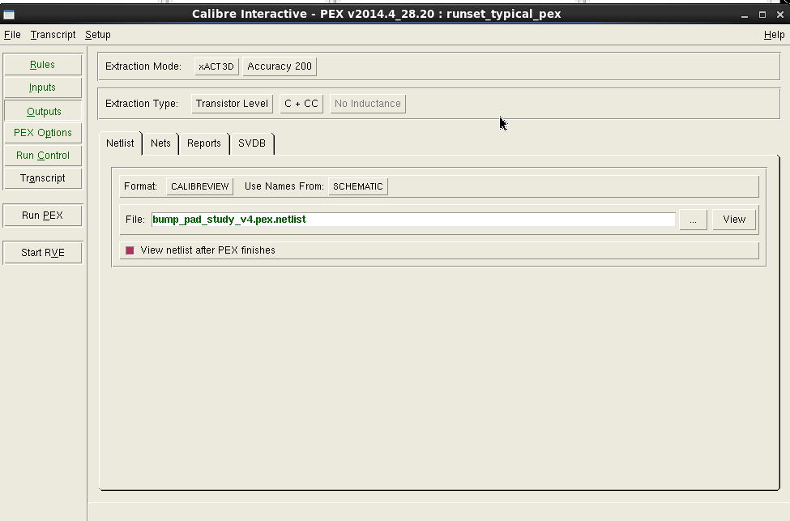
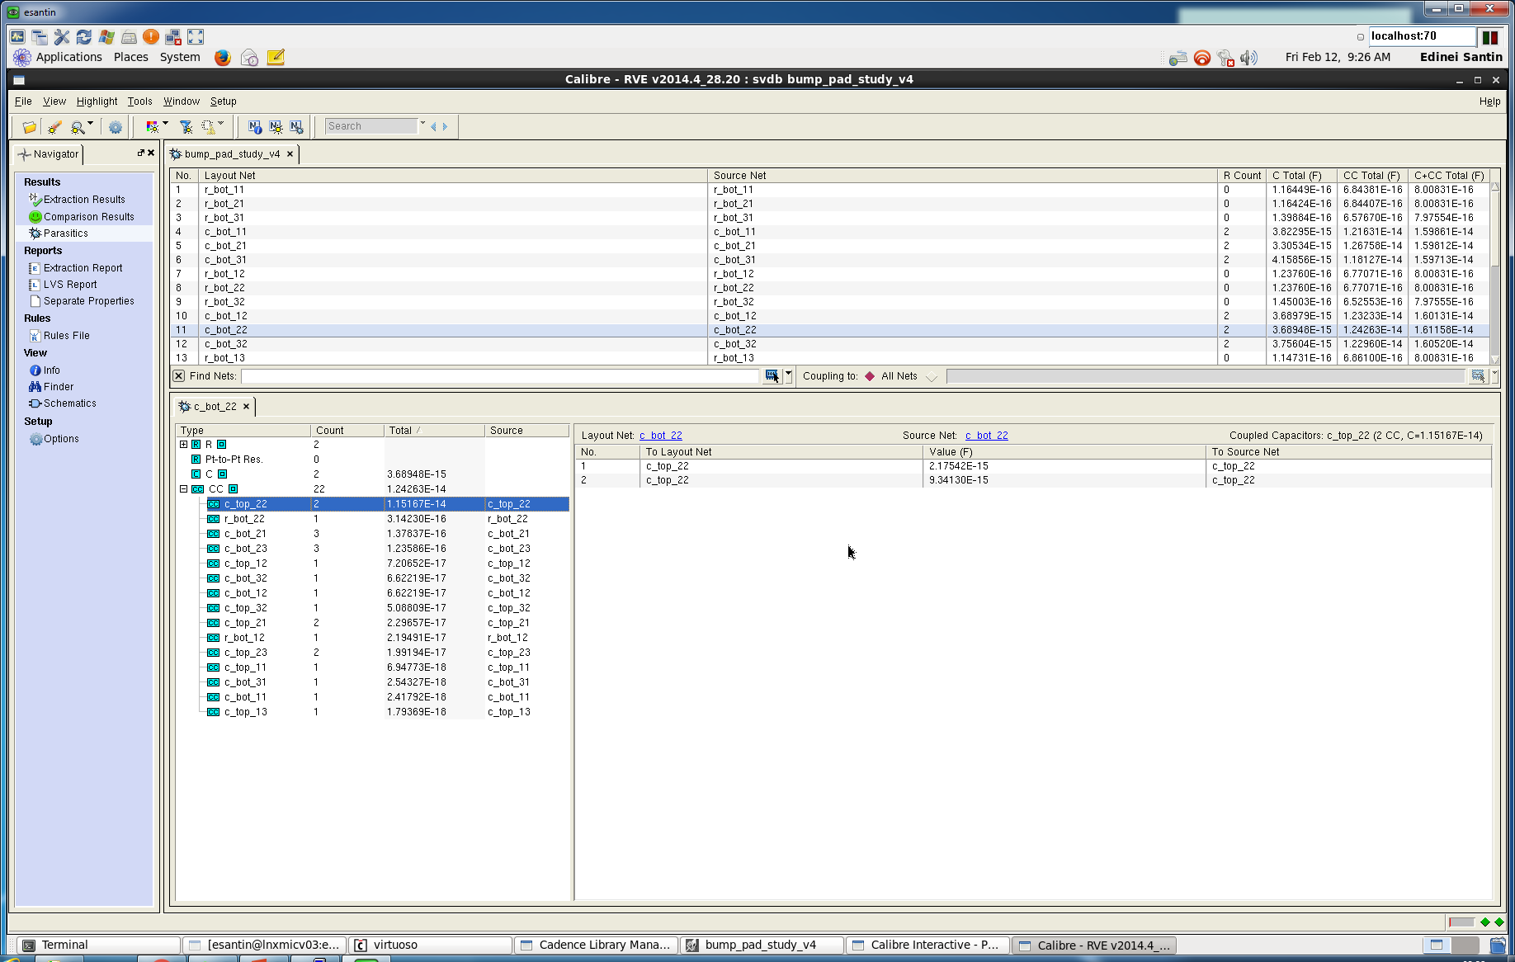
Accurate 3D field solver
layout
Calibre xACT 3D
Extracted parasitics

Slide 6
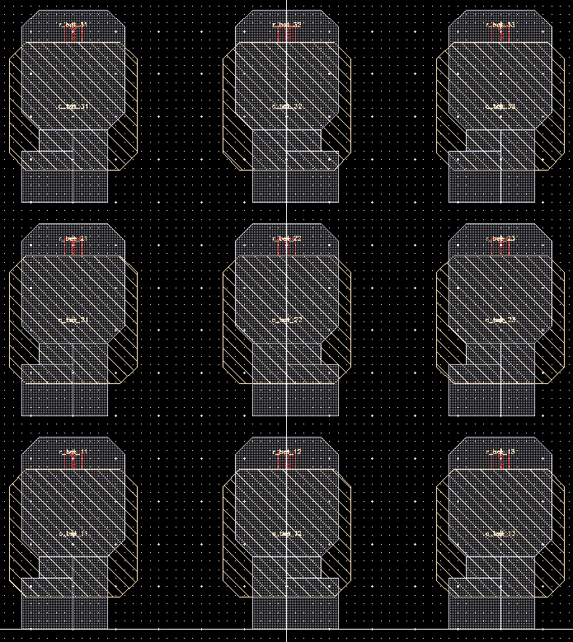
Coupling capacitances without GRs
15µm
15µm
C_{2,2BOTtoTOP} =11.5 fF
C_{2,2BOTto2,1BOT} = 0.14 fF
C_{2,2BOTto2,3BOT} = 0.12 fF
C_{2,2BOTtoOTHERS} < 0.07 fF
3,1
C_{2,2TOP}
3,2
3,3
C_{2,2BOT}
CLICpix2
C3PD
create signal crosstalks
2,1
2,2
2,3
we want to minimize this phenomenon
1,1
1,2
1,3
Without guard rings (GRs), there are capacitive couplings from C_{2,2BOT} (i.e. C3PD bump pad) to all other bump pads (i.e. adjacent C3PD and CLICpix2 pads). The couplings to the CLICpix2 pads are, however, very small.

Slide 7
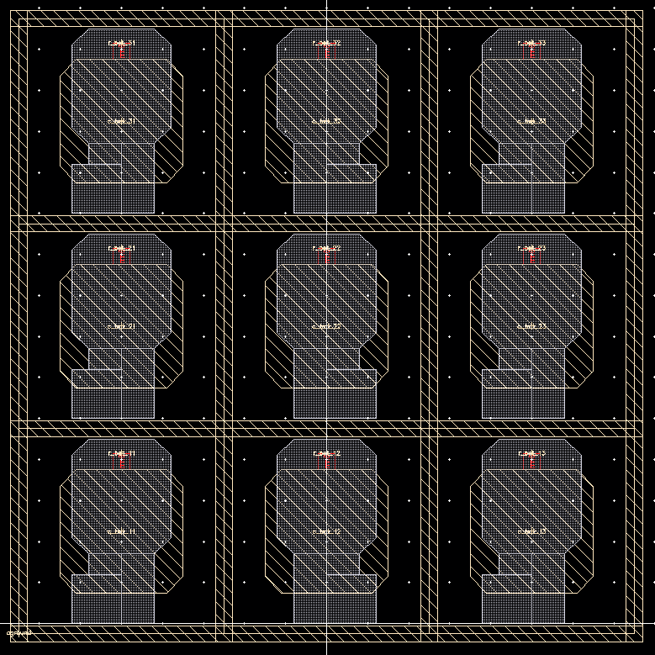
Coupling capacitances with GRs
15µm
15µm
C_{2,2BOTtoTOP} =11.2 fF
C_{2,2BOTtoVSSA} = 2.5 fF
3,1
3,2
3,3
not a problem
2µm
2,1
2,2
2,3
Guard rings are a good solution to minimize undesirable crosstalks!
4µm
4µm
1,1
1,2
1,3
With guard rings (GRs) around the C3PD bump pads, the capacitive coupling from C_{2,2BOT} to other adjacent bump pads are negligible. On the other hand, there is a fixed capacitance between the pads and the analog ground, V_{ssa}, which is not a problem.

Slide 8
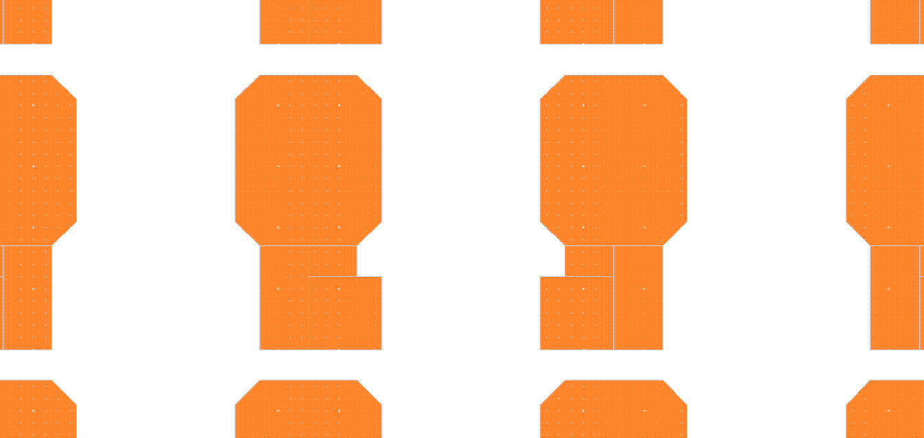
Final CLICpix2 bump pads layout
bump pad
14µm
12µm
25µm
8µm
via
6µm
22.5µm
10µm
Bump pad size is 240 µm²
Vias adjacent to the bump pad openings to comply with foundry DRC rules

Slide 9
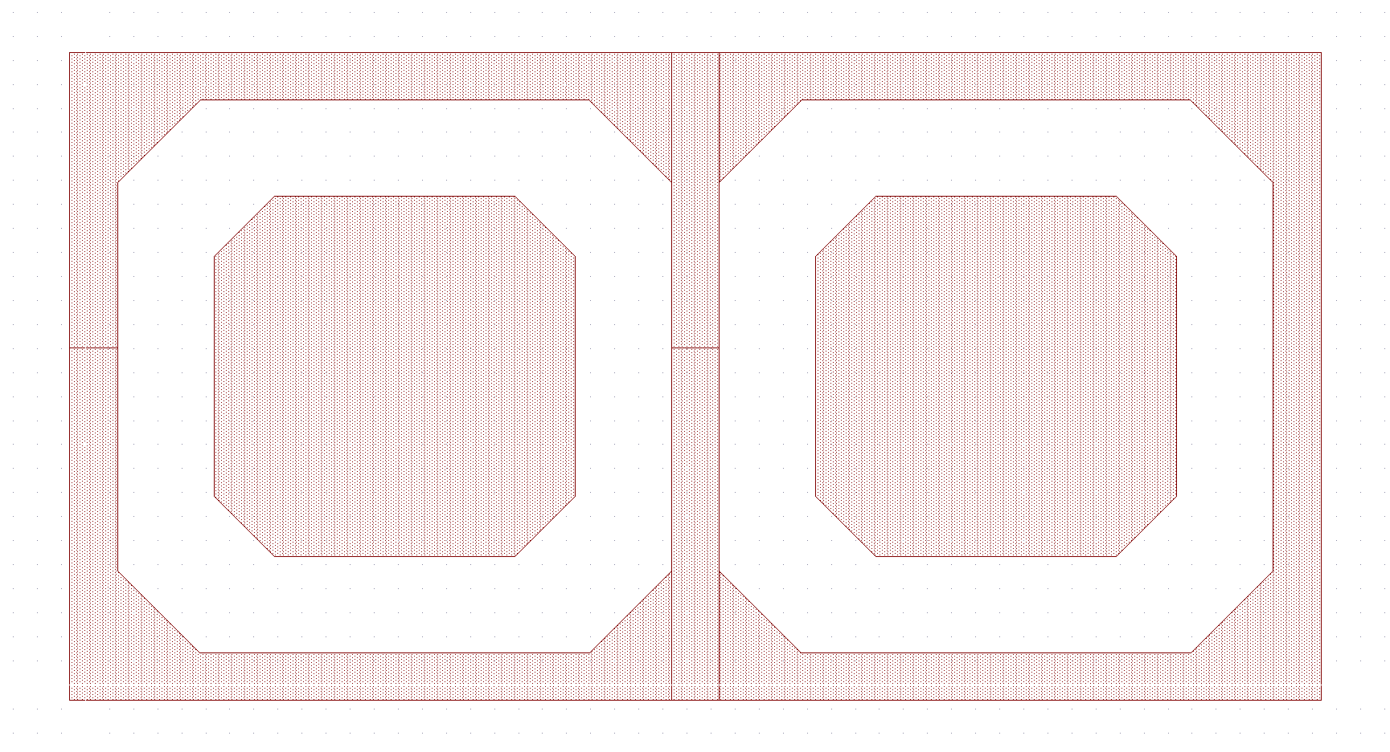
Final C3PD bump pads layout
bump pad
2µm
15µm
25µm
15µm
4µm
guard ring
Bump pad size is about 15 x 15 µm²
Guard rings around the bump pads are connected to the same low-noise, low-impedance voltage (i.e. V_{ssa}) and they minimize inter-pad (capacitive) coupling

Slide 10
Conclusion
CLICpix2 bump pad final size is imposed by the power distribution grid and technology constraints (i.e. via)
C3PD bump pad final size is imposed by the “shielding” guard rings (to minimize crosstalks)
Open question: Is it possible to avoid the passivation layer on the C3PD chip to increase C_{total} (i.e. the intended coupling capacitance between C3PD and CLICpix2 bump pads)?

Slide 11
Thank you for your attention!

Slide 12
Backup slides

Slide 13
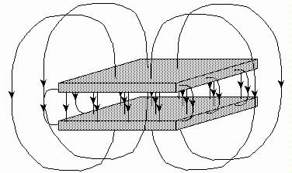
Capacitance between two plates
C_{total}
C_{total} = C_{area} + C_{fringe}
http://maxwell.ucdavis.edu/~electro/dc_circuits/images/cap_fields.jpg
Total capacitance is a result of two components: area capacitance, C_{area}, and fringe capacitance, C_{fringe}
Question: Which one of the two dominates in the CLICpix2 and C3PD bump pads arrangement?

Slide 14
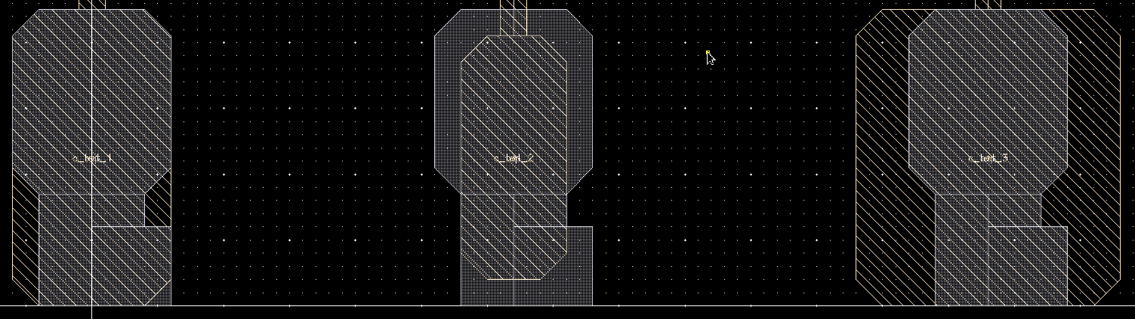
Extracted coupling capacitances
(using TSMC 65nm back-end layers as an approximation)
CLICpix2 bump pad vs three C3PD bump pad layouts
Case 1
Case 2
Case 3
C_{total}=15.1 fF
C_{total}=10.7 fF (-29%)
C_{total}=16.3 fF (+8%)
Case 2 should favor the fringe capacitance component, but since the C_{total} is smaller than the other two cases it tells us that the area capacitance component dominates in these three scenarios
  But, do not ignore the analysis limitations mentioned on slide 4

