Slide 1
What Implications does the “Science DMZ” have for GridPP
Andrew Sansum
10th April 2016

Slide 2
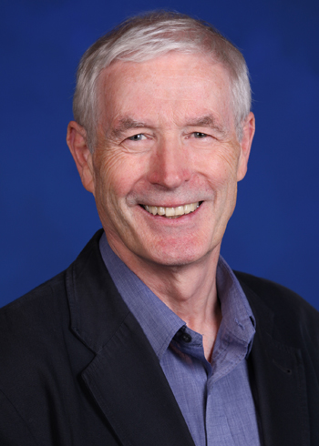
Why am I talking about the Science DMZ?
Because this guy is talking about it.
Tony Hey. Professor Anthony John Grenville Hey CBE FREng FIET FInstP FBCS
STFC Chief Data Scientist.
Because GridPP sees an effective “low cost” network as strategic to its operation.

Slide 3
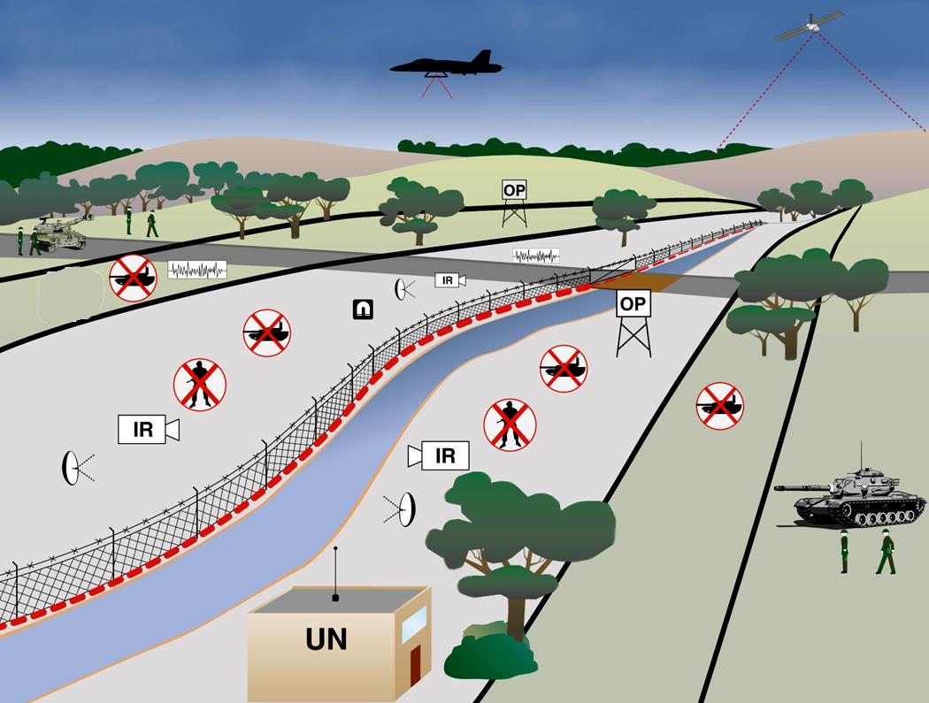
DMZ? - Demilitarized Zone
“An area in which it is forbidden to station military forces or maintain military installations.
Any area, place, or circumstance in which conflicts or hostilities are held in abeyance.” Dictionary.com

Slide 4
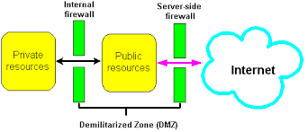
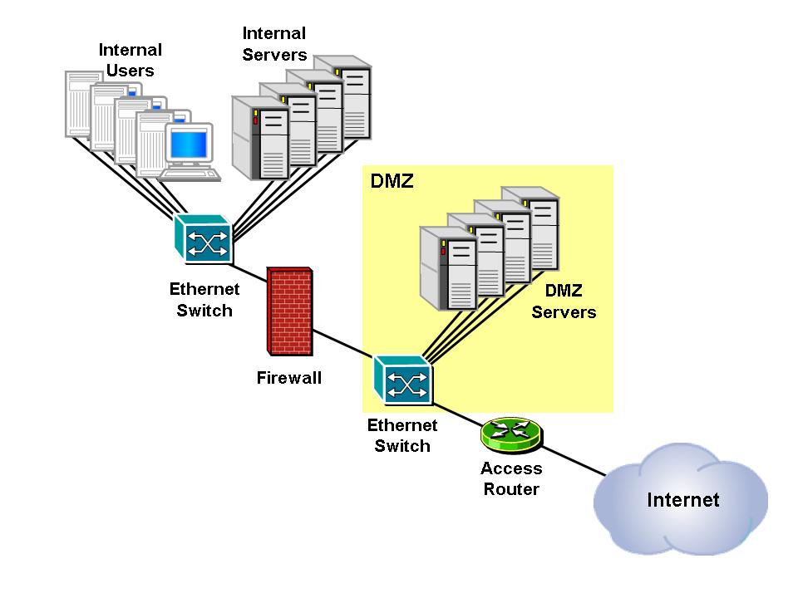
Network - DMZ

Slide 5



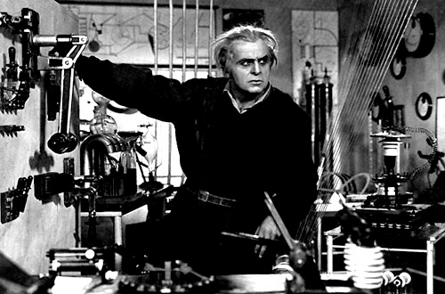
Science?

Slide 6
So What is the “Science DMZ”
The Science DMZ: A Network Design Pattern for Data-Intensive Science. E. Dart. 2013. SuperComputing 2013.
https://fasterdata.es.net/science-dmz/
Should also be put into the context of: Esnet Strategic Plan FY2014-FY2023: March 2013
Both interesting reads – however there is a risk that the detailed analysis/discussion provided by ESnet is lost and people latch onto the “DMZ” terminology and implement a solely network topology solution.

Slide 7
In the context of Esnet Strategy
ESnet’s Mission
To enable and accelerate scientific discovery by delivering unparalleled network Infrastructure, capabilities, and tools.
ESnet’s Vision
Scientific progress will be completely unconstrained by the physical location!of Instruments, people, computational resources, or data.
Collaborations at every scale, in every domain, will have the information and tools they need to achieve maximum benefit from scientific facilities, global networks and emerging network capabilities.
Esnet will foster the partnerships and pioneer the technologies necessary to ensure that these transformations occur.

Slide 8
What constitutes a Science DMZ
The Science DMZ is:
A portion of the network, built at or near the campus or laboratory's local network perimeter that is designed such that the equipment, configuration, and security policies are optimized for high-performance scientific applications rather than for general-purpose business systems or “enterprise” computing.

Slide 9
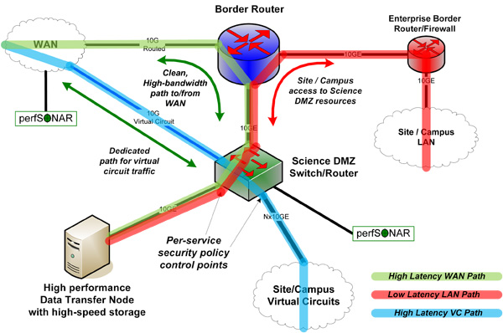
4 Key Components
A network architecture explicitly designed for high-performance applications, where the science network is distinct from the general-purpose network
Appropriate Science Security policies
Monitoring
Data Transfer Nodes

Slide 10
What has Tony said?
"We're overwhelmed with data" - interview with Digifest speaker Tony Hey JISC Interview 22nd Feb 2016
"I see Jisc as capable of playing a leadership role in providing a high performance research network.”
“What you need is what they call in the US a ‘Science DMZ’ - a science demilitarised zone. This architecture means that when the data gets to the firewall, it doesn't go through the firewall but goes straight to where you need it. In this way, you solve the ‘last mile’ problem and can have sustained high end-to-end bandwidth.”
“Traditionally, Jisc’s responsibility has stopped at the university firewall so there is a worrying gap in our UK e-infrastructure. To address the needs of the new generation of data-intensive scientists, I think that Jisc needs to partner with universities to implement high speed end-to-end data links.”

Slide 11
Prior Art/Activities
Of course many GridPP sites have addressed the “last mile problem. Ral first implemented a “firewall bypass” around 2005.
JANET have previously been active in this area. Eg:
  March 2015 JANET End to End Performance Initiative
  October 2015 JANET End to End Performance Workshop
GridPP has been represented at this event. Brian Davies presented at the workshop.

Slide 12
What should be GridPP’s response ?
We should see this as a positive initiative.
  May help new communities we wish to engage with
  May generate new (appropriate) investment in university infrastructure
  May support the case for JANET to prioritise effort to support Science High Throughput.
GridPP Should
  Engage positively – avoid appearing defensive.
  Be humble – don’t explain that we solved this 10 years ago
  Use our expertise where feasible to support (eg presentations)
  Draw on our experience to avoid bad outcomes (eg inappropriate network structures/investment).

