Slide 1
CMOS: A broad overview
J. Dopke (STFC RAL)
UK community meeting on CMOS sensors for particle tracking
10.03.2016, Cosenors House, Abingdon

Slide 2
Outline
Where we come from
What we mean by CMOS sensors
  Features for us
  Features we need
Technologies
  Differences and commonalities
  Fabs
Summary

Slide 3
Where we come from
High energy physics community (as well as others) very often relies on hybrid detector assemblies:
  Two individual pieces of silicon, different feature sizes, extra handling steps for assembly
Sensor production usually runs on special substrates
  Limited number of suppliers
  Production rate usually small
Frontend
Interconnect
Sensor

Slide 4
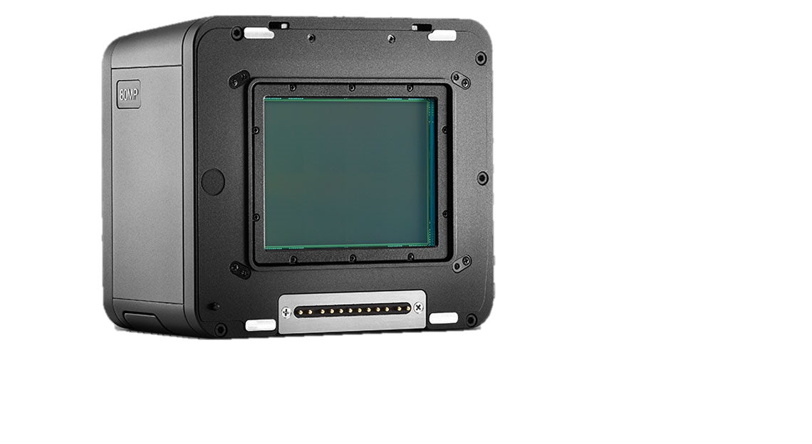
CMOS sensors
Physics community seeks to tap into potential from semiconductor production:
Current camera imaging sensors deliver 1um2 pixels for imaging purposes
  Scientific community very often rests at the 100x100um2
CMOS production happens in large volumes
  Many “secure” providers
  Large wafers used, reduces cost
Single layer assembly makes it easier to build thin structures (down to 50um)
Notes:
Image of a pixelised sensor?

Slide 5
To scale

Slide 6
CMOS Features
What we already get from the imaging sensor world:
  High resolution
  Low noise
    Depending on process and implementation
What we still need:
  Consistent (and possibly fast) timing
    LHC based experiments need to associate measurements with bunch timing (25ns spacing)
  Radiation hardness
    Ionising dose resistance comes (almost) for free in (most) processes (up to O( 50Mrad ))
    Bulk damage changes collection efficiency (not necessarily bad)
Notes:
Main difference between existing chips and things still to be done:
Mimosa, based on diffusion, timing and rad-hardness shite
Bulk damage destroys diffusion, major difference between some applications and others

Slide 7
Nomenclatures
Many processes are either branded as HV or HR
  A high voltage (HV) process can be delivered on a highly resistive substrate
  A high resistivity (HR) process can be designed to have high voltage applied to its sensitive volume
Processes actually differ in
  Feature size (some allowing for full monolithic implementations - MAPS)
  Available number of deep-wells/metals
  Silicon base (Bulk, Epitaxial, Silicon on Insulator)
Fabs
  Some come with their own Multi-purpose-wafer (MPW) program
  Some are available through Euro-practice
Notes:
Start can be a standard process, then radiation hardness through either high resistivity or high voltage, latter for drift, former for larger native depletion
Plot ueber triple well und quadruple wells – what do they do, shielding der electronic

Slide 8
Cross-sections
Different charge collection electrodes
  Larger fill factor gives more rad-hardness, but larger noise
Isolation of CMOS depends on process

Slide 9
Fab List
AMS (180nm/350nm, 120V design rules)
TowerJazz (180nm, EPI, stitching)
Lfoundry (150nm, HV design rules, stacked deep wells)
Global Foundry (130nm)
ESPROS (150nm)
XFAB (180nm SOI)
These are all being looked at by various groups in Europe with partial contributions from the UK here and there
MPW through Europractice, MPW through foundry

Slide 10
Design cycles and cost
Design cycle time depends on
  Availability of manpower for design & verification
  Availability of MPW runs (reduced cost small size submissions for tests)
    A submission return can take from 2 months up to … long
Cost
  Very much feature size dependant (scales roughly with square of inverse feature size)
  MPW can be as low as 5k GBP for a minimalistic sample
  Engineering runs can be as low as O(50k) and as high as O(400k) for the processes we’re looking at here

Slide 11
Testing requirements
Many scientific endeavours have to operate for years under harsh conditions
  Temperature cycles to liquid Argon temperatures
  High radiation environment
  Extremely long lifetime of the experiments
    No 2-year warranty business
Mostly untested in any of these processes hence requires extensive verification
  Many of these tests take months to conduct (radiation hazard for transport, sheer length of heat treatments…)

Slide 12
What we need
Technology is out there, many of us (as will be shown) already touch it
Can we save effort in a common approach to the subject?
  Mostly to save money by seeing commonalities in development and not repeating effort, e.g.:
  Radiation testing could be a subject attacked in every submission, based on a test structure in different processes – development time is small, testing time is long but could be (largely) unified for different processes

Slide 13
Summary … thoughts for the day
What do people want with CMOS?
  Radiation hardness always required?
What has already been done?
  Which processes do we fancy?
  Which technologies show promising results?
Where do we already have expertise?

