Slide 1

MAPS for Calorimetry in e+e-
Alasdair Winter
University of Birmingham

Slide 2
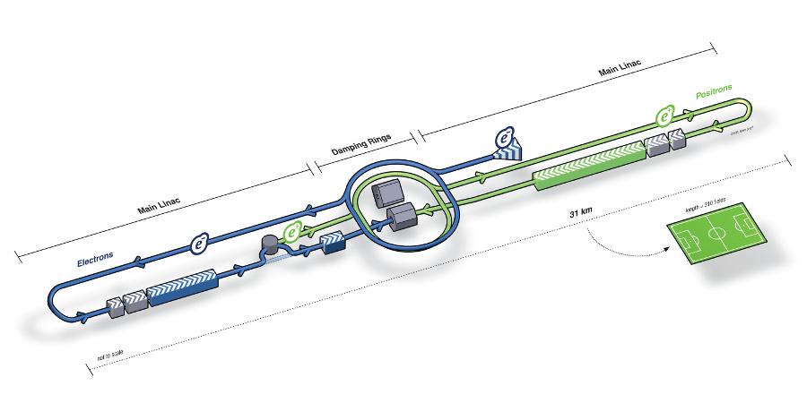
ILC
Energy Staging
  250, 500, 1000TeV
Collision Rate
  Bunch train frequency 5Hz
  1300 bunches per train
    Bunch length 730µs
    Bunch separation 554ns
1% Detector Duty Cycle
  Allows “power pulsing” instead of active cooling
Makes Use of Particle Flow
Notes:
Emphasise lack of pressure on readout speed, lack of active cooling, use of particle flow.
Main emphasis of calorimetry is to obtain the best measurement of hadronic jet energies, in conjunction with trackers via particle flow approach.

Slide 3

Requirements for Key Measurements
Essential to be able to separate W/Z hadronic jets
Sets requirement of $\frac{σ_{E}}{E}\sim \frac{30\%}{\sqrt{E}}$
Notes:
Sets minimum requirement for detector

Slide 4
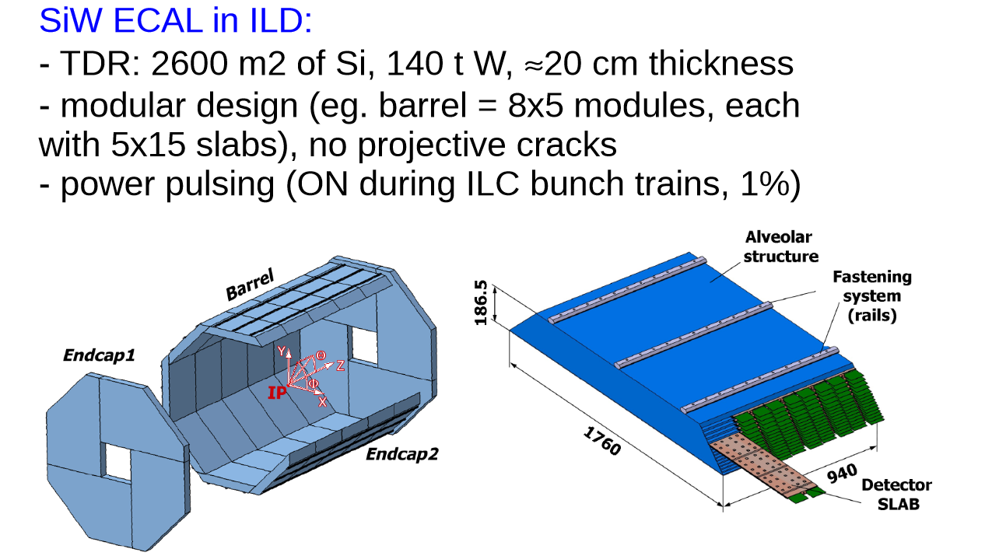
ILD ECAL
Notes:
Show current AECAL structure, mention that is based on 5x5mm silicon diodes, extensively tested – but expensive.

Slide 5
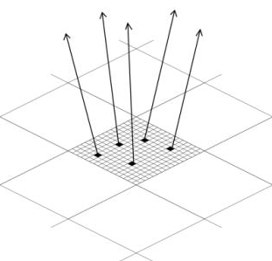
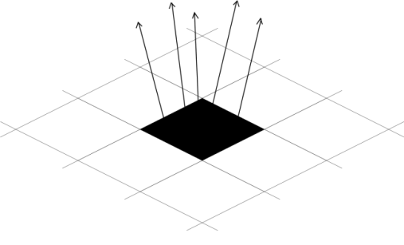
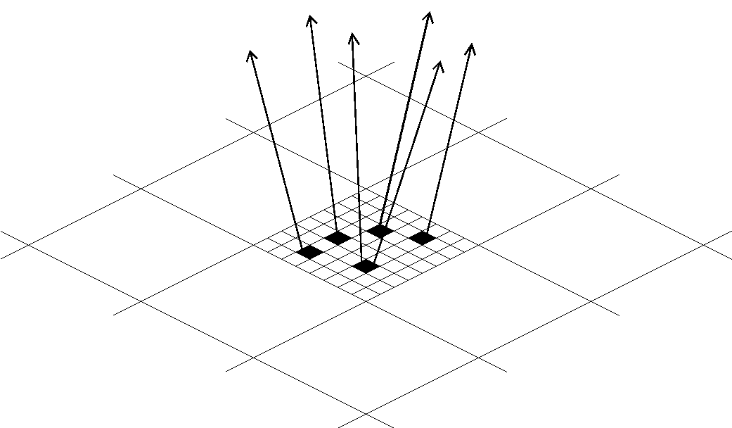
DECAL Concept
Concept, swap ~0.5x0.5 cm² Si pads with small pixels (“Small” := at most one particle/pixel,1-bit ADC/pixel)
How small to avoid saturation/non-linearity?
  EM shower core density at 500GeV is ~100/mm²
  Pixels must be<100×100μm²
    Used baseline 50×50μm²
  Gives ~10¹² pixels for ECAL – “Tera-pixel APS”
  Mandatory to integrate electronics on sensor
AECAL
DECAL N_{pixels}<N_{particles}
DECAL N_{pixels}=N_{particles}
Notes:
Novel idea, led by UK groups for ILC, potential to improve on analogue by removing problems due to variation in thickness of material seen by particles at differing angles, nowhere near as tested as AECAL

Slide 6
DECAL: CMOS MAPS for Linear Collider
Mature, high volume industrial devices: no proprietary processes → reduced costs
Low(-ish) power, depends on duty cycle
Low material budget, can be very thin
Radiation hard (few >Mrad)
  OK for ILC ECAL, but not for other applications, e.g. HL-LHC, FCC(h)
Very granular (pixels ~10um)
New features developed for LC
TPAC et al. (digital ECAL)
Deep p-well implant/InMAPS process
  Makes MAPS viable
  Improved charge collection efficiency
High resistivity/HV epitaxial layers
  Further charge collection and radiation hardness improvements
LCUK, Liverpool, 01-Feb-2016
Notes:
CMOS necessary for required granularity, highlight other benefits of CMOS, mention both previous sensors and their adaptations- deep p well and HR/HV

Slide 7

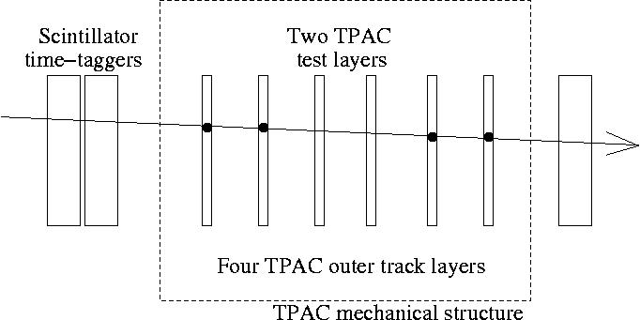
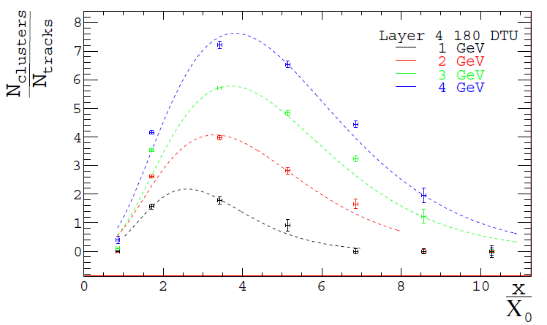
MAPS for DECAL, (~)Shower Profile
2 TPAC test sensors
Project tracks to individual test sensors
Vary depth of absorber thickness, study downstream hit multiplicity
Purely to cut cost – not ideal
scintillators
4 TPAC track sensors
Study TPAC sensors as “calorimeter” layer
Peak of sensor activity vs. depth of material
Single sensor study of EM shower response
Electron beam shows expected log behaviour
(NB: single sensor transverse size)
# clusters/# tracks
Absorber thickness (X₀)
Notes:
Want to briefly discuss what tests have been done so far, describe what you see for next few slides

Slide 8
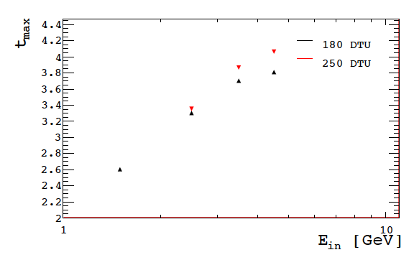
MAPS for DECAL, (~)Shower Profile
2 TPAC test sensors
Project tracks to individual test sensors
Vary depth of absorber thickness, study downstream hit multiplicity
Purely to cut cost – not ideal
scintillators
4 TPAC track sensors
Now (Bham, PPD, Sussex) using CHERWELL sensor to find show stoppers for DECAL
Power consumption (→ 1% duty cycle “no harm” tests)
Pixel ganging (exploit tracker technology)
Future (-- “ --), investigating rad hard MAPS for DECAL and tracking (higher intensity hadron colliders + LC)
Shower max. depth (X₀)
Incident e⁻ energy (GeV)

Slide 9
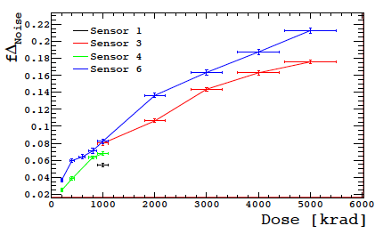
Radiation hardness testing
Potential use of TPAC sensor technology in high radiation environments such as tracking and vertex systems
Need to understand sensor’s response/tolerance
Multiple sensors tested, 50 keVγ
Sensors held at 0 V and 1.8 V
Exposures between 0.2-5.0 Mrad
Mean noise and pedestal of the pixels tested after each dose
Conclusion: rad. Hard enough for use in ILD (CLIC ILD or ILC ILD)
Fractional increase in noise,
Non-biased sensors (@60rad/s)
Acceptable noise increase to ~5 MRad
T Price et al, First radiation hardness results of the TeraPixel Active Calorimeter (TPAC) sensor, 2013 JINST 8 P01007,doi:10.1088/1748-0221/8/01/P01007
Notes:
Conclude that sensors are radiation hard enough for e+e- applications

Slide 10
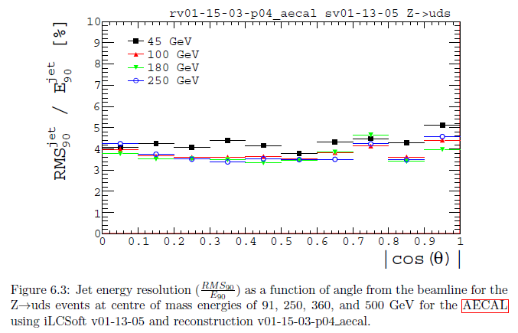
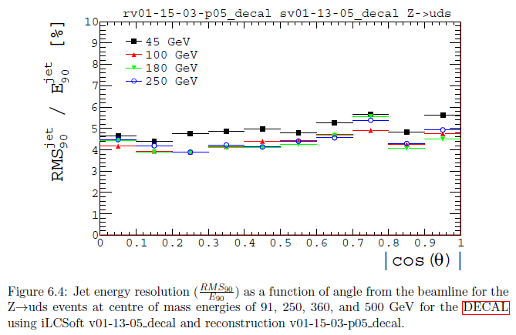
Pre-2015 studies
uds jets
Full Mokka, DBD vintage
Compare SiECAL with DECAL in ttH study
Multi-jet performance
Detector model ILD_01_v02
Only parameters changed were
  Cell sizes reduced to 50x50μm²
  Sensitive epi thickness to 12μm (as in TPAC sensor)
  Digital readout turned on in PandoraPFA
Minimal change in performance
  Individual quantities and “bottom line” for ttH analysis
  All details in Tony Price thesis ( and papers:
SiECAL
RMS₉₀(jet) (%)
DECAL
RMS₉₀(jet) (%)
T. Price, N. Watson, T. Tanabe, and V. Martin, Measurement of the top Yukawa coupling at sqrt(s)=1 TeV using the ILD detector
LC-REP-2013-004, http://www-flc.desy.de/lcnotes/notes/LC-REP-2013-004.pdf
Notes:
Relate back to requirement on Jet Energy resolution- still of the right order to meet requirements

Slide 11
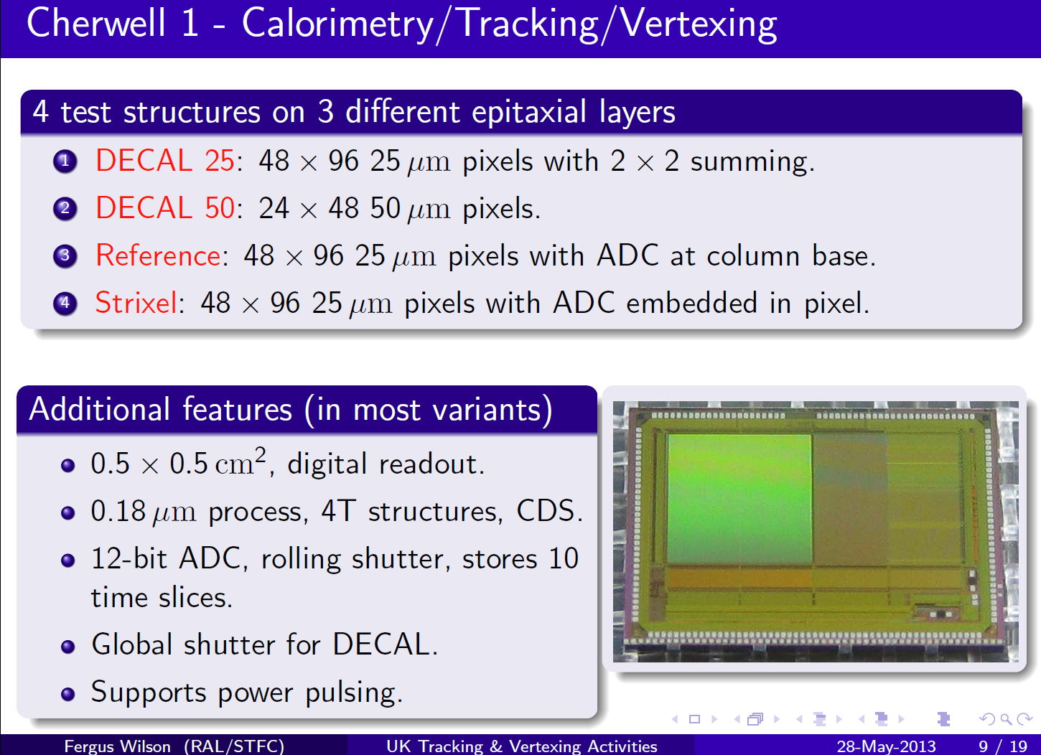
Cherwell Overview
See Fergus Wilson’s talk, ECFA LC 2013, DESY, for generic MAPS/silicon R&D in UK

Slide 12
Cooling and power
Cooling for the ECAL is a general issue
Compared to analogue pad ECAL
  Factor 10³-10⁴ more channels
  Factor ~10 more power
Power savings due to duty cycle (1%)
Target value for existing ECAL ASICS
  4 µW/mm2
Last measured (years ago) consumption of MAPS ECAL:
  40 µW/mm2 depending on pixel architecture
  TPAC1 not optimized at all for power consumption
Advantage: Heat load is spread evenly
Aim: characterise for noise/source/laser
Study impact of variable duty cycle (firmware controlled), how close to 1% can we go?
Some difficulties with firmware, work in progress from designer at DL
So…
Notes:
Tests we need to do to validate technology- power consumption is the dominant factor

Slide 13
ILD optimisation
Following completion of e⁺e⁻ → ννH(H→WW*,WW*→qqlν) for CLIC Higgs paper (not detector study)
Use ILD to test DECAL design, for new sensors
  Explore potential gain from very high granularity of MAPS
  Previously shown no significant performance loss for hadronic jets relative to analogue Si-W ECAL
  Next, use e⁺e⁻→ZH (H→τ⁺τ⁻), and τ⁻→h⁻π⁰ν_{τ} to test benefit of pixels ~50μm for particle flow algorithm
  Study both for use in whole ECAL or a preshower detector
  Geometry of ECAL udpated w.r.t. previous studies
  Use stable, well-understood software framework (Mokka, ILD-01-v05, ScEcal04 in ILCSoft-17-07)
  Standard tools to determine calibration parameters of DECAL based on test samples of photons, K_{L} and muons
Work in parallel with DECAL evaluation for FCC-hh et al
Notes:
Want to look at potential physics benefits other than cheapness

Slide 14
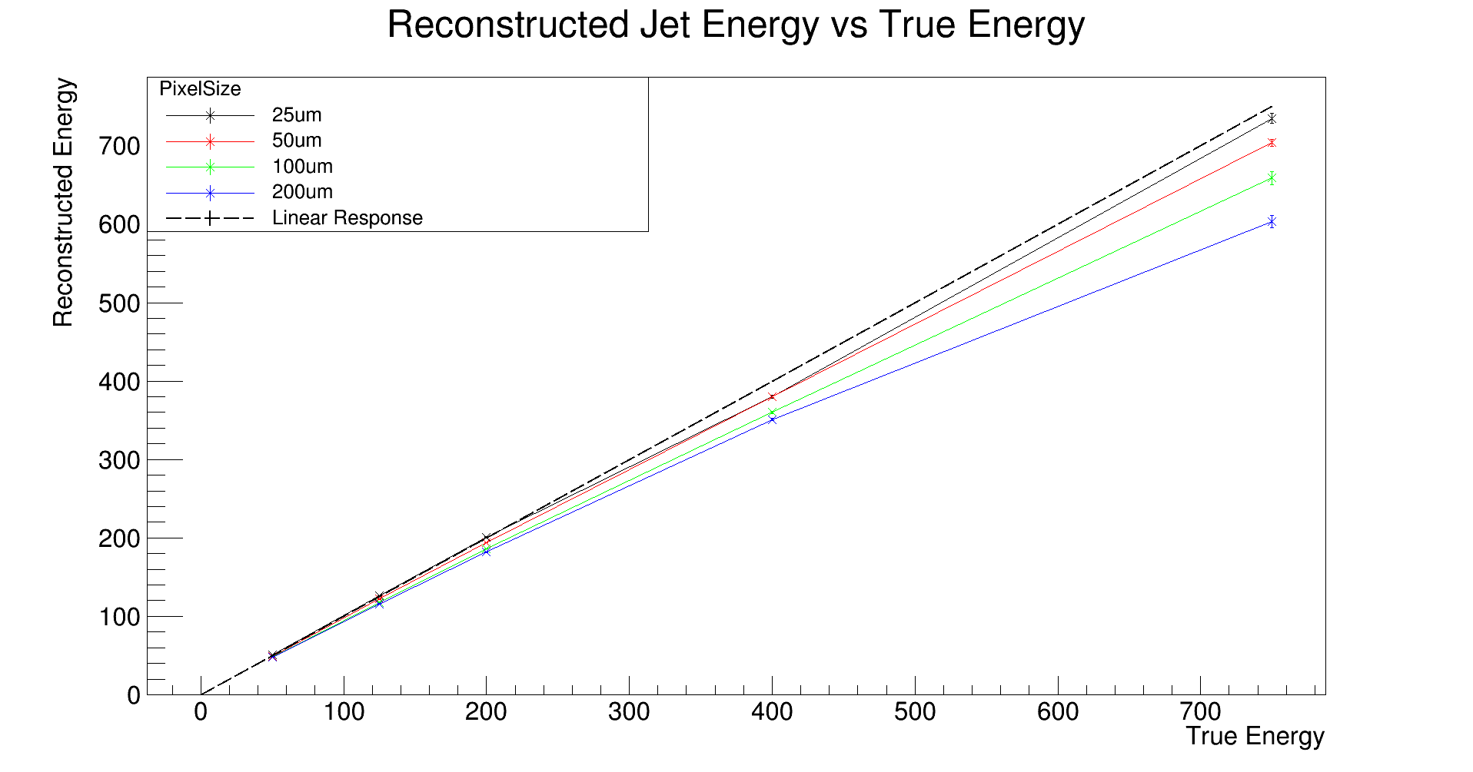
Applications for Other Experiments
Reconstructed energy of jets
True energy of jets
Notes:
Mention FCC, funding acquired for rad hard maps, simulations done in the context of ILD

Slide 15
Applications for Other Experiments
For high energy applications it becomes essential to know when linearity breaks down
There is a max. energy above which non-linearity becomes significant
Quantify using 2nd order polynomial fits, up to a given max. energy
Study variation of size of second order coefficient vs. max. energy
  Repeat for each pixel size and compare
Reconstructed energy of jets
True energy of jets
Notes:
Discuss how the deviations are caused by saturation of DECAL

Slide 16
Conclusions
CMOS technology makes DECAL possible
Effort led by UK groups
Initial testing shows promising results
  No “show-stoppers” discovered so far
  Performance similar to AECAL
  Sufficient jet energy resolution and Rad hardness
  Power performance still to be evaluated
Possible applications for other colliders
  High energy simulations required

Slide 17
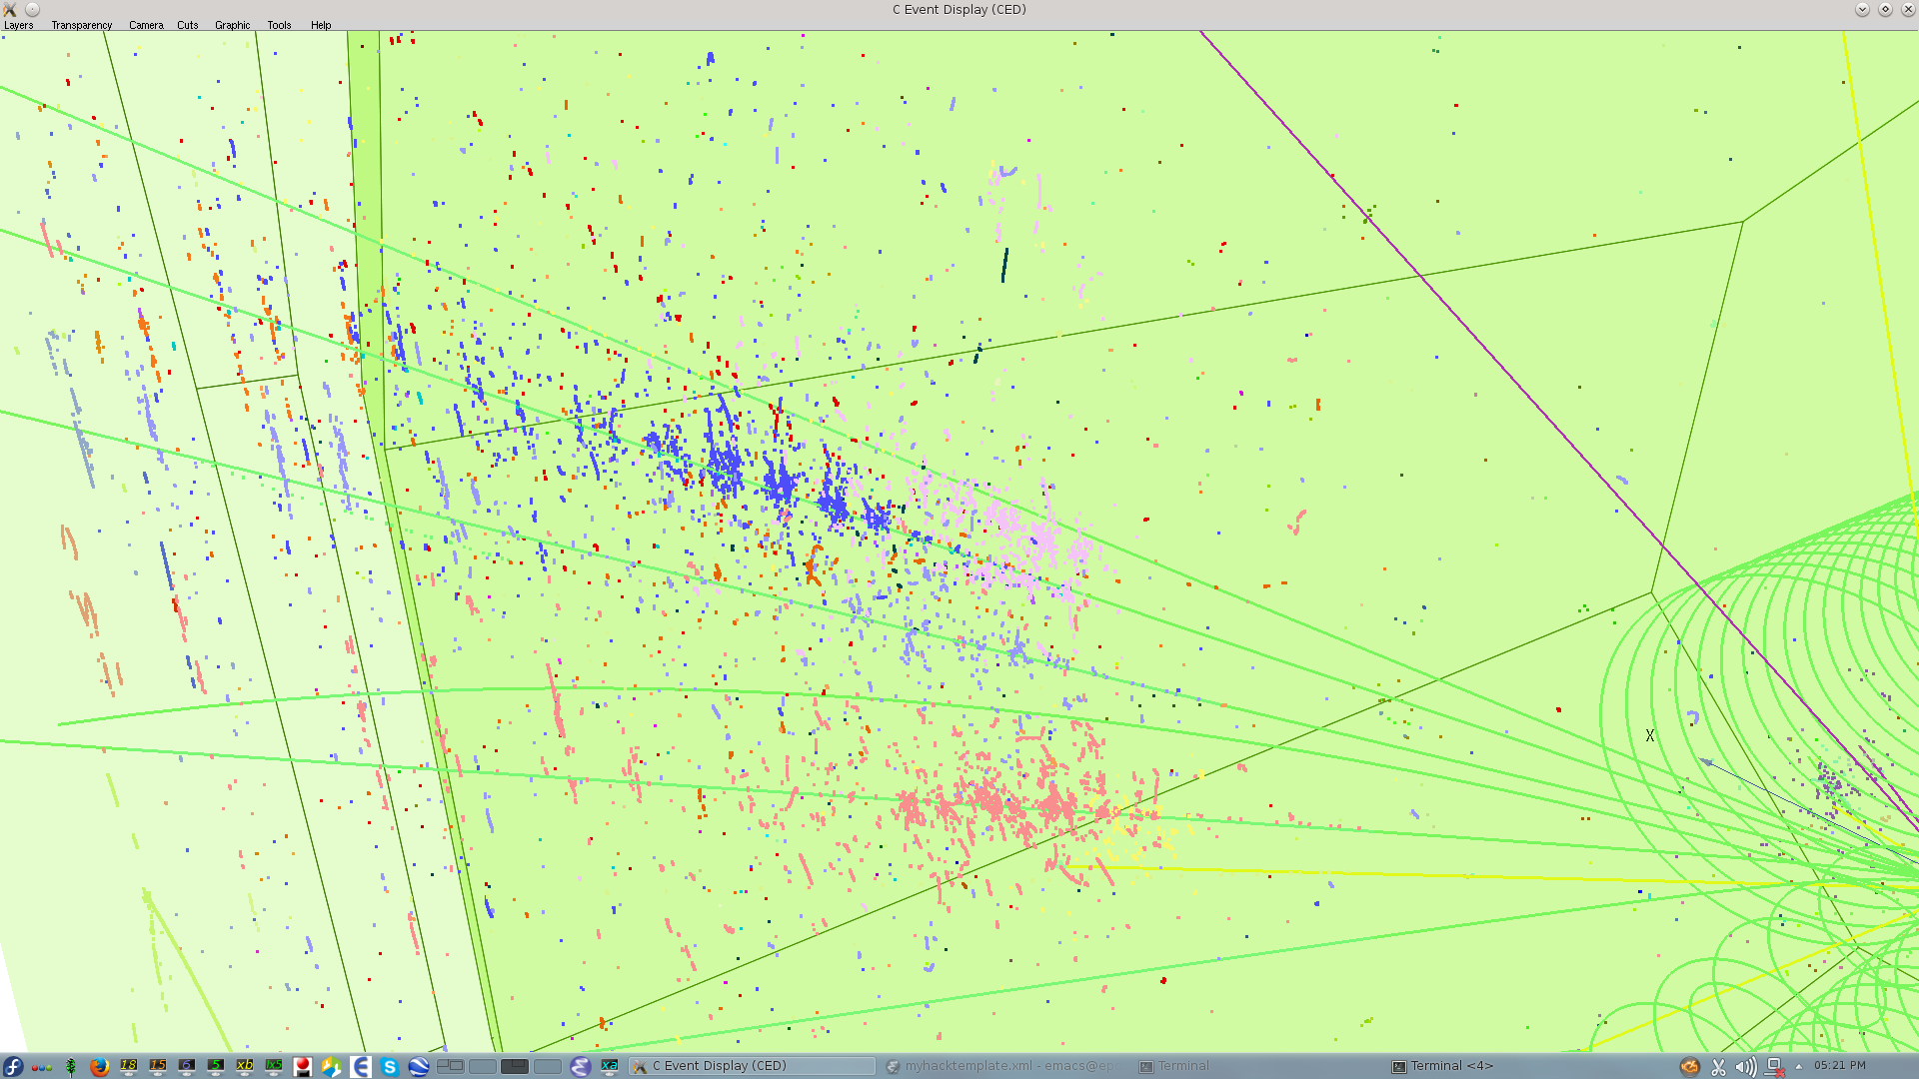
Thank you!
Notes:
Leave with an image from the ilc event display showing the detail acquired by using the DECAL

Slide 18
Backup slides

Slide 19
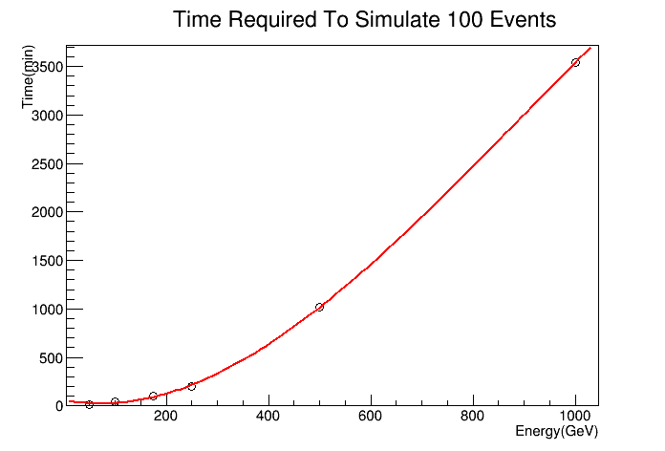
EM shower, simulation times
Full Geant4 simulation…
Detail level as per ILC TDR, etc.
Single electrons from beam crossing point
Distributed uniformly across theta and phi

Slide 20
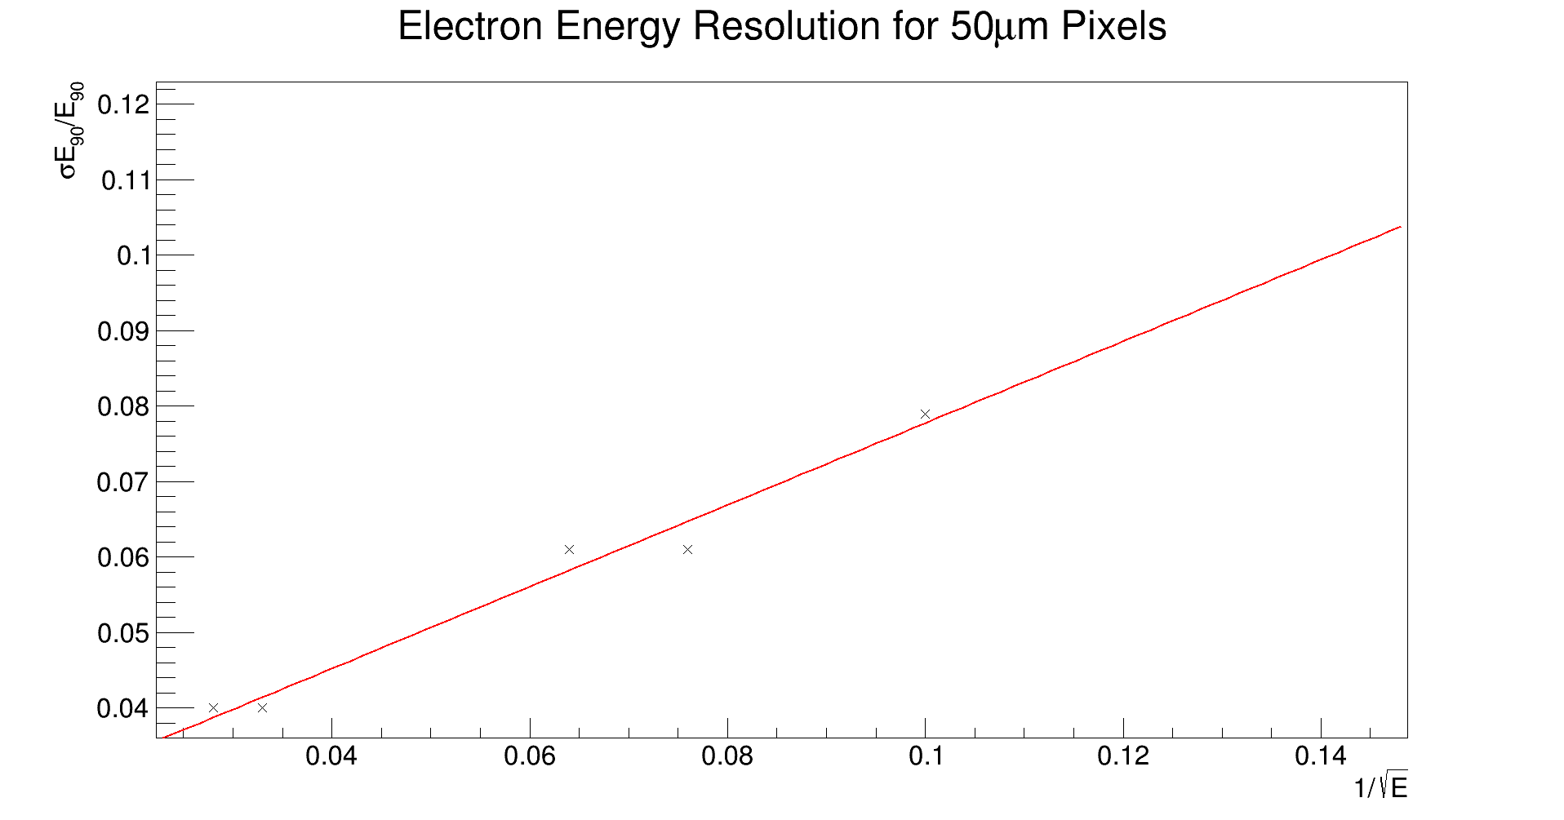
Electron energy resolution
σ_{Ε}/Ε
More statistics to be added
Study with different pixel sizes (max. 100um)
1/√E

Slide 21
Pixel optimisation
Rcently completed physics (not detector) study of
  e⁺e⁻ → ννH(H→WW*,WW*→qqlν) for CLIC Higgs paper
Now using ILC detector (ILD) to test DECAL design, for new sensors
  Explore potential gain from very high granularity of MAPS
  Previously shown no performance loss for hadronic jets relative to SiW
    Tony’s thesis and follow ups
  Next, we use e⁺e⁻→ZH (H→τ⁺τ⁻), and τ⁻→h⁻π⁰ν_{τ} to test benefit of pixels ~50μm for PFA, not just for lower cost
  Study use case for whole ECAL or preshower detector
  Use standard ILD G4 application (Mokka, ILD-01-v05, ScEcal04 in ILCSoft-17-07)
  Geometry of ECAL udpated w.r.t. previous studies
  Updated Particle Flow AlgorithmPandora, with improved tools to determine calibration parameters based on test samples of photons, K_L and muons
Work will continue in parallel with other studies for DECAL
  E.g. using smearing simulation (Delphes) to study physics impact of improved (…) performance
  Needs input from G4 to define resolutions, as Delphes has no predictive power for these
  Studies started (Msci project students) using tt~ and ZH in ILC context

Slide 22
Pixel optimisation
Rcently completed physics (not detector) study of
  e⁺e⁻ → ννH(H→WW*,WW*→qqlν) for CLIC Higgs paper
Now using ILC detector (ILD) to test DECAL design, for new sensors
  Explore potential gain from very high granularity of MAPS
  Previously shown no performance loss for hadronic jets relative to SiW
    Tony’s thesis and follow ups
  Next, we use e⁺e⁻→ZH (H→τ⁺τ⁻), and τ⁻→h⁻π⁰ν_{τ} to test benefit of pixels ~50μm for PFA, not just for lower cost
  Study use case for whole ECAL or preshower detector
  Use standard ILD G4 application (Mokka, ILD-01-v05, ScEcal04 in ILCSoft-17-07)
  Geometry of ECAL udpated w.r.t. previous studies
  Updated Particle Flow AlgorithmPandora, with improved tools to determine calibration parameters based on test samples of photons, K_L and muons
Work will continue in parallel with other studies for DECAL
  E.g. using smearing simulation (Delphes) to study physics impact of improved (…) performance
  Needs input from G4 to define resolutions, as Delphes has no predictive power for these
  Studies started (Msci project students) using tt~ and ZH in ILC context

Slide 23
Next steps
Extend linearity studies to higher energy to find point of failure for 25 and 50um- decides if valid option for FCC!
Examine linearity for EM showers- worst case scenario
Study Electron energy resolution with more statistics and for alternative pixel sizes
Effects of threshold spread, noise, clustering of adjacent pixels
  Similar to studies c. 2008 for TPAC
  Updated for current estimates of pixel parameters
  Will be done in G4 with very fine grid
  E.g. 1% of whole pixel area

Slide 24
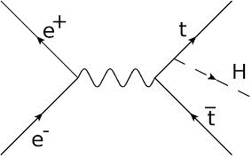
Pre-2015 studies
Full Mokka, DBD vintage
Compare SiECAL with DECAL in ttH study
Multi-jet performance
Detector model ILD_01_v02
Only parameters changed were
  Cell sizes reduced to 50x50μm²
  Sensitive epi thickness to 12μm (as in TPAC sensor)
  Digital readout turned on in PandoraPFA
Minimal change in performance
  Individual quantities and “bottom line” for ttH analysis
  All details in Tony Price thesis and papers:
Study semileptonic channel
6 hadronic jets, 1 charged lepton, neutrino
Good test of PFA impact of ECAL
MVA-based removal of ttZ, tt, ttbb backgrounds
T. Price, N. Watson, T. Tanabe, and V. Martin, Measurement of the top Yukawa coupling at sqrt(s)=1 TeV using the ILD detector
LC-REP-2013-004, http://www-flc.desy.de/lcnotes/notes/LC-REP-2013-004.pdf
T. Price, P. Roloff, J. Strube and T. Tanabe, Full simulation study of the top Yukawa coupling at the ILC at sqrt(s) = 1 TeV, Eur. Phys. J. C (2015) 75:309

Slide 25
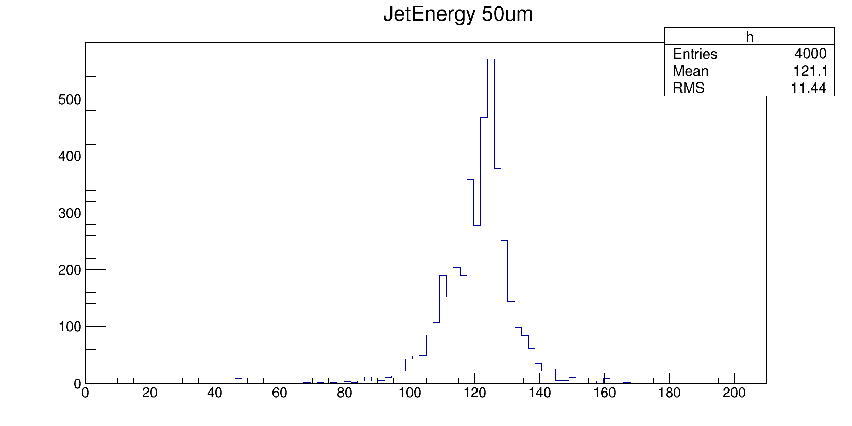
Energy deposits in hadronic jets
For hadronic jets, Z->qq (uds only)
Mean energies of jets 125 GeV
Particle flow approach for reconstruction of jet energies
Contribution from ECAL ~1/3 total energy
Roughly symmetric distribution of energy

Slide 26
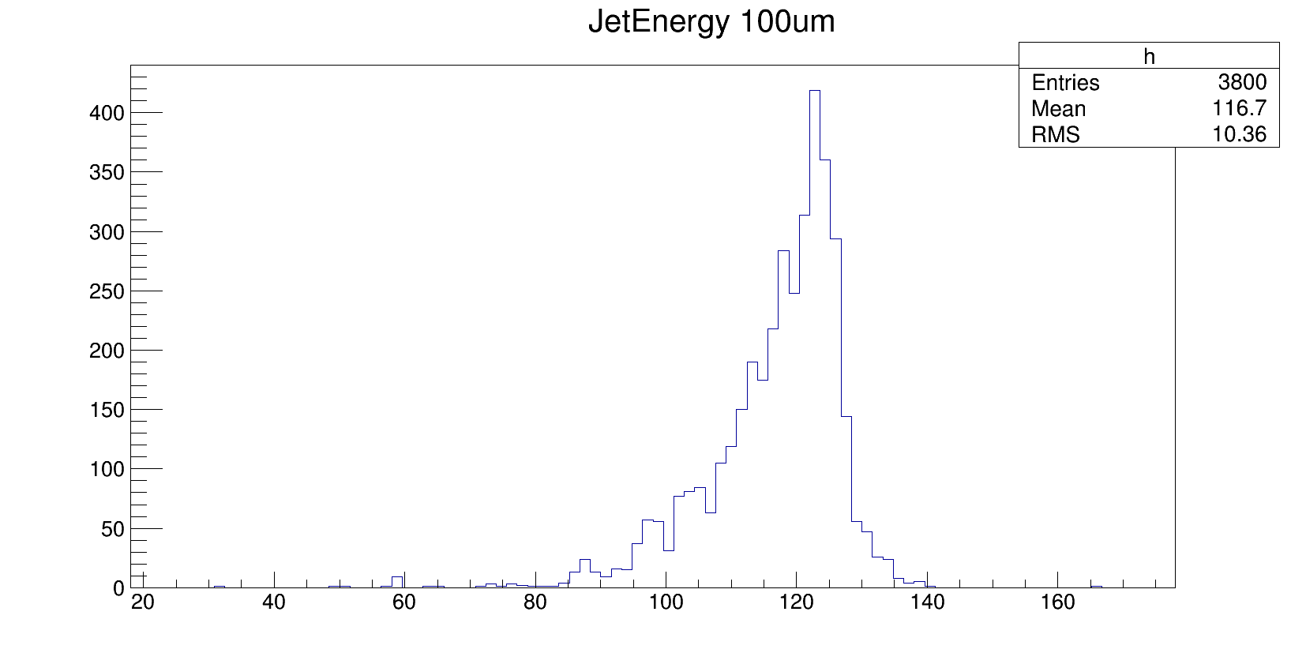
Energy deposits in hadronic jets
For hadronic jets, Z->qq (uds only)
Mean energies of jets 125 GeV
Particle flow approach for reconstruction of jet energies
Contribution from ECAL ~1/3 total energy
Distribution no longer symmetric with larger pixel size

