Slide 1
Relative Biological Efficiency of Antiprotons
The AD-4 ACE Experiment
Michael H. Holzscheiter
University of New Mexico, Albuquerque
Introduction and historical background
Phase I – Biological Effective Dose Ratio (BEDR)
Summary of results
Phase II – Relative Biological Efficiency (RBE)
Experimental Methods
Biology meets Physics – Problems and Issues
Data Analysis and Error Discussions
Final Results
Summary Missing items?
Future tasks?
Lessons learned?

Slide 2
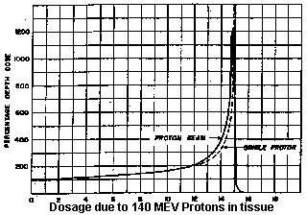
Historical Background
Heavy Charged Particles proposed for cancer treatment by Robert Wilson in 1946 (R R Wilson; Radiology 47 (1946) pp. 487 – 491)
“Higher-energy machines are now under construction, however, and the ions from them will in general be energetic enough to have a range in tissue comparable to body dimensions. It must have occurred to many people that the particles themselves now become of considerable therapeutic interest.”
“The object of this paper is to acquaint medical and biological workers with some of the physical properties and possibilities of such rays.”
Wilson already includes all essential elements: Straggling in target, ionization density, relative biological effectiveness, and the benefits and dangers of using heavier particles.
Initial work at Berkeley laid foundation for cancer treatment with heavy ions (C, Ne, Ar), but only proton treatment survived the funding cuts by NSF and NIH.
Luckily two post docs involved in the work at Berkeley (G. Kraft and H. Tsujii) took the knowledge home to Europe and Japan allowing the development of carbon ion therapy.

Slide 3
Historical Background II
More exotic particles were proposed early on:
Pion Therapy was established at Los Alamos, SIN, and TRIUMF. Enhancements in therapeutical efficiency was expected due to annihilation of pions (Star formation).
Pion Therapy eventually faded away due to poor spatial conformity of high dose region.
LANL: 227 patients 1974 – 81
SIN: 126 patients 1982 - 84
TRIUMF: 1982 - 85 randomized
trials of pions versus photons
S.B. Curtis and M.R. Raju;
Rad. Res. 34 (1968) 239-255
Antiproton Therapy was first proposed in 1984 by L. Gray and T. Kalogeropoulos: High concentration of dose around annihilation vertex predicted. (Rad. Res. 97 (1984) 246-252).
A. Sullivan, CERN: Measured relative energy deposition antiproton to proton: ONLY 30 MeV of 1.9 GeV deposited in target – BUT THAT’s FACTOR OF TWO

Slide 4
The birth of AD-4 ACE
Letter of Intent I-225 submitted August 2002
Proposal PS-324 submitted October 2002 and accepted February 2003.
MINUTES OF THE 162nd MEETING OF THE RESEARCH BOARD:
6. REPORTS AND MATTERS ARISING FROM THE SPSC MEETING OF 14 JANUARY 2003:
K. Königsmann reported on the recent meeting of the SPSC. He first discussed proposal
P324, to study the biological effectiveness of antiprotons for cancer treatment [12]. The
experiment involves exposing cells to the antiproton beam from the AD, and measuring
their survival fraction as a function of the position in the target. ……….
The Research Board approved the experiment for 9 shifts…….The experiment is to be
known as AD-4.
AD-4 ran at 46.7 MeV for 17 individual shifts between June 2003 and November 2004.
No absolute dosimetry of antiproton beam
Measured relative biological effect Peak-to-Plateau compared to protons (BEDR)
We have produced the first measurements of the biological consequences of antiproton irradiation. These data substantiate theoretical predictions of the biological effects of antiproton annihilation within the Bragg peak, and suggest antiprotons warrant further investigation. “Antiprotons are 4x times more powerful in killing cancer cells.”

Slide 5
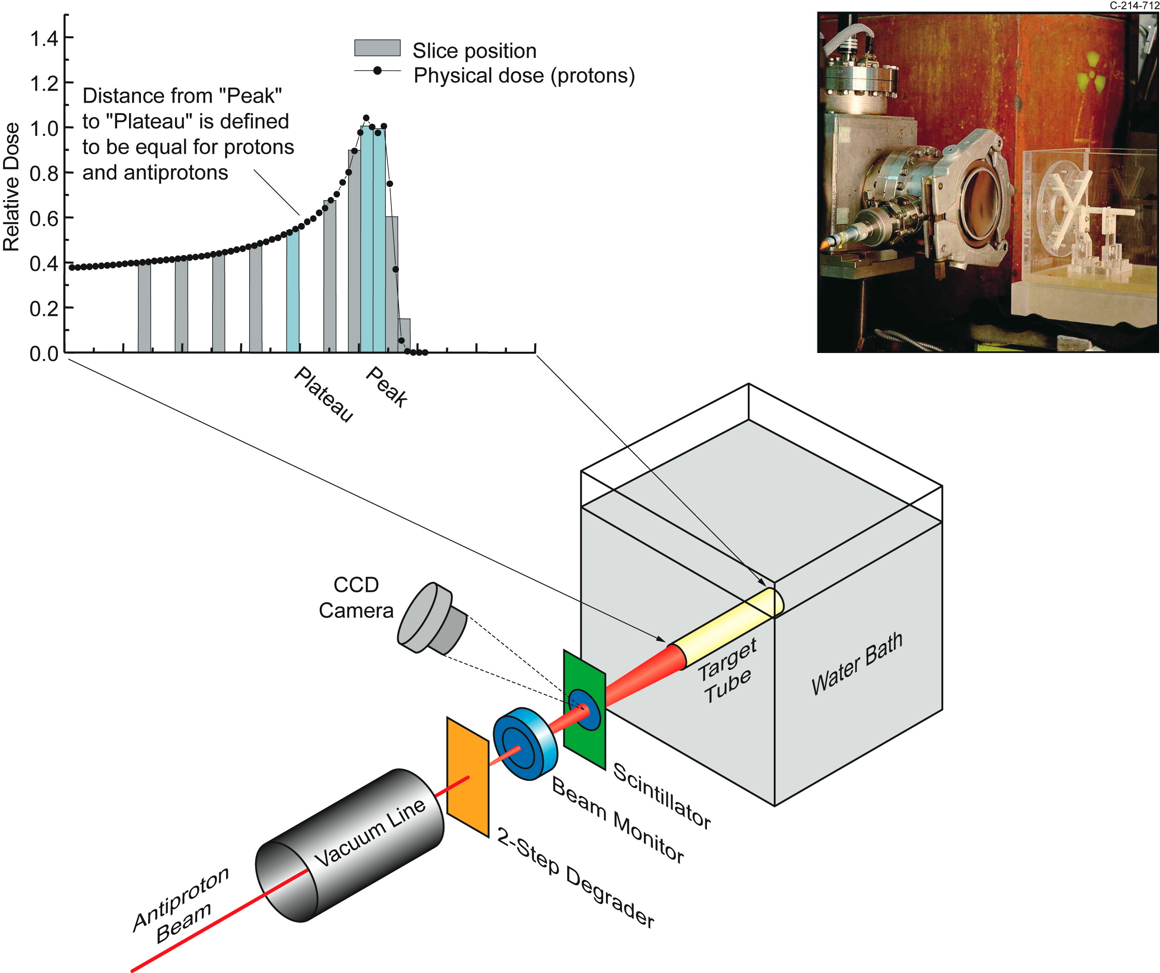
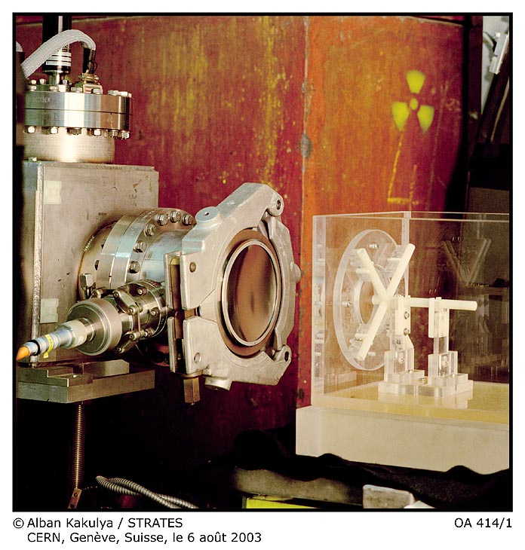
AD-4 ACE Phase I
INGREDIENTS:
V-79 Chinese Hamster cells
embedded in gelatin
Antiproton beam from AD (46.7 MeV)
METHOD:
Irradiate cells for prescribed fluencies
to give dose values where survival in
the peak is between 0 and 90 %
Slice samples, dissolve gel, incubate
cells, and look for number of colonies
ANALYSIS:
Study survival vs. dose in peak and
plateau and compare to protons
(and carbon ions)

Slide 6
AD-4 ACE Phase I - Results
From: M.H. Holzscheiter et al. / Radiotherapy and Oncology 81 (2006) 233–242

Slide 7
AD-4 ACE Phase I - Results
From: M.H. Holzscheiter et al. / Radiotherapy and Oncology 81 (2006) 233–242

Slide 8
AD-4 ACE Phase II
Goals:
Build clinically relevant Spread Out Bragg Peak (SOBP)
Penetration in Target ≈ 10 cm/Width of SOBP ≈ 1 cm.
Include absolute Dosimetry in order to measure Relative Biological Efficiency (RBE)
which then can be used for dose planning excercises.
Requirements to AD:
Increase beam energy to 500 MeV/c (126 MeV kinetic)
Resulting in fewer but longer shifts due to more difficult switch-over of accelerator

Slide 9
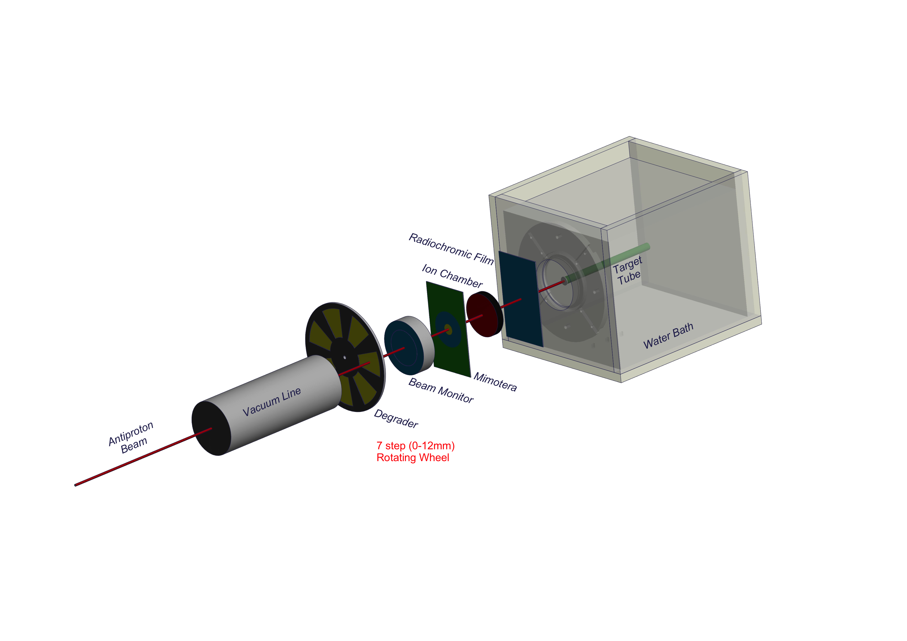
AD-4 ACE Phase II – Experimental Set-Up
Minor, but essential, changes:
Mimotera for shot-by-shot beam monitoring
Calibrated Ion Chamber for Dosimetry
EBT-2 Film on Tank for Beam Profile
Automated 7-Step Degrader System

Slide 10
Relative Biological Effect
= ratio of DOSE of reference radiation to dose of test radiation
producing same BIOLOGICAL EFFECT
RBE_{0.1} 1.56
SF_{0.1}
5.17 Gy
SF_{0.1}
3.31 Gy

Slide 11
Measuring RBE requires Dose and Biological Effect
Biological Effect:
Embed cells in gelatin matrix inside 6 mm diameter tube
Irradiate with different fluences of antiprotons (various doses)
Extract gelatin from tube and take 2 mm slices at several positions
Disolve slices and seed number of cells determined by predicted
survival in growth medium
Incubate for 5 – 6 days
Stain cells and count number of colonies ➔ extract survival fraction
Monte Carlo Assisted Dosimetry:
Determine number of antiprotons entering experimental set-up
Measure beam spot and position at entrance to target tank
Estimate beam divergence (0 mrad/source distance 200 cm)
Build model of experimental set-up in FLUKA
Transport 5 million primaries through FLUKA
Rerun using +/- sigma for parameters with know errors
Study systematic errors due to arbitrary assumptions

Slide 12
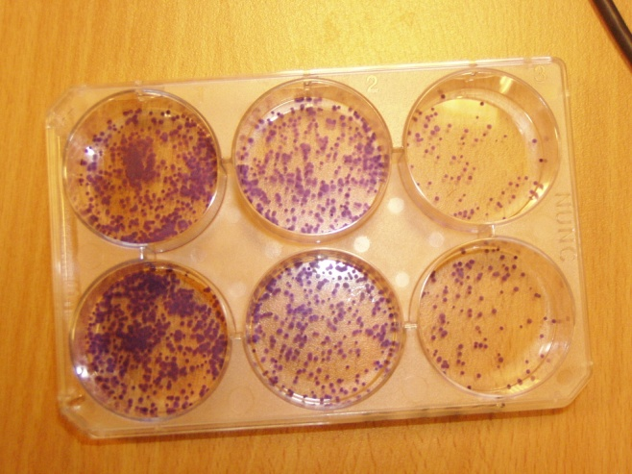
Biological Effect - The tube approach
Irradiate V79 CELLS – Chinese hamster lung fibroblasts
Use different dose levels to cover 100% to 0.1% survival
Seed number of cells for expected survival of 100 cells
Beam

Slide 13
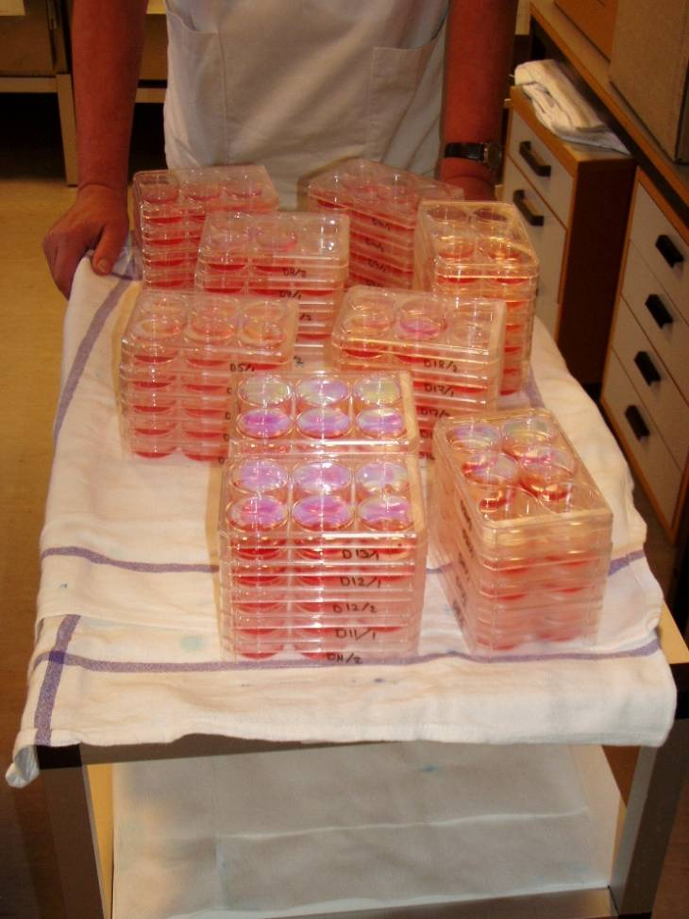
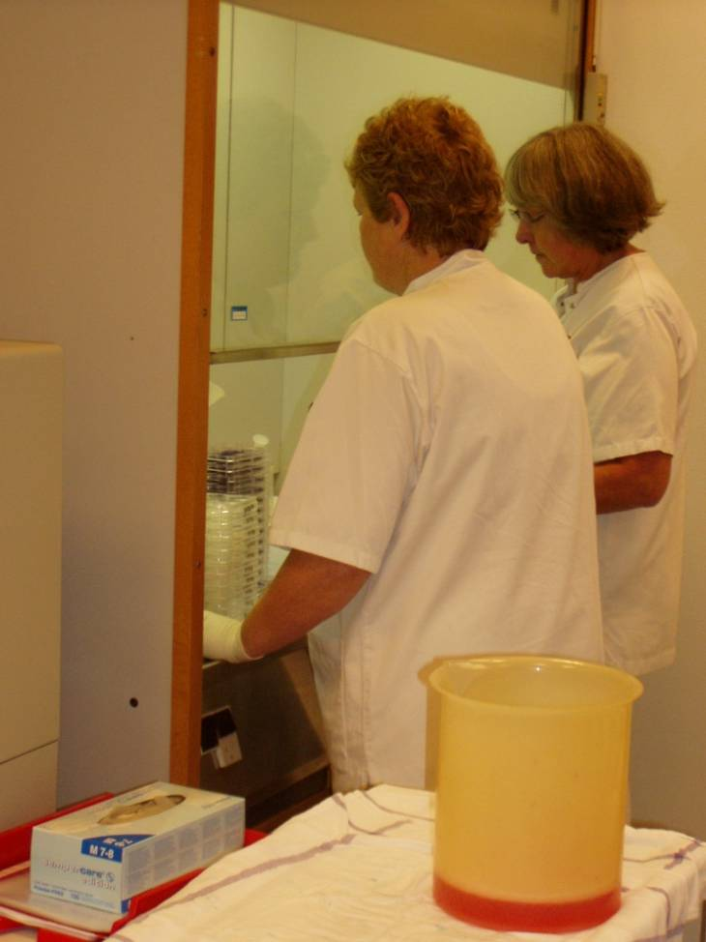
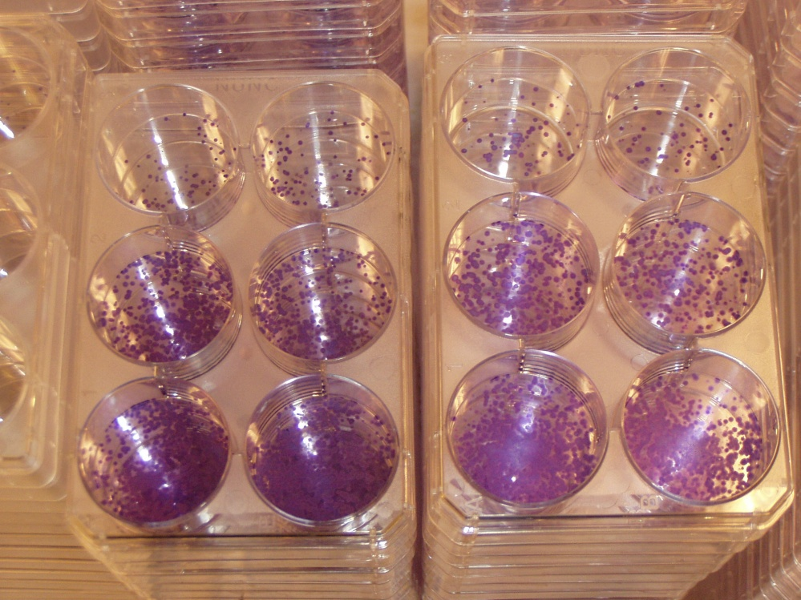
The tube approach – not a trivial task

Slide 14
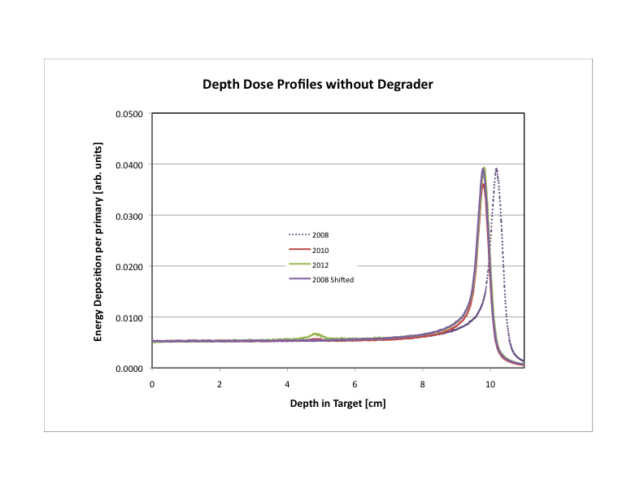
Monte Carlo Assisted Dosimetry
Correction for change in experimental set-up after 2008
x-Axis for 2008 needed to be shifted by 4 mm

Slide 15
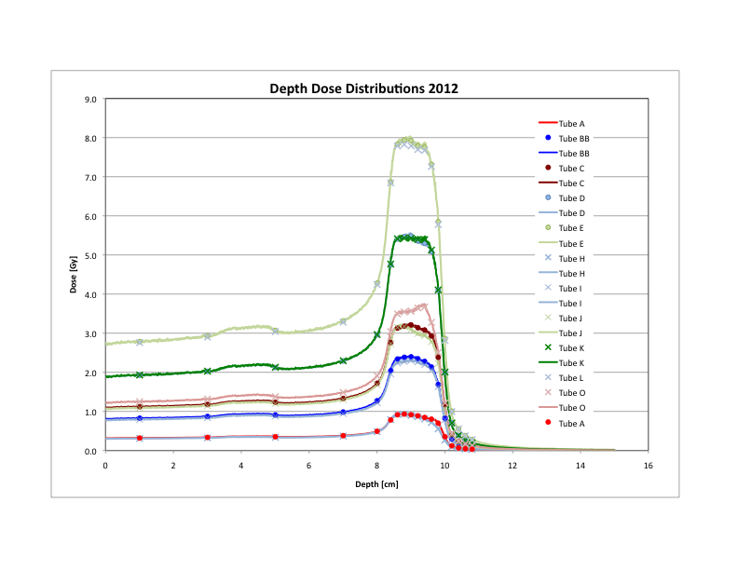
Building the Spread-Out Bragg Peak (SOBP)

Slide 16
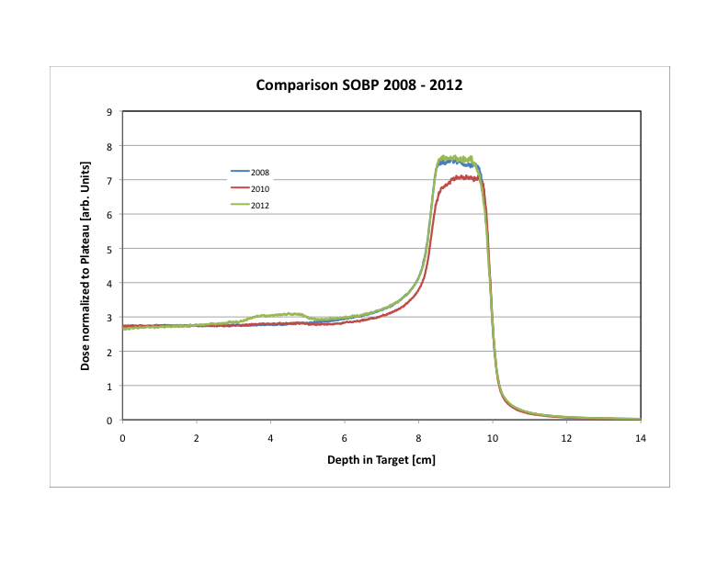
SOBP Comparison between Years

Slide 17
RBE Analysis
Correct survival fraction for Plating Efficiency
(obtained from unirradiated tubes and/or from unrestricted fits)
Fit data to ln(SF) = -αx-βx², obtain α, β, and sigma(α), sigma(β)
84 mm 2012
Extract Dose for 10% survival D_{10%}

Slide 18
RBE Analysis - Errors
Use σ(α) and σ(β) from fit to establish error band and σ(D10%)
ln(SF) = -αx-βx² ➔ ln(SF) = -(α±κ∗σ(α))x – (β±κ∗σ(β))x²
κ is chosen so that ≈ 68 % of data points are in between the two curves
84 mm 2012

Slide 19
RBE Analysis
Repeat procedure for all years (2008, 2010, and 2012)
RBE = D_{10%,x-rays}/D_{10%, pbars}
Plot Average of RBE’s for each slice
Combine statistical errors in quadrature
(as long as variance of values is less than 2 sigma)

Slide 21
Discussion
Error bars contain only statistical variations (counting of survival)
Systematic errors affecting the result for each set are probably
“covered” by averaging all sets. These are:
Error in Plating efficiency (11% - 15%)
Error in Dose calculation (<10%)
Definition of beam spot size and position and beam divergence
(Dose calculations with all parameters changed by respective sigma’s
and variations added in quadrature)
Both would shift the individual RBE vs. Depth curves up and down
Alternative: normalize RBE in plateau? Fit in plateau carries largest errors
Dose error affecting Peak and Plateau region differently:
Final uncertainty of FLUKA dose
2014 Benchmark Experiment

Slide 22
Benchmark Experiment 2014 - Preliminary
14 %
Over-estimation of dose in Peak would result in increase of RBE values.
Analysis including correction factors for pressure and temperature in progress

Slide 23
Summary and Discussions
Primary Goal:
RBE of antiprotons vs. depth up to the distal edge of the Bragg Peak.
Steep increase of RBE confined to the SOBP region.
Lessons learnt?
Biology experiments are hard!!
Need best possible diagnostic for beam!
Mimotera only installed in 2010, multiple monitors better
Clinical beam would have been much better, but unrealistic!
Flat field of 5 x 5 cm to eliminate divergence and scatter
Compress experiment to 1 year to avoid changes over time
(Set-up changes, alignment, MC assisted dosimetry -
but that would have inhibited the “learning curve”).
Leave experiment mounted at all times
Survey of experiment impossible after installation of AeGIS

Slide 24
We close the chapter but not the book
No further real progress achievable with beam at CERN.
Original FAIR/FLAIR facility should have been running by now
offering higher intensity and continuous extraction.
Theoretical predictions in general confirmed,
replacing theoretical “guesses” with experimental data.
Principle of real-time imaging confirmed.
Thank you AD Team
AD users
and CERN

