Slide 1
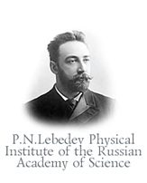













GBAR 2016 STATUS REPORT
Gravitational Behaviour of Antihydrogen at Rest
An experiment to test the Weak Equivalence Principle with antimatter , using antihydrogen ions $\overline{H}+$

Slide 2
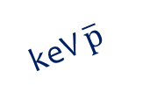

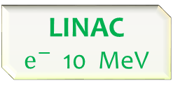
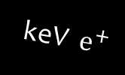



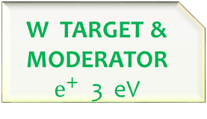



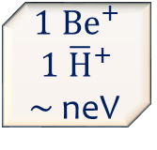
GBAR synoptic view
CAPTURE & COOLING ${\overline{H}}^{+}{− Be}^{+}$
keV $\overline{H}$
DETECTION
keV $\overline{p}$
$${1 Be}^{+}$$
$$1 {\overline{H}}^{+}$$
$∼$ neV
keV ${\overline{H}}^{+}$
LASER
1.64 µm
LASERS
313 nm
LINAC
$e^{−}$ 10 MeV
W TARGET & MODERATOR
$e^{+}$ 3 eV
Buffer Gas
$e^{+}$ 1 keV
MR TRAP
keV ${ e}^{+}$
Ps
ELENA
CERN-AD
$\overline{p}$ 100 keV
LASER 410 or 243 nm
DECELERATOR $\overline{p}$ keV
FOCUS
keV $\overline{p}$

Slide 3
Overview of 2015 progresses
Linac /Bunker/Cern installation
Positron source/beam line /interaction chamber
Antiproton deceleration
Antihydrogen cooling
Free fall detector

Slide 4
GBAR synoptic view
CAPTURE & COOLING ${\overline{H}}^{+}{− Be}^{+}$
keV $\overline{H}$
DETECTION
keV $\overline{p}$
$${1 Be}^{+}$$
$$1 {\overline{H}}^{+}$$
$∼$ neV
keV ${\overline{H}}^{+}$
LASER
1.64 µm
LASERS
313 nm
LINAC
$e^{−}$ 10 MeV
W TARGET & MODERATOR
$e^{+}$ 3 eV
Buffer Gas
$e^{+}$ 1 keV
MR TRAP
keV ${ e}^{+}$
Ps
ELENA
CERN-AD
$\overline{p}$ 100 keV
LASER 410 or 243 nm
DECELERATOR $\overline{p}$ keV
FOCUS
keV $\overline{p}$

Slide 5
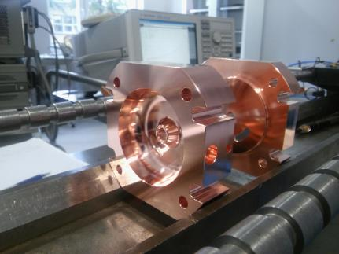
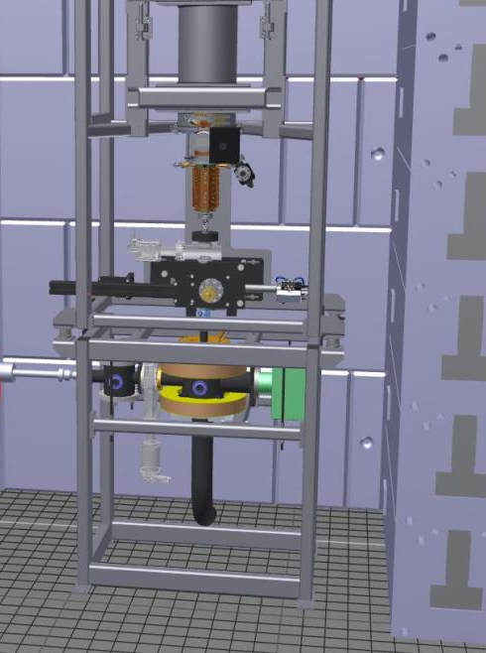
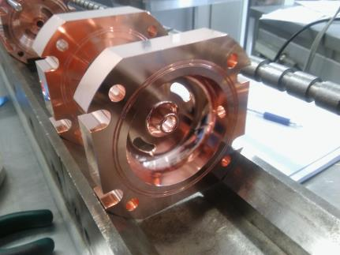
GBAR Linac
9+ MeV/0.2 mA e⁻ linac building in progress at NCBJ
Vertical position (radiation protection)
Installation: May-June 2016

Slide 6
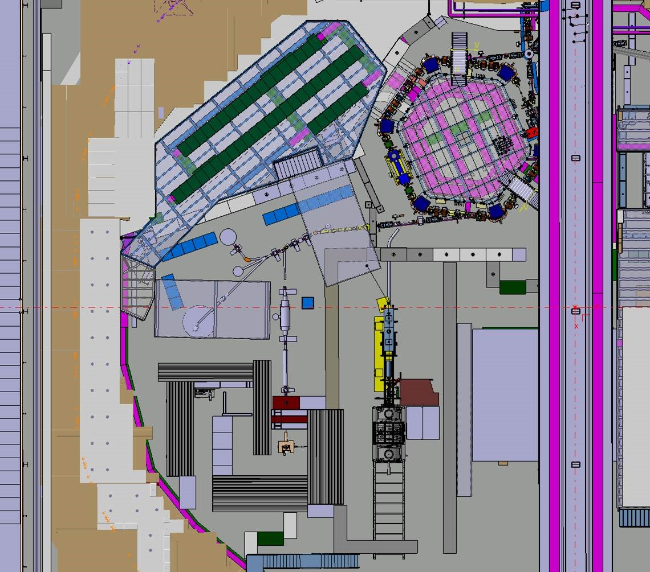
Linac bunker
Linac shielding : many different versions (nearly final, now ∼1400 t)
  Will use LEP magnet yokes (cost & availability)
  Yoke refurbishing started; installation early 2016; careful control of AD level…
ELENA
Interaction chamber
GBAR
Free fall vessel
GBAR decelerator
High field trap
Buffer gas trap
Linac
AeGIS2

Slide 7
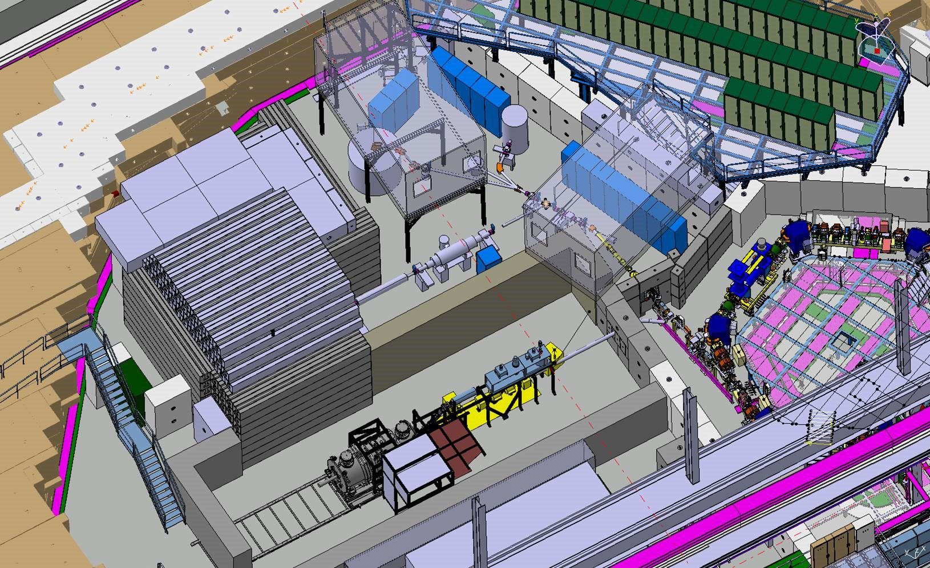
Linac bunker
ELENA
GBAR

Slide 8
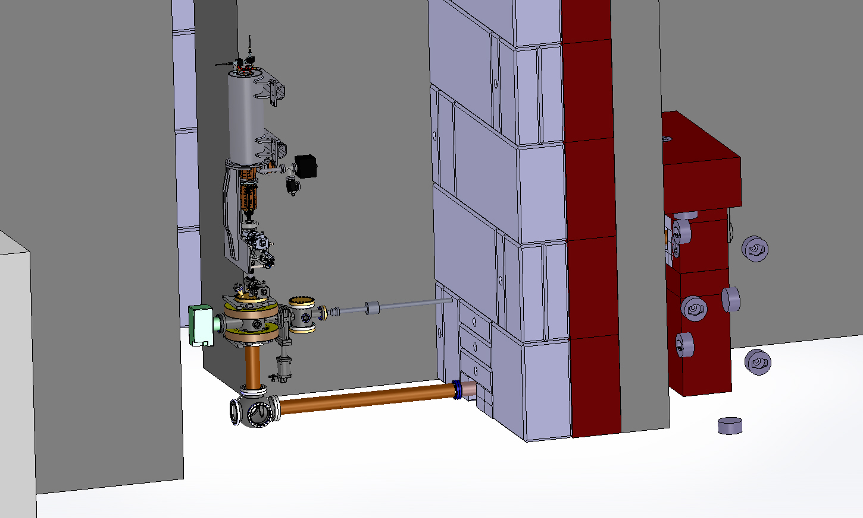
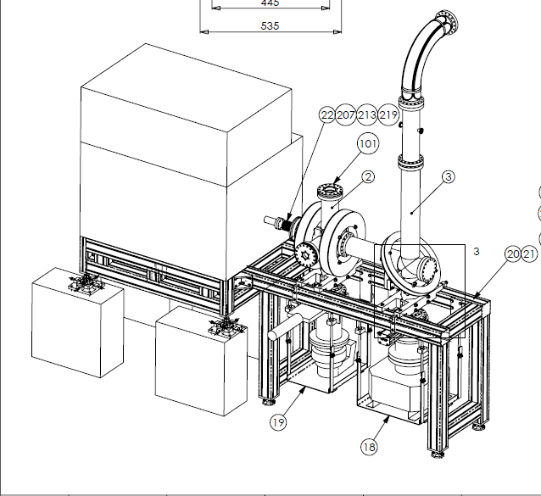
Positron source/beam line
A new positron source design will be implemented soon at Saclay facility as a prototype for the Cern installation.
The GBAR beam line design is completed, tenders are in preparation.
Design of the new Saclay source
CERN current implementation of the positron source and beam line

Slide 9
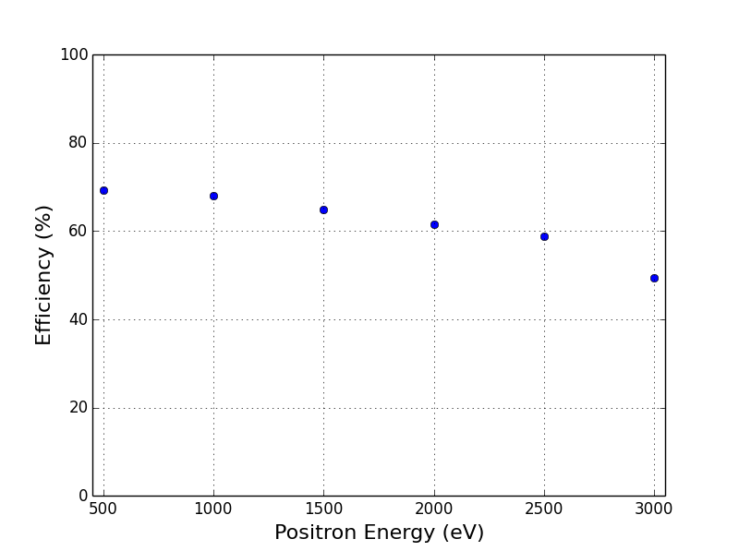
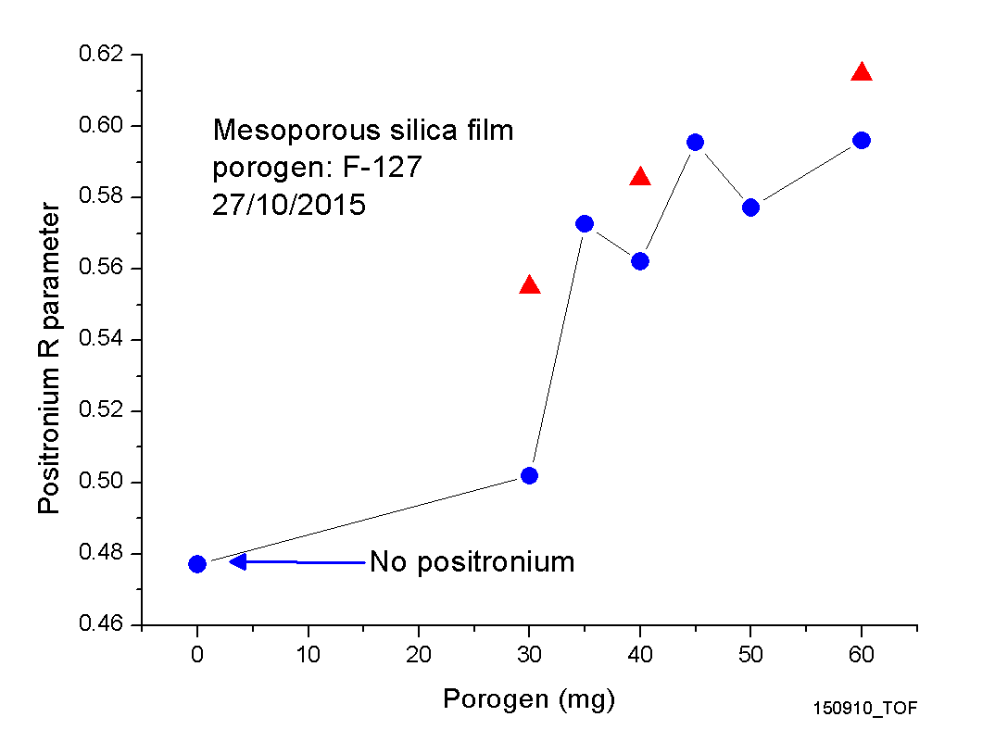
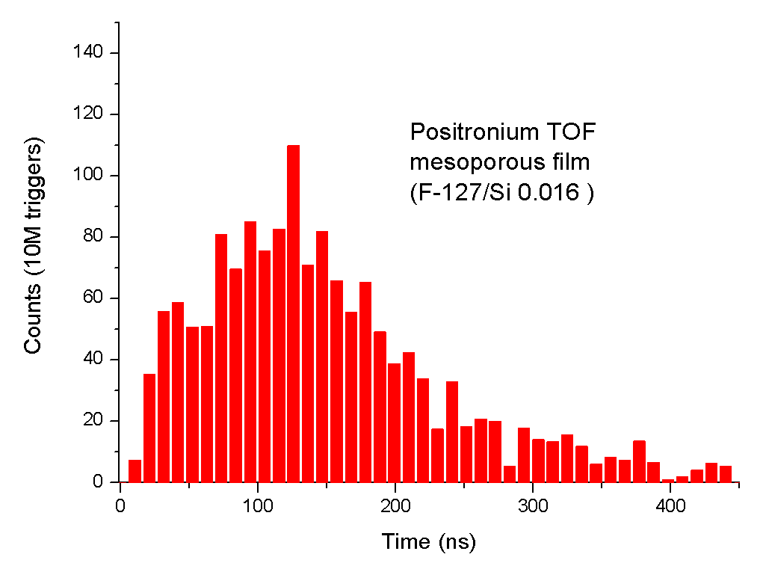
e⁺ moderation, Ps study
Study with the Saclay positron beam line: qualification of a SiC layer for remoderation.
  Remoderation efficiency up to ∼ 70 % (Usual W remoderation ∼ 10 %)
  Commercialy available layer
  New perspectives for improving e⁺ beam
Continue study of different e⁺/positronium converters: improve Ps yield, reduce Ps emission energy…
PRELIMINARY
SiC remoderation efficiency vs incident E
~ 30% positronium
YIELD:
R parameter versus porogen mass
TOF: kinetic energy of Ps
(peak ~50 meV)

Slide 10
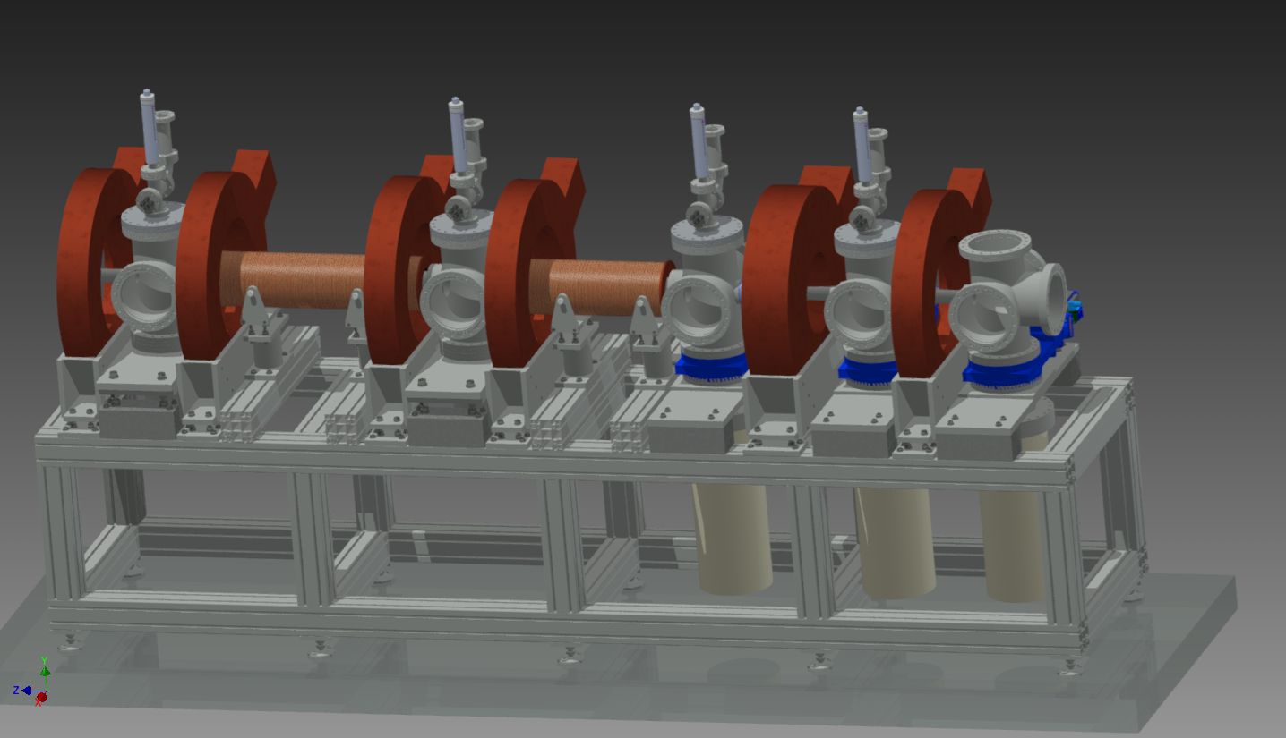
Positron trapping
Electron cooling & trapping efficiency should be ∼ 75% but not yet achieved
  Work was going on : calculation of cooling time, alignment of e⁺ beam on e⁻ plasma, HV instabilities… Delayed for exchange of the MRT SC magnet cryocooling head (No more maintenance for old head) .
Buffer gas cooling (N₂ or SF₆) is routinely reaching 25% : GBAR decision to add such a trap as injector to high field trap → guarantee minimal efficiency ∼ 25%
A new BGT will be constructed and tested at Saclay in 2016
(Parts ordered , delivery well advanced)
Cooling with N₂ or SF₆
50 eV e⁺
to high field trap
Trapping
with N₂
pumping

Slide 11
GBAR synoptic view
CAPTURE & COOLING ${\overline{H}}^{+}{− Be}^{+}$
keV $\overline{H}$
DETECTION
keV $\overline{p}$
$${1 Be}^{+}$$
$$1 {\overline{H}}^{+}$$
$∼$ neV
keV ${\overline{H}}^{+}$
LASER
1.64 µm
LASERS
313 nm
LINAC
$e^{−}$ 10 MeV
W TARGET & MODERATOR
$e^{+}$ 3 eV
Buffer Gas
$e^{+}$ 1 keV
MR TRAP
keV ${ e}^{+}$
Ps
ELENA
CERN-AD
$\overline{p}$ 100 keV
LASER 410 or 243 nm
DECELERATOR $\overline{p}$ keV
FOCUS
keV $\overline{p}$

Slide 12
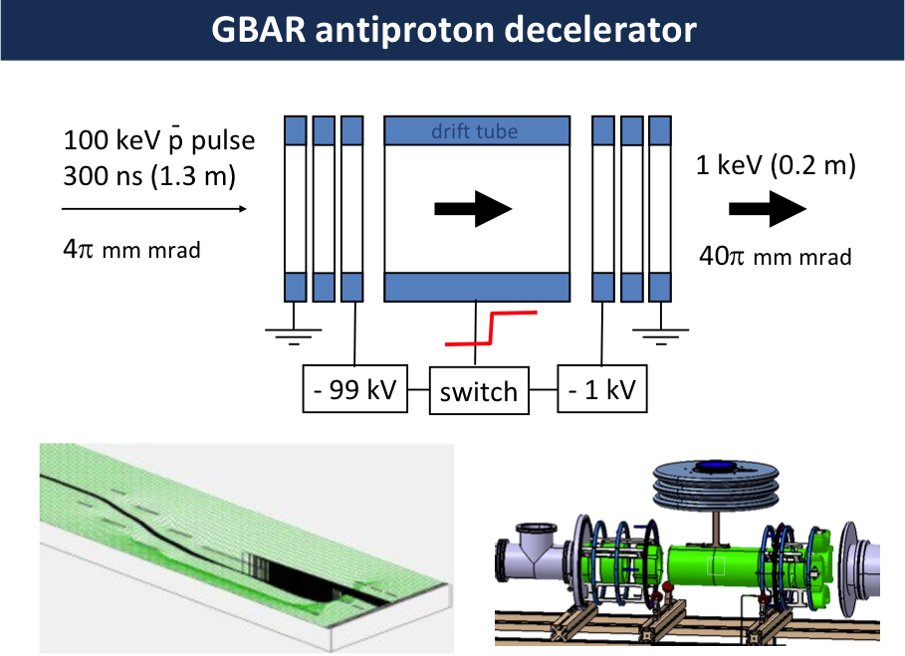
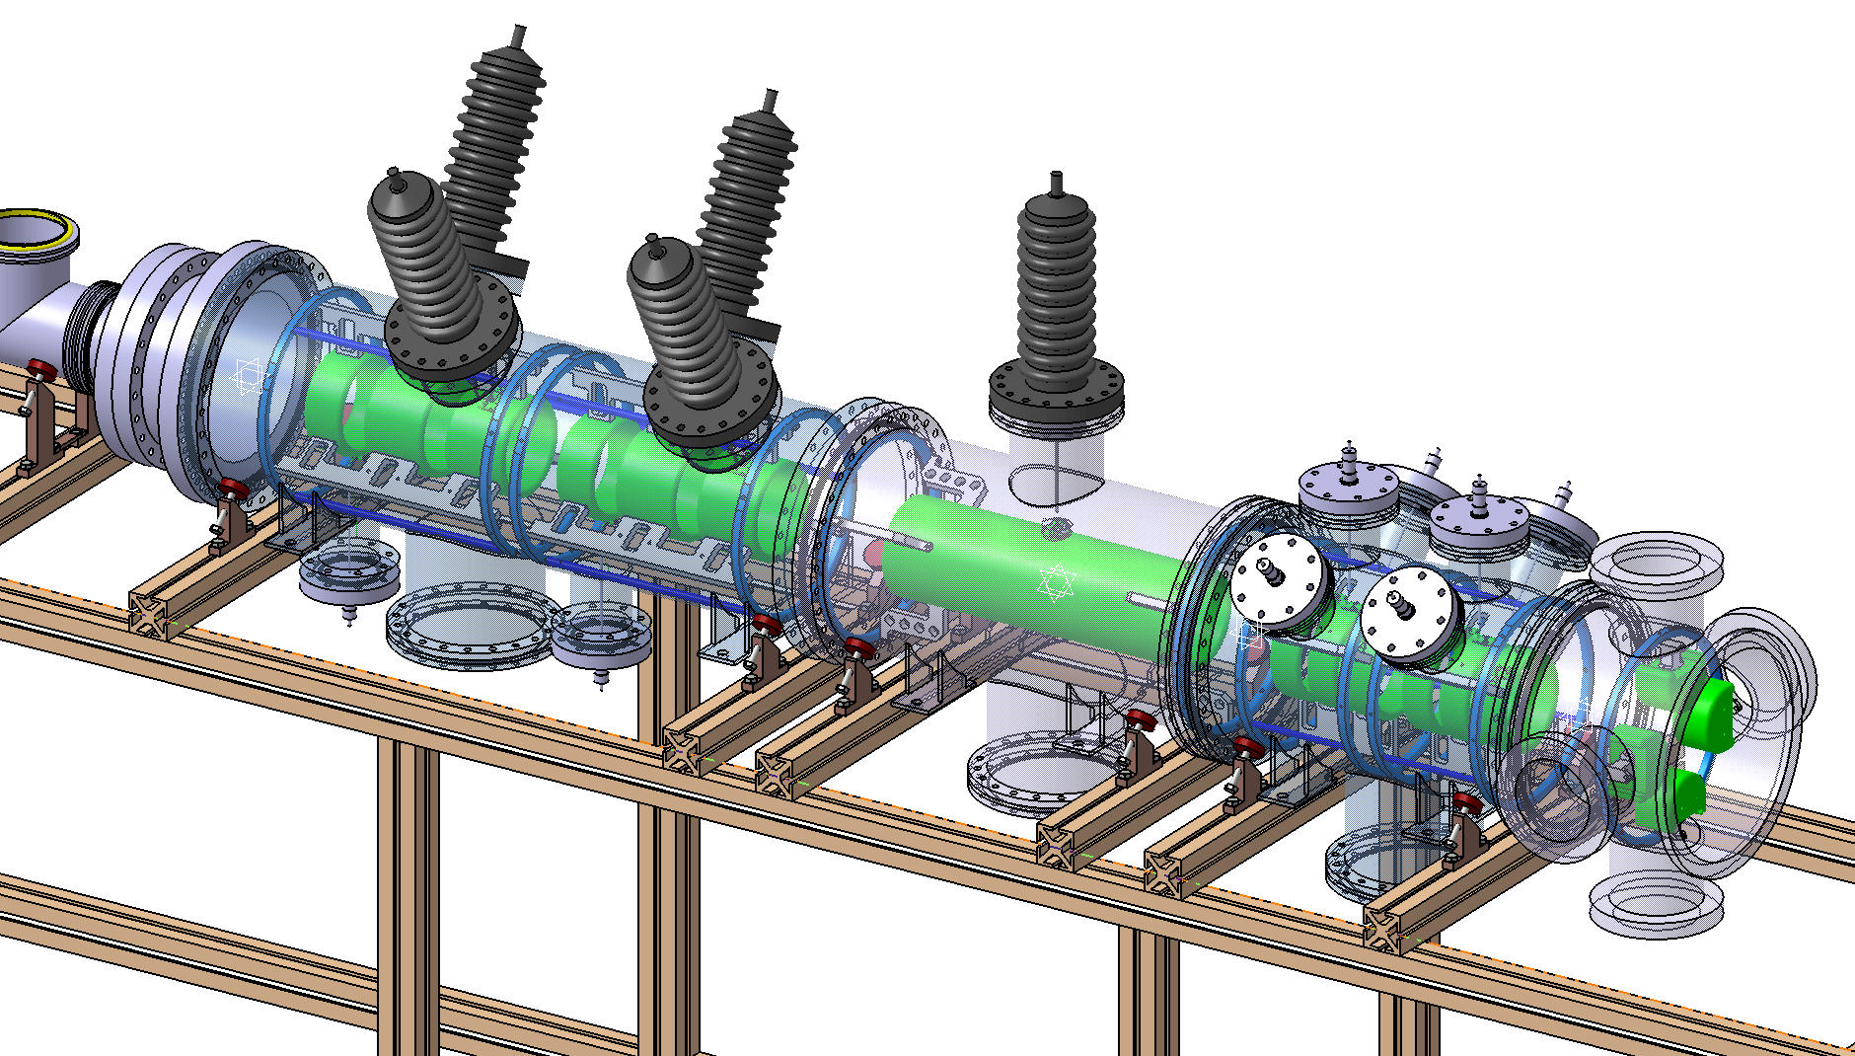
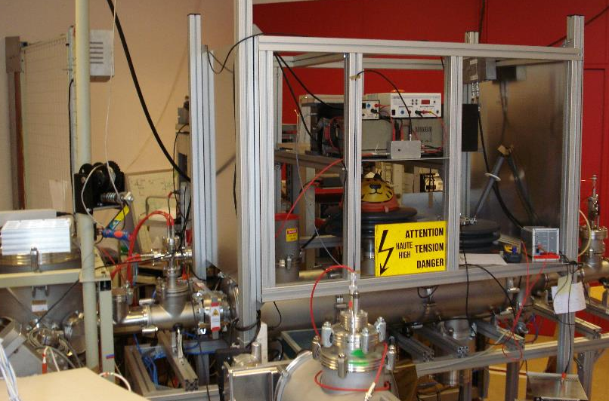
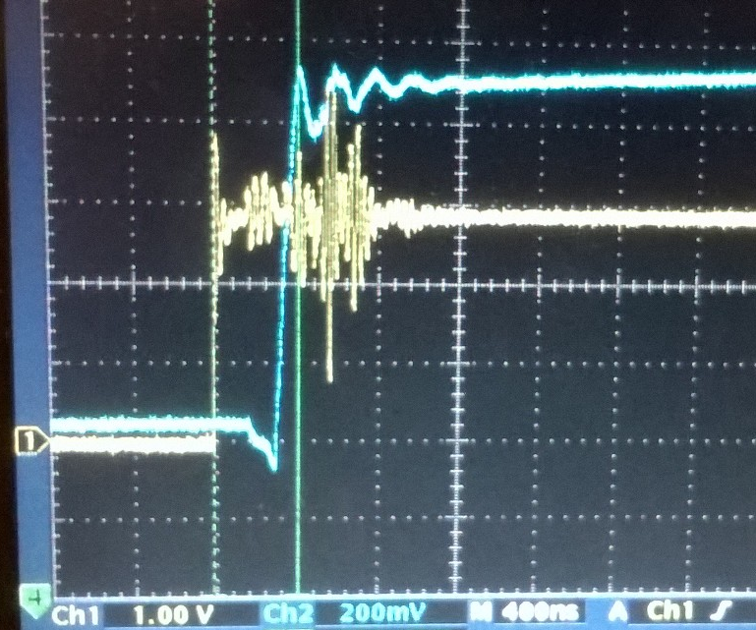
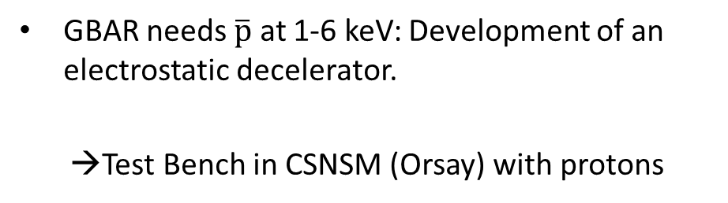

p/$\overline{p}$ decelerator decelerator
GBAR needs $\overline{p}$ at 1-6 keV: Development of an electrostatic decelerator.
→Test Bench in CSNSM (Orsay) with protons
drift tube
→Switch tested OK at 20 kV;
now conditioning for 100 kV
Proton gun to be installed at Saclay, later at CERN, for H/H⁻ production study

Slide 13
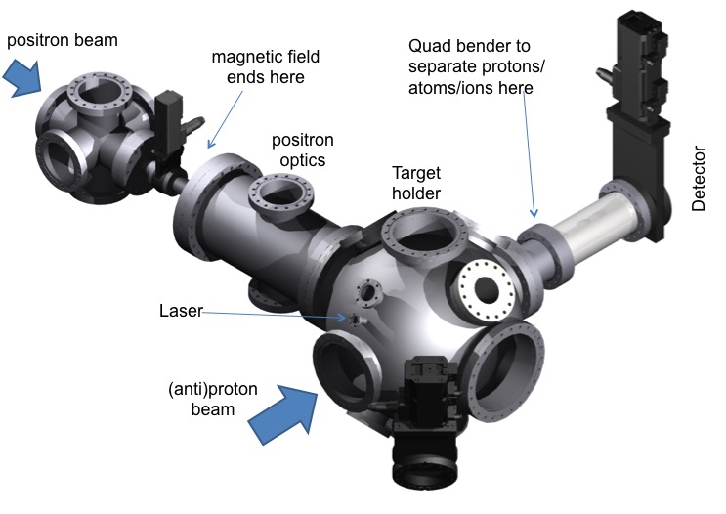
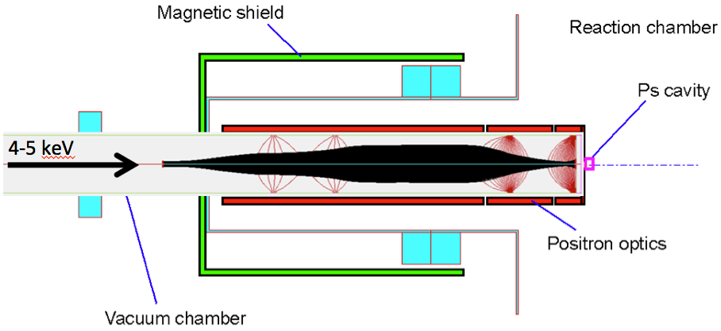
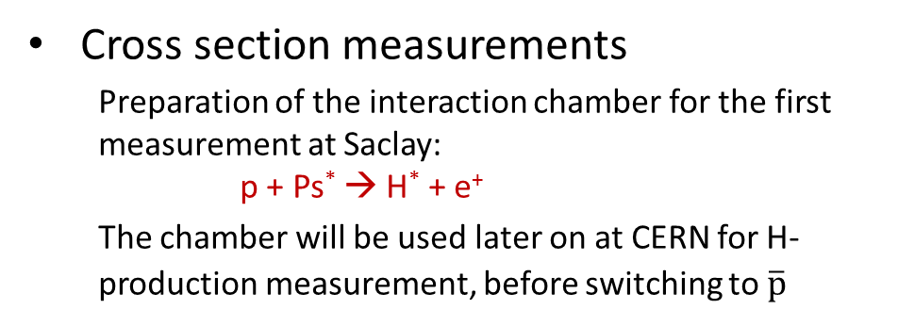

p/$\overline{p}$ – Ps interaction
Cross section measurements
  Preparation of the interaction chamber for the first measurement at Saclay:
  p + Ps* → H* + e⁺
  The chamber will be used later on at CERN for H- production measurement, before switching to $\overline{p}$
Positron extraction optics:
  Need strong focussing on the Ps converter: magnetic shield, Einzel lenses
  Parts delivery in progress, assembly started, measurement 2nd half 2016

Slide 14
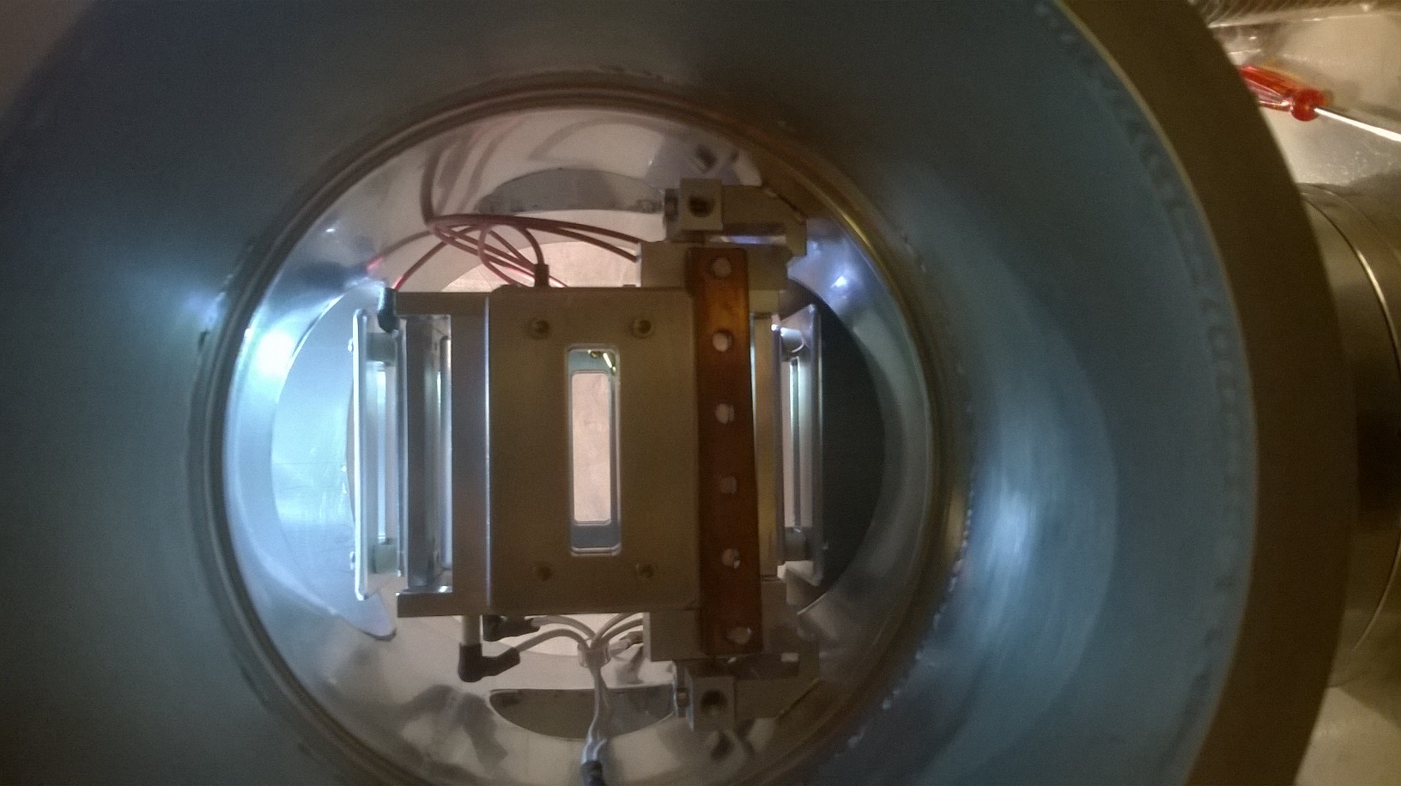
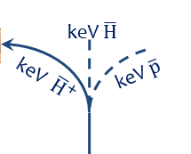
Electrostatic deflector
Built and presently tested in Orsay.
  To be used for the H production measurement in Saclay, then at Cern

Slide 15

GBAR synoptic view
CAPTURE & COOLING ${\overline{H}}^{+}{− Be}^{+}$
keV $\overline{H}$
DETECTION
keV $\overline{p}$
$${1 Be}^{+}$$
$$1 {\overline{H}}^{+}$$
$∼$ neV
keV ${\overline{H}}^{+}$
LASER
1.64 µm
LASERS
313 nm
LINAC
$e^{−}$ 10 MeV
W TARGET & MODERATOR
$e^{+}$ 3 eV
Buffer Gas
$e^{+}$ 1 keV
MR TRAP
keV ${ e}^{+}$
Ps
ELENA
CERN-AD
$\overline{p}$ 100 keV
LASER 410 or 243 nm
DECELERATOR $\overline{p}$ keV
FOCUS
keV $\overline{p}$

Slide 16
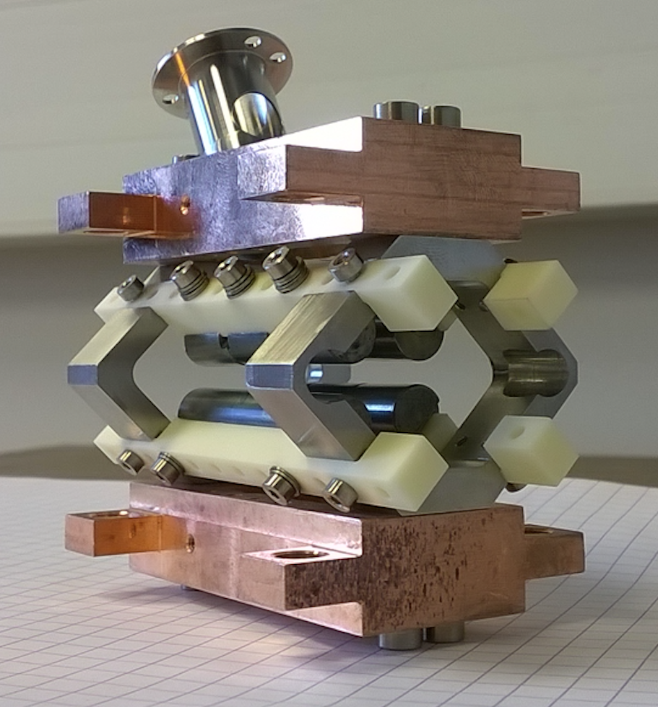
Antihydrogen cooling
Capture Trap (LKB)
Detailed simulations of sympathetic cooling with laser cooled Be⁺ are developed for different elements. Ion energy is crucial. Tests with H₂⁺ are planned.
The capture Paul trap (first stage of cooling) is being assembled, together with the cooling laser (626 nm DBR master diode → 313 nm)
Laser
RF guides
Integration design of the capture trap

Slide 17
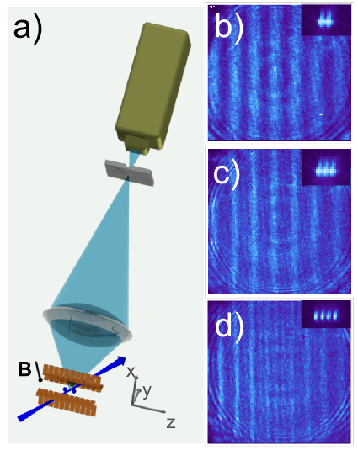
Antihydrogen cooling
Precision Trap (JGU)
Study of interference in the light scattered from trapped ⁴⁰Ca⁺ ion crystals
  Measure of the interference visibility → ion temperature measurement (to be known at the photo detachment)
  Paper submitted to PRL (ArXiv.1511.08697)
Ion trap fabrication
  Improve trap gold coating technique, to reduce parasitic heating (by factor 1000)
  New trap chips designed and fabricated→ improve heating rate
Loading scheme for Be⁺
  Tested with different wavelength, 350 and 260 nm
  New proton source to test the injection, capture and cooling of light ions in Be⁺ crystals.
Lasers
  Cooling lasers for Be⁺ at 313 nm are ready (one master, one slave, resonance frequency doubler)
  Set-up second master for line width measurement
Contrast is temperature dependent

Slide 18
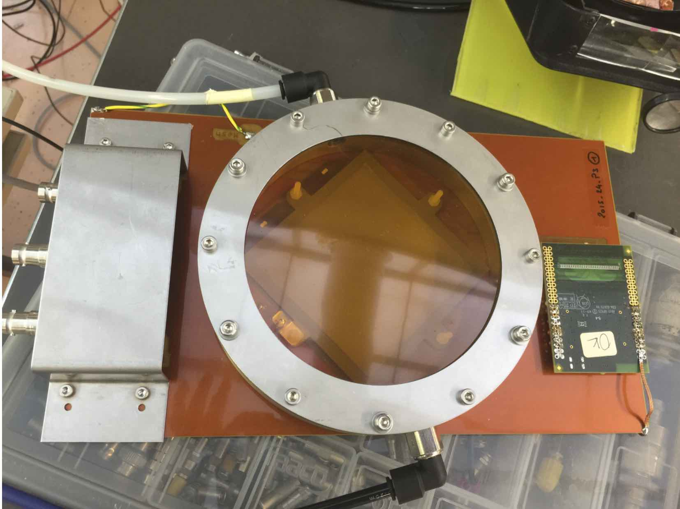
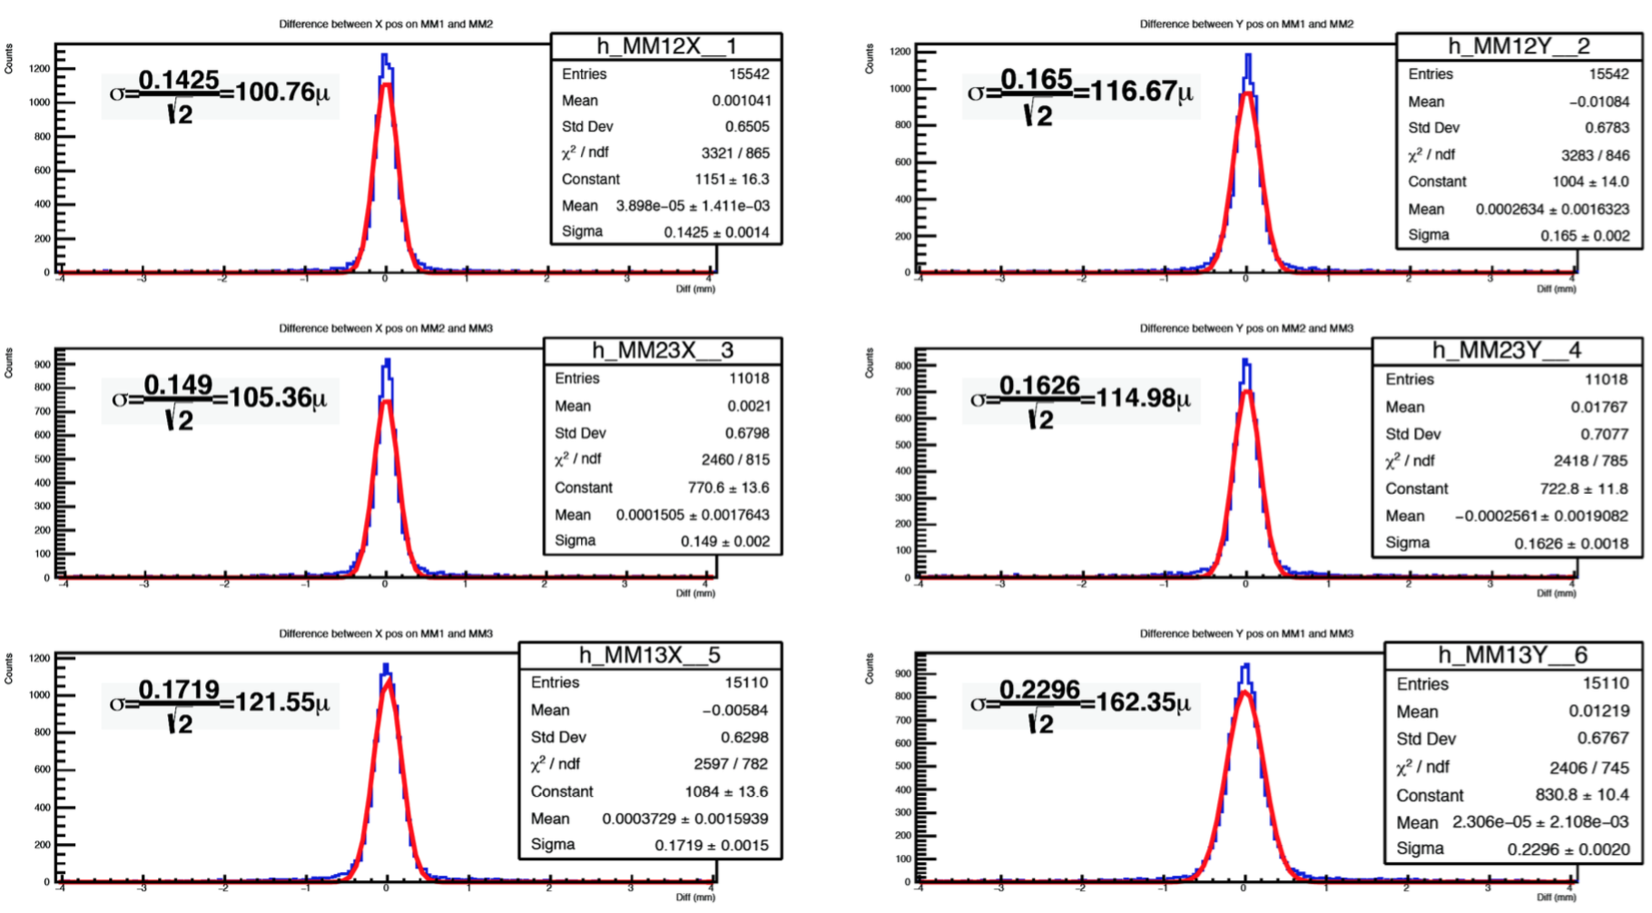
Free fall detector
Prototype built and tested in 2015
  3 microstrip Micromegas chamber detectors (MMD), 8x8 cm², with X-Y readout, built at CERN
  Using the RD51 electronic readout developed at CERN
  Tested with CR and CERN beams
  Design to be finalized for the GBAR detector
  MMD resolution
  ∼ 120 µm

Slide 19
Free fall detector
GBAR final detector
Present global design
  5 planes of 3MMD, 50x50 cm², with X-Y readout
  Spatial vertex resolution ∼ 1.5 mm
  CR background being studied
First 3 modules to be built soon
  With prototype experience
  15 modules ready for summer 2017
Scintillator coverage to be designed
  Contribution from Korean groups.

Slide 20
Overview of 2015
The GBAR collaboration got new forces
  2 Korean groups
  New technical coordinator
All subparts of the experiment are now covered
  GBAR starts installation at CERN in 2016:
  Linac bunker (Jan.-Apr.)
  Linac installation and commissioning (June)
  Installation of the e+ beam line (Sept.)
  Start installation of the decelerator → aims to be in phase with ELENA commissioning

Slide 21
Thank You

Slide 22
GBAR Planning…

