Slide 1
Improvements to the online chromaticity tool for the LHC
ABP Information Meeting 14/01/16
ABP: X. Buffat, L.R. Carver, E. Métral
OP: K. Fuchsberger, M. Solfaroli

Slide 2
Outline
Introduction
Chromaticity Tool in 2012
Chromaticity Tool in 2015
Summary

Slide 3


Introduction
Chromaticity is the tune sensitivity to momentum offsets, and is given by
This is expressed (to first order) in relative terms as
In the LHC, a slow modulation to the momentum is applied (~20s time period), which then creates a modulation in the tune.
Online tool in the CCC uses the modulation signal and the tune (measured from the BBQ system) and calculates the Q’ by fitting procedures.

Slide 4
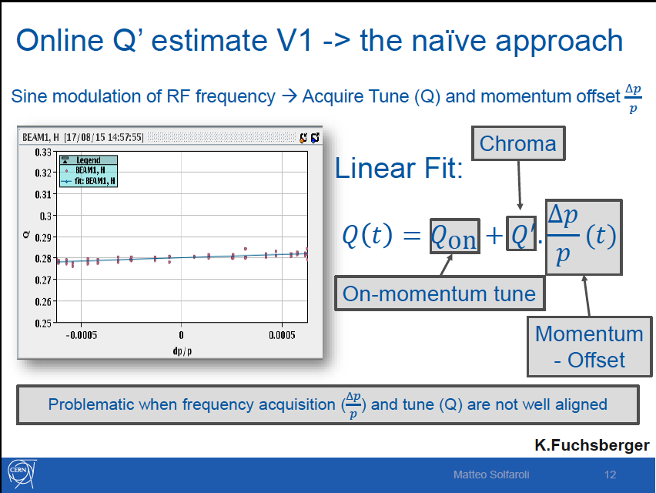
Chromaticity Tool in 2012
Simple linear fit applied to the data. Great for when tune is clean
See LBOC ‘Chromaticity correction without RCS –M. Solfaroli 18/08/15’

Slide 5
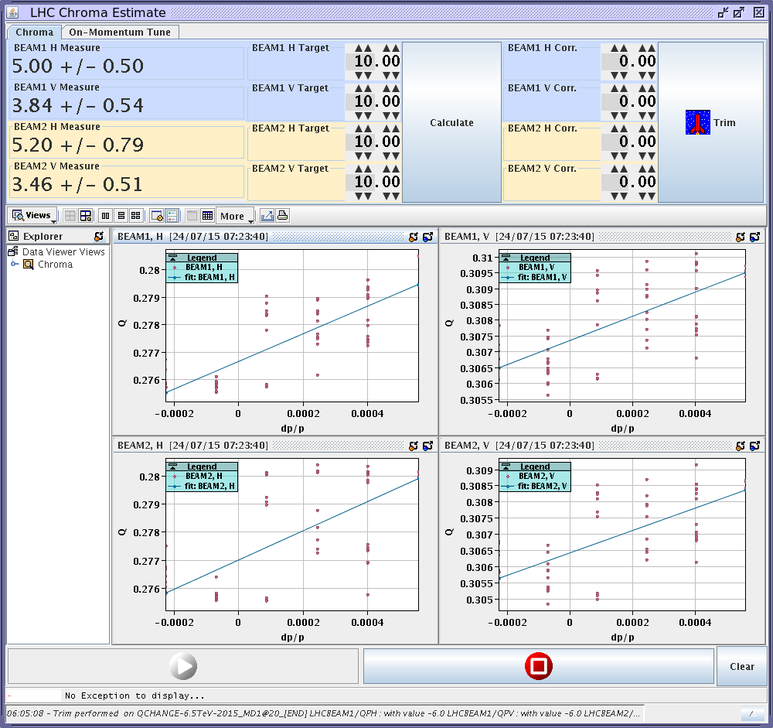
Chromaticity Tool in 2012
Not so great when tune signal is very noisy.
Taken from logbook on 24/07/15 05:39

Slide 6
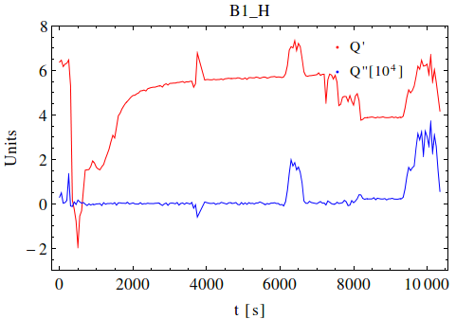
Chromaticity Reprocessing
Fill 3806 was a validation fill, modulation kept on throughout the cycle with octupoles at 0 (unless specified).
Chromaticity was recalculated using available data. Time offset between the two signals was corrected, and a parabolic fit applied.
Estimate of Q’ from chromaticity tool, taken from logbooks.
Significant discrepancies between Q’ from online tool and reprocessed Q’.
Motivated improvements to online tool
Ramp
Octupole to 280A,
then to 565 A
Octupole to 375A, back to 0A.
Squeeze
See LBOC ‘Chromaticity Reprocessing – Fill 3806’ – L.R.Carver 16/06/15’

Slide 7
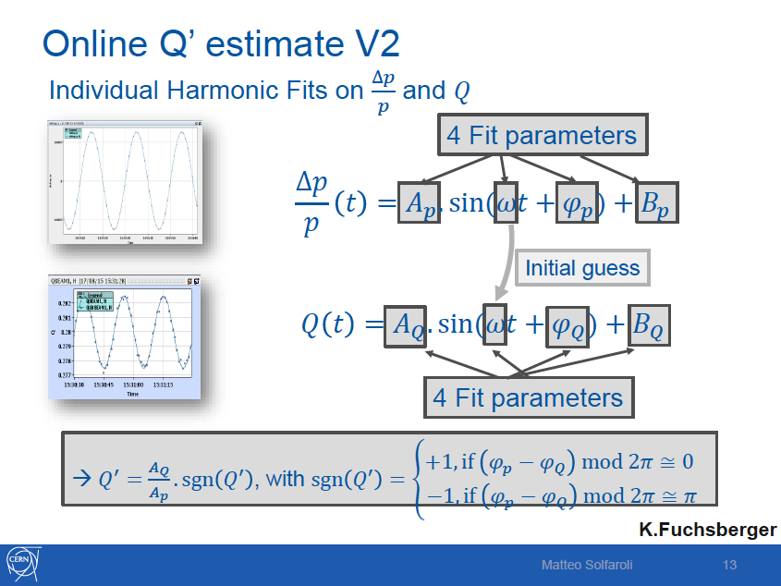
Chromaticity Tool in 2015
Improvements to tool implemented by K. Fuchsberger. Tool now fits sinusoids to modulation and tune. Q’ is now ratio of amplitudes.
See LBOC ‘Chromaticity correction without RCS –M. Solfaroli 18/08/15’

Slide 8
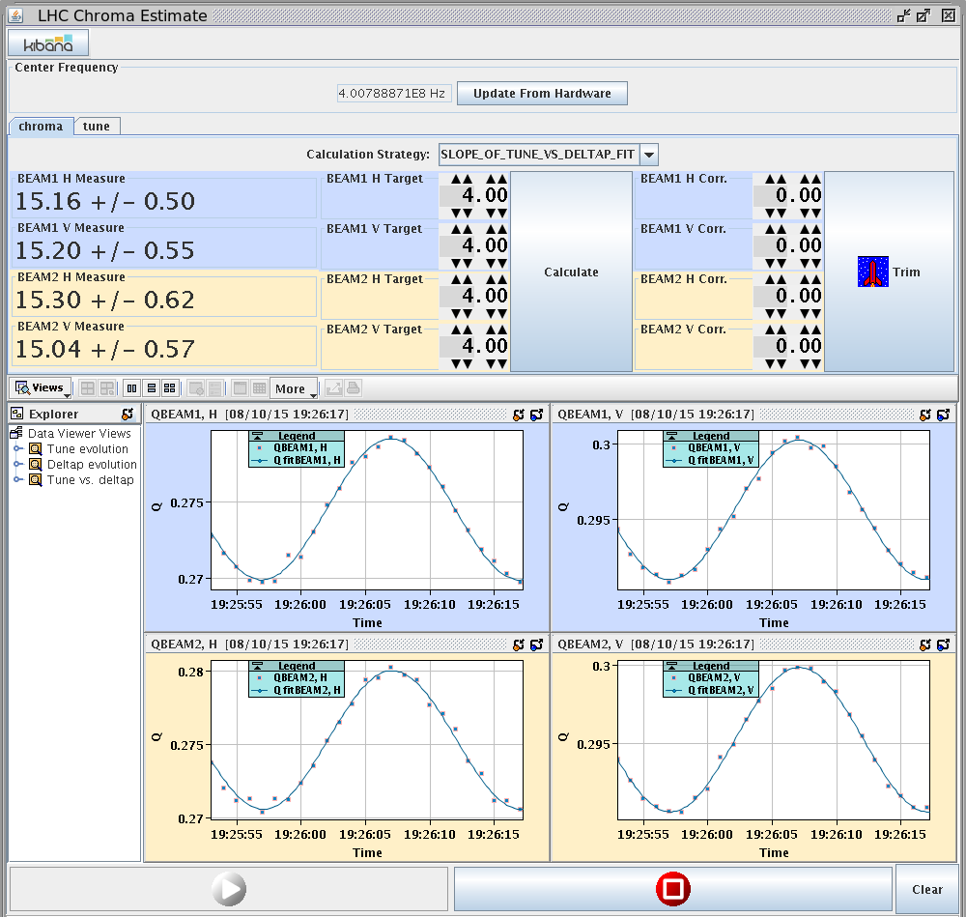
Chromaticity Tool in 2015
Works very well (also for noisy signals). Negates time offset between signals.
Taken from logbook on 08/10/15 19:26

Slide 9
Chromaticity Tool in 2015
Improvements allow much greater control of chromaticity during operation.
Also allowed measurements of instability threshold to be made, which are shown above alongside DELPHI simulations.
At flat top, incrementally lower current in Landau Octupoles until instability develops.
Comparison of measured threshold vs simulated threshold allow us to verify LHC impedance model.

Slide 10
Summary
Tool used in 2012 and early 2015 performed linear fitting to data and had large uncertainties due to time offset between rf modulation and tune signals. Even worse for noisy tune signals.
Discrepancies highlighted in LBOC talk, when chromaticity was re-processed for validation fill. Motivated improvement to tool.
Improvements implemented by K. Fuchsberger. Tool now performs sinusoidal fit to data and calculates chromaticity by the ratio of the amplitudes of the two signals. Negates effect from time offset.
In 2015, we were able to make accurate measurements of stability threshold and compare to simulations.
These measurements would not have been possible in 2012. Improvements to chromaticity tool have made it possible.

