Slide 1

11T Dipole Circuits
S. Yammine - H. Thiesen - L. Bortot
TE-EPC-MPC – TE-MPE-PE
21/03/2016
Acknowledgements
TE-MSC-LMF F. Savary, H. Prin, L. Grand-Clement
TE-MSC-MDT S.I. Bermudez
TE-MPE-PE B. Auchmann, M. Prioli
TE-MPE-EE F. Rodriguez Mateos
BE-ABP-HSS M. Giovannozzi
TE-MSC-MNC P. Fessia
EN-ACE-INT J.P. Corso
WP6, WP11 members, …

Slide 2
Contents
01 Integration of the 11 T Dipoles in the RB Circuits
02 11 T Circuit and TRIM Power Converter
03 Electrical Protection of the 11 T Circuit
04 Summary

Slide 3
01
Integration of the 11 T Dipoles in the RB Circuits

Slide 4
Integration of the 11 T Dipoles
Main Dipole Circuits (RB Circuits) before LS2 :
8 Main Dipole Circuits in the LHC
Per Circuit (Current Configuration prior to LS2) :
154 MB Dipoles (77 Type A – 77 Type B)
L_{TOT} ≈ 15.708 H (102 mH / Magnet)
R_{TOT} ≈ 1 mΩ
R_{extraction} = 140 mΩ (2x70 mΩ)

Slide 5
Integration of the 11 T Dipoles
Current Characteristics in the RB Circuit :
Ramp-Up Current Slope = 10 A/s
Ramp-Down Current Slope = -10 A/s
Continuous Mode Current :
  6.5 TeV : I_{RB_cont} = 11 kA
  7 TeV : I_{RB_cont} = 11.85 kA (Nominal)
  7.6 TeV : I_{RB_cont} = 12.84 kA (Ultimate)

Slide 6
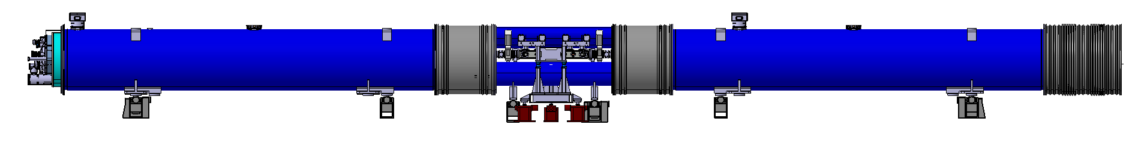
Integration of the 11 T Dipoles
Present-Day Integration Planning :
2 Cryo-Assemblies for LS2 ^{(*)} : MBA-B8L7 and MBB-B8R7
2 Additional Cryo-Assemblies for LS3 ^{(*)} : MBA-B10L7 and MBB-B10R7
11T Magnet
Collimator
11T Magnet
Cryo-Assembly : 2 x 11T Magnets (2 x 5.5m) + Collimator (3 m)
L_{11T} = Inductance of the Two 11T Magnets in Series ≈ 130 mH
^{(*)} Ref : F. Savary, “WP11 Road Map following Chamonix 2016”, Presentation for WP11 Technical Coordination Meetings, 10 Feb. 2016.

Slide 7
Integration of the 11 T Dipoles
Magnets Replaced for LS3 ^{(*)} :
  MBA-B8L7 and MBA-B10L7 (Circuit RB.A67)
  MBB-B8R7 and MBB-B10R7 (Circuit RB.A78) – Transfer to A Line
Circuit RB.A67
Circuit RB.A78
(*) could be subject to modification

Slide 8
Integration of the 11 T Dipoles
Modification of the Circuit Characteristics :
 | Circuit | Current Configuration | LS2 | LS3
Maximal Required PC Voltage | RB.A67 - RB.A78 | 171 V | 171.6 V | 172.2 V
Total Circuit Inductance (L_{TOT}) | RB.A67 - RB.A78 | 15.708 H | 15.768 H | 15.828 H
Circuit Time Constant (τ) | RB.A67 - RB.A78 | 4hr22min | 4hr23min | 4hr24min
Energy Extraction Time Constant | RB.A67 - RB.A78 | 1min52s | 1min53s | 1min53s
Maximum Common Voltage in Case of FPA | RB.A67 | 420 V | 433 V | 447 V
 | RB.A78 | 420 V | 425 V | 431 V
Maximum Common Voltage in Case of FPA + Earth Fault | RB.A67 - RB.A78 | 910 V | 910 V | 910 V

Slide 9
02
11T Circuit and TRIM Power Converter

Slide 10
11 T Circuit and TRIM PC
Requirements on the 11 T Dipole Current :
Modification of RB Current in the 11 T Dipoles ^{(*)} for Readapted Magnetic Field :
6.5 TeV
I_{RB} = 11 kA
ΔI_{11T} = -67 A
7 TeV (Nominal)
I_{RB} = 11.85 kA
ΔI_{11T} = 0 A
7.6 TeV (Ultimate)
I_{RB} = 12.84 kA
ΔI_{11T} = 91 A
11 T Circuit : TRIM PC + 11 T Dipole
Current Controlled Power Converter
(*) Preliminary curves - should be confirmed by operation

Slide 11
11 T Circuit and TRIM PC
Normal Operation of the TRIM PC for 7 TeV:
Current Rating : [-250 A … 0 A]
Voltage Rating : [min (-1.5 V, 1.5 - 250xRcable) … 1.5 V] (< +/- 5 V)
4 Quadrants (Positive Currents for 7.6 TeV)
Current Voltage Locus
Electrical Equivalent Circuit

Slide 12
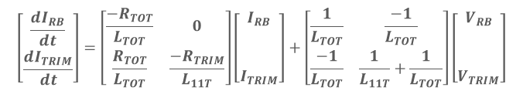
11 T Circuit and TRIM PC
Coupling of the TRIM – RB Circuits :
$$\left[\begin{aligned}\frac{{dI}_{RB}}{dt} \\ \frac{{dI}_{TRIM}}{dt}\end{aligned}\right]=\left[\begin{matrix}\frac{−R_{TOT}}{L_{TOT}} & 0 \\ \frac{R_{TOT}}{L_{TOT}} & \frac{−R_{TRIM}}{L_{11T}}\end{matrix}\right]\left[\begin{aligned}I_{RB} \\ \\ \\ I_{TRIM}\end{aligned}\right]+\left[\begin{matrix}\frac{1}{L_{TOT}} & \frac{−1}{L_{TOT}} \\ \frac{−1}{L_{TOT}} & \frac{1}{L_{11T}}+\frac{1}{L_{TOT}}\end{matrix}\right]\left[\begin{aligned}V_{RB} \\ \\ \\ V_{TRIM}\end{aligned}\right]$$
I_{RB}/V_{TRIM}
Space State Representation
RB Circuit
I_{TRIM}/I_{RB}
TRIM Circuit
Controlled System Block Diagram Representation
TRIM Bandwidth Frequency >> RB Bandwidth Frequency
Ref : https://indico.cern.ch/event/507166/

Slide 13
11 T Circuit and TRIM PC
Resonating Frequencies due Circuit Bandwidth :
TRIM F_{BW} is limited due to resonance
Current F_{BW} = 10 Hz
Voltage F_{BW} = 100 Hz
Current F_{BW} = 8 Hz
Voltage F_{BW} = 30 Hz
Ref : https://indico.cern.ch/event/507166/

Slide 14
03
Electrical Protection of the 11 T Circuit ^{(*)}
(*) Ref : https://indico.cern.ch/event/507166/

Slide 15
Protection of the 11 T Circuit
Major Issues on TRIM Circuit :
Maximum TRIM Current Limited by the Magnet-TRIM Connections
Baseline Electrical Protection Elements of the TRIM Circuit :
Crowbar for Over-Current Protection
Bypass Diode for 11 T Dipole Quench Protection

Slide 16

Protection of the 11 T Circuit
Common Failure Scenarios and Corresponding Constraints :
Failure Scenario | Actions | Equivalent Circuit | Constraints
TRIM PC Failure | Fire TRIM Crowbar Circuit Stop TRIM PC |  | To avoid engaging the Bypass Diode :
$$\left(R_{crowbarTRIM}+R_{Cable}\right)<\frac{5 V −0,7 V}{250 A}= 17 mΩ$$

Slide 17
Protection of the 11 T Circuit
Common Failure Scenarios and Corresponding Constraints :
Failure Scenario | Actions | Equivalent Circuit | Constraints
Quench at 11T Dipole | Fire TRIM and RB Crowbar Circuits Stop TRIM and RB PCs Engage Extraction Circuits |  | Total resistance limits to avoid over-current ^{(*)} : Bypass diode will be fired if this constraint is respected. If not respected (constraint on diode respected), I_{TRIMmax} = 400 A when 11 T quench occurs
$$R_{crowbarTRIM}+R_{Cable}> \frac{Diode Forward Voltage (≈6V)}{I_{TRIMmax}} =24 mΩ$$
(*) determined by the TRIM/magnet connections

Slide 18
Protection of the 11 T Circuit
Common Failure Scenarios and Corresponding Constraints :
Failure Scenario | Actions | Equivalent Circuit | Constraints
Quench at Random Magnet | Engage TRIM and RB Crowbar Circuits Stop TRIM and RB PCs Engage Extraction Circuits |  | Total resistance limits to avoid over-current ^{(*)} : Bypass diode will be fired if this constraint is respected. If not respected (constraint on diode respected), I_{TRIMmax} = 750 A when FPA occurs.
$$R_{crowbarTRIM}+R_{Cable}> \frac{\left|Maximum V_{11T}\right|\left(≈12 V\right)}{I_{TRIMmax}}=60 mΩ$$
(*) determined by the TRIM/magnet connections

Slide 19



Protection of the 11 T Circuit
Recapitulation :
$$R_{crowbarTRIM}+R_{Cable}> 24 mΩ$$
11 T Quench Constraint
If respected, bypass diode will be engaged when TRIM PC at |I_{TRIM}| > 60 A.
Heat dissipation in the diode could lead to quench ?
$$R_{crowbarTRIM}+R_{Cable}>60 mΩ$$
FPA Constraint
If respected, over-currents in the TRIM circuit occur when FPA is launched (around 750 A).
An issue for the magnet-circuit connection!
$$R_{crowbarTRIM}+R_{Cable}< 17 mΩ$$
Bypass Diode Constraint
Extraction System Constraint

Slide 20
Protection of the 11 T Circuit
Simulations of FPA with no Quench at 11 T Magnet :
 | R_{TOT} = 16 mΩ | R_{TOT} = 100 mΩ
FPA at Maximum RB Current : I_{RB} = 11.85 KA I_{TRIM} = 0 A
FPA at Minimum TRIM Current : I_{RB} = 6 KA I_{TRIM} = -250 A
Energy Dissipated in Diode = 1.5 kJ
Courtesy of L. Bortot

Slide 21
Protection of the 11 T Circuit
Simulations of FPA with Quench at 11 T Magnet :
 | R_{TOT} = 16 mΩ | R_{TOT} = 100 mΩ
FPA at Maximum RB Current : I_{RB} = 11.85 KA I_{TRIM} = 0 A
FPA at Minimum TRIM Current : I_{RB} = 6 KA I_{TRIM} = -250 A
Courtesy of L. Bortot

Slide 22
Protection of the 11 T Circuit
Recapitulation of the Simulations :
11 T No Quench | R_{TOT} = 16 mΩ | R_{TOT} = 100 mΩ
FPA @ I_{RB} = 11.85 KA I_{TRIM} = 0 A | TRIM Circuit Current = 700 A | TRIM Circuit Current = 120 A
FPA @ I_{RB} = 6 KA I_{TRIM} = -250 A | TRIM Circuit Current = 320 A | TRIM Circuit Current = 60 A Diode carries I_{TRIM} decay (1.5 kJ dissipated in diode – to be discussed)
11 T Quench | R_{TOT} = 16 mΩ | R_{TOT} = 100 mΩ
FPA @ I_{RB} = 11.85 KA I_{TRIM} = 0 A | TRIM Circuit Current = 340 A | TRIM Circuit Current = 50 A
FPA @ I_{RB} = 6 KA I_{TRIM} = -250 A | TRIM Circuit Current = 340 A | TRIM Circuit Current = 50 A
Courtesy of L. Bortot

Slide 23
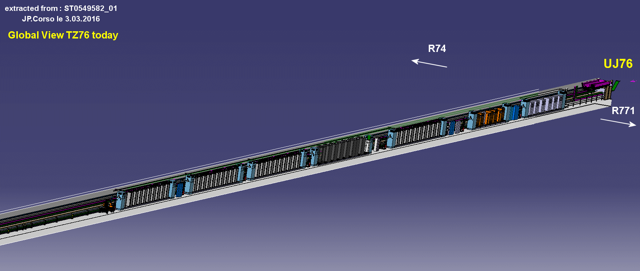
Protection of the 11 T Circuit
Integration and Cable Resistance :
A9 option | L_{Cable} (m) | R_{cable} (mΩ)
MB.B8L7 | 440 | ≈13
MB.B8R7 | 360 | ≈11
3x400mm^{2 (*)} Cables/Phase
6x400mm² Cables/PC
12 Cables for LS2
24 Cables for LS3
A20 option | L_{Cable} (m) | R_{cable} (mΩ)
MB.B8L7 | 550 | ≈16
MB.B8R7 | 470 | ≈14
A9
A20
Courtesy of P. Fessia – JP. Corso
^{(*)} Suggestion on the cable section – not definite

Slide 24
04
Summary

Slide 25
Summary
To decouple the RB and TRIM dynamics, TRIM F_{BW} should be high.
TRIM F_{BW} is limited due to resonating frequencies.
TRIM PC is a 4 quadrants PC.
Common mode voltage of the TRIM circuit could reach around 1000 V.
TRIM voltage is limited to have minimal impact in case of instability (+/-5 V).
Protection and integration imposes constraints on cable and crowbar resistances.
Test plan is studied (SM18) for constraint definition (which constraints to keep).
Functional Specifications of the TRIM Power Converter is being defined in line with circuit and quench protection, magnet requirements, …

Slide 26
Thank you for your attention
References (for circuit simulations and constraints explication)
S. Yammine and H. Thiesen, “ 11T Magnets Powering – TRIM PC Constraints”, in the Biweekly Meeting on the 11T TRIM Powering and Protection, 02 March 2016. (https://indico.cern.ch/event/507166/)
L. Bortot , “Impact of Quench-Induced Fast Power Aborts on the RB Hi-Lumi Circuit”, in the Biweekly Meeting on the 11T TRIM Powering and Protection, 02 March 2016. (https://indico.cern.ch/event/507166/)

Slide 27
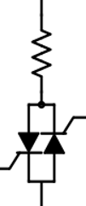


Additional Slides
Reference design (R_{TOT} = 16 mΩ)
  No Quench: Not suitable FPA @ 11.85kA 0A/s, crowbar current 700 A
  Quench + QH: Suitable
  Quench + CLIQ: Not suitable crowbar current 500 A
Variant 01 design (R_{TOT} = 0.1 Ω)
  No Quench: Suitable (!) Effects of MIITS in the bypass diode to be discussed
  Quench + QH: Suitable
  Quench + CLIQ: Not suitable crowbar current 500 A
Variant 02 design (R_{TOT} = 0.1 Ω + reverse bypass diode 20 V)
  No Quench: Suitable (!) Effects of MIITS in the bypass diode to be discussed
  Quench + QH: Suitable
  Quench + CLIQ: Suitable
0.1 Ω
0.1 Ω
20 V

