Slide 1


Inner Triplet Magnets (MQXF) and Protection
G. Ambrosio, V. Marinozzi, E. Ravaioli, T. Salmi, E. Todesco
and the whole QXF team
Conceptual Design Review of the Magnet Circuits for the HL-LHC
March 21-23, 2016
CERN

Slide 2
Outline
MQXF Magnets and Protection plan
Protection elements
Simulations without CLIQ
Conclusions

Slide 3
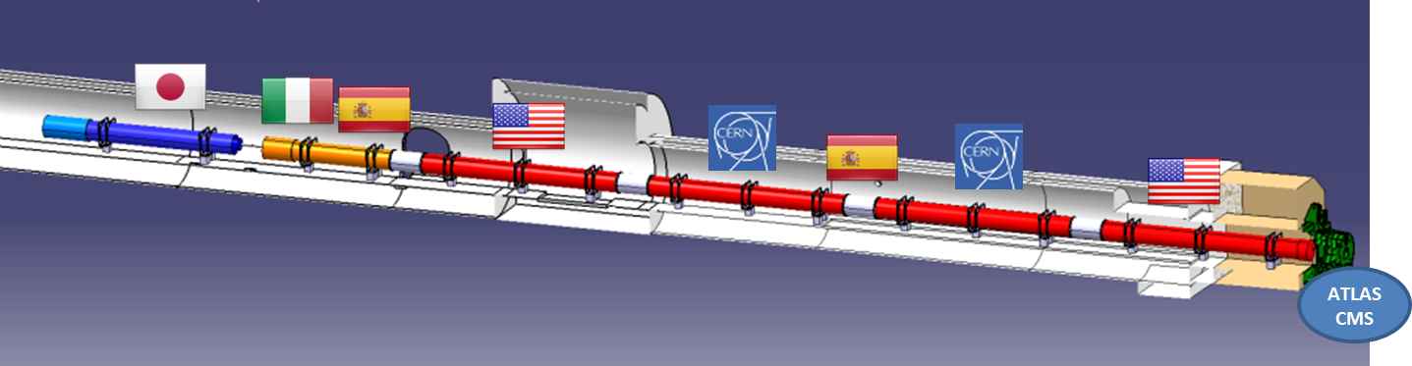
Inner Triplet Magnets (MQXFA/B)
Operating gradient: 132.6 T/m
Coil aperture: 150 mm
Q1/Q3 magnetic length: 4.2 + 4.2 m
Q2 magnetic length: 7.15 m
Max outer diameter: 630 mm
Operating temperature: 1.9 K

Slide 4
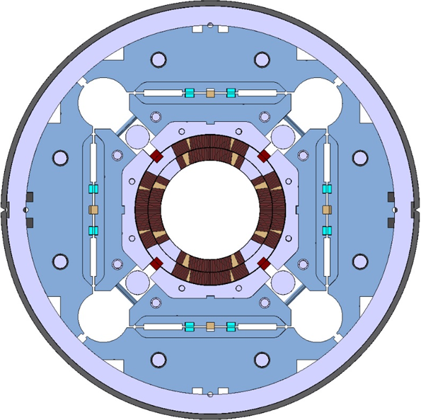
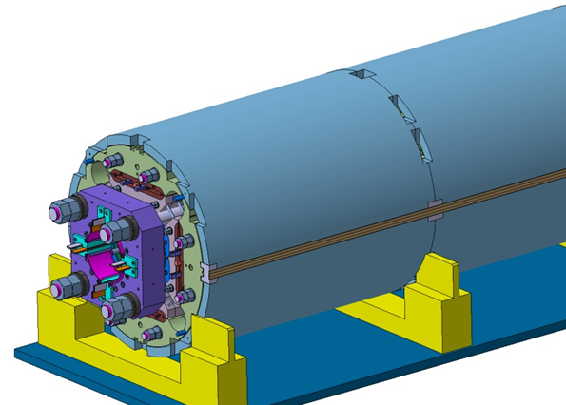
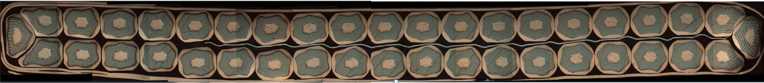
MQXFA/B Main Parameters
Parameter | Unit | MQXFA/B
Coil aperture | mm | 150
Magnetic length | m | 4.2/7.15
N. of layers |  | 2
N. of turns Inner-Outer layer |  | 22-28
Operation temperature | K | 1.9
Nominal gradient | T/m | 132.6
Nominal current | kA | 16.5
Peak field at nom. current | T | 11.4
Stored energy at nom. curr. | MJ/m | 1.2
Diff. inductance | mH/m | 8.2
Strand diameter | mm | 0.85
Strand number |  | 40
Cable width | mm | 18.15
Cable mid thickness | mm | 1.525
Keystone angle |  | 0.4
1st short model exceeded ultimate current at 1.9K
and 93% SSL at 4.5K

Slide 5
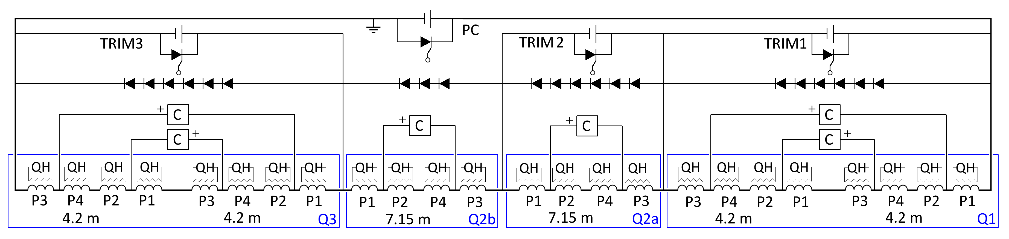
Quench Protection Plan
Elements:
No Energy Extract.
CLIQ units
Heaters
Instrumentation
Strategy:
Heaters & CLIQ provide redundancy
Heaters can be optimized for low current (because there is no dump)
Some heaters may be “backup”

Slide 6
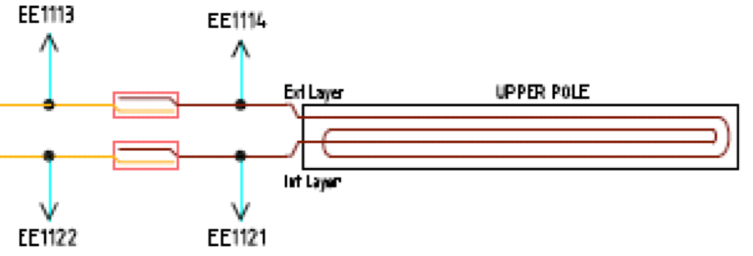
Quench Detection
Instrumentation for Quench Detection:
4 voltage taps per coil
  2 VT per lead around Nb₃Sn-NbTi splice
Detection:
Threshold: 100 mV
  at high current
Verification: 10 ms
Power supply switch:
delay: 5 ms

Slide 7
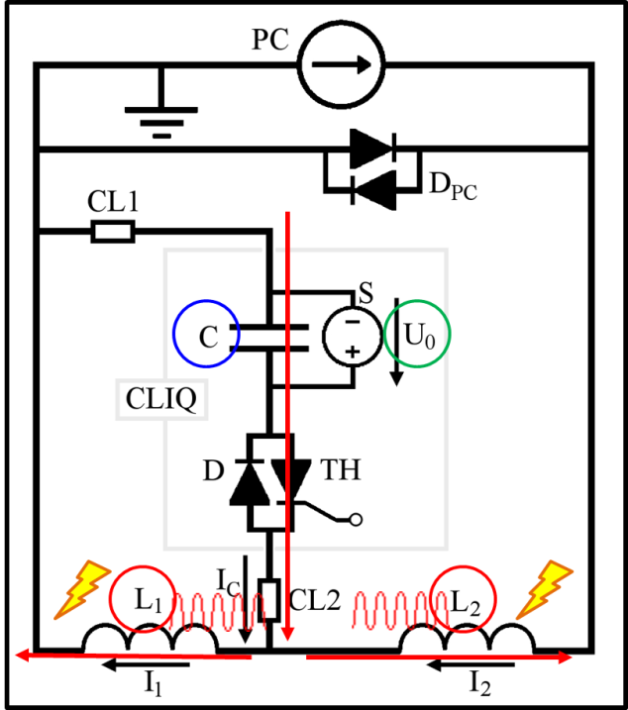
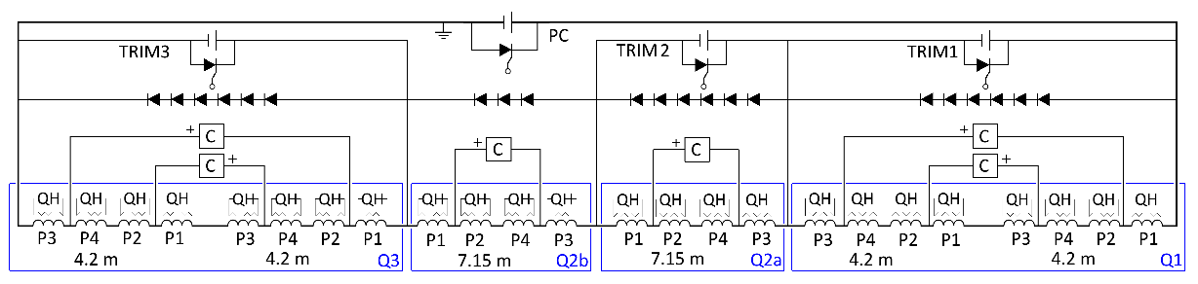
CLIQ
Coupling-Loss Induced Quench system
  Concept and validation presented by E. Ravaioli
  Next presentation for application to Inner Triplet Circuit and failure scenarios
Note: the failure of a CLIQ unit can be simulated by single magnet analysis because of the diodes

Slide 8
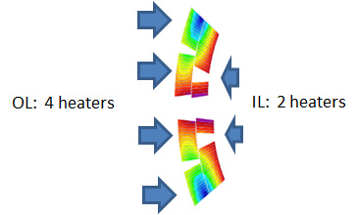
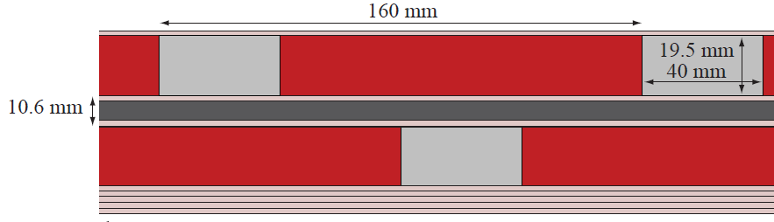
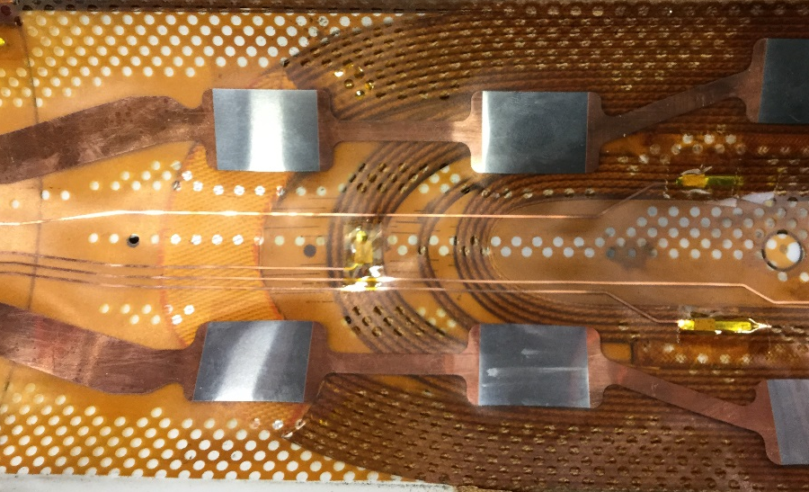
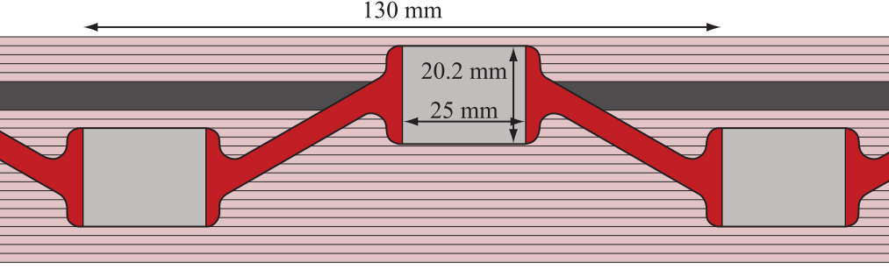
Protection Heaters
Quench heaters have been designed using copper plating for inner and outer layer:
  Two strips on each side of the outer layer
    “High Field” and “Low Field”
  One strip on each side on the inner layer
  Inner layer 40% polyimide free
Outer Layer
Inner Layer

Slide 9
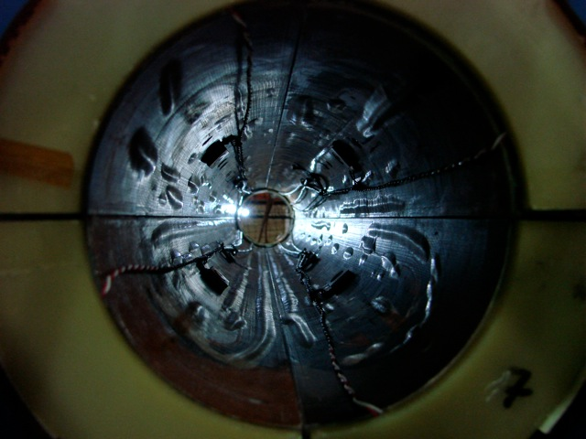
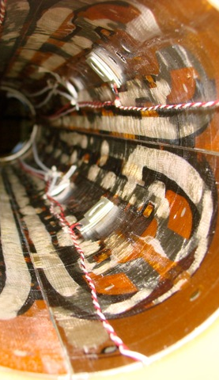
Post-test HQ02b (90 mm aperture) bore, viewed from RE
Heater bubble
HQ02 quenched many times, including many High Temperature quenches
No heater failures
Porosity through the polyimide layer should reduce this problem
- Inspection in a few weeks
Heaters on the Inner Layer may develop bubbles during operation

Slide 10
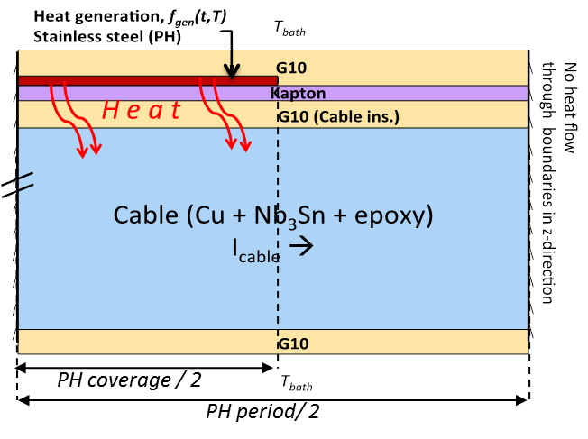
Heaters Optimization
Heaters have been designed & optimized by
  M. Marchevsky (LBNL) design w/o copper plating
  E. Todesco (CERN) design with copper plating
  T. Salmi (Tampere Univ.) delay computation & optimizat.
    2D thermal simulation using CoHDA
    Verification & calibration using LARP HQ magnets
      Criteria adjusted from T_{max} = T_{cs} ➔ T_{ave} = T_{cs}
HQ02a-b outer layer

Slide 11
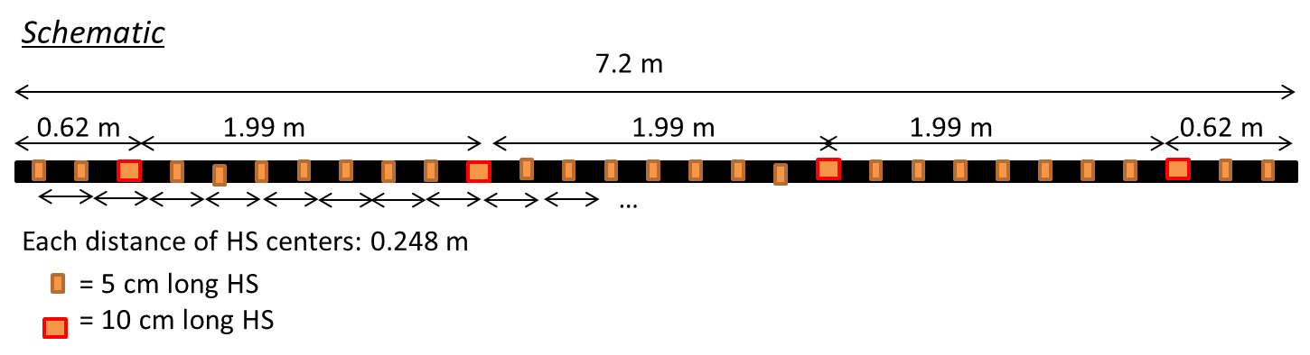
Protection at Low Current
Without energy extraction MQXF magnets need active protection also at low current (1 kA)
  Quench initiation in a few points per coil is enough
  Heater design can be adjusted to do it in case present heaters cannot (to be tested soon)
    ➔ Super-Heating stations

Slide 12
Quench Protection Simulations w/o CLIQ
Hot spot computed by V. Marinozzi using QLASA
  Validation & calibration using LARP HQ and LQ magnets
  Max allowable temperature: 350 K†
    Plan to keep Hot Spot Temp < 300 K in normal condition
Peak voltages computed V. Marinozzi using ROXIE
  Used also for 11T simulations
†G. Ambrosio, “Maximum allowable temperature during quench in Nb3Sn accelerator magnets”, Yellow Report CERN-2013-006, pp. 43–46, WAMSDO 2013, CERN, Geneva, CH.
†H. Bajas, et al., “Cold Test Results of the LARP HQ02b magnet at 1.9 K”, TASC.2014.2378375

Slide 13
Assumptions used for QLASA simulations:
Protection heaters only on the outer layer, considering super heating stations
100 mV threshold
10 ms validation time + 5 ms PS switch opening time
No energy extraction
Average heaters delay time for HF and LF zone, for normal heating stations and for super heating stations (computed by T. Salmi using CoHDA)
Longitudinal and transversal propagation taken into account
No quench propagation to the inner layer @ 1 kA
20 ms quench propagation time from outer to inner layer @ 16.47 kA
Dynamic effects on the inductance
No quench back
OL heaters delay time @ 1 kA
HF, normal HS | HF, super HS | LF, normal HS | LF, super HS
75 ms | 52 ms | 80 ms | 55 ms
OL heaters delay time @ 16.47 kA
HF, normal HS | HF, super HS | LF, normal HS | LF, super HS
22 ms | 20 ms | 24 ms | 22 ms

Slide 14
Hot Spot Temperature (w/o CLIQ)
At 1 kA the hot spot temperature is 34 K
  If only super heating stations are considered, with 200 ms delay time (4 x computed delay time), hot spot temperature rises to 45 K
At nominal current, with only OL heaters:
  IL heaters are kept as back-up
No CLIQ No IL heaters | No CLIQ No IL heaters 1 HF strip fails | No CLIQ No IL heaters Both HF strip fail in a coil | No CLIQ No IL heaters All 4 OL strip fail in a coil
325 K | 329 K | 336 K | 347 K

Slide 15
Peak Voltages (w/o CLIQ)
Assumptions used for ROXIE simulations:
Magnet lenght: 7.15 m (worst case)
No energy extraction
Voltage between ends: 0 V (short circuit)
Heaters delay time from CoHDA (Tiina Salmi)
Transversal propagation considered
Inter layer propagation: 20 ms (from HQ measurem.)
Ground positioned at magnet end
No quench back
 | To ground (V) | Turn-Turn (V) | Layer-Layer (V) | Midp-Midp (V)
All heaters on | 513 | 47 | 463 | 281
Half coil OL-HF fails | 540 | 47 | 521 | 407
Half coil fail | 640 | 48 | 547 | 553
1 coil fail | 1930 | 60 | 1900 | 1790
Only OL | 757 | 86 | 560 | 350

Slide 16
Conclusions
Quench heaters protect MQXF magnets and provide redundancy to CLIQ system
Heater design can be adjusted to protect MQXF magnets at low current
  Tests will show if design adjustments are needed
Exploring option of keeping some heater strips disconnected and used as back-up
  checking voltages in failure scenarios is in progress

Slide 17
Back up Slides

Slide 18
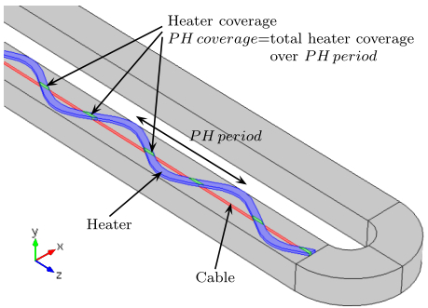
CoHDA: Code for Heater Delay Analysis
Heat conduction from heater to the superconducting cable
Quench when cable reaches T_{cs}(I,B)
Each coil turn considered separately
  Symmetric heater geometry: Model half of the heater period
  2-D model (neglect turn-to-turn)
  Uniform magnetic field in the cable
Thermal network method
Model implementation verified in comparison with COMSOL (Thanks to Juho Rysti, CERN)
H e a t
y, radial (in cosθ)
PH coverage / 2
z, axial
PH period/ 2

Slide 19
QLASA*
Slides by V. Marinozzi
QLASA^{[1]} is a program developed by the University of Milan and the INFN/LASA for the simulation of quench evolution in solenoids.
Main features:
Pseudo-analytical: quench propagation is based on Wilson analytical formulas^{[2]}; thermal calculations are made solving the heat equation in adiabatic approximation.
Magnetic field is given as input
  It is possible to simulate magnetic quadrupoles or other kind of magnets
Magnet inductance is given as input
  Iron saturation can be simulated
  It is possible to simulate dynamic effects (reduction of the inductance^{[3]})
Protection circuit with external dump resistor
It is possible to simulate protection heaters with heating stations^{[4]}
Material properties from MATPRO^{[5]}
*
[1] “QLASA: a computer code for quench simulation in adiabatic multicoil superconducting windings”, L. Rossi and M. Sorbi, 2004.
[2] “Superconducting magnets”, M.N. Wilson, 1983.
[3] “Effect of coupling currents on the dynamic inductance during fast transient in superconducting magnets”, V. Marinozzi et al., 2015.
[4] “Guidelines for the quench analysis of Nb3Sn accelerator magnets using QLASA”, V. Marinozzi, 2013.
[5] “MATPRO upgraded version 2012: a computer library of material property at cryogenic temperature,” G.Manfreda et al., 2012

Slide 20
Heater design parameters
Parameter (unit) | Value
Voltage (V) | 450
HFU capacitance (mF) | 19.2
Max. Current (A) | 200
Polyimide thickness (mm) | 0.05
Stainless steel thickness (mm) | 0.025
(Also 20 mm wide is OK.)
12*1.88 mm =22.6 mm : 18 mm wide heater
(2 turns without coverage)
OL HF
OL LF
16*1.88 mm =30.0 mm : 24 mm wide heater
(To get 150 W/cm² and not exceed 200 A)

Slide 21
Heater delay simulation
2-D thermal simulation using CoHDA:
2 possible criteria for quench onset
  Cable maximum temperature reaches T_{cs}
    -> Current redistribution starts, visible in test set-ups
  Cable average temperature reaches T_{cs}
    -> Current sharing with copper starts, quench propagation starts
Criterion B gives 5-10 ms longer delays
The criterion B is more conservative, and it is used in this design and analysis.

Slide 22
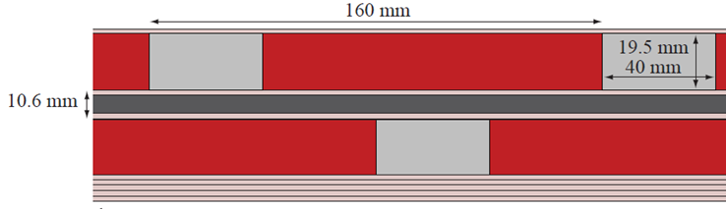
The concept of Super- Heating Stations
The idea: Add a few long heating stations to make sure it quenches also at low current (as sure as possible).
Only a few HS should be enough at low current
The rest of the heater can have shorter HS with shorter period for high current quench protection
Super-HS = 2 normal lenght HS combined in every ~ 2 m
  According to my preliminary analysis (details in the appendix) this should be enough at low current (1 – 8 kA) but this needs to be confirmed by Vittorio
First generation Outer Layer heaters

Slide 23
OL HF geometry with 5-cm-long normal HS and 10-cm-long Super-HS
Strip width = 18 mm (covers 9 turns)
Normal HS length = 5 cm (25 normal HS / strip)
Super-HS length = 10 cm (4 super-HS / strip)
Period = 25 cm (distance between the centers of heating stations)
Period for super-HS = 1.99 m
Schematic
7.2 m
0.62 m
1.99 m
1.99 m
1.99 m
0.62 m
…
Each distance of HS centers: 0.248 m
Strip R @4.5 K = 1.8 Ω
Tot R with 1 Ω margin = 2.8 Ω
I with 450 V = 157 A
Peak power = 150 W/cm²
RC τ with 19.2 mF HFU = 55 ms
= 5 cm long HS
= 10 cm long HS
SS thickness 25.4 µm, ρ = 5e-7 Ωm
Cu thickness = 10 µm, ρ = 2e-9 Ωm

Slide 24
OL LF geometry with 6-cm-long normal HS and 12-cm-long Super-HS
Strip width = 24 mm (covers 12 turns)
Normal HS length = 6 cm (16 normal HS / strip)
Super-HS length = 12 cm (4 super-HS / strip)
Period = 36 cm (distance between the centers of heating stations)
Period for super-HS = 1.8 m
Schematic
7.2 m
0.9 m
1.8 m
1.8 m
1.8 m
0.9 m
…
Each distance of HS centers: 0.36 m
Strip R @4.5 K = 1.2 Ω
Tot R with 1 Ω margin = 2.2 Ω
I with 450 V = 202 A
Peak power = 140 W/cm²
RC τ with 19.2 mF HFU = 43 ms
= 6 cm long HS
= 12 cm long HS
Two other options for PH geom. presented in the Appendix.
SS thickness 25.4 µm, ρ = 5e-7 Ωm
Cu thickness = 10 µm, ρ = 2e-9 Ωm

Slide 25
Simulated delays at Imag = 1 kA
Bpeak in mag. = 0.81 T
OL HF heater, normal HS
OL HF heater, super HS
OL LF heater, normal HS
OL LF heater, super HS
B at the conductor edge (T) | HS = 5 cm (150 W/cm²) Heater delay (ms) | HS = 10 cm (150 W/cm²) Heater delay (ms) | HS = 6 cm (140 W/cm²) Heater delay (ms) | HS = 12 cm (140 W/cm²) Heater delay (ms)
0.6 (B/Bpeak = 0.8) | 69.6 | 50.6 | 73.6 | 53.6
0.6 (B/Bpeak = 0.7) | 70.3 | 51.0 | 74.5 | 54.0
0.5 (B/Bpeak = 0.6) | 78.1 | 52.1 | 85.4 | 55.2
0.4 (B/Bpeak = 0.5) | 79.1 | 52.5 | 86.9 | 55.6
0.3 (B/Bpeak = 0.4) | 80.2 | 53.0 | 88.6 | 56.2
In the heater delay simulation the conductor field is taken at the edge of the conductor. This is usually the maximum field in the conductor.
For quench simulations: Associate the conductor maximum field to these delays.

Slide 26
Simulated delays at Imag = 16.5 kA
Bpeak in mag. = 11.4 T
OL HF heater, normal HS
OL HF heater, super HS
OL LF heater, normal HS
OL LF heater, super HS
B at the conductor edge (T) | HS = 5 cm (150 W/cm²) Heater delay (ms) | HS = 10 cm (150 W/cm²) Heater delay (ms) | HS = 6 cm (140 W/cm²) Heater delay (ms) | HS = 12 cm (140 W/cm²) Heater delay (ms)
9.1 (B/Bpeak = 0.8) | 17.0 | 16.3 | 17.0 | 16.6
8.0 (B/Bpeak = 0.7) | 19.7 | 18.7 | 19.8 | 19.2
6.8 (B/Bpeak = 0.6) | 22.7 | 21.3 | 22.8 | 21.9
5.7 (B/Bpeak = 0.5) | 26.1 | 24.1 | 26.2 | 24.8
4.6 (B/Bpeak = 0.4) | 30.0 | 27.1 | 30.2 | 28.0
In the heater delay simulation the conductor field is taken at the edge of the conductor. This is usually the maximum field in the conductor.
For quench simulations: Associate the conductor maximum field to these delays.

Slide 27
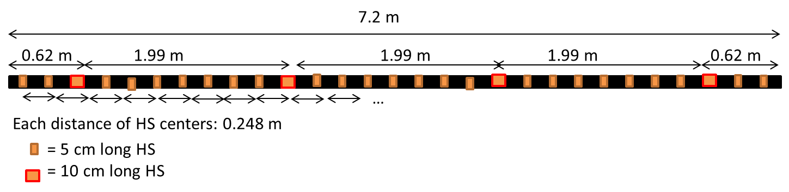
Next Steps
Heater studies during MQXFS01 test
Adjustment of CoHDA parameters (if needed)
Adjustment of heater design w SuperHeating stations
Fabrication of 2nd generation MQXF heaters

Slide 28
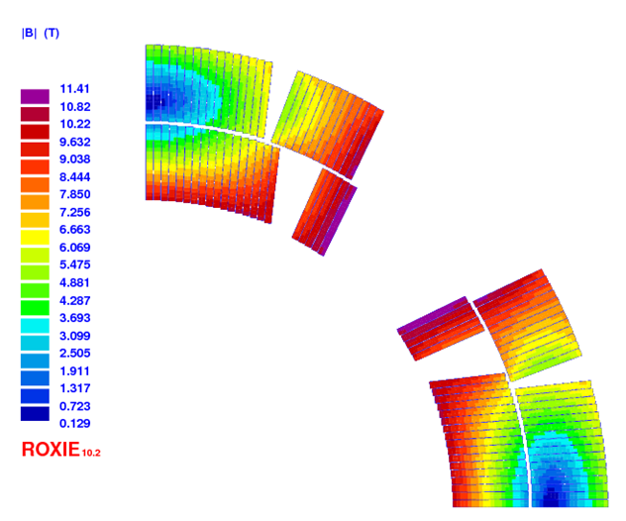
1. Introduction
Aperture diameter | 150 mm
Gradient | 132.6 T/m
Nominal current | 16470 A
Magnetic stored energy | 1.17 MJ/m
Inductance | 8.3 mH/m
Magnetic length Q1/Q3 | 2 x 4.2 m
Magnetic length Q2a/Q2b | 7.15 m
Conductor peak field | 11.4 T
Operating temperature | 1.9 K
Strand diameter | 0.850 mm
Bare cable width | 17.86 mm
Bare cable thin/thick edge thickness | 1.462/1.588 mm
Insulation thickness | 0.145 mm
Number of strands | 40
Copper/non-copper ratio | 1.2
Copper RRR | 100
High stored energy
High peak field
  Protection challenging!

Slide 29
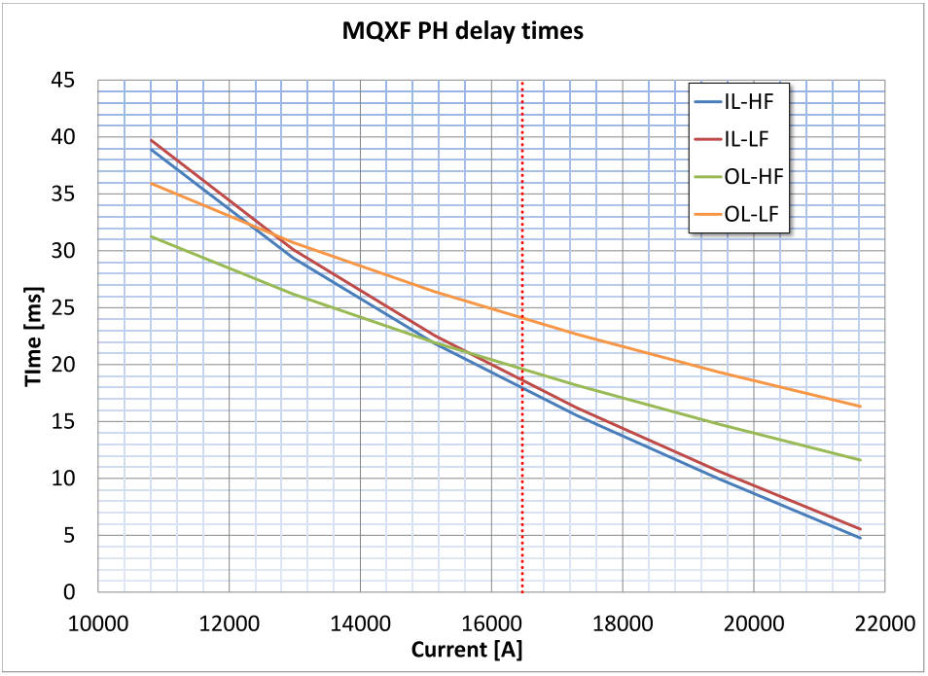
3. Quench heaters design
Quench heaters have been designed using copper plating for inner and outer layer:
Two strips on each side of the outer layer (“High Field” and “Low Field”)
One strip on each side on the inner layer
  Inner layer 40% polyimide free

